Slide 1
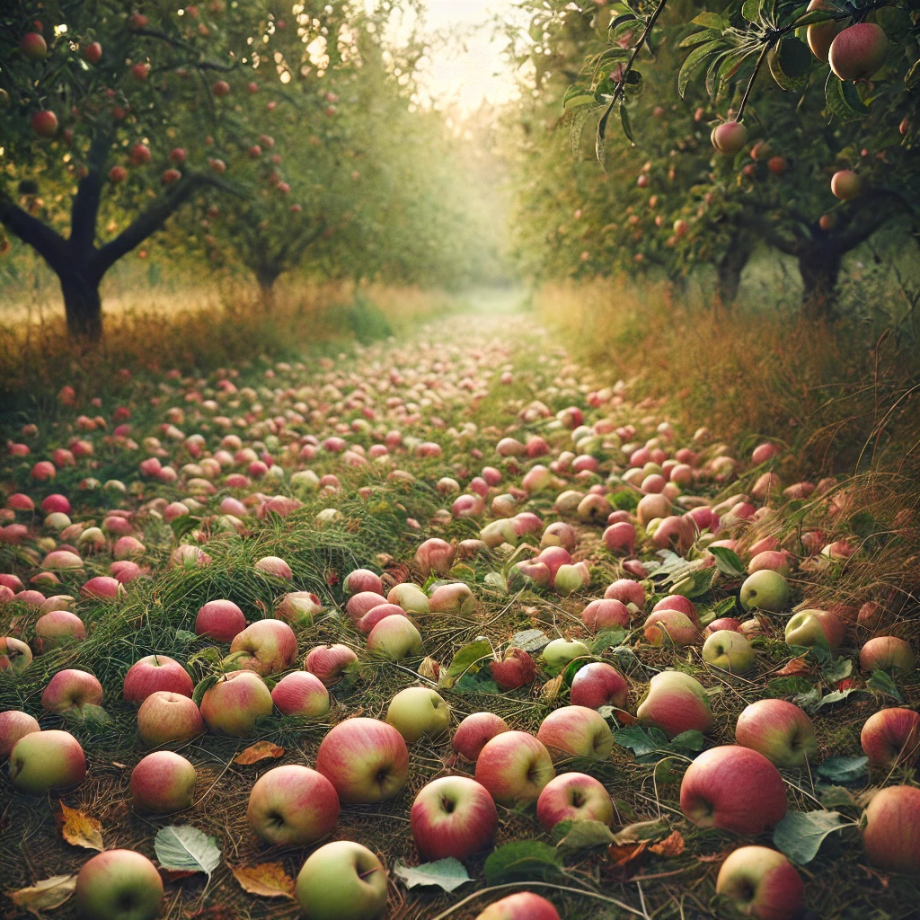
Windfallen
Darby Brown
Erik Sambrailo
River Schieberl
Tim Tung
Notes:
The root of our team name is “windfall”, which has dual meanings as 1) fruit that has been blown down by the wind and 2) unexpected good fortune.

Slide 2
Index
Presentation
Title Slide
Team
Problem
Visualizing Fallen Apples
Solution
Competitive Landscape
Target Customer
Target Customer (Secondary)
User & Community Discovery
Real-World Agriculture Environments
Research and MVP
Model Demonstration
Environment Details
Model Architecture
Technical Approach
Model Evaluation
Grid Search & Reward Function Tuning
Key Takeaways: Technical Innovation
Roadmap
Mission Statement
Thank you!

Slide 3
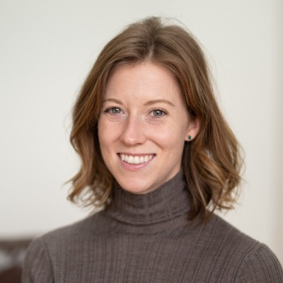
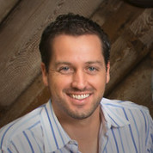
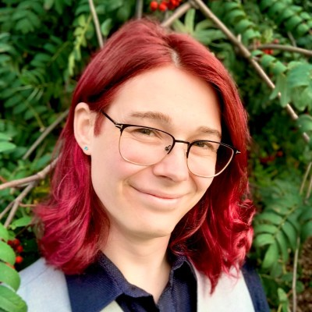
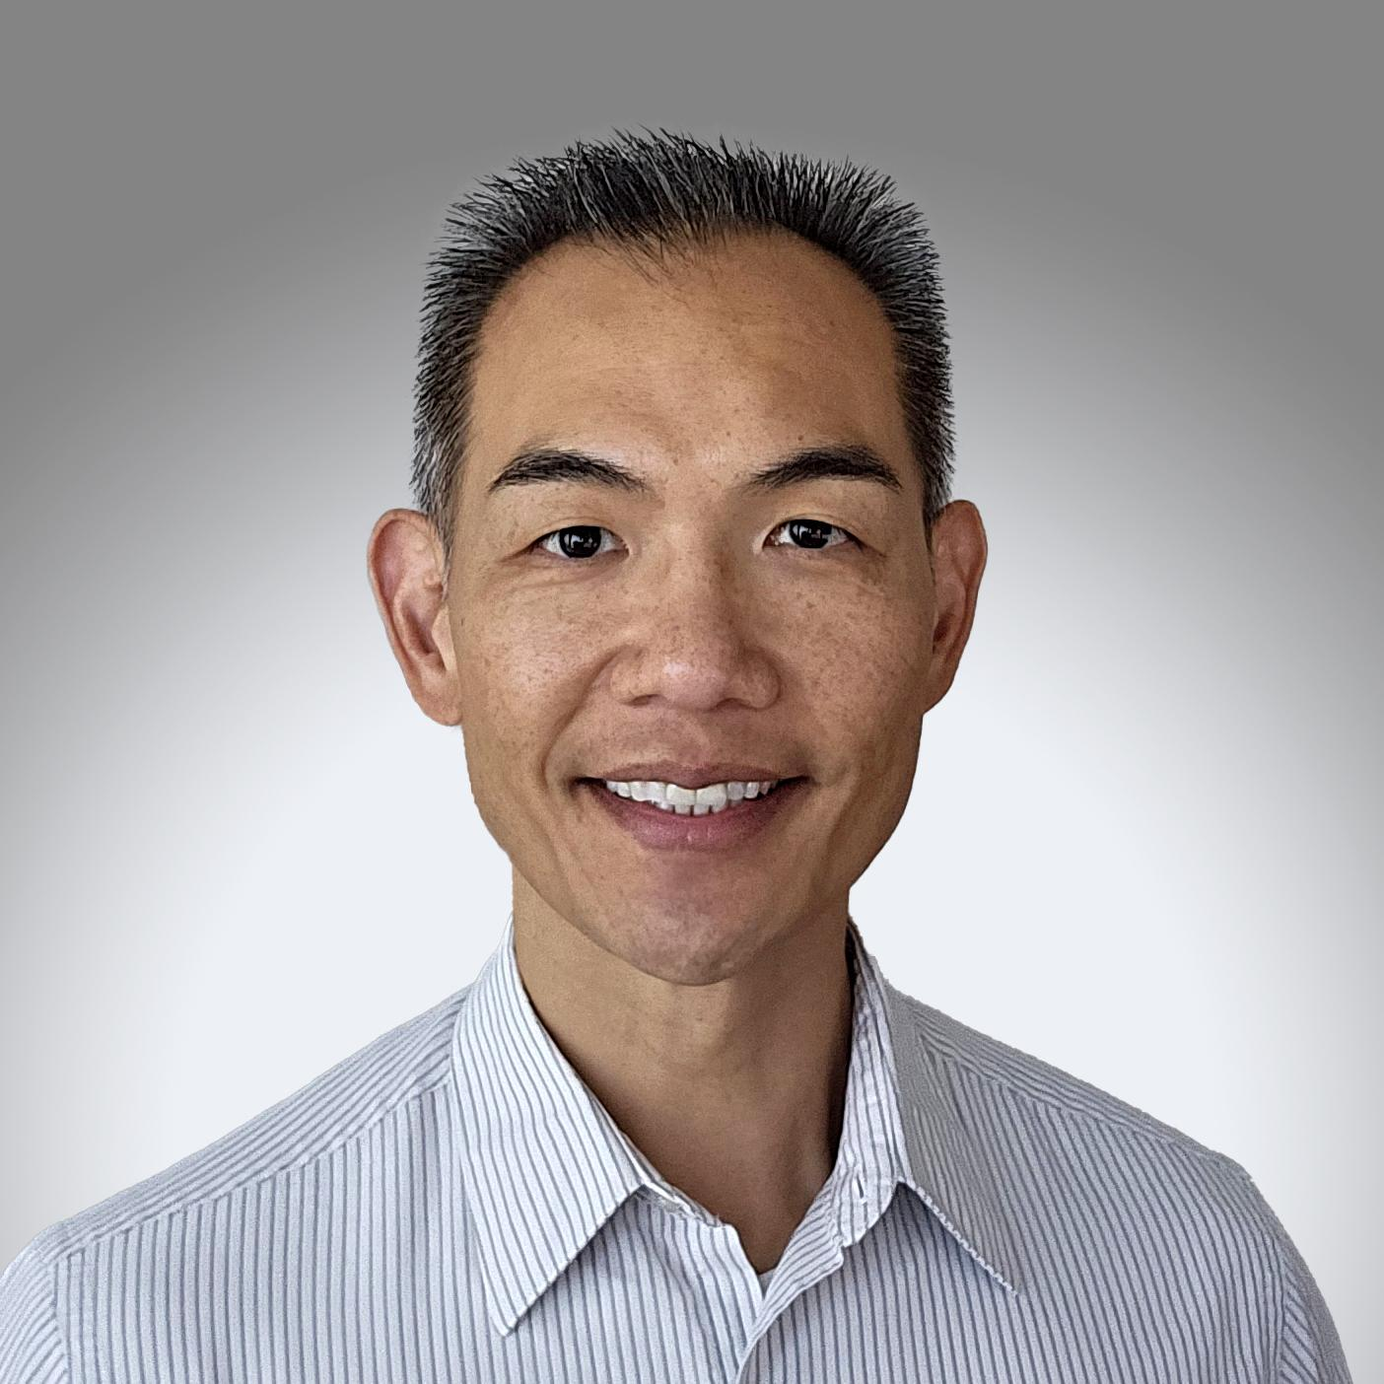
Our Team
Darby Brown
Project Manager
Erik Sambrailo
Machine Learning
River Schieberl
Simulation
Tim Tung
Infrastructure
Multi-Agent Reinforcement
Agriculture
Sustainability
Notes:
We’re a team that’s passionate about machine learning and agriculture, and applying emergent technology to really hard problems.

Slide 4
We’re on a mission to reduce food waste
92 billion pounds of food is wasted in the U.S. each year
Field losses of edible produce are ~34% of marketed yield
“Windfall” fruit is a key contributor to waste on modern commercial farms
Notes:
It’s widely understood that there is a significant amount of food waste. More precisely, it is estimated that 92 billion pounds or about 38% of all food is wasted. Less well known is the amount of food wasted at the farm level, which researchers at Santa Clara University estimate at about 34% of marketed yield.
Therefore, we believe that windfall fruit is a key contributor to food waste, and a key opportunity for reducing this waste.

Slide 5
Notes:
With that in mind, take a moment to look at this picture of an actual operating orchard that our team visited for field research. Contemplate how many people this windfall fruit could feed.

Slide 6
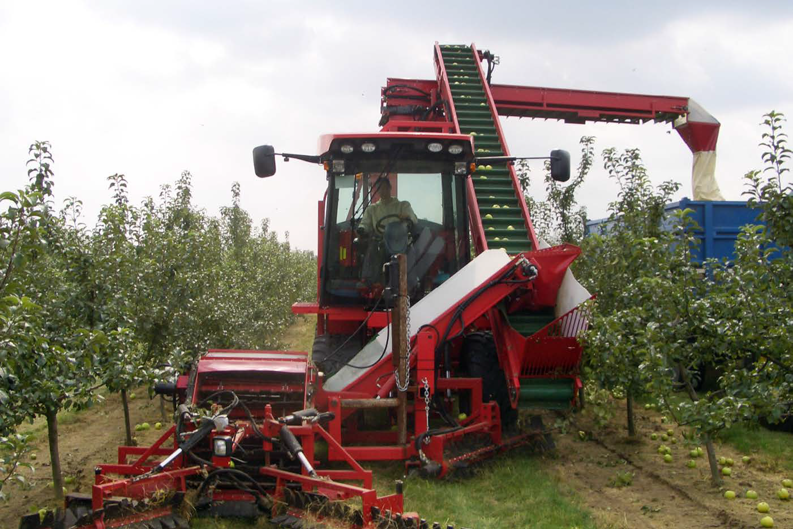
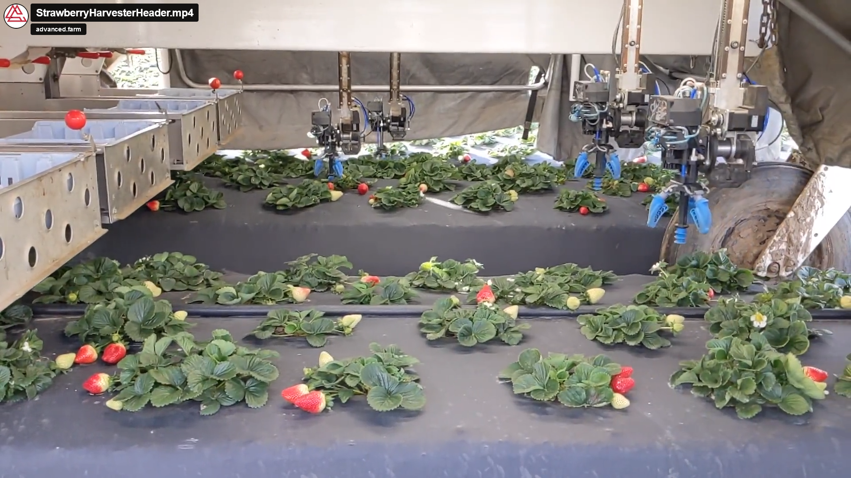
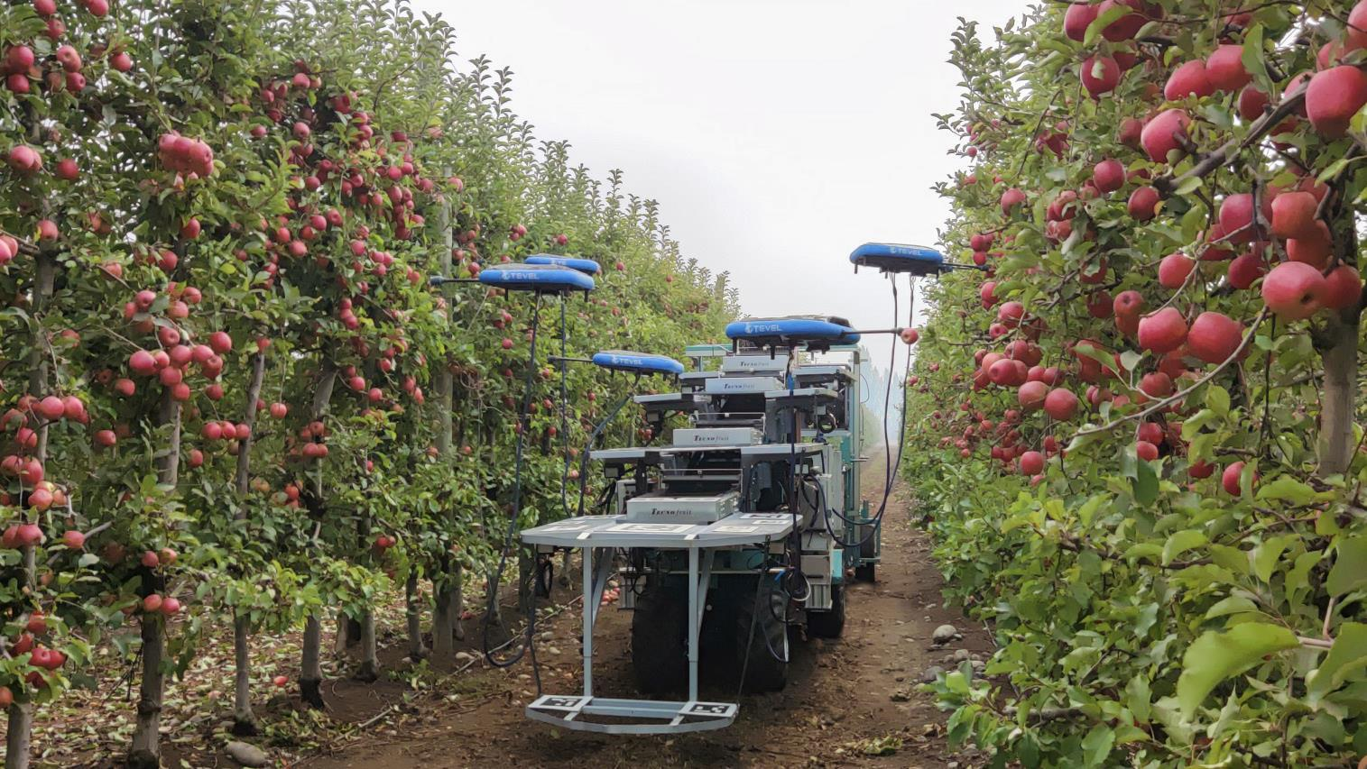
Existing Technology
Manually operated equipment that specializes in windfalls (Zim)
Robotic platforms that harvest fruit from the plant
Each platform tends to work on only a small number of specific fruits
Platforms often are designed to work in specialized environments
Indoor or greenhouse farms with rails between rows (advanced.farm)
Vertical wall trellis systems for orchards (Tevel)
Notes:
Harvesting windfall fruit is a very challenging task that is typically not economical to pursue with human labor, and not a task currently solved by robotics firms.
Commercial farms could benefit from our technology, as well as various fruit processing companies.

Slide 7
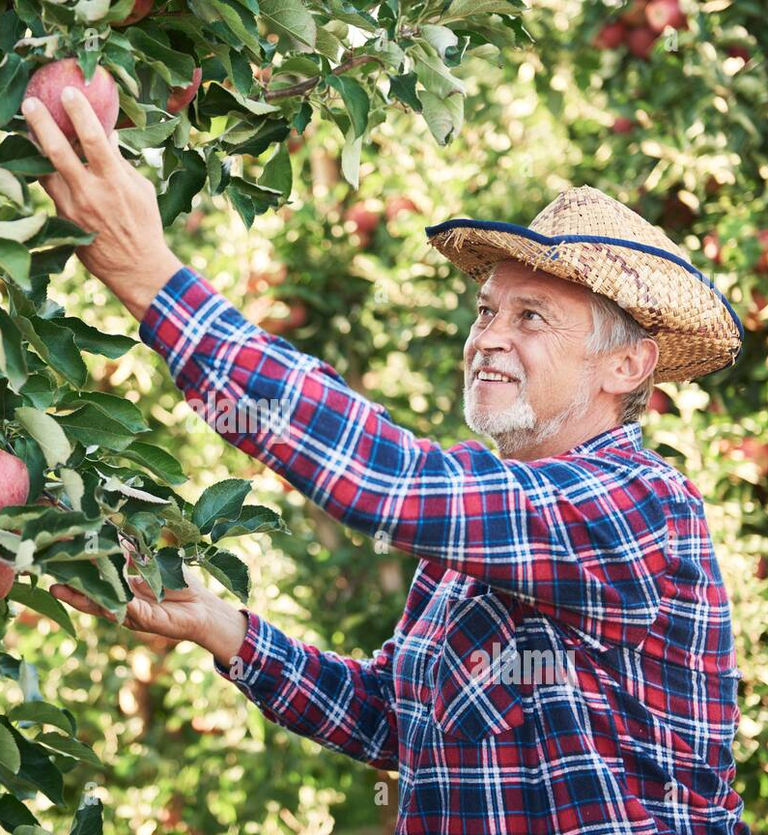
Target Customer (Primary)
Commercial Farms
- apple growers w/ 10+ acres
- orchard layout conducive to automation
- acceptable apple variety for processing
- desire to harvest windfalls
- open to implementing robotic technology
Business Model: subscription or rental model for technology deployment

Slide 8
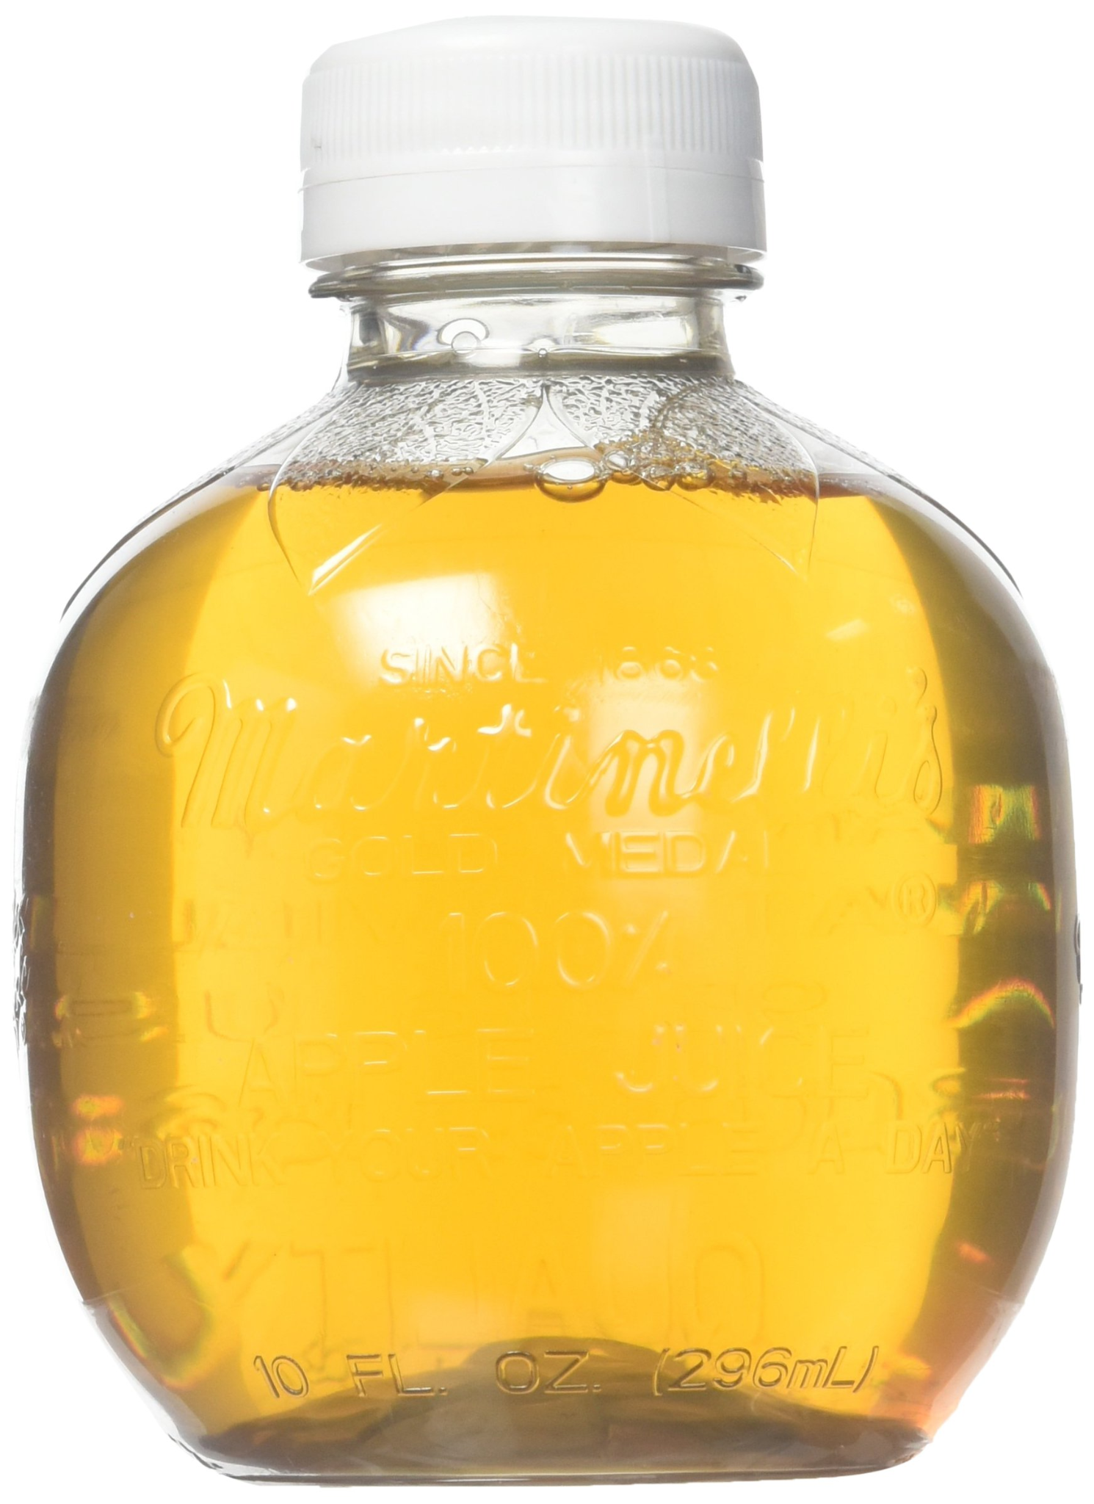
Target Customer (Secondary)
Apple Processing Companies
- Juice and Cider Manufacturer’s
- Applesauce and Apple Butter Producers
- Dried Fruit Manufacturers
- Animal Feed Producers
- Distilleries
- Pectin Manufacturers
Business Model: acquiring the rights to harvest windfalls and selling direct to processors

Slide 9
Merging technology with agriculture to revive windfall
Windfall loss is a very challenging problem that is often solved with manual labor or not at all.
Extending cutting edge Multi-Agent Reinforcement Learning (MARL) research to food sustainability
Improving yield could drive higher revenues by ~$220M in the U.S. market
Paving the way for additional research through extensible and generalizable models and environments
Our secret sauce is APPLESAUCE
Notes:
Harvesting windfall is a very challenging problem that is currently solved with manual labor or not at all. We can do better in the next 10, 20, or 50 years with the aid of robots. Imagine that world.
We set off on this journey to extend cutting edge research in multi-agent reinforcement learning to food sustainability.
Our solution--a technology that we call Applesauce--is the autonomous collection of windfall fruit with robotic collaboration to optimize the harvesting process.
As resources become increasingly scarce, it is essential to optimize their use. By salvaging edible fruit that would otherwise go to waste, our project has the potential to significantly reduce food waste, improve resource efficiency, and create new opportunities for secondary markets.
For the apple industry, we estimate that this represents a $220 million revenue opportunity in the U.S. market that could benefit farmers, provide food to individuals facing food insecurity, or a combination of the two.
Finally, our Applesauce work paves the way for additional research since the models and environment that we built are extensible and generalizable for other tasks.

Slide 10
Farmers are open, and the industry enthusiastic
We interviewed:
Farmers
Robotics Experts
RL Developers
Labor too costly to harvest windfall.
Timeliness is key (3-4 day window).
Open to robotics as a potential solution.
Multi-agent orchestration is a burgeoning field.
Software-only orchestration is a better business than E2E development.
Key research areas include novel environments and novel training.
Research libraries under active development.
Notes:
We believe robotic technology has finally reached the point where this type of deployment is possible, and interviews with subject matter experts confirmed that there is an opportunity here.
We talked with local farmers, where we learned that labor has become too costly to harvest windfall apples–leaving an untapped opportunity to increase yield through robotic harvesting.
Using robots also makes sense in this scenario because apples must be harvested from the ground within 3-4 days of falling. Most farms can only afford to contract human laborers once per year, so only a small proportion of the apples that fall throughout the season get collected when they are on the job.
We also talked with robotic experts at Nvidia and InOrbit, where we learned that orchestrating fleets of robots in industrial settings is a burgeoning field. There are entire startups focusing on this problem alone. MARL is a super promising technology for more efficient robotic orchestration, so we chose to focus on this specific technical challenge for our capstone.
Finally, we got strong feedback from fellow RL developers around the idea to test MARL in a real-world environment specific to our use case.

Slide 11
Research leads to an MVP to Test Efficacy in Agriculture Settings
Research Question:
Can multi-agent reinforcement learning increase the efficiency of robotically recovering dropped apples?
Key Features of MARL Research:
Multiple agents with different jobs
Performant on unseen scenarios
Environment setup based on real-world harvesting scenarios
MVP:
Trained neural network for MARL implementation in an orchard setting
Trained model leveraged by downstream robotic fleet owners & operators
Notes:
Since it wasn’t possible to achieve full robotic deployment in just 14 weeks, we focused on building the robotic orchestration component of our solution, and intend to publish the results as research. Our research question is the following:
Can multi-agent reinforcement learning increase the efficiency of robotic recovery of dropped apples?
Some of the key features we’re including in our research to test assumptions are:
The inclusion of multiple agents with different jobs
The inclusion of unseen scenarios to ensure trained bots can perform in new orchards
The use of an environment that is based on real-world harvesting scenarios.
Ultimately, the results of our research provide an MVP, which is a trained neural network for MARL implementation in an orchard setting. This trained model would be leveraged by downstream robotic fleet owners and operators to test the efficacy of this solution in the field.

Slide 12
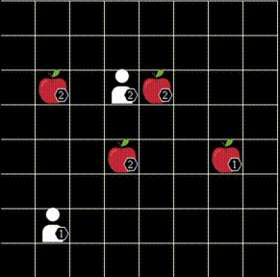
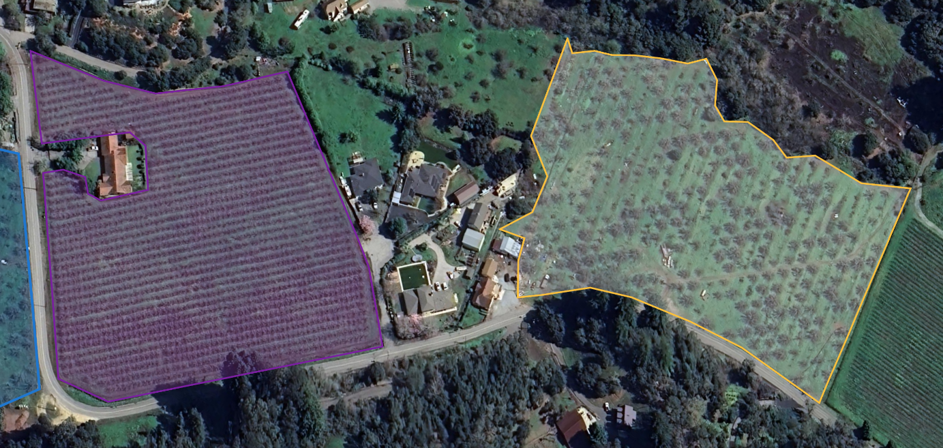
Existing multi-agent reinforcement learning environments do not represent
real world agricultural scenarios
Existing Simulated Environments
Aerial View of Operating Orchards
Notes:
A key feature of our research is that it pushes the boundaries of MARL research toward a more real-world use case.
On the right, you can see a common MARL training environment called Level Based Foraging, this and other currently available environments are oversimplified and resemble a game of pacman more than they do a real-world agricultural setting. We wanted to represent real-world orchards like you see on the right, with all of the variety and inconsistencies that come with them.

Slide 13
We took field measurements from ten local California orchards to inform our environment layout
Existing Simulated Environments
Aerial View of Operating Orchards
Notes:
To achieve this, we spent a full day in the field collecting data on ten local orchards so that we could build a more representative environment.

Slide 14
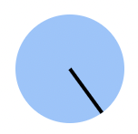
Custom environment developed for use case
Incorporates real-world dimensions, randomness and inconsistencies
Task-specific bots designed for minimally disruptive deployment
Ranges for key parameters generate a variety of possible orchard layouts.
tree_diameter = [9, 44]
distance_btw_rows = [365, 762]
distance_btw_trees = [150, 762]
canopy diameter = [150, 762]
apple_diameter= [5, 9]
vacancy_rate = [0, 0.3] (percent)
big_bin_dimension = 122 x 122 x 72
small_bin_dimension = 41 x 61 x 30
“Picker bots” pick up one apple at a time and deposit into a bin.
Movable bins auto-locate to reduce distance traveled by pickers
(on roadmap)
Continuous environment space
(not grid world)
Notes:
The custom environment we developed succeeds in pushing MARL research closer to real world use cases.
A few key features differentiate this environment from past work:
First is that it incorporates real world dimensions for key parameters like tree diameter and distance between trees (which you see on the right). It uses these parameters to randomly generate a unique orchard for each training run.
Second, we incorporate task-specific bots whose jobs have been defined with minimally disruptive deployment in mind. “Picker bots” pick apples up off the ground” and “moveable collection bins” will auto locate to reduce the distance traveled by pickers when they go to deposit apples.
Finally, our environment was developed in continuous space, as compared to the pacman style gridworld setup you saw on the previous slide. This is key to representing a real world scenario but makes for a much more challenging training task.

Slide 15
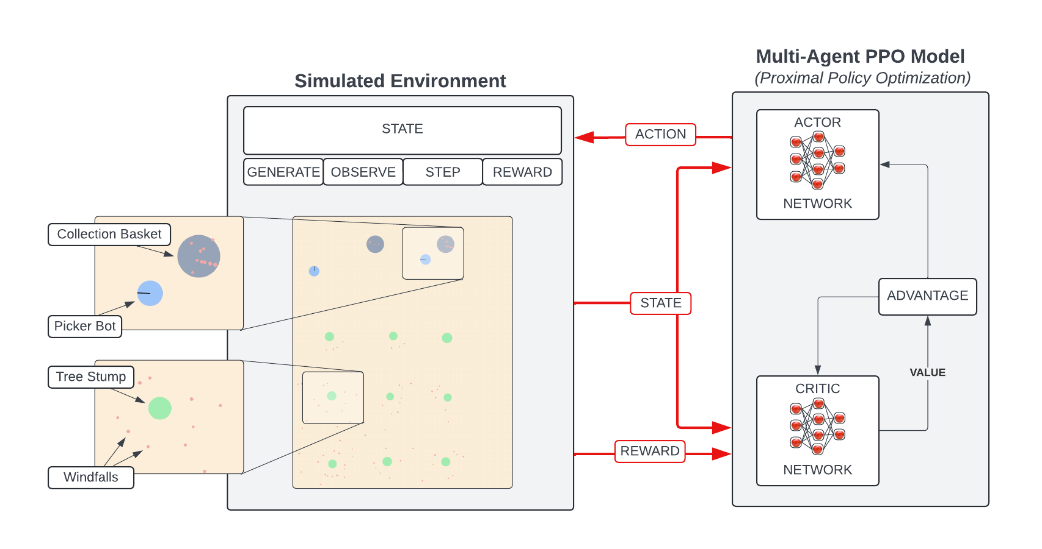
Overview
Notes:
Our next challenge was designing an architecture that bridges the gap between mimicking realistic complexity and enabling efficient model training.
This architecture has two main components: the environment and the model.
On the environment side, we built interactive classes that merge real orchard attributes with training compatibility.
On the model side, we use a Multi-Agent proximal policy optimization approach, designed to interact seamlessly with the environment. It trains two networks:
The actor network, which selects the best action based on observations.
The critic network, which evaluates the value of a state and critiques the actor’s choices to improve its decision-making.
By combining these components, we aim to create a system that is both realistic enough to be useful and simplified enough to be trainable.

Slide 16
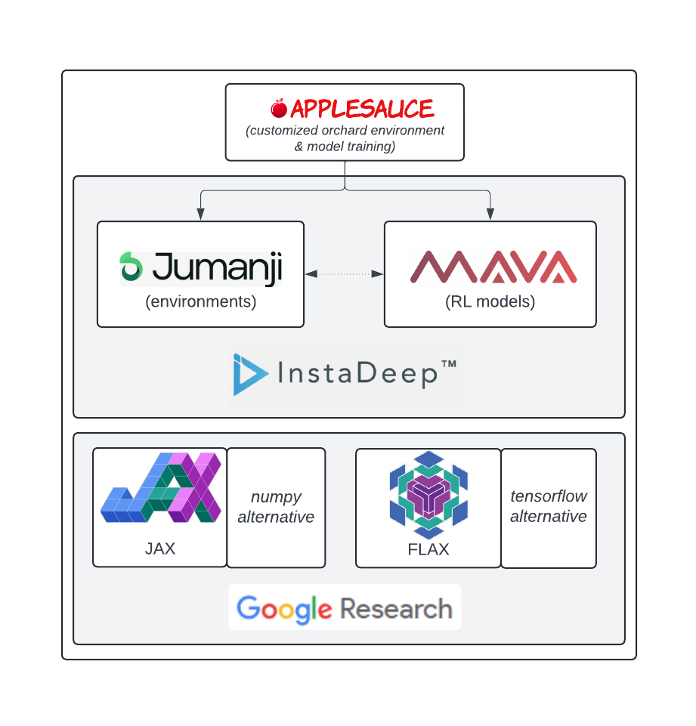
Technical Approach
reinforcement learning requires parallelization
deep study of:
Jumanji/Mava
Jax/Flax
: 4,000 lines of code built upon InstaDeep libraries
Notes:
Training reinforcement learning models demands extensive iterations and compute, making parallelization essential.
We explored InstaDeep's open-source libraries, Jumanji and Mava, which are specifically designed for reinforcement learning.
These libraries are built on top of Jax and Flax,
which are high-performance libraries designed for parallelized deep learning.
While Jumanji and Mava offered an excellent foundation, their standard configurations didn’t align with our unique use case.
To address this, we performed a deep study of these libraries, and created Applesauce, a custom repository with 4,000 lines of integrated code.
Applesauce was pivotal in enabling us to explore our specific realistic requirements while harnessing the power of these advanced tools.

Slide 17
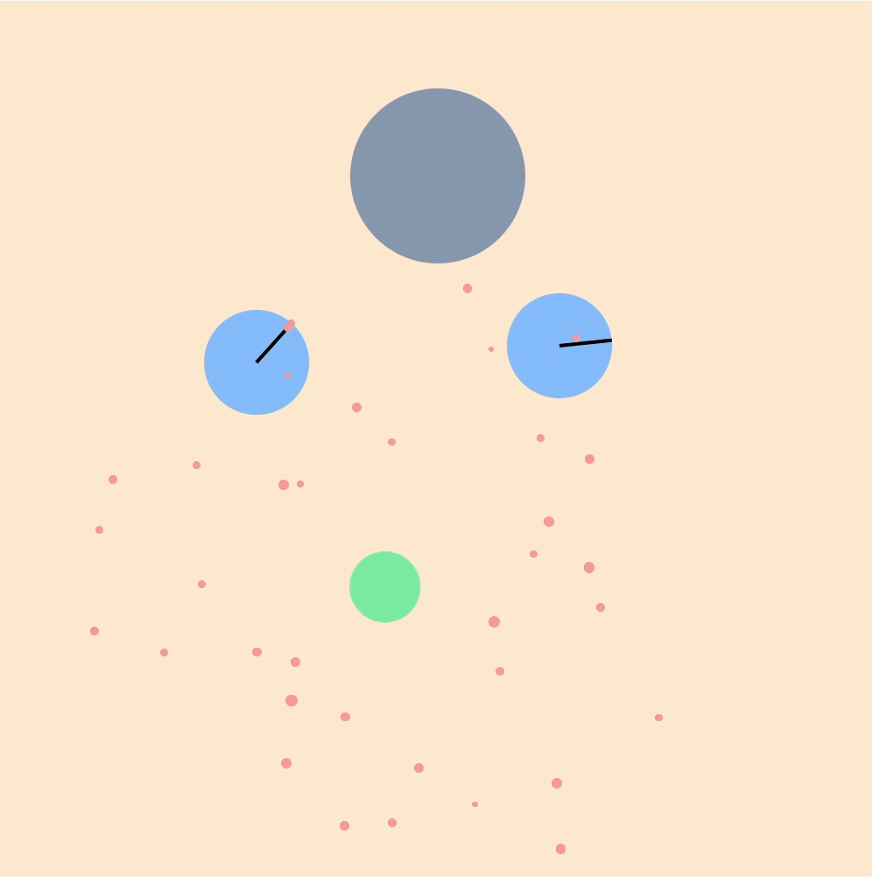
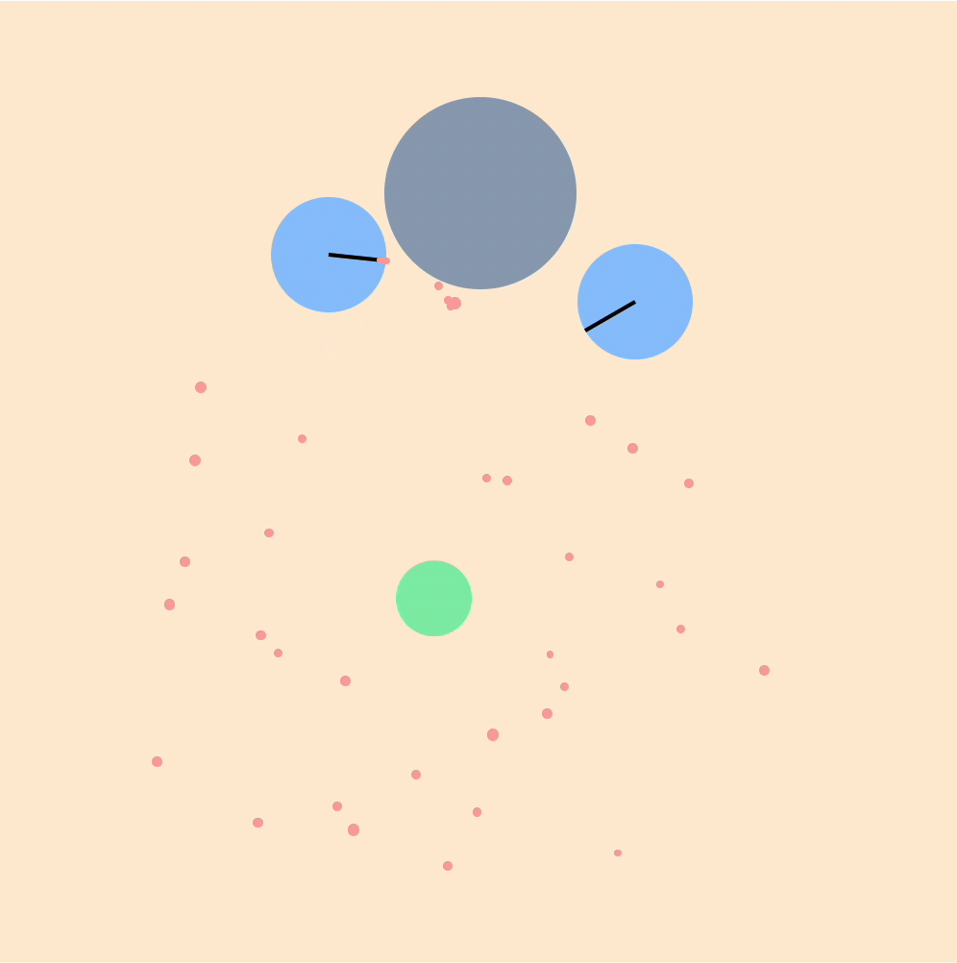
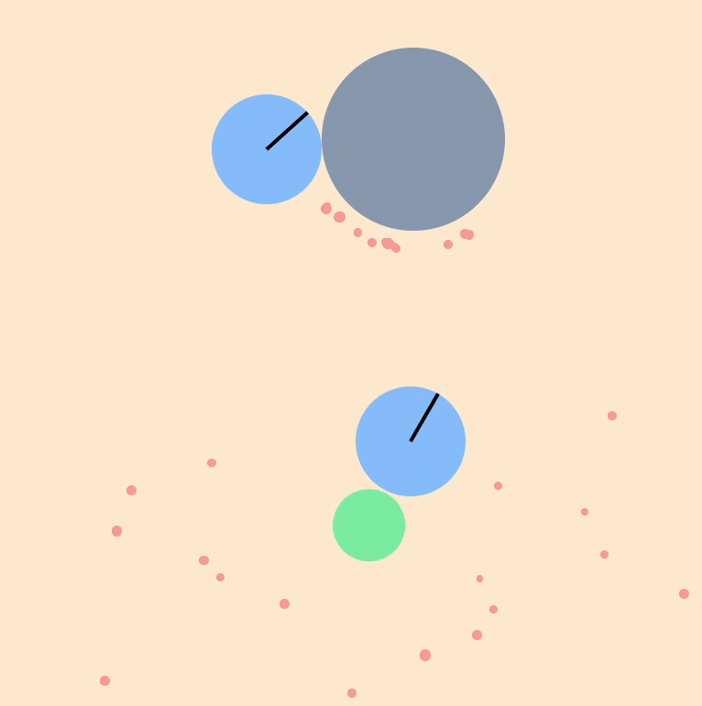
Model Demonstration
Hundreds of simulations simultaneously = quick learning
Starting Point
Learnings
Current Model
Wandering with apple
Stuck
“Goaltending”
Out of Bounds
Random Actions
Effective Collection
Notes:
And those efforts paid off when it came time to training.
With our architecture, we are capable of training across hundreds of environments simultaneously.
This provided the opportunity for our models to run through and learn from millions of timesteps in short runs.
Which then allowed us to learn quickly as well.
Shown here are some examples of that journey.
As a reminder, the blue circles -> robots,
the grey is the bin they are looking to deposit into.
green represents a tree trunk and the red dots scattered around it are apples.
Our starting point is a rendering of bots after dismal training. As can be seen, they appear to be taking random actions,
while they may luck out on picking up an apple, none get deposited into the bin.
This middle section highlights just some of the many learnings along the way.
A bot that goaltends the basket in hopes for a quick reward.
Another seemingly stuck by a tree
another wondering out of bounds
and lastly one that picks up an apple and just wanders around with it.
These are just a few examples of the many iterations that were made to improve our environment and model,
through addressing environment logic, intrinsic attributes, reward functions and fine tuning modeling parameters.
Lastly shown here is our current model performing effective collection of the apples.
Now I will hand it off to River to discuss baseline comparison.

Slide 18
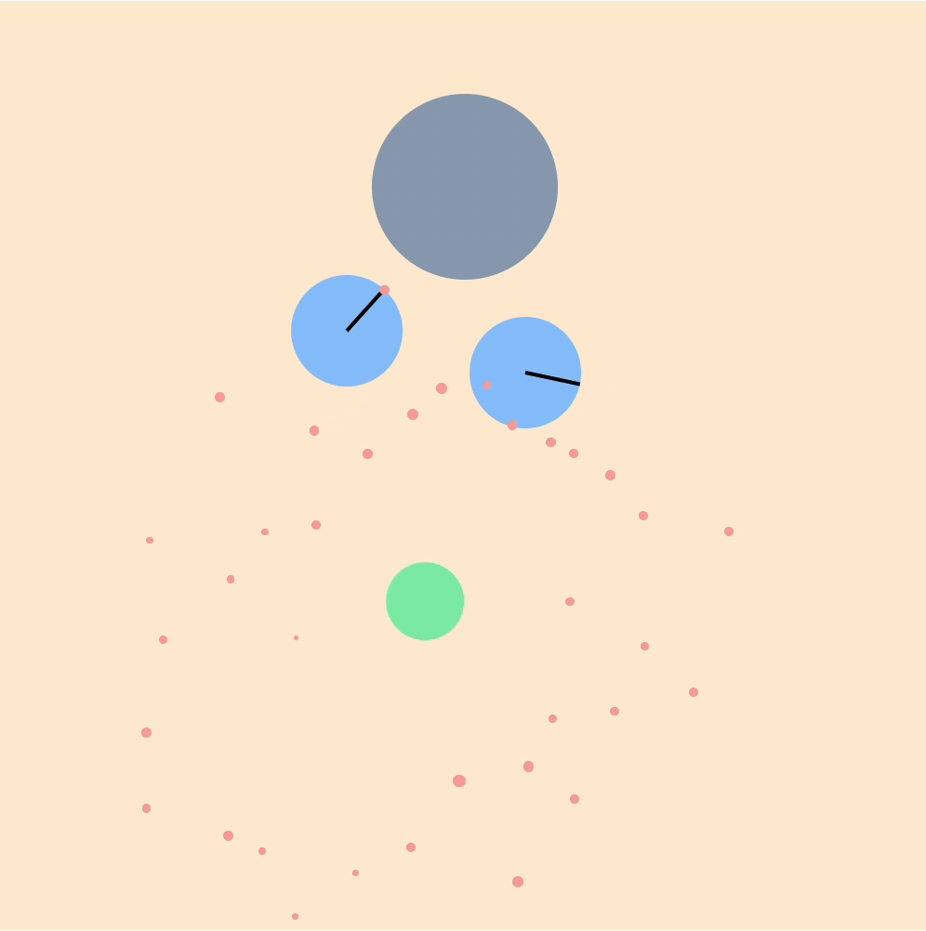
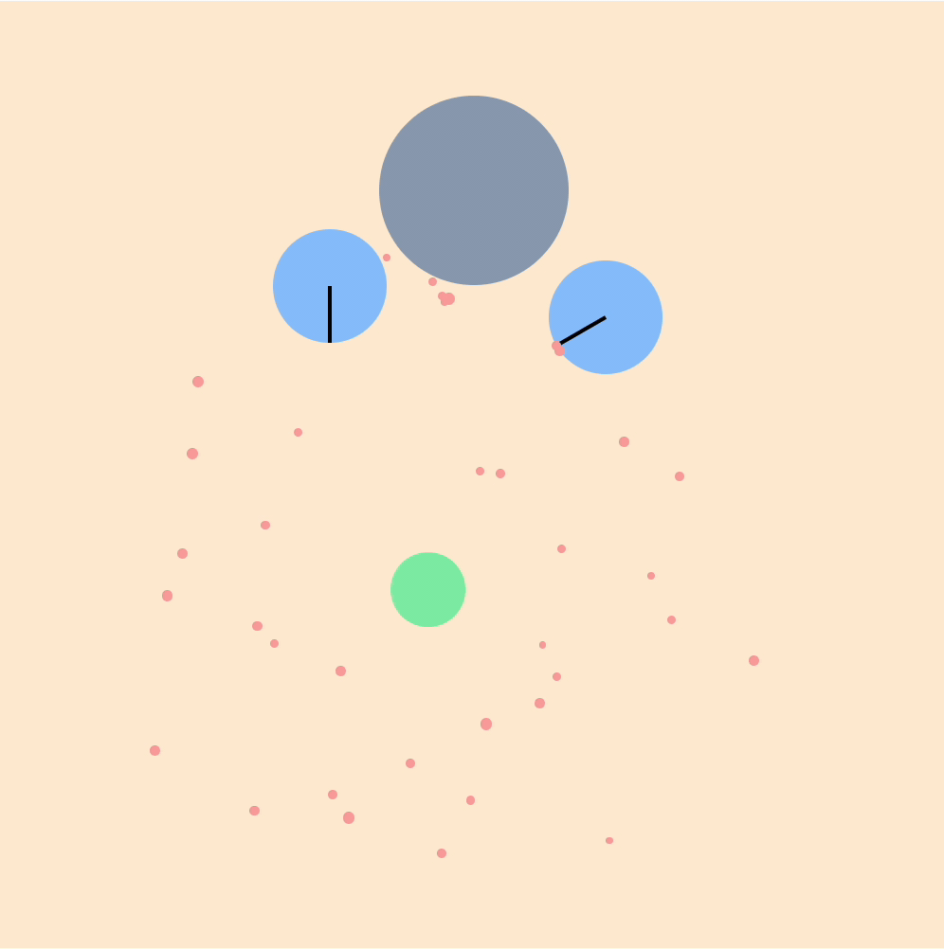
Model Demonstration
A* Baseline
(18 of 35 Collected in 3mins)
MARL Model
(25 of 35 Collected in 3mins)

Slide 19
Hyperparameter Optimization - Grid Search
Training Duration
 | 256 Steps | 512 Steps | 1024 Steps | 2048 Steps | 4096 Steps
400 / Epoch | 264 /hr | 266 /hr | 84 /hr | 288 /hr | 264 /hr
800 / Epoch | 252 /hr | 204 /hr | 252 /hr | 288 /hr | 300 /hr
1600 / Epoch | 264 /hr | 276 /hr | 288 /hr | 276 /hr | 300 /hr
Gradient
Update Frequency
Reward = 20
Reward | 5 | 10 | 20 | 100 | 200
Result | 144 /hr | 192 /hr | 300 /hr | 216 /hr | 216 /hr
Duration = 4096 / Updates = 800

Slide 20
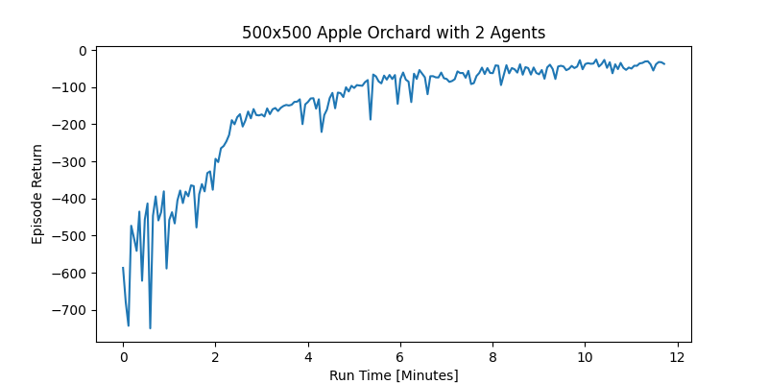
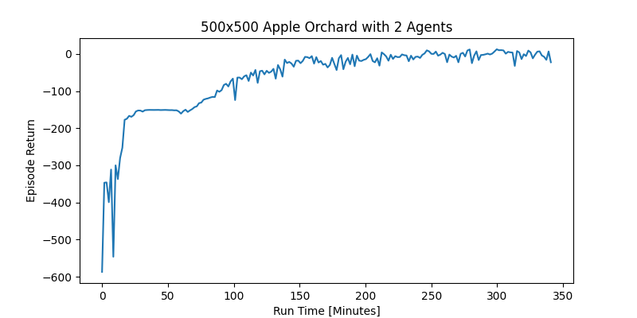
Training Statistics
Appears to Plateau
102 models trained
20 virtual machines
85 compute-hours
24,000,000,000 timesteps
52,000 unique orchards visited
BREAKTHROUGH!

Slide 21
Model Evaluation
Human Baseline
957 apples/hr**
$25/hr
A* Baseline
201 apples/hr*
$2/hr
MARL Model
300 apples/hr*
$2/hr
= 10 apples
*Assumes bots only hold one apple at a time.
**Assumes human is able to hold 5 apples at a time, but has imperfect efficiency.

Slide 22
Model Evaluation
Human Baseline
957 apples/hr
$25/hr
MARL Model
3,750 apples/hr
$25/hr

Slide 23
Key takeaways: Technical Innovation
Research Contribution:
MARL research has seen significant progress over the past decade
Yet, minimal research available for MARL applied to agriculture
Our research explores the application of MARL in the agricultural space and provides a new environment for further development of this use case.
Key Technical Challenges:
Environment complexity and transferability to real world
High compute requirements to complete billions of training steps
Nascent research area with changing libraries
Notes:
Solution for # 1. Designed new environment that suits real world, started with simplest version of that enviro.
Solution for # 2. Leveraged MARL library and JAX for easy parallelization.
Solution for # 3. (to be edited) Engage with other researchers and practitioners in the MARL and robotics field to keep up with the pace of innovation and design our research / product in the best possible way.

Slide 24
Roadmap
Future Work: Phase I
Incorporate Autonomous Moveable Bins
Incorporate Fog of War
Publish Research
Aug
Sep
Oct
Nov
Dec
2024
2025
Future Work: Phase II
Time-series component for short-term memory
3D environment
Tune communication methods between bots
Jan
Feb
Mar
Apr
May
Research Paper Draft
Model Development, Training, & Eval
Environment Development
User Discovery
Project Planning
Notes:
We’ve conducted a substantial amount of research and laid a strong foundation for our project this fall. We plan to continue in the spring by incorporating autonomous moveable bins as an additional class of agents, incorporating a fog of war that limits bot visibility of the environment. We will then publish our research for others to use and extend upon.
Opportunities for future work includes adding a time-series component, extending our environment to 3D, and tuning communication between the bots.

Slide 25
We’re on a mission to reduce food waste by
extending cutting edge multi-agent reinforcement learning research to food sustainability.

