Slide 1
[En]ergy In[form]ation Portal
search differently

Slide 2
Push UX design limits
Integrate
divergent systems
Scalability across
sectors
Shaun Giudici ­
“The Judge”
Hassan Jannah ­
“The Rainman”
Anthony Suen ­
“The Philosopher”
Advisor: Prof. Marti Hearst

Slide 3
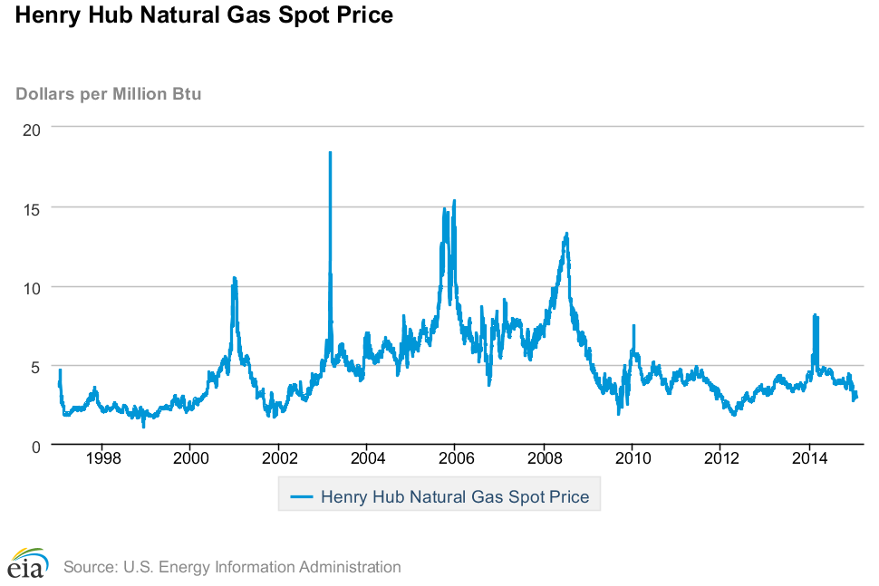
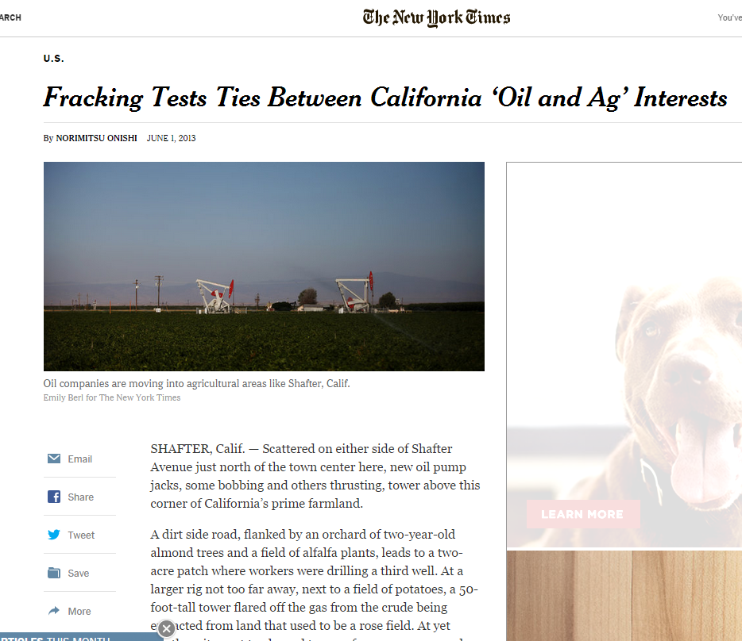
Energy Information is scattered in…
places
formats
Notes:
For many user needs, Information is scattered in different places and exists in various forms. Uncovering it often starts with search,
And what are the best tools we have for that today?

Slide 4
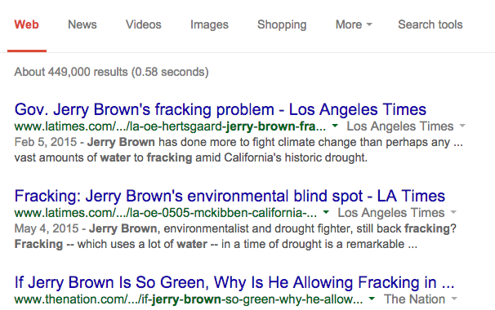
For most users, they see 10 blue links
Notes:
Lists…
This project started with the idea that current solutions are not optimized for research in complex verticals, like energy.

Slide 5
“We envision…
… a platform that collects, synthesizes and visualizes structured and unstructured data sources to support integrated research and analysis.”
Notes:
We envisioned a platform that collects, synthesizes and visualizes structured and unstructured data sources to support integrated research and analysis.”
Today we’re happy to present Enform, a search platform optimized for people who interested in energy-related issues
to quickly search and review web resources, and use them to assemble narratives.

Slide 6
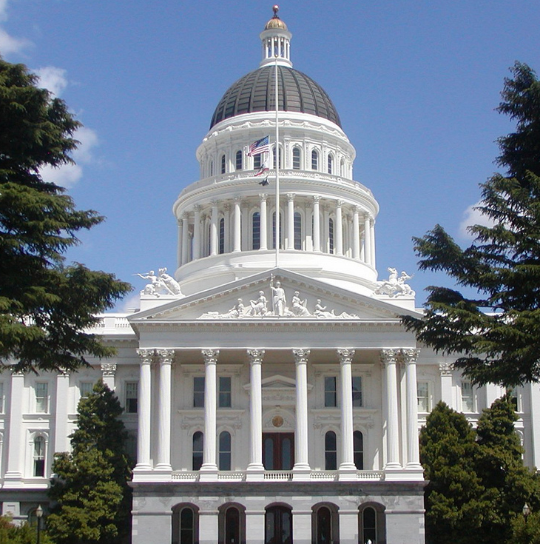
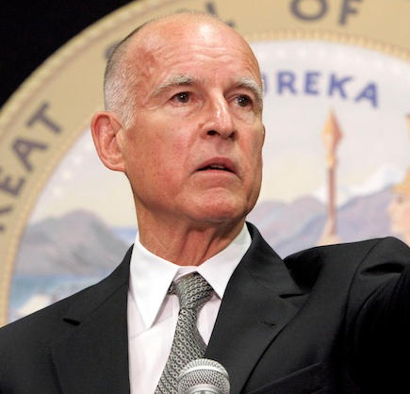
What does Barbara need?
Notes:
I want to introduce you to Barbara.
Barbara is a junior analyst in Governor Jerry Brown’s offices focused on environmental policy.
She is tasked with build a report on the impact of fracking on California’s water crisis.

Slide 7
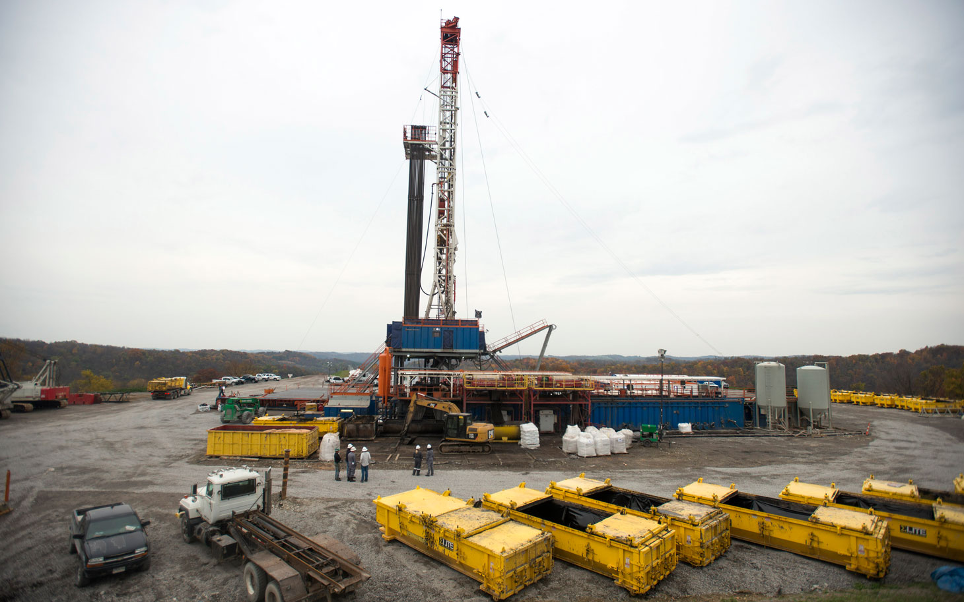
What does Barbara need?
Notes:
For her research, Barbara needs to find and integrate data sets and research related to fracking.
This currently involves searching multiple news articles and reports
and downloading data files from various government websites.

Slide 8
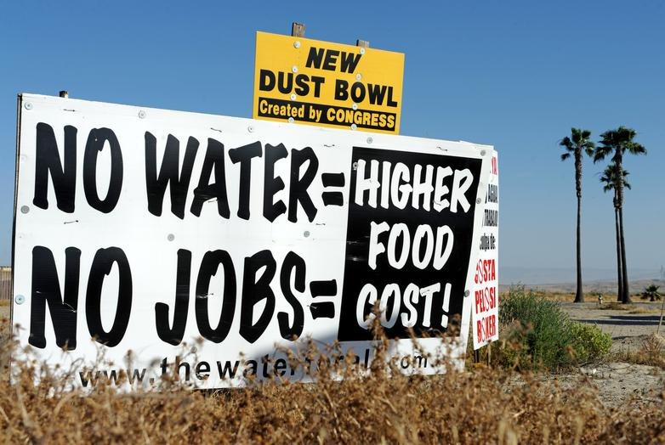
What does Barbara need?
Notes:
She needs to track the needs and concerns of the current stakeholders.
This requires her identify and analyze those stakeholder and study their arguments.

Slide 9
What does Barbara need?
Notes:
She then has to synthesize all the relevant information and insights.
This requires Barbara to copy and paste links from many reports and data sets, while also collect her notes.
Enform envisions a better information discovery process for analysts like Barbara

Slide 10
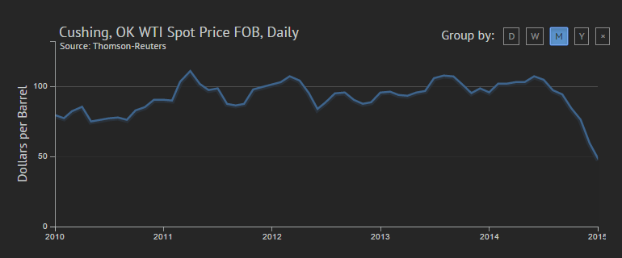
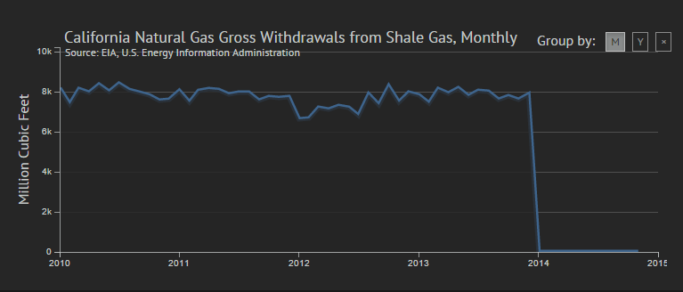
Get content from different sources and formats
Context
Combined
Text
Datasets
Notes:
Enform will provide Barbara text and dataset content in one place,
instead of multiple search boxes or separate databanks.

Slide 11
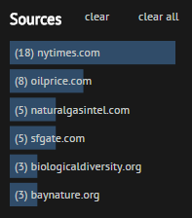
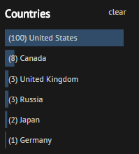
…and context about the issue
Notes:
Enform will give Barbara awareness about the main issues
and the players involved in this space she is searching into.

Slide 12
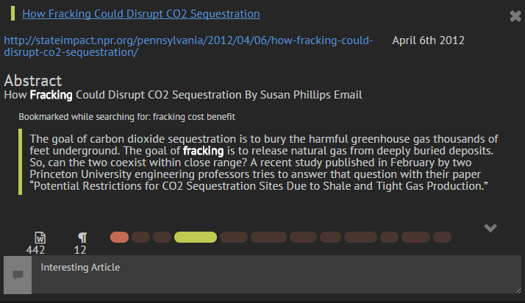
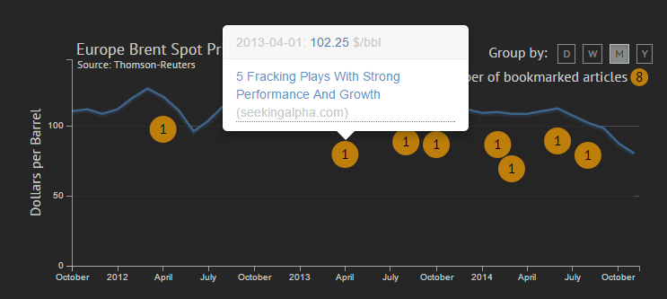
…and create collections of results
Relevant text
Infographic
Notes:
Finally, Enform will allow her to synthesize all of her
- datasets,
- reports,
- and notes into one place, without all the cutting and pasting.
This is what we propose, now lets show you HOW we will help Barbara discover information differently.

Slide 13
DEMO
enform.ddns.net

Slide 15
Backend Technology
Information System
Integrating
Disparate Data & Disjointed Systems
Notes:
The demo you just saw is of a fully functional information system.
I am going to tell you about the techonology behind it.
The heavy lifting in enform starts way before they open the web page.

Slide 16
Basic Building Blocks
Integrate Modular Components
Use External Services
Notes:
We started doing technology research very early in the project.
Because of the complexity, we needed to use good software engineering practices.
We buit our backend using many small integrated modules that can be moved around, enhanced, reused, or replaced easily.
We alsso used external open-source libraries and services whenever possible.
So what’s under the hood?

Slide 17
Basic Building Blocks
Integrate Modular Components
Use External Services
Front End
Stanford NER
Source API
Backend Hub
Freebase API
Kimono API
Geocoder API
MongoDb
ElasticSearch
Notes:
We desigend the building blocks in parallel with user interviews.
By mid-project review, we had a functional backend with most features implemented
This allowed to start functional prototyping early on.
At the core is the python hub that connects everything together.
We used MongoDB as a repository and ElasticSearch as a search engine on top of it for better search features and performance
We also used several external APIs and services to load and process data.

Slide 18
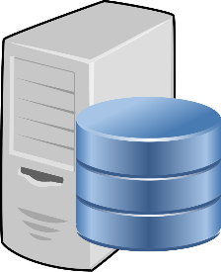
The EnForm Loading Pipeline
Offline Pre-processing
On-demand Queries
Configure Source
Load Content
Process Content
Update Index
Search Articles
Calculate Stats
Search Datasets
Render
ElasticSearch
Notes:
There are two main phases in the enform user experience pipeline.
First we pre-process all the content in bulk because because Many of the algorithms we use are cpu, memory, and time intensive.
We learned that from previous preparation projects.
The user would then interact with this pre-processed collection in real time.
I am going to go over some of the key phases of this pipeline

Slide 19
Multi Purpose Scraper to load content
ElasticSearch
61,000 Articles
5,000 Datasets
Configure Source
Load Content
Process Content
Update Index
Search Articles
Calculate Stats
Search Datasets
Render
Notes:
First we built a multi-purpose API loader thit brign content into enform.
Today, we have more than 61 thousands processed energy-related articles from the new york times, google news, and a few journals.
we also have about 5000 of the most relevant national and international datasets from the Energy Information Administration.
That’s the corpus that Barbara was searching.

Slide 20
Article Processing Pipeline
1. Scrape & Parse Articles
Extract Text
Generate Keywords
Generate Summary
2. Process Entities
3. Post Processing
Configure Source
Load Content
Process Content
Update Index
Search Articles
Calculate Stats
Search Datasets
Render
Notes:
The heart of the backend is the article processing pipeline.
First we extract the text from news site URLs.
Then, the library will generate a list of keywords like shale or water and a brief summary of the text.

Slide 21
Article Processing Pipeline
1. Scrape & Parse Articles
Extract Entities
Process Persons
Process Organizations
Process Locations
2. Process Entities
3. Post Processing
Configure Source
Load Content
Process Content
Update Index
Search Articles
Calculate Stats
Search Datasets
Render
Notes:
As you saw in Barbara’s scenario, the interface contains several faceted filters like person names.
Those entities were extracted from the text of each article. We used the Stanford Named Entity Extraction library to extract named entities, or proper nouns, from the text.
Our main targets were Persons, Locations and Organizations. These became search facets For each of these classes, we had a unique algorithm to make entities more uniform within articles and across a corpus.

Slide 22
Article Processing Pipeline
1. Scrape & Parse Articles
Process Persons
Jerry Brown
Governor Brown
Gov. Jerry Brown
Mr. Brown
2. Process Entities
Jerry Brown
Name | Jerry Brown
Role | Politician
freebase | freebase.com/m/017pf5
3. Post Processing
Configure Source
Load Content
Process Content
Update Index
Search Articles
Calculate Stats
Search Datasets
Render
Notes:
For example, Jerry brown is referred to with different names like Mr. Brown, or Governor Brown.
We mapped all of these into a single semantic representation of Jerry Brown on the freebase web database of named entities.
This method allowed us to remove and ambiguities about names within a single article and also across the entire corpus.
We used a similar method for Organizational Entities.

Slide 23
Article Processing Pipeline
1. Scrape & Parse Articles
Process Locations
UC Berkeley
San Ramon
California
2. Process Entities
City | Berkeley | San Ramon
State | California | California | California
Country | USA | USA | USA
3. Post Processing
Configure Source
Load Content
Process Content
Update Index
Search Articles
Calculate Stats
Search Datasets
Render
Notes:
For Locations, we used geocoding services like bing and google to get Country, State, and City for every location
This allowed us to provide better geo-based searches.
For example, a search within california will return all result that contain locations in california, such as “Berkeley”,
even if the word california was not explicitly mentioned.

Slide 24
Article Search with Boosting
Search Articles
Search Datasets
Configure Source
Load Content
Process Content
Update Index
Search Articles
Calculate Stats
Search Datasets
Render
Notes:
From the user perspective, Enform is a search engine.
We used the Elasticsearch platform as a search engine for our content.
It has many knots and bolts that we could play with to fine-tune search parameters and result scores.

Slide 25
Article Search with Boosting
Search Articles
Index
Query
Boost
Search Datasets
Title
Find all word in any field
Title
Text
Keywords
Authors
Keywords
Entities
Configure Source
Load Content
Process Content
Update Index
Search Articles
Calculate Stats
Search Datasets
Render
Notes:
We indexed key fields such as title, text, and authors on elasticsearch. we also indexed fields created in the pipeline such as locations and persons.
For articles, we search for all terms across fields to find relevant articles.
We added boosting parameters for some fields to improve relevance scores.
For example, if a search term occurs in the title, the article is given a higher relevance score.

Slide 26
Dataset Search with Keywords
Search Article
Index
Keywords
Query
Boost
Search Dataset
Name
From article search
Find any word in any field
Name
Description
Geography
Configure Source
Load Content
Process Content
Update Index
Search Articles
Calculate Stats
Search Datasets
Render
Notes:
Datasets were a more challenging search problem.
Search terms alone returned poor results, if any. For example, using “fracking California” would not return any relevant datasets.
To resolve this, we used the top keywords extracted from article search as additional search terms for datasets.
So the Fracking California search would look for word like shale and gas and California in the dataset collection.
As you saw, this method improved both recall and precision of the dataset search.
If you are interested, we can discuss the details of each of these algorithms at the end. There is some interesting code jujitsu there.

Slide 27
Frontend Development
Iterative process
Human-centered
Notes:
Hassan
Having done all of this, we needed to build an interface that could use of all this content to provide the user experience
that people like Barbara need.
Shaun
put a a significant focus on humans, and sought user feedback often
So how did we find people like Barbara?

Slide 28
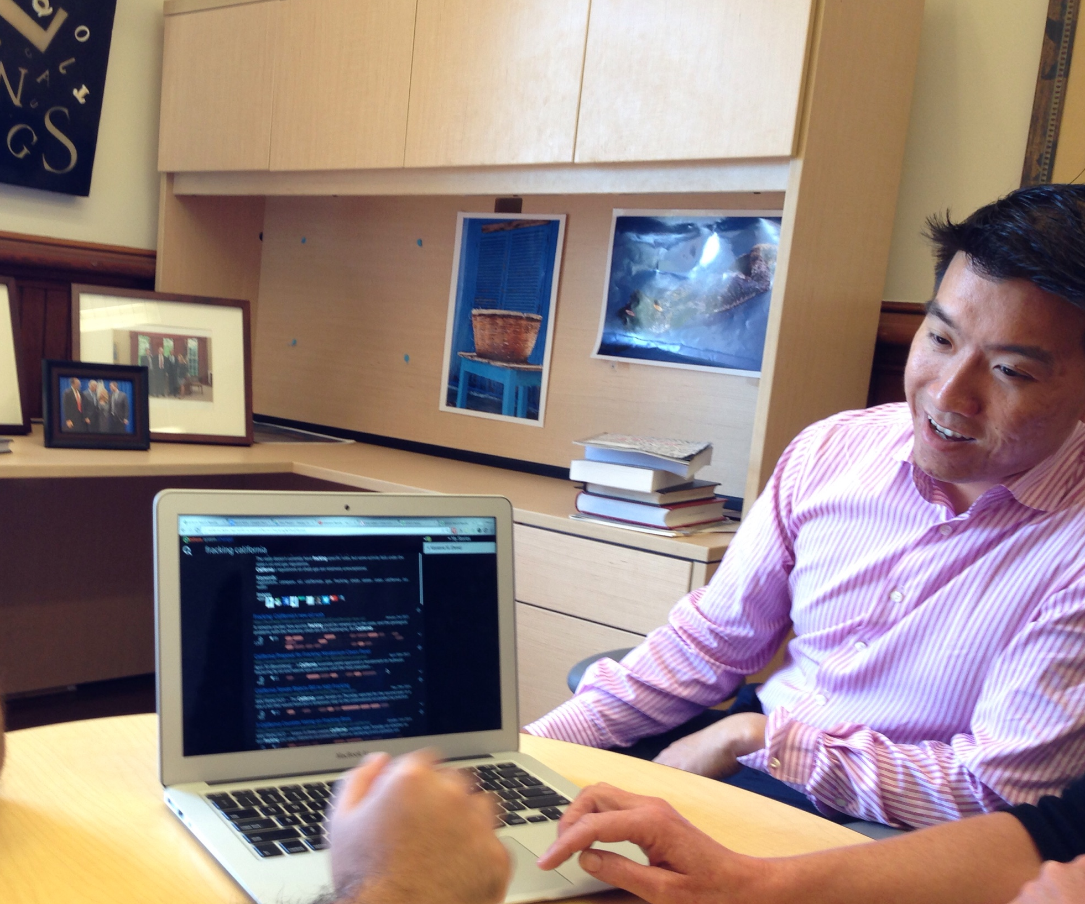
User research
User Interviews
Affinity Diagrams
Notes:
We began by conducting many user interviews with professionals that have ties to the energy industry
We talked with them and listened for: - their goals at work - the technology they use - and we tried to spark their imaginations for systems that could improve the way they deal with information.
We used our observations and insights from the interviews to create detailed personas (with real needs, behaviors and resources to consider)

Slide 29
Persona Preferences
Also prefer breadth over depth
Notes:
We rated them on a number of factors, narrowing down our target focus to a scope that we felt we could have the biggest impact in.
PAUSE

Slide 30
Information discovery process
Find
Skim
Dive
Save
Surface new content
It quickly for relevance
Deeper for more details
Interesting bits for later
Notes:
Armed with a better understanding of our users We identified a typical workflow that arose as a theme through observation.
It begins with a find - where new content is surfaced User moves to a “skim behavior” - when they rapidly scan for relevance among results At some point, sometimes later, - user does a deeper dive for more details within a source And lastly, they save interesting bits for later - for their reports, personal archives, or other sharing needs
This workflow served as the core of our experience design requirements.

Slide 31
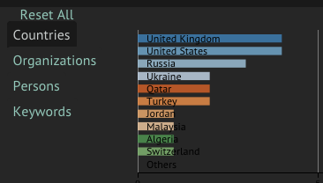
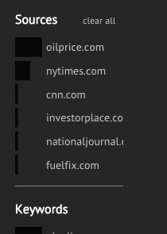
Iterative Process: Faceted Filters
V1
V2
V3
V1: Tabs + Correct statistics + Filter Interaction
V2: New Layout + Reordering + Tooltips
V3: Better Styling + Count Label + New facet (Length)
Notes:
All of our frontend elements were designed via an iterative process
- with heavy emphasis on user feedback to enform improvements.
in this example we see the evolution of our faceted search filters over the course of 3 functional prototypes version 1 The initial prototype proves the concept of using a distribution as a facet to filter results also notice the tabbed view design to move between filters
user feedback indicated - failure to understand that these were tabs - poor readability of the filters - and lack of clarity of color meaning
v2 in version 2 we addressed these issues
- and also updated the order of filters based on observations of the users favorites the feedback this time indicated: - deep black color is dominating the page - label positions feel awkward (and were sometimes bleeding into other elements) - and some users also expressed interest in a more specific count within the distribution
in version 3 we put heavy emphasis on - improved color and readability, - adding actual count labels to the visualization, and - and brought in an additional facet (article length)

Slide 32
User favorite: Paragraph Tiles
Paragraph Length
Article Length
Relevance
Hover to preview paragraph
Click to bookmark
More
Let’s dispel the misapprehension that this is attributable to fracking. To blame is shoddy regulation, not the process of fracking per se…
Less
Notes:
Feedback also served as a way to understand what was working.
The paragraph tile visualizations are our most innovative concept, and represent the feature in Enform that got the most users excited.
They are an abstraction of an articles full text, divided into paragraphs. Length of tiles - indicates word count, Density of color - “relevance”, or number of keywords matched
These tiles are enabled for two interactive controls. hovering them reveals a preview of the paragraph clicking them quotes the specific paragraph in your story draft.

Slide 33
Blending Text an Datasets
Search View
Datasets
Result distribution
Notes:
One of the key features of enform is that in blends data of different formats in a single interface
In the search view
we aligned time series data with a distribution of articles over time
to help users identify interesting time periods,
or dig deeper into results that correlate with interesting data patterns

Slide 34
Blending Text an Datasets
Search View
Datasets
Result distribution
Story View
Datasets
Bookmark overlay
Notes:
In the story view
We brought both together into a single infographic that shows the bookmarked articles
overlaid with their corresponding data values
to help tell a story about the search topic in a visual fashion
These examples serve to showcase the power of user centered design to build an easy-to-use system that has a high density of information

Slide 35
An ISchool project…
Notes:
What brought us together as a team is that we wanted to build something the is useful to users and also fun to make.
Each of us had a different path at the I-School. These divergent paths complement each and allowed us create Enform.

Slide 36
System Design
UX Design
User Centered
Search
Usability
NLP
Information Architecture
Info Visualization
Data Science
Integration
Story Telling
Info Organization
Notes:
So We wanted to make something that encapsulates everything we learned here.
We have condensed our 2 years at the I School into one four month project.
We pushed ourselves to innovate, learn, experiment with information and technology.
Our main goal, however, was to help Enform.

Slide 37
Acknowledgements
Prof. Marti Hearst
BIDS
All of our interviewees
Notes:
Before we take questions.
We would like to thank our Advisor, Prof. Marti Hearst for her valuable advice.
We also want to than the Berkeley Institute of Data Science for being such gracious hosts for us.
We would also like to thank our interviewees for their generosity in time, feedback, and advice.

Slide 38
Questions
enform.ddns.net

Slide 39
Questions you might want to ask
Why Energy?
Can you describe the NLP methods more specifically?
What would I do with a “story”?
What do you see as the next major changes for this app going forward?

Slide 40
Appendix

Slide 41
Humble Brags
17,000 lines of code (3 different languages)
15 customer interviews
30+ usability tests
4 design critiques
and 1 newborn baby

Slide 42
System Architecture and Data Flow
Flask App
Live
Front End
Offline
API
API Loader
App Views (Web Services)
EIA Data
NYT
API
API Loader
Newspaper Scraper
Text Processing
Calculate Statistics
Google News
Kimono Scraper
Get Results
Search Query
Oil Gas Journal
API
Search Scrape
Stanford NER
Geocoder
MongoDb
Elastic Search
Notes:
First we built a multi-purpose API loader. The loader can be configured to query and process many APIs for articles and datasets. The main purpose of the loader is get URLs of articles.
We used the Loader to load more than 10 thousands energy-articles from New York Times. We used The kimono web scraping platform to scrape various search page includes Google News, Oil and Gas Journal, EIA Reports.
Once URLs are pulled, they are passed to the Newspaper python scraping library which is optimized to scrape news sources.
Once text is extracted, it goes through a series of transformations to extract contextual information including keywords and different classes of named entities. The named entities go through a process of cleaning, normalization, and consolidation to create uniform entities across the corpus.
The final processing step is to update the elasticsearch index to allow fast, multi-field search.

Slide 43
Processing
Named Entities

Slide 44
Article scraping and processing pipeline
1. Scrape and Parse Articles
2. Process Named Entities
3. Post Processing
Scrape HTML
Run Stanford NER
Clean Results
Extract Text
Process Person Names Reverse lookup, Freebase mapping
Generate Basic Statistics
Run built-in library NLP (Keywords, Summary, Metadata)
Process Locations Geocoding APIs
Save to DB
Process Organizations Decode Abbreviations, Freebase Mapping
Notes:
The heart of the backend is the article processing pipeline. It takes an article’s URL and returns a document containing text, meta data, and processed, clean named entities.
The external scraper library would load HTML pages and extract the primary content using an internal voting mechanism. We also built a backup scraper to handle pages generated by client-side scripts.
Once text is loaded, the library would extract keywords, generate a summary of the text, and map additional fields obtained through the API such as publish date.
Using the Stanford Named Entity Extraction library, we extracted 7 classes of entities from the text. Our main targets were Persons, Locations and Organizations.
For each of these classes, we had a unique algorithm to normalize entities within articles and across a corpus.
For example, all the different variations of President Barack Obama would be mapped to a single semantic representation of Barack Obama on freebase. This allows us to create better, more accurate contextual filters in the front end as well.
If you are interested, we can discuss the details of each of these algorithms at the end. There is some interesting code jujitsu there.

Slide 45
Normalizing person names using backward lookup and Freebase API
NER Person
Barack Obama
Ken Salazar
Salazar
President Obama
Salazar
Tom Vilsack
Obama
Salazar
Salazar
Luke Popovich
Popovich
Barack Obama (2)
President Obama (1)
Ken Salazar (5)
Tom Vilsack (1)
Luke Popovich (2)
Backward Lookup
Barack Obama
Ken Salazar
Tom Vilsack
Luke Popovich
Freebase Mapping
http://freebase.com/m/02mjmr
US President
count : 3
http://freebase.com/m/03mdtj
U.S. Congressperson
count : 5
http://freebase.com/m/0pf6f
Politician
count : 1
null
null
count : 2

Slide 46
Normalizing organizations using abbreviation decoding and Freebase API
NER Organization
Energy Information Administration (EIA)
Bureau of Land Management
BLM
EIA
BLM
U.S. Congress
Abbreviation Decoder
Energy Information Administration
Bureau of Land Management
U.S. Congress
Energy Information Administration
United States Bureau of Land Management
United States Congress
Freebase Mapping
http://freebase.com/m/05ptrz
Organization
count : 2
http://freebase.com/m/0f4r5
Government Agency
count : 3
http://freebase.com/m/07t31
Government Body
count : 1

Slide 47
Normalizing locations using geocoding APIs
Search Primary Geo API (Bing)
Ok?
No
Search Backup APIs (x3)
Yes
Use result to search primary
Yes
Ok?
Yes
Ok?
No
No
Save Location Object
Save Alternate Location Object
Save raw location only
Save Country, State, City in Article

Slide 48
EIA Dataset loading pipeline
Offline
On-demand
Download EIA Data Dump
Load all series into DB
Refresh Outdated Datasets
Generate Dataset Lineage
Create ElasticSearch Index

Slide 49
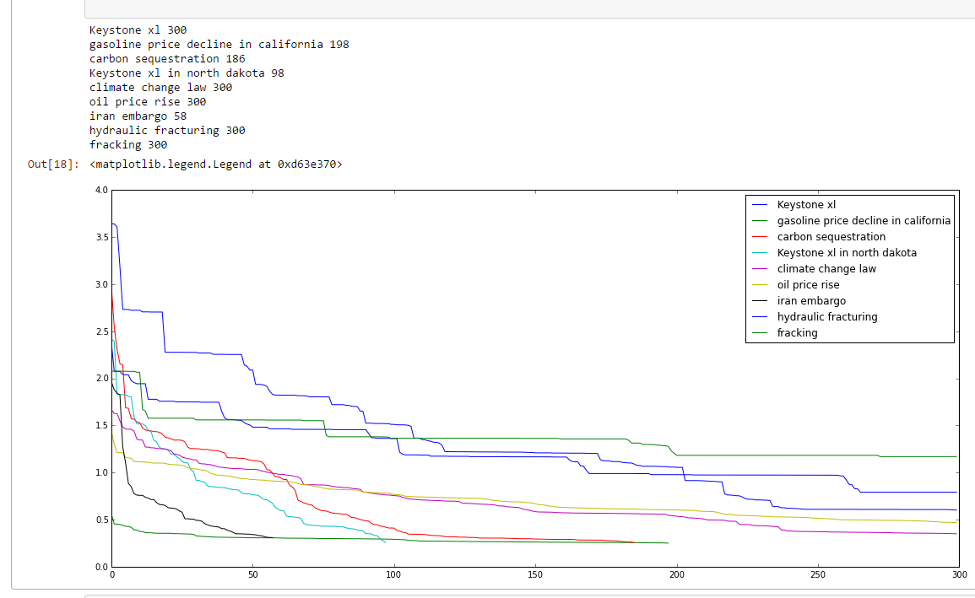
Search Limit Analysis

Slide 50
Wireframe Examples

Slide 51
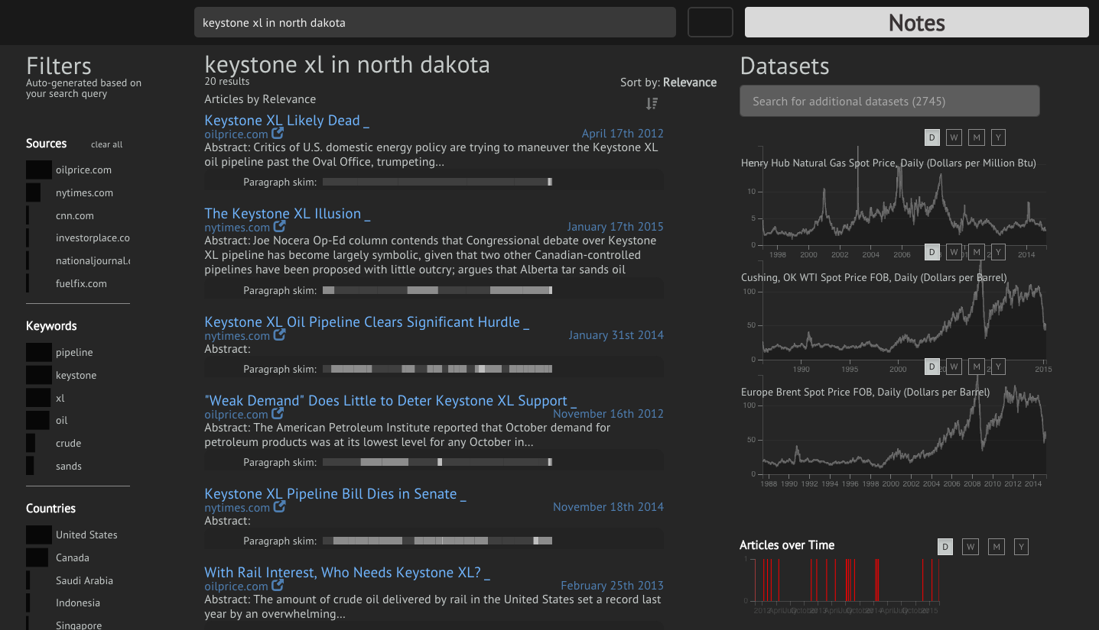
Notes:
more traditional layout
Users did see difference with datasets results and search results

Slide 52
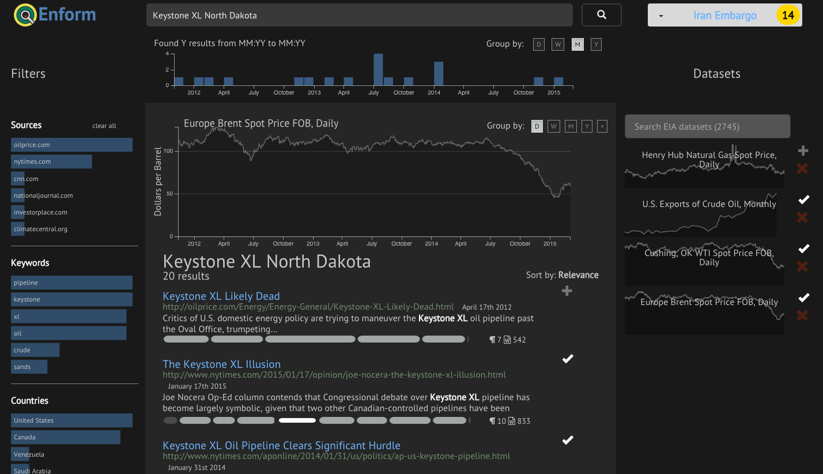
Notes:
We improved the pills and reemphasized the graphs in addition to having sparklines.

Slide 53
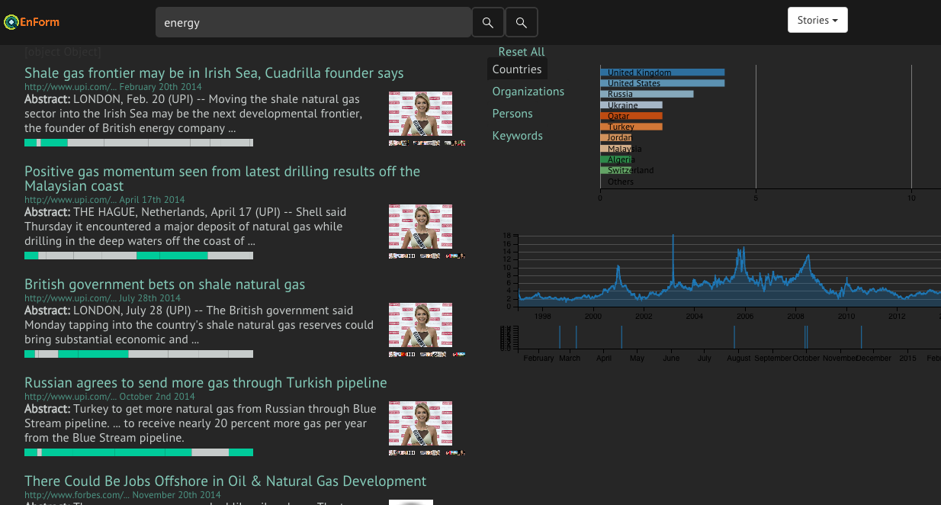
Functional prototype v1
Notes:
in the first prototype we were mainly proving concepts.
Yes we can populate these elements from search results
Yes we can enable them to be linked and filtering between one another.

Slide 54
Search card v1

Slide 55
User feedback informed many changes
Notes:
Talk about the faceted search as one example of user-generated change, but then focus on the pills

Slide 56
Search card v2
Notes:
more traditional layout
Users did see difference with datasets results and search results

Slide 57
Search card v3
Notes:
We improved the pills and reemphasized the graphs in addition to having sparklines.

Slide 58
Search card v4
Notes:
Final Iteration

