Slide 1
Guns N' Roses - Knockin' On Heaven's Door
Guns N' Roses - Knocking On Heavens Door
Guns 'N' Roses - Knockin' On Heaven's Door
Guns N' Roses - Knockin On Heavens Door
Guns N' Roses - Knockin' On Heavens Door
Guns N'roses - knockin on heavens door
Guns N' Roses - Knocking On Heaven's Door
Guns N Roses - Knockin' On Heaven's Door
Guns N Roses - Knockin On Heavens Door
Guns And Roses - Knocking On Heavens Door
Guns Nroses - Knockin On Heavens Door
Guns'n' Roses - Knockin' On Heaven's Door
Guns N Roses - Knocking On Heavens Door
Guns'n'Roses - Knockin' On Heaven's Door
Guns 'N Roses - Knockin' On Heaven's Door
Guns & Roses - Knockin' on Heaven's Door
Guns N'roses - Knockin' On Heaven's Door
Guns and Roses - Knockin' On Heaven's Door
Guns'n Roses - Knocking On Heavens Door
Guns 'n' Roses - Knockin' On Heavens Door Aerosmith - Knocking On Heaven's Door
Guns 'n Roses - Knocking On Heaven's Door
Guns 'n' Roses - Knocking On Heavens Door
Guns N Roses - Knocking On Heaven's Door
Guns N' Roses - Knockin On Heaven's Door
Aerosmith - Aerosmith - Knocking On Heaven’s Door
Guns And Roses - Knocking on heavens doors
Guns 'n' Roses - Knockin On Heavens Door
Guns & Roses - 04 Guns & Roses - Knockin' on Heaven’s Door
Guns And Roses - Knockin On Heavens Door
Guns 'n' Roses - Knocking On Heaven's Door Guns'n'Roses - Knocking On Heavens Door
Guns 'N Roses - Knocking On Heavens Door
Guns n' Roses - Knockin' On heaven's door.mp3
Guns'n'Roses - Knockin' On Heavens Door
Guns 'N Roses - Knockin On Heavens Door
Guns N' Roses - Knockin' On Heaven's Door
Guns N' Roses - Use Your Illusion II - 04 - Knockin' on Heaven's Door
Guns'N'Roses - Knocking On Heaven's Door
Guns N' Roses - Knocking On Heavens Doors
GNR - Knocking on Heaven's Door
Guns and Roses - Knocking on Heaven's Door
Guns 'N Roses - Knockin' On Heavens Door
Guns'n Roses - Knockin' On Heaven's Door
Gun's and Roses - Knocking on haven's door
Guns'n'Roses - Knockin On Heavens Door
Guns N Roses - Knockin On Heaven's Door
Guns N Roses - Knockin' On Heavens Door
Gun's and Roses - Knockin' on Heavens Door
Guns & Roses - Knocking On Heavens Door
Guns N'Roses - Knockin' On Heavens Door
Guns N' Roses - Guns N' Roses - Knocking On Heavens Door Guns N' Roses - Knockin' On Havens Door
Guns N'Roses - Knocking On Heavens Door
Guns N' Roses - Knocking' on heaven's door GunsÂ´n Roses - KNOCKIN' ON HEAVENS DOOR
Guns & Roses - Knocking On Heaven's Door
Guns'n Roses - Knockin On Heavens Door Aerosmith - Knockin' on Heaven's Door
Guns N Roses
s;N Roses - Knockin On Heavens Door
Guns N'Roses - Knocking On Heaven's Door
Guns N' Roses - Knockin' On Heaven's Door (LP Version)
Guns N Roses - Knocking On Hevens Door
Guns 'N' Roses - Knockin On Heaven's Door
Guns N' Roses - Knockin'on Heaven's Door
Guns N' Roses - Knocking On Heavens
Guns & Roses - Knockin On Heavens Door
Guns’ n Roses - Knockin' On Heavens Door
Guns N Roses - Knocking on Heaven

Slide 2
Making Metadata:
The Case of MusicBrainz
Jess Hemerly
School of Information
University of California, Berkeley
Advisor: Brian Carver
Notes:
Hi. Thank you all for coming. I’m Jess Hemerly, and I’m looking forward to sharing my research with you today.

Slide 3
Guns N' Roses - Knockin' On Heaven's Door
Guns N' Roses - Knocking On Heavens Door
Guns 'N' Roses - Knockin' On Heaven's Door
Guns N' Roses - Knockin On Heavens Door
Guns N' Roses - Knockin' On Heavens Door
Guns N'roses - knockin on heavens door
Guns N' Roses - Knocking On Heaven's Door
Guns N Roses - Knockin' On Heaven's Door
Guns N Roses - Knockin On Heavens Door
Guns And Roses - Knocking On Heavens Door
Guns Nroses - Knockin On Heavens Door
Guns'n' Roses - Knockin' On Heaven's Door
Guns N Roses - Knocking On Heavens Door
Guns'n'Roses - Knockin' On Heaven's Door
Guns 'N Roses - Knockin' On Heaven's Door
Guns & Roses - Knockin' on Heaven's Door
Guns N'roses - Knockin' On Heaven's Door
Guns and Roses - Knockin' On Heaven's Door
Guns'n Roses - Knocking On Heavens Door
Guns 'n' Roses - Knockin' On Heavens Door Aerosmith - Knocking On Heaven's Door
Guns 'n Roses - Knocking On Heaven's Door
Guns 'n' Roses - Knocking On Heavens Door
Guns N Roses - Knocking On Heaven's Door
Guns N' Roses - Knockin On Heaven's Door
Aerosmith - Aerosmith - Knocking On Heaven’s Door
Guns And Roses - Knocking on heavens doors
Guns 'n' Roses - Knockin On Heavens Door
Guns & Roses - 04 Guns & Roses - Knockin' on Heaven’s Door
Guns And Roses - Knockin On Heavens Door
Guns 'n' Roses - Knocking On Heaven's Door Guns'n'Roses - Knocking On Heavens Door
Guns 'N Roses - Knocking On Heavens Door
Guns n' Roses - Knockin' On heaven's door.mp3
Guns'n'Roses - Knockin' On Heavens Door
Guns 'N Roses - Knockin On Heavens Door
Guns N' Roses - Knockin' On Heaven's Door
Guns N' Roses - Use Your Illusion II - 04 - Knockin' on Heaven's Door
Guns'N'Roses - Knocking On Heaven's Door
Guns N' Roses - Knocking On Heavens Doors
GNR - Knocking on Heaven's Door
Guns and Roses - Knocking on Heaven's Door
Guns 'N Roses - Knockin' On Heavens Door
Guns'n Roses - Knockin' On Heaven's Door
Gun's and Roses - Knocking on haven's door
Guns'n'Roses - Knockin On Heavens Door
Guns N Roses - Knockin On Heaven's Door
Guns N Roses - Knockin' On Heavens Door
Gun's and Roses - Knockin' on Heavens Door
Guns & Roses - Knocking On Heavens Door
Guns N'Roses - Knockin' On Heavens Door
Guns N' Roses - Guns N' Roses - Knocking On Heavens Door Guns N' Roses - Knockin' On Havens Door
Guns N'Roses - Knocking On Heavens Door
Guns N' Roses - Knocking' on heaven's door GunsÂ´n Roses - KNOCKIN' ON HEAVENS DOOR
Guns & Roses - Knocking On Heaven's Door
Guns'n Roses - Knockin On Heavens Door Aerosmith - Knockin' on Heaven's Door
Guns N Roses
s;N Roses - Knockin On Heavens Door
Guns N'Roses - Knocking On Heaven's Door
Guns N' Roses - Knockin' On Heaven's Door (LP Version)
Guns N Roses - Knocking On Hevens Door
Guns 'N' Roses - Knockin On Heaven's Door
Guns N' Roses - Knockin'on Heaven's Door
Guns N' Roses - Knocking On Heavens
Guns & Roses - Knockin On Heavens Door
Guns’ n Roses - Knockin' On Heavens Door
Guns N Roses - Knocking on Heaven
Notes:
From a blog post on the Last.fm blog in 2007, about 50 of 100 ways that Last.fm users had “knockin on heaven’s door” tagged in their music collections. For those not familiar with Last.fm, it’s an online, streaming radio service that also offers software that allows you to track and post your listening habits to the Last.fm site in order to build a library for better recommendations. This is what people’s data looked like. Inconsistent, misspelled, mixed capitalization, mixed punctuation, album name for some, letter N instead of ampersand… and 2 with the wrong artist. They called it “the guns n roses” issue. I call it the metadata problem.

Slide 4
Proprietary Metadata Sources
— iTunes
— TuneUp
— Mitsubishi
— Mercedes
— at&t
— iTunes
— Spotify
— Ticketmaster
— Napster
— Borders
Notes:
The two major proprietary metadata sources and some of their partners. You’ll notice that iTunes uses both. When you pop a cd into itunes, it’s accessing gracenote’s CDDB; iTunes uses allmusic for biographical information

Slide 5
Community Metadata Sources
Notes:
Three of the major peer-produced metadata sources, FreeDB and discogs, which is also a music marketplace, and MusicBrainz.

Slide 6
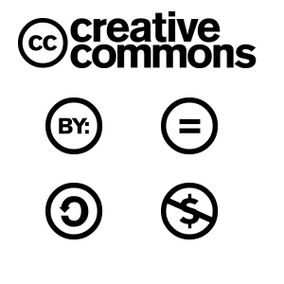
Intellectual Property Scheme
Notes:
MusicBrainz, the focus of this research study. MusicBrainz was actually founded by Robert Kaye after Gracenote purchased and privatized CDDB. CDDB was user-contributed, and the founder of MBz was upset that the work he and other contributors had done was no longer freely available to him to use. He made a pledge, which is reflected in the MusicBrainz social contract, that the resource he created would not be privatized. MusicBrainz is a “community metadatabase” and an “open music encyclopedia.” 3 different kinds of licensing happening: Live data feed, tags and annotations are CC; the actual facts are in the public domain; and the Picard tagger, which allows users to automatically add metadata to digital music tracks, is licensed under the GNU General Public License, or GPL.

Slide 7
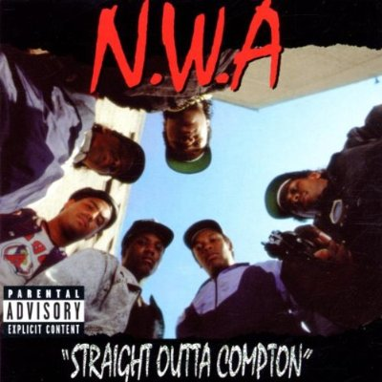
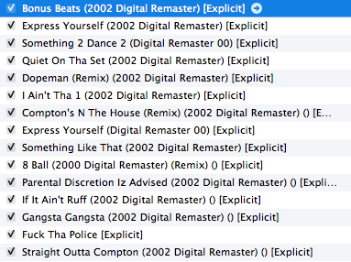
Use Case 1: Sloppy Syntax
Notes:
SO lots of people use iTunes, why does anyone use this site when Gracenote works with iTunes just fine? Well here are a couple of use cases.
Sometimes you get lousy metadata from official sources, here is some less than ideal metadata. This is the metadata on Straight Outta Compton that was on the file when I downloaded it from Amazon. It shows weird empty parentheses, and inconsistency in the way Digital Master is typed out. If you download music from multiple sources with different metadata syntax, you will end up with inconsistent metadata cross your music collection. This becomes a challenge for music information retrieval—that is, it alters the way your things are listed and may make it harder to find exactly what you are looking for.

Slide 8
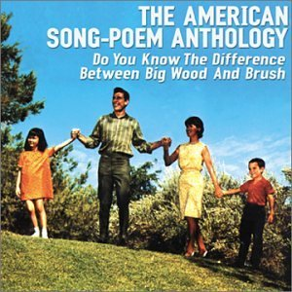
Use Case 2: Weird Tunes
Notes:
This is a CD I have that isn’t in Gracenote or Allmusic, because it’s fairly obscure.. When I went to see if I could add it to MusicBrainz, it was already there. If it hadn’t been there, I could have added it, but adding to Gracenote or Allmusic means submitting to their staff and it may never be added.

Slide 9
Use Case 3: F/OSS Music Player
Notes:
Not everybody uses iTunes. if you don’t use iTunes to rip CDs, you don’t have access to CDDB. You enter metadata manually for CDs, and may have changed your CD ripping settings at some point in time so that the data displays differently. You probably also acquire metadata from multiple digital stores. You may be also philosophically aligned with free and open source software principles, so MusicBrainz would be for you.

Slide 10
“…environments for developing and distributing cultural and scientific knowledge through institutions that support pooling and sharing knowledge
in a managed way…”
Constructed Cultural Commons
Madison, M., Frishmann, B., and Strandburg, K. Constructing Commons in the Cultural Environment. Cornell Law Review 95, (2010), 657.
Notes:
Literature review began in Brian Carver’s Commons-based Peer-production class here at the I School, and I latched on to a framing and a framework presented by Madison, Frishmann, and Strandburg’s in the Cornell Law Review called “Constructing Commons in the Cultural Environment.” based their framework on the natural resource commons work of Elinor Ostrom. Here is the definition they use for constructed cultural commons.

Slide 11
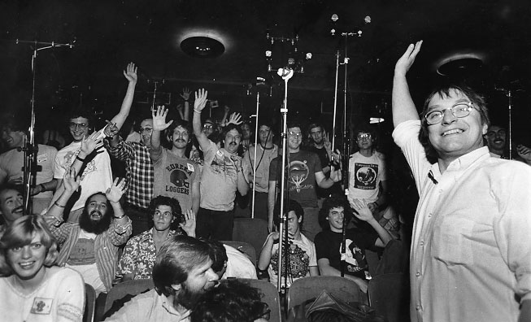
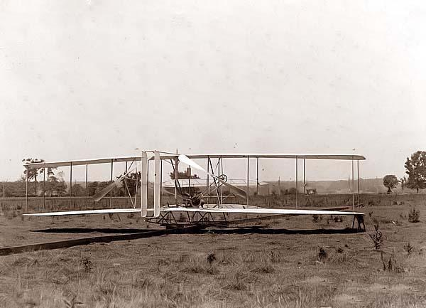
http://www.trufun.com/gd.gallery/taping.section.jpg
http://www.old-picture.com/wright-brothers/Wright-Brothers-Airplane-001.htm
Notes:
They give several examples of cultural commons. Jamband fan communities where fans share tapes of live performances; patent pools; the associated press; wikipedia; and linux.

Slide 12
free
peer-produced
open community
open license
self-governance
http://musicbrainz.org/doc/MusicBrainzLogo
Notes:
I intentionally put linux and wikipedia at the end because they are most similar to MusicBrainz, which is also a cultural commons. Some of the characteristics of MusicBrainz are shown on this slide. MusicBrainz fits the cultural commons definition, ad shares some characteristics in common with Wikipedia and Linux that are listed here.
MusicBrainz as a constructed cultural commons:
— free
— peer produced
— open source, open license
— community standards

Slide 13
Lakhani and Wolf (2005)
“Why Hackers Do What They Do: Understanding Motivation and Effort in Free/Open Source Software Projects”
Intrinsic Motivation
Extrinsic Motivation
Enjoyment-based
“Flow” (Csikszentmihalyi)
Community/Obligation-based
Group dictates normative frame of action
Immediate Payoffs
Pay
Satisfying a user need
Delayed Benefits
Professional skills
Career advancement
Notes:
Another chunk of literature presented studies of different aspects of cultural commons, largely Wikipedia and free/open source software. One particular article, in the book Free and Open Source Software, laid out a nice motivational framework that I used along with the constructed cultural commons framework to inform my research questions and frame some if my findings.
Intrinsic:
Enjoyment-based — Flow “enjoyment is maximized, characterized by intense and focused concentration”
Community/Obligation-based
Group dictates normative frame of action
Extrinsic: Immediate Payoffs
Pay
Satisfying a user need
Delayed Benefits
Professional skills
Career advancement

Slide 14
Contribution
Who, what, where, when, how, and, most importantly… WHY?
Information Resource
Why is metadata so important?
Notes:
Why do people contribute?
Who are the MusicBrainz contributors?
What characterizes editors’ participation?
How is contribution linked to cultural preference?
How does MusicBrainz negotiate guidelines and standards?
What is the relationship of MusicBrainz to other music resources?
What is the role of metadata in music technology?

Slide 15
Methodology

Slide 16
Survey
Open to All (18+)
MusicBrainz Usage
Basic Information
Registered Users Only
Activities
Attitude
Resources
Contribution
Editing
Administered via LimeSurvey
July 8 — July 24, 2010
256 responses in dataset
241 MusicBrainz editors
valid usernames
114 valid email addresses
2237 editors made at least one edit
557 editors made 10+ more edits
Notes:
It was open for ~2 weeks, posted on my blog, the official MusicBrainz blog, sent to the mailing list, and posted to the forums; from those channels I got a convenience sample of 256 total respondents, 241 were registered editors and 114 volunteered their email address for follow-up interviews, which indicates the willingness for people to talk about why they do what they do. 18+ only. All users were asked general questions about music information sources, while registered users only were asked to respond to questions about actual contribution. Editors were also asked to provide usernames, registration date, and, as I mentioned, email addresses. The entire survey is included in the appendix of the paper.

Slide 17
Data Scraping
Location by IP Address
Profile Data
Edits accepted
Auto-Edits entered
Edits voted down
Edits failed for other reasons
Artist subscriptions
IPurl = "http://www.melissadata.com/lookups/iplocation.asp?ipaddress="
editsAccepted = re.findall('"label"\>\s*([0-9]*)</td>\s*<td>\s*edits accepted', page)
autoedits = re.findall('"label"\>\s*([0-9]*)</td>\s*<td>\s*autoedits entered', page)
votedDown = re.findall('"label"\>\s*([0-9]*)</td>\s*<td>\s*edits voted down', page)
failedOther = re.findall('"label"\>\s*([0-9]*)</td>\s*<td>\s*edits failed for other reasons', page)
totalSubs = re.findall('<strong>([0-9]*)</strong> artists', page)
Notes:
I wrote and executed two Python scripts to gather additional data about my sample. In order to satisfy the requirements of a qualitative research methods class, I needed to conduct two of my interviews face-to-face. I asked users to enter their region on the survey, and since I also logged IP addresses to prevent duplicates, I created a script that looked up the North American respondents’ IP address on melissadata.com (which had the easiest URL to modify) and returned their city and state. For the second script, since 186 usernames was such an overwhelming response, I thought I could add to the data set by scraping information about their MusicBrainz activity from their user profiles. I created five regular expressions to extract the data from their public profiles and printed it to a CSV file.

Slide 18
Interviews
Editors:
24 editors contacted
14 interviews conducted
2 in person
7 Skype audio/SkypeOut
1 Skype video
1 Google Chat
1 Jabber
1 Skype audio & IM
Experts:
Robert Kaye (MusicBrainz)
Dan Trenz (Rovi)
Linda Quach (Rovi)
Ian Rogers (Topspin Media)
114 valid email addresses collected
Interview Guide
Part I. Discovery
Part II. Contribution
Part III. Community
Part IV. Music
Part V. Future of MusicBrainz
Notes:
Contacted 24, talked to 14; I also conducted interviews with four music technology experts, including the MusicBrainz founder, Rob Kaye, Dan Trenz and Linda Quach from Rovi, who own AllMusic, and Ian Rogers of Topspin Media, a music marketing and distribution platform, where I interned this summer.

Slide 19
How MusicBrainz Works
Notes:
I want to give a quick overview of how MusicBrainz works to set the stage for my findings.

Slide 20
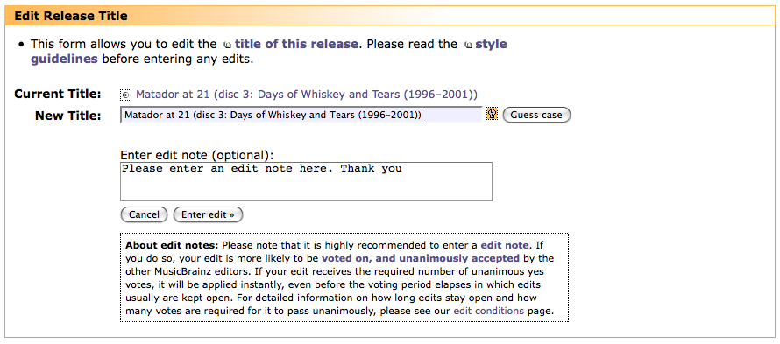
Notes:
This is what the page looks like when you enter an edit. In this case, I was looking at a release I just entered.
There’s a voting period; if it gets enough votes it’s accepted; it is recommended that you enter an edit note that includes some kind of citation for your edit. Official sources like band websites are preferred, but Wikipedia and discogs, mentioned at the beginning of this talk, are okay if nothing else is available.
Edit notes help other editors verify your edit so that they can vote yes or no. All editors’ edits go through a voting queue, and you can read more about that process in my paper. Only the editors of Auto-Editors are committed to the database instantly.
It’s also important to note that MusicBrainz does not classify by genre; there is a field for tags, but those are not official and there are no standards for genre. Interviewees suggested that genre is simply too subjective for the community to agree on the right ones.

Slide 21
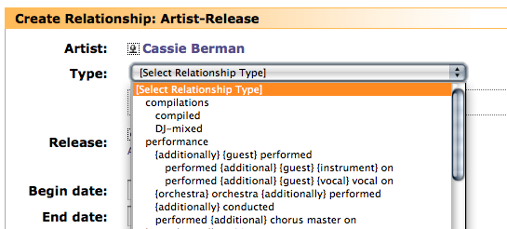
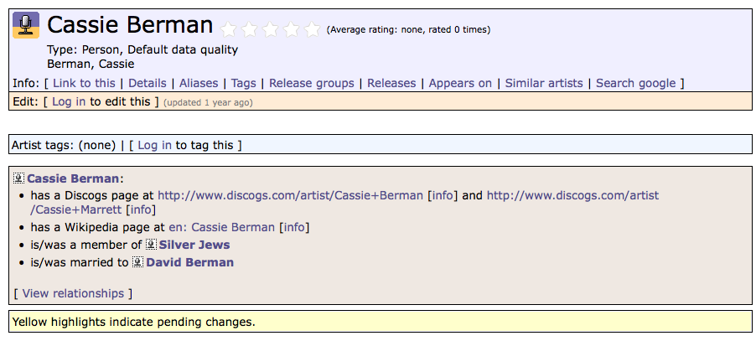
Notes:
This is an example of what adding a relationship for an artist looks like, and I’m adding a relationship here between the artist Cassie Berman and an album she played on. The bottom half shows Cassie Berman’s page on MusicBrainz, and you can see the relationships are outbound links to other websites and a link to another artist who’s her husband.

Slide 22
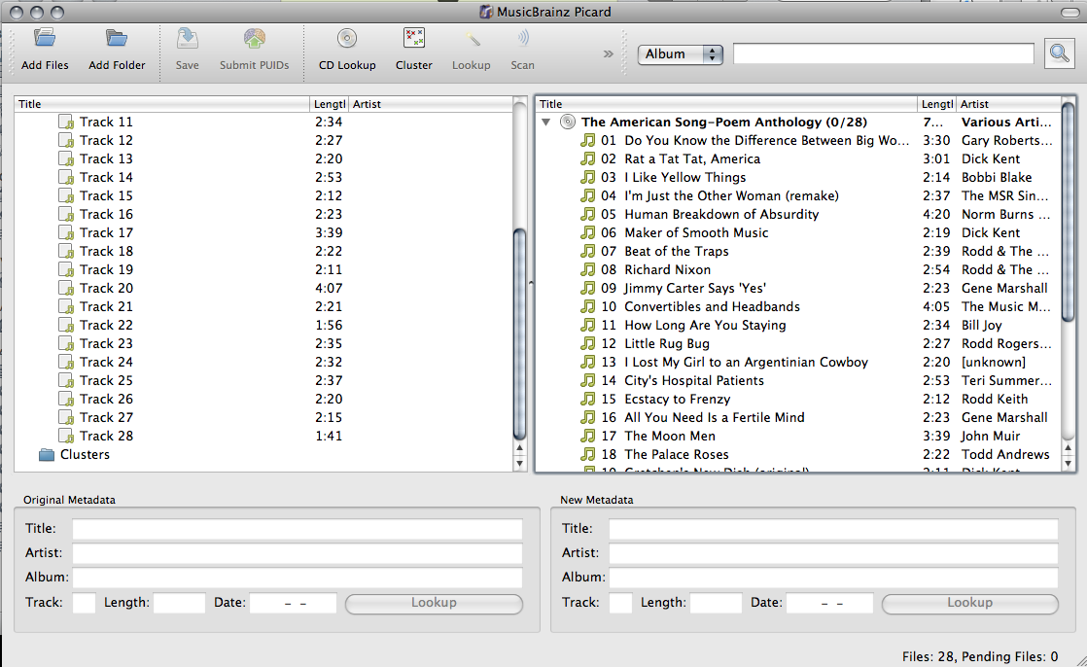
Picard
Notes:
Screenshot of the American Song-Poem Anthology in Picard, on the left are the untagged tracks as I ripped them into iTunes and on the right is the matched metadata for the tracks. To add the the metadata, I would drag the untagged files from the left-hand pane into the right-hand pane. The actual tagging functionality is explained in greater detail in the paper.

Slide 23
Demographics

Slide 24
Gender Makeup of Respondents (Registered Users Only)
Notes:
My respondents and my participation bears this out – representative sample

Slide 25
Respondents by Region (All Survey Respondents)
Notes:
My sample was dominated by Europe and North America.

Slide 26
Respondents by # Years Registered
N = 207
Mean = 4.5622 years
SD = 2.0765
Minimum = 0.2683 years
Maximum 10.7871 years
Notes:
It’s the active contributors who really have staying power, as I found. MusicBrainz signed a deal with Last.fm in 2007 to provide data, but it was about 6 years ago that Last.fm started using the data, and 5 years ago that Rob recognized it publicly on the MusicBrainz blog. There’s a reason I point this out, which we’ll get to a little later.

Slide 27
When did you last log in to MusicBrainz?
N = 184
Notes:
And this shows that most of the respondents log in regularly; only 9 logged in more than a year ago. You did not need to be logged in to take the survey or to see the post about it on the MsuicBrainz blog, but it could have prompted respondents to log in because they hadn’t for a while.

Slide 28
Edits Entered
Mean = 13,591.72 edits
SD = 46,793.73
Minimum = 3 edits
Maximum = 494,857 edits
N = 184
Notes:
The majority of users are under 10,000 edits, but there are a handful that exceed that number. This is broken down by the percentiles. Four users had more than 100,001 edits, and they are not bots. It’s pretty crazy.

Slide 29
Findings
Notes:
I am presenting only a few findings, and sparing you the tables and statistics. If you are interested in more of this, my thesis is available online, and is about 60 pages of written text.

Slide 30
Discovering MusicBrainz
 | R selected Yes |  | R selected No
Source | N | Mean (SD) | N | Mean (SD) | t | Cohen’s d
**Friend | 6 | 6.13 (0.66) | 160 | 7.35 (2.32) | 3.7541+ | 0.7175
Blog/Twitter | 10 | 6.82 (3.28) | 156 | 7.34 (2.22) | 0.4914+
Online discussion forum | 36 | 7.29 (2.00) | 130 | 7.31 (2.37) | 0.505
***Last.fm | 28 | 8.43 (2.21) | 138 | 7.08 (2.24) | -2.9029 | 0.6044
Web search to clean up music metadata | 55 | 7.05 (2.24) | 111 | 7.44 (2.31) | 1.0425
Other | 21 | 7.10 (2.57) | 145 | 7.33 (2.25) | 0.2370
Can’t remember | 9 | 7.16 (2.18) | 157 | 7.32 (2.20) | 0.2043
N = 166; diff = mean(no(0)) – mean(yes(1)); +SD inequality required Welch’s unequal t-test
** pr(T > t) = 0.0012; *** pr(T<t) = 0.0021
Notes:
I mentioned the Last.fm connection for a reason. I asked survey respondents how they first learned about MusicBrainz. This lists the sources and the mean number of the log of edits entered into MusicBrainz. Most significant is that users who come from Last.fm have entered a larger average number of edits than those who did not, and with a p-value of 0.0021, which is highly significant. It also shows a large effect size, so there’s practical significance. There is something about Last.fm that brings MusicBrainz great contributors. Users come to MusicBrainz from a number of sources, but those who come from Last.fm tend to be more active contributors. Because getting good recommendations in last.fm depended on accurate metadata, many of these editors were driven by an extrinsic motivation—that is, satisfying an information need, building something they want and need to use.

Slide 31
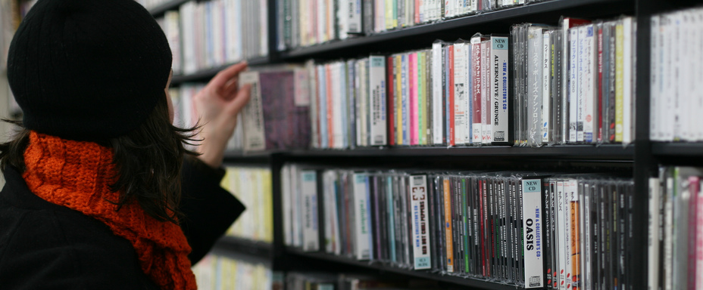
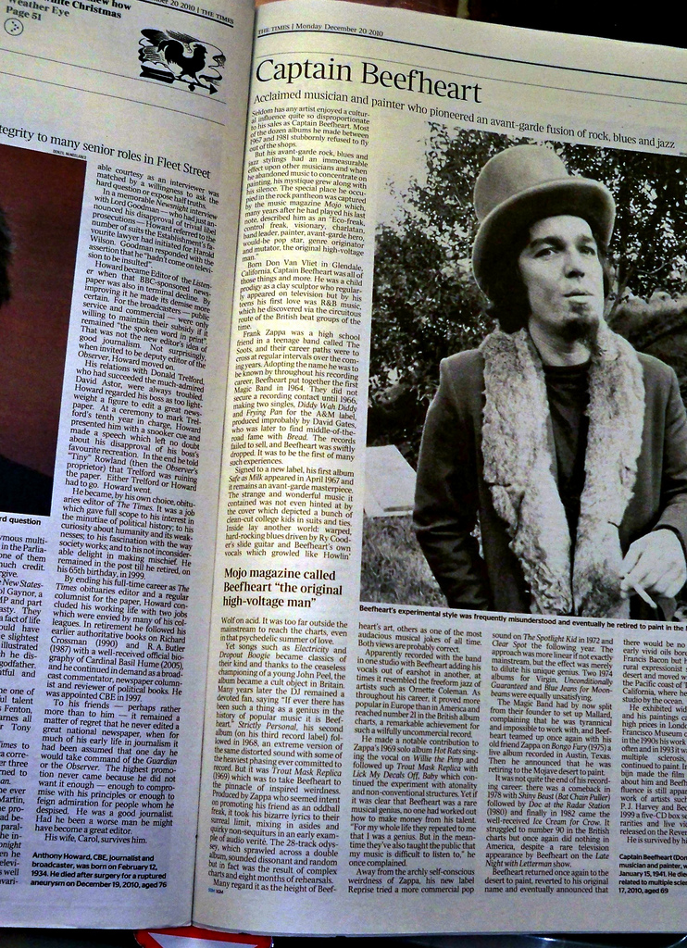
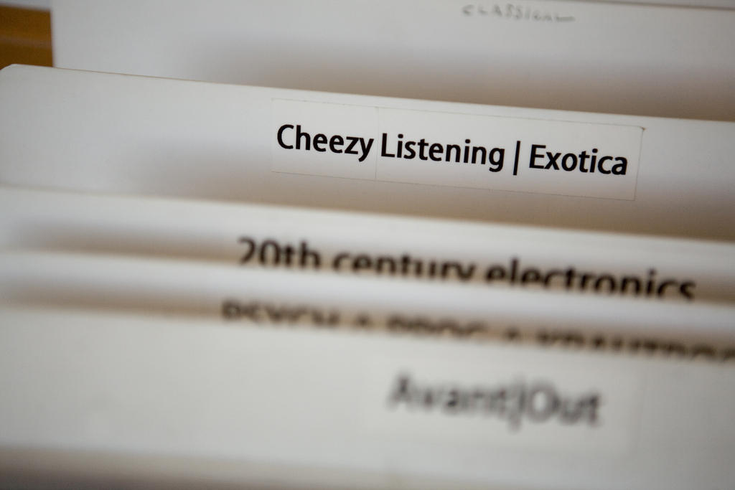
Breadth
http://www.flickr.com/photos/koshi/2227901906/
Depth
http://www.flickr.com/photos/koshi/4647679998/
http://www.flickr.com/photos/fawbs/5295760957/in/pool-1625613@N22/
Notes:
One of the most interesting findings in terms of patterns of contribution is a distinction between activities that contribute to the breadth of the information and activities that contribute to the depth of the information. Breadth is tightly tied to musical taste, and I’ll show a little bit of that in the next slide; depth is something that can be done by anyone, such as adding advanced relationships or linking out to lyrics for tracks on LyricWiki. It sounds macabre, but one interesting finding was in the use of obituaries as an information resource. There’s a group of editors who add artist death dates when an artist dies.
You can also artists and get email updates of any changes to those edits, sort of a way to “own” an area of the database and help new editors working specifically in those areas.
“We cannot evade the conclusion that the answer to our question, ‘What is good music?,’ may differ from culture to culture, from epoch to epoch, from person to person, and even from time to time within the same person, as well as the particular occasion” (Mueller, 1956)

Slide 32
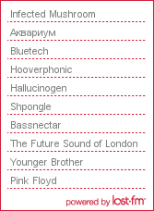
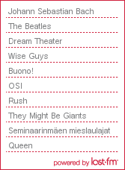
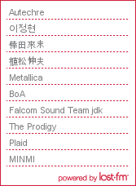
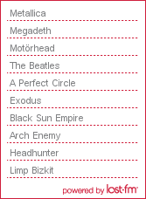
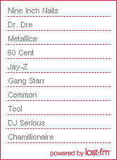
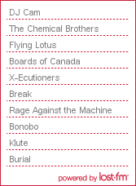
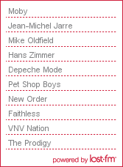
obscure
eclectic
niche
pretty wide
jolting
heavy & fast
170bpm & electronic
J-pop
Notes:
This slide is meant to address the breadth issue, showing how distributed users’ taste is. The breadth of the database depends on people who like “obscure” and “niche” stuff—things that would not fall under “popular music.” MusicBrainz users are passionate about music, and some of the findings in the paper show this in various ways. These are the Last.fm top 10 artists of all time for 7 of the 14 interviewees who had public Last.fm profiles, and some of the adjectives interview subjects use to describe their taste. The swirls indicate shared artists — Metallica, The Beatles, The Prodigy — which span multiple genres. Eclecticism is paramount here, and subjects repeatedly describe their taste as “eclectic.” It seems to be the way that people say “I listen to everything that’s good” despite genre, and that could be an interesting launching point for future work on taste, that was outside the scope of this study — what does it mean to have “eclectic” taste in music?

Slide 33
Music Discovery through Contribution
Comparing means on log of edits entered.
 | R selected Yes |  | R selected No
 | N | Mean (SD) | N | Mean (SD) | t | Cohen’s d
**Have you discovered an artist through MusicBrainz? | 72 | 8.56 (1.84) | 99 | 6.27 (2.09) | 7.4396 | 1.16418
diff = mean(yes) – mean (no); ** P(T>t) = 0.0000
“Voting on others' edits, I've come across lots of artists I'd never have heard of otherwise.”
“You see that other artists collaborated with the artist you were looking at, and then discover them.”
Notes:
Editors also often discover new artists just by browsing new edits or watching musical “areas.” T-test results: p-value of 0.000, editors who have discovered a new artist through musicbrainz have on average entered more edits than those who have not, meaning that the more contributions you make, the more likely you are to discover a new artist through MusicBrainz.
But how the editors interpret the word “discovered” varies. Some editors actually listen to the music and add it to their collections. Other editors just interpreted “discovered” to mean read about or were informed of. This is another area for further investigation.

Slide 34
The Importance of Open Source
“I think people who really value things will want to ensure they continue. And there are two ways you can do it. One, you can use your wallet. The other one is, if it's an option, you can contribute and make it a better thing”
Notes:
Community/obligation-based motivation from the Lakhani and Wolf framework — there is a sense of being a part of something bigger, something that everyone can use. Frustrations are also a price to be paid for access to a free resource. Survey results back this up and interview data back this up.

Slide 35
Sense of Community
“If you ask for help with a particular metal album you'll never get nasty comments from people who don't like metal or anything. They are all people who care about the data and want to help make the database better.”
Notes:
Developing reputation by making edits, and people just get to know you after a while. They recognize your username, see what you’re doing. Many of the most active users also hang out in the internet relay chat room talking about everything from data representation to drinking. The community helps people to cooperate, really fostering these community/obligation-based motivations.
Despite the disparity in taste people get along and help each other to learn the guidelines and the system. Because they have one thing in common…

Slide 37
The Act of Editing
“Well the Auto-Editor is basically like a badge of obsessive compulsiveness.”
“I started editing slowly and kind of got hooked really I guess and sort of OCD, I had to get all of my music on there.”
“I'm kind of a little OCD about it, I want it to be right.”
Notes:
In my interviews, a theme of obsessive-compulsive disorder as a colloquialism emerged. Editors describe editing as “meditating” and “relaxing,” but which shows enjoyment-based motivation for editing, but there’s also what seems to be a COMPULSION-based motivation as well. I actually put a bunch more quotes like this in the paper as well.

Slide 38
Auto-Editors: Recognition & Reward
“With great power comes great responsibility.”
 | R is an Auto-Editor |  | R is not an Auto-Editor
 | N | Mean (SD) | N | Mean (SD) | t | Cohen’s d
** Log of total edits entered | 59 | 9.35 (1.85) | 110 | 6.50 (1.64) | 10.2773 | 1.6285
** Log of total artist subscriptions | 57 | 6.08 (1.85) | 74 | 4.56 (1.98) | 4.4823 | 0.7934
diff = mean(yes(1)) – mean(no(2)); **p(T>t) = 0.0000
Notes:
And the ones who are REALLY OCD are the ones who become Auto-Editors. Auto-Editors are nominated by the community for their contribution and their willingness to help others. Achieving auto-edit status means that your edits are no longer held in the voting queue. There is added pressure to be correct. But the data on this slide shows that the title is indeed consistent with more and with more subscriptions, which indicates greater engagement with MusicBrainz.

Slide 39
Future Work
Notes:
There’s a lot that can be done with the study because of the amount of detail, and I also have access to the community such that gathering more data is a possibility.

Slide 40
Future Work
Application of the CCCE framework
Women and cultural commons
Comparisons between MusicBrainz and Wikipedia and F/OSS
MusicBrainz vs. music metadata sources
MusicBrainz and Last.fm
Notes:
I have a CPHS protocol for this research, meaning that I can use it in published papers. Here are afew areas of potential future investigation or focus.

Slide 41
Jess Hemerly
jhemerly@ischool.berkeley.edu
MusicBrainz
musicbrainz.org
Q&A
(thank you!)
Full Report
www.ischool.berkeley.edu/programs/
Masters/projects/2011/musicbrainz
Notes:
There’s a lot that can be done with the study because of the amount of detail, and I also have access to the community such that gathering more data is a possibility.

