Slide 1
Flyover
Ankita | Divya | Siddharth | Sufia

Slide 2
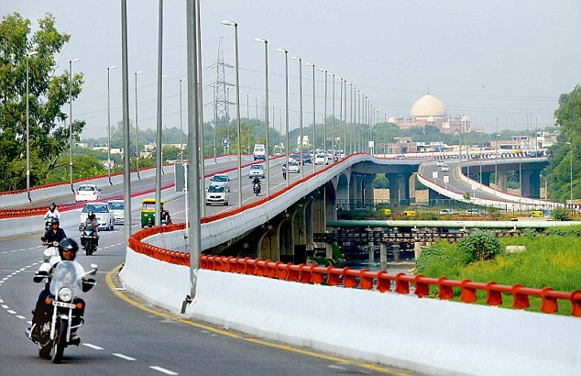
New Delhi, India

Slide 3
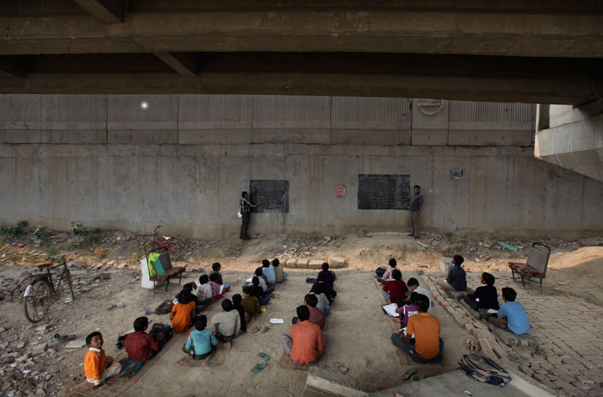
New Delhi, India
Mumbai, India

Slide 4
208 Million
Number of children going to primary & middle school in India

Slide 5
I go to school. My uniform is white.
My shoes are black. I love to read books.
52% of grade 5 students cannot read the above quote
Grade 5 students struggle with grade 2 content
(ASER 2012 report)
Notes:
2012 research was done

Slide 6
Mission
Expand the reach and equity
of English literacy in India
Notes:
Wages are 34% higher in India for fluent English speakers
Explain English advantages over here

Slide 7
Needs Assessment
Notes:
Wages are 34% higher in India for fluent English speakers
Explain English advantages over here

Slide 8
80+ Interviews
Students
Teachers
Parents
Volunteers
ESL Experts

Slide 9
Meet Arjun
Notes:
Some kids are privileged to goto schools...lets meet one kid now...11years...Hardoi..small town in north india...200miles from delhi
He can speak Hindi fluently...his english knowledge is all rote….if you ask him abt the defn of noun..he can tell you the textbook definition….passive knowledge….lets visit his classroom

Slide 10
Arjun, 11
Lives in a satellite town in India
Uses Hindi to learn English and translate back and forth
Passive knowledge of English
Comfortable using feature phones
“English seekhni hai, Mujhe teacher banna hai”
“I want to learn English.
I want to be an English teacher.”
Notes:
Can we make the image like that? the tiger image style?
I can change it, just wanted to make sure you are ok with it.

Slide 11
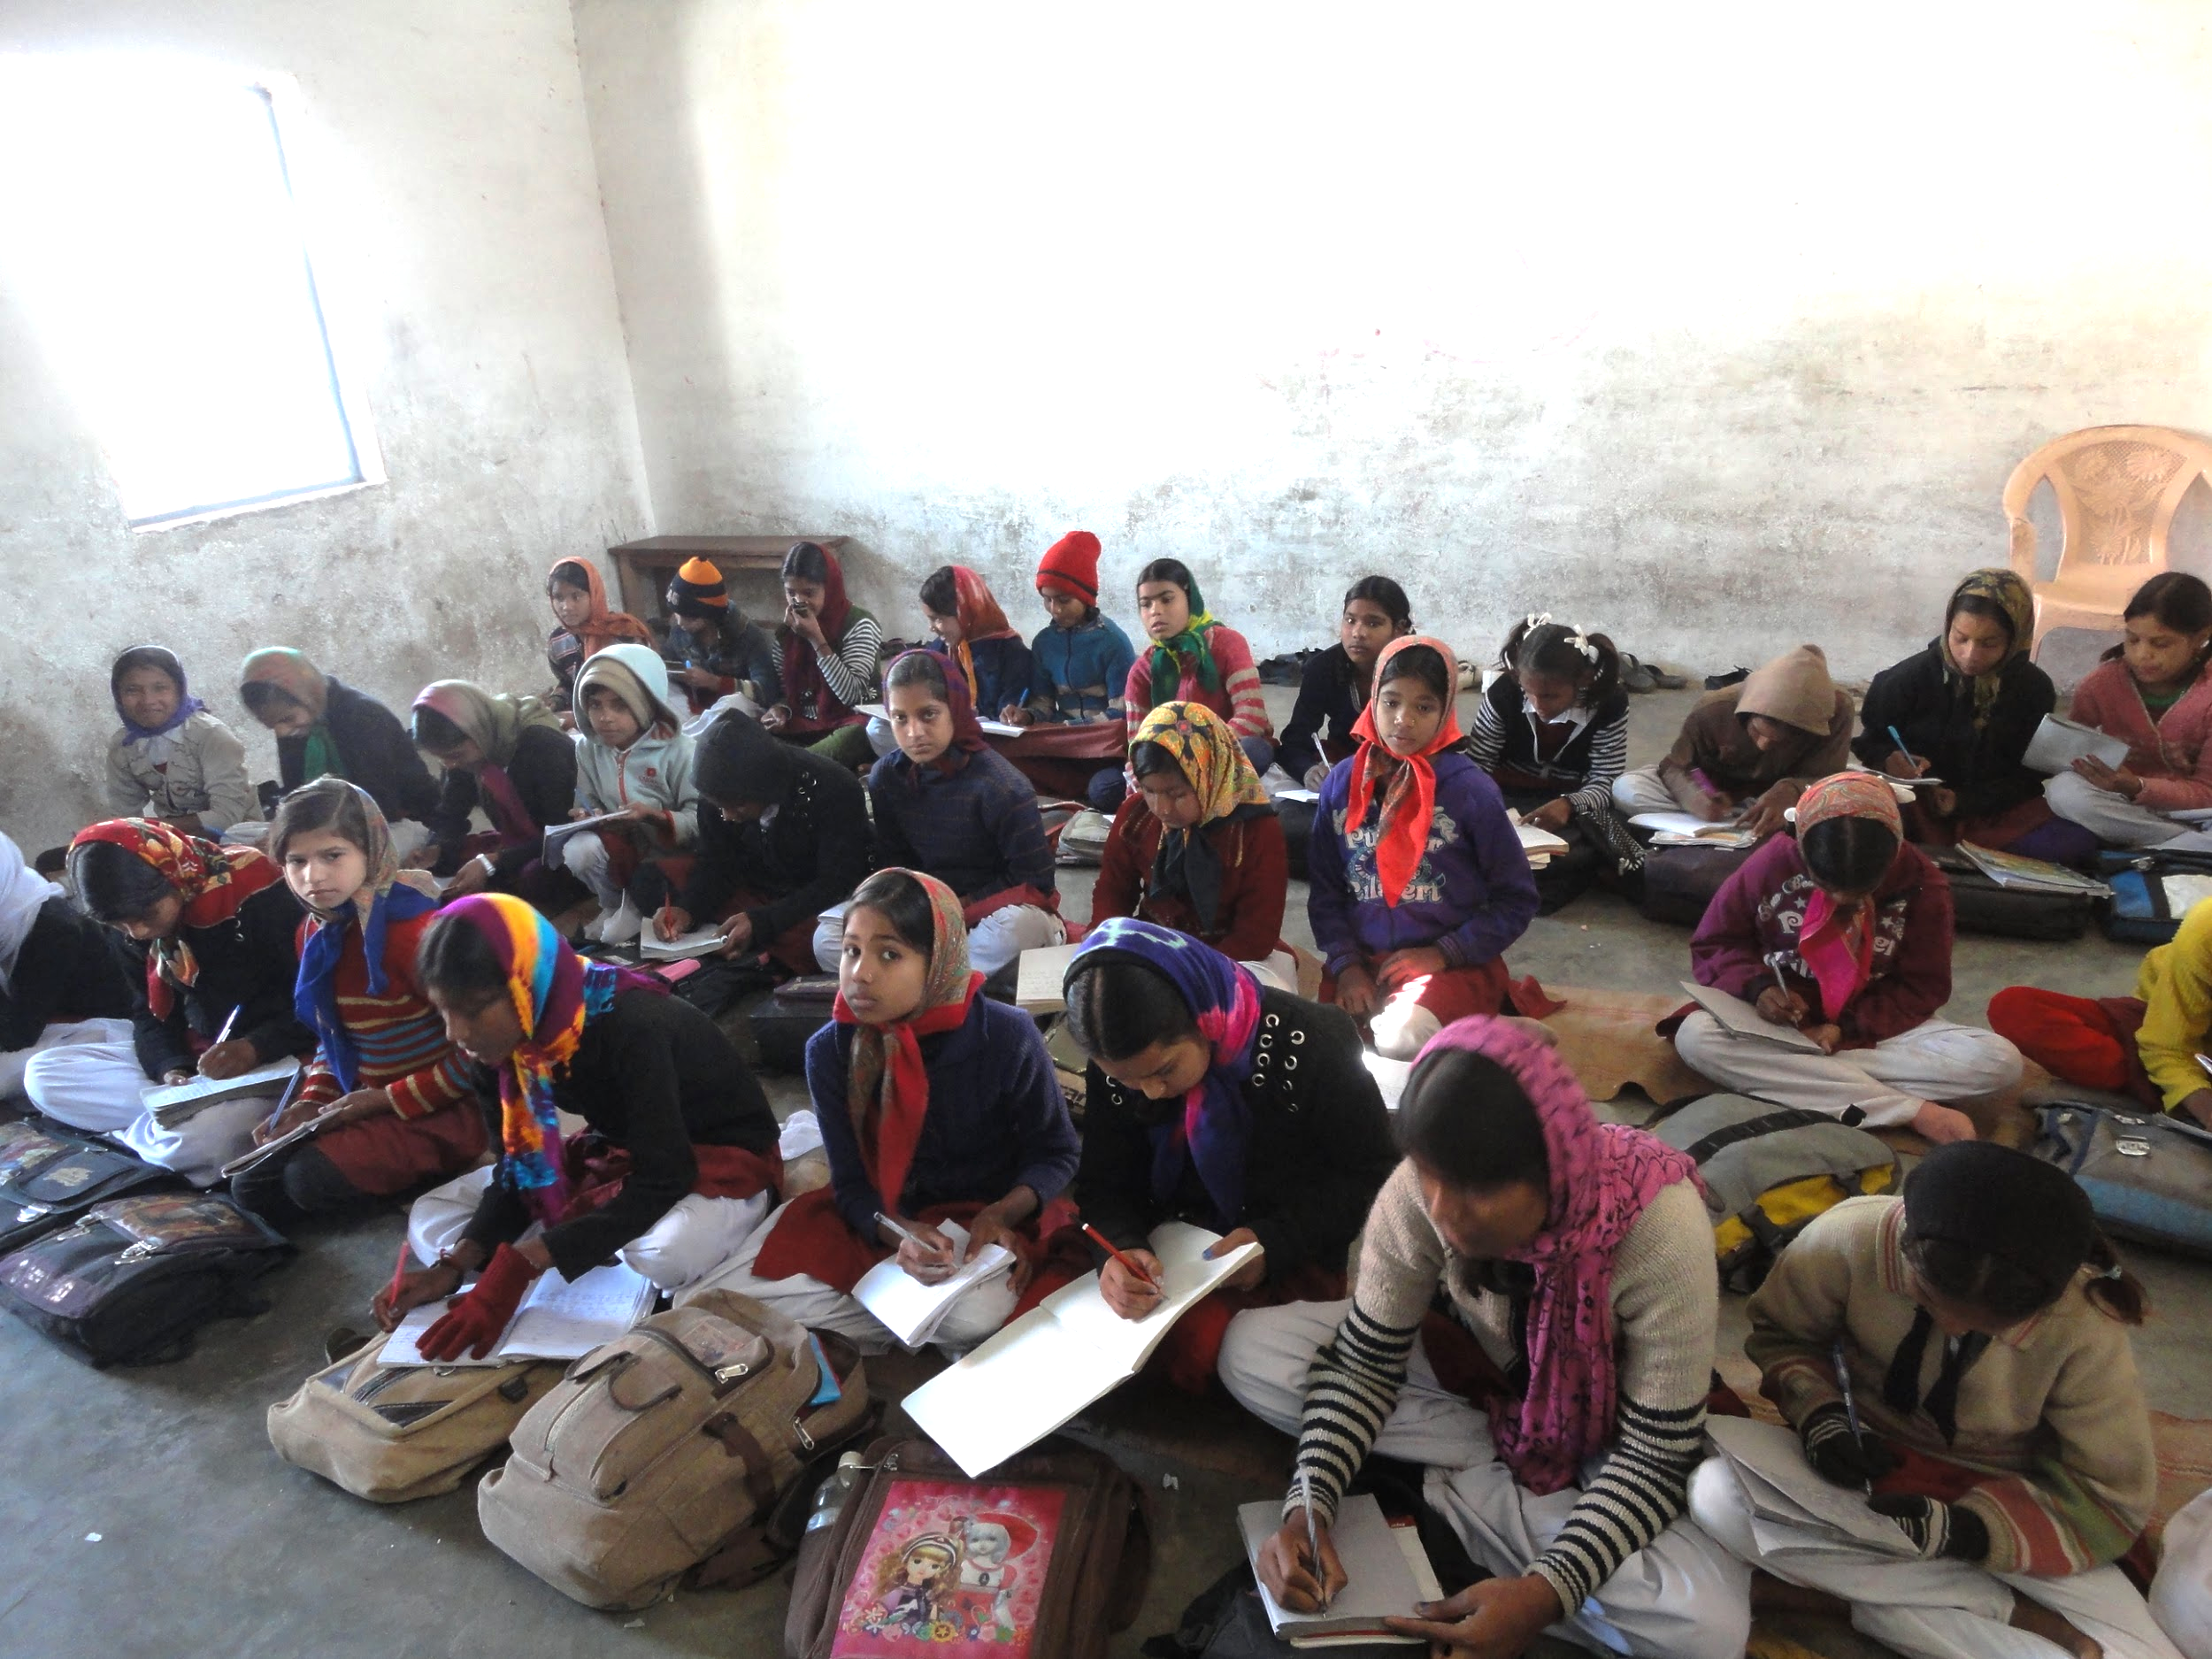
50:1 Student Teacher Ratio
Notes:
English gets deprioritized, syllabus of other subjects to be completed
Same teacher teaches all subjects

Slide 12
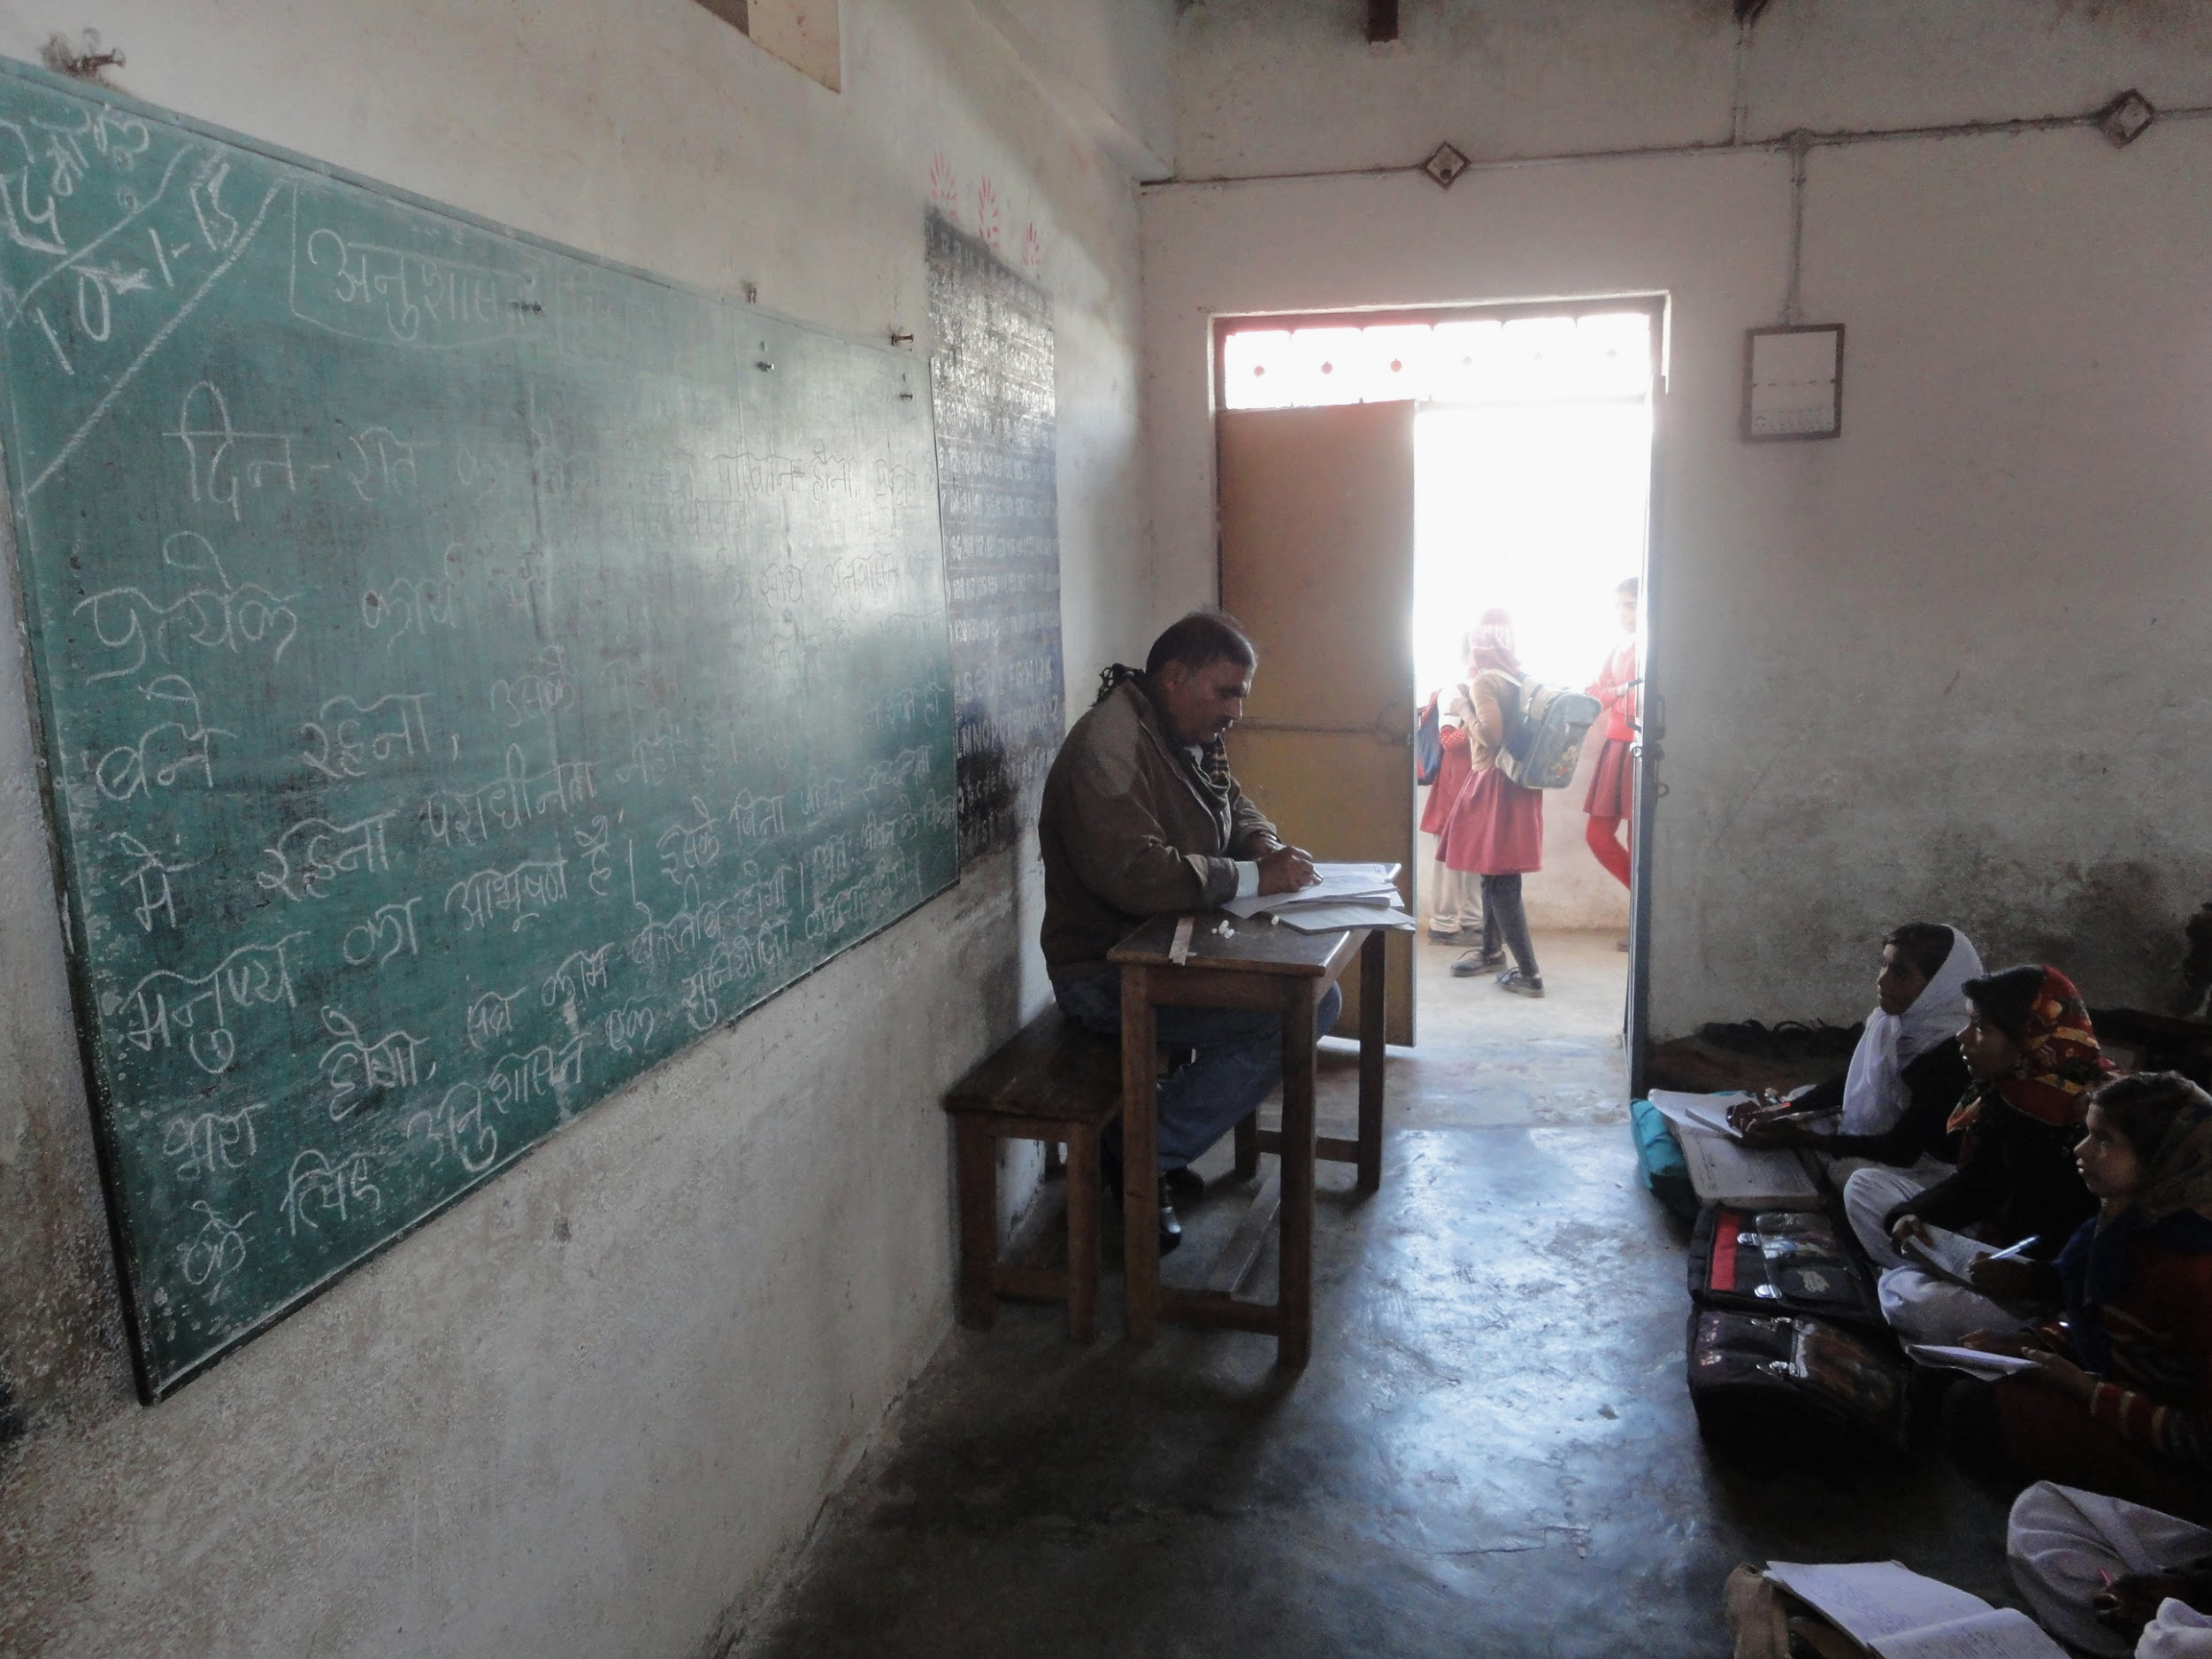
Teachers are absent, disengaged, unqualified
Notes:
English gets deprioritized, syllabus of other subjects to be completed
Same teacher teaches all subjects

Slide 13
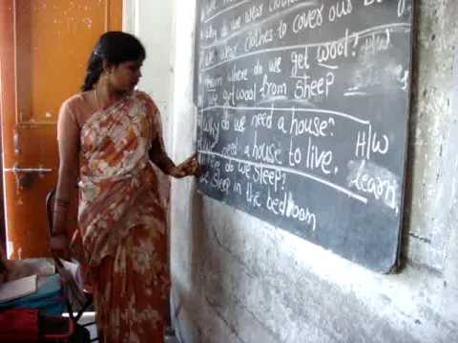
Arjun’s classroom
Lack of conducive environment to practice English
Notes:
English gets deprioritized, syllabus of other subjects to be completed
Same teacher teaches all subjects

Slide 14
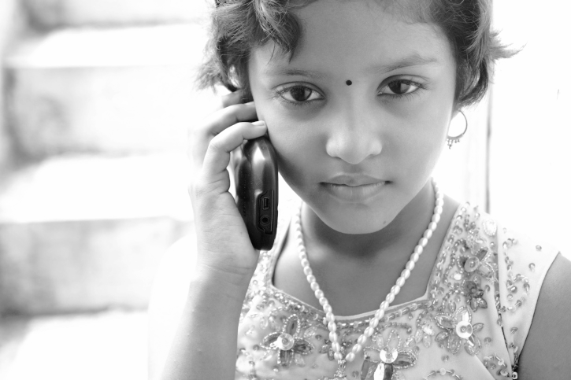
Insights
Demographic - Middle school students
Lack of a conducive environment to practice English
No smartphone, no Internet
Not everybody is at the same level
Cultural sensitivity
Notes:
http://wws.princeton.edu/news-and-events/news/item/beyond-proficiency-how-early-english-exposure-influences-non-native
There are over 1600 languages spoken in India.
Use local language as an aid to connect with children.
Same volunteer should teach a child for at least 3 months to build the rapport.
Match volunteers and children who speak the same language.
Match girl child with female volunteer.

Slide 15
Solution
Notes:
Wages are 34% higher in India for fluent English speakers
Explain English advantages over here

Slide 16
Solution
Volunteers
Flyover
Students
Flyover is a platform providing students access to
volunteers and content via Interactive Voice Response (IVR)
Notes:
Based on the key findings which Divya just described, we have developed this platform which connects students with volunteers.
There are 2 ways -

Slide 17
Live Sessions
FLYOVER
Volunteer
Student
Parent
Web App
Notes:
Sync
Student and volunteer
Phone call establish between the two parties on phone
Volunteer sees webapp
Show live conversation and content + Assessment

Slide 18
Recorded Sessions
Dials
1800-FLYOVER
Press 1
LESSON
PROMPT
Student
IVR System
Press 2
QUESTION
Press 3
ANSWER OPTIONS
Notes:
Clarify that responses (keys pressed) are recorded and stored on server.

Slide 19
Integrated Solution
FLYOVER
Volunteer
Progress Report
Web App
IVR System
Notes:
Progress report is recorded and displayed on the web interface for volunteer to track the progress of child.
To complete the loop our system

Slide 20
Flyover
Volunteers
Students
Localized Content
Mother Tongue
Mobile
Notes:
There are 3 main components:
Flyover is an ecosystem providing students access to volunteers and content via IVR
Use of culturally relevant content and regional language as a tool to facilitate English learning
Need to accommodate highlighted content somewhere, trash the rest. This slide should have a better representation of these 3 main components
3 components - culturally, mother tounge, mobile phones
Multiple education reports suggested the abysmal state of English education in India
Research suggested the role of mother tongue
Reviewed existing ICTD implementations in education in developing countries using IVR/mobile phones
Reviewed IVR implementations CGNet, Awaaz De to identify tech stack and implementation details
ESL content designers gave insight on what constitutes effective, engaging content (cultural relevance)
Mobiles proven to be most effective medium to facilitate informal learning in out of school environments

Slide 21
Demo
Notes:
Wages are 34% higher in India for fluent English speakers
Explain English advantages over here

Slide 22
Web Interface

Slide 23
Live Session

Slide 24
Recorded Session - Hotline
1800-FLYOVER

Slide 25
Design Process

Slide 26
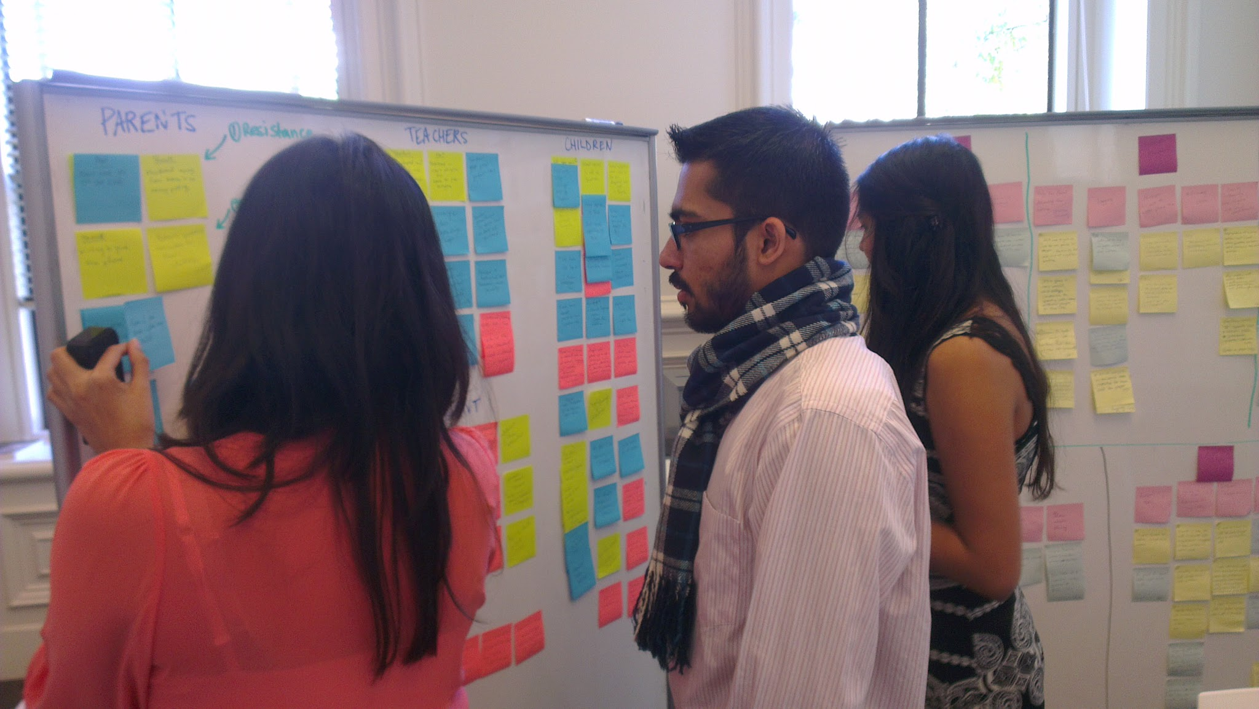
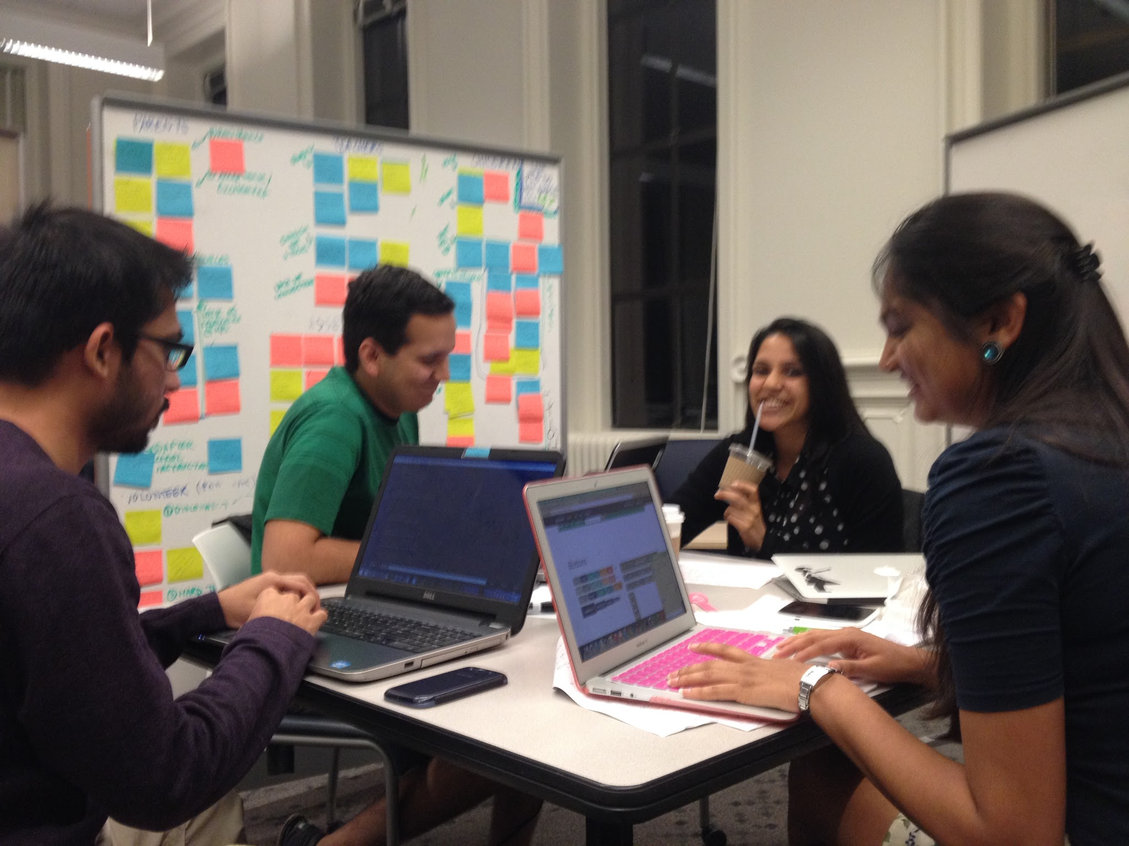
Synthesis
Notes:
Synthesized our findings from interviews and CI
>> Created Affinity, Personas and Scenarios
>> Feedback went into ???

Slide 27
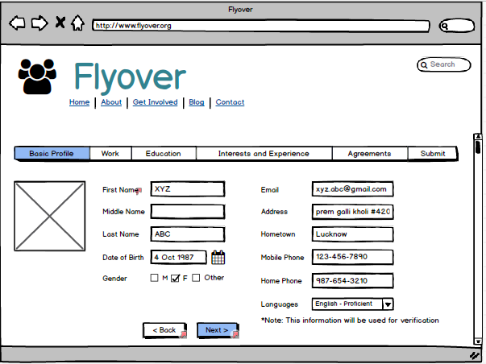
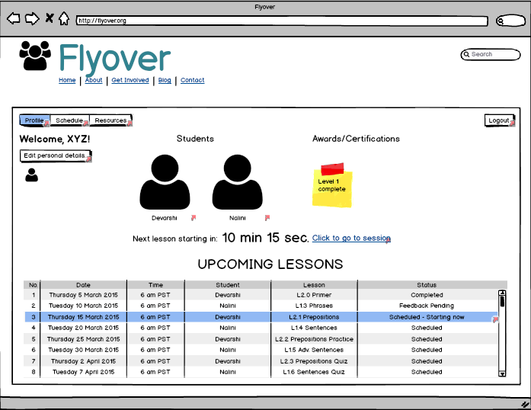
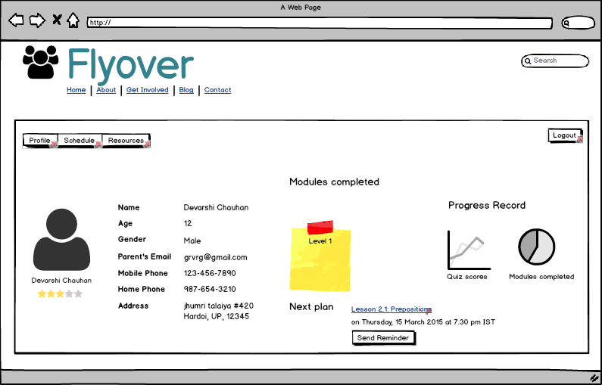
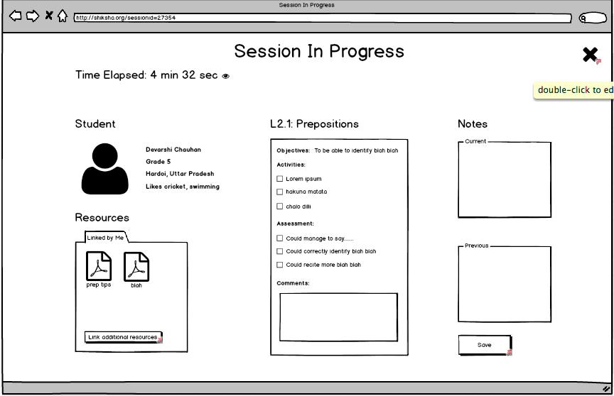
Low Fidelity Prototype
Registration
Profile Page
Student Profile
Session Feedback Form
Notes:
We stuck to human centered design approach

Slide 28
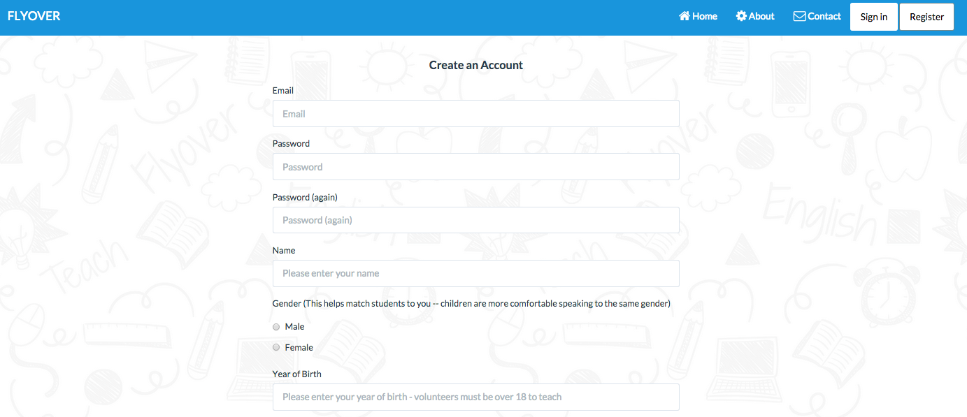
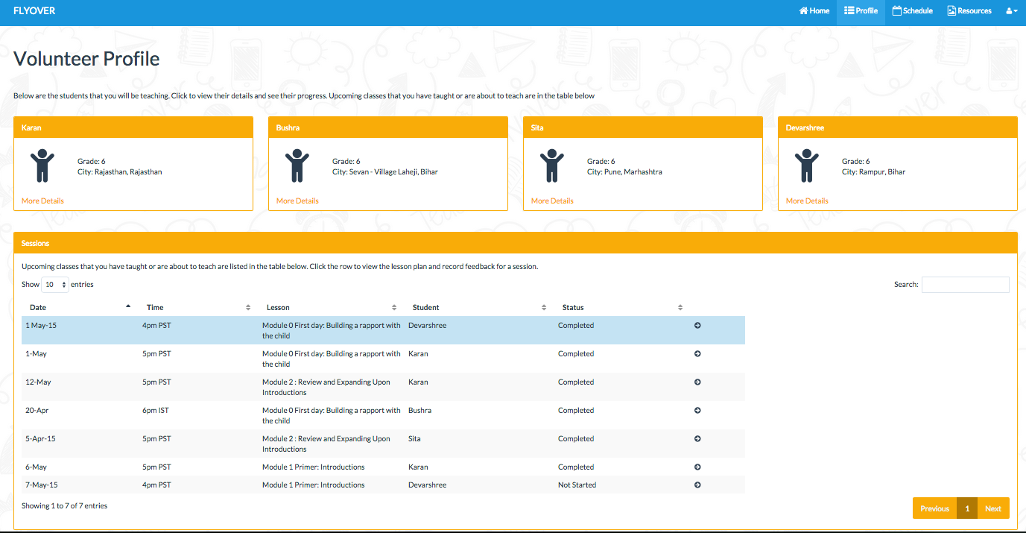
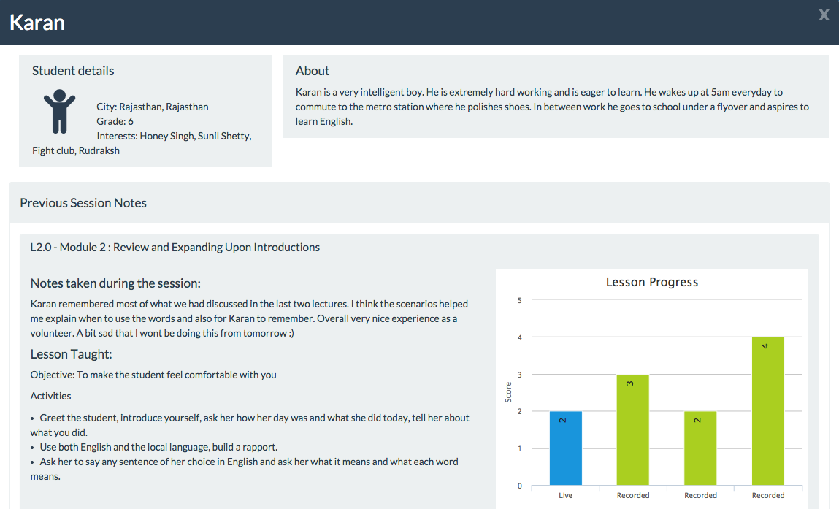
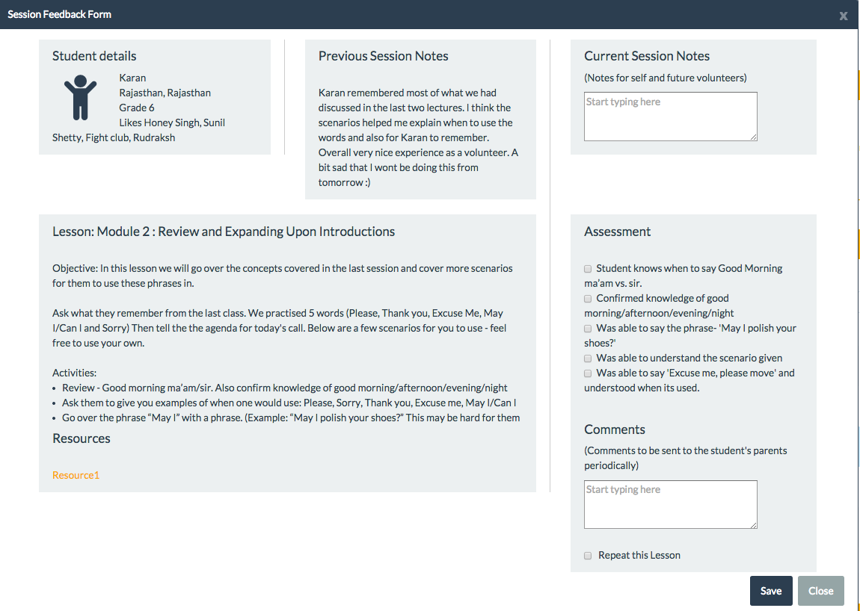
High Fidelity Prototype
Registration
Profile Page
Student Profile
Session Feedback Form

Slide 29
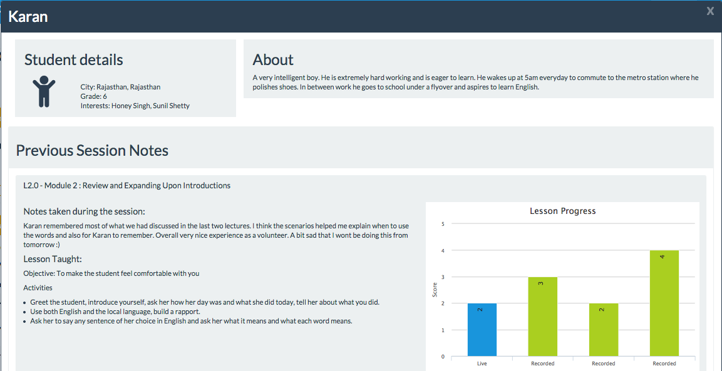
Key Feature 1: Details of the Student
Notes:
“Child to be the main focus of the interface”

Slide 30
Key Feature 1: Details of the Student
Information about the student
(Student Details, Short Biography)

Slide 31
Key Feature 1: Details of the Student
List of previous lessons taught
Notes:
List of previous lessons taught

Slide 32
Key Feature 1: Details of the Student
Progress in live and IVR sessions
Notes:
Progress in live and IVR sessions
Child to be the main focus of the interface”

Slide 33
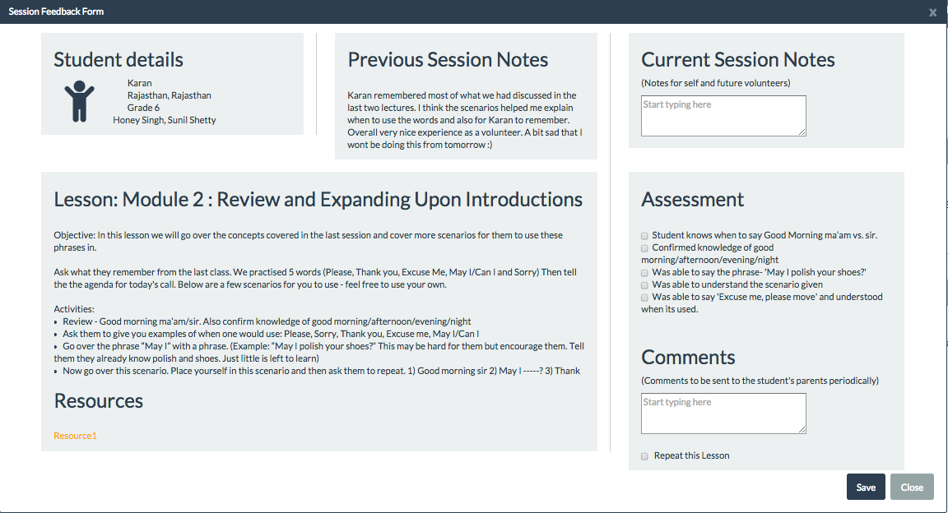
Key Feature 2: One tool for conducting a session
Notes:
“Child to be the main focus of the interface”

Slide 34
Key Feature 2: One tool for conducting a session
Used to refer to when teaching
(Lesson Plan, Previous Session Notes)
Notes:
“Child to be the main focus of the interface”

Slide 35
Key Feature 2: One tool for conducting a session
Used to provide feedback:
(Notes for the Volunteer, Assessment Feedback for Parents)
Notes:
“Child to be the main focus of the interface”

Slide 36
Content Design
Balance between English and Native language
Navigation of levelled content via IVR
Notes:
Next task was to develop the content. Question we had was how to maintain a good balance between English and native language in our content.
Looked at existing approaches for language learning - Opelanguage.com, Duolingo
Talked to ESL experts
We put our creative hats on, wrote scripts, recorded the first lesson and created first module

Slide 37
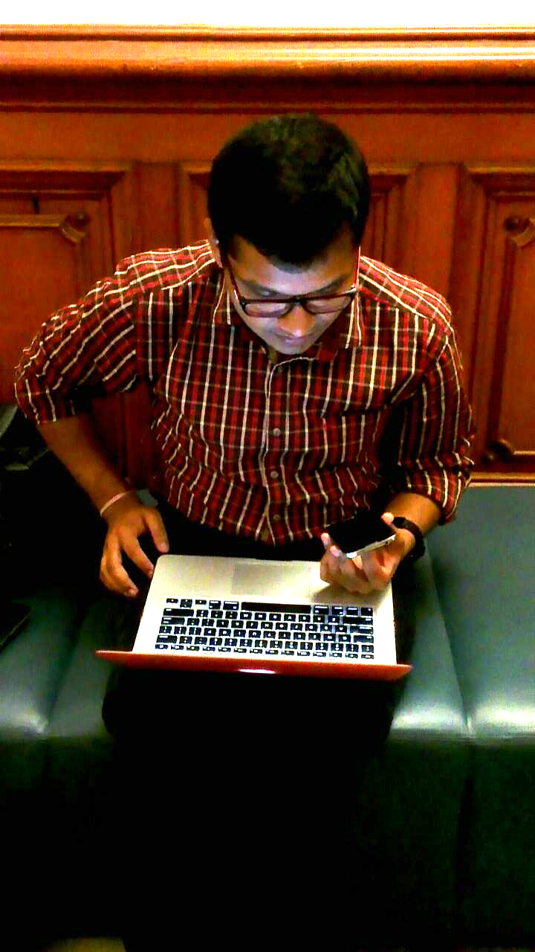
Usability Test
Web Interface Testing
IVR Testing

Slide 38
Usability Test Cycle
Matched volunteers and students based on gender, language and hometown
Conducted tests with 4 student - volunteer pairs who were geographically dispersed
Rapport Building
Lesson
1
IVR Practice
Review of Lesson 1
Test Cycle for One Student - Volunteer Pair
Notes:
Consists of 3 live sessions and 1 IVR session
4 iterations completed during test cycle

Slide 39
Key Findings from Testing
Medium works
Establishing a rapport with the child helped in subsequent lessons
Students and volunteers need training
Notes:
After first round of testing we had to re-recorded the lessons based on the feedback
Added multiple choice assessment questions which could be easily answered over the phone
Need for training - # key, MCQ format, Length of audio clips
Phone network issues - Our biggest requirement is good phone network. With 84% it’s pretty good now but there were few instances of dropped calls and unreachability.
Hardware issues - Background noise, echo
Need of building rapport - Volunteer should teach them for at least 3 months to build the rapport and get comfortable.

Slide 40
Impact

Slide 41
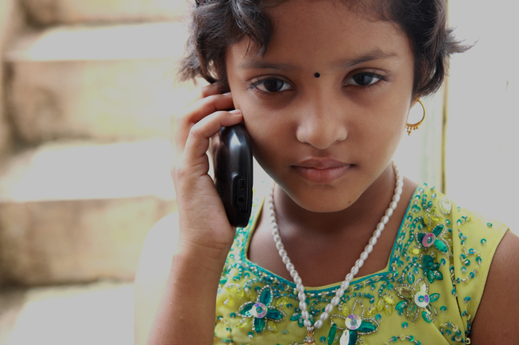
Social Impact
Equal access to all children
Academic success,
Employment
opportunities
More capable, confident future workforce
Notes:
Eq access..
With the barriers crossed they will be free to pursue their social, academic and economic development goals and participate and compete in an increasingly globalized world
In the face of existing ineffective or no solutions in this area, providing novel pathways to learning leveraging existing easily available resources - mobiles through a simple, lightweight solution
Opportunity to participate in a globalized world
New pathways to learning English using available technology (mobiles)

Slide 42
Next Steps

Slide 43
Next Steps & Challenges
Security & Privacy
Voice application in India
Partnerships for content and user groups
Impact evaluation

Slide 44
Flyover
Expand the reach and equity
of English literacy in India

Slide 45
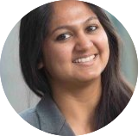
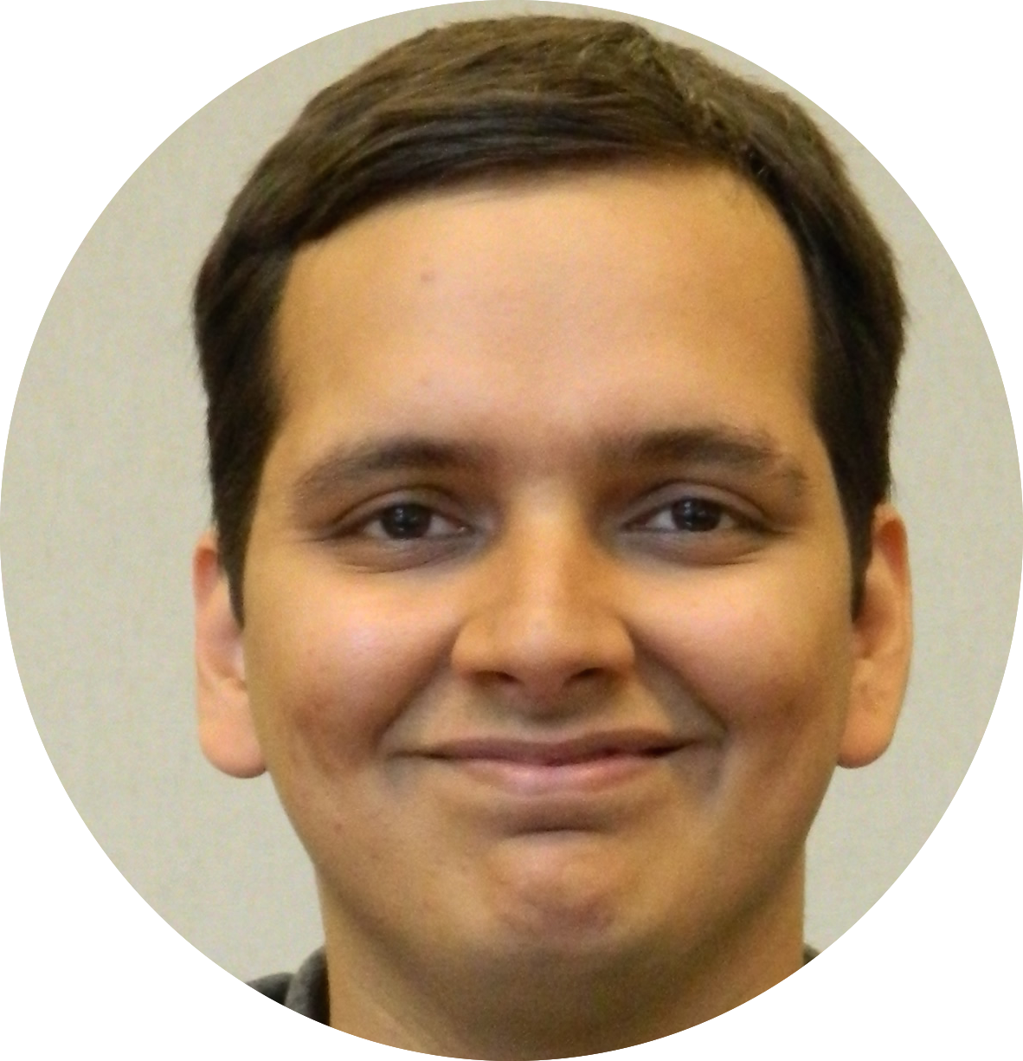
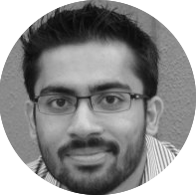
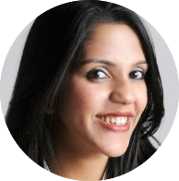
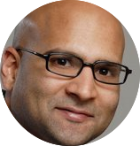
Team
Ankita Bhosle
Divya Menghani
Siddharth Agrawal
Sufia Siddiqui
Tapan Parikh
Kimiko Ryokai
Notes:
All of us are Master of Information Management and Systems candidates at the I School, Berkeley
We have all been a part of the education system in India and lived the experience, united by our shared concern for the space
Our deep understanding/acute awareness of the Indian context and cultural nuances and ability to work within those realistic constraints is an asset to this project
Our strong personal networks in our home country combined with the access to resources and mentorship that Berkeley provides gives us a strong edge
Our diverse and complementary areas of expertise across design, tech and business
Advised by professors extraordinaire Tapan Parikh and Kimiko Ryokai

Slide 46
Thanks!
Any questions?

Slide 47
Tech Stack
Notes:
2 modes:
Synchronous - Both parties should be able to talk to each other at the same time
Asynchronous - Student should be able to call and listen to recorded lessons and take assessment
Evaluated 5 platforms:
Awaaz.De
Asterisk and Freeswitch
Twilio and Plivo
Verboice
Voxeo
Based on our analysis we picked Voxeo because

Slide 48
208 Million
1.5 USD (100 INR)
3.2 Million USD
Number of children going to primary & middle school in India
Fee per child per year
with just 1% adoption

Slide 49
Pilot
180
Days Program
New Sunbeam Public School,
Hardoi, UP, India
50
Students
20
Volunteers
Teaching Model
Content
Assumptions
Evaluation
Notes:
Match x days program with timelines slide

Slide 50
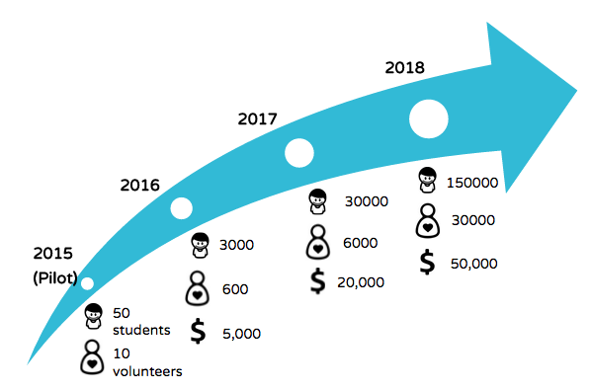
Vision
Partnerships
Schools. NGOs, ESL Content, Government
Scalability
Capital for marketing, administration, technology; New geographies, new regional languages

Slide 51
Sustainability
Partnerships
Schools to drive adoption
ESL content specialists to design custom content
For-profit organizations interested in CSR opportunities
Organizations such as WorldReader for culturally relevant content
With Government for greater outreach
Scalability
Capital for marketing, administration, technology infrastructure
System requirements to handle higher load
Large volunteer network to maximize reach
Newer geographies, newer regional languages

Slide 52
Success Factors
Effectiveness | Usability | Sustainability
- CEFR Scores - Academic scores - Cost Per Student | - Success rates - Time taken - Number of Errors - Learnability - Efficiency | - Acquisition - Activation - Retention - Referral - Attrition
Qualitative and Quantitative Methodologies
- Treatment/Control
- Longitudinal Study
- Comparative Study
- Orientations, Interviews
- Forums, Focus Groups
- Usability Tests

Slide 53
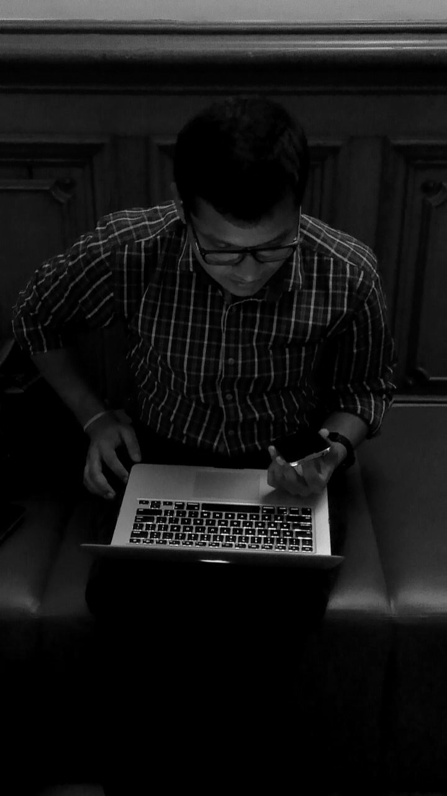
Concept Validation
“I feel bad that the test phase is over - could you let him know that I really enjoyed teaching him”
“ I like that I can hear the lessons again. ”
Volunteer
Student
Notes:
I like the lessons but is there a way I can hear the lessons again?” - I’m just

Slide 54
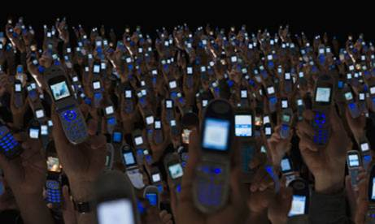
No Smartphone, No Internet
81%
Mobile Phone
Users
10%
Smartphone
Users
19%
Internet
Users
Nielsen, 2013
Notes:
78% penetration
Mobile phones offer the greatest opportunity to facilitate informal learning in out-of-school environments.
Children are comfortable using feature phones.

Slide 55
Appendix
We can have slides for FAQs:
“How will you get so many volunteers?”
“How will you address privacy issues?” etc.
“Why not IRB”
“Who pays”
“Quality of volunteer ensured?”
“Feedback mechanisms”
“Sustainability”
“Pilot/how to operationalize it?”

Slide 56
Ram, Arjun’s father, 36
Lower middle class upbringing and socio-economic background
Frustrated from the quality of teaching at school
Understand the importance of education
“Bacche ke bhavishya ke liye jo ho sakta hai woh karenge”
“Will do anything in my power, for my child’s future”

Slide 57
Pia, 26
Millennial
Bilingual in English and Hindi
Wants to give back to her community
“If I can make an impact in even one child’s life, it will be immensely satisfying”

