Slide 1
Connecting the food community
SHAWNA HEIN
HAZEL ONSRUD Advisor: JENNA BURRELL
AYLIN SELCUKOGLU
uc berkeley school of information
2009 master’s final project
Notes:
Intro Slide
hi we're shawna, aylin and hazel
squash and vine is our final masters project a suite of tools to connect all of the participants/actors in the food system.

Slide 2
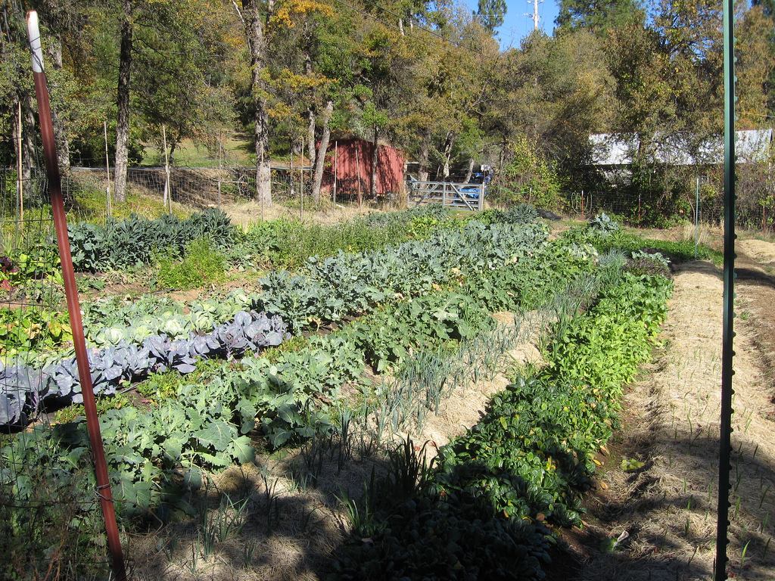
Our Story
Introduction
Research
Design
Conclusion
Notes:
Background photo: http://www.flickr.com/photos/29971881@N06/3036979285/

Slide 3
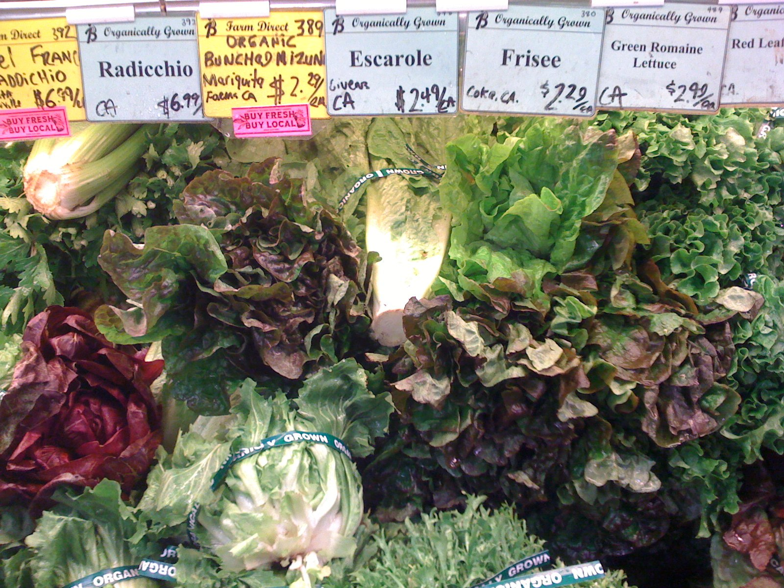
Introduction
Notes:
Farm on top, then restaurant, then person

Slide 4
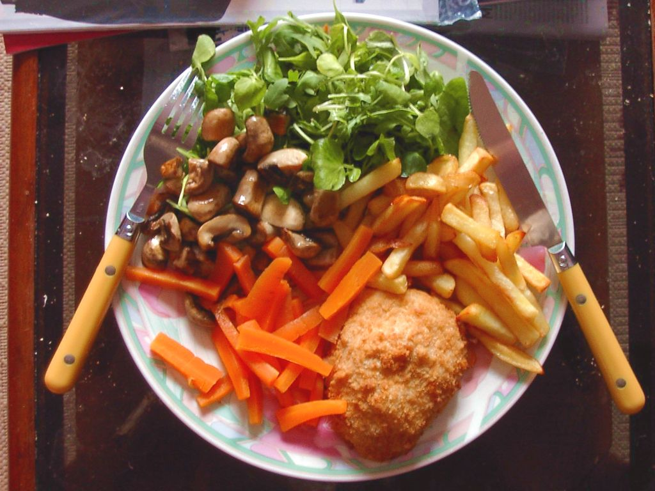
Notes:
NEED ITS ATTRIBUTION THING!!

Slide 5
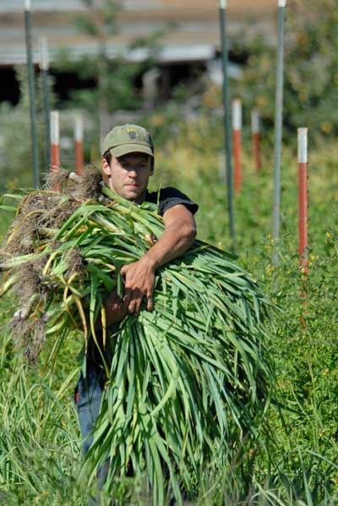
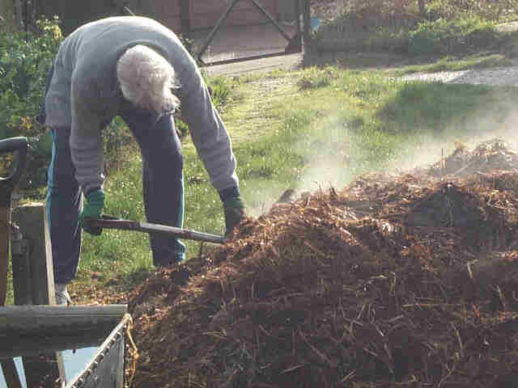
Notes:
Chef: http://www.igougo.com/photos/travel_blog/Top-Chef-L.jpg
Farmer: http://mikeely.files.wordpress.com/2008/04/young-farmer-with-leeks_tana-butler.jpg
Manure Man: http://www.saundersallotment.co.uk/Resources/Copy%20of%20John%20with%20manure.jpg

Slide 6
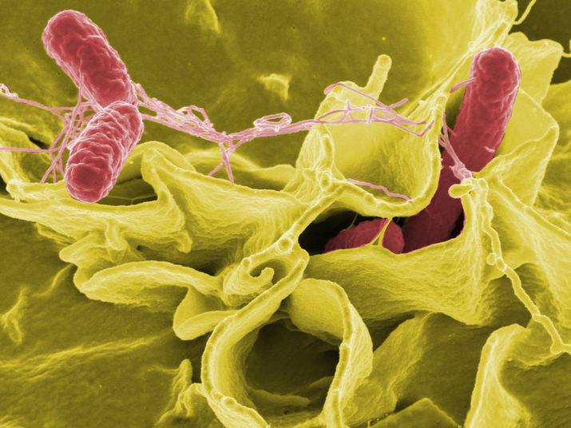
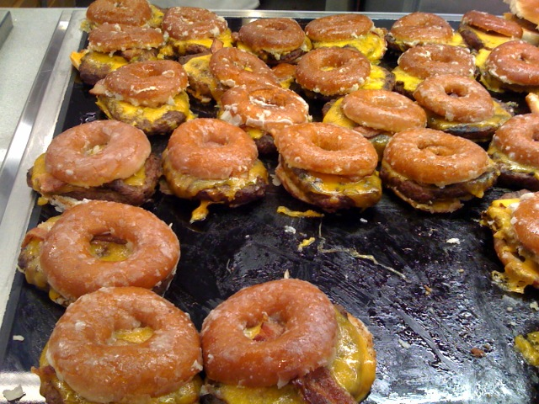
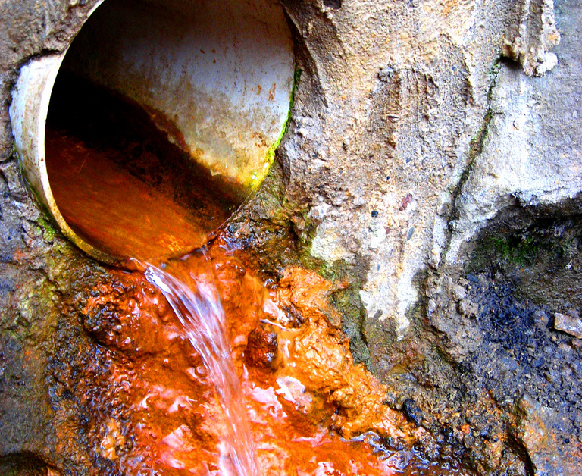
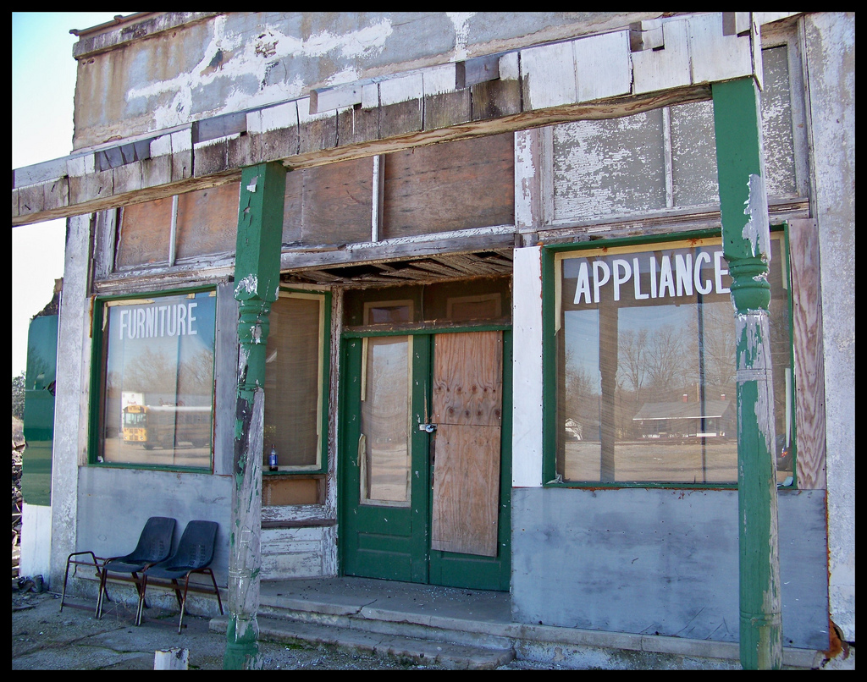
we have
problems
Notes:
NEEDS THEIR ATTRIBUTION

Slide 7
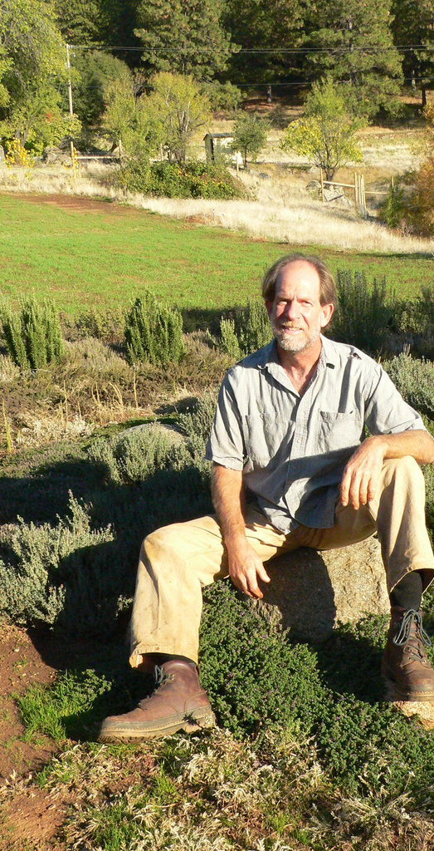
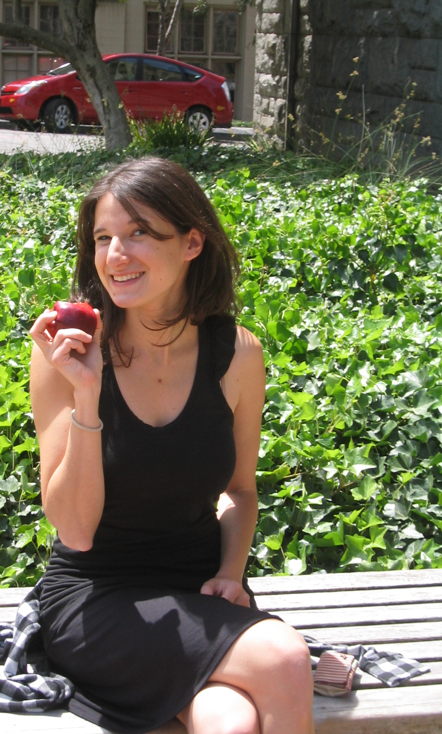
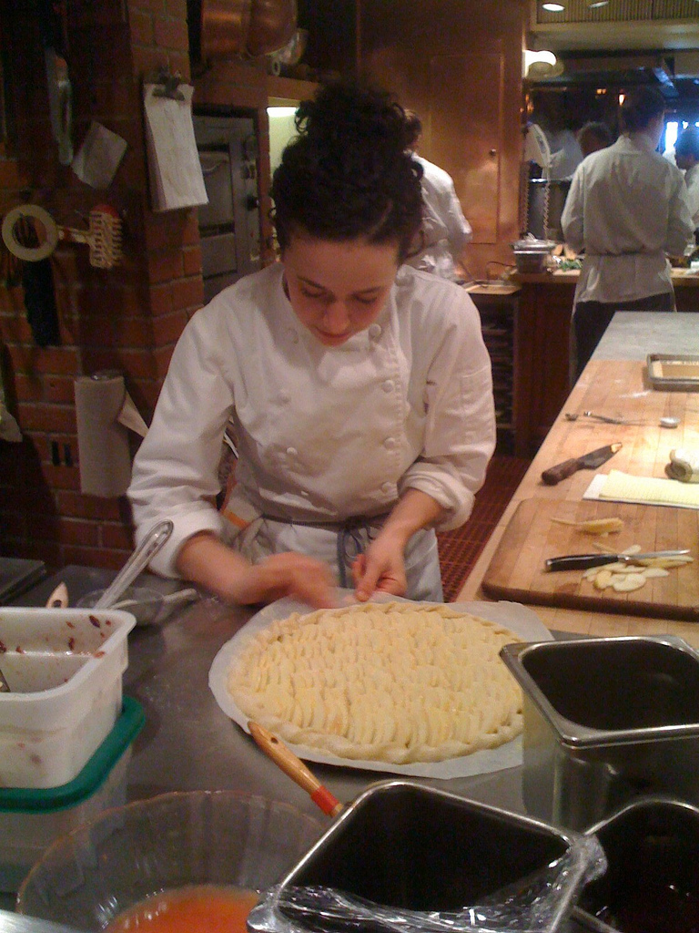
Producers
Retailers
Consumers
Notes:
Slide 7: our process, interviewing

Slide 8
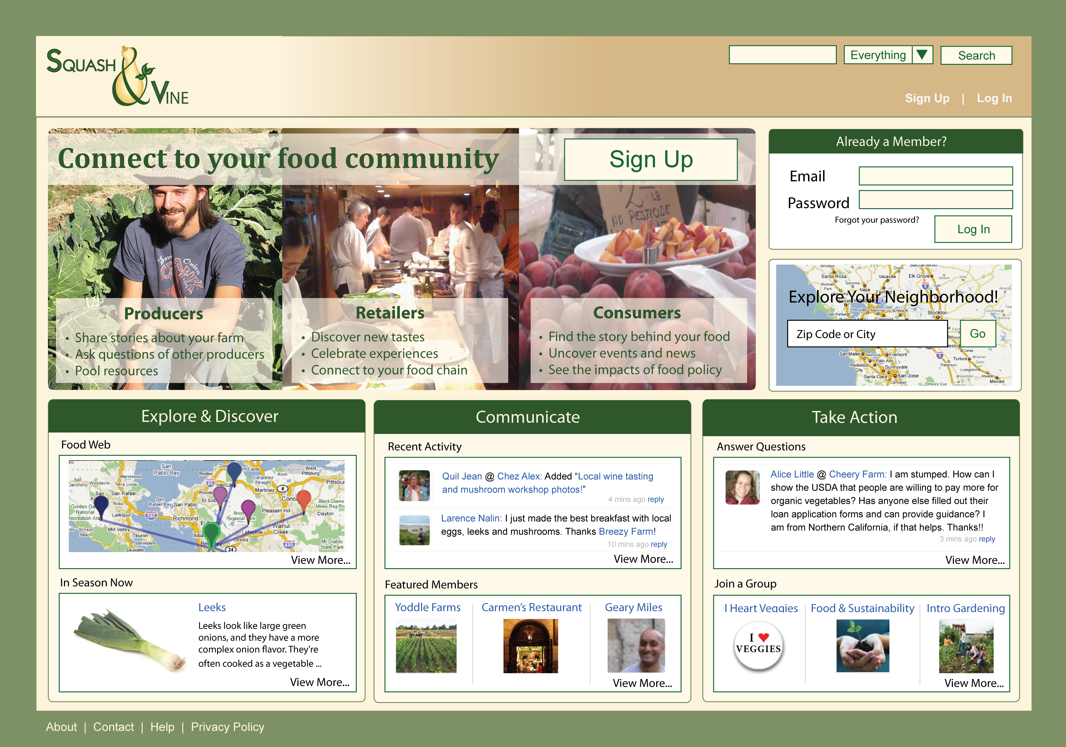

Slide 9
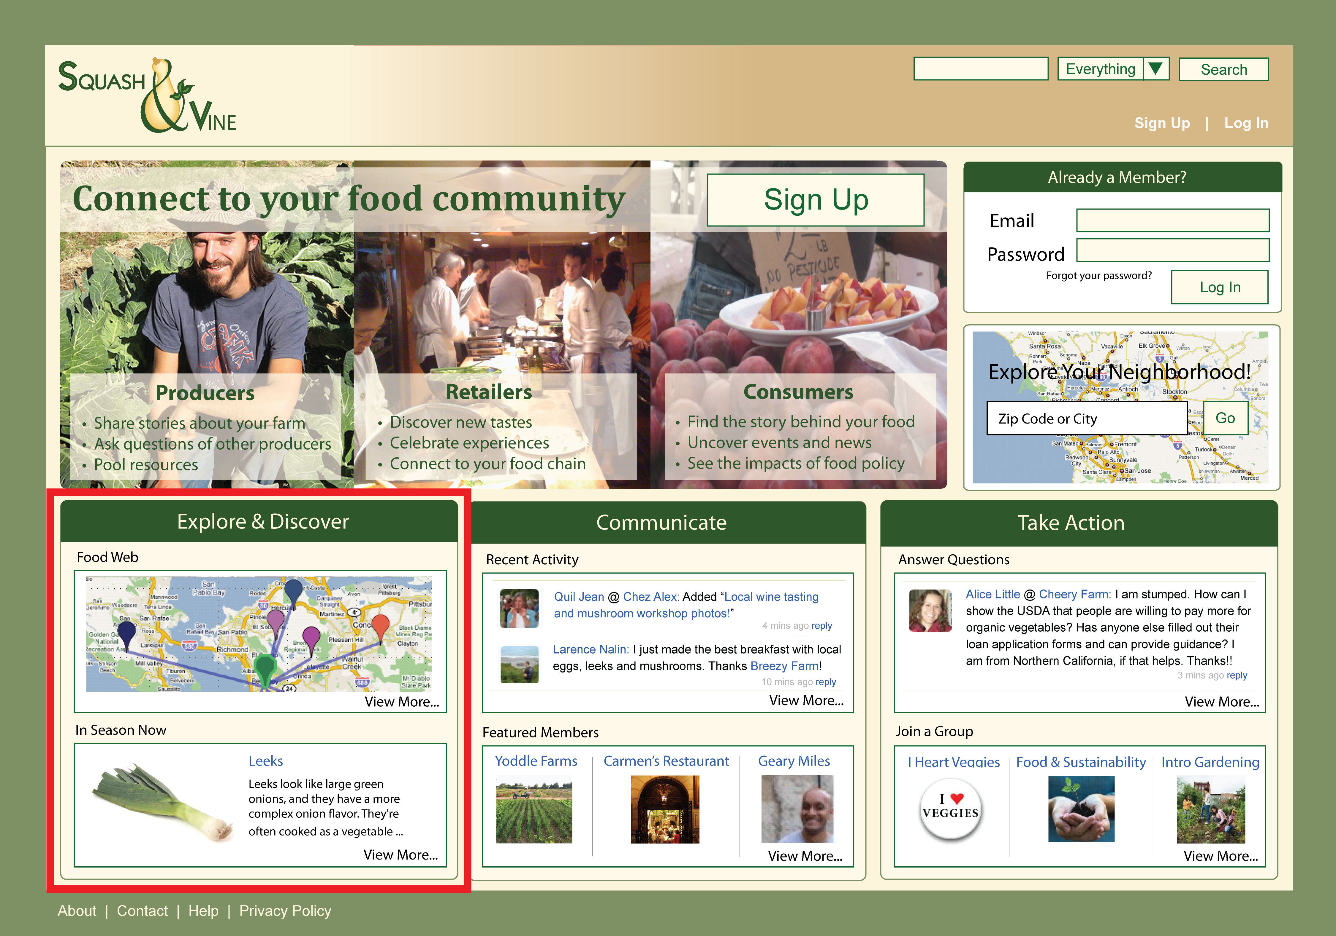

Slide 10
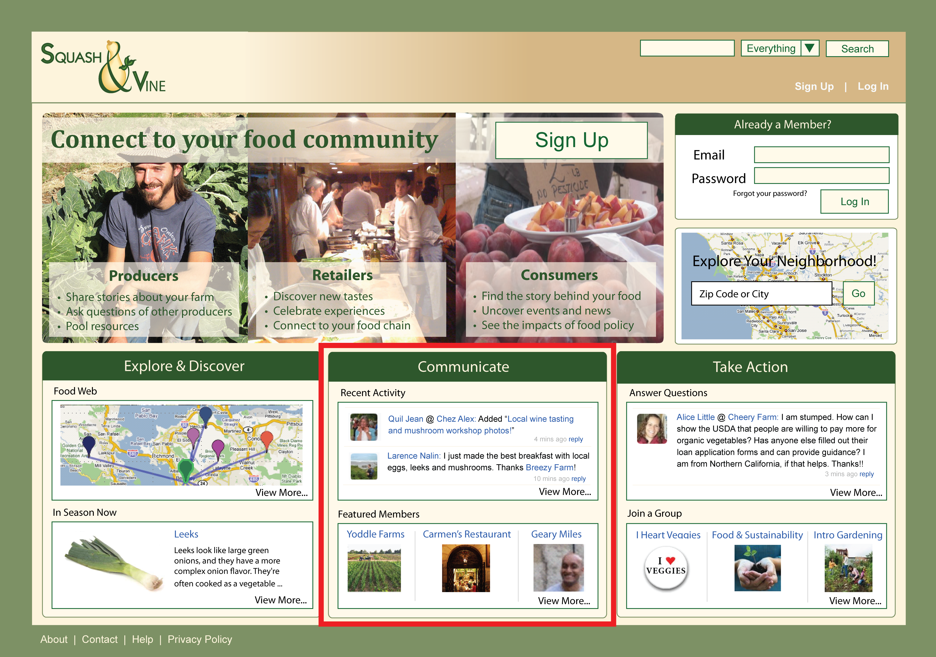

Slide 11
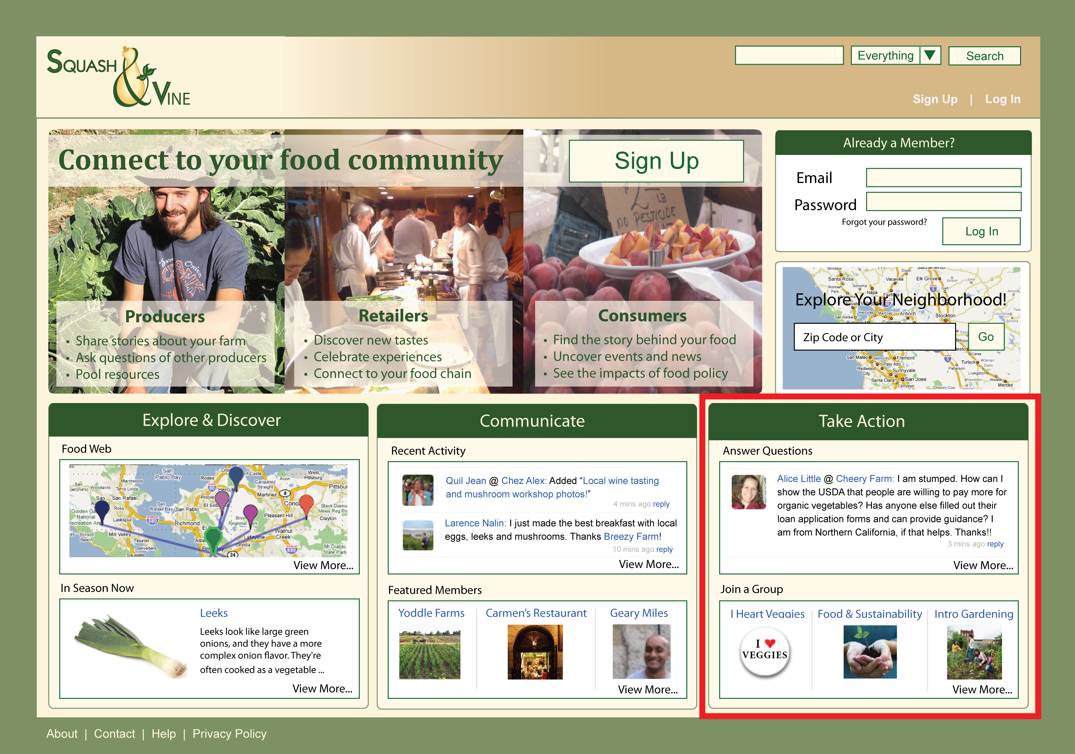

Slide 12
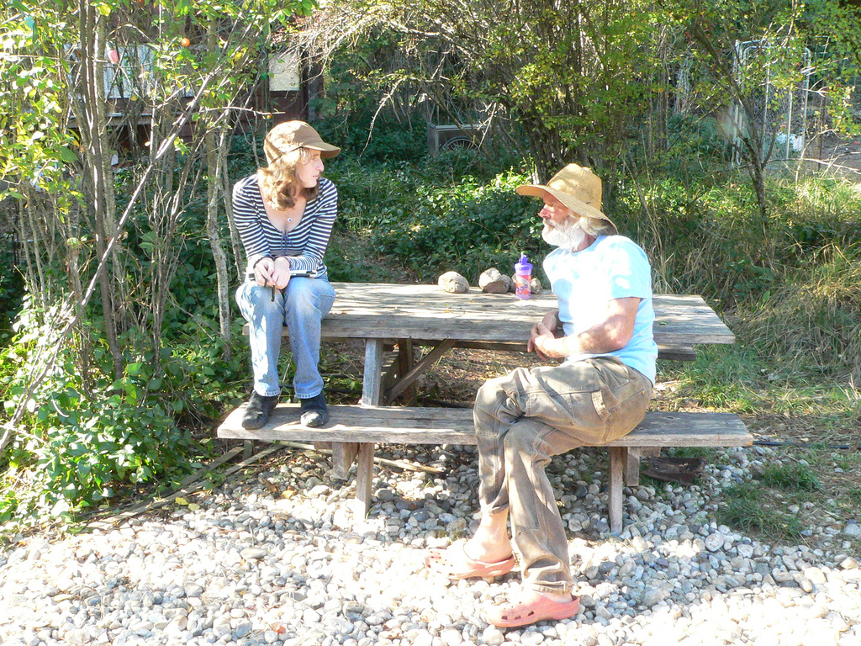
Research

Slide 13
Current Landscape
Broad Audience
Static
Presentation
Rich
Interaction
Narrow Audience
Notes:
2 key attributes / properties

Slide 14
20 Producers
18 Retailers
11 Consumers
Notes:
Slide 7: our process, interviewing

Slide 15
Want to…
Be recognized and
appreciated
Focus on farming,
but develop online
presence
Share advice
Want to…
Keep up-to-date
Use time efficiently
Educate consumers
Want to…
Explore the story
behind food
Find food that
matches values
Learn about
seasonality
Producers
Findings
Retailers
Consumers
Notes:
Slide 7: our process, interviewing

Slide 16
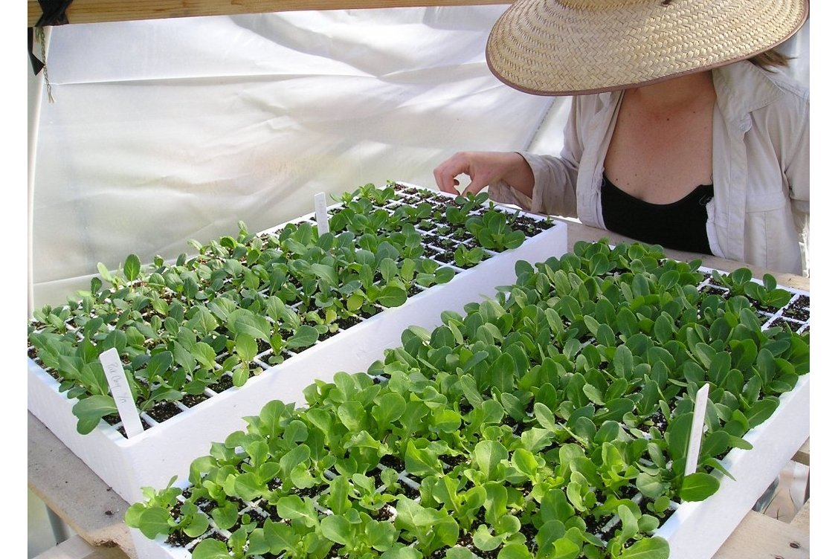
Project Goals
Promote transparency and lower barriers to eating locally
Support new and struggling producers
Encourage political awareness
Foster delight
Notes:
connection must foster over time ------------ sustainable
Efficient
low risk
high return approach

Slide 17
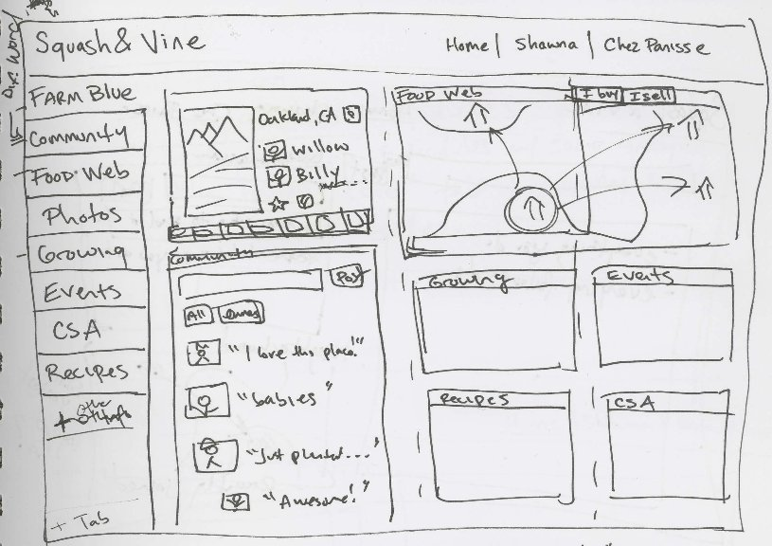
Design
Notes:
Farm on top, then restaurant, then person

Slide 18
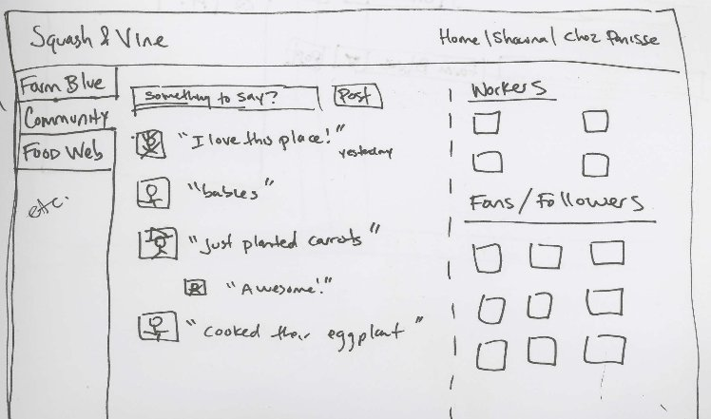
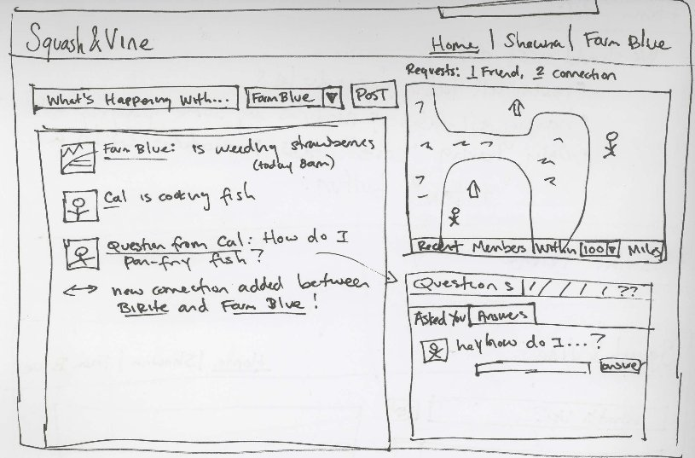
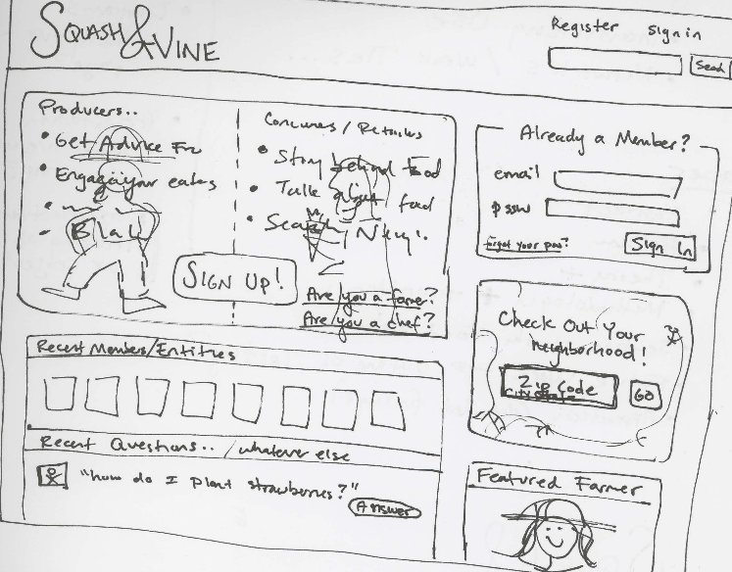
Sketching
Notes:
Farm on top, then restaurant, then person

Slide 19
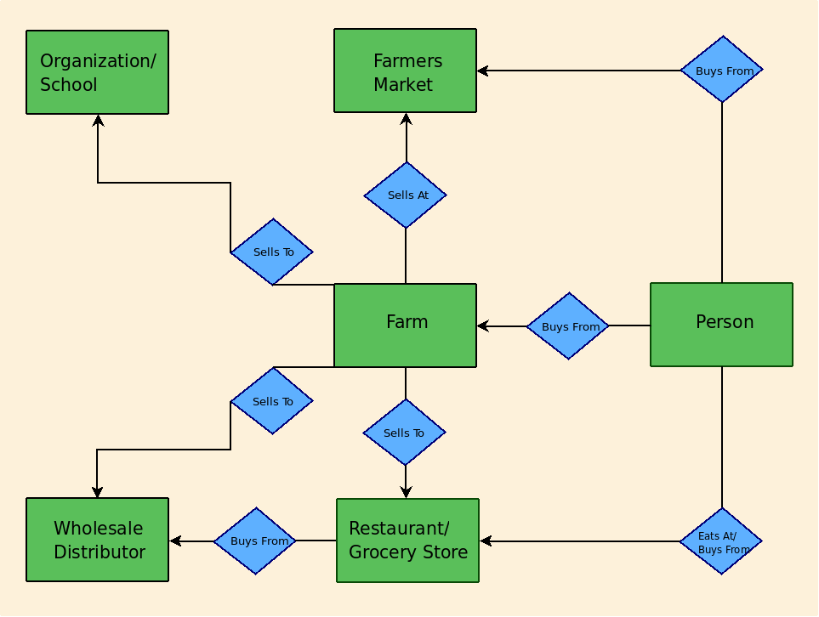
Entities

Slide 20
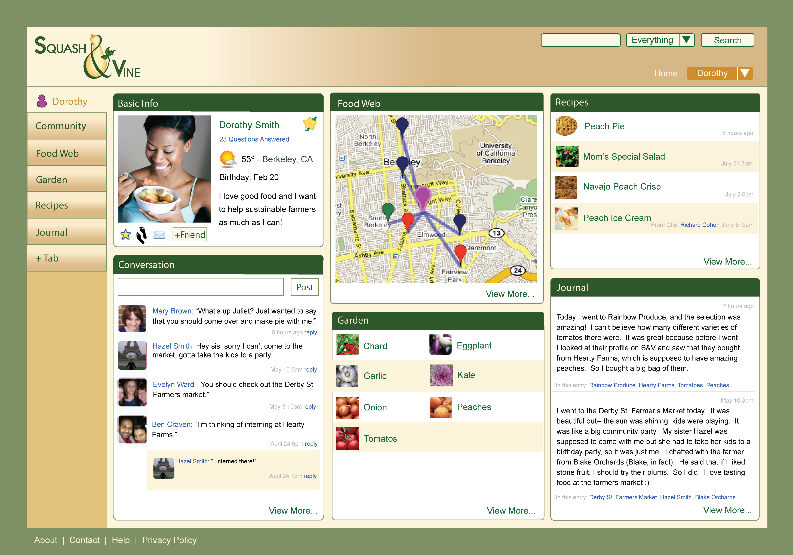
Entities

Slide 21
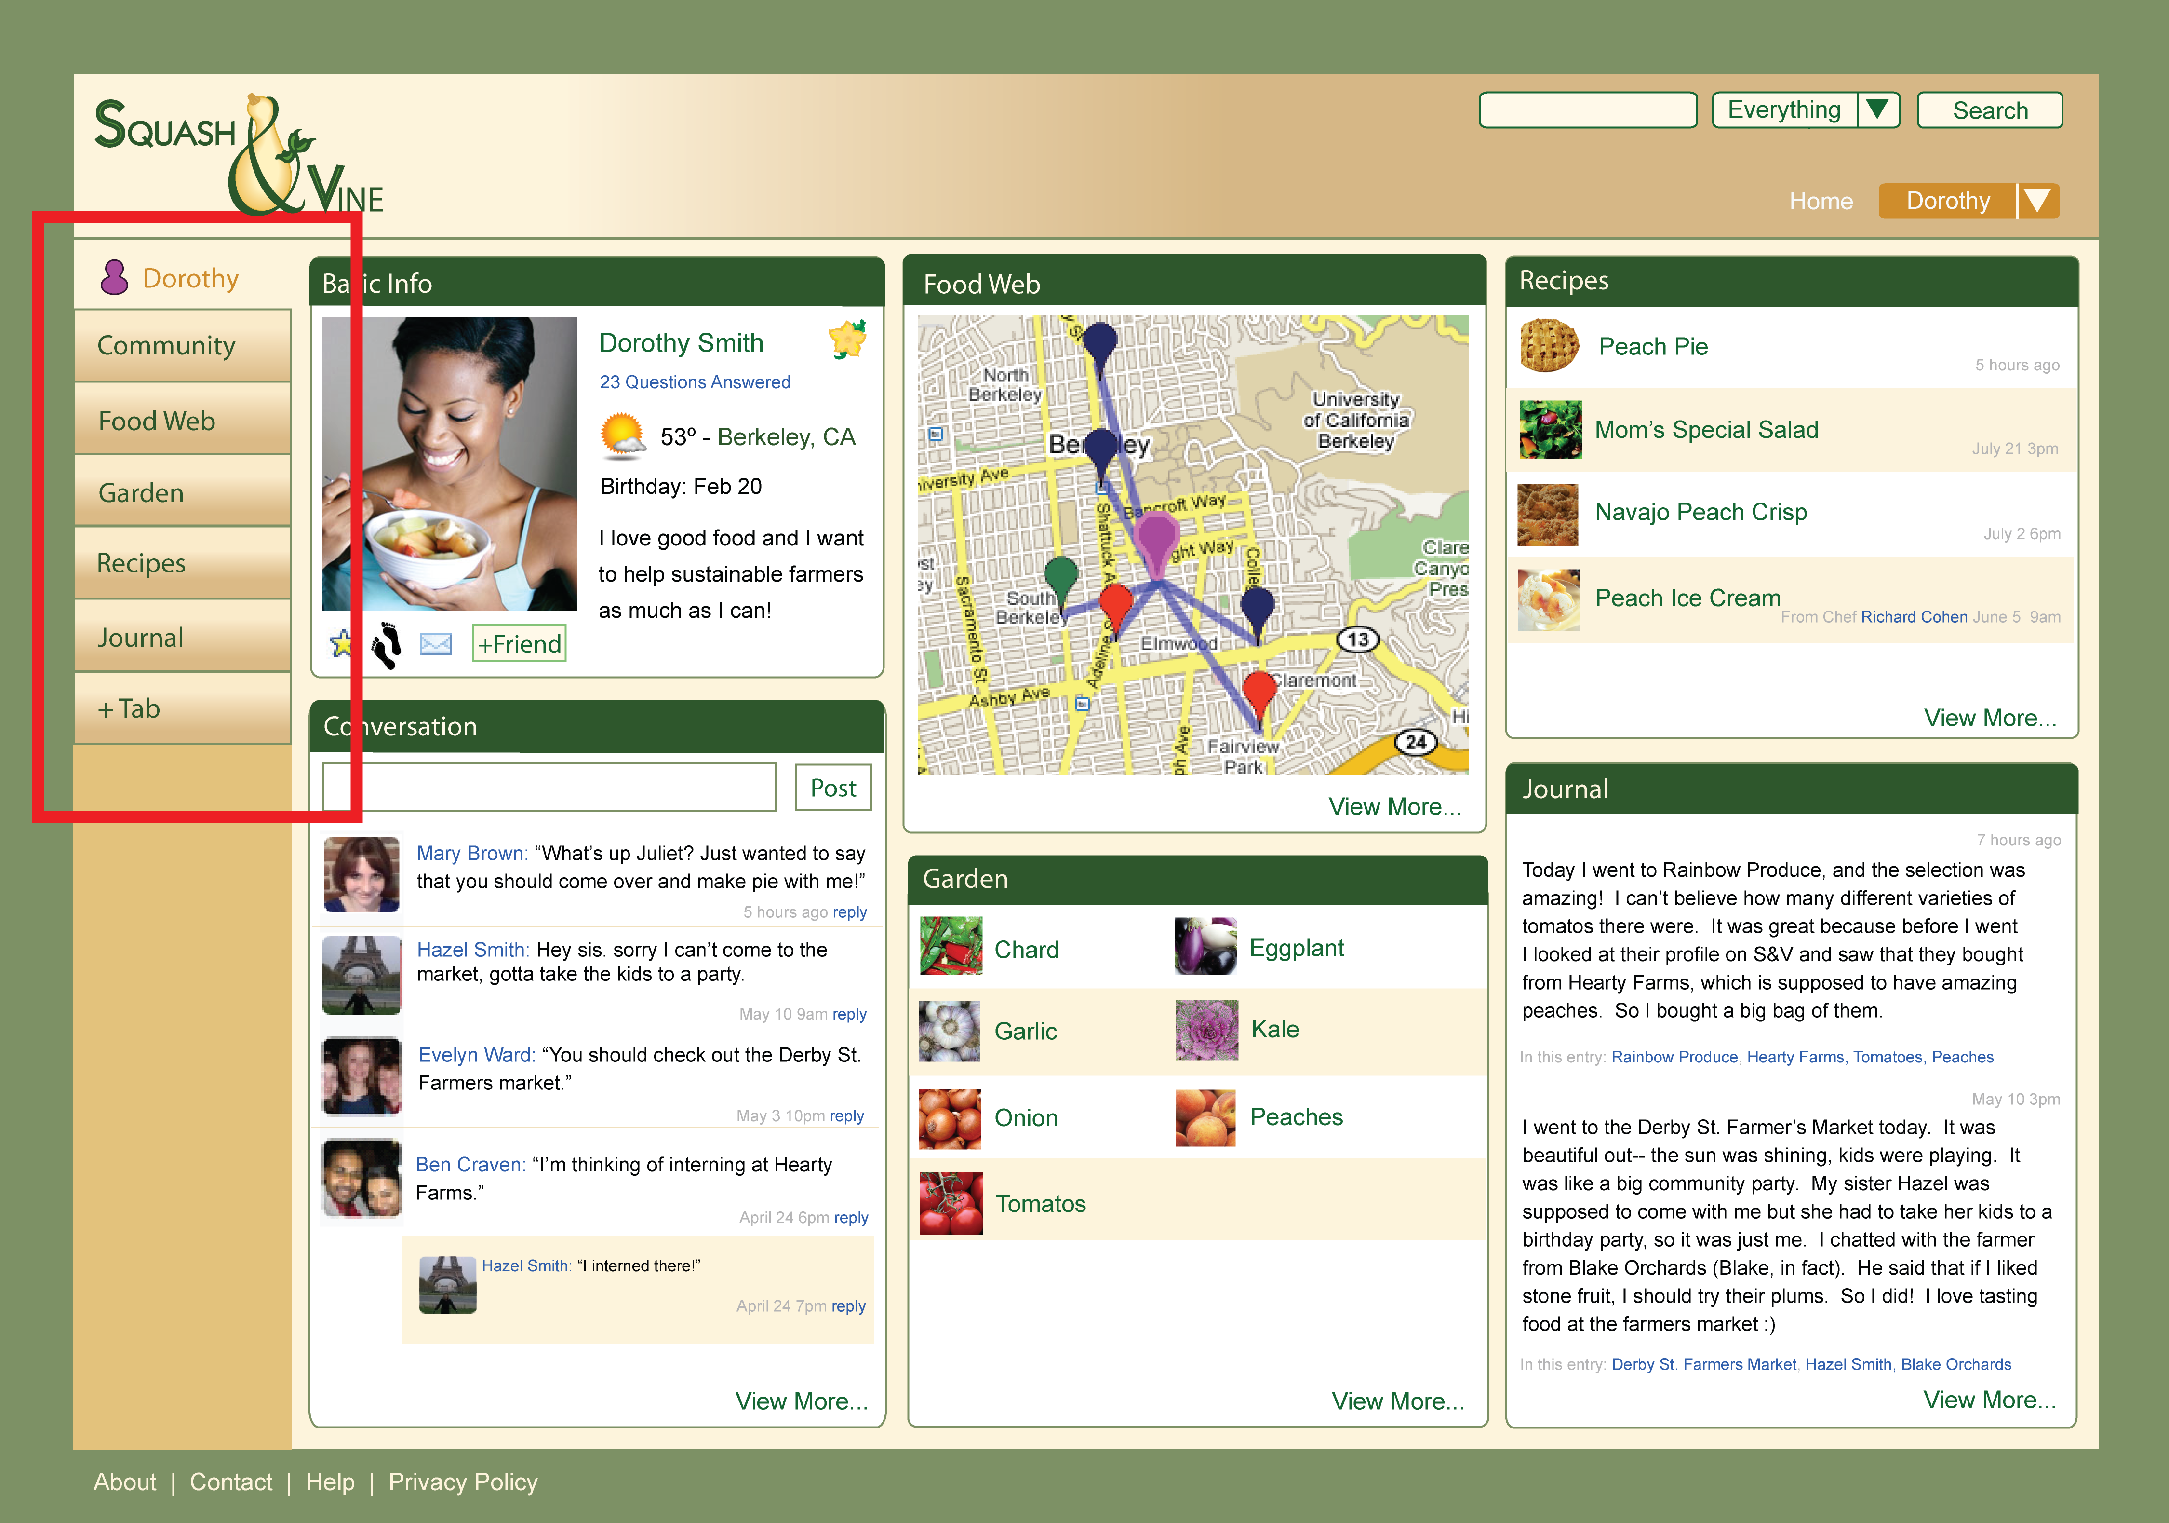

Slide 22
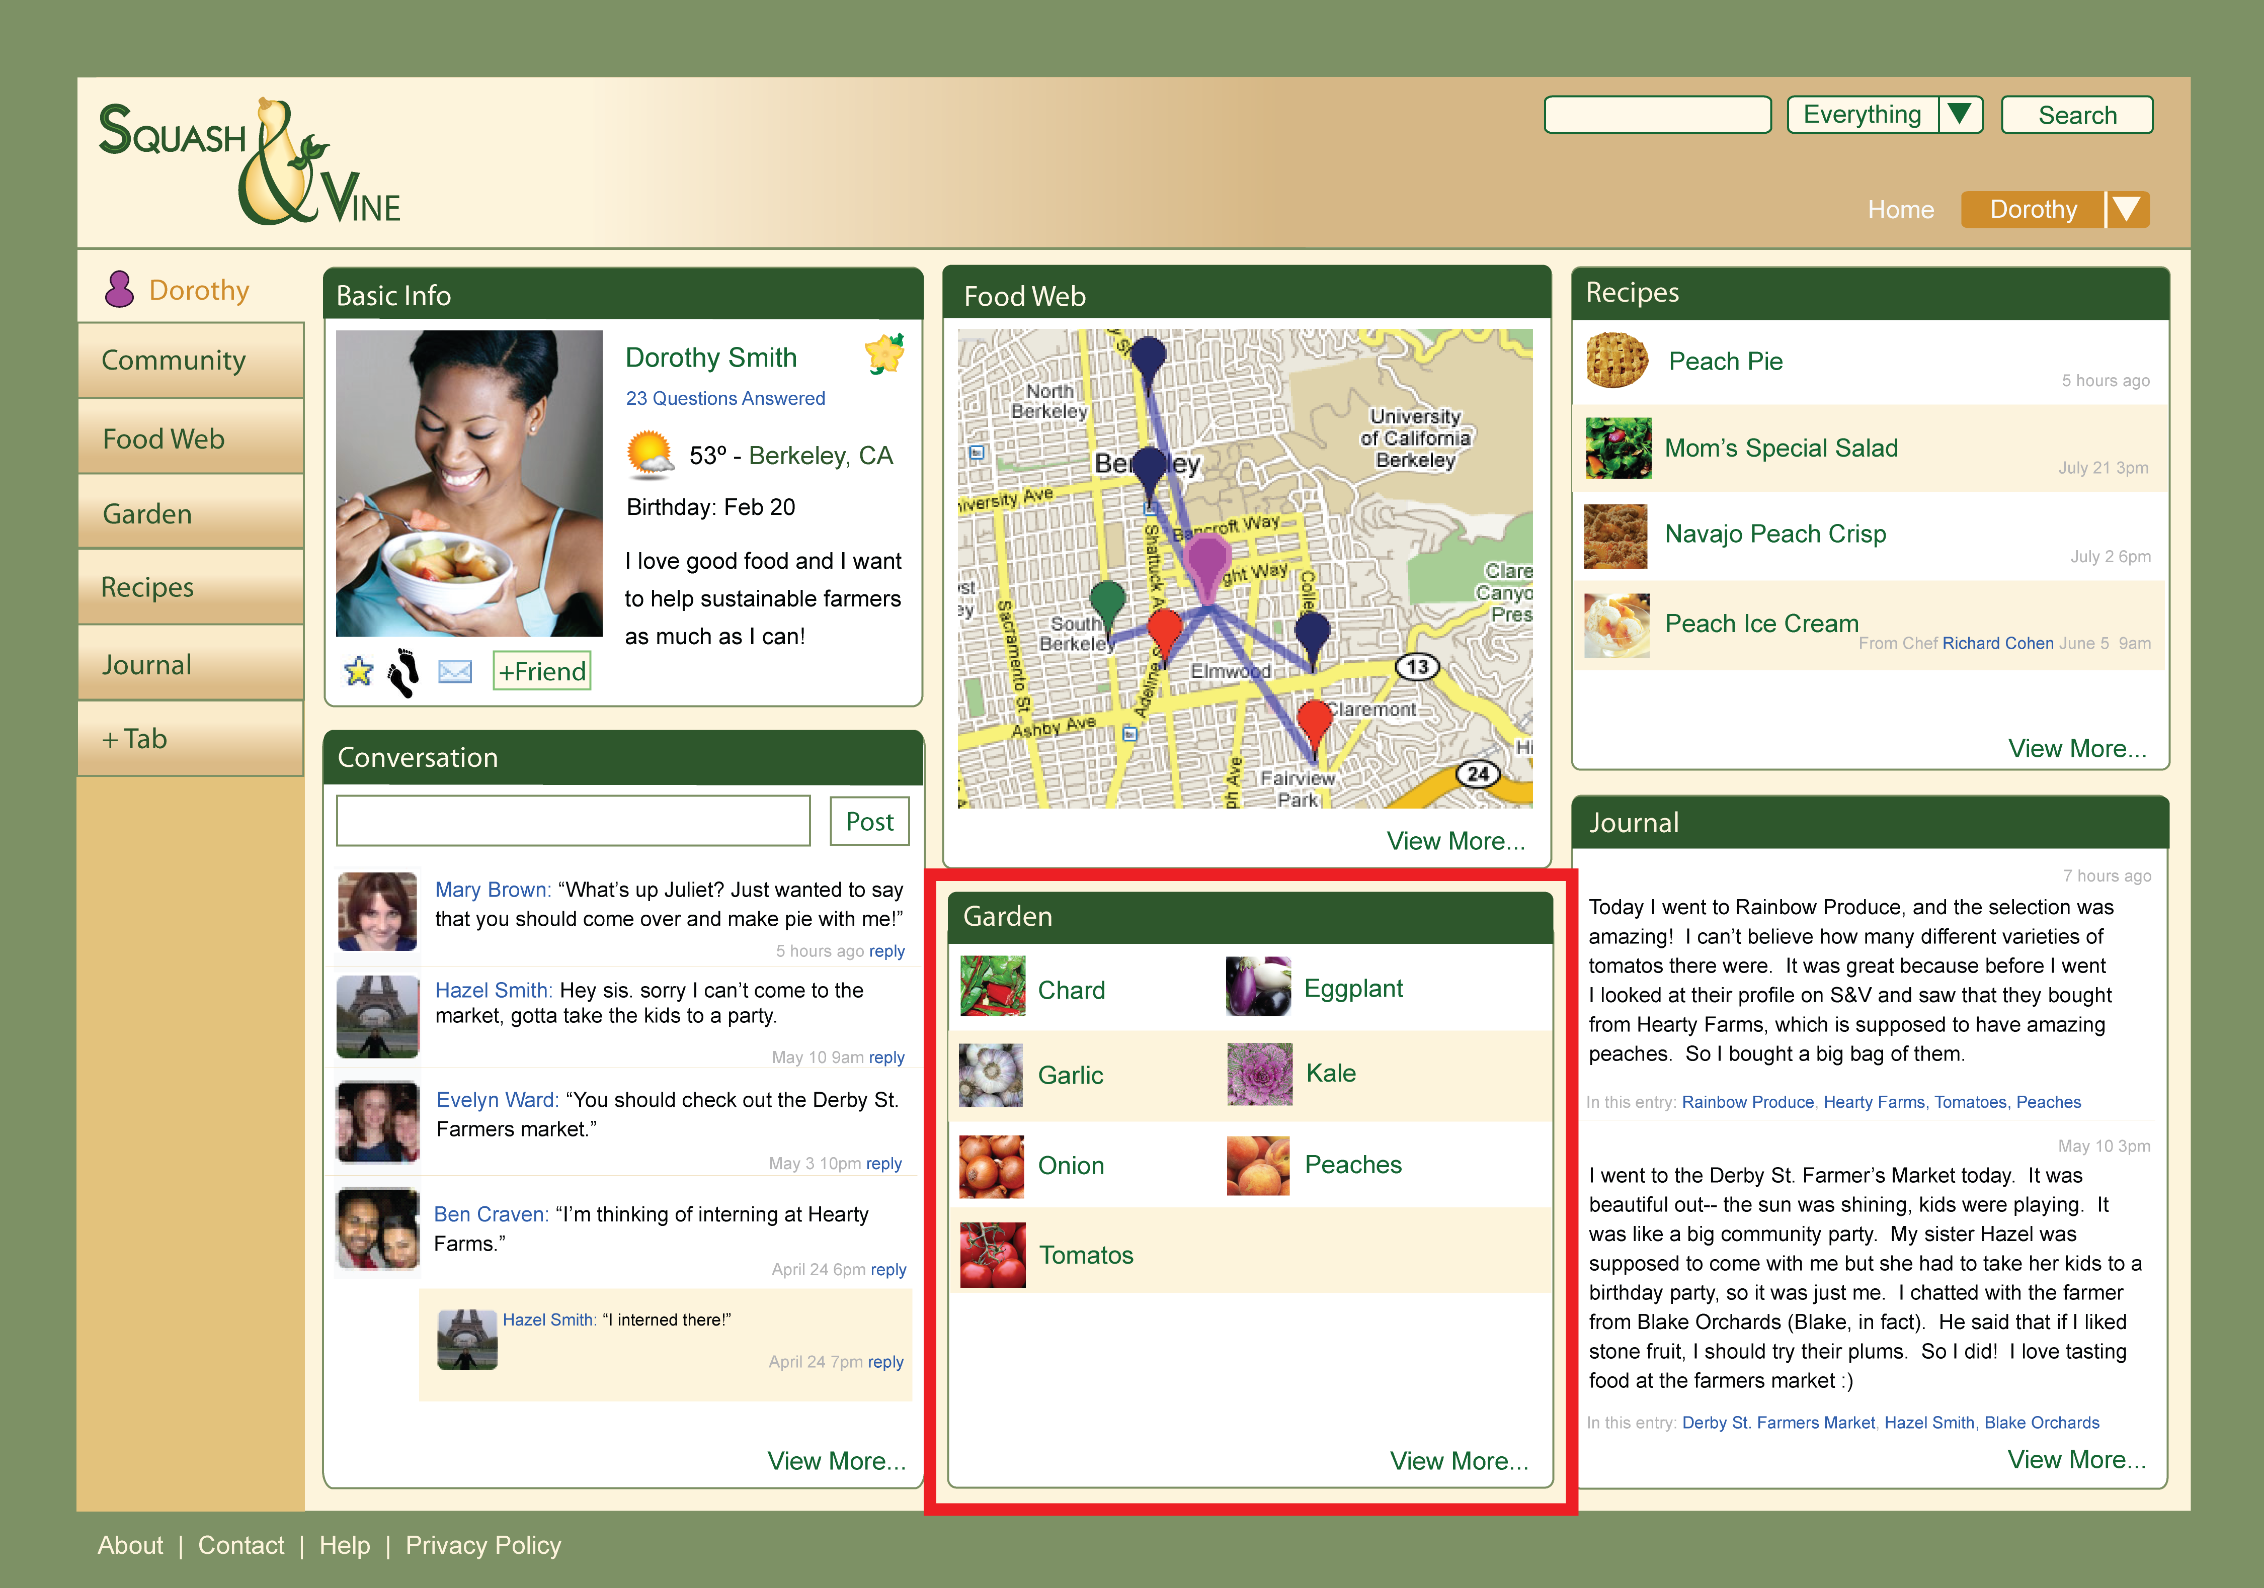

Slide 23
Want to…
Be recognized and
appreciated
Focus on farming,
but develop online
presence
Share advice
Producers
Notes:
Slide 7: our process, interviewing

Slide 24
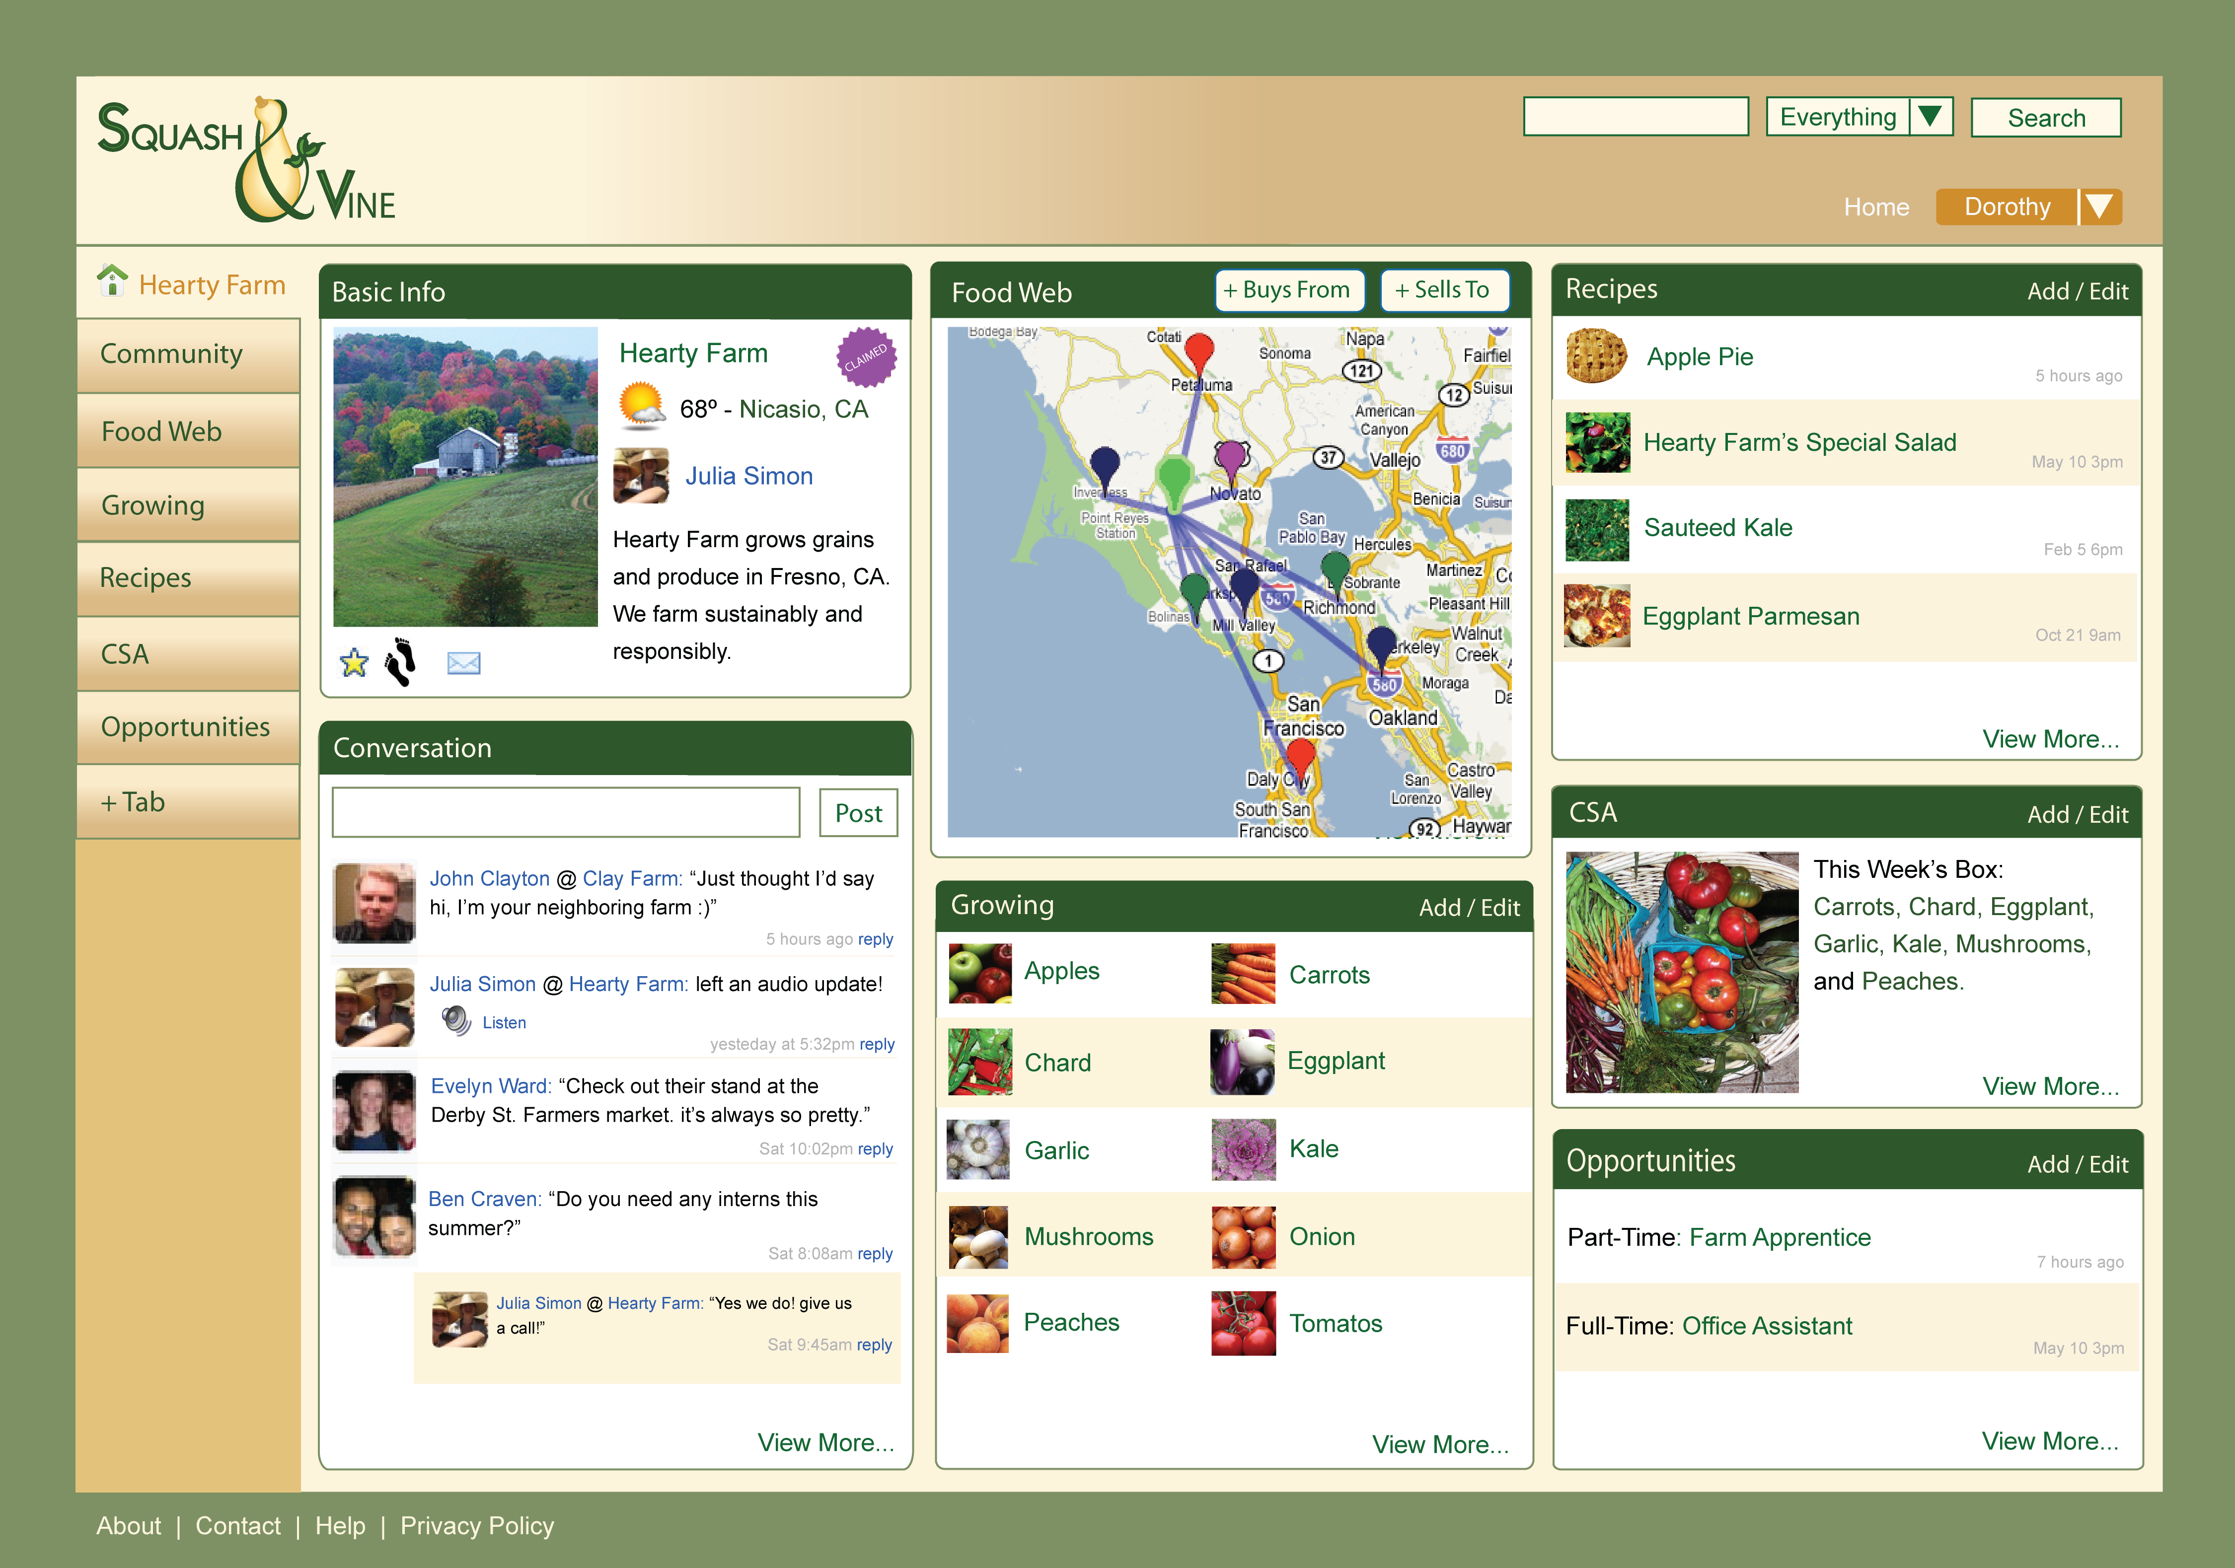
Be Recognized

Slide 25
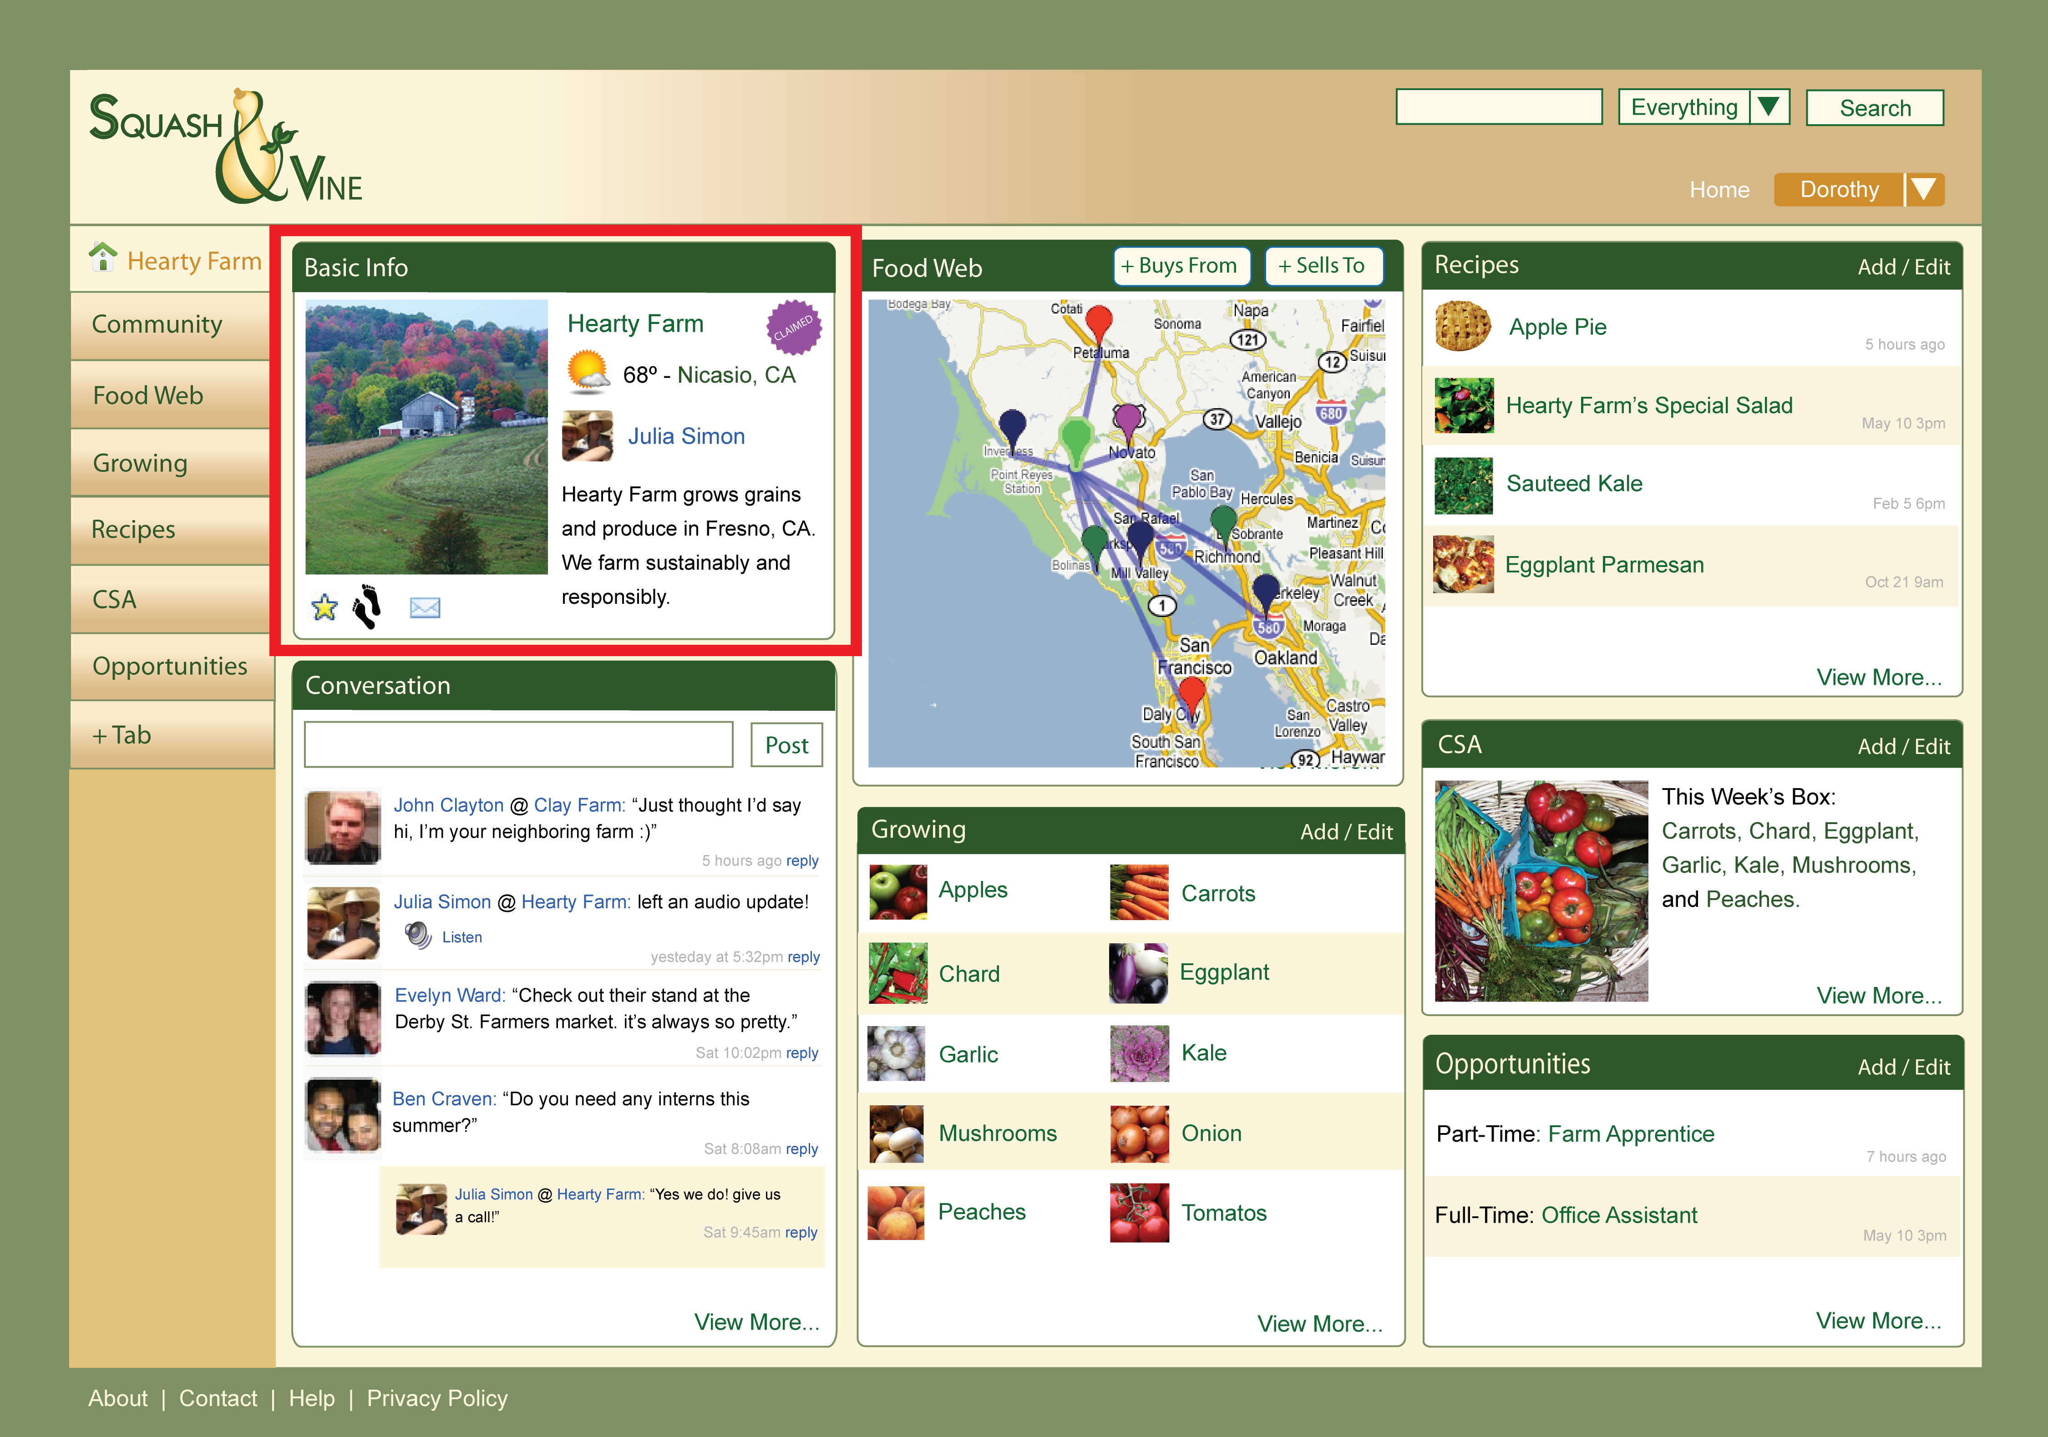
Be Recognized

Slide 26
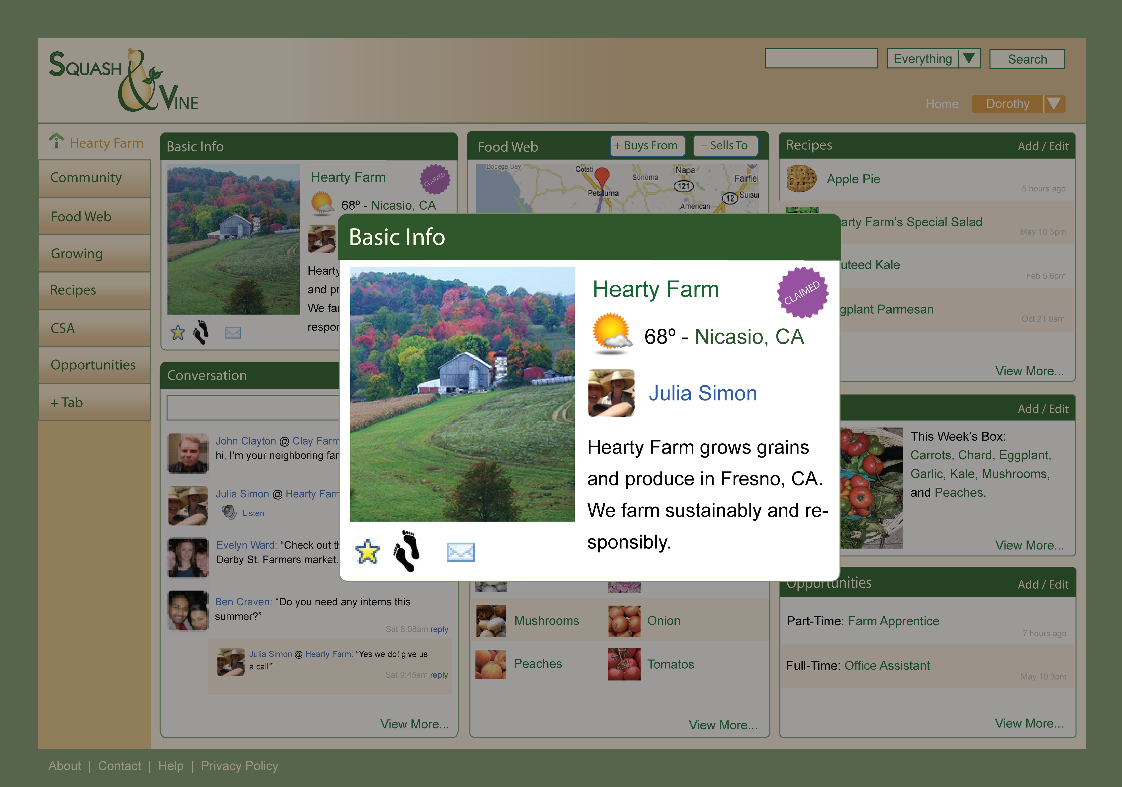
Be Recognized

Slide 27
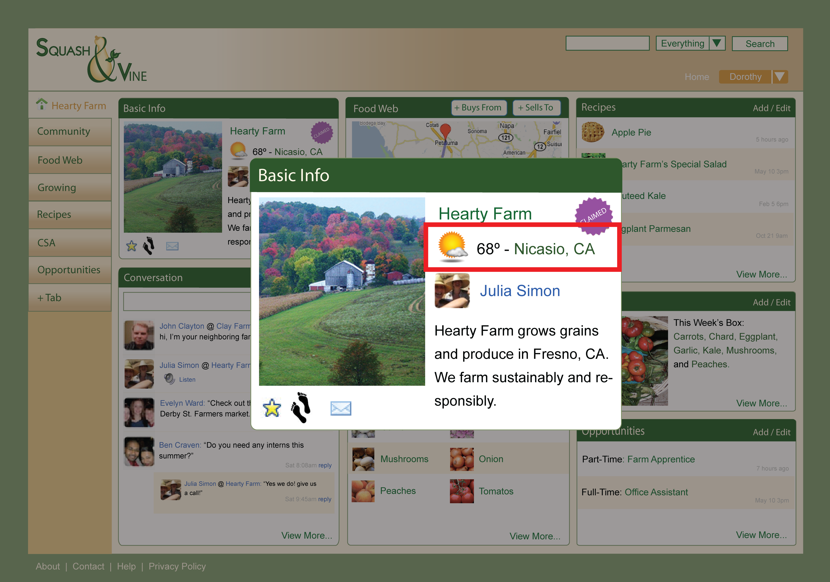
Be Recognized

Slide 28
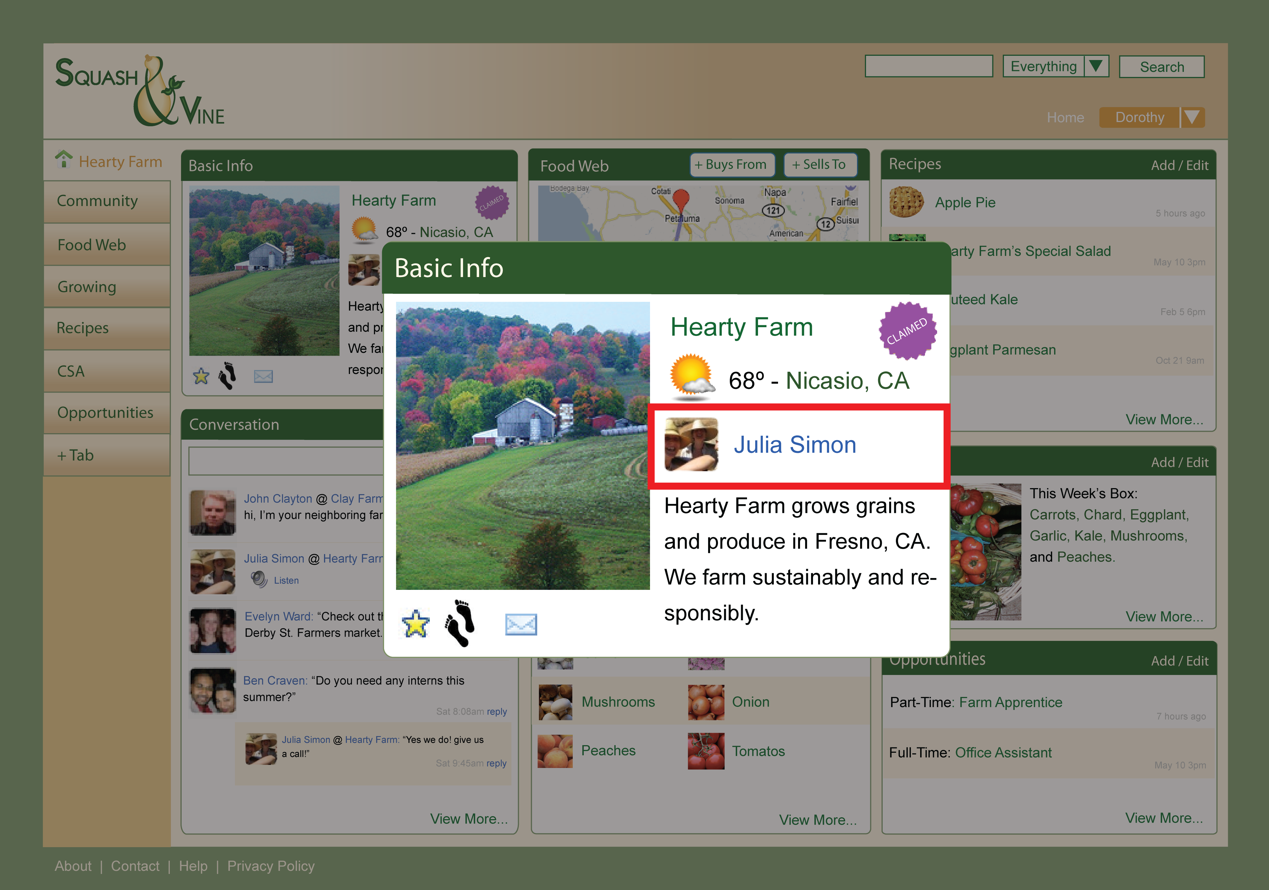
Be Recognized

Slide 29
Develop Presence Easily

Slide 30
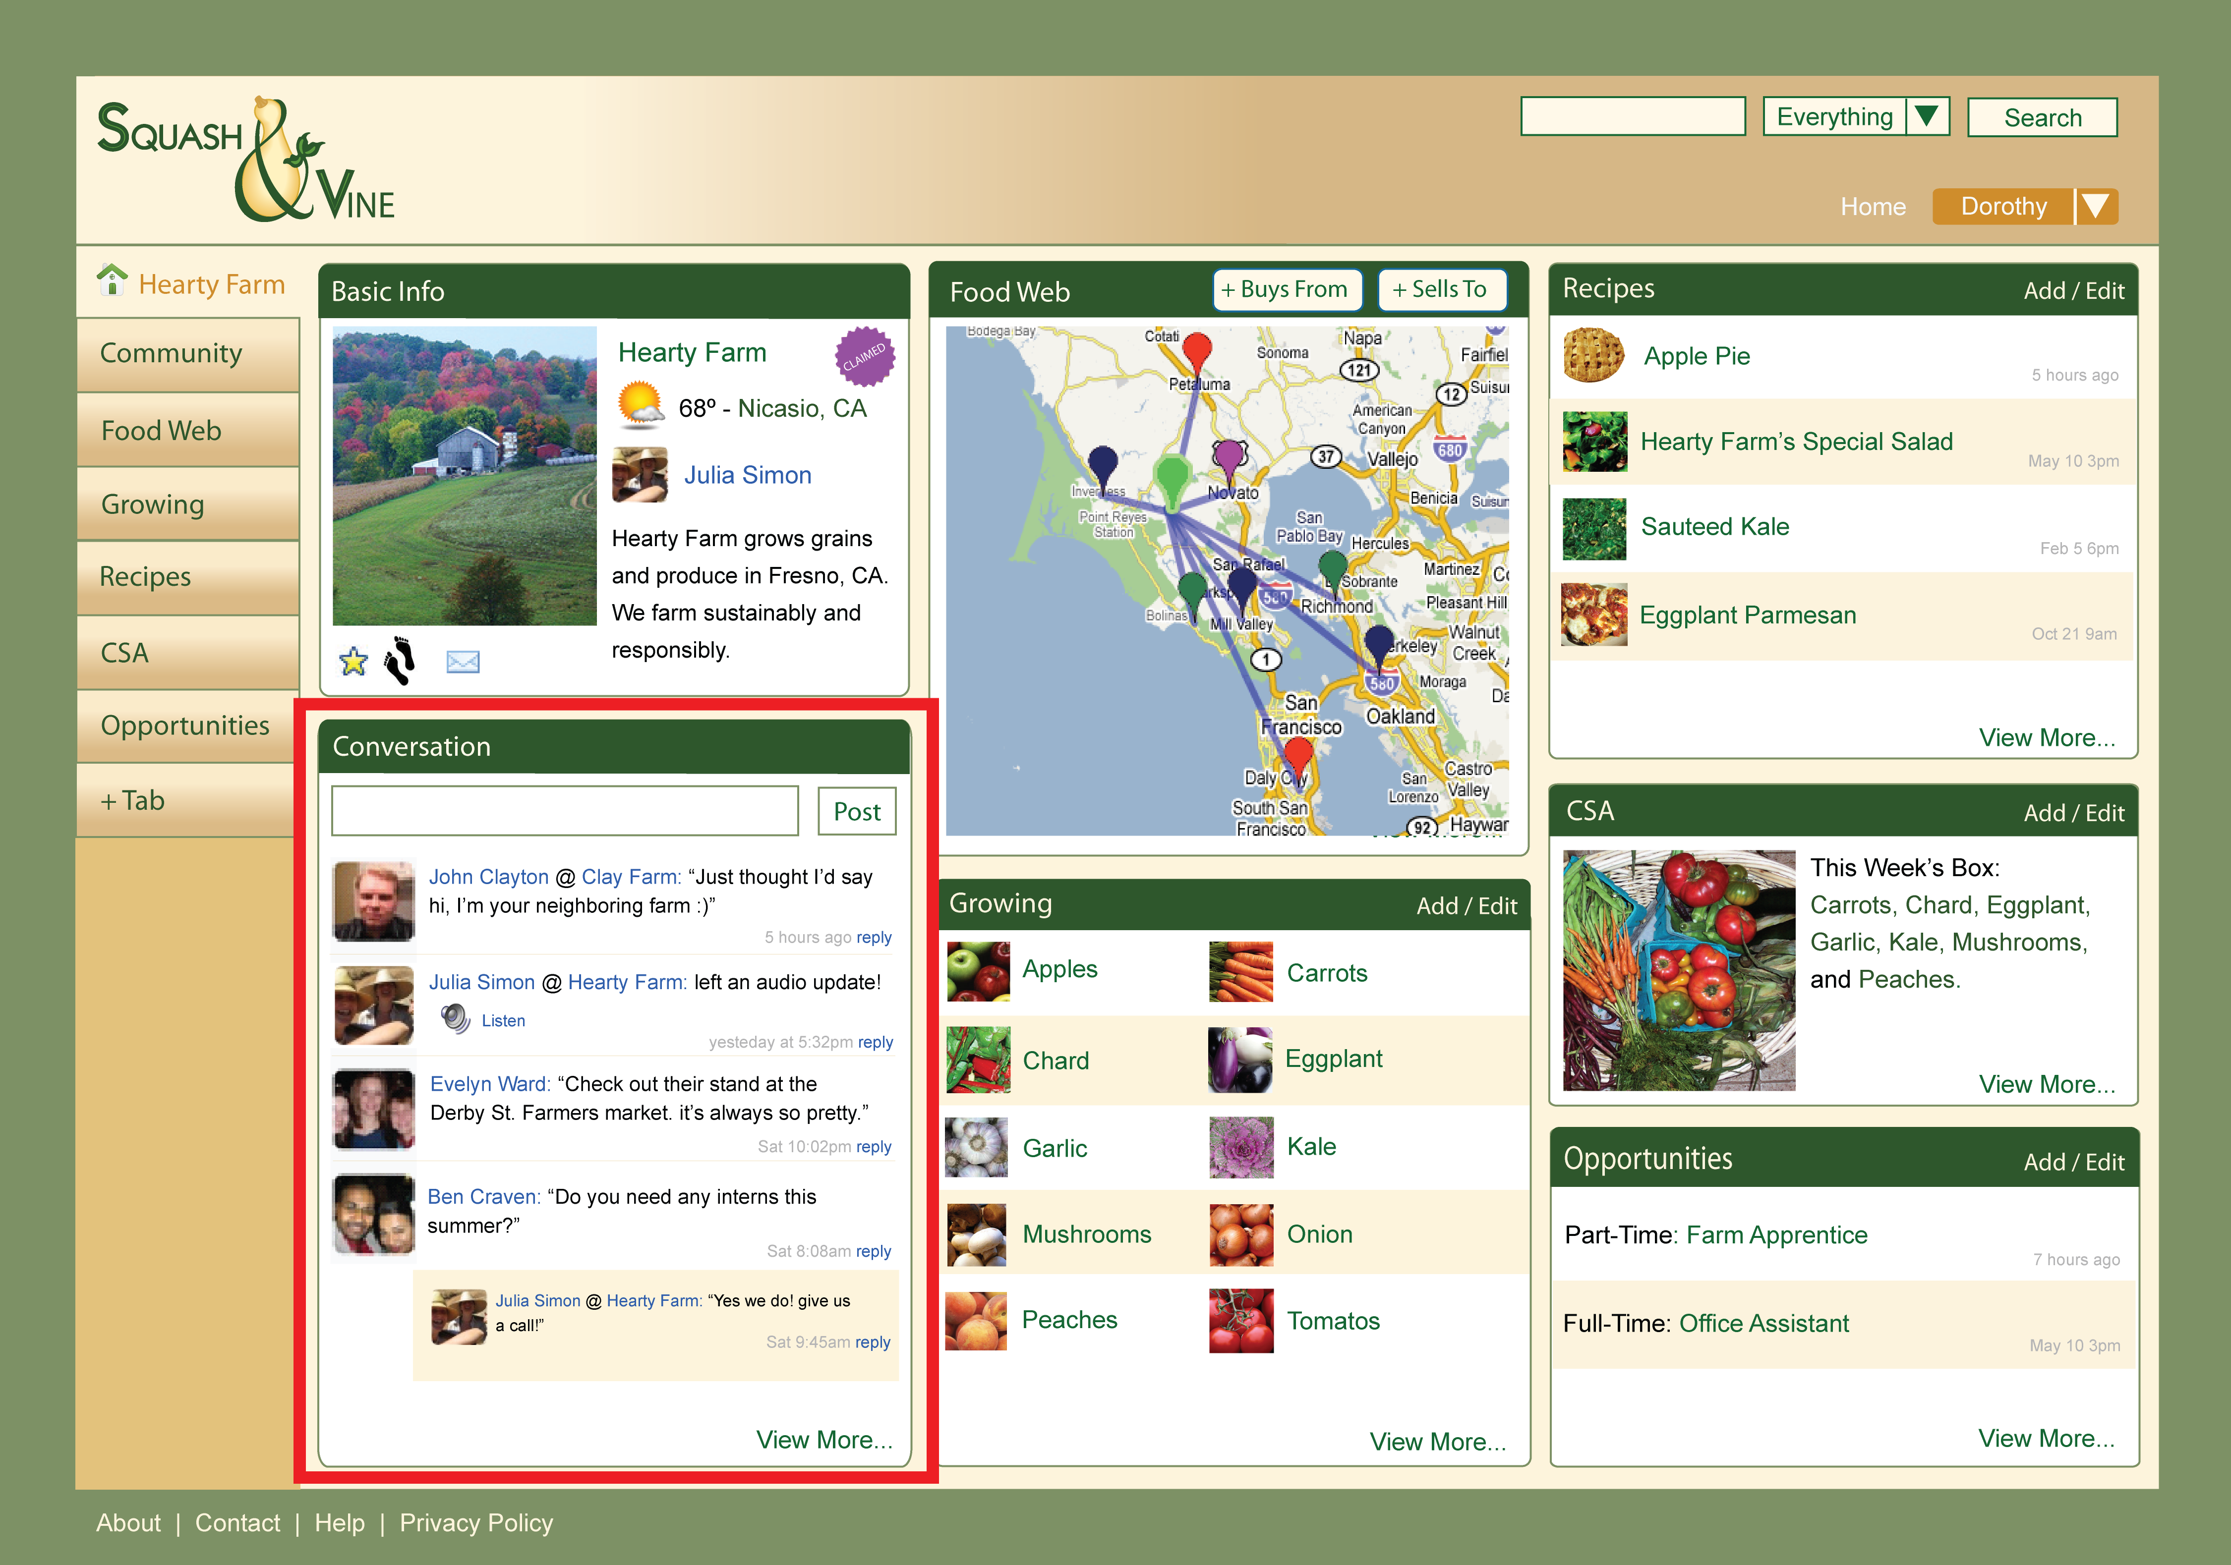
Develop Presence Easily

Slide 31
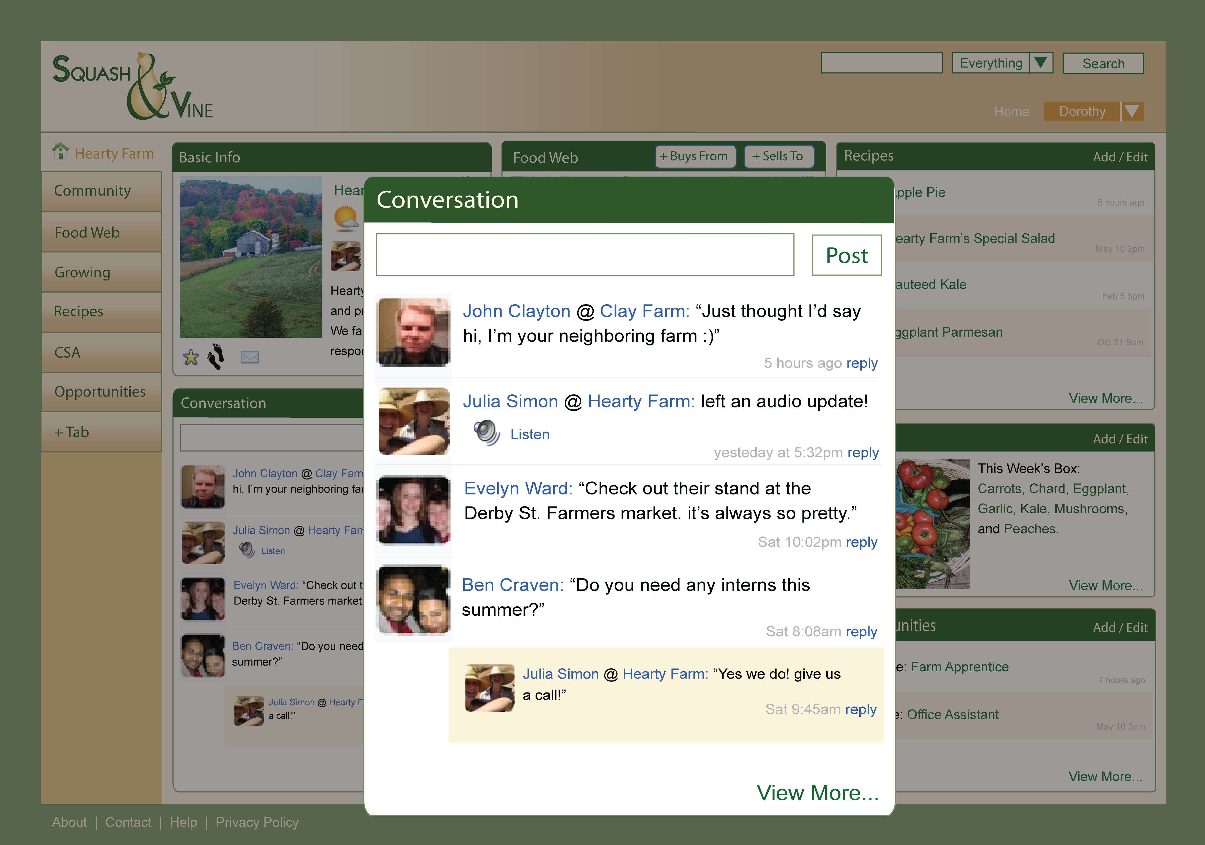
Develop Presence Easily

Slide 32
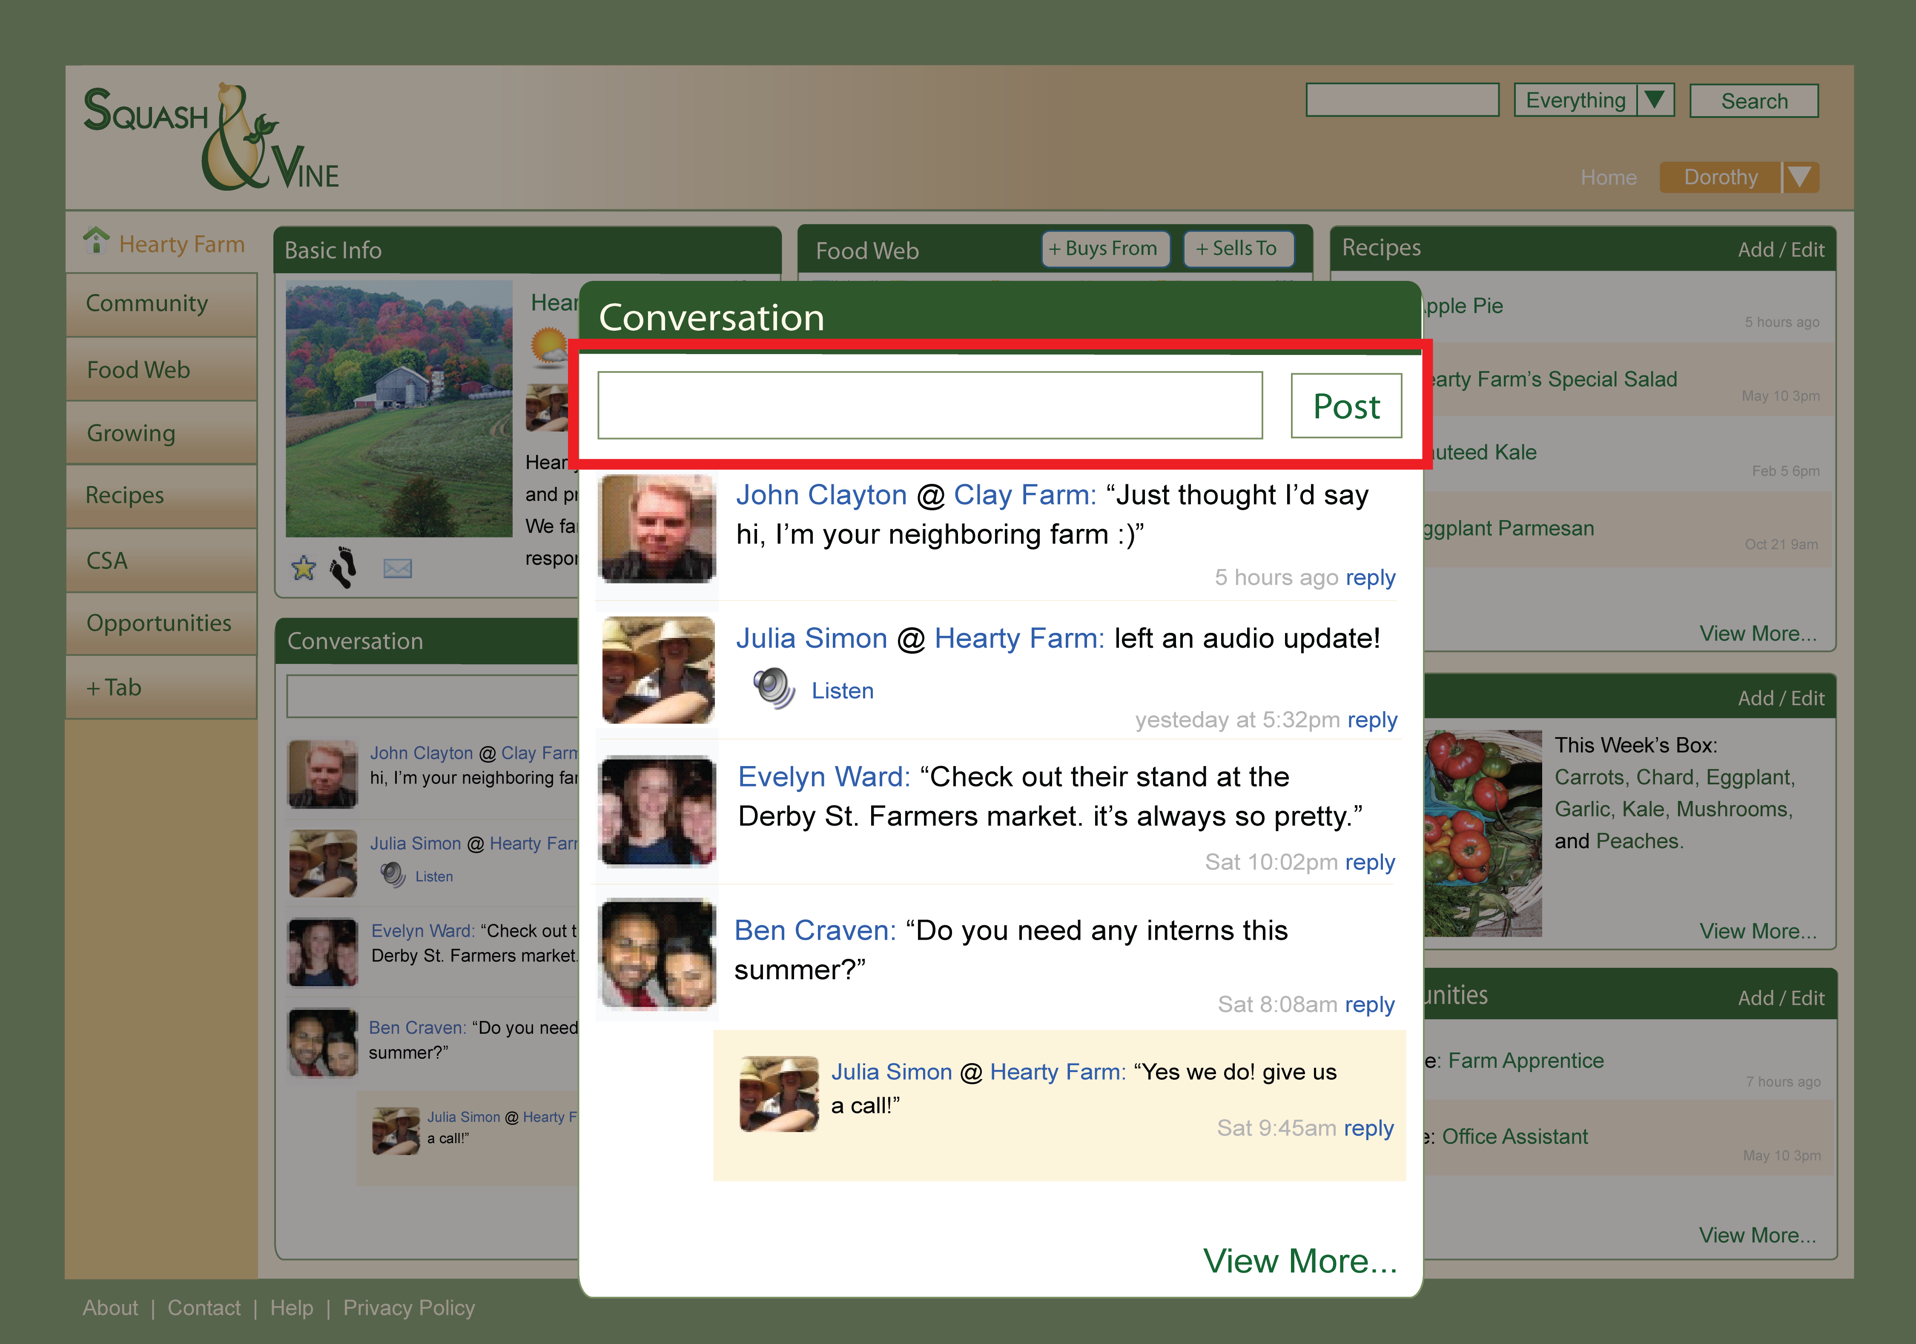
Develop Presence Easily

Slide 33
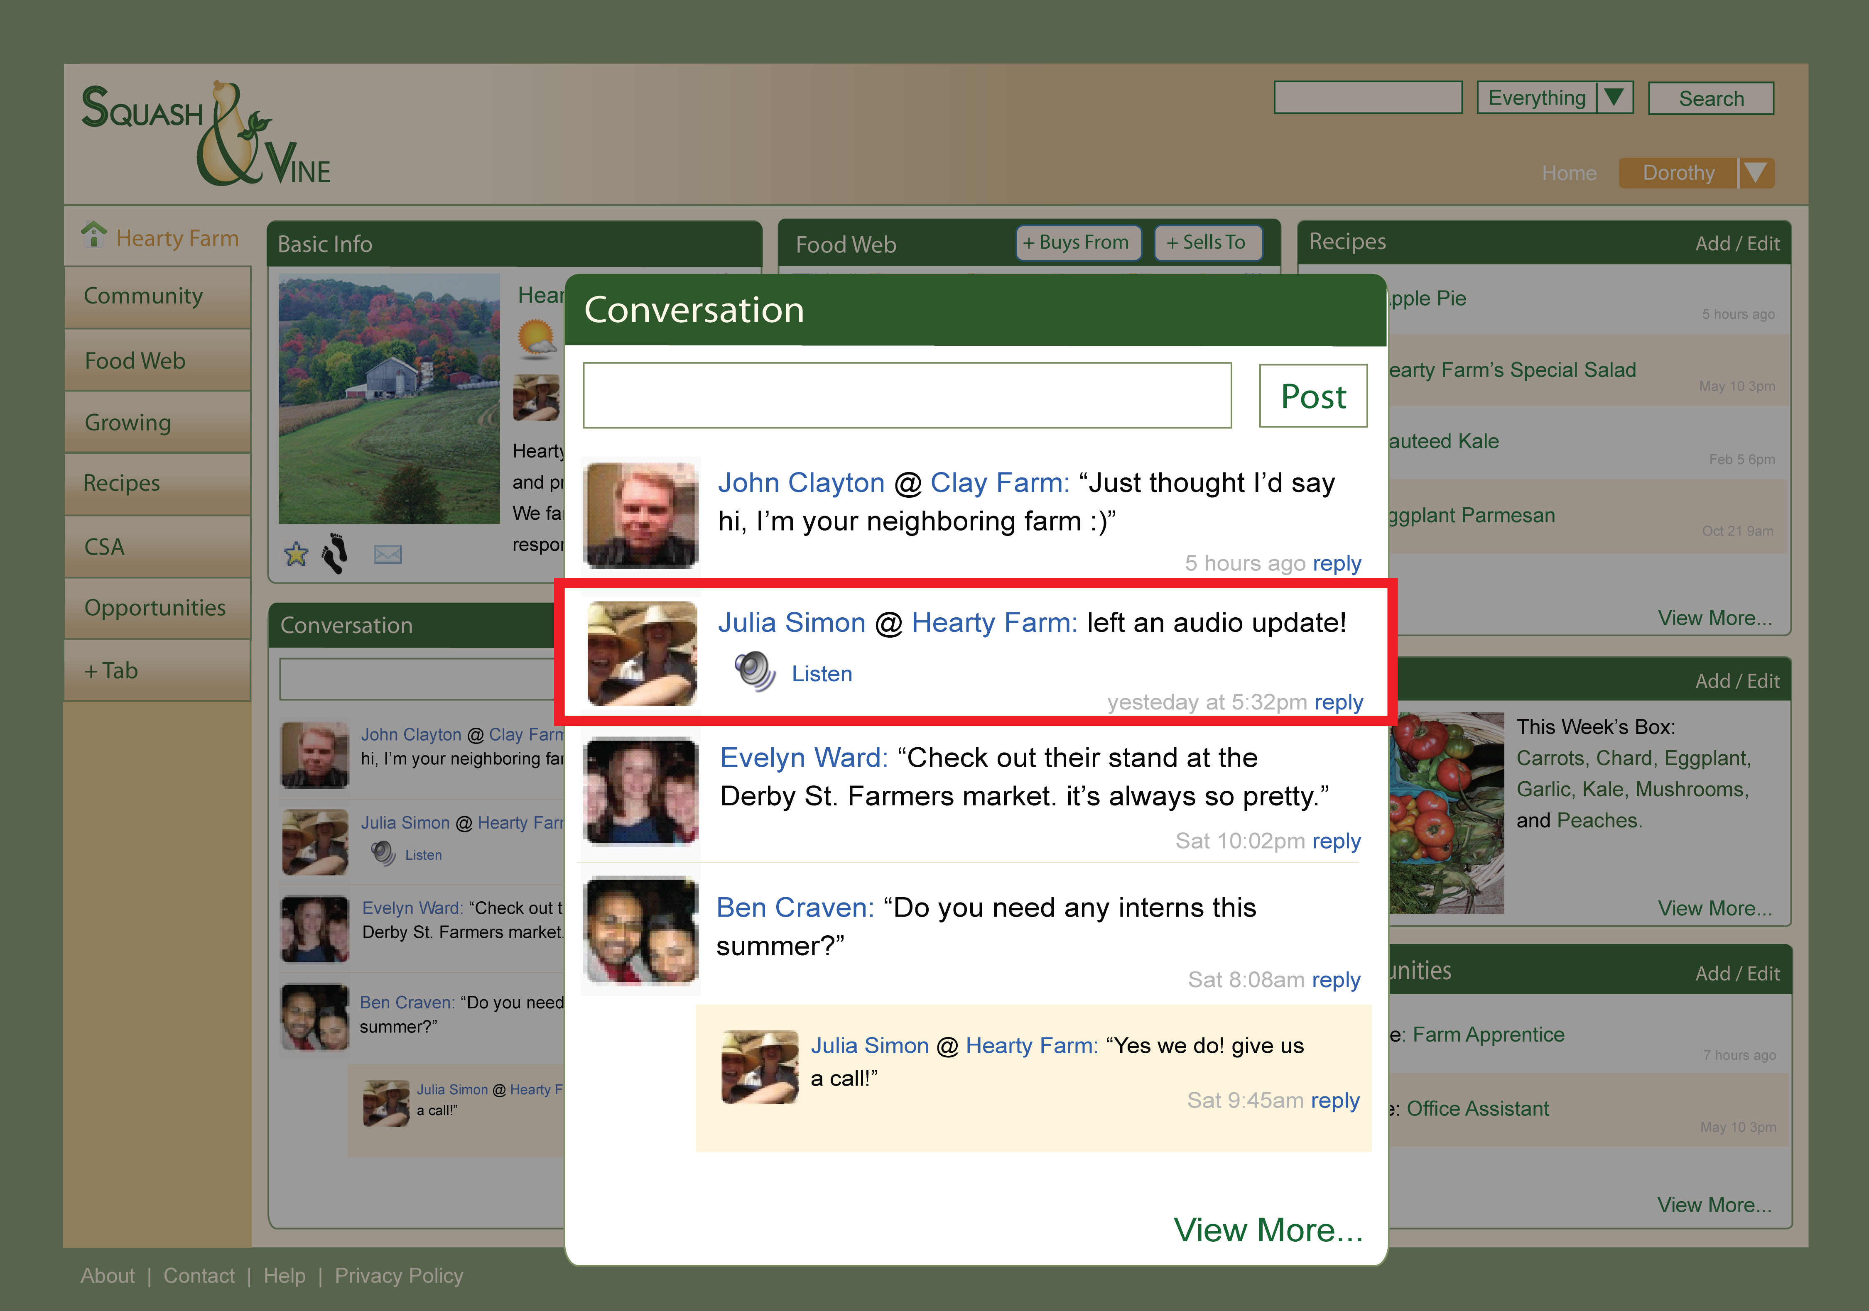
Develop Presence Easily

Slide 34
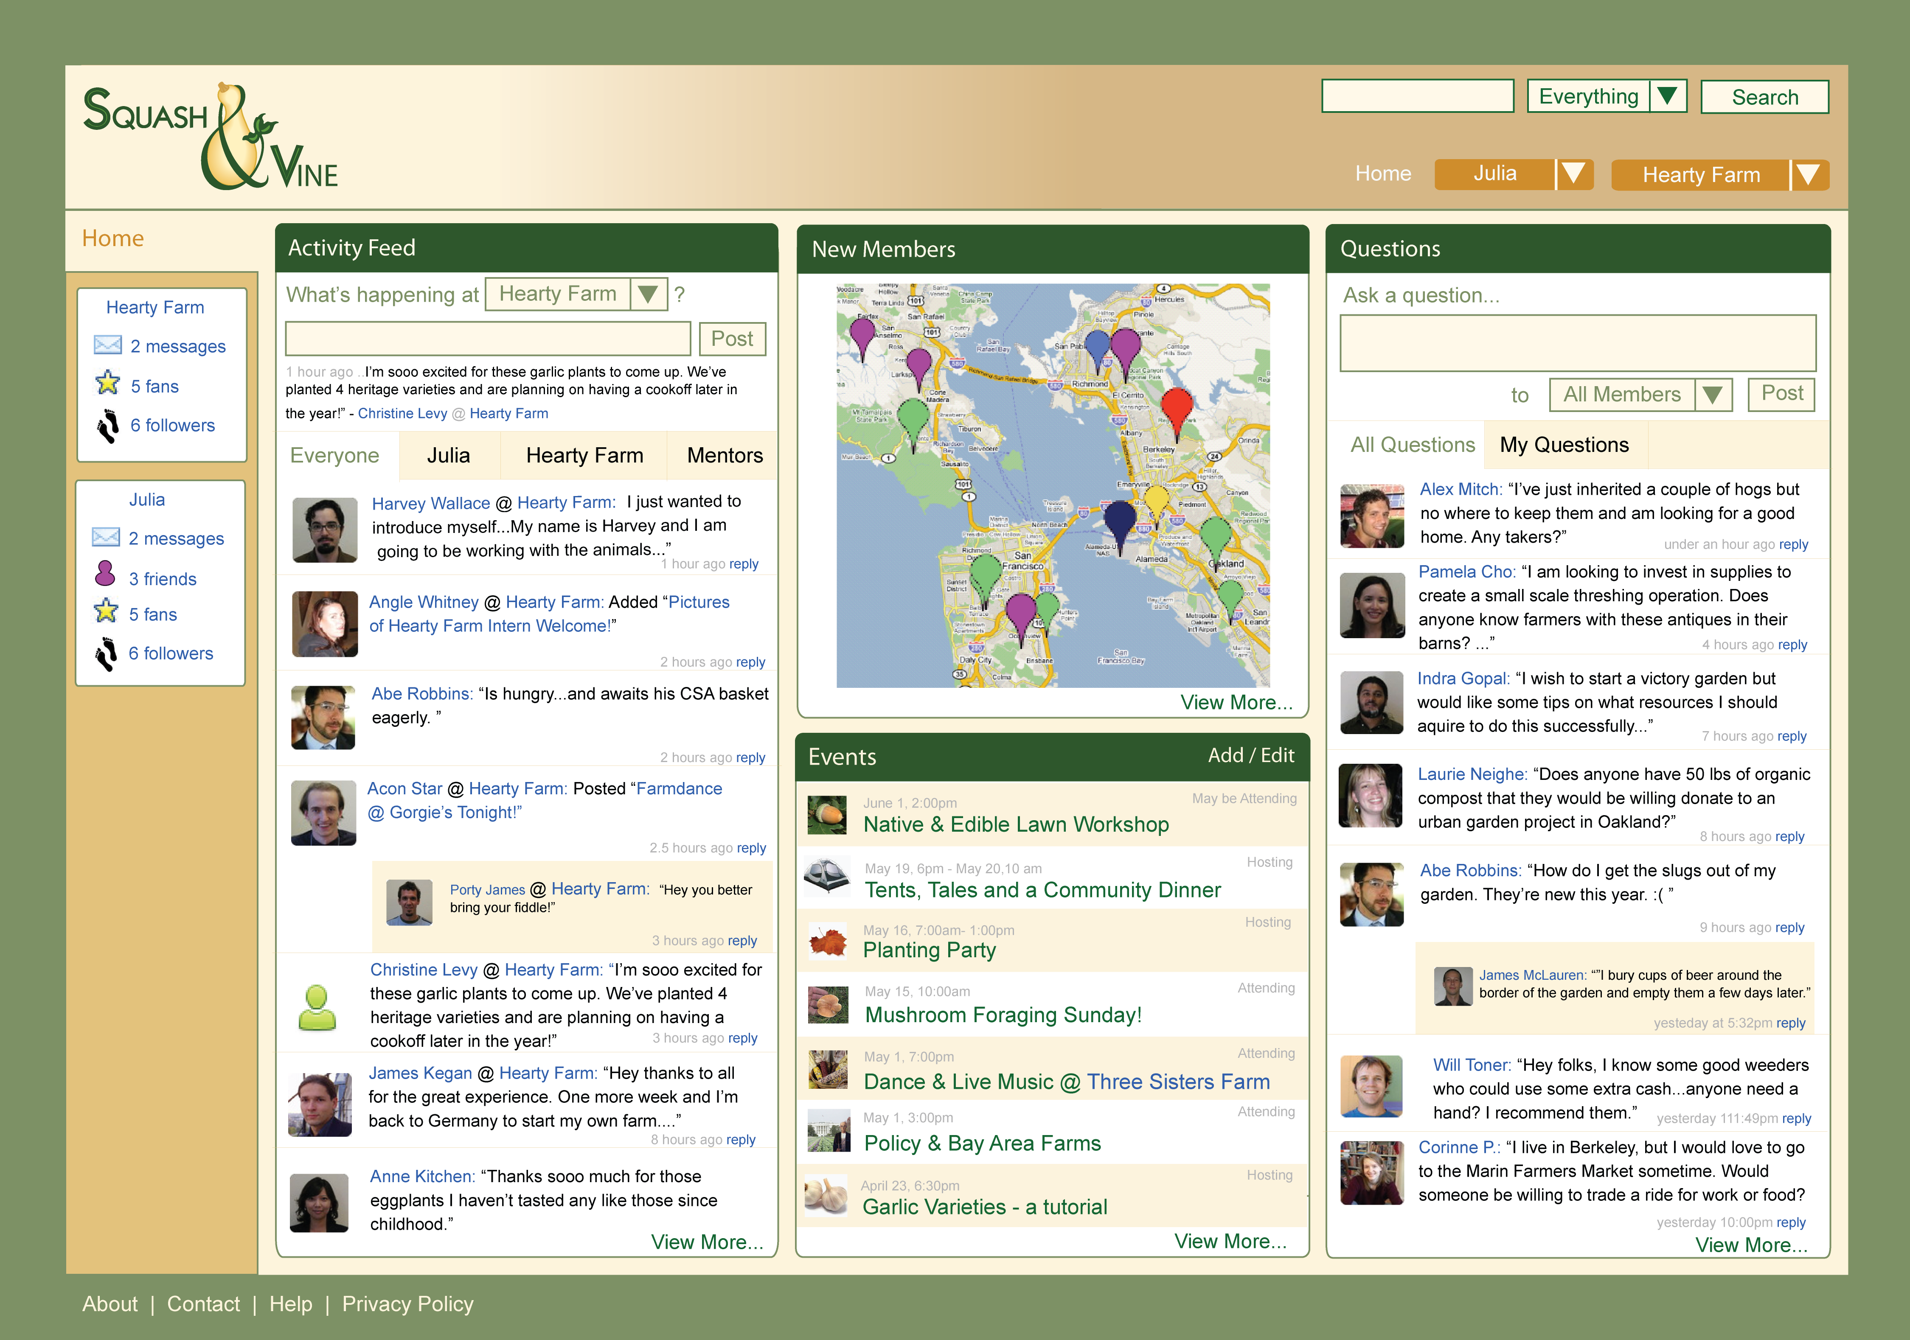
Share Advice

Slide 35
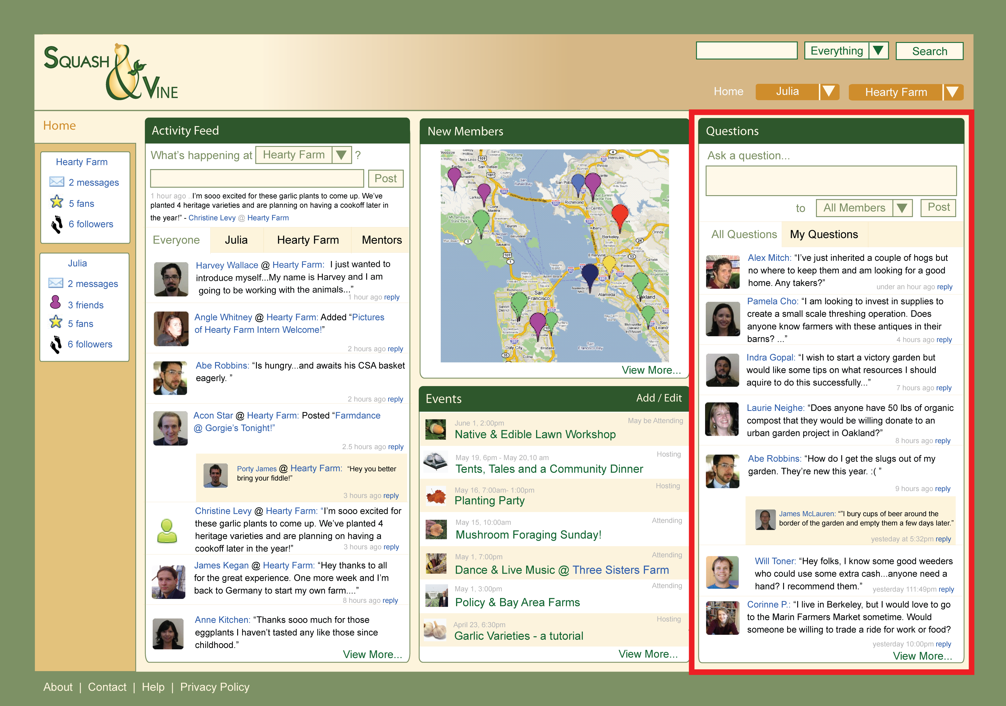
Share Advice

Slide 36
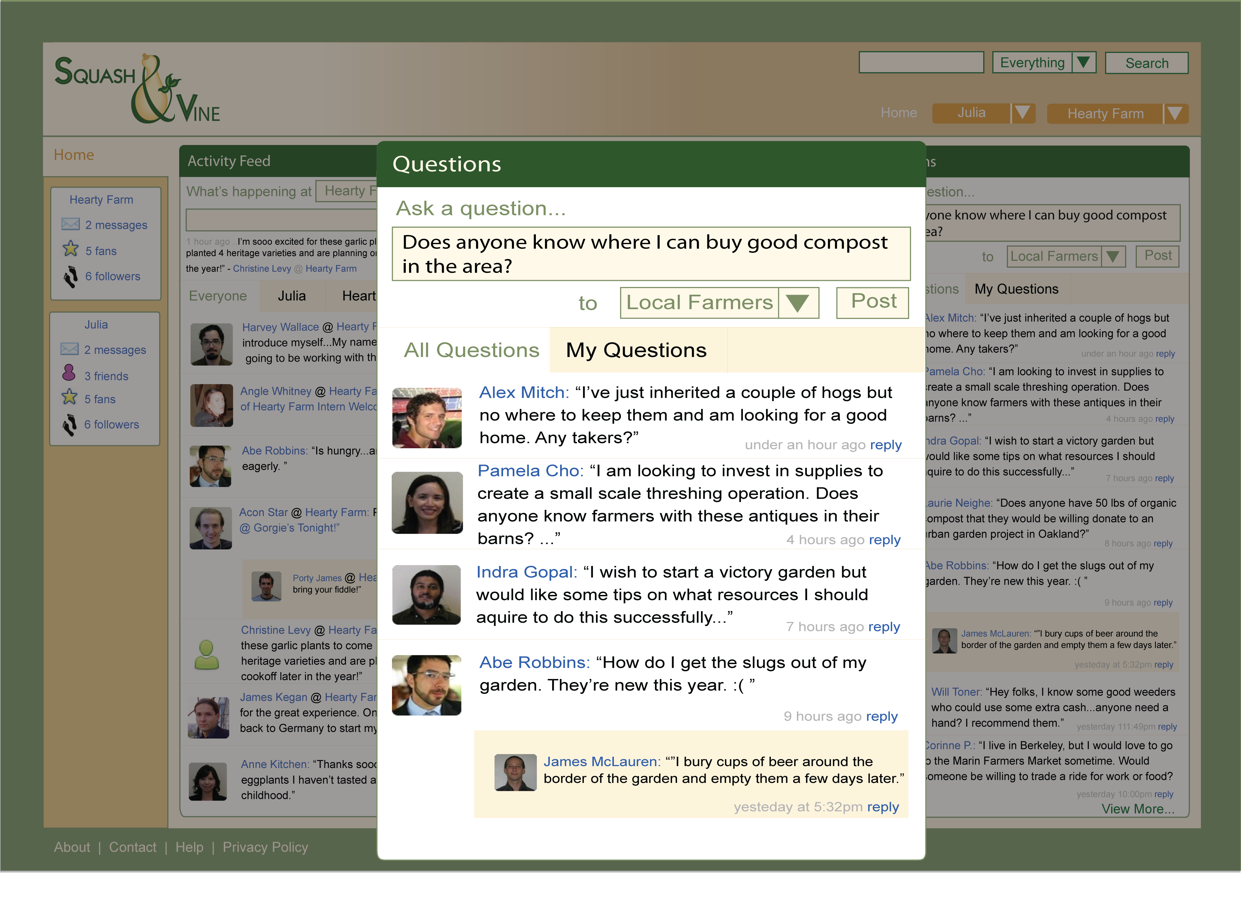
Share Advice

Slide 37
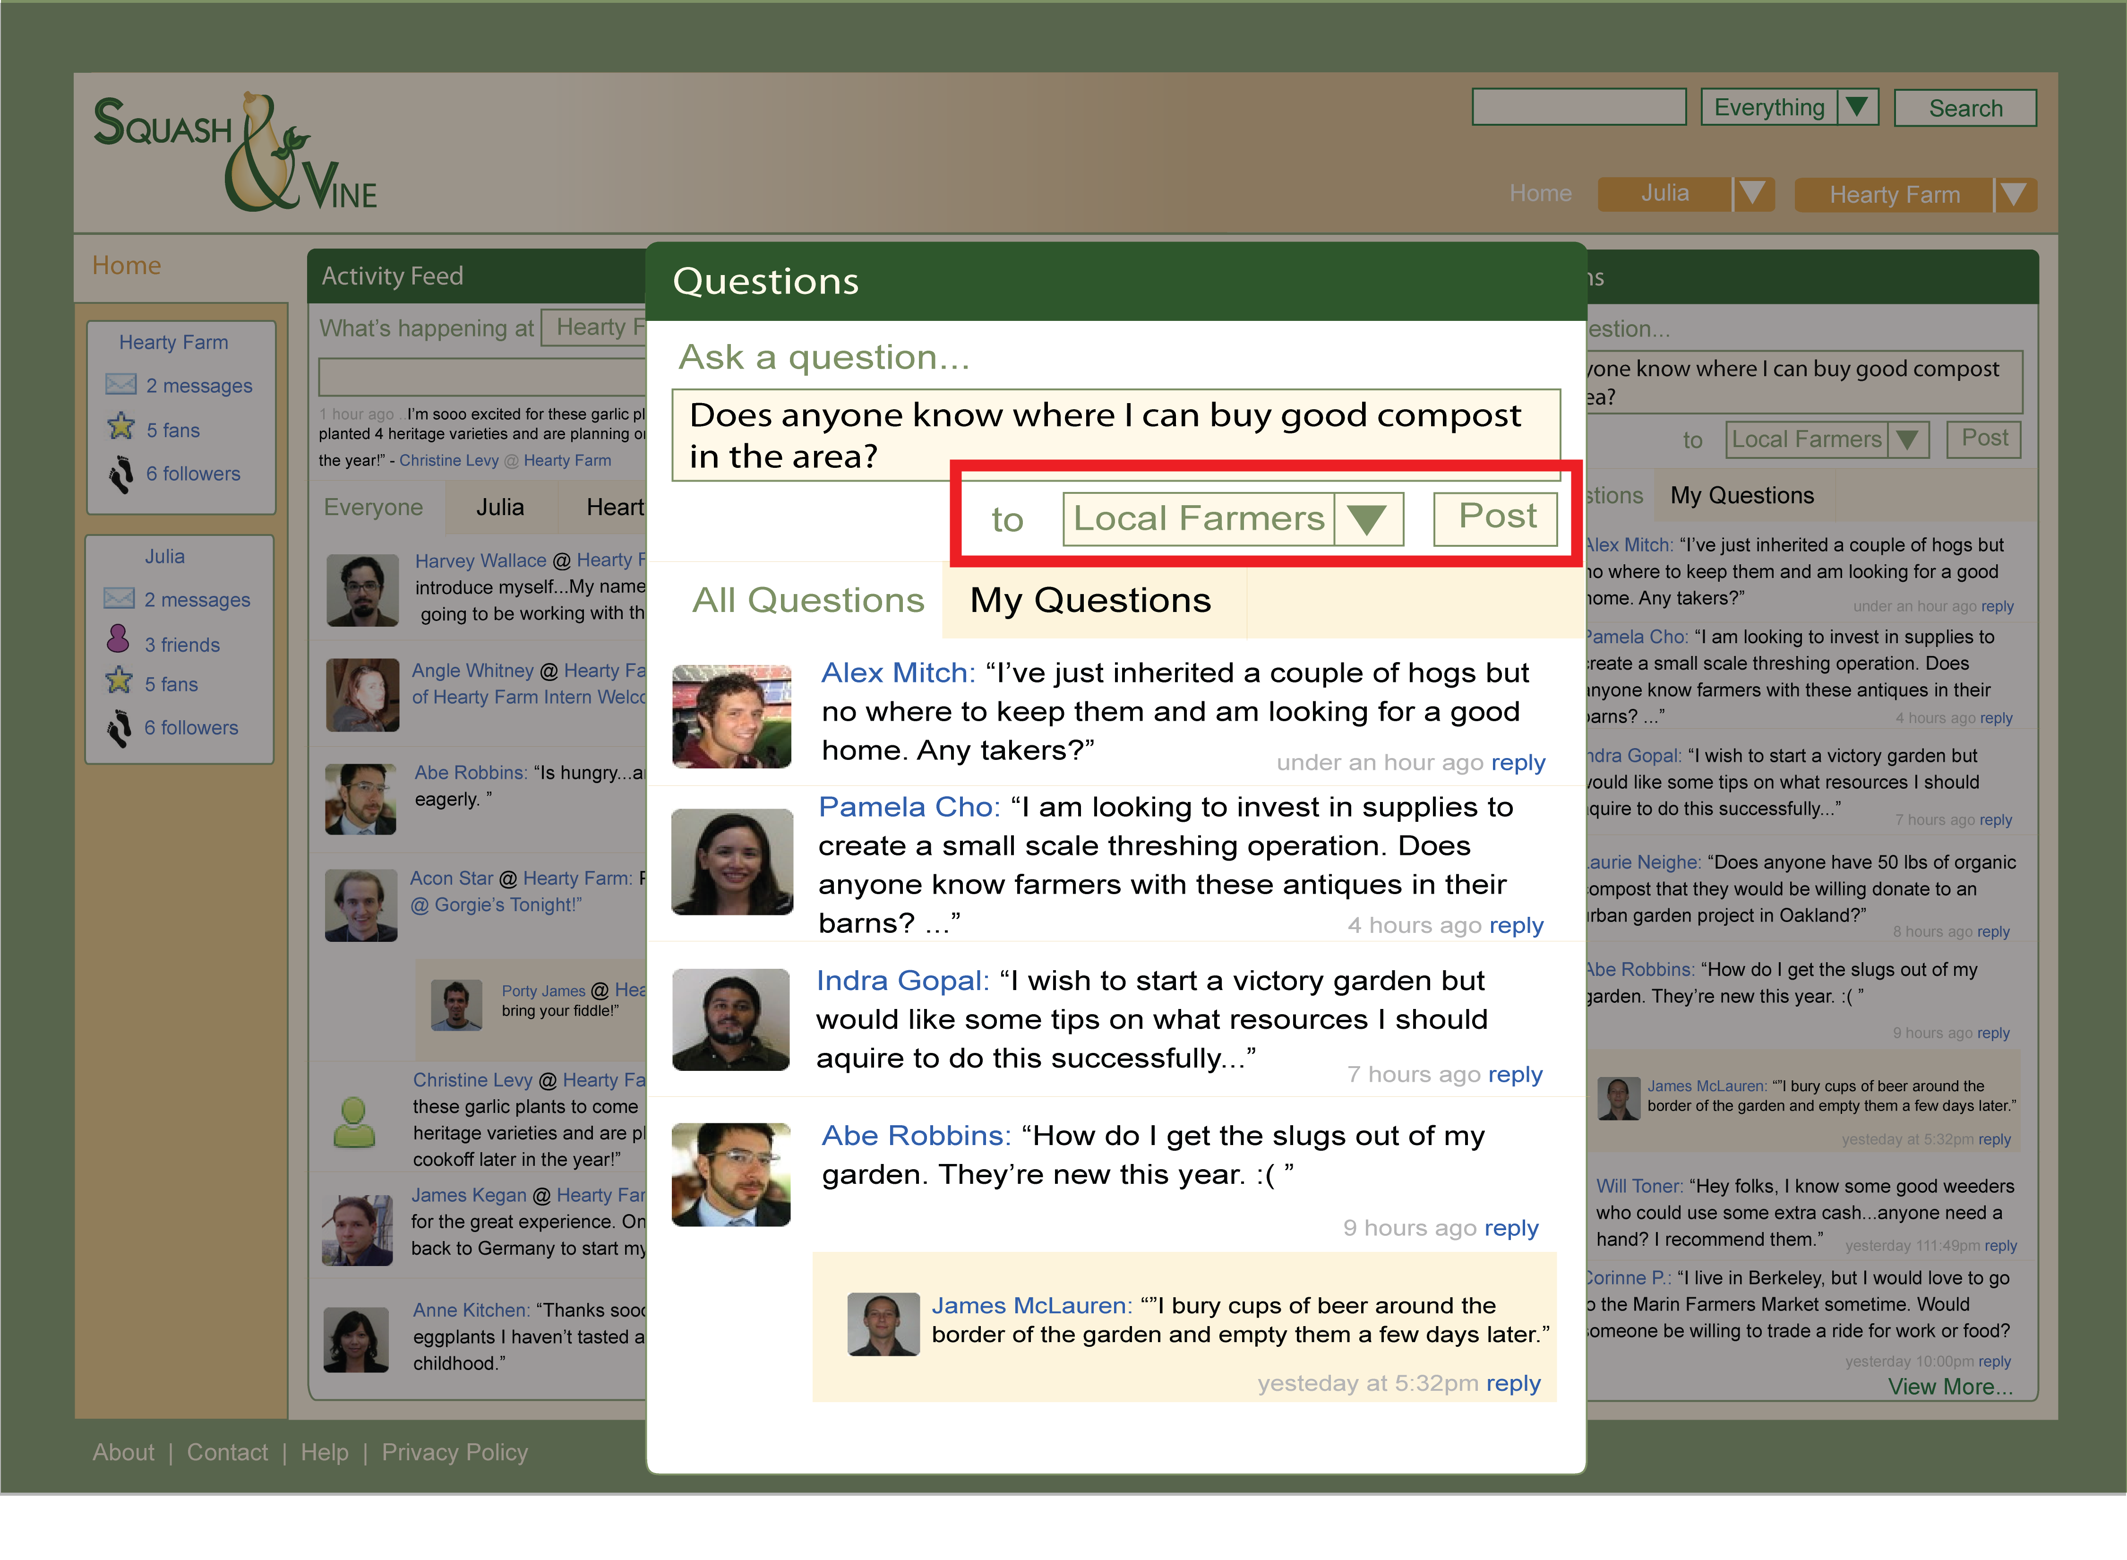
Share Advice

Slide 38
Want to…
Keep up-to-date
Use time efficiently
Educate consumers
Retailers
Notes:
Slide 7: our process, interviewing

Slide 39
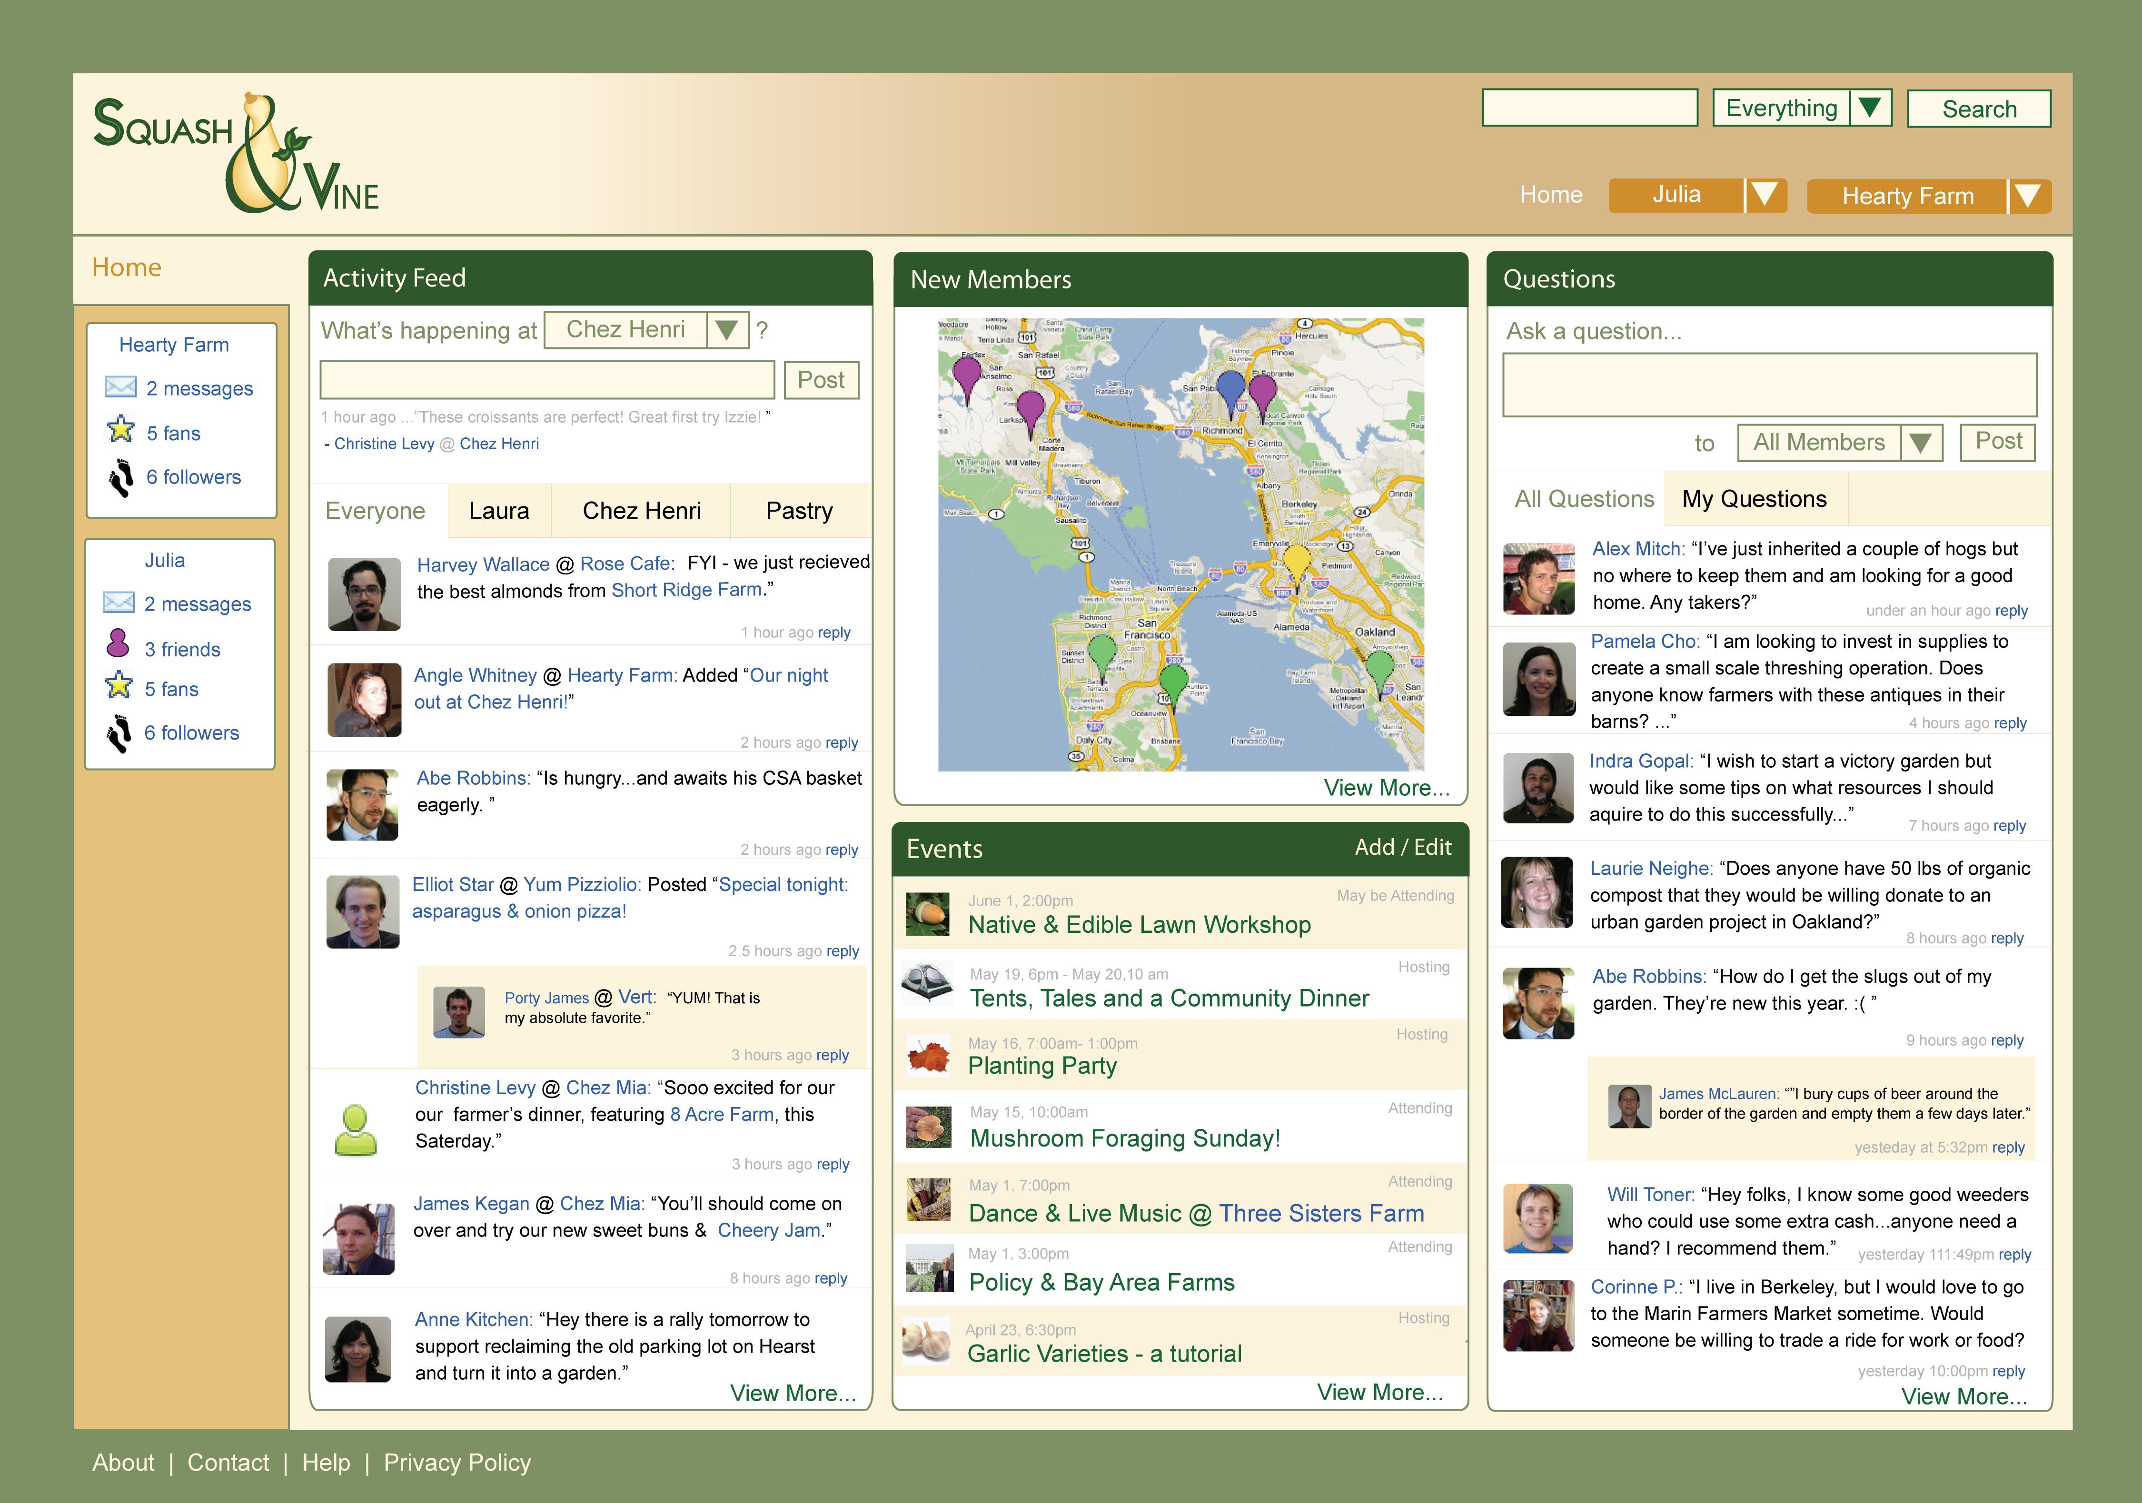
Keep Up-To-Date

Slide 40
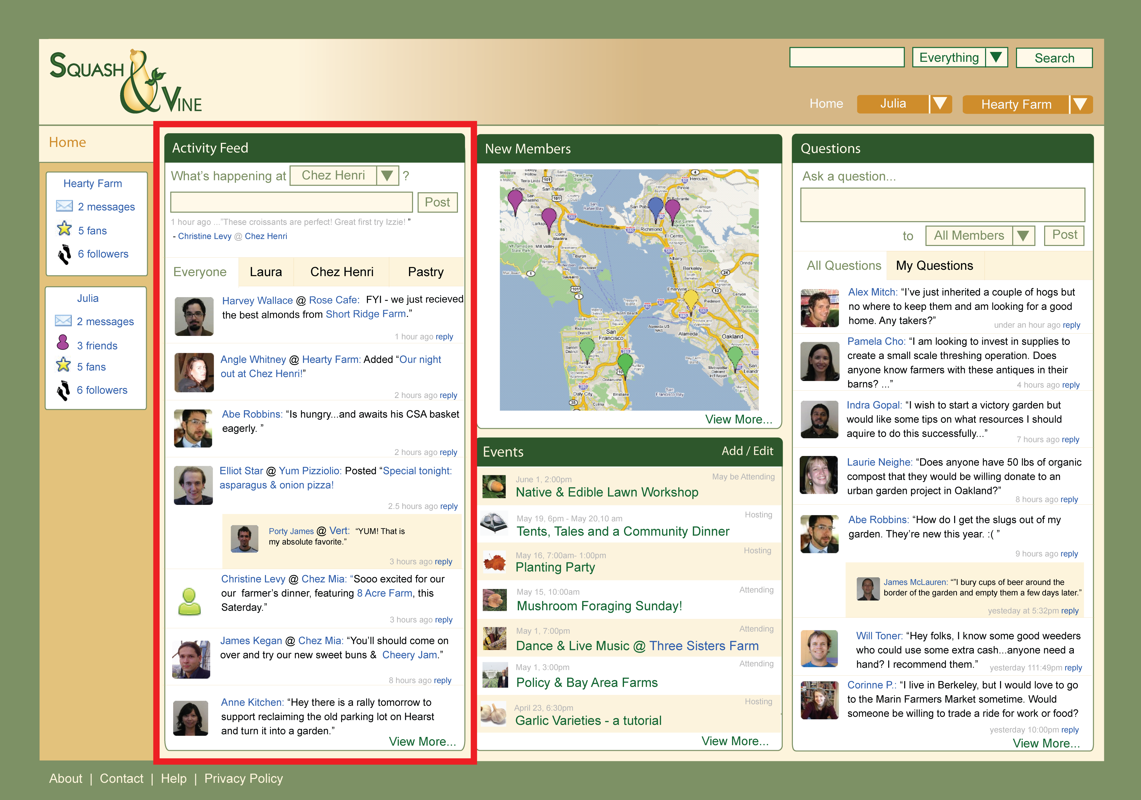
Keep Up-To-Date

Slide 41
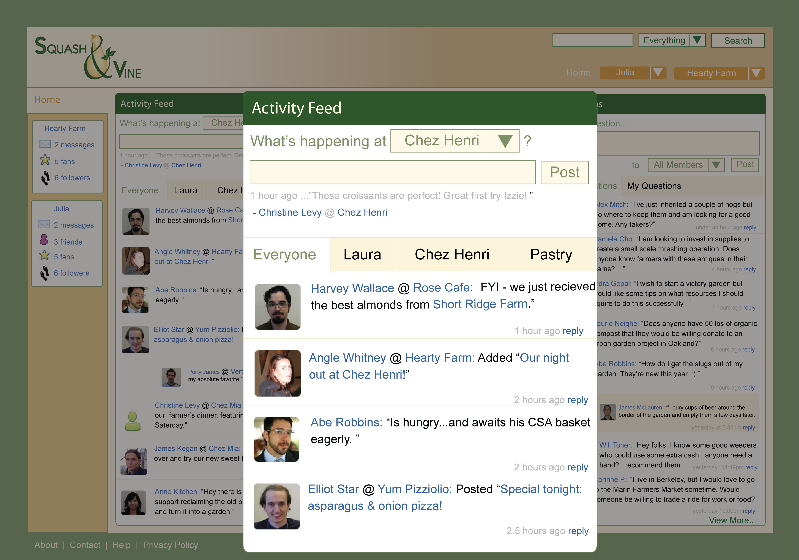
Keep Up-To-Date

Slide 42
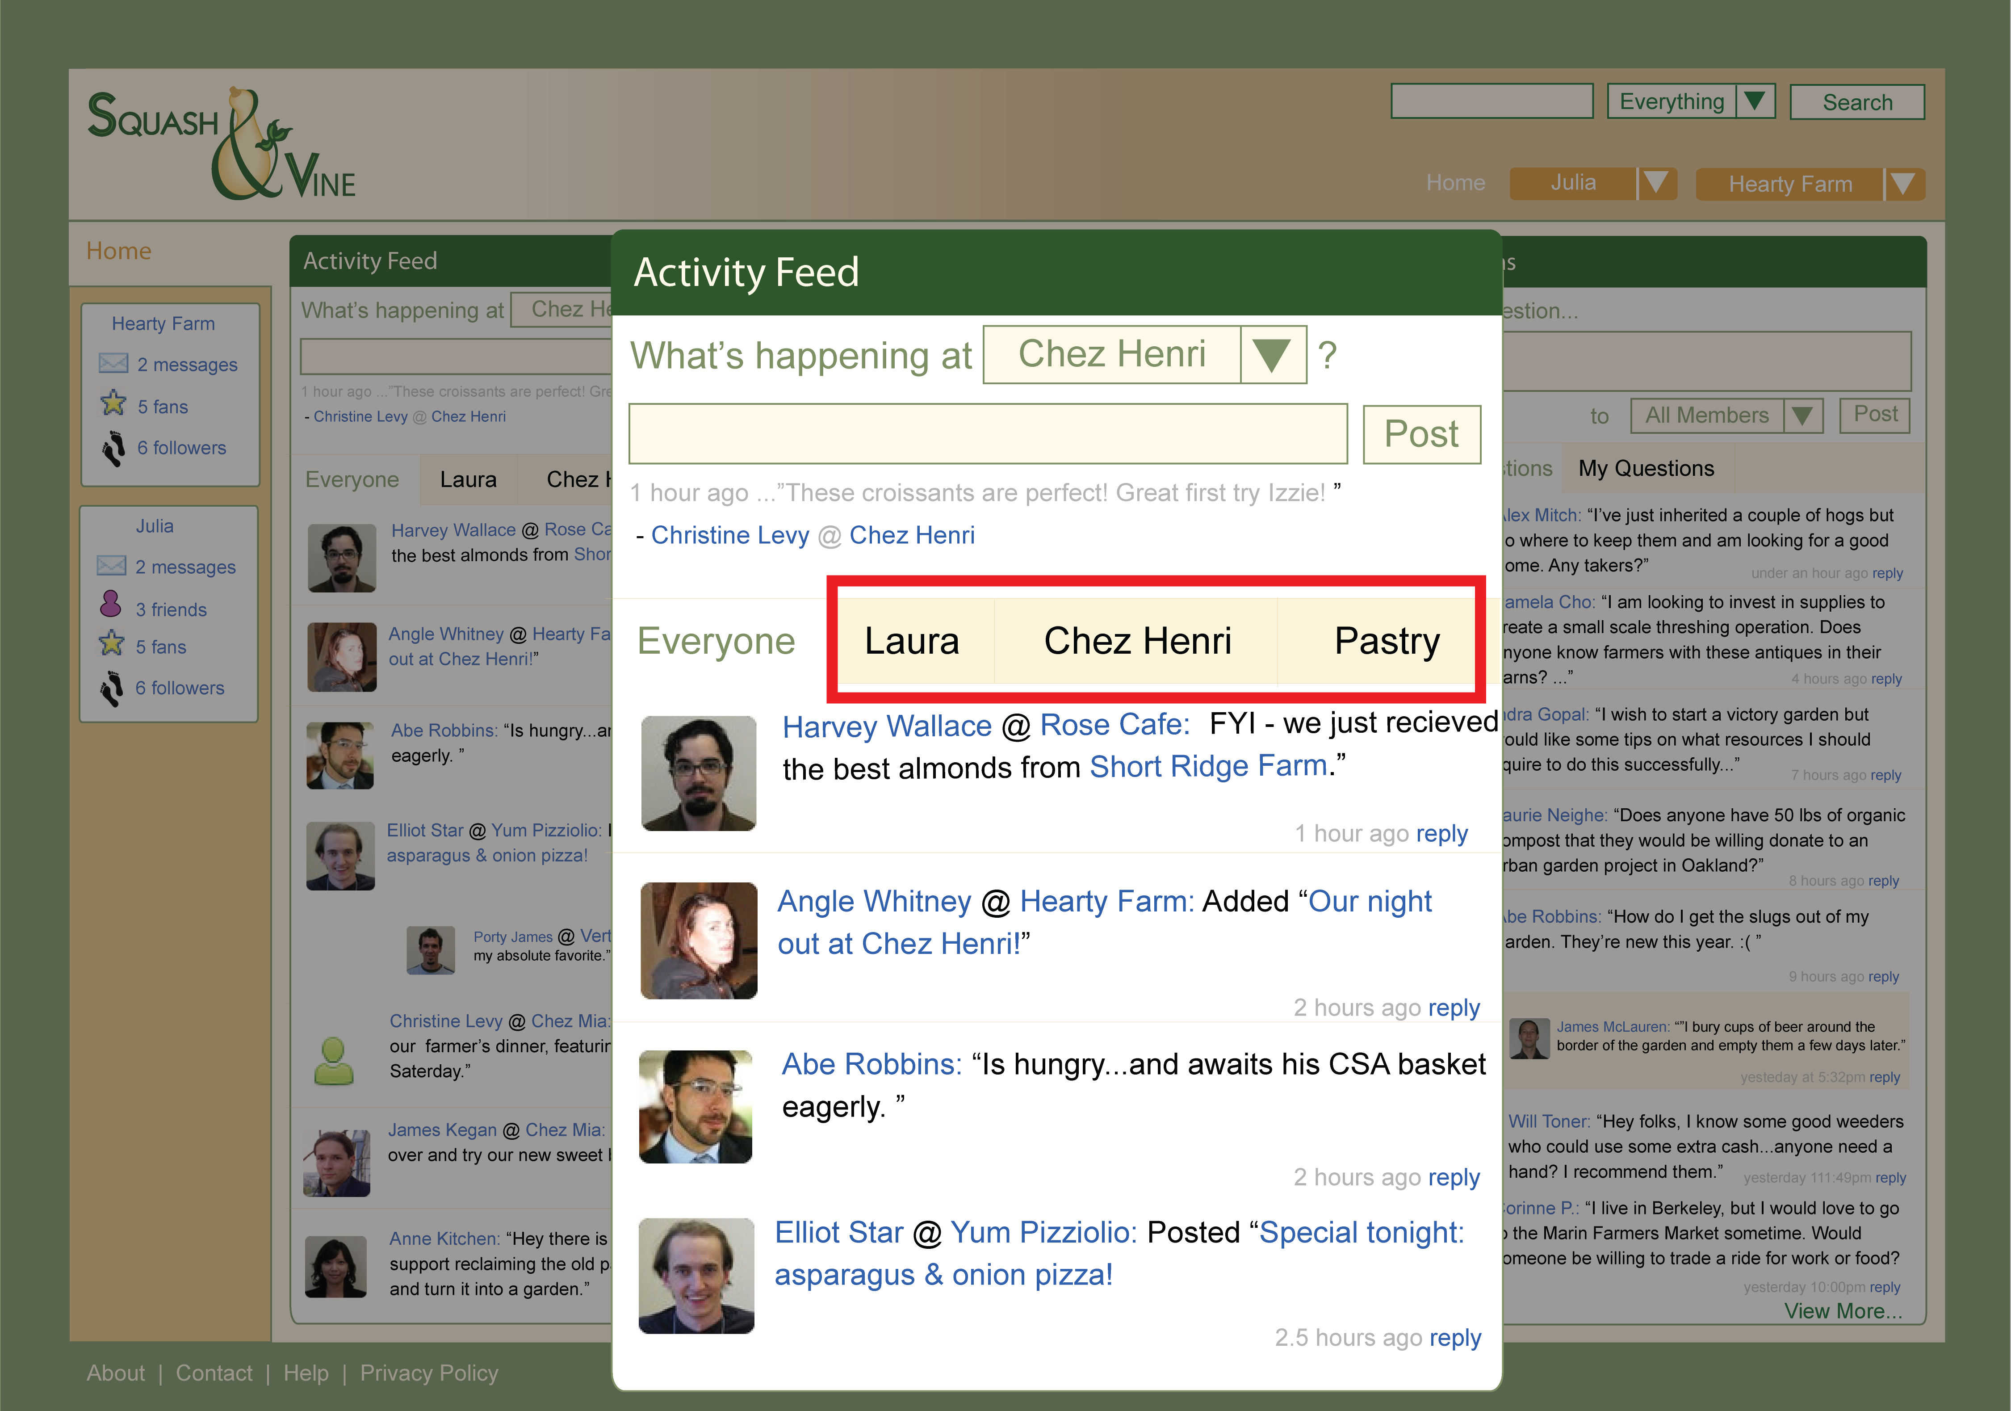
Keep Up-To-Date

Slide 43
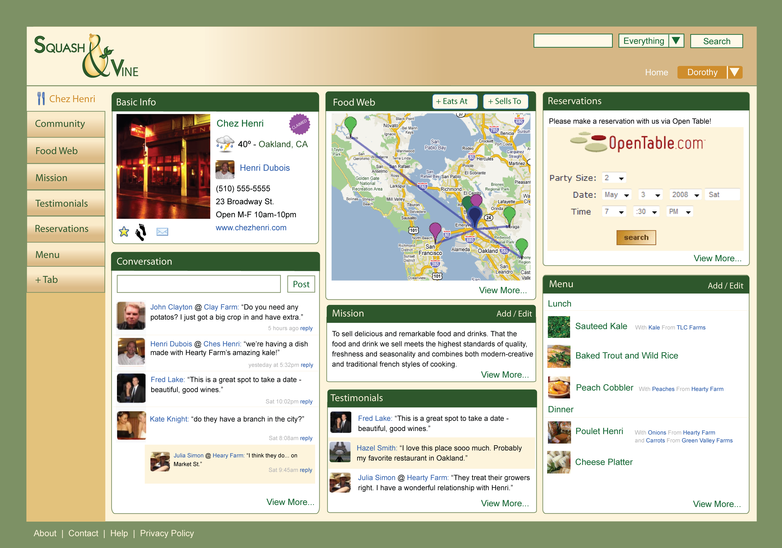
Use Time Efficiently

Slide 44
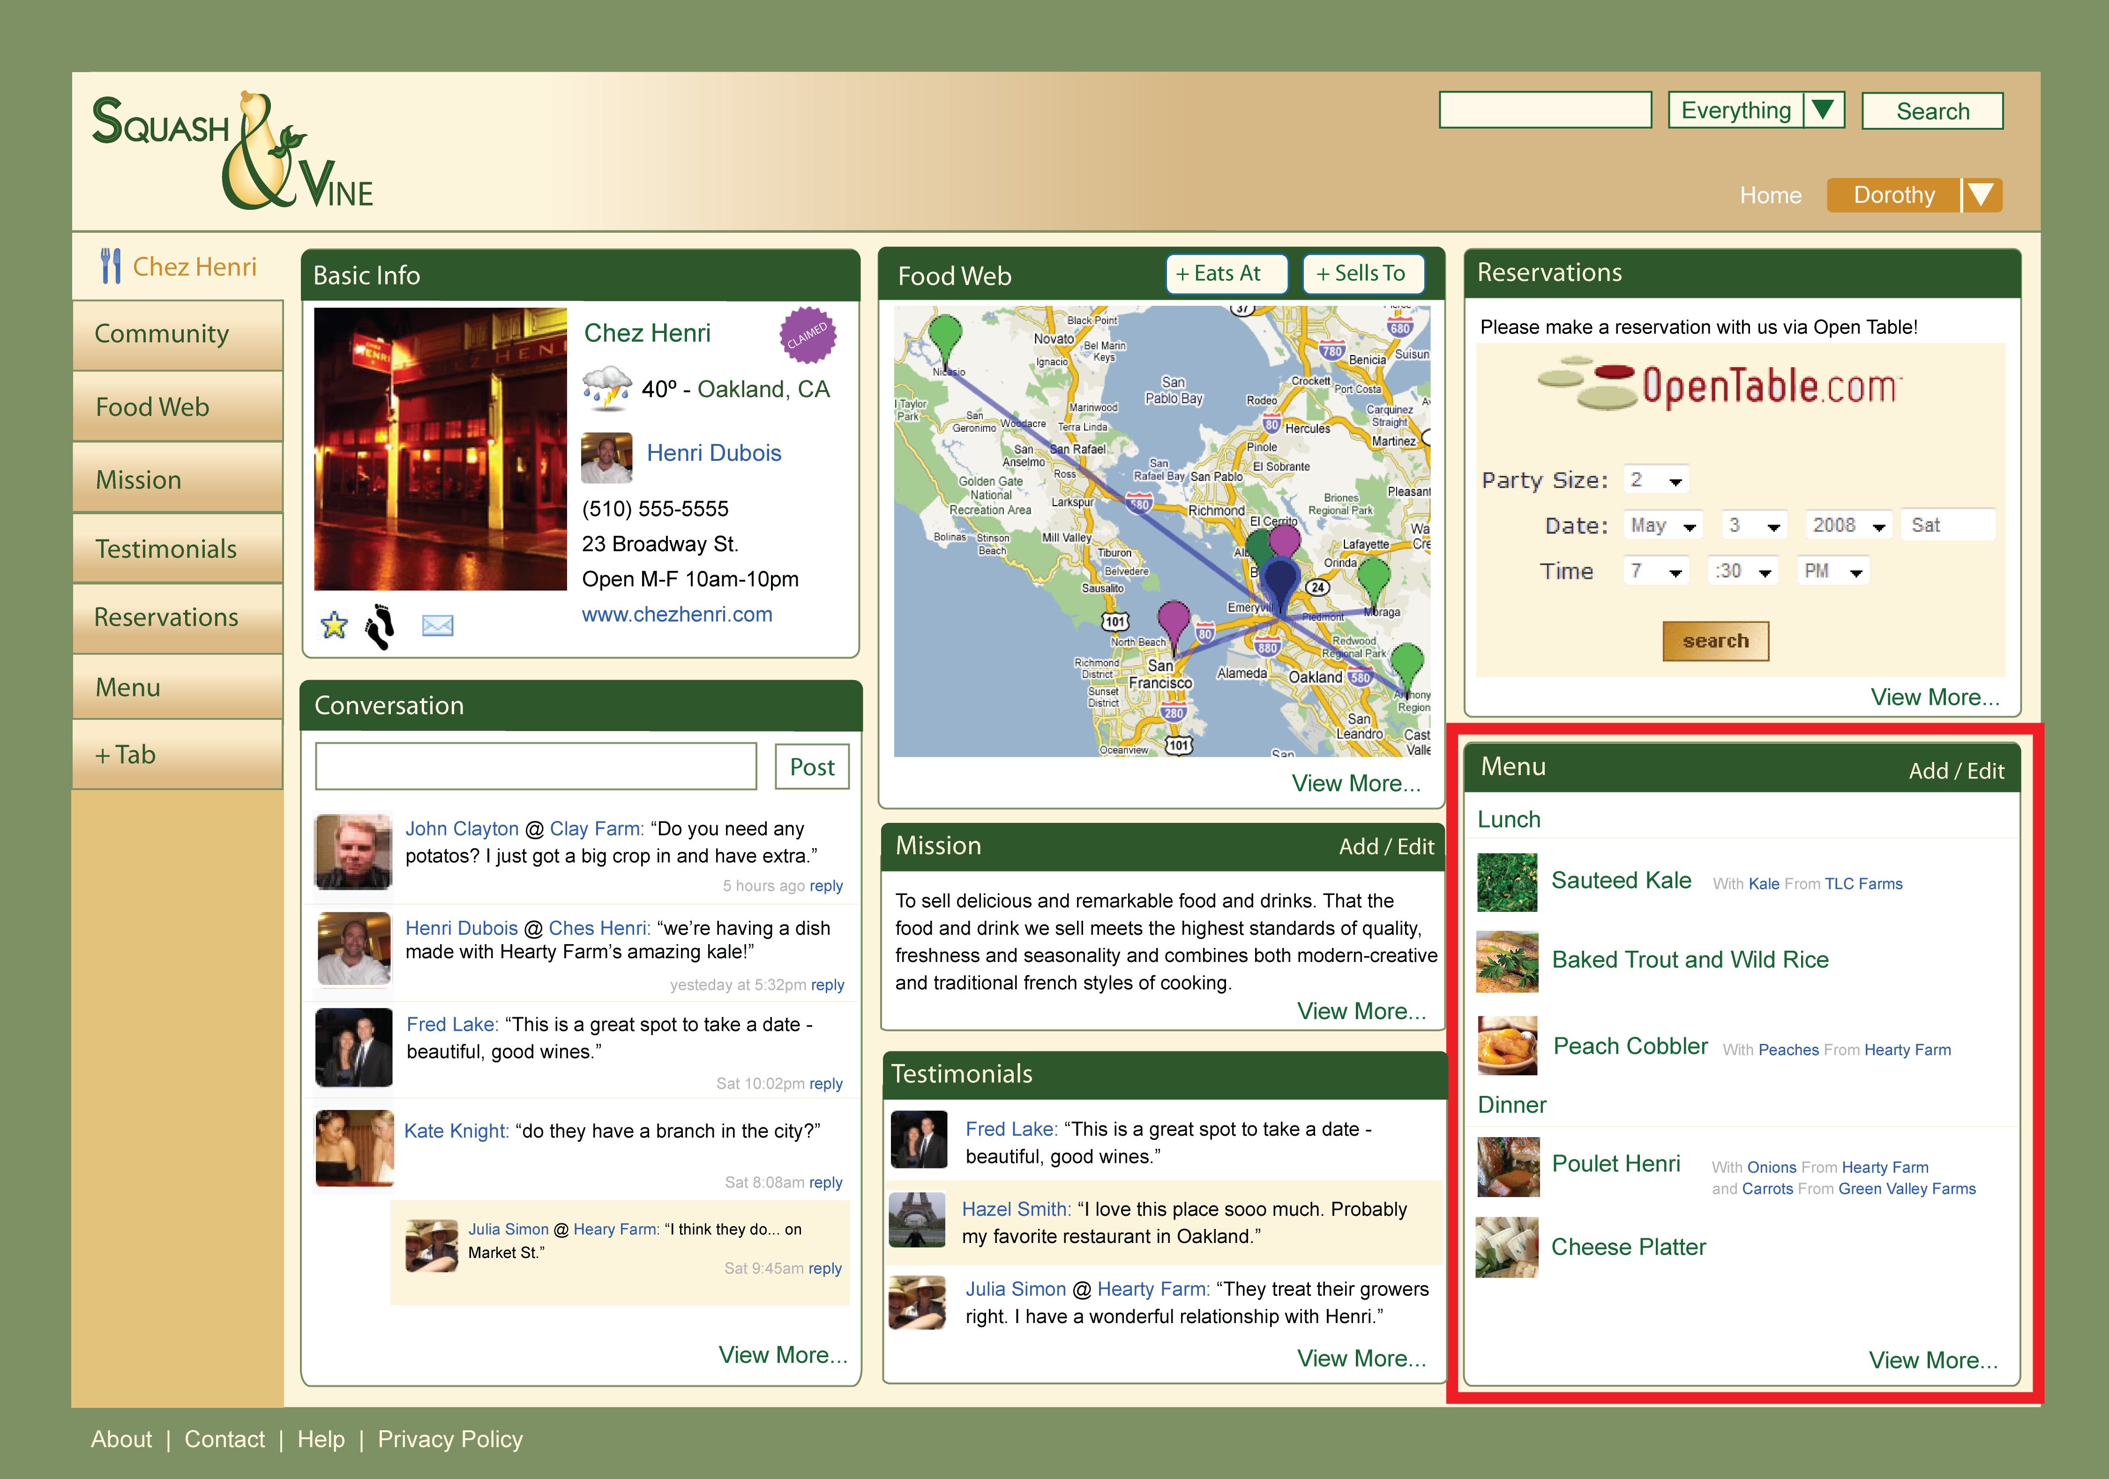
Use Time Efficiently

Slide 45
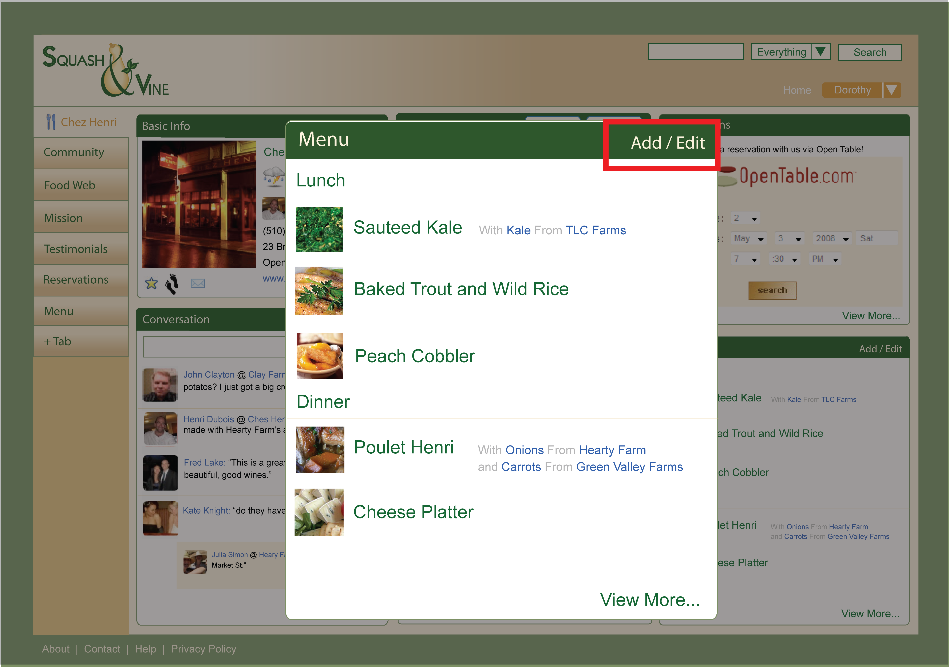
Use Time Efficiently

Slide 46
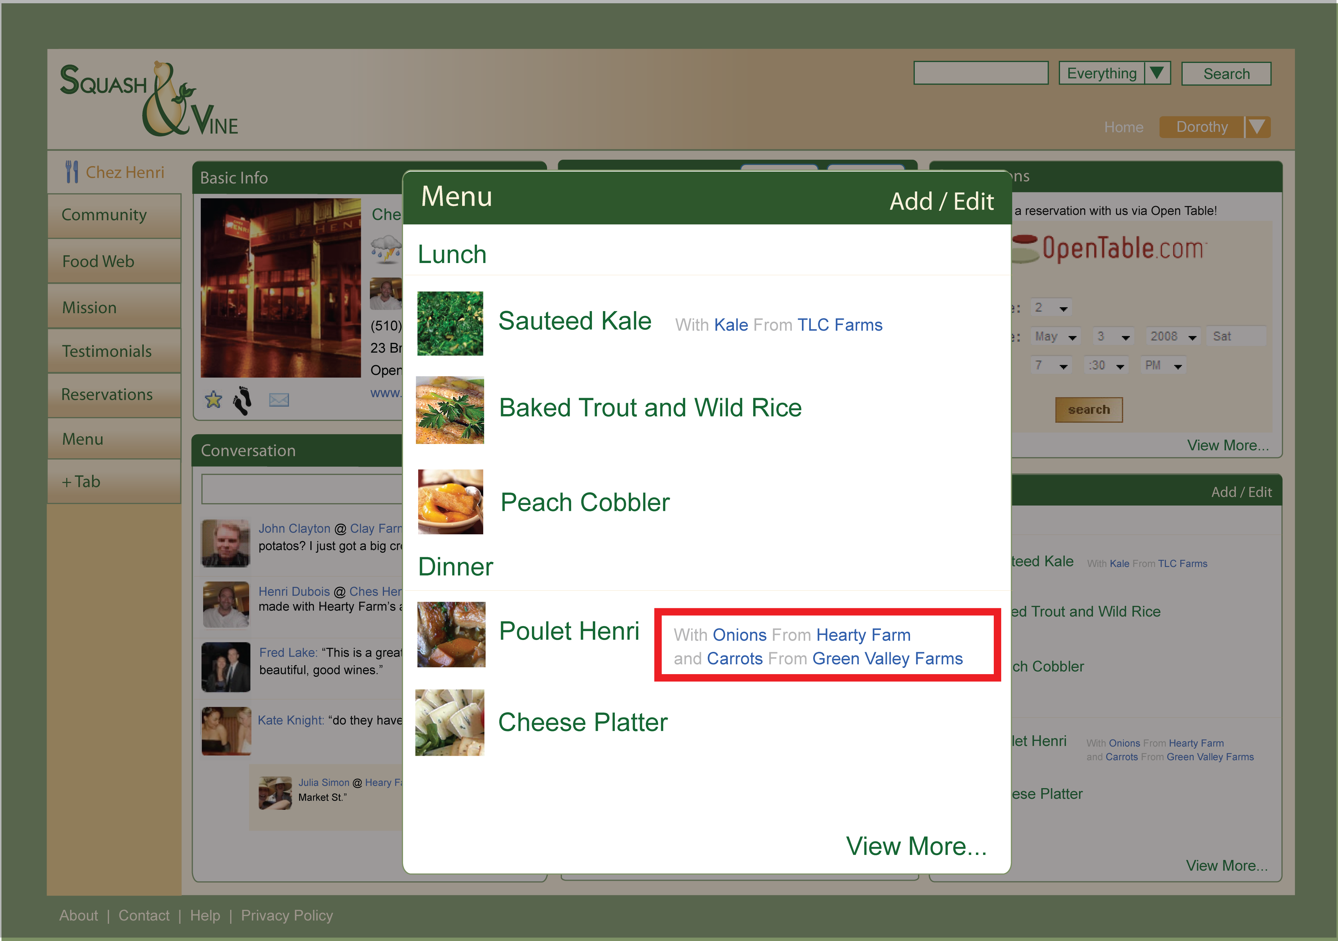
Educate Consumers

Slide 47
Want to…
Explore the story
behind food
Find food that
matches values
Learn about
seasonality
Consumers
Notes:
Slide 7: our process, interviewing

Slide 48
Explore Story of Food

Slide 49
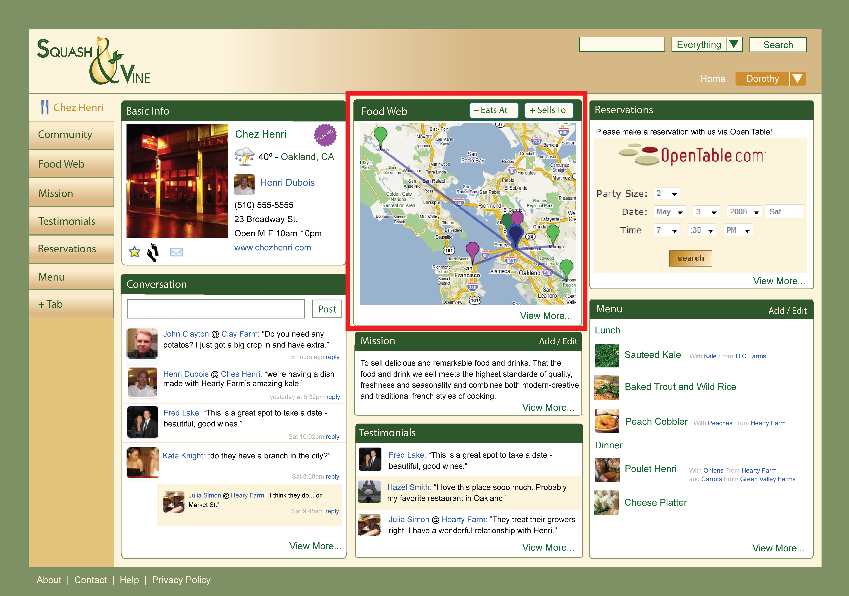
Explore Story of Food

Slide 50
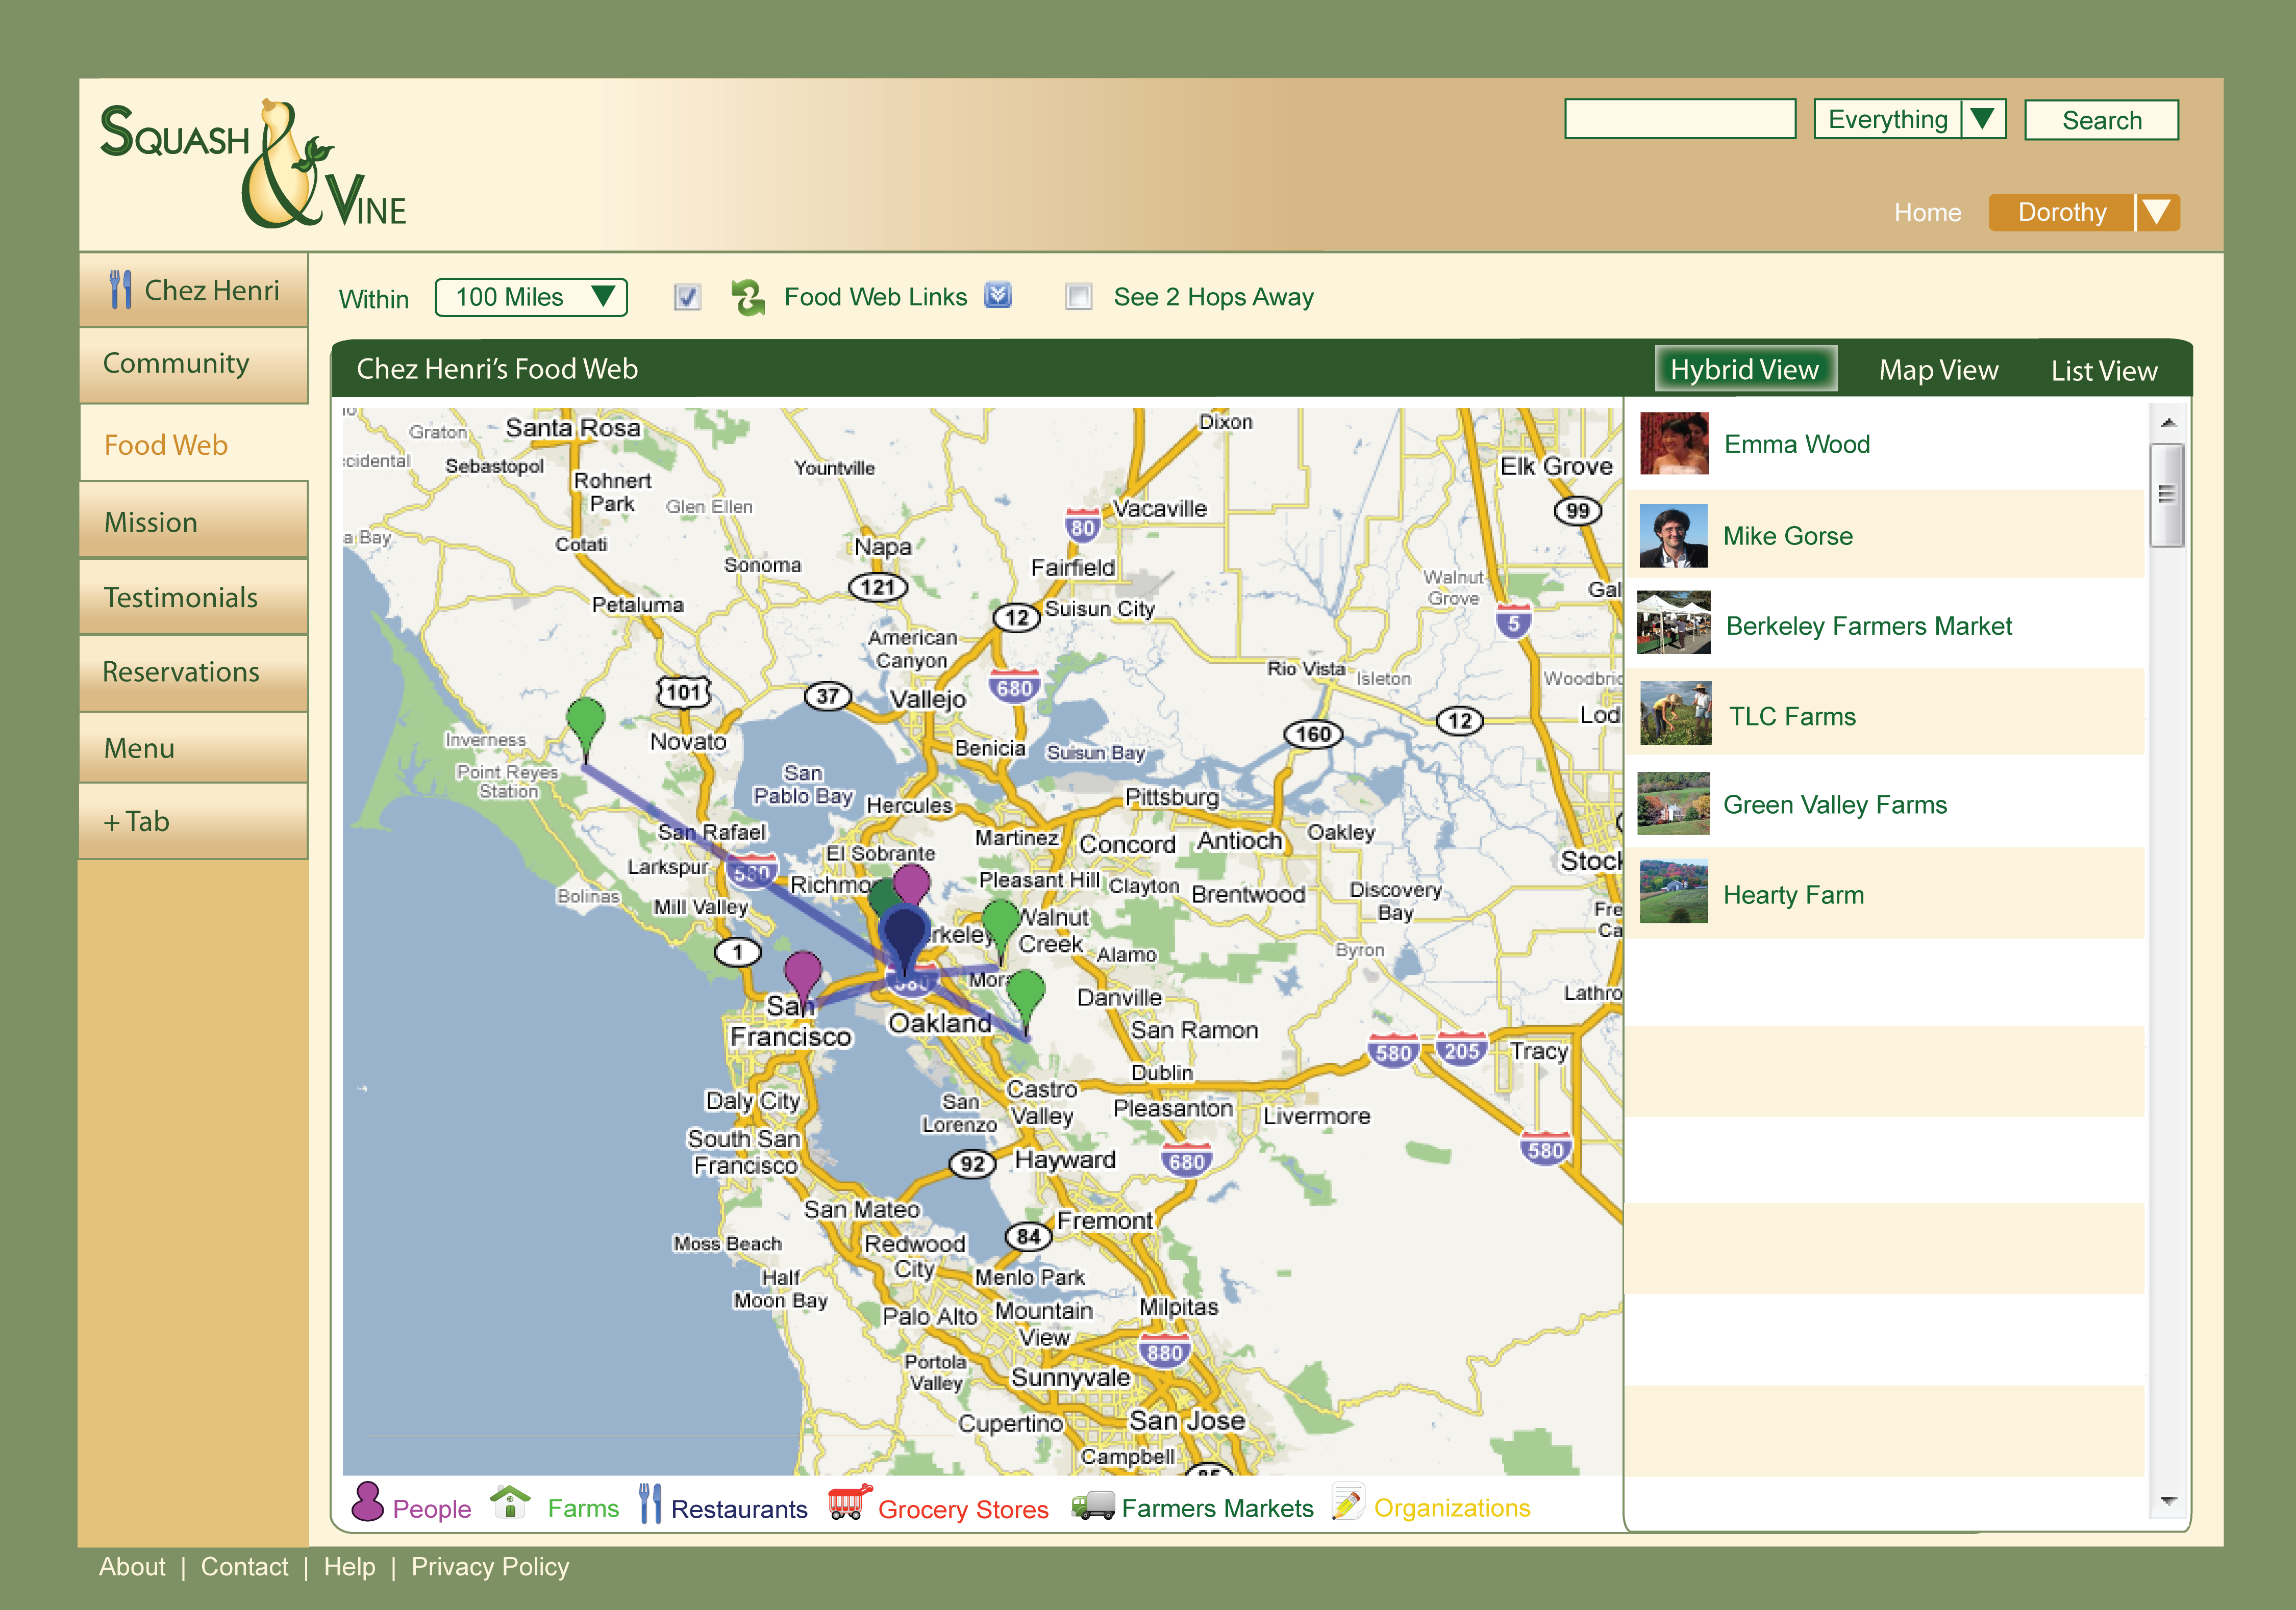
Explore Story of Food

Slide 51
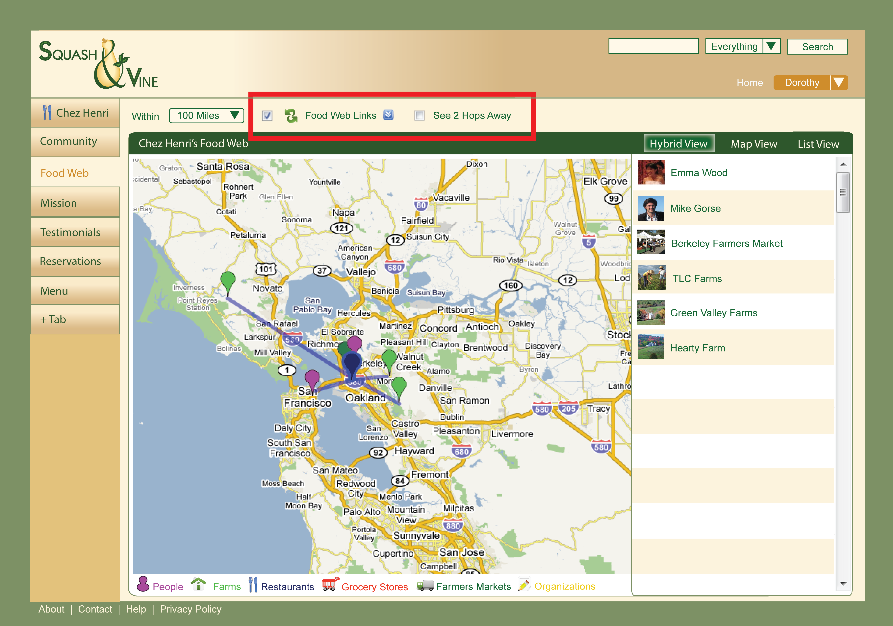
Explore Story of Food

Slide 52
Explore Story of Food

Slide 53
Find Food = Values

Slide 54
Find Food = Values

Slide 55
Find Food = Values

Slide 56
Find Food = Values

Slide 57
Learn About Seasonality

Slide 58
Learn About Seasonality

Slide 59
Learn About Seasonality

Slide 60
Learn About Seasonality

Slide 61
Many Interfaces
Notes:
Slide 11: Data flow diagram, extensibility for future

Slide 62
Conclusion
Notes:
Farm on top, then restaurant, then person

Slide 63
Next Steps
Funding
Development
User Testing
Launch
Refinement

Slide 64
Future Work
Visualizations
Farm Journal & Crop Planning
Logistical Coordination
Personal Mobile Interface
Internal & External Widgets
Seedsharing & Microclimates
Notes:
IMAGE http://news.uns.purdue.edu/images/+2008/gurneyvulcan1.jpg

Slide 66
Thank You!
Notes:
Acknowledgments

Slide 67
SHAWNA HEIN • HAZEL ONSRUD • AYLIN SELCUKOGLU
contact@squashandvine.org
http://www.squashandvine.org
Notes:
Here is our contact info
They are also on stickers at the door STICKERS Thanks for your time

Slide 68
Photo Attribution
slide 4: (cc) 2006 Sammy (http://www.flickr.com/photos/sahmeepee/158265337/)
slide 5: http://www.igougo.com/photos/travel_blog/Top-Chef-L.jpg;
slide 5: http://mikeely.files.wordpress.com/2008/04/young-farmer-with-leeks_tana-butler.jpg;
slide 5: http://www.saundersallotment.co.uk/Resources/Copy%20of%20John%20with%20manure.jpg
slide 6: (cc) 2007 Nutloaf (http://www.flickr.com/photos/nutloaf/1644090403/)
slide 6: (cc) 2008 Clay Caviness (http://www.flickr.com/photos/ccaviness/2625223578/)
slide 6: (cc) 2008 The Joy Of The Mundane (http://www.flickr.com/photos/mundane_joy/2198867460/)
slide 6: (cc) 2009 Andy (http://www.flickr.com/photos/naslrogues/3207717227/)
slide 16: http://www.freshmanfarmer.com/farms/honeyintheheart/2009/04/moms-and-lessons/
slide 65: http://static.howstuffworks.com/gif/maps/pdf/NAM_US_THEM_Climate.pdf
slide 66: (cc) 2009 Dewayne Neeley (http://www.flickr.com/photos/dn1975/3192675782/)
All other photos are (cc) 2008, 2009 Shawna Hein (sshein), Hazel Onsrud (h-a-z-e-l), or Aylin Selcukoglu (aylin)
Notes:
flickr attribution

Slide 69
Notes:
Slide 6: Our NAME

