Slide 1

Hyoumanity Final Presentation
Social Search and Incentive Alignment in Health Care
Jon Hicks (jonhicks@ischool.berkeley.edu)
Xiaomeng Zhong (zhongxm@ischool.berkeley.edu)
May 14, 2009
Notes:
Hyoumanity: Social Search and Incentive Alignment in Health Care
UC-Berkeley School of Information Final Project Presentation
Jon Hicks (jonhicks@ischool.berkeley.edu)
Xiaomeng Zhong (zhongxm@ischool.berkeley.edu)
May 14, 2009

Slide 2
Abstract
Why
  Inspiration
Who
  Potential Audience
  Online Participation
    Patients
    Clinicians
Where
  Where Hyoumanity Fits
How
  How Hyoumanity Works
    Patient Profiles
    Clinician Search
What
  User Experience
  Information Architecture
  Security
  Q & A
Notes:
We present the design of a web-based platform that facilitates diagnosis via the aggregation and augmentation of extant personal health records. Our platform intends to align the incentives of the diagnostic process with the stakeholders most invested in each stage of healthcare – the clinician is rewarded for finding patients they can help, while the patient is rewarded for good stewardship of their medical information. We describe a data model that leverages existing standards for communication, indexing, and storage of health-related data in a sustainable manner and an interface that conforms to user-centered design principles and best practices in accessibility, information retrieval, and usability.

Slide 3

Inspiration
NAME: Jenny
AGE: 14
ONSET: May 2007
SYMPTOMS: Progressive neurodegeneration leading to incapacitation, seizures, pityriasis lichenoides (autoimmune skin condition)
DOCTORS SEEN: UCSF, Stanford, Penn, Cal Pacific
TESTS COMPLETED: EMG, MRI, DNA, muscle and nerve biopsy, full blood panel
DIAGNOSIS: None
Notes:
Many patients go for an extended period of time without being able to secure a diagnosis

Slide 4
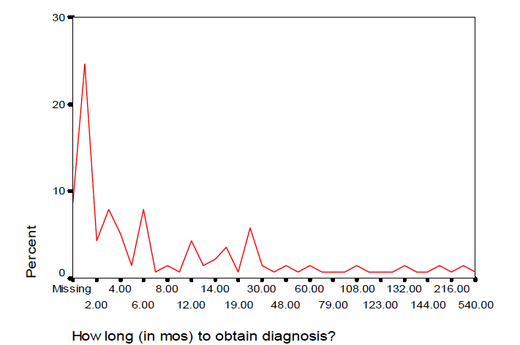
Potential Audience
Months from first doctor visit to obtain diagnosis*
Incidence of 5+ doctor visits with no diagnosis (per year)
Rare Diseases: 225,000
Common Conditions: 280,000
Newly Affected : 500,000+
Implications
Increased medical costs
Worse health outcomes
Pain and suffering
Source: Marlene G. Krammer, The National Organization of Rare Disorders and the Experiences of the Rare Disorder Community, 2003 (available at www.rarediseases.org)
Notes:
Lack of diagnosis is much more prevalent than many first assume and many of these cases are solveable.

Slide 5
Potential Audience
Difficult Diagnoses
Not diagnosable
Psychosomatic
All Diagnoses
Highly Specialized
e.g. Muscular Dystrophy
Challenging
e.g. Multiple Sclerosis
Abnormal Manifestations
e.g. Syphilis, Lyme
Difficult
Rare Diseases
e.g. Behcet’s Disease
Syndromes
e.g. Cushing’s Syndrome
Notes:
Diagnosis is essentially a matching problem – many conditions can only be diagnosed by specialists with expertise in those conditions.

Slide 6
Online Participation: Patients
Patients are actively looking for information and cues online
Search Keyword | Google | Yahoo! Answers | Yahoo! Groups | Ask.com (Q&A)
“Medical ” | 600,000,000 | 200,000 | 33,000 | 90,000
“Medical condition” | 44,000,000 | 11,000 | 2,700 | 8,000
“Diagnosis help” | 24,000,000 | 18,000 | 650 | 120
“Misdiagnosed” | 1,000,000 | 1,700 | 100 | 173
“Disease” | 210,000,000 | 130,000 | 30,000 | 52,000
“Rare disease” | 26,000,000 | 1,900 | 550 | 90
(as of April 2009)
Notes:
We anticipate attracting patients will not be a challenge – our research and observation suggests that the potential audience is substantial.

Slide 7
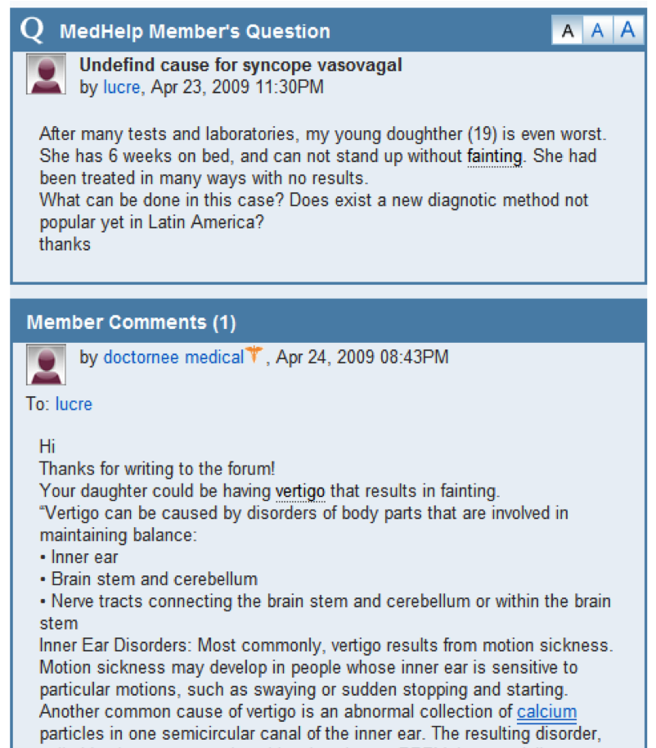
Online Participation: Patients
Notes:
MedHelp is full of patients seeking diagnostic help. The lack of structure or incentive means successful diagnosis is rare.

Slide 8
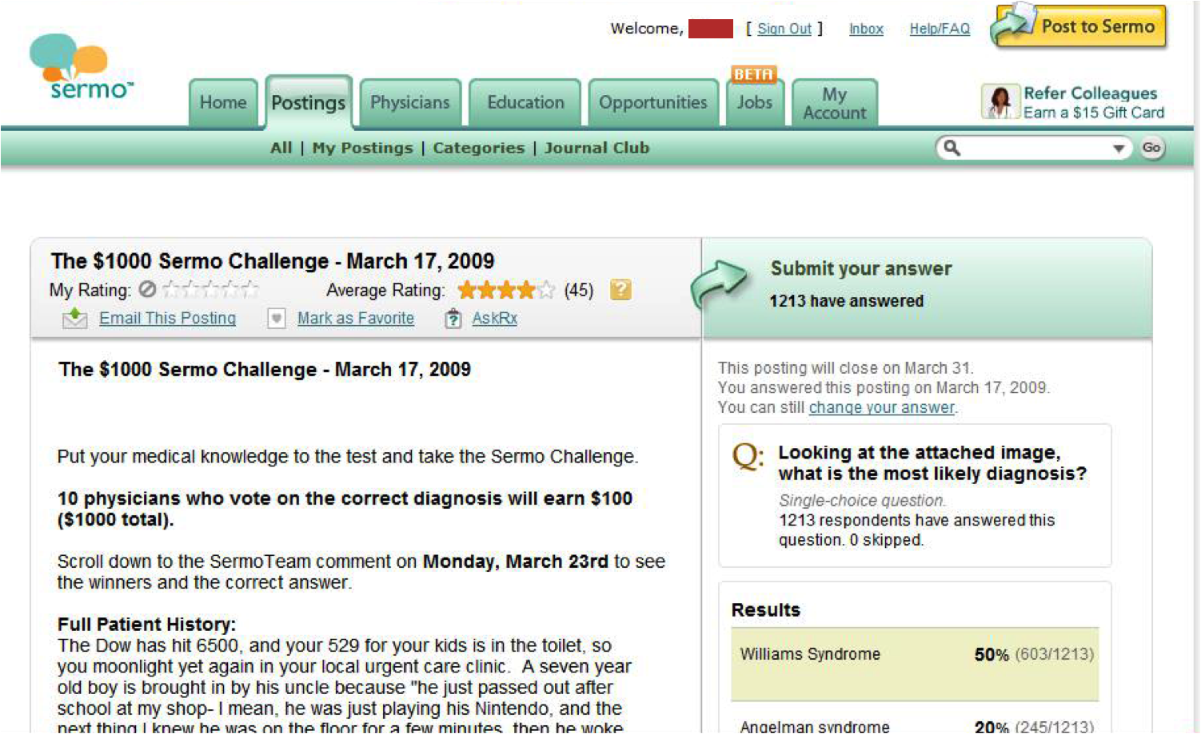
Online Participation: Clinicians
Clinicians are interested in being involved in diagnosis online
Notes:
Clinicians use social networks like Sermo to not only fraternize, but to confer with their peers on challenges like diagnosis. Here, a modest award has prompted doctors to submit 1213 possible diagnoses in one weekend.

Slide 9
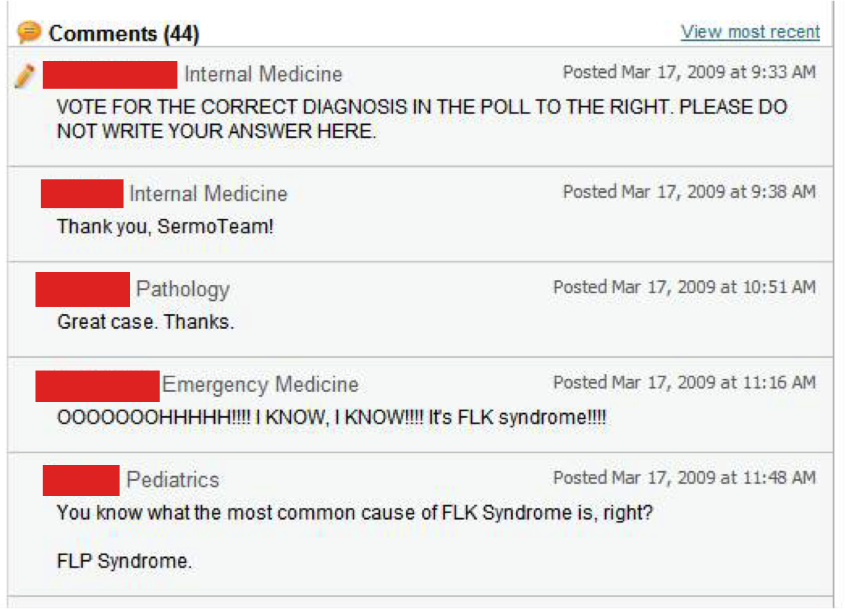
Online Participation: Clinicians
Notes:
Discussion is an important part of the diagnostic process – Sermo includes it more as an afterthought.

Slide 10













Where Hyoumanity Fits
Manifestation
Symptoms
Diagnosis
Treatment
Disease Management
Notes:
Hyoumanity is intended to occupy an underserved niche in online medical praxis.

Slide 11
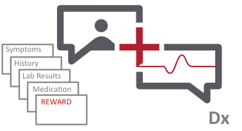
How Hyoumanity Works
Connecting patients facing complex and difficult diagnoses to the clinicians with the expertise, insight, and incentive to solve their cases
Hyoumanity
=
Notes:
Given the highly fragmented nature of medical knowledge, resolving many of these cases of difficult diagnosis essentially becomes a matching problem in which a patient with a specific condition must find a clinician with the right expertise to recognize and diagnose it. Under the current structure of the healthcare delivery system, patients lack the required information and resources to complete this search efficiently and effectively, while physicians lack the tools and incentives to independently locate patients to whom their expertise might be most valuable.
We posit that using technology to facilitate the appropriate patient-to-provider match holds the potential to solve many of these difficult cases.

Slide 12
How Hyoumanity Works
1.
2.
3.
4.
5.
Patient Posts Case Profile and Award
Clinicians Review Targeted Cases
Clinicians Offer Potential Diagnoses
Patient Confirms With Local MD
Hyoumanity
Awards
Clinician
Notes:
Broken down further:
1. Patients post a structured case profile on the Hyoumanity online marketplace, including their medical records and a narrative qualifying their illness.
2. Patients offer a cash award for information leading to a correct diagnosis
3. Clinicians register, verifying their licensure, then search and review targeted cases pertinent to their expertise.
4. Clinicians offer suggested diagnoses that may not have been considered or adequately explored, including rationale and guidance for confirming diagnosis.
5. Suggested diagnoses are reviewed for quality control and then released to patients.
6. Patients will explore suggested diagnoses face-to-face with their local doctor, maintaining the traditional doctor-patient relationship.
7. When a correct diagnosis is secured, the promised payment will be released to the doctor who suggested the diagnosis via Hyoumanity, with Hyoumanity retaining a commission.

Slide 13
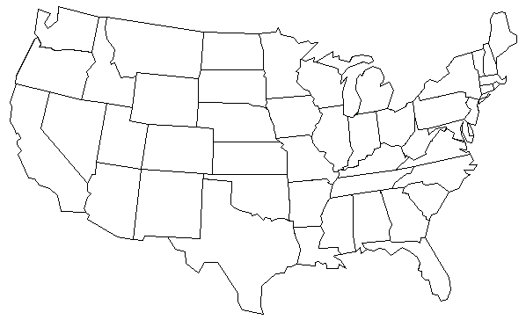
How Hyoumanity Works
Hyoumanity flips diagnostic search around, giving doctors the mechanism and incentive to find the patients who they can help.
Traditional reach of patient search
Potential Hyoumanity reach
Notes:
Freed from the constraints of geography and the need to seek out physicians, a patient’s case is open to a larger audience.

Slide 14
User Experience: Initial Findings
  Hyoumanity Clinician Survey (n=15):
  Hyoumanity Patient Survey (n=10):
  33% of doctors surveyed said they were “somewhat likely” or “very likely” to participate
  53% said that diagnosis can be done remotely “sometimes” or “in many cases”
  Reasons for participation include Opportunity to help patients (80%), Financial reward (73%), and Intellectual challenge (60%)
  47% said they would be “not at all” or “slightly” concerned about liability
  80% said that a reward of $5,000 or less would be sufficient for them to spend 30-60 minutes evaluating a case
  90% would be at least “somewhat likely” to use an online tool to assist with diagnosis
  40% of patients indicated that they have been undiagnosed for 1-2 years, with an additional 40% saying >3 years
  70% of these patients have seen at least 10 doctors during this time
  60% said they would offer at least $5,000 for a correct diagnosis, with 30% indicating they would offer >$100,000
  60% said they would “certainly pay” if they were successfully diagnosed and 20% said they would “most likely pay”
Notes:
Our user experience research findings supported

Slide 15
User Experience: Interaction Flow
Patients
Clinicians
Home
Home
Patient
Log in
Clinician
Log in
My
Hyoumanity
My
Hyoumanity
View Case
Comm.
w/ Doctors
Payment
Manage Account
Find a Case
My Cases
Manage Account
Edit Case
Search
Browse
View Case
Solved Cases
Save Search
Discuss
w/ Doctors
Comm.
w/ Patient
Suggest Diagnosis
Payment Status

Slide 16
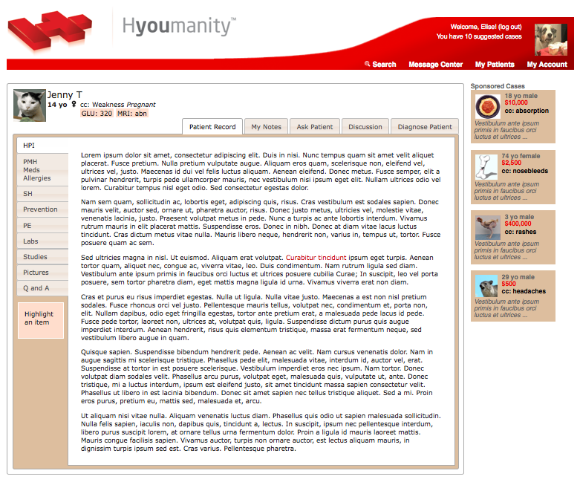
User Interface: Overview
Notes:
User Interface: Clinician
Conventional medical records are complex structured documents that can easily be hundreds of pages of notes, charts, images and test results. In order to succeed, our interface has to present the information found in a conventional medical record in a way that makes sense to clinicians and allows them to process information quickly. We took inspiration from the traditional paper medical records, which are normally organized in tabbed-folders.
In this case, Jenny is the patient. Below Jenny’s name, there is a list of immediate relevant data points regarding her profile and the chief complaint bringing her to the site. The vertical tabs list all the different sections of her medical record. The labels for those sections are common medical acronyms that are understood by clinicians across the field. The horizontal tabs are different actions a clinician can take with a viewed case. All the information and actions regarding a case are displayed in plain view just one click away, allowing clinicians to sort through information quickly and easily.
The top red banner lists the user’s account information, notifications and higher-level site functions. This will stay with the user from case to case, serving as a context switch to other views.

Slide 17
User Interface: Search & Browse
Help clinicians to locate the cases most interesting to them
  For clinicians with general interests: Browse
    Rank cases by posting time, amount of award, most viewed, and least viewed
  For clinicians with specialized interests: Search
    Simple search
      Only search on patients’ chief complaints
    Advance search
      Able to define criteria on all structured information in a case
      Able to combine different criteria to refine search
      Able to save search criteria for future use
Notify clinicians with new cases that matches their saved search criteria
There is a new patient waiting for you! ☺
Notes:
In order to engage clinicians in our system, we interviewed doctors to explore the most common methods they use to find patients in databases – for example, finding patients to enroll in a clinical trial. From that exploration, we settled on three strategies for information retrieval:
The clinicians that are in highly specialized fields may only care about certain values in a few tests. To meet their needs, we intend to provide a powerful advanced search to allow clinicians to set values on any pieces of information we capture, and combine those different criteria to customize a search query that works for them. These queries can also be saved, so the system can automatically find matching cases for the users.
For clinicians in less specialized fields, a simple search against the most frequent complaints or highest awards would permit filtering of cases without eliminating opportunities.
For clinicians who don’t have particular criteria in mind, we intend to provide a browse function, which allows the clinicians to skim through different cases along a variety of filters to find challenges.

Slide 18
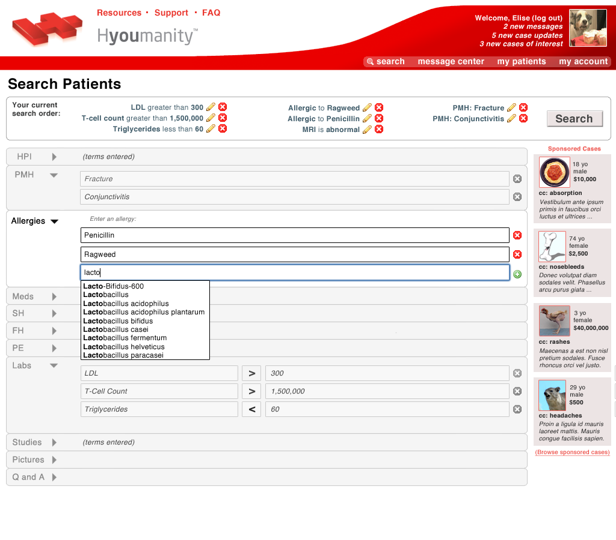
User Interface: Search & Browse
Notes:
In order to engage clinicians in our system, we interviewed doctors to explore the most common methods they use to find patients in databases – for example, finding patients to enroll in a clinical trial. From that exploration, we settled on three strategies for information retrieval:
The clinicians that are in highly specialized fields may only care about certain values in a few tests. To meet their needs, we intend to provide a powerful advanced search to allow clinicians to set values on any pieces of information we capture, and combine those different criteria to customize a search query that works for them. These queries can also be saved, so the system can automatically find matching cases for the users.
For clinicians in less specialized fields, a simple search against the most frequent complaints or highest awards would permit filtering of cases without eliminating opportunities.
For clinicians who don’t have particular criteria in mind, we intend to provide a browse function, which allows the clinicians to skim through different cases along a variety of filters to find challenges.

Slide 19
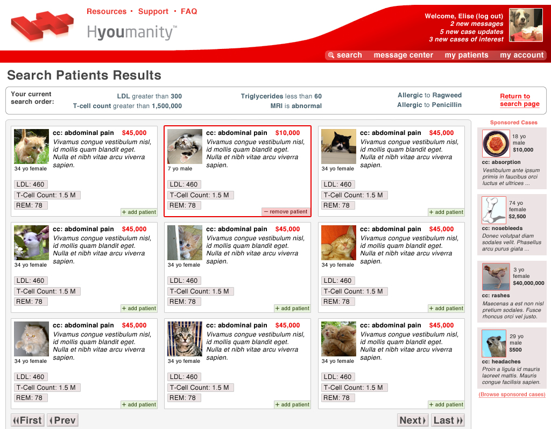
User Interface: Search & Browse
Notes:
In order to engage clinicians in our system, we interviewed doctors to explore the most common methods they use to find patients in databases – for example, finding patients to enroll in a clinical trial. From that exploration, we settled on three strategies for information retrieval:
The clinicians that are in highly specialized fields may only care about certain values in a few tests. To meet their needs, we intend to provide a powerful advanced search to allow clinicians to set values on any pieces of information we capture, and combine those different criteria to customize a search query that works for them. These queries can also be saved, so the system can automatically find matching cases for the users.
For clinicians in less specialized fields, a simple search against the most frequent complaints or highest awards would permit filtering of cases without eliminating opportunities.
For clinicians who don’t have particular criteria in mind, we intend to provide a browse function, which allows the clinicians to skim through different cases along a variety of filters to find challenges.

Slide 20


Information Architecture
Patient
Google Health
API
Hyoumanity DB
Doctor
Other PHRs
HL7 EMRs
Supplemental Information
Frontend
Accessible, standards-compliant XHTML/CSS
DOM / AJAX functionality via jQuery
Backend
MySQL 5.0/Python 2.5
Pylons framework (SQL Alchemy, Genshi templating, Web Server Gateway Interface)
Notes:
Frontend
Hyoumanity’s interface is being developed in accessible, standards-compliant XHTML and CSS, with DOM and AJAX functionality provided via the jQuery JavaScript library. The design itself is grounded in proven usability heuristics and stakeholder feedback. Each stage of the design has been subject to physician and patient critiques. Larger scale user focus groups are to be convened at UCSF’s School of Medicine and Duke University Medical Center’s private diagnostic clinics, with additional sites enrolled as partners come on board.
Backend
Hyoumanity’s systems are being developed using open source, proven web technologies. The current framework rests upon a Python 2.5/MySQL 5.0 system using a modified version of the Pylons application framework, allowing the Hyoumanity software to take advantage of the portability of the Web Server Gateway Interface standard and the modularity of Genshi’s XML-derived design templates. Hosting for Hyoumanity is co-located in a HIPAA-compliant facility and all protected health information will be stored and transmitted in full compliance with technical safeguards outlined in HIPAA § 164.312.

Slide 21
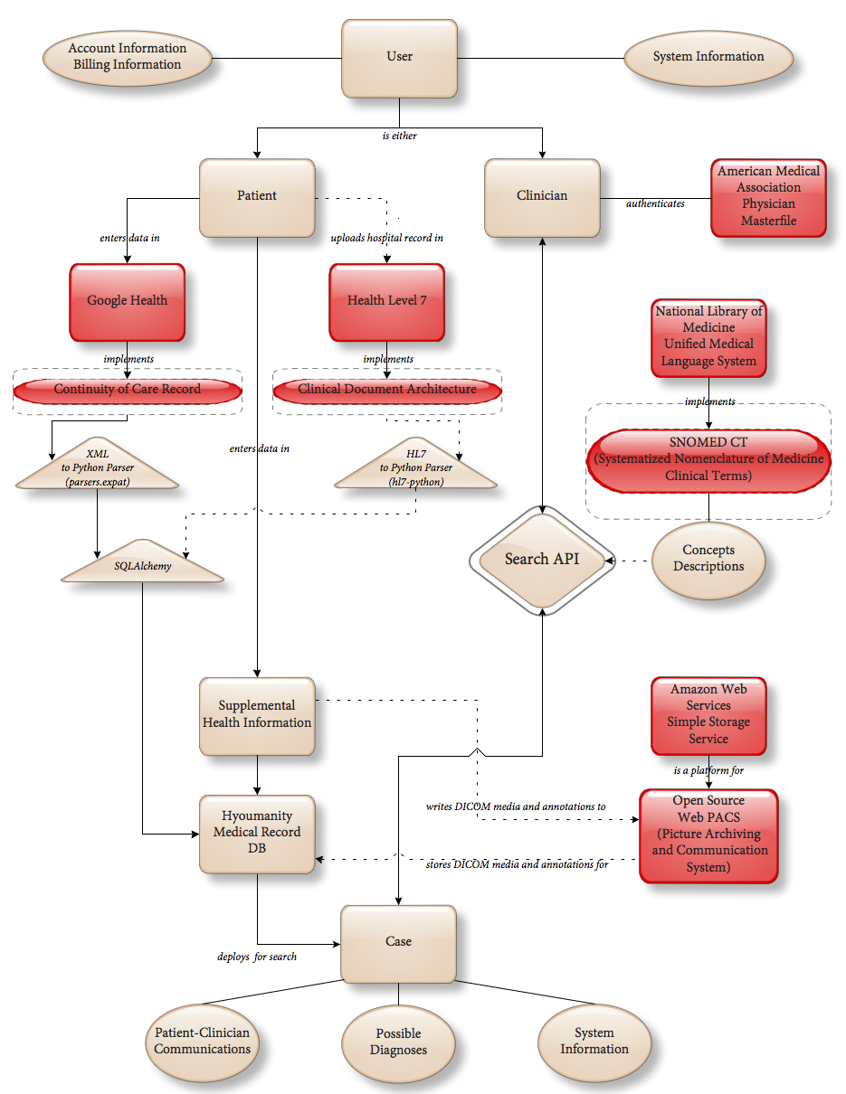
Data Model
Notes:
Our data model demonstrates the silos of information Hyoumanity’s data model is designed to navigate. The clinician interacts solely with our database, while the patient aggregates his or her medical record from a smorgasbord of established systems combined with our own supplementary layer, aligning the data management workload with the patient. Beige objects represent internal entities while red objects are foreign entities or externally derived data types. Solid lines indicate extant connections while dotted lines indicate future work.

Slide 22
External Data Management
Google Health
  Continuity of Care Record (CCR) XML standard
  Robust, intuitive UI
  Continuous development
  Partnership opportunities
  Additional layer of authentication and security
Systemized Nomenclature of Medicine – Clinical Terms (SNOMED-CT)
  Component of Unified Medical Language System
  Internationally recognized controlled vocabulary for each component of Hyoumanity
  Represented in Google Health controlled vocabulary
Health Level 7 (HL7) messaging standard
  Electronic Medical Record (EMR) integration
  Parsing via Python
Notes:
In the interim, our reliance on Google Health will give Hyoumanity users access to a fully functional and constantly improving best-of-breed personal health record (PHR). Our partnership enables us to be quick to launch while minimizing up-front development costs, allowing us to focus on adding value to those records.
Using SNOMED-CT, we anticipate encapsulating a majority of clinician searches within the bounds of a controlled vocabulary.
In the long term, our data model is built to support importing health records not only from Google Health, but from health care providers and Regional Health Information Organizations (RHIOs) using both modern XML and the more common Health Level 7 (HL7) messaging standards.

Slide 23
Security
Google Health
  SSL encryption
  Google authentication
  User is required to authorize Hyoumanity to access patient profile
    User has granular control over Hyoumanity’s access
Hyoumanity
  Clinicians verified through American Medical Association Physician Masterfile
  Servers housed in HIPAA-compliant facility (per HIPAA § 164.312)
  Authkit (via Python)
    Built for WSGI applications and middleware
    Sophisticated and extensible permissions system
    Built in support for HTTP basic, HTTP digest, form, cookie and OpenID authentication methods plus others
  SSL encryption
Notes:
Google Health and Hyoumanity provide two separate authentication layers. Hyoumanity provides additional clinician verification and its own HIPAA-compliant hosting, with HTTP-based security enforced via AuthKit and SSL encryption.

Slide 24
Future Work
Grants
  CITRIS
  Amazon Web Services
Infrastructure
  Microsoft HealthVault
  Clinical Document Architecture (CDA) standard
Pilot Patient Enrollment
  Pediatric patients summer of 2009
Pilot Physician Enrollment
  Pediatric specialists from UCSF, Stanford (2009) Duke, UPenn (2010)
Imaging Support
  DICOM
  WebPACS
Notes:
In April 2009, Hyoumanity was awarded two grants. One, from the Center for Information Technology Research in the Interest of Society, provides $8,000 in funding to be used to pay technical costs and further operational and legal research. The second, from Amazon.com, provides an initial grant of $400 to be used to explore the possible applications of Amazon Web Services in future development.
We hope to begin enrolling patients in our system by the end of May 2009, a milestone pending Google Health’s formal acceptance of our software. Our pilot patients will be recruited from the pediatric space in California in the summer and fall of 2009, expanding to other regions and specialties in 2010.
Much work remains to be done on the data model and user experience – we need to finish implementing and connecting both systems to each other, and ensuring that our prototype search engine is capable of scaling up to meet demand.

Slide 25
Questions and Answers
Thanks for coming!

