Slide 1
StorAI
Designing Ethical Applications with LLMs for Mental Health
MIMS 2025 Capstone
Yvette Vargas, Silvana Moiceanu, Sharon Hu, Rachel Fung

Slide 3
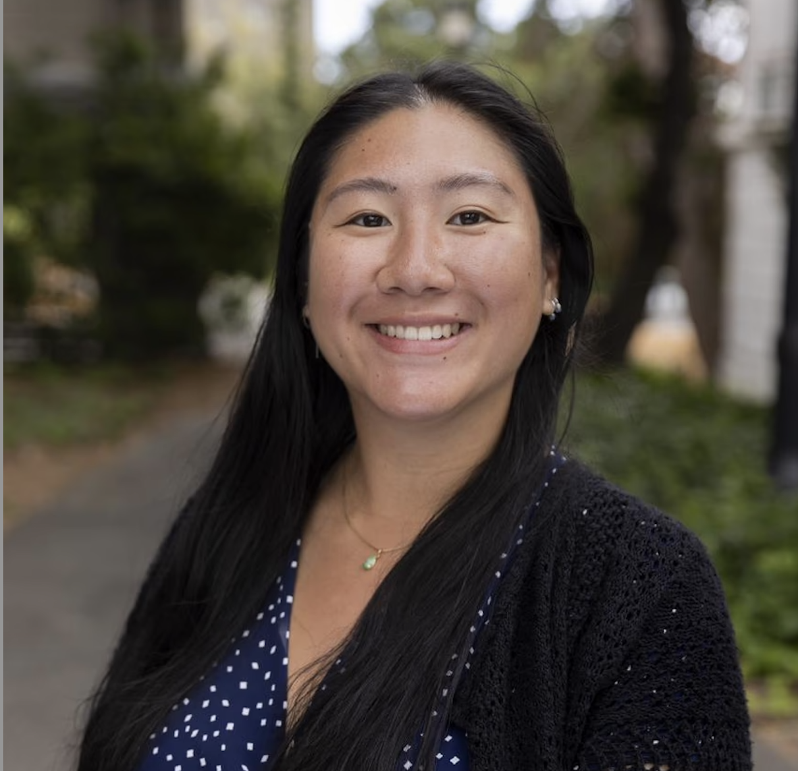
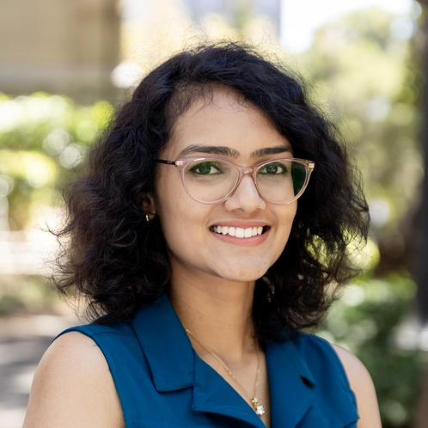
Our Team
Yvette Vargas
Sharon
Hu
Silvana
Moiceanu
Rachel
Fung
MIMS 2025
Legal Analyst
MIMS 2025
Product Designer
MIMS 2025
Product Manager
MIMS 2025
Researcher
Anagha
Ananth
Arnur
Sabet
MIMS 2026
Developer
MIMS 2026
Developer

Slide 4
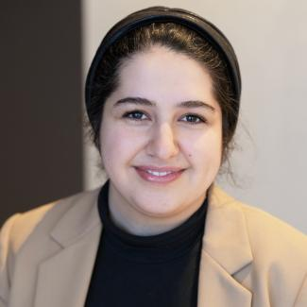
Our Advisors
Niloufar Salehi
Michael Rivera
Associate Professor
Assistant Professor of Practice

Slide 5
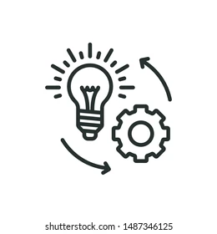
A Hand-Off Model: Navigating Ethics, Privacy, and Responsibilities
Product
Development
Definition: a conceptual framework that explains how ethical and privacy related responsibilities are transferred between various stakeholders across the lifecycle of a technology.
Research
UI/UX
Design
Software Development
Law &
Policy

Slide 6
Therapist Subject Matter Experts
Discussions
Perceptions of AI tools
Privacy, security, and ethical values
Note taking practices and administrative work

Slide 7
Therapist Subject Matter Experts
Evaluation
Application flow
AI effectiveness
FAQ section

Slide 8
Thoughts on AI
Autonomy via user consent
Transparency via digestible language
Protection of all forms of patient information

Slide 9
The Legal Loophole of HIPAA
HIPAA: a federal law that creates a privacy rule for medical records and “other individually identifiable health information” (PHI)
Covered | NOT Covered
Who: Healthcare providers or business associates What: Protected Health Information (PHI) | Who: Independent third parties What: Personal health data entered directly by users
VALUES

Slide 10
No Perfect Framework, But Commitment to User Alignment

Slide 11
Our Policy Framework & Design Choices
Accessibility
Trust
Data Privacy & Security
Transparency
Data
Intuitive Design
cloud storage
anonymize data
brand identity
icon clarity
simple explanations
HIPAA Compliance
User Autonomy
User Consent
data storage
data deletion
data privacy & protection

Slide 12
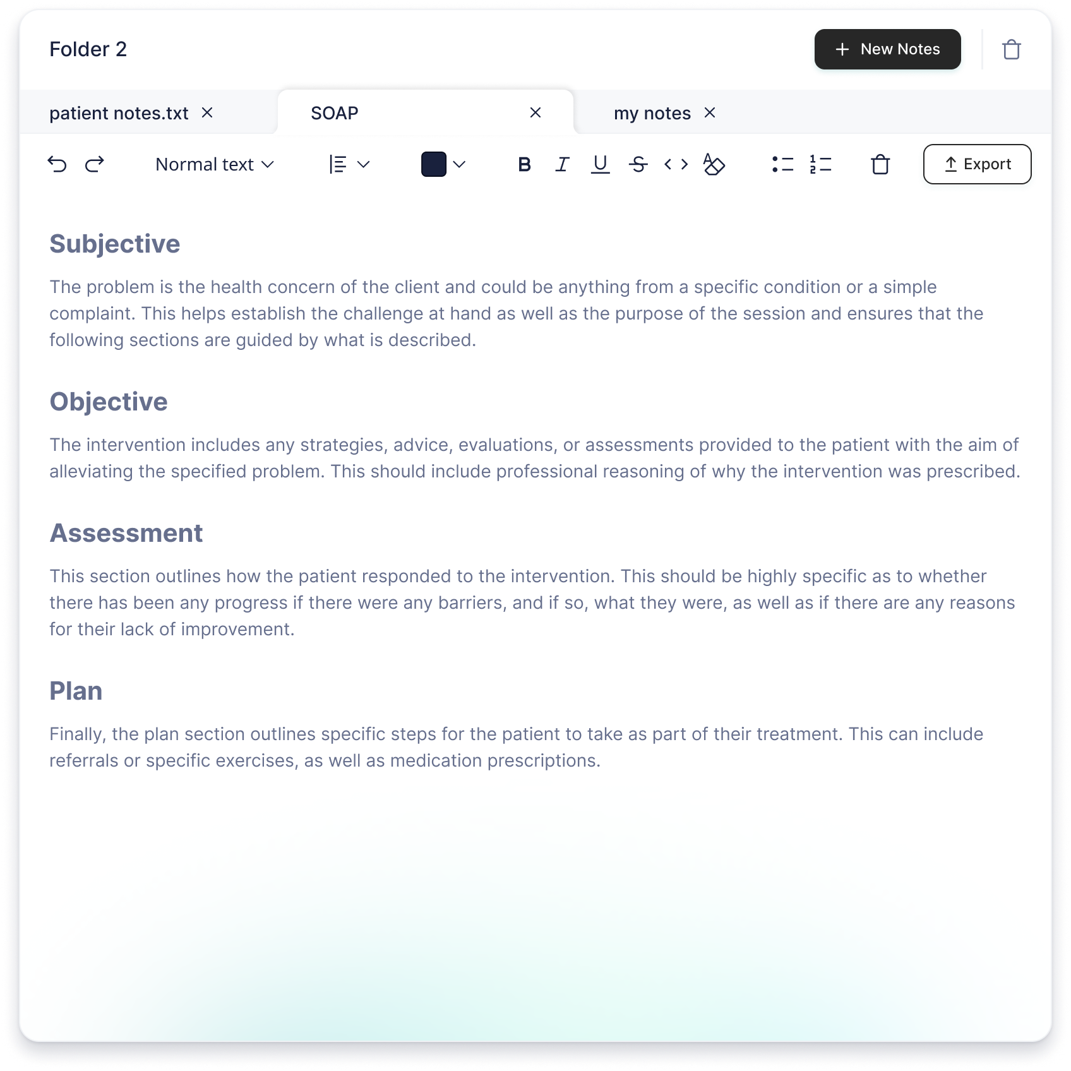
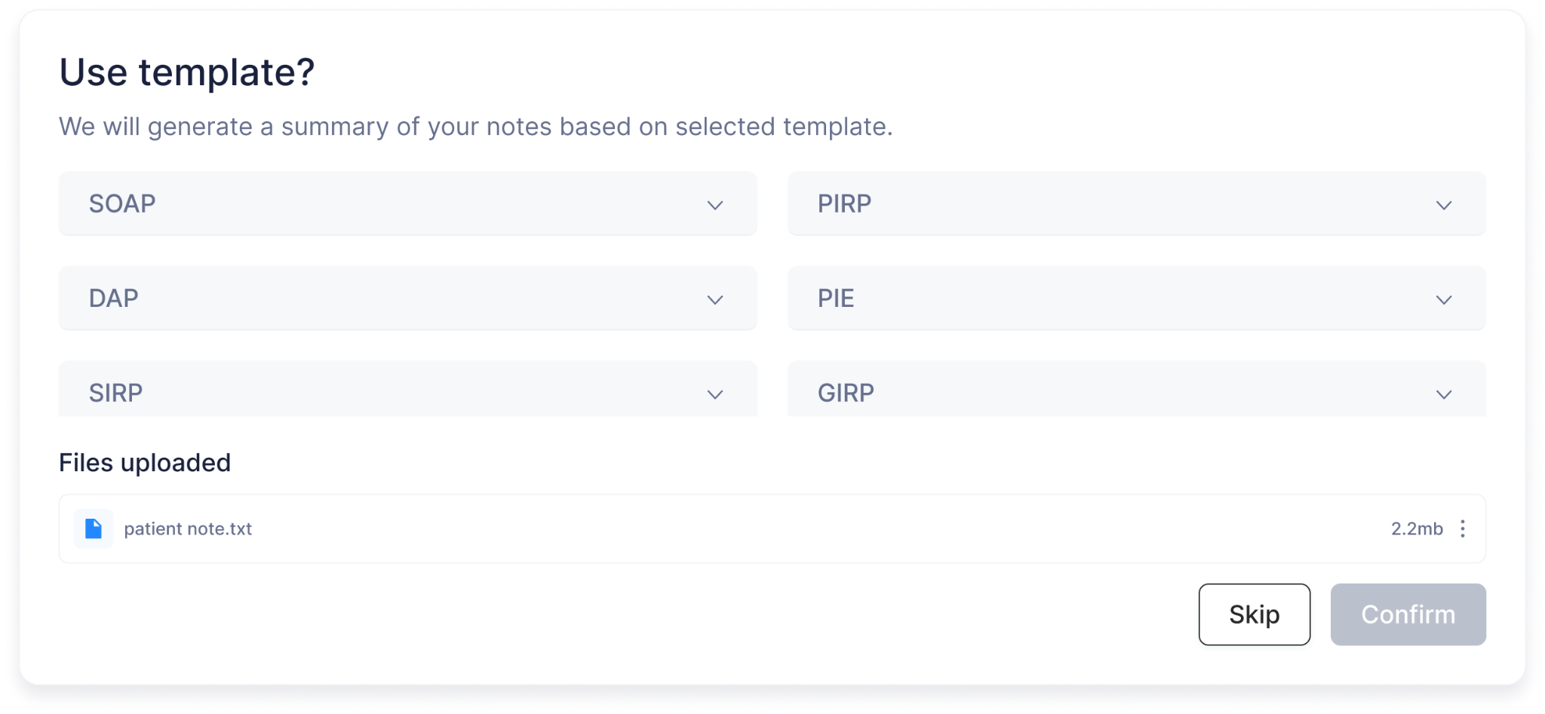
Customization Features
Directly type and edit AI generated notes
Choose from multiple templates to support diverse workflows

Slide 13
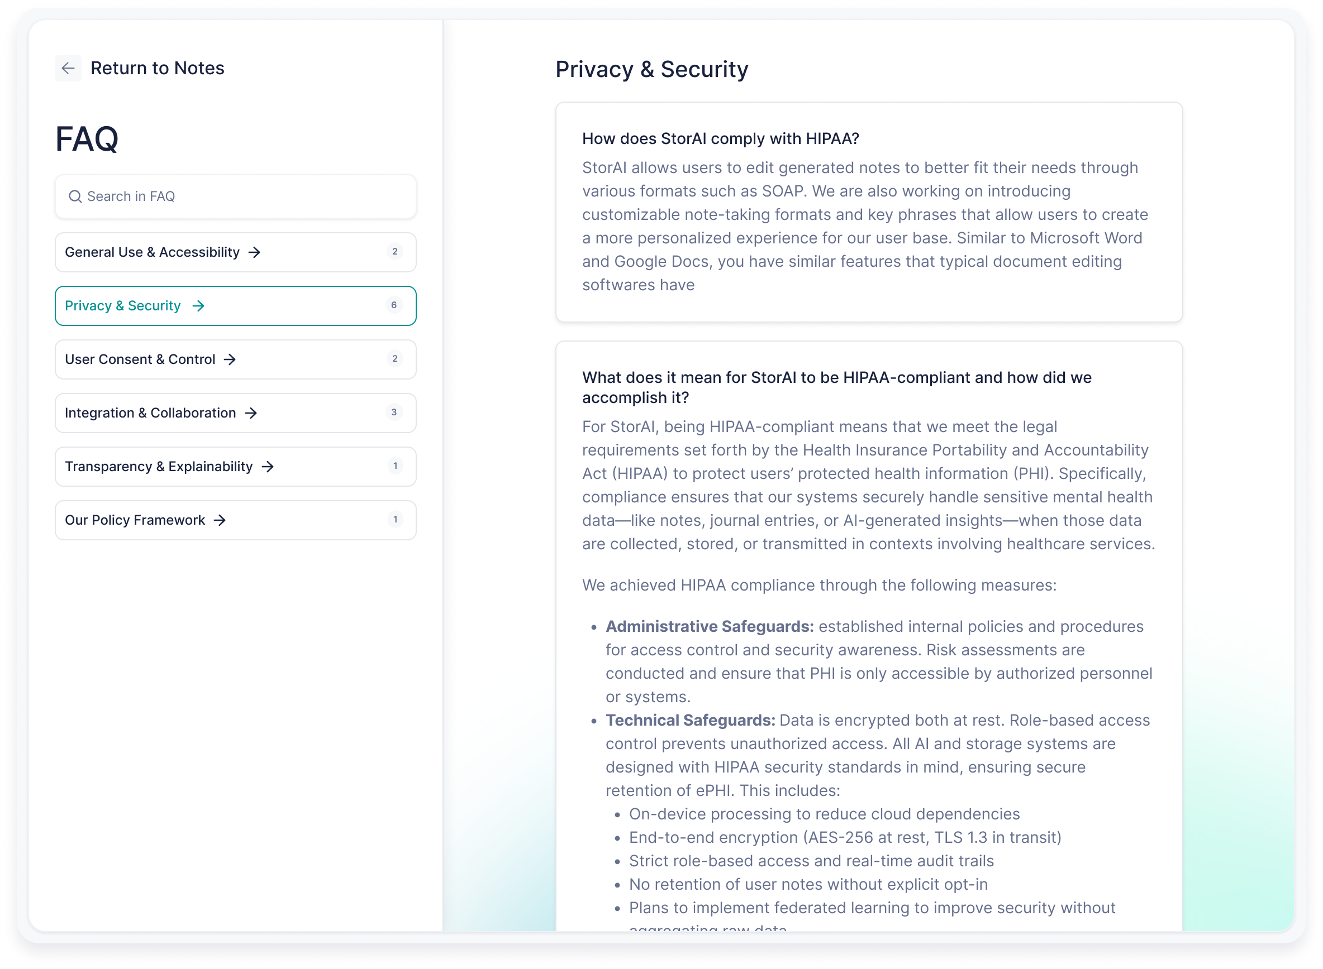
FAQ
Addresses app functions and data practices
Digestible language

Slide 14
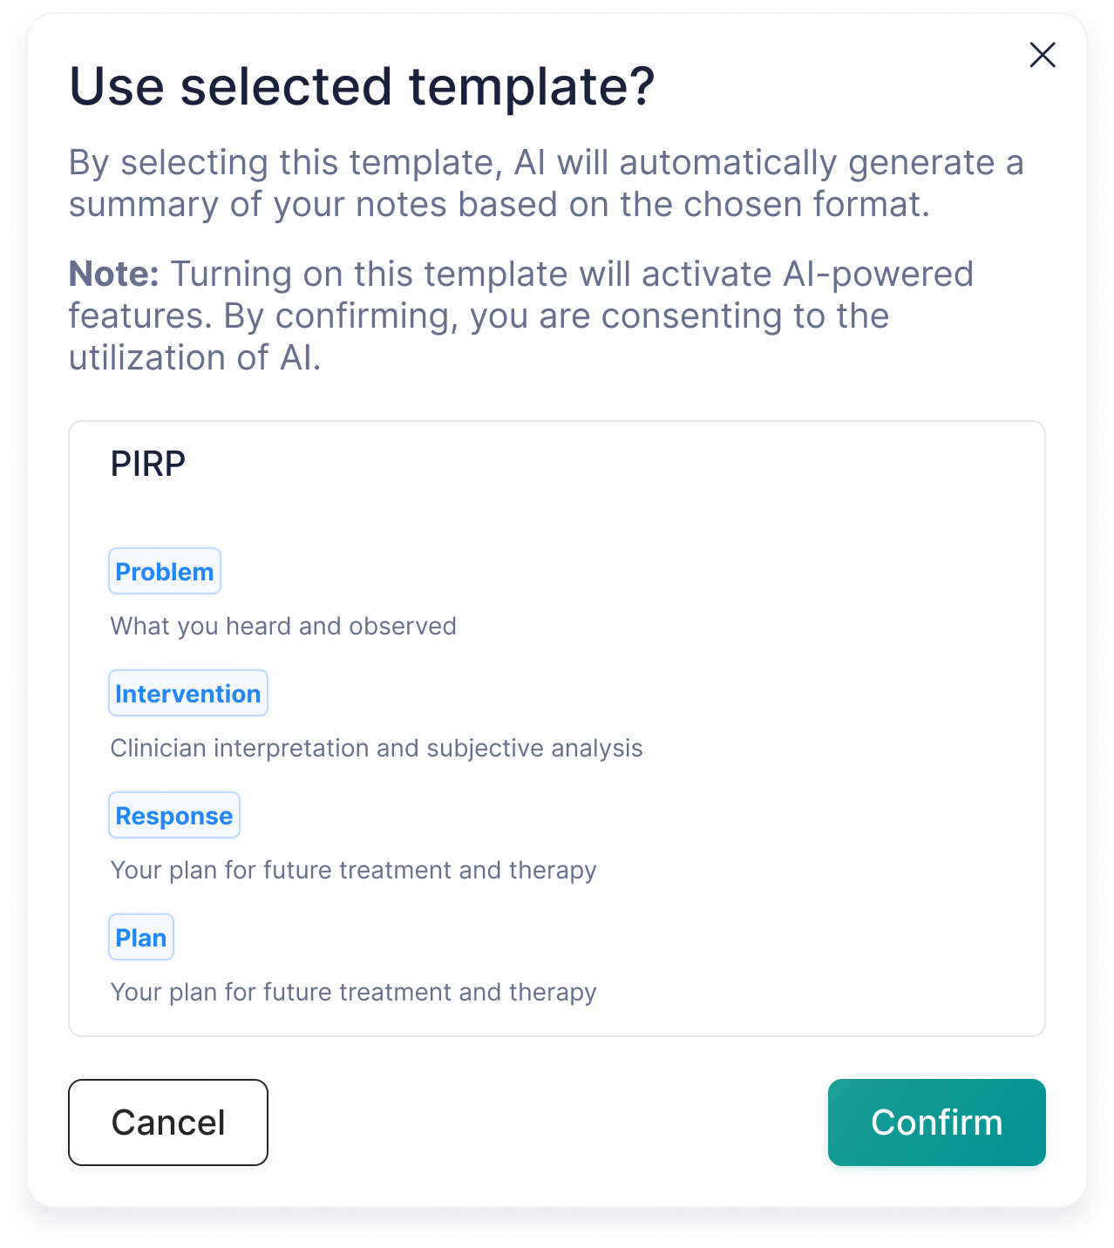
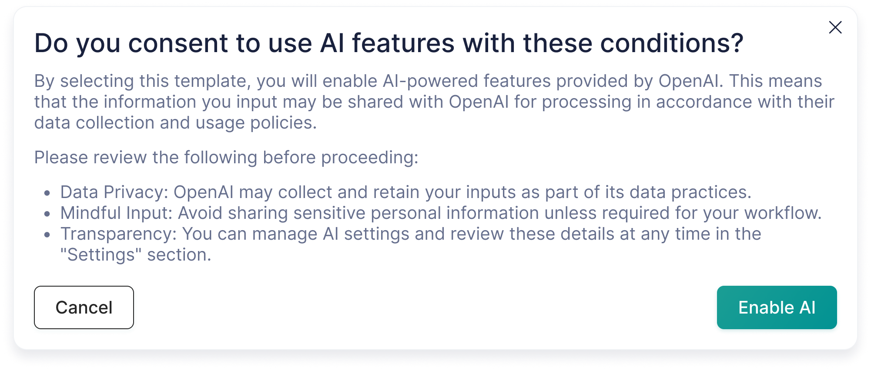
Opt-in Model
Confirmation Pop Ups

Slide 15
Impact: Therapist Testimonies

Slide 16
THANK YOU!

