Slide 1
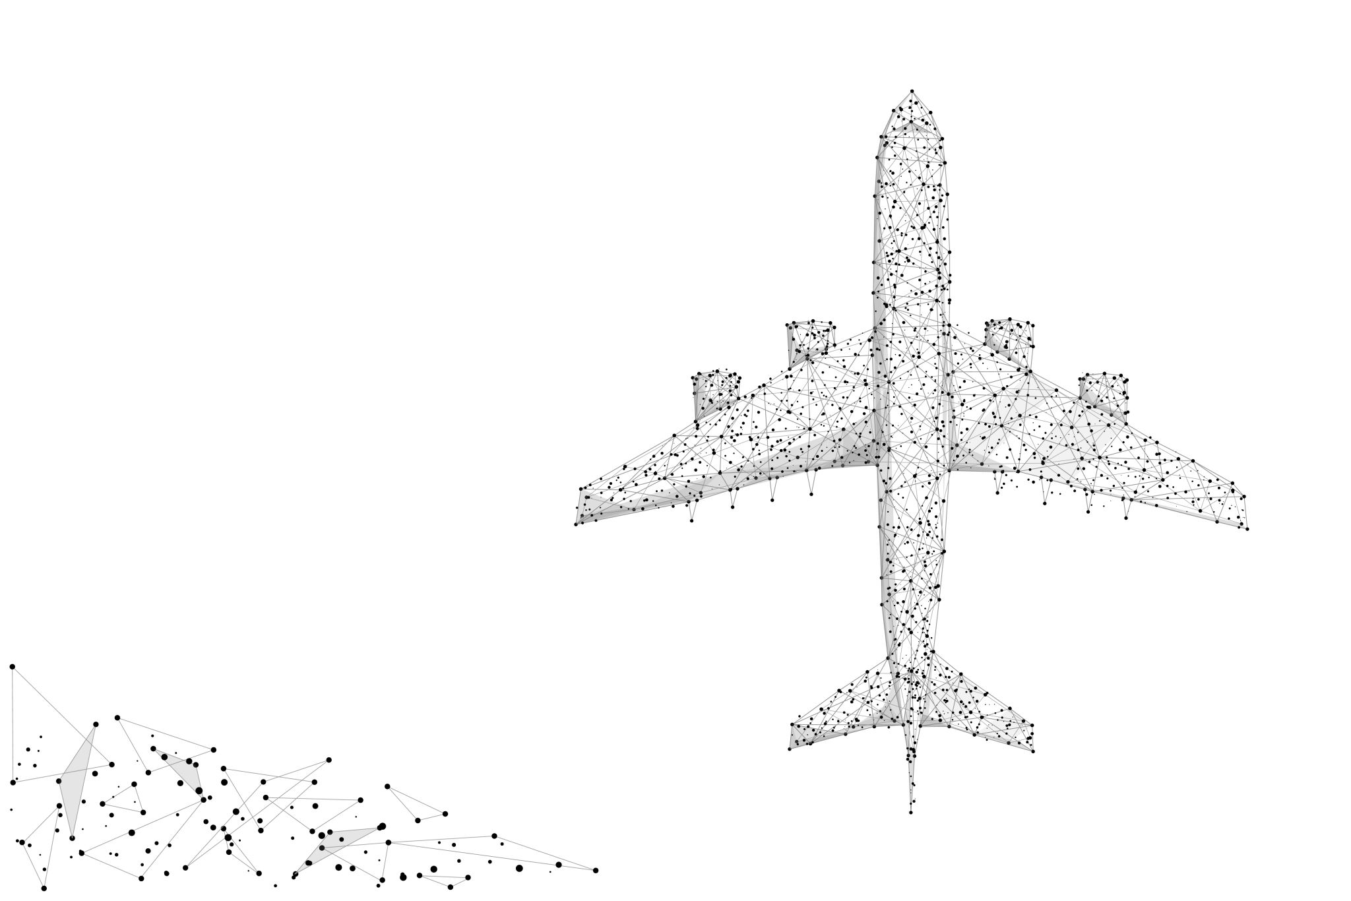
Project METIS
Final Presentation
Team 16
Leena Bhai
Shannie Cheng
Pavan Emani
Satheesh Joseph
Metis ~ Titan-goddess of planning, wisdom and good counsel

Slide 2
Agenda
Business Case
EDA
Feature Engineering
Performance
Models
Novelty
Next Steps
Notes:
Since midterm we developed the following

Slide 3
Business Case
Issue: Flight delays are 33B addressable problem
Goal: To predict a flight delay two hours before the departure time.
Problem: An imbalanced classification problem, with one class representing the overwhelming majority of the data points.
Metrics:
Outcome: An ensemble model with Majority Voting approach.
Notes:
By now,we all know that flight delays are 33B addressable problem and the goal of the project is to predict if a flight will be delayed two hours before the departure time. From the data, we can see that we are dealing with an imbalanced classification problem and one class,in our case,on time flights represent majority of the data points.
So metrics like recall and precision are good metrics to understand the usefulness of our models. We focused on optimizing the recall for our models,while also making sure presion does not suffer.
The outcome as you would see is an ensemble model with majority voting approach which will be explained later in the presentation.

Slide 4
EDA
Airlines:
`DEP_DEL15` has 4935 (1.6%) missing values.
`OP_CARRIER` is highly correlated with ORIGIN_STATE_NM.
`DISTANCE_GROUP` is highly correlated with ORIGIN_STATE_NM.
`CANCELLED` has 312915 (98.4%) zeros.
`ORIGIN` has a high cardinality: 366 distinct values.
`DEST` has a high cardinality: 365 distinct values.
Notes:
Since our midterms, we did a deeper dive on EDA and got these interesting findings.

Slide 5
EDA
Weather:
Date Range for weather data is 01/01/2015 to 12/31/2019.
WND, CIG, VIZ, TMP, DEW and SLP are composite features with comma seperated values Eg. 999,9,C,0000,5 ; 22000,5,9,N ; +9999,9 ; +9999,9; 10151,1 respectively. <br>
Missing values are coded in 9s.
Tool tips:
Databricks’ data profile can be used for quick data analysis.
Pandas profiling generates an interactive profile report for selected features.
Notes:
On the weather data too we did a deeper dive, and figured out some nuances that we had not considered earlier. We focused on certain features mentioned in the slide and figured that those are composite features. We separated them, and removed all the missing values from these features. We also kept only values that are of high quality.

Slide 6
Feature Engineering
Characteristics of airline & airport
Is_base_airport_origin
is_base_airport_destination
is_regional_airline
Seasonality
Is_weekend
is_holiday
Notes:
Since midterm we developed the following features using external data about a airlines’ home base. We added features to understand if the airlines was national or regional. Inspired by mid term presentations of other teams,we added seasonlity features.
9.6% of all the departing airport are at corresponding home base airport
17.2% of regional flights are delayed, 18.4% major airlines are delayed
18.2% delay is on weekend, 18.2 is on weekdays
16.4% travel are on holiday
17.3% delays are on holidays, 18.3% delay are not on holidays

Slide 7
Time Based Features
Flights_delayed one hour before the prediction time on a given airport
Find the total number of flights that are delayed in an airport in each DEP_TIME_BLK.
Self-join the airlines table with a time block which is three hours before the airline’s time block.
Join on flight date, airport_id, and on two different DEP_TIME_BLK
Notes:
To utilize the information about flight delays from an airport prior to our prediction, we created a feature called “Flights_Delayed”. The approach in layman terms is as depicted on the slides.

Slide 8
ML Pipeline Execution Stats
Cluster Capacity:
Total Compute: 28 vCPUs
Total Memory: 112 GB
Total Executors: 24
Process | Time Taken
EDA | 15 min
Feature Engineering | 10 min
Joins | 12 min
Model Training | 30 min
Model Predictions | 2 min

Slide 9
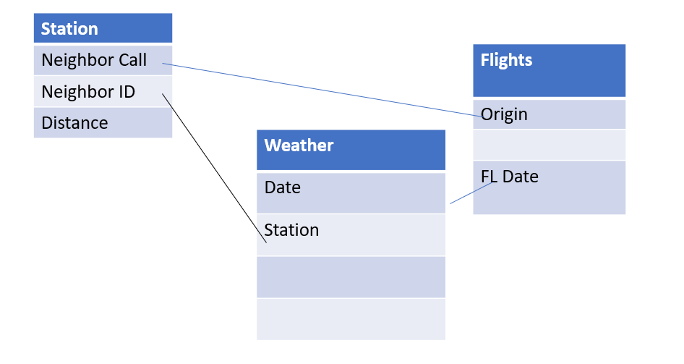
Joining Datasets

Slide 10
Join Optimization
Issue | Mitigation
Data Quality issues in IATA codes in Stations dataset | Used an IATA lookup file from datahub.io
Join between Airlines and Stations data was slower | Improved join performance by only getting stations for unique airports in Airlines dataset. Ranked stations by distance_to_neighbor
Join between Airlines and Weather data was slower | Denormalized Weather table by Station and Date and used collect_set to generate list of all weather reports per day to join to Airlines. Cached this dataframe to speed up join time
Persisting Join results to disk | Used local Databricks tables vs writing to Blob storage
Caching and Un Persisting Data Frames | Cache multiple data frames during the pipeline and unpersisted them right after writing to disk

Slide 11
Performance and Scalability Concerns
Caching intermediate data frames could cause cluster restarts. Mitigated it by un-persisting dataframes
Cluster Auto-Scaling and Scale down caused changes in overall performance
Expensive shuffles due to skewness in datasets
Writes to blob storage are expensive due to network overhead

Slide 12
Modeling

Slide 13
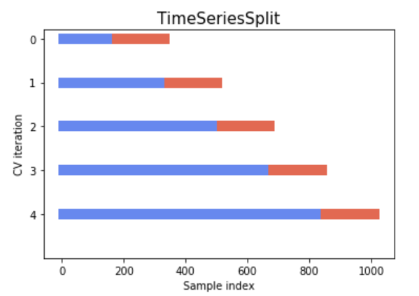
Modeling - Data Preparation
Train and Test Split
2015-2018 Train, 2019 Test
Cross Validation Preparation
5 folds cross validation
Time series split by day
Undersample
Sample same number of DEP_DEL15 = 1 and DEP_DEL = 0
Remove the imbalance in raw data
Notes:
We have done time series split to split the data into 5 folds and all the data are split by day. Additionally, we have created a function to undersample the data so that we can remove the imbalance in the raw data

Slide 14
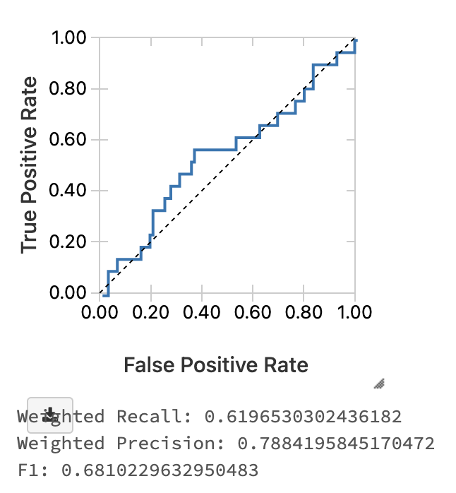
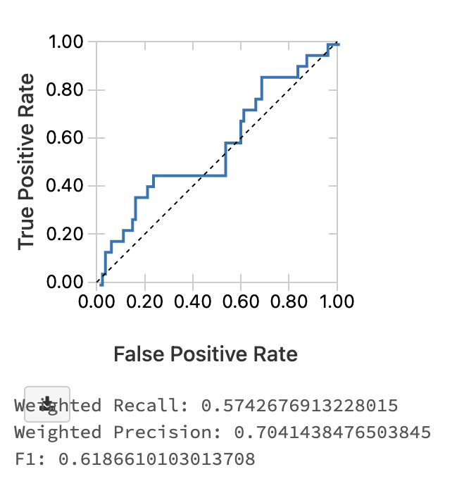
Logistic Regression
Built a pipeline with assembler and LR
lr = LogisticRegression(featuresCol="features", labelCol="DEP_DEL15", regParam=1.0)
Trained on fold 1 and fold 2
Saw decrease in F1 and Recall
Notes:
For our logistics regression, we started with a simple model with L1 regularization and some weather features are selected based on the joined dataset. We have then trained over for fold 1 and fold 2. As seen from the graphs, the recall has dropped from 0.62 and 0.57. We then did some tuning for the model

Slide 15
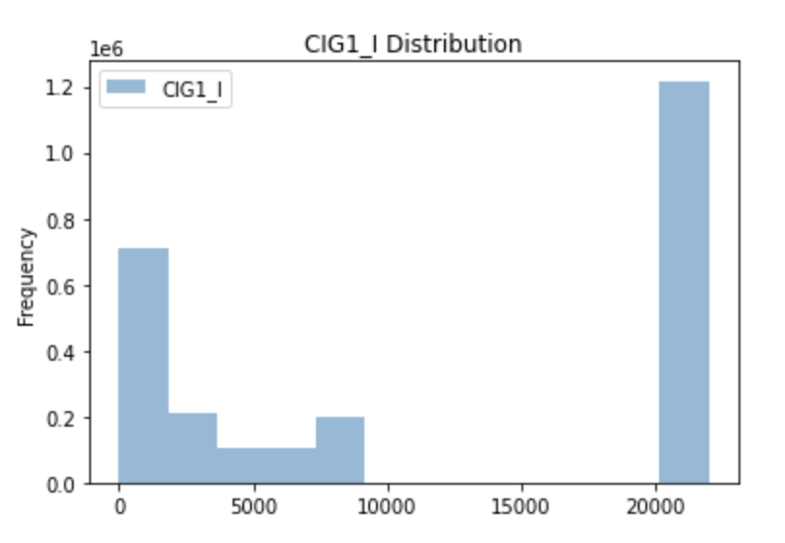
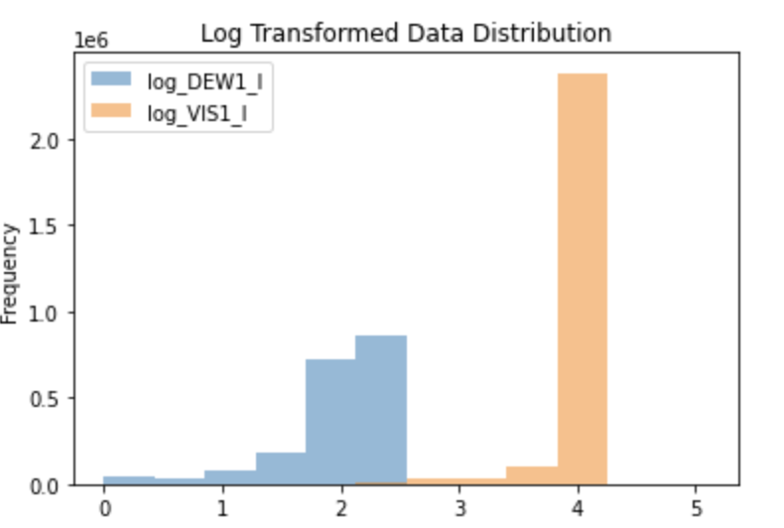
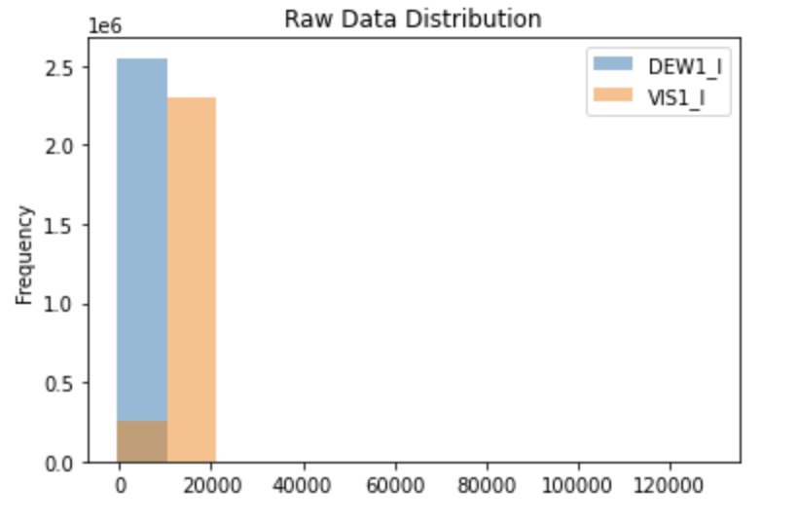
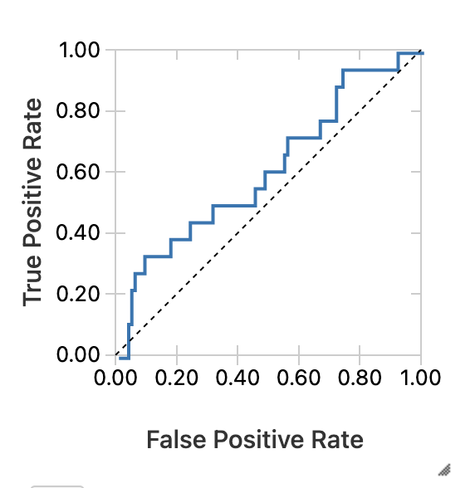
Logistic Regression - Model Tuning
Column filtering and transformation
Dropping binomial column
Log transformation did not smooth out distribution
L2 Regularization
Notes:
For model tuning, we have done some column filtering such as filtering out the binomial columns, and also done some log transformation. However, we found log transforming some skewed columns are not helpful so we have decided to keep the columns as is. The other thing we have done is to change T our model to do L2 regularization so that it will be less impacted by outliers.
Trained over full dataset, and we see with the test data, the recall has been much better. Additionally, compared to fold 1, the ROC curve is further away from diagonal, meaning that the model has more power.

Slide 16
Random Forest
Pipeline built containing stringIndexer, OneHotEncoder
Categorical data added – ORIGIN, DEST
rf = RandomForestClassifier(labelCol="DEP_DEL15", featuresCol="features", numTrees=100)
Fold 1
Fold 2
Notes:
For random forest, we have built a pipeline with additional components such as stringIndexer and OneHotEncoder to transform the ORIGIN and destination. Combined with our other feature such as whether airport is the home base airport, we believe that the combination of these two feature will improve the model. We initiate the numTree to be 100.
After fold 1 and fold 2, we see recall and F1 has all been lower. We continue to do some model tuning after fold 2. The reason why we do model tuning after fold 2 is because after fold 2, the dataset has span 2015 to 2016 february where our seasonality feature will come into effect. We have selected the ORIGIN and DEST feature because from EDA we have found that our airport feature such as is_base_airport_origin will be useful when combined with the airport origin and destination.

Slide 17
Random Forest - Model Tuning
Tuned on three hyperparameter
numTree=20 Tested numTree = [100, 1000]
minInfoGain=0.0 Tested minInfoGain = [0.000001, 0.00001, 0.0001, 0.001, 0.01, 0.025, 0.05]
maxDepth=5 Tested maxDepth= [1,2,4,10]

Slide 18
Random Forest - Model Tuning
Tuned on three hyperparameter
numTree=20 Tested numTree = [100, 1000]
Notes:
For numTree we have tested 100 and 1000. We see that training on fold 2 with num tree is 1000, the training time tripled but the recall only increased in small amount. Unlike logistic regression, training random forest is more resource heavy, thus triple the training time and getting only 0.01 recall increase is not a good exchange.

Slide 19
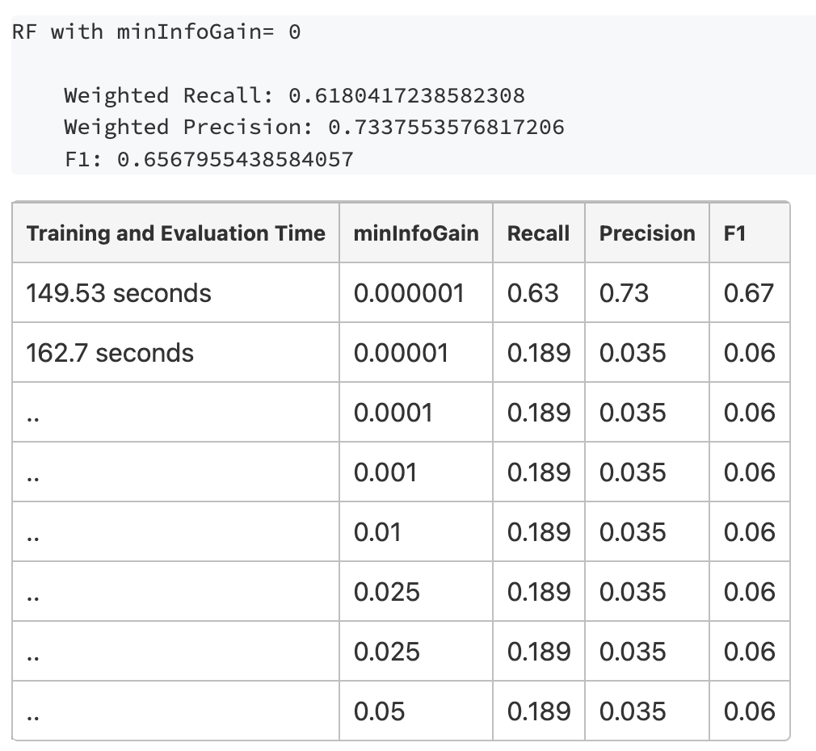
Random Forest - Model Tuning
Tuned on three hyperparameter
minInfoGain=0.0 Tested minInfoGain = [0.000001, 0.00001, 0.0001, 0.001, 0.01, 0.025, 0.05]
Notes:
We have decided to do some change on the minimal information gain because increasing minimal information gain can prevent overfitting as decisions that doesnt divide training data well might not divide unseen data well either.
What we have found is that adjusting the minInfoGain doesnt affect training and evaluation time a lot. However, increasing minInfoGain does help increase the F1. precision and recall

Slide 20
Random Forest - Model Tuning
Tuned on three hyperparameter
maxDepth=5 Tested maxDepth= [1,2,4,10]
Notes:
For decreasing the maxDepth it is also a way to prevent overfitting because we would not allow chain divisions happening.
We see that increasing depth does increase training time. Although having max depth = 1 and 2 gives a higher recall. But based on our understanding of the data having 2 level might underfit the data. Thus we have decided to keep maxDepth as default value

Slide 21
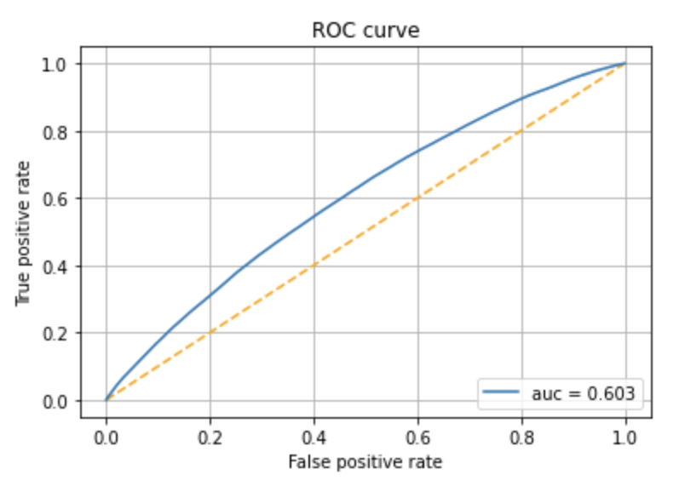
Random Forest
Notes:
Here is our final pipeline code snippet and the recall for final data is 0.63

Slide 22
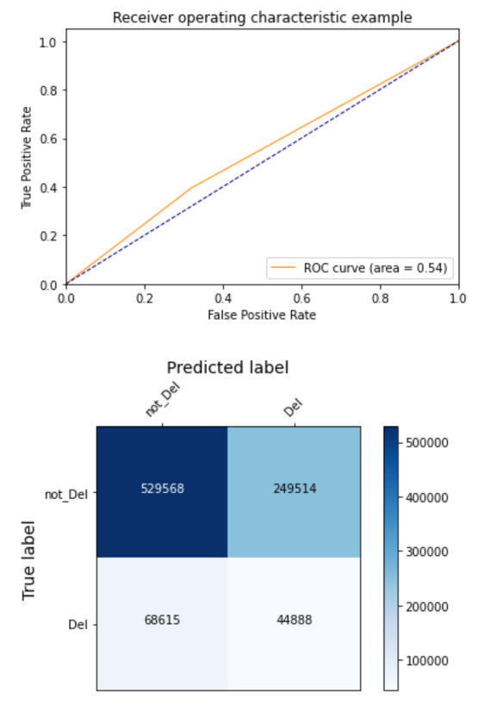
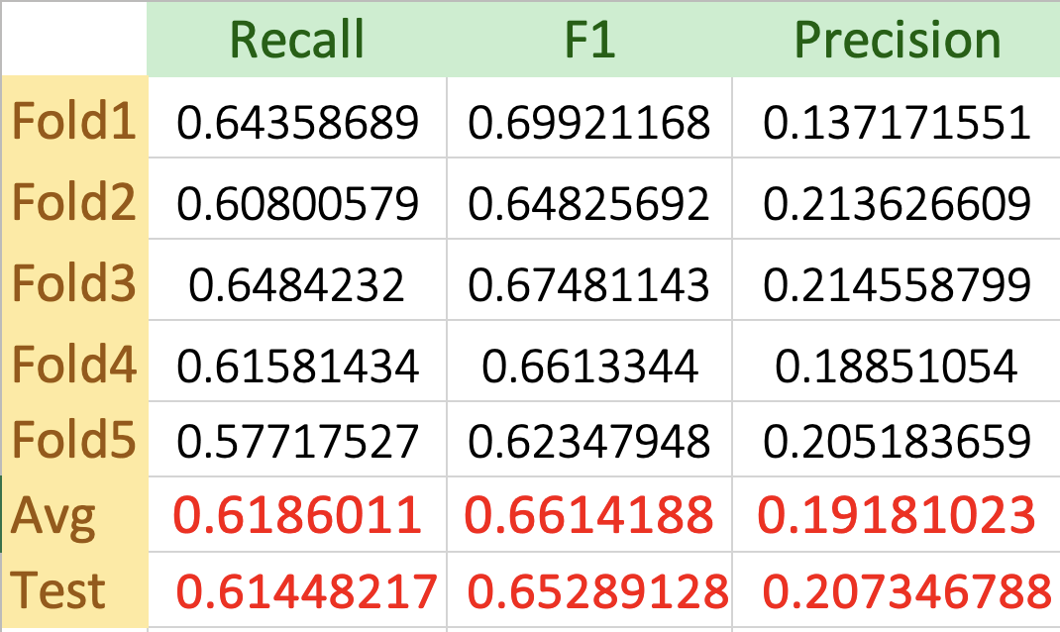
XgBoost
XgBoost
Undersample
Weather & Embedded features
Beta factor - Seasonality
Experimented with params like - Gamma, max_depth, lr, objective, num_features

Slide 23
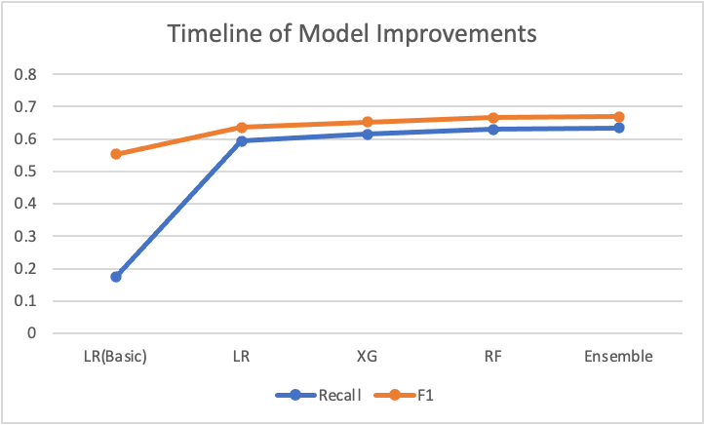
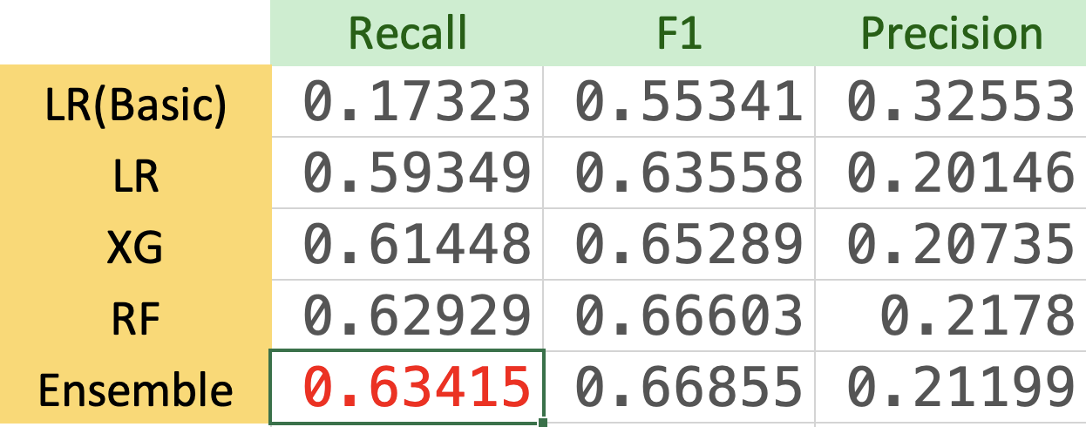
0.05 Improvement by Majority Voting
Ensemble
Baseline Model Recall Score 0.17
Majority.Vote(LR+XG+RF)
Excited to see Models align in prediction
As Majority Voting can minimize your best Recall Score, as well

Slide 24
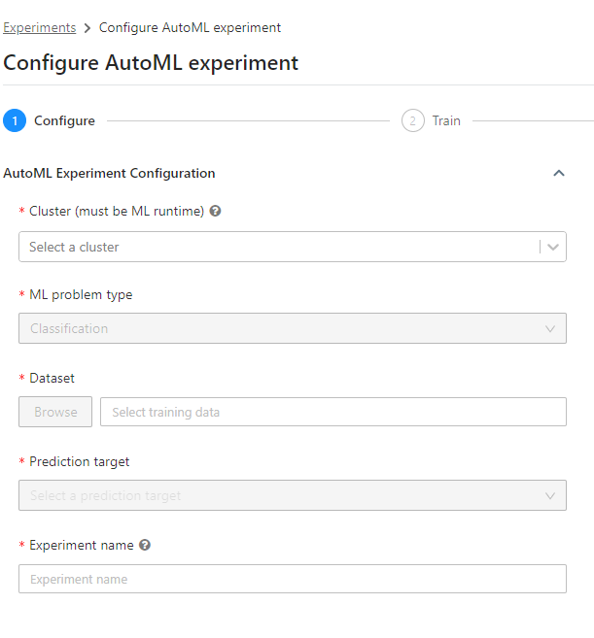
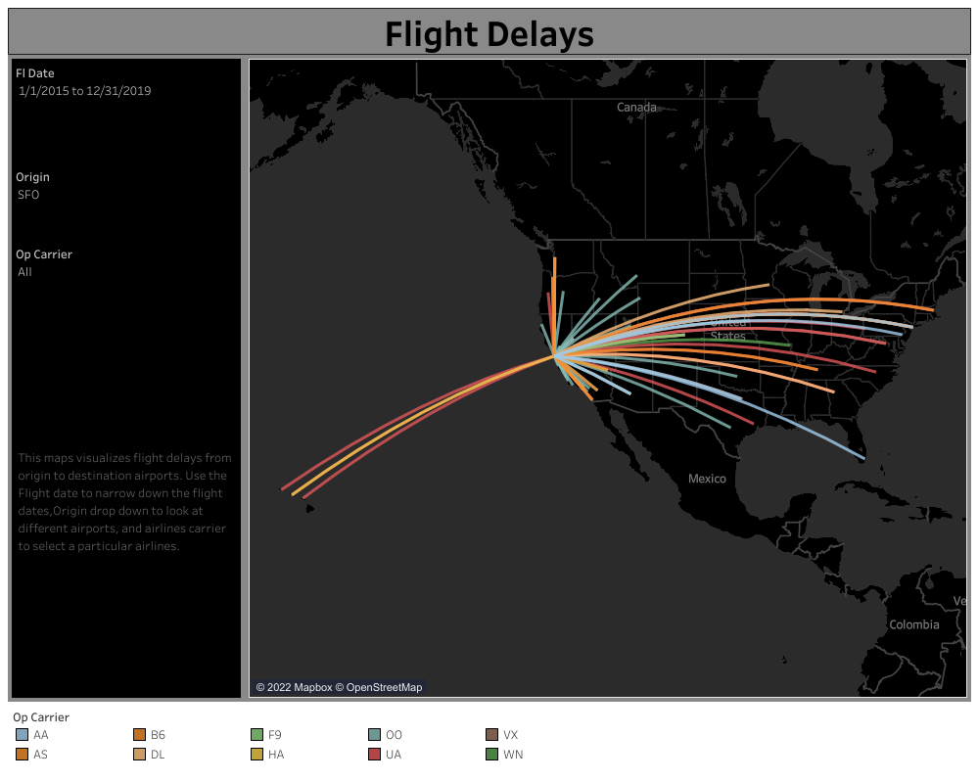
New and Novel Approaches
Majority Voting based Ensemble
Exploring Automated Modeling via Databricks’ Auto ML feature.
Data visualization using Tableau integration.

Slide 25
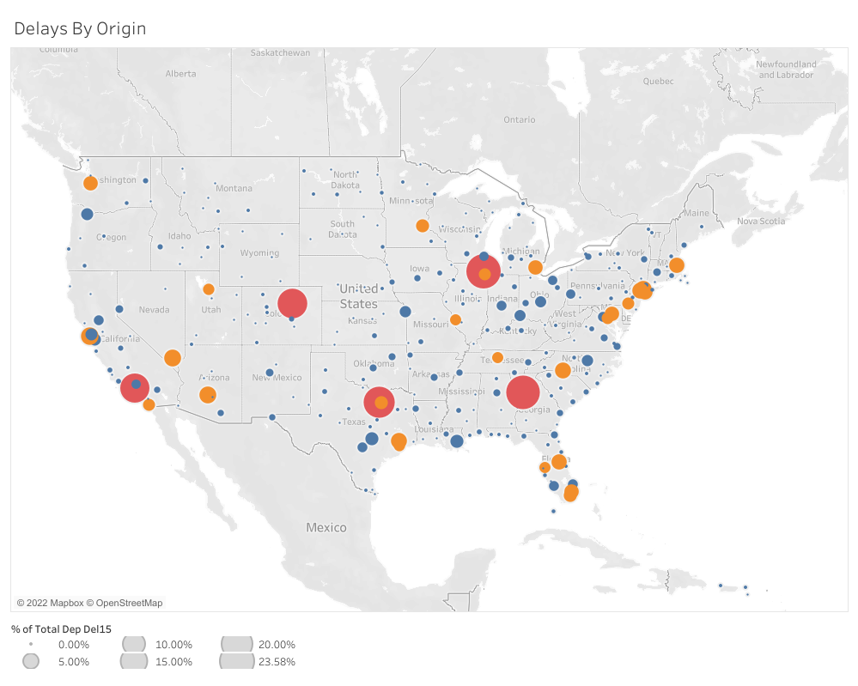
Next Steps
Deep Learning all the parameters
Weighted Ensembling by the strong features of a model
Clustering first on the basis of percentage of delay, then create separate models for each cluster.
Notes:
More planning using Deep Learning.
Weighted Ensembling

Slide 26
Thank You!
Questions
Team METIS

