Slide 1
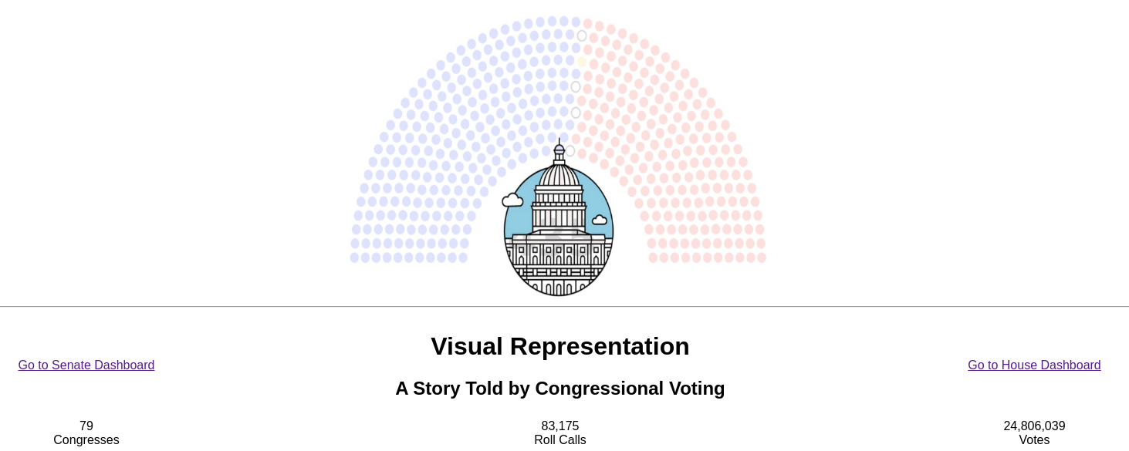
Team members: Edward Salinas, Jason K. Moore, Chandra Shekar Bikkanur, Junjie Ma
Sources: https://voteview.com, https://www.senate.gov, https://www.congress.gov

Slide 2
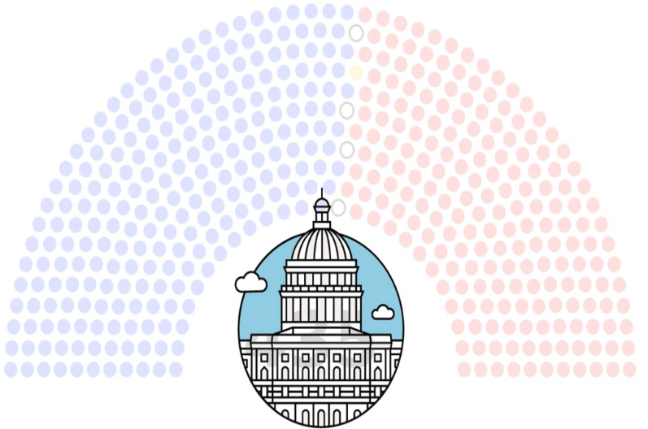
About the Project
The Project was premised on the idea of deriving insight from the voting patterns our congressional representatives in the Senate and House of Representatives. We wanted provide a tool that could help users visualize congressional voting trends in both chambers and drill down to the specifics of those votes. We believe the insight gained by reviewing the voting trends will be useful for journalists, historians, researchers, and even the representatives themselves.
In his famous 1858 Republican convention speech, President Lincoln warned that "A house divided against itself cannot stand." His biblically inspired expression echoed George Washington's warning about "the baneful effects of the spirit of party." President Washington called for its restraint, lamenting of the party, that:
It serves always to distract the public councils and enfeeble the public administration. It agitates the community with ill-founded jealousies and false alarms, kindles the animosity of one part against another, foments occasionally riot and insurrection. It opens the door to foreign influence and corruption, which find a facilitated access to the government itself through the channels of party.
Our intent with this website is to let you explore the administration of the US Government while providing you tools view that administration within the context of the political party. To that end, you can begin your exploration in Congress and navigate through the Senate or the House of Representatives, examining bill proposals and passages over time and drilling in on specific votes and the degree to which they reflect the political factionalism warned about in these speeches.
For more fun facts, visit: https://www.visitthecapitol.gov/about-congress

Slide 3
Definitions
Roll Call: An item (e.g. bill, resolution, official confirmation, etc.) over which congress votes.
Congress: A series of meetings and voting (often broken into one or more “sessions”). Each Congress covers the work of both chambers (Senate and House of Representatives). For this project all sessions for a given Congress have been merged into a single session. This imposes a strictly serial and increasing series of roll calls (i.e. 5,6,7,8,9,10 for 2 sessions instead of 5,6,7,1,2,3 for 2 sessions)
House/Chamber: The legislative bodies that make up the Congress (Senate or House of Representatives); the Senate is one house/chamber of Congress and the House of Representatives is the other house/chamber of Congress. “House” is commonly used as shorthand for “House of Representatives”, the site refers to “House” in the same way.
Click here for additional US civics influences/assumptions for this project
Notes:
A quick pit-stop for a couple of definitions; either because the term is not generally well-known or because the term is used in confusing contexts.
In congressional speak, a roll call is literally a call of the rolls - a request for full accountability of all Senators (for Senate) or congresspersons (for HoR) to officially record their vote on an issue. Roll is not called unless there is a quorum to make the vote official.
“Congress” and “house” are conversationally often used synonymously with “house of representatives.” To avoid confusion - in this presentation and on the site - we take care to reserve the term “Congress” to mean the two-year series of meetings in both chambers. We accept the common usage of “house” to refer to the “House of Representatives,” so we will use “chamber” to clarify a specific element of Congress.

Slide 4
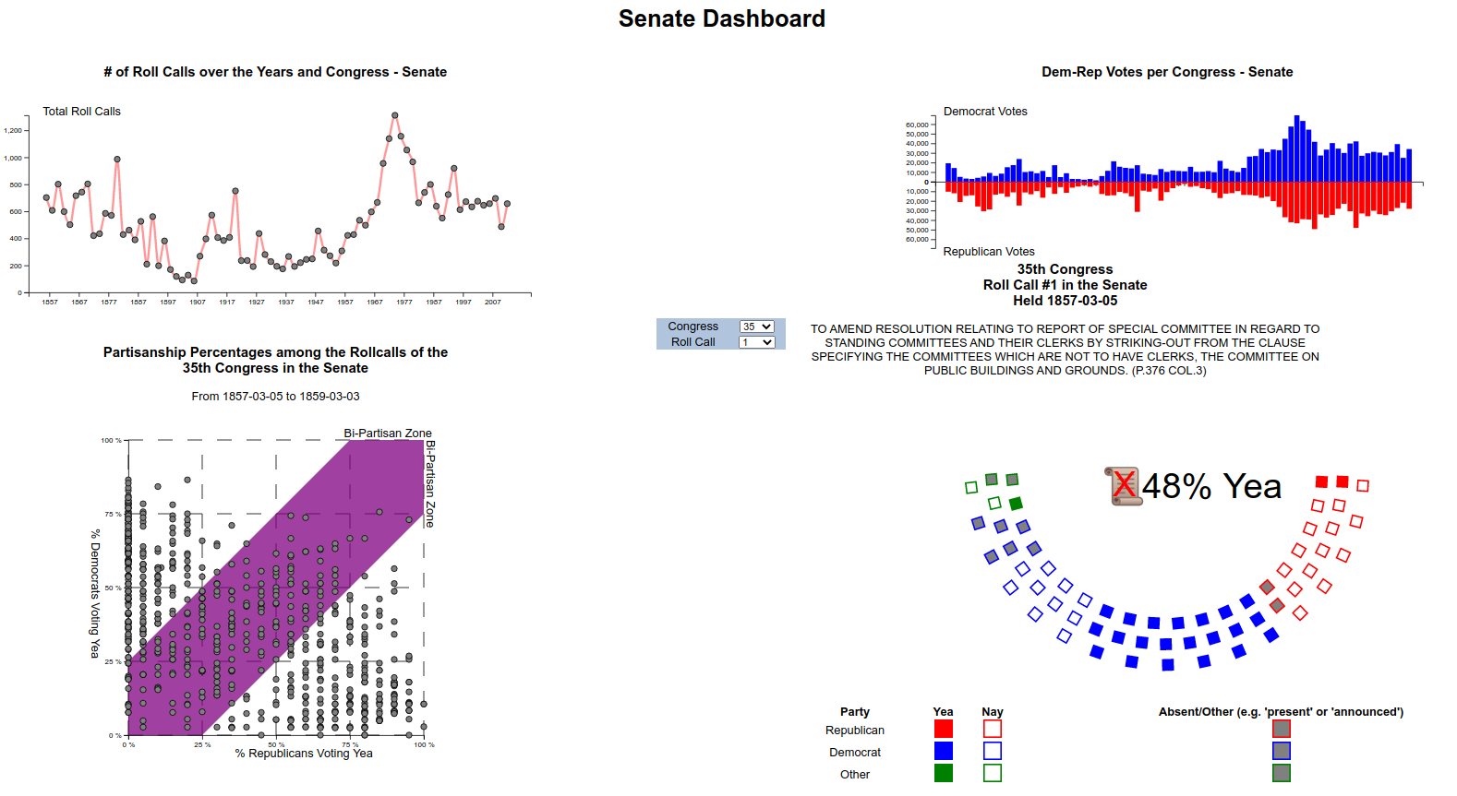
An Overview
VisualRepresenation lets you explore voting trends within the context of the political affiliation. We provide a Dashboard for the Senate and House chambers. Navigate to either chamber to examine bill proposals, bill passages over time, and dril in on specific votes.

Slide 5
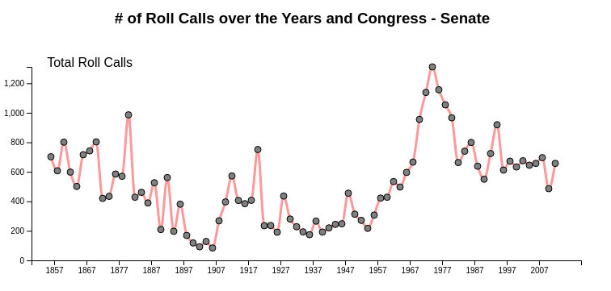
Roll Calls Timeline
The Roll Call timeline provides a sense of the general “productivity” level for each chamber during each Congress as measured by the number of roll calls.
Hover over one of the points to get additional pictorial & historical context.

Slide 6
Historical Context through Interaction
The Roll Call timeline provides a sense of the general “productivity” level for each chamber during each Congress as measured by the number of roll calls.
Hover over one of the points to get additional pictorial & historical context.

Slide 7
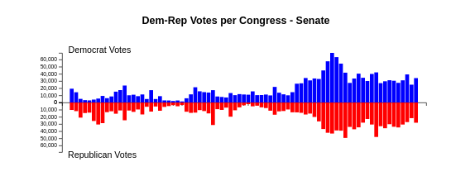
Congressional Influence
Use the butterfly chart to estimate periods where one party clearly controlled their chamber. The chart reflects the number of votes cast by each party and is indicative of having more seats.

Slide 8
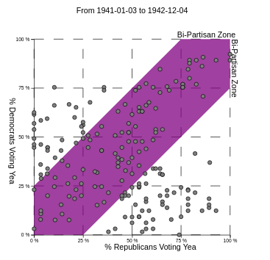
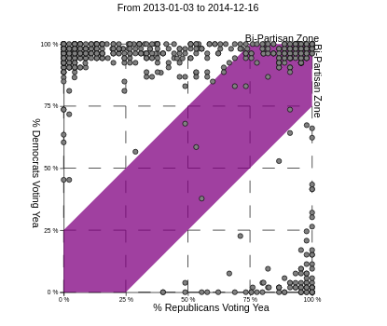
Roll Call Partisanship
These two Congresses highlight the differences we see in partisanship over time. Each chart reflects a series of roll call outcomes. Roll calls in the purple area received more bipartisan support

Slide 9
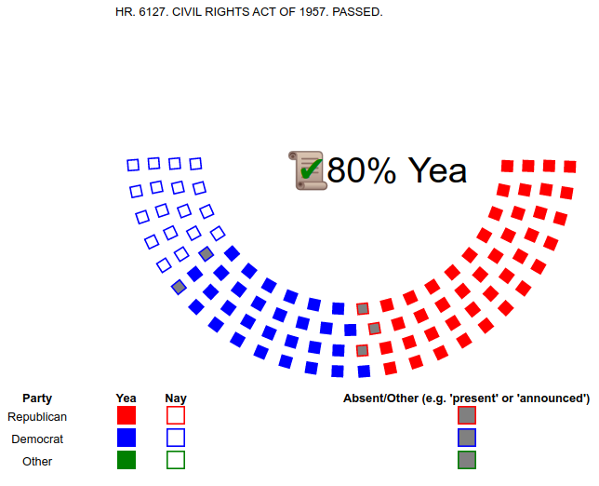
Seats and Vote Details
The seating chart provides details about the outcome of a specific vote. It summarizes the outcome (pass or fail as illustrated by a check or X - and the percentage of approving votes), it also details the specific votes for or against the roll call motion.

Slide 10
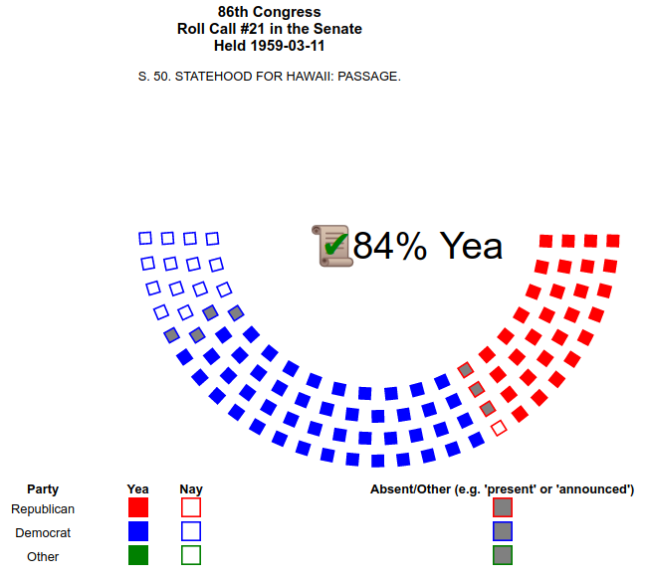
History in Legislation
Use the Roll Call Search Table to pull the thread on some of the things thay may have grabbed your interest.
For example: by searching the roll calls for “Hawaii” we can see the history and political machinations related to its history from sovereign kingdom to the US’ 50th state - all in the span of about 55 roll calls.

Slide 11
History in Legislation
1875: Commercial Reciprocity Treaty between US and Hawaii
1876: Funding US envoys/ministers in Hawaii
1883: Termination of Commercial Reciprocity Treaty
1887: Amend the Convention Between US and Hawaii - giving US Exclusive rights to Pearl Harbor
1891: Amend consular appropriations bill to set groundwork for laying telegraph cable to Hawaii
1895: Recognize Hawaiian government by protecting the rights of US citizens their with Naval Warships
1894-1898: several failed proposed amendments related to annexation of Hawaii
1954: Enable Hawaii to form constitution and State Government
1954: Commonwealth or Statehood shall be decided by referendum (failed)
1959: Statehood for Hawaii passed in Senate (3mo later Hawaii voted in referendum to accept)
1993: On 100th anniversary of 1893 of Kingdom of Hawaii, - Apology issued

Slide 12
A Short Civics Lesson
The United States system of government is one in which citizens elect officers to represent their political interests. The United States Congress consists of two legislative bodies (Chambers or Houses): the House of Representatives and the Senate.
Political officials in the Senate are called senators - and we have two senators per State - they serve six year terms
Political officials in the House of Representatives are called congresspersons and they serve two year terms
The tenure in each chamber is designed balance political stability with responsiveness to the people. Congresspersons are in a constant state of election, which tends to make them more responsive to the people who elected them. With longer terms and greater overlap in representation - Senators are less susceptible to short term political trends.
Since 1856, the United States has essentially been a two-party system consisting of Democrats and Republicans. Every President since 1852 has been either Republican or Democrat, and every Congress has been controlled either by Democrats or Republicans since 1856

