Slide 1
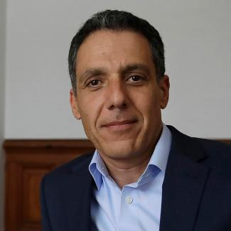
SWEEP SMART
Prof. Hany Farid
Yi Gai
Jessie Lyu
Tobey Yang
Anna Waldo
Zhi Li

Slide 2
THE PROBLEM
Street sweeping parking violations account for 57% of all parking tickets in the city of Oakland, fining the city’s residents more than $10M a year.
How might we minimize the interruption to the community activities while keeping the city clean?
Notes:
Sweep smart was initiated with a serious problem in mind - Street sweeping parking violations account for 57% of all parking tickets in the city of Oakland -- this means among more than 50 possible violation types, the vast majority come from street sweeping parking violations and that translate to more then $10m dollars a year in the past several years.

Slide 3
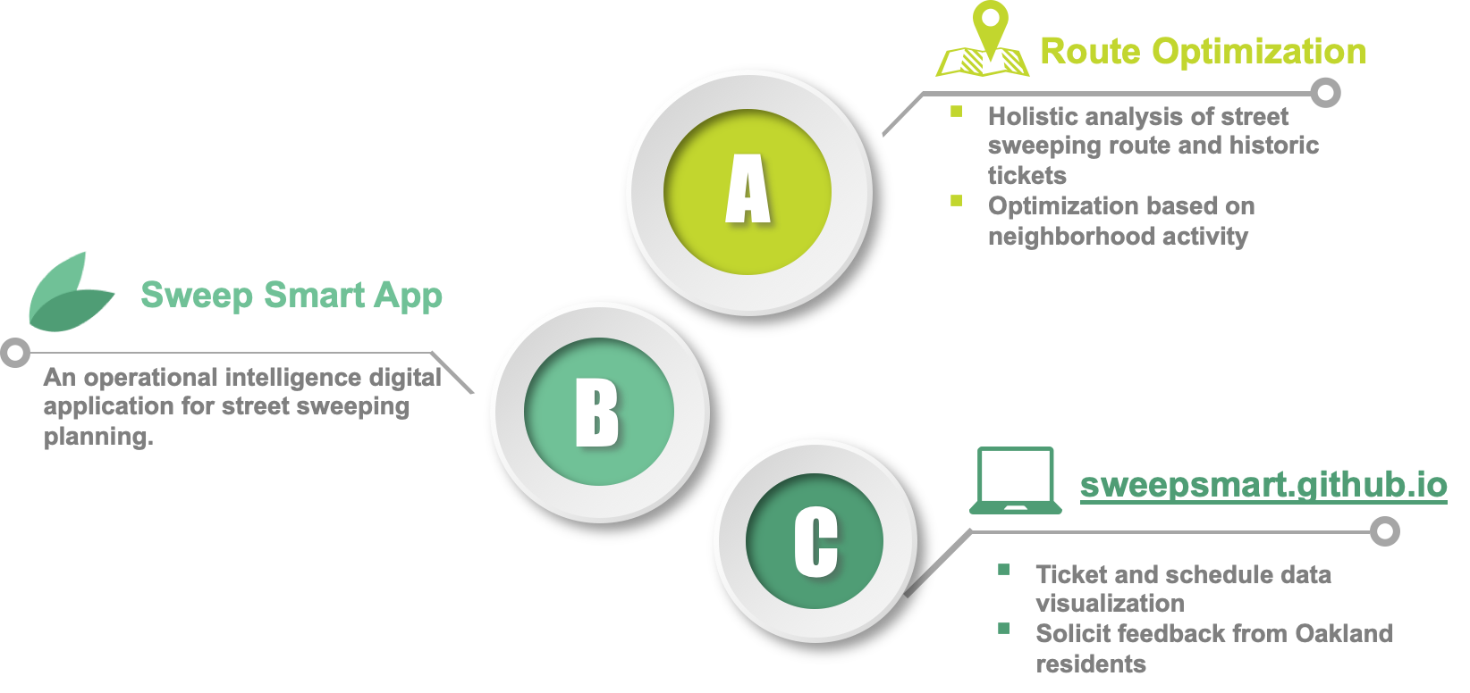
OUR APPROACH
User Research & Design
Extensive research channels and iterations

Slide 4
USER RESEARCH & DESIGN
DEFINE PROBLEMS
NARROW SCOPE
ITERATE DESIGN
3 rounds of needfinding interviews with DOT
Exploratory ticket data analysis
Survey analysis with 435 Oakland residents
1-1 Interviews with consented Oakland residents
4 interviews & observation studies
Low-fid -> High-fid
Usability testings
Expert reviews
Partner with Sweep Smart team in UXR class:
Virtual Fieldwork
Market Research
Heuristic Evaluation
Notes:
We have 3 major stages for user research
Stage 1 is about defining problems
To kickoff the project, we first conducted 3 rounds of needfinding interviews with DOT to understand their demands
Then, we did exploratory ticket data analysis for the past few years using Python to understand ticket distribution patterns
Stage 2 is about narrowing down the project scope
Analyze survey results for 435 oakland residents about ppl’s experience in dealing with parking violation tickets.
We contacted consented respondents from the survey for 1-1 open-ended qualitative interviews, to know more about their detailed concerns.
Finally we did remote field study using Google Map street view for those ticket hotspots (especially SS violation), to find possible reasons for the high number of parking violations by observing the surrounding neighborhood.
Stage 3 research is about iterating the designs for both sweep smart tool and public website
We did 4 rounds of interviews and observation studies with Street sweeping unit in City of Oakland, to collect data about supervisors’ planning process.
We also did usability testing for both the tool and the website throughout the whole design process, with different stakeholders, such as Oakland residents, and government officials.
Besides, we also partnered with a team of three students from user experience research class (info 214), and they helped us perform additional research, such as: virtual fieldwork about ss signage using Map Street View; market research about existing 2-G and parking applications, heuristic evaluation of sweep smart application’s prototype.

Slide 5
RESEARCH FINDINGS
Street Sweeping schedule doesn’t match regular parking activities of citizens
Street Sweeping Unit is still manually doing all the planning on paper -- less efficient
Street sweeping parking violation is not an awareness issue -- residents do not know how to feedback
Notes:
Three majors findings obtained from our users and stakeholders:
Ss schedule doesn’t match regular activities of citizens, which cause conflicts between residents’ normal parking hours and ss hours.
Street sweeping unit is still manually doing route planning, which is very inefficient and difficult to communicate with other departments in DOT.
SS parking violation is not an awareness issue -- residents do know the no-parking enforcement time in their neighborhood.

Slide 6
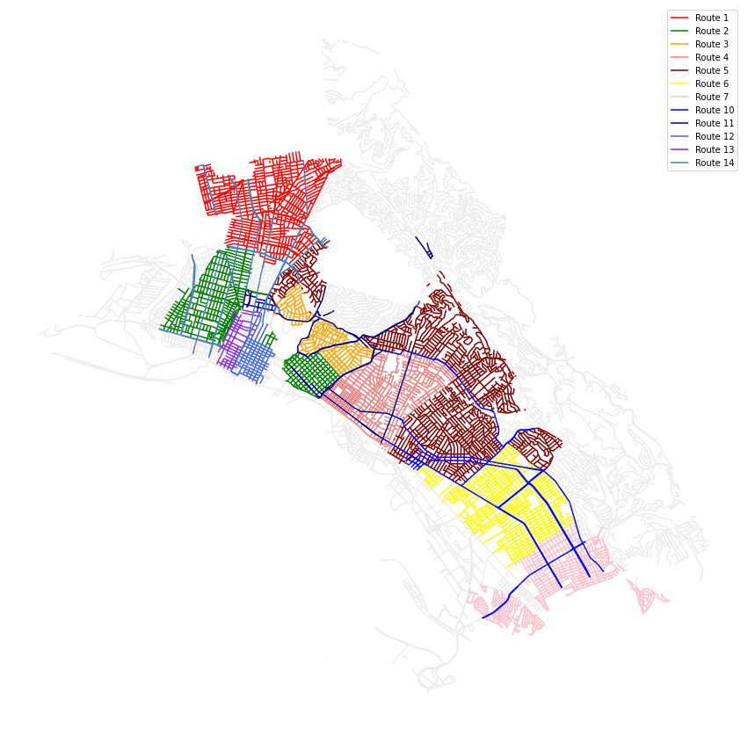
ROUTE OPTIMIZATION
Goal
Find inefficiencies in current sweeping schedule and offer alternatives
Method
Number of tickets / Monthly street sweeping frequency
Case by case analysis for top 50 streets (>4 tickets/sweep)
Data
Street Sweeping Route Schedules (address)
Historical Ticket Data (address, time)

Slide 7
ISSUES AND OPTIMIZATIONS
Issues
Optimizations
Areas with too frequent sweeping
Reduce sweeping frequency for 6 streets
Improper sweeping hours
Adjust hours for 14 streets
Inconsistent schedules along the same street
Adjust boundaries of schedule for 4 streets
Specific hot spots
Bespoke recommendations for 18 streets

Slide 8
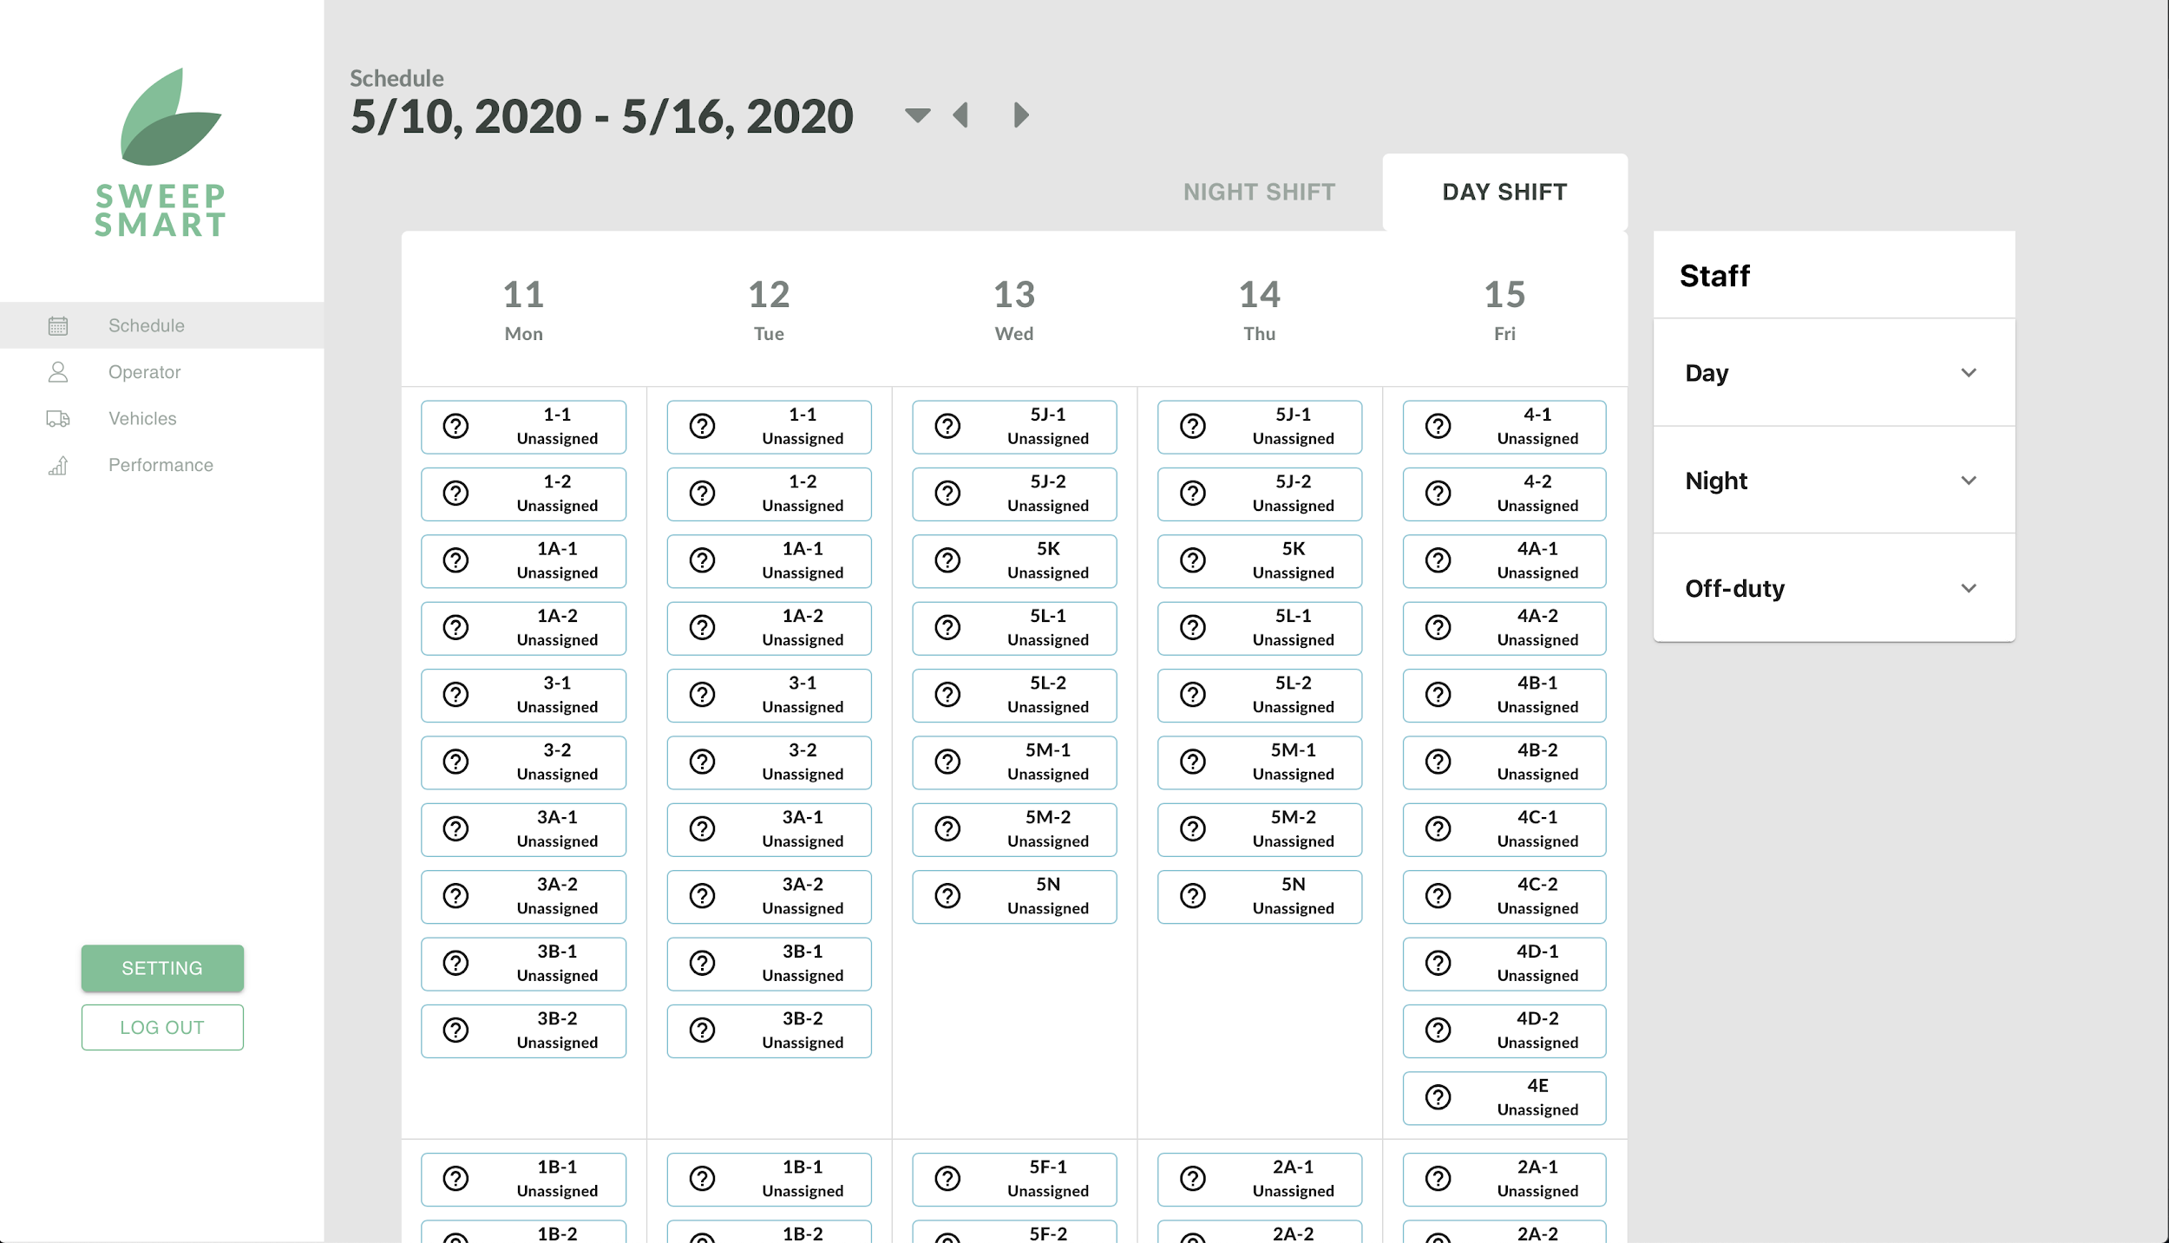
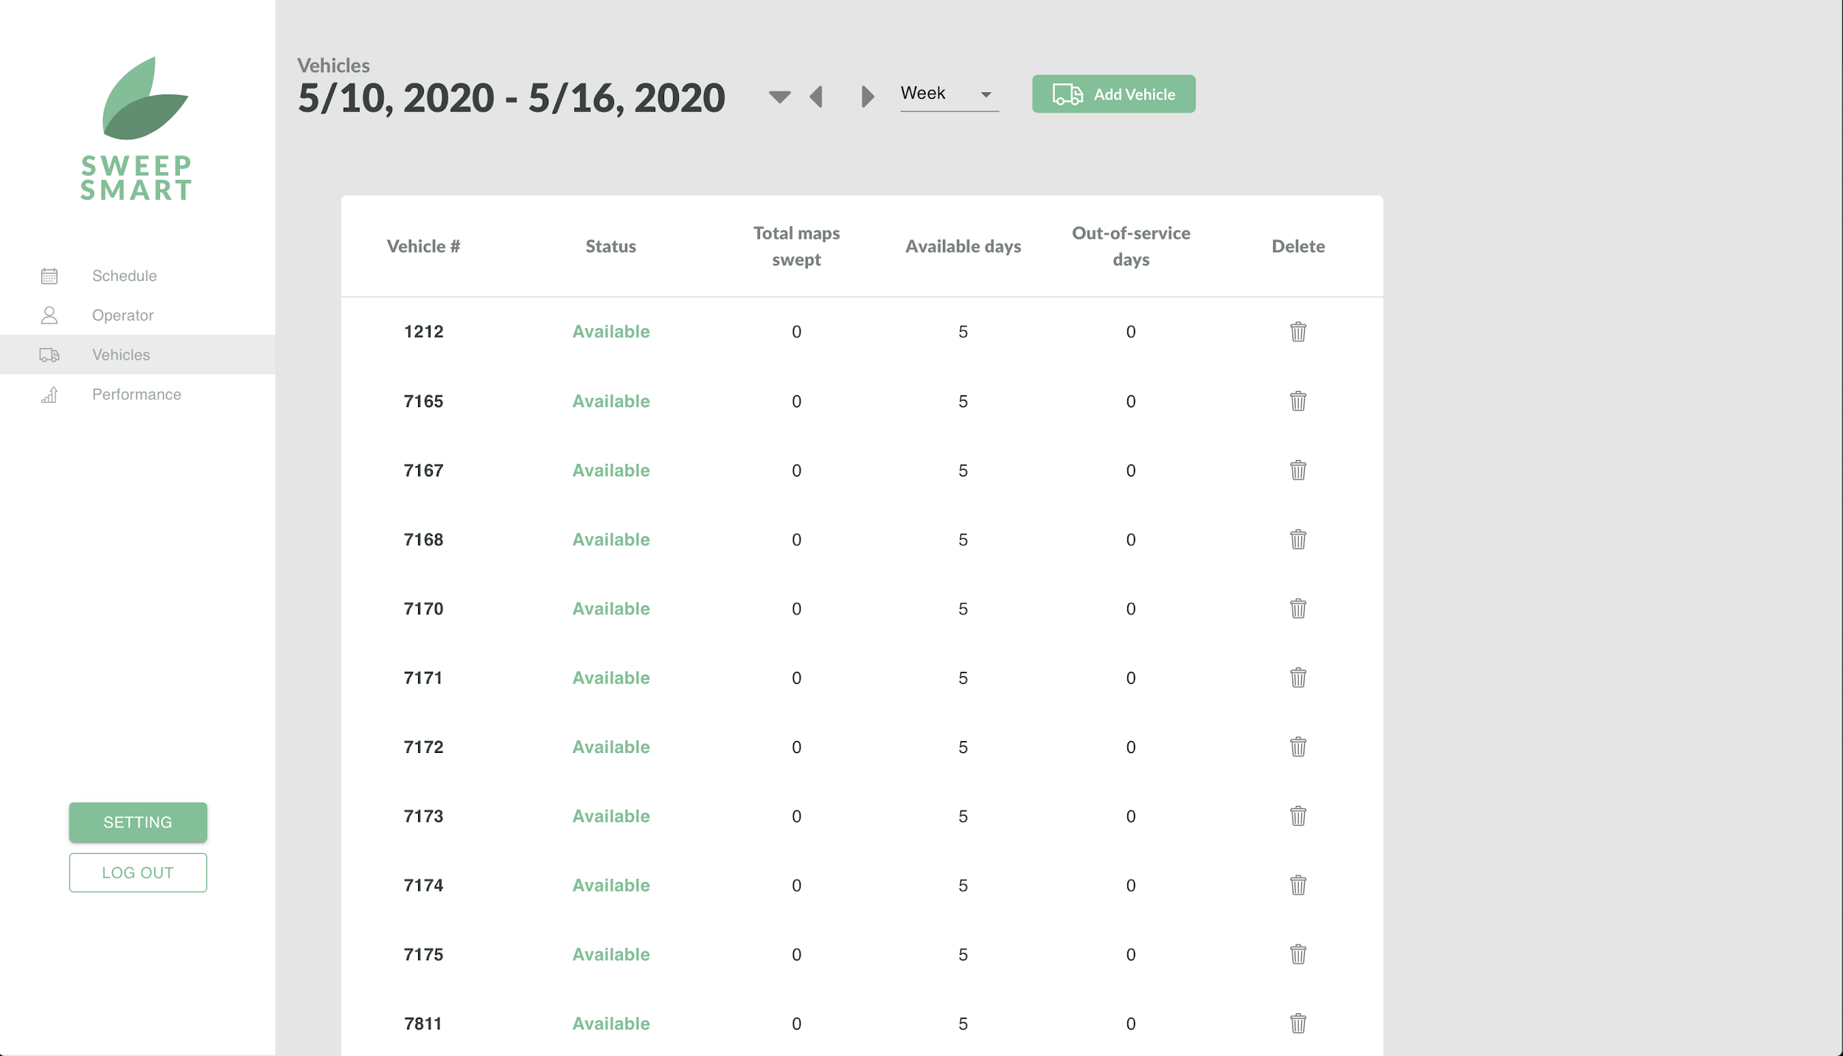
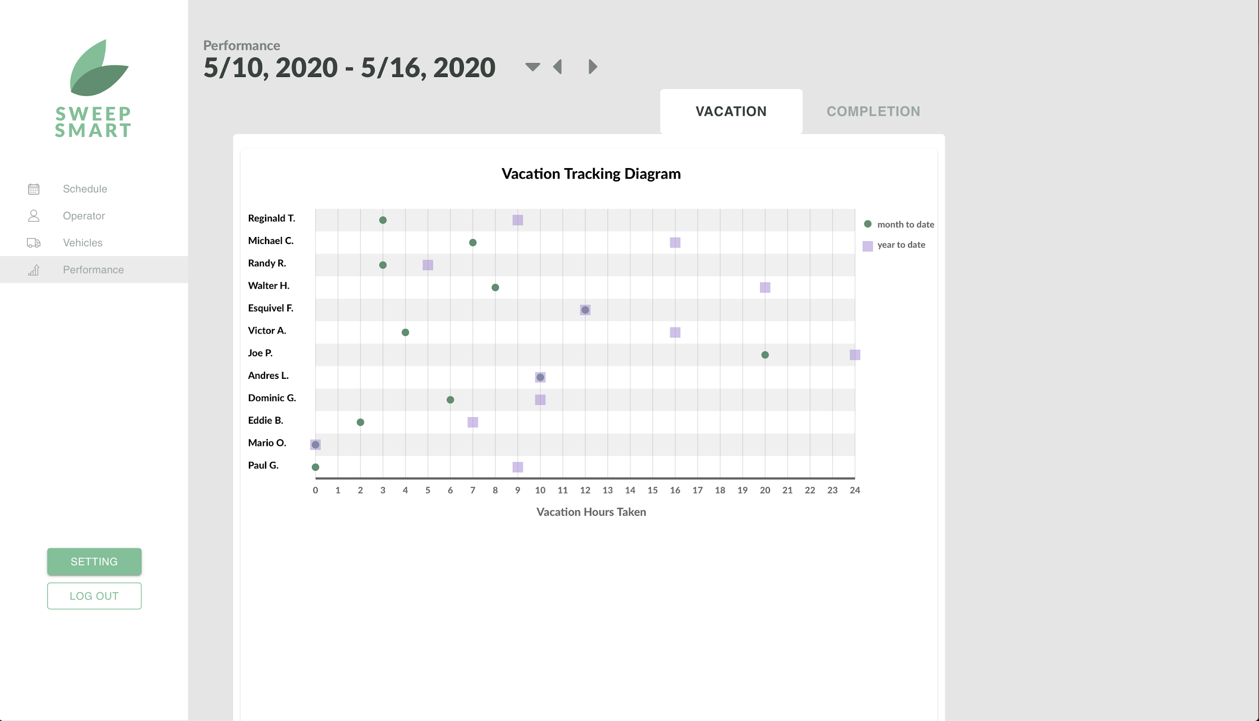
SWEEP SMART APPLICATION
Database
API
Front-end Interface
Route Schedules
/schedule/week/route GET
/schedule/week/route/action PUT, POST
Drivers
/schedule/week/route/item GET
Vehicles
/schedule/day/overview GET
/schedule/day/weather GET, PUT
Streets
/schedule/day/main/action PUT
Absences
/operator/week GET
/operator/individual/info GET
Schedule Daily Log
/operator/individual/add_leave POST
/operator/day/comment GET, PUT, POST
Attendance Daily Log
/vehicle/day GET
Vehicle Daily Log
/vehicle/day/action PUT, POST
/vehicle/action PUT, POST, DELETE
Holidays
/vehicle/day/maintenance PUT, POST
Vehicle Maintenance
/performance/month/operator GET
/performance/absences GET
.
.
.
.
13 schemas
.
44 routes
.

Slide 9
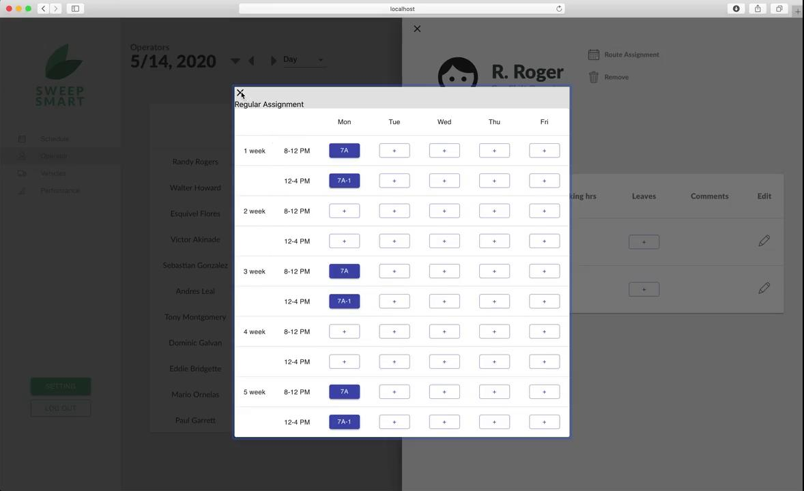
Video Demo of Sweep Smart

Slide 10
PUBLIC WEBSITE
Inform residents of street sweeping situation
Raise awareness of available feedback channels
Solicit feedback from the residents
Please visit https://sweepsmart.github.io/ for live demo

Slide 11
SWEEP SMART
Q & A

