Slide 2
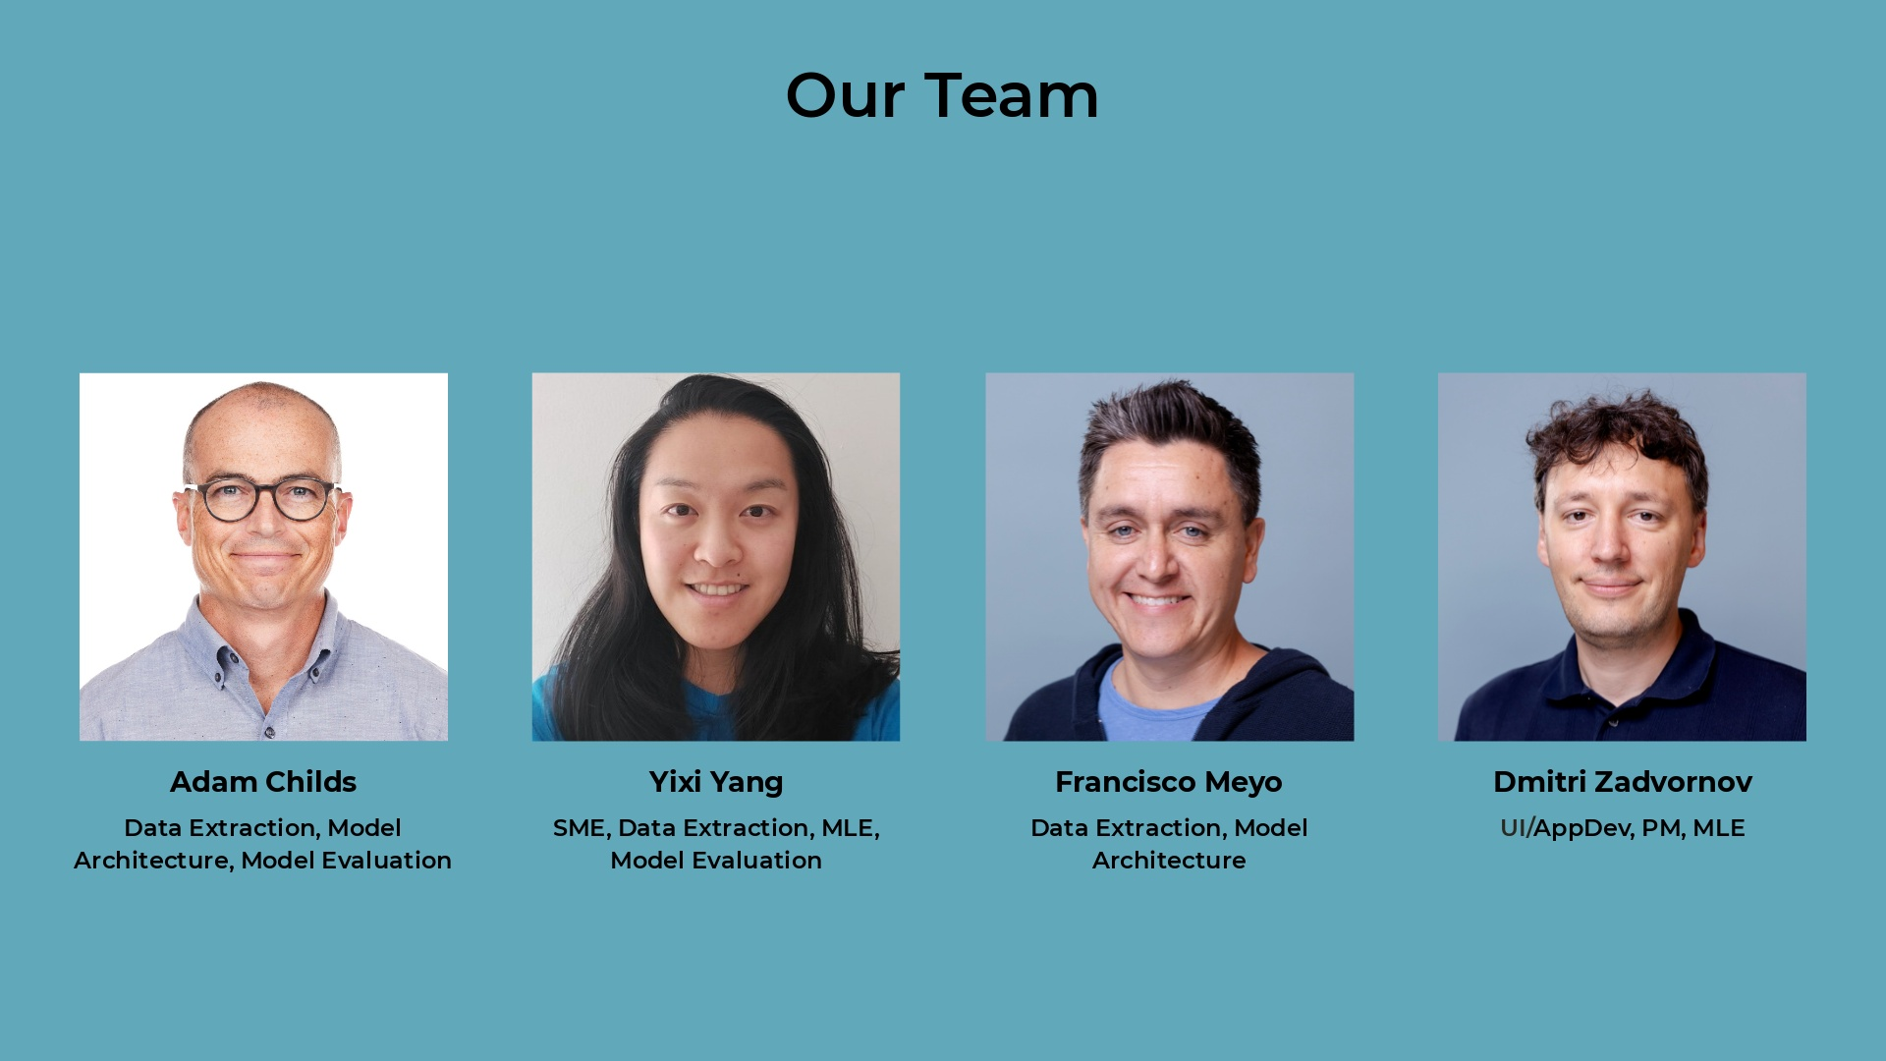

Slide 10
Notes:
Unstructured.io - sampling, identification of missing contentProcess: new Library, identify text diff across pages, Verify, Include in Store pages with delta above thresholdUnstructured.io - sampling, identification of missing content

Slide 15
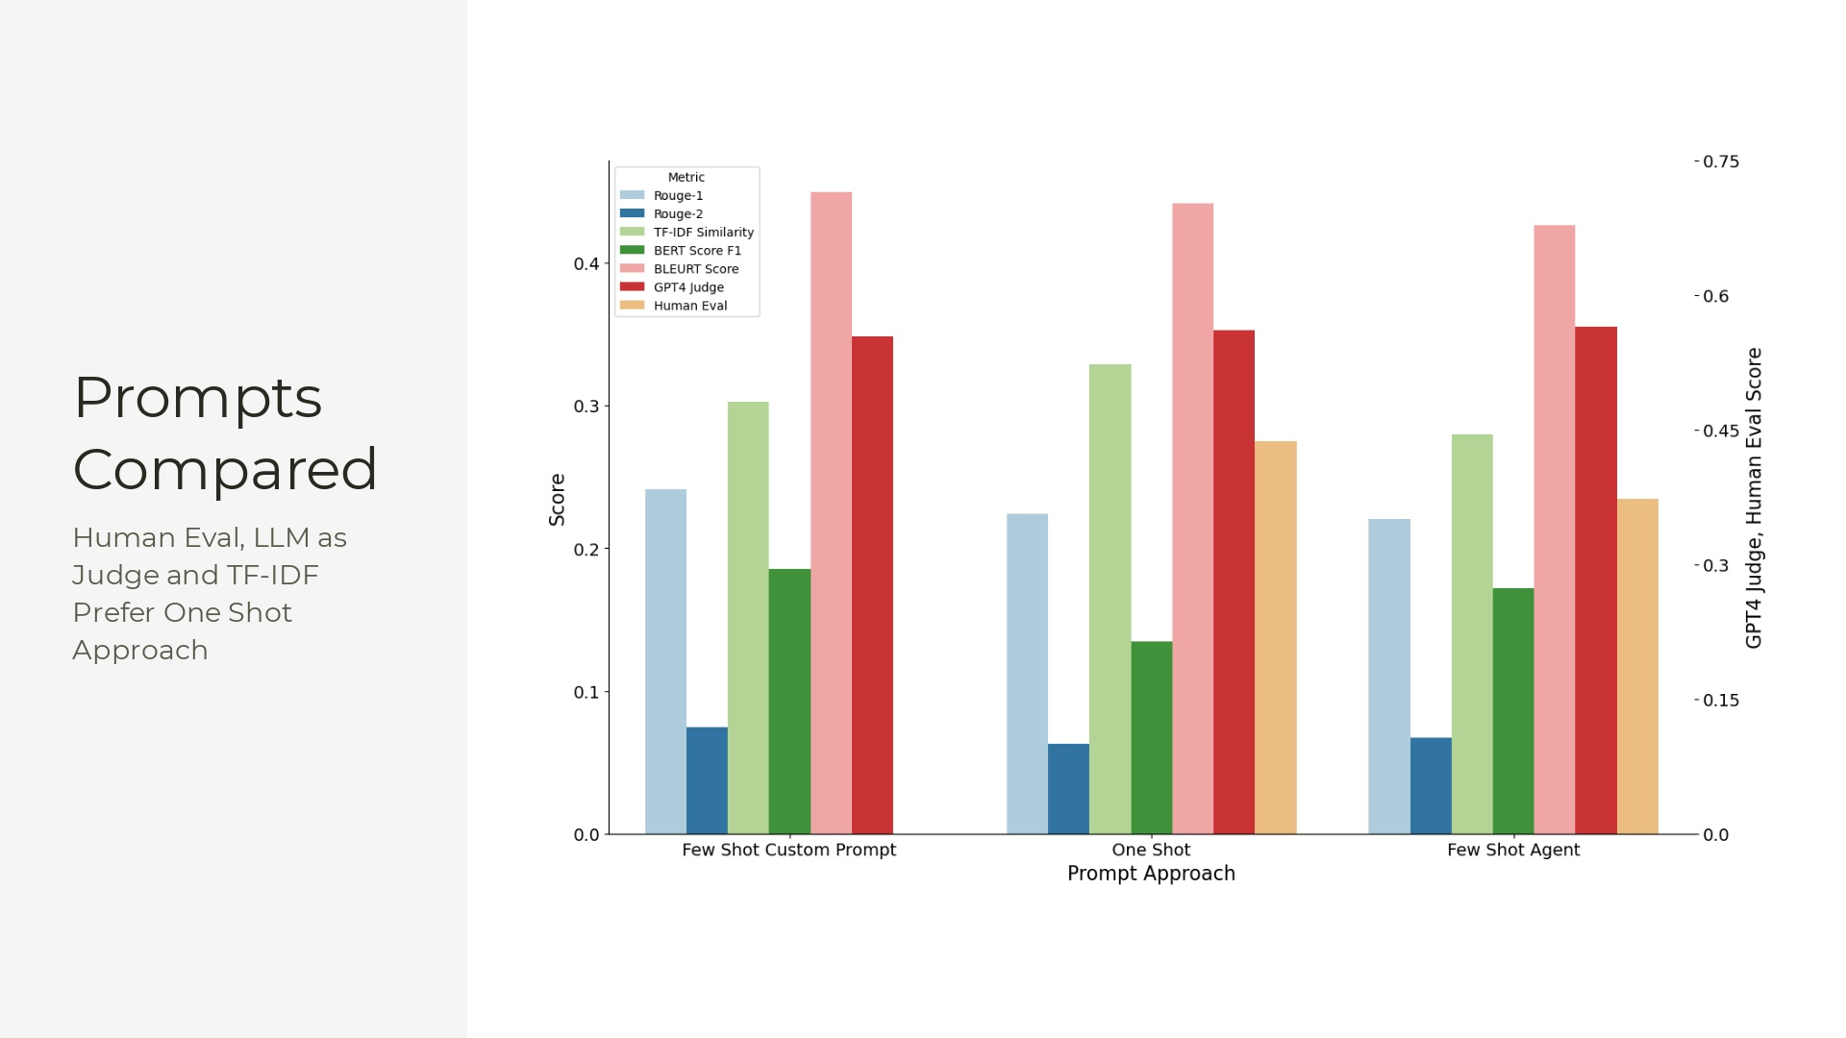

Slide 17
Notes:
Ground Truth for 243 Questions486 Human Evaluated Answers

