Slide 1
PRESSURE®
Real-time Crisis Navigator
Capstone Presentation-Spring 2017
Al Arsenault
Beth Partridge
Martin Neuhard
Rohitha Bhushan
Kevin McLanahan

Slide 2
07.22.2015
Notes:
A team of consultants from San Francisco is in meeting in a conference room in Gombe, Nigeria. They are installing a call center for pregnant women as part of the effort to reduce infant mortality in the developing world. Suddenly, a man bursts into the room yelling something in the local language. Panic sets in when make out from the chatter that there has been a bombing at a nearby bus station.

Slide 3
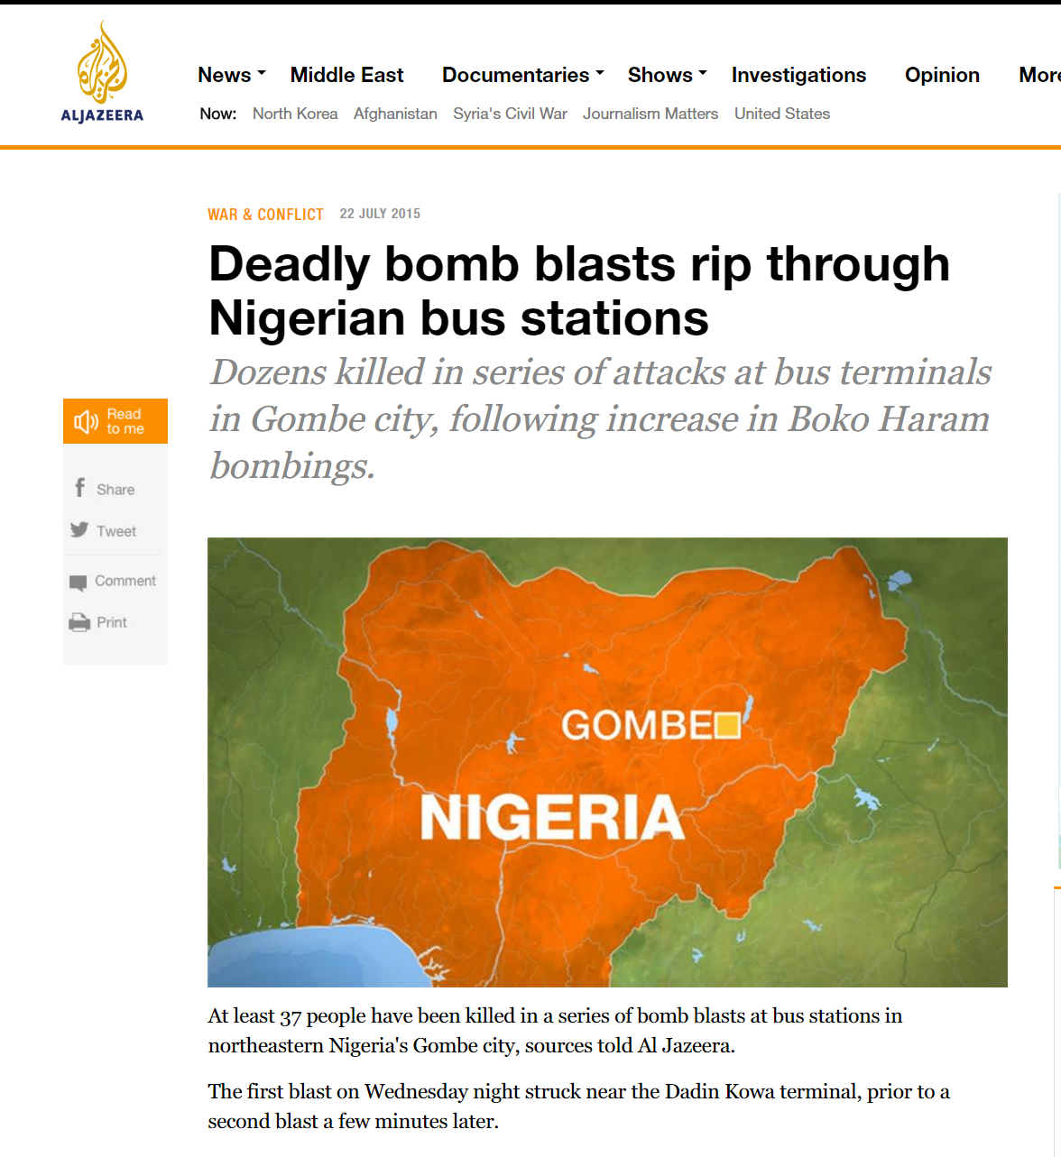
Notes:
The locals begin scrambling, concerned about their own loved ones. The consultants stunned and unsure of what to do. Should they stay put? Try to leave? One of their colleagues is in the field doing research. What about him?
They eventually make it safely back to their hotel. By the time they get their bearings and decide they need to evacuate, every international flight out of the country for the next 48 hours is completely booked. Their loved ones at home are in a panic.
As you might have guess by now, those were my employees, and this is a true story. And not an unusual one.
There is a huge development community in place carrying out a myriad of humanitarian programs in Africa
There can be literally be ten’s of thousands of foreign nationals on the ground at any given time
Bombings are not the only serious safety issue there

Slide 4
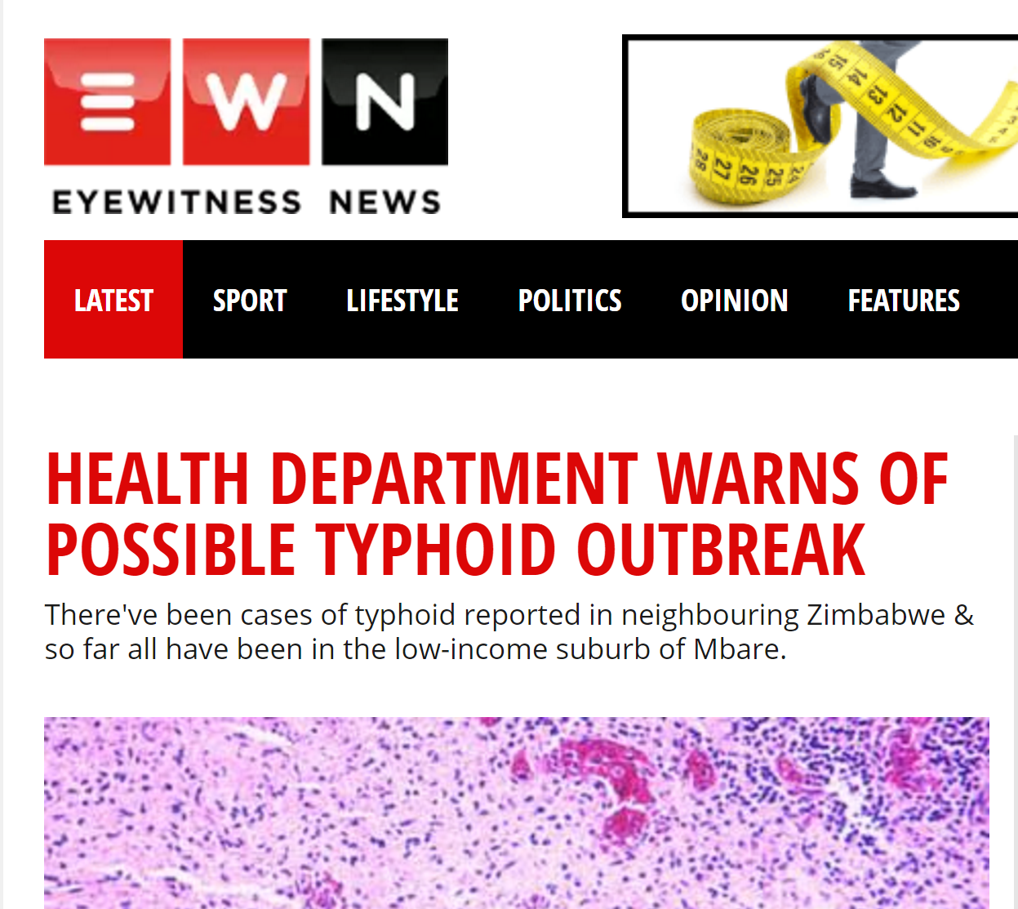
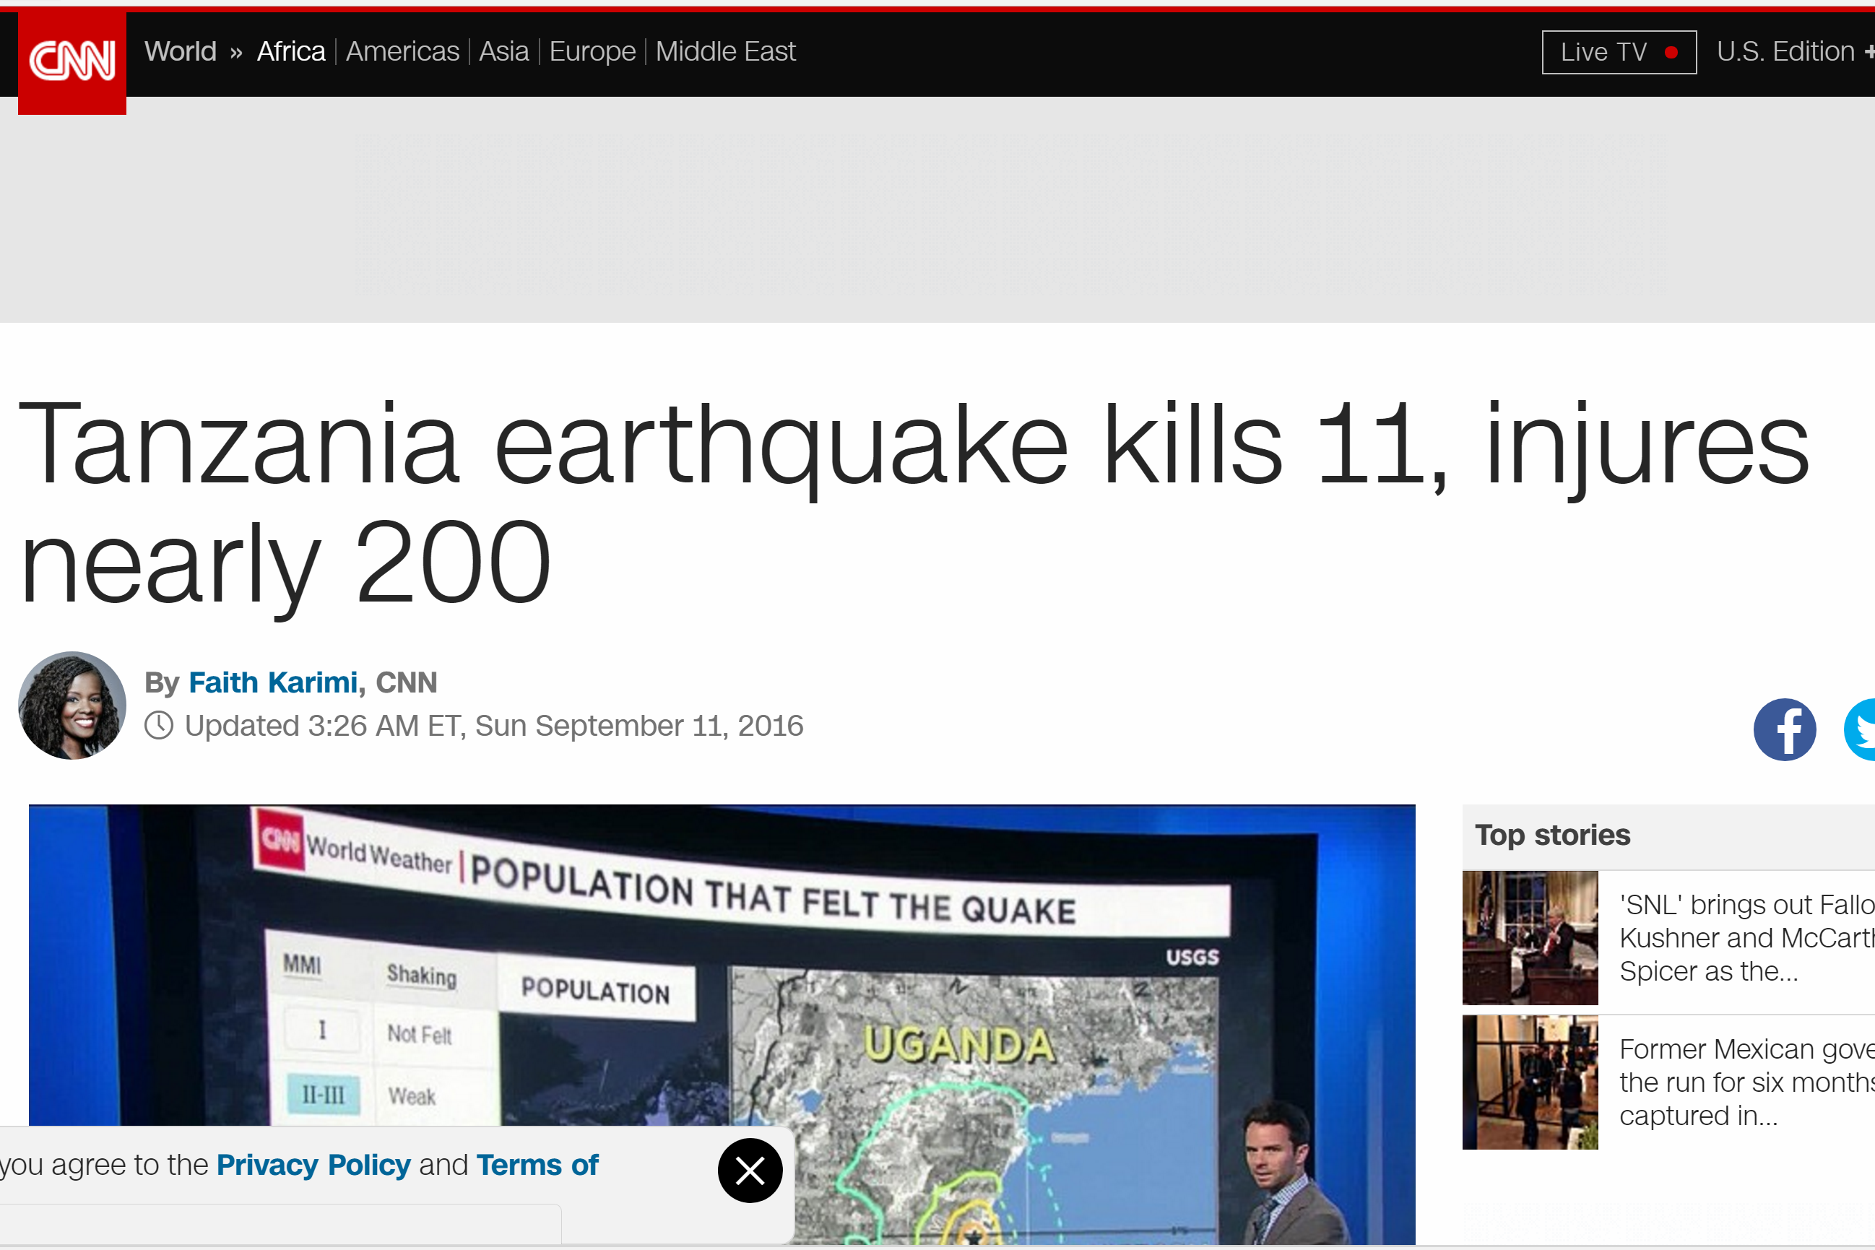
07.22.2015
Notes:
Political unrest, health crisis, natural disasters are all unfortunately, not uncommon there
It is truly terrifying to find yourself in a crisis situation in a dangerous, unfamiliar place.

Slide 5
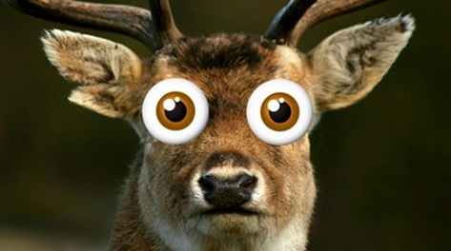
Notes:
Immature infrastructure and lack of information severely hamper a traveler’s ability to know how to respond in a crisis, leaving them feeling like the proverbial deer in headlights.

Slide 6
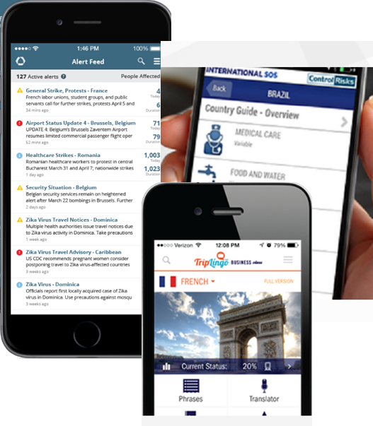
Product Definition
Domain expert interviews:
Joe Roark – Director Global Business Solutions, Richter International Consulting
Chris Welch – VP Sales, Direct Travel
Neil Wood – CEO, Aspen Security Consultants Ltd
Brendan Smith – VP Professional Services, Vital Wave Consulting
Derek Treatman & Leah Gatt – In-country Consultants, Vital Wave Consulting
7 of 10 Africa
Notes:
We began our project by doing secondary research; it was not hard to confirm that risks are real
7 of 10 most dangerous countries in the word are on the African continent
Next we conducted and several domain expert interviews, including a couple of corporate travel executive, an international security expert, and several consultants who have worked and traveled extensively in Africa
Those conversations again validated the need: once an afterthought, traveler safety in Africa has become a primary concern over the last 24 months
Finally, we evaluated several similar travel applications that we encountered during our discovery, used all of the inputs to isolate two key differentiating features for our project:
Several offer news and alert services, but they were all based on information obtained from news outlets or governmental organizations that can lag an actual event by precious minutes or even hours
Others offered location tracking and notification, but none provided any on-the-ground condition visibility and communication

Slide 7
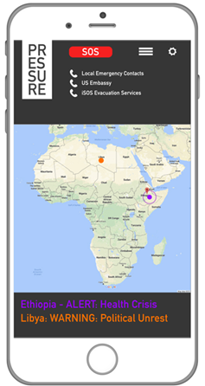
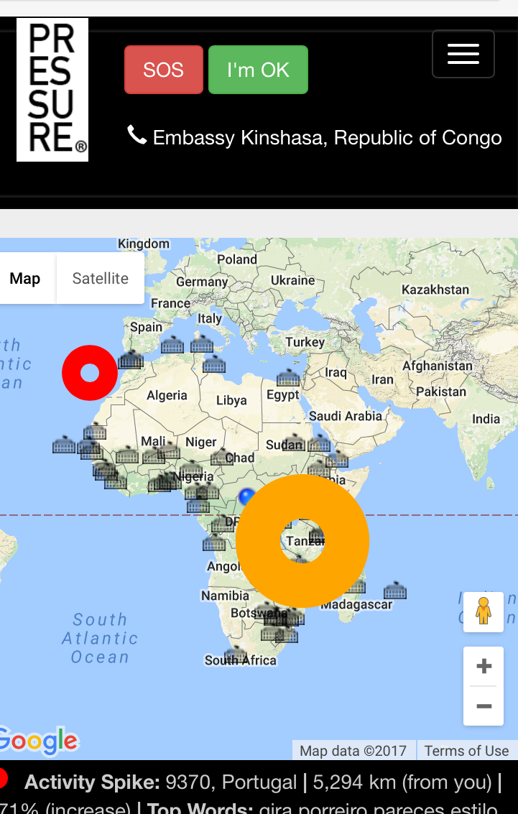
Our Solution: PRESSURE® Real-Time Crisis Navigator
The only real-time system designed for panicked travelers on the ground
Early warning system based on Twitter stream alerts users in real-time
Machine learning algorithms identify the threat and locate hot spots on the ground
Embedded functions to notify emergency contacts and transmit location information
Local emergency resource contacts embedded for instant access
Integrated with Google Map navigation functions

Slide 8
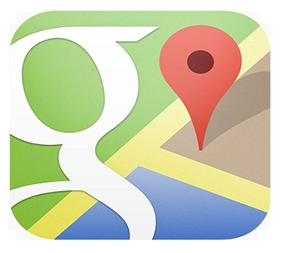
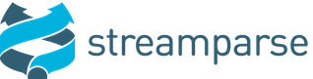
Solution Architecture & Data Flow
Event ID
Front End
Lat/Long Filter
Tweet Database
Spike Table
Spike Detector
Averages Table
> 500% of Average?

Slide 9
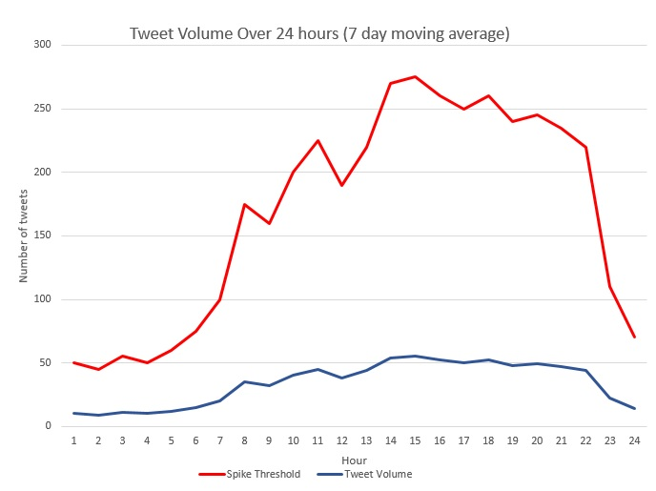
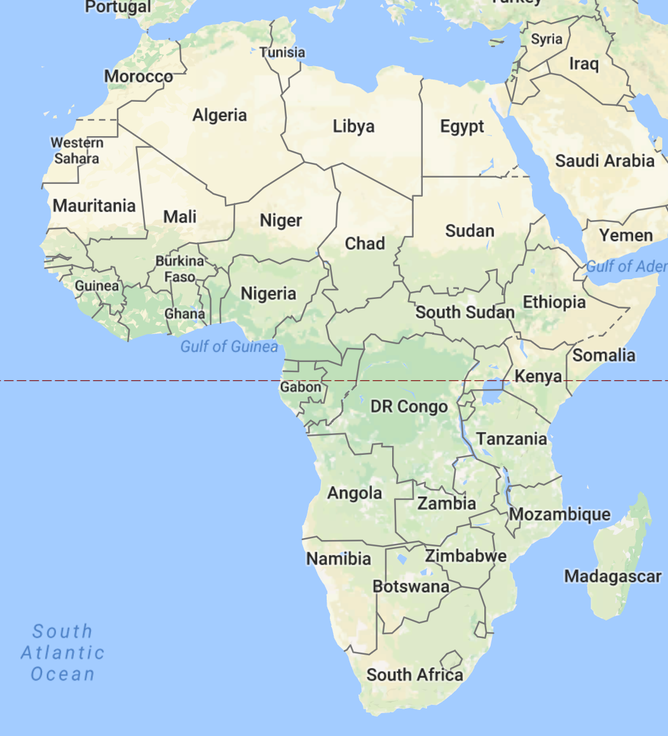
Spike Detection Algorithm
50 x 50 Grid
(Lat/Long)

Slide 10
Prototype Limitations
Location obfuscation in Twitter Garden Hose limits value as precise navigation device
In production we would get exact locations from the full Firehose and plot exact origins of tweets
Limited volumes of Tweets in Garden Hose make event identification difficult
In production we would replace top words by count with bigrams or trigrams for more accurate event description

Slide 11
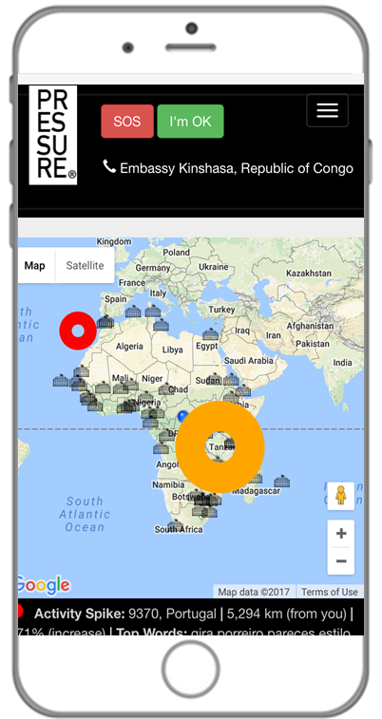
Product Demonstration (Simulated Crisis Event)

Slide 12
Future Improvements
Convert to smartphone app with push alerts and badges
Implement full Twitter Firehose for exact locations and better event ID
Implement travel companion location sharing and communication
Embed Google Translate functions to process foreign language tweets and enable emergency communication
Accumulate training data to implement Neural Language Model for event better event ID and filtering of true crisis events

Slide 13
Notes:
Let’s replay our opening scenario, but this time one of our consultants has a fully functional PRESSURE® running on his phone
They are once again in the conference room engulfed in their meeting when

Slide 14
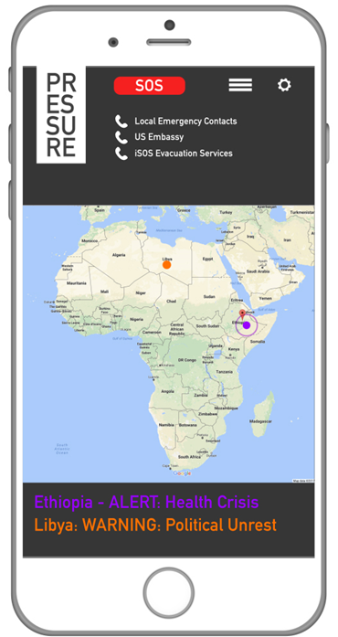
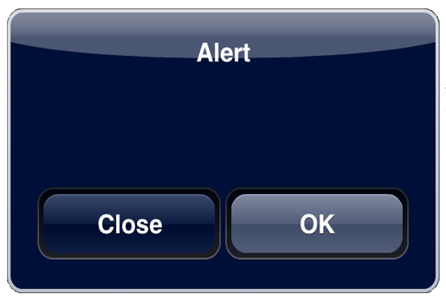
Activity Spike 10km away from you
Notes:
Our consultant gets a phone alert that something is going on very close to his location, several minutes before the man burst into the room.
He interrupts the meeting to let everyone know what’s going on

Slide 15
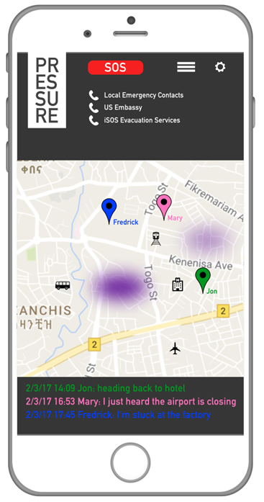
Notes:
His first concern is his companion in the field; he uses the app locate him and let him know what’s going on and where to meet
His second thought is about getting out of the country if things escalate; He quickly calls the 24-hour travel agency number and confirms seats on the next plane out for he and his collogues
Next his thoughts turn to his own loved ones at home; I’M OK button on the app to let his loved ones know they are ok and start transmitting his location, giving them some peace of mind and a way to monitor his situation

Slide 16
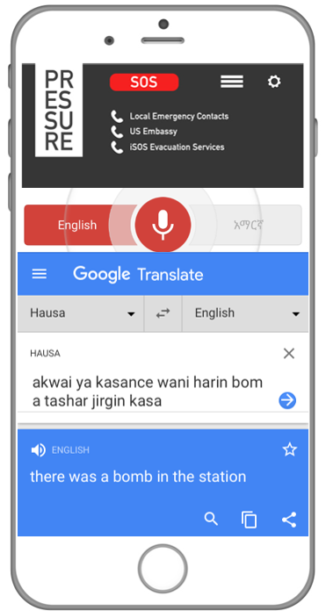
Notes:
He uses the embedded translate function to understand chaotic chatter going on in the room around him around him

Slide 17
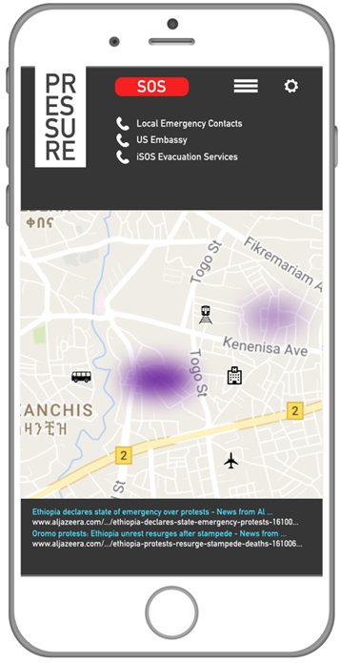
Notes:
On their way to the airport he consults the app frequently to make sure to avoid routes with high levels of activity
He continues to monitor the Tweet traffic and embedded news search results for updates until they are safely aboard the plane home

Slide 18
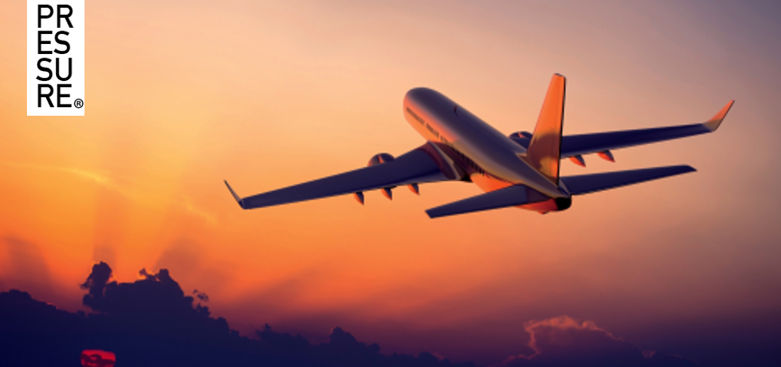
Notes:
Let’s replay our opening scenario, but this time one of our consultants has PRESSURE running on his phone
They are once again in the conference room engulfed in their meeting when…

