Slide 2
Kipitup
Utilizing biosensory data for nuanced marathon and cardio training recommendations

Slide 3
Motivation
621.2M
49M
+229M
#1
Runners in the world [1]
Runners in the US alone [2]
Apple Watches sold in the world until 2022 [3]
Wearable Devices
(22% of Market Q2-23) [4]
Sources: [1] [2] [3] [4]

Slide 4
Background
Meet Alex, an enthusiastic runner who wants to run a marathon.
He tried a generic online training plan for a marathon, but the program didn't consider his health needs.
During training, Alex often exceeded his safe heart rate, which made him feel uncomfortable and ultimately discouraged him from continuing the plan.
Notes:
Img src: https://www.google.com/url?sa=i&url=https%3A%2F%2Fdribbble.com%2Fshots%2F4292368-Hi-I-m-David-How-are-you-Marathon-GIF-17-30&psig=AOvVaw0fA2X2ZhJaKeZk6UNlui5E&ust=1714112209341000&source=images&cd=vfe&opi=89978449&ved=0CAQQjB1qGAoTCNikq9zb3IUDFQAAAAAdAAAAABCBAQ

Slide 5
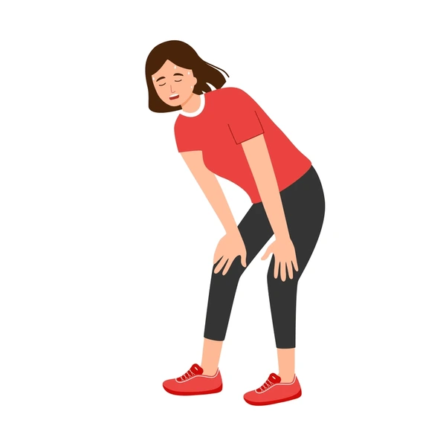
Problem Statement
The standard "one-size-fits-all" approach to fitness fails to accommodate individual physical limitations and specific needs, often discouraging personal engagement in fitness activities.

Slide 6
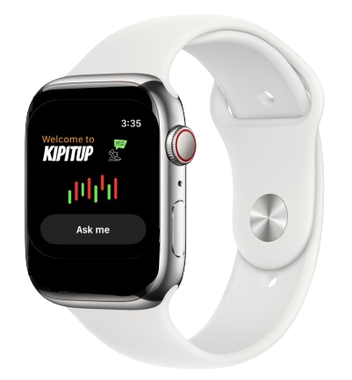
What is Kipitup?
Customizes fitness advice using Apple Watch data.
Integrates expert recommendations for effective training.
Provides targeted plans for cardio and marathon prep.
Notes:
Kipitup provides adaptive training routine for specific fitness goals like marathon preparation leveraging biosensory feedback from the Apple Watch tailored specifically to the user's current physical condition and fitness goals.

Slide 7
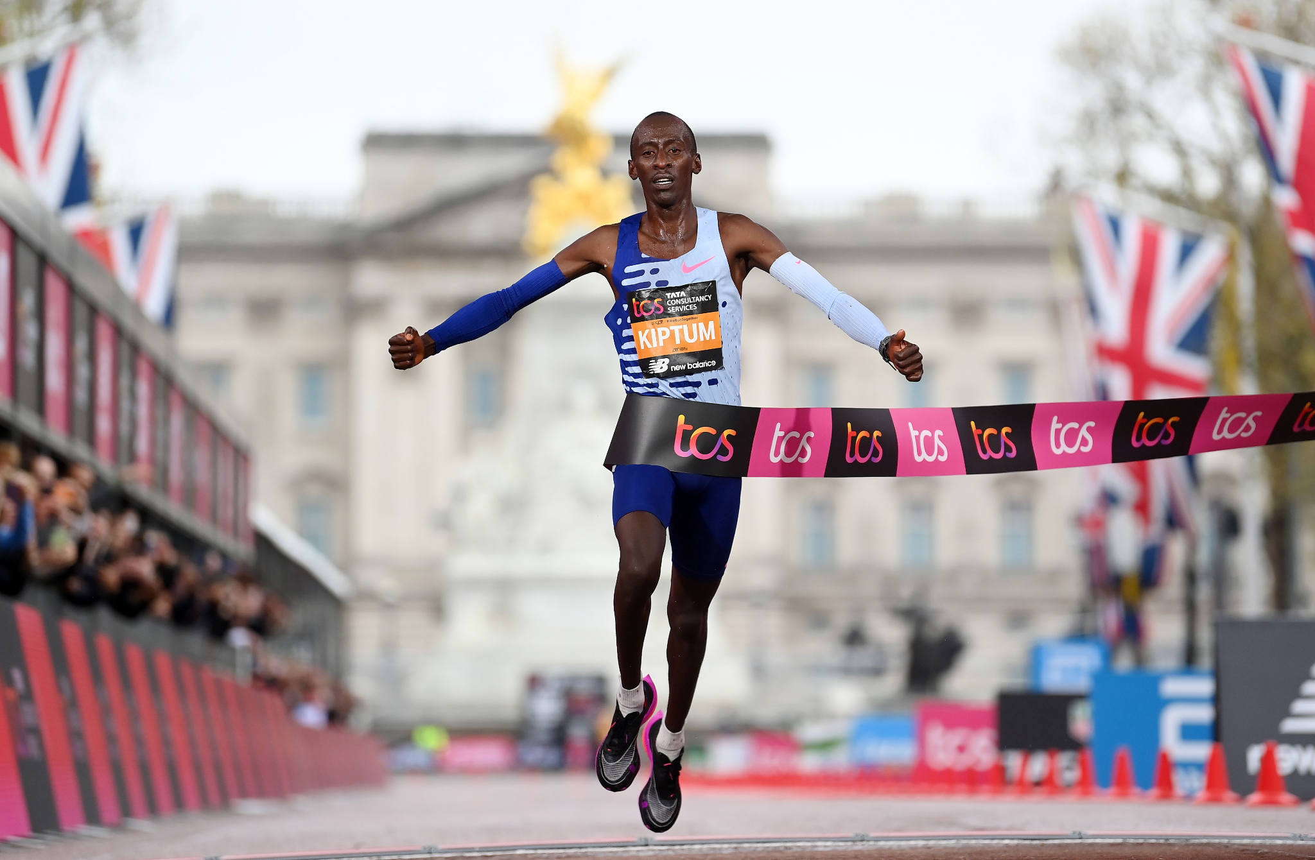
Elevate → Kipitup
Kelvin Kiptum
Kenyan long-distance runner
1999-2024

Slide 8
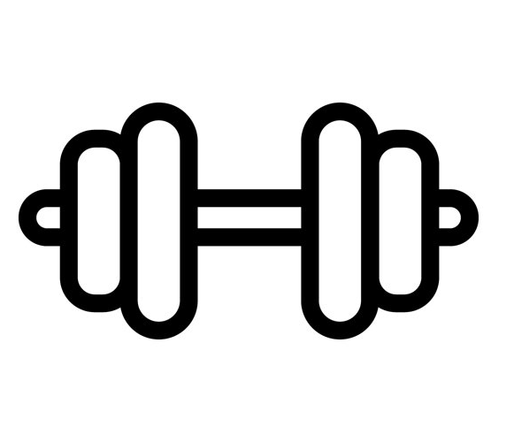
Key features
Personalized Training Routines
Biosensory Data Utilization
Tailored advice for marathon preparation and other fitness goals.
Understanding your body vitals before sharing crucial advice
Interactive Prompts
Question Versatility
Voice-activated fitness advice directly from your Apple Watch.
Kipitup will intelligently respond to any type of question posed

Slide 9
Product Design

Slide 10
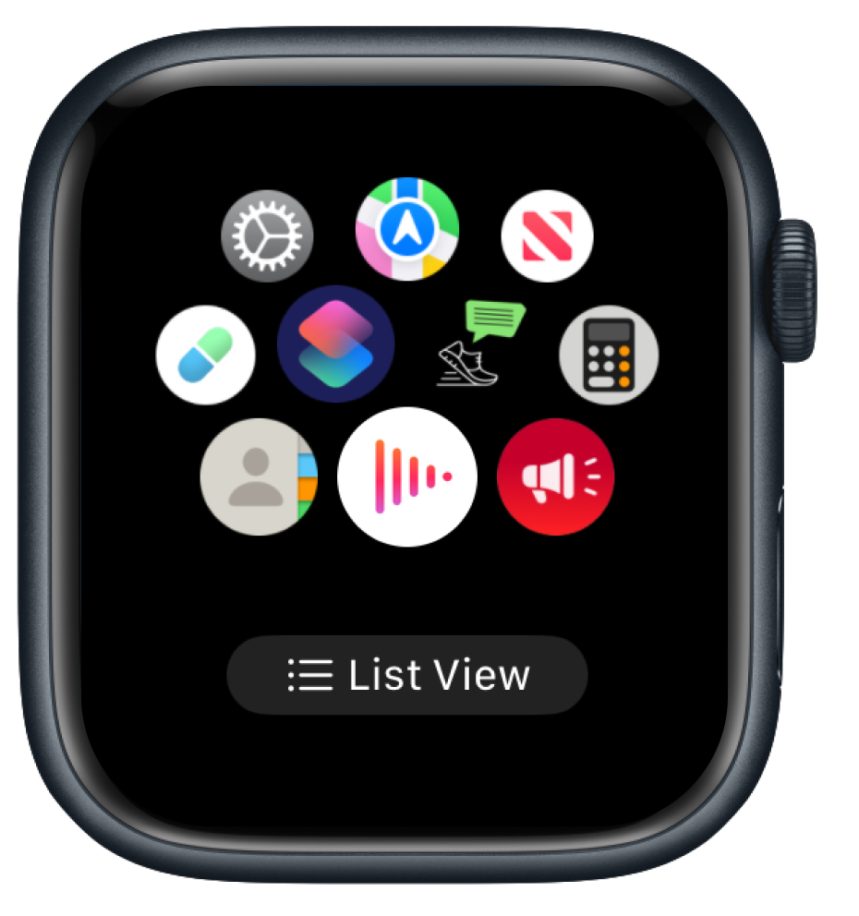
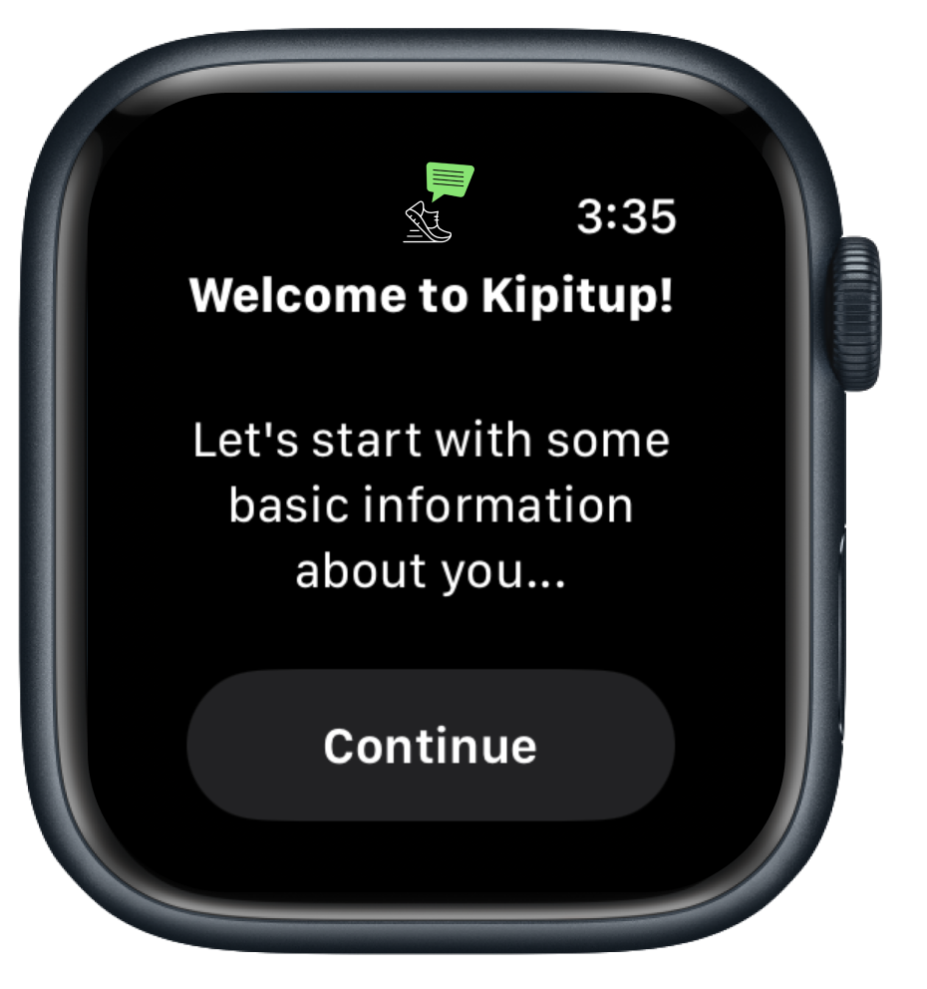
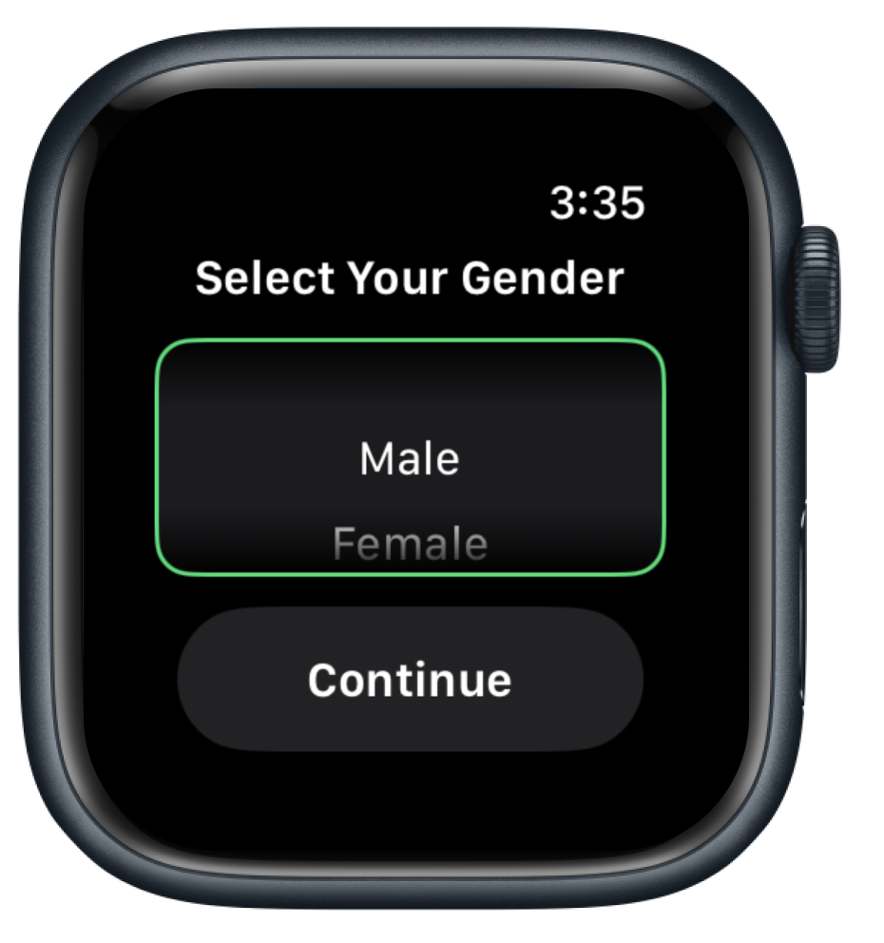
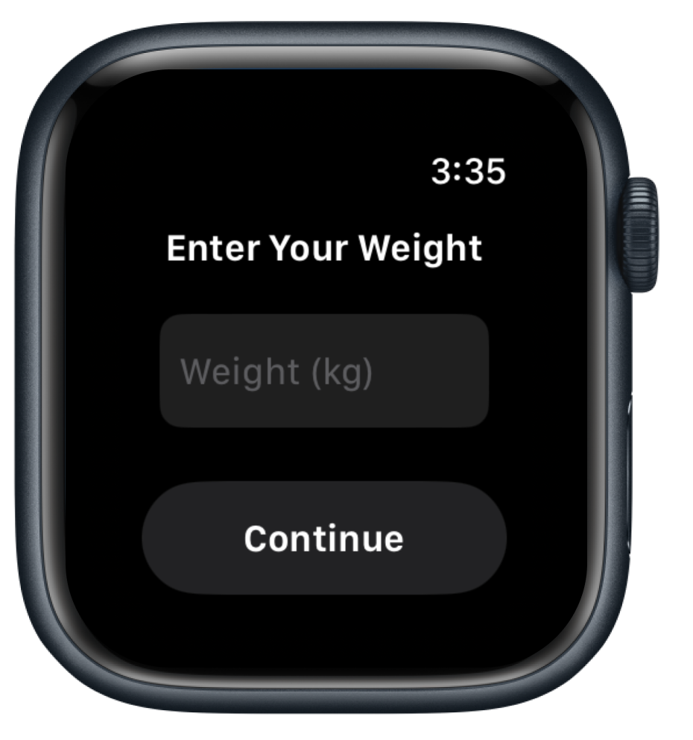
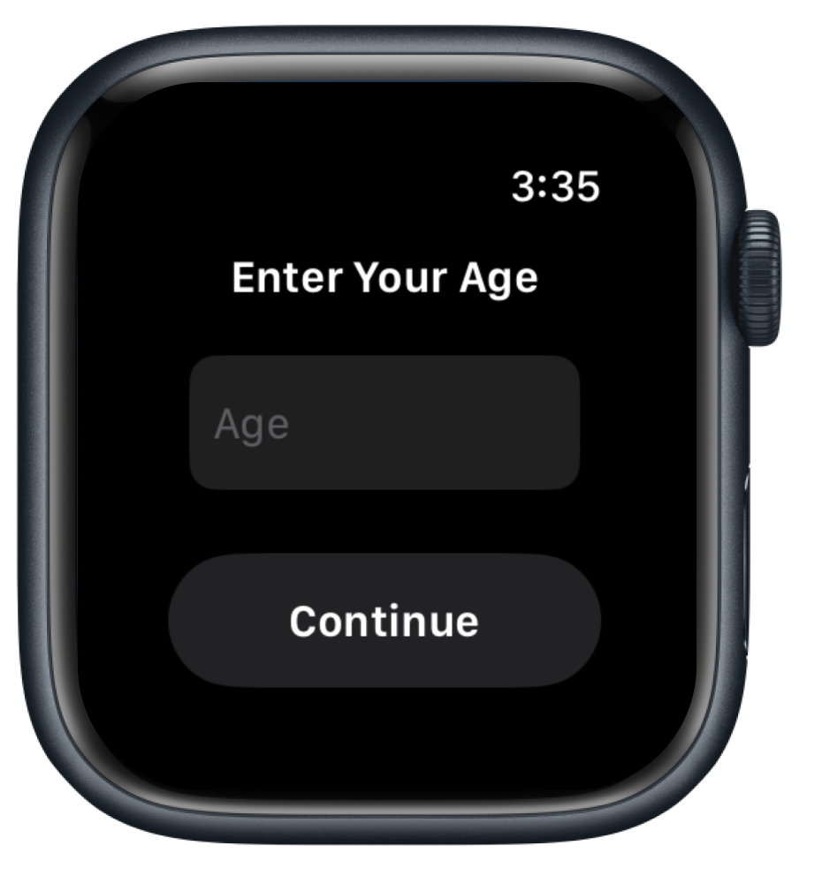
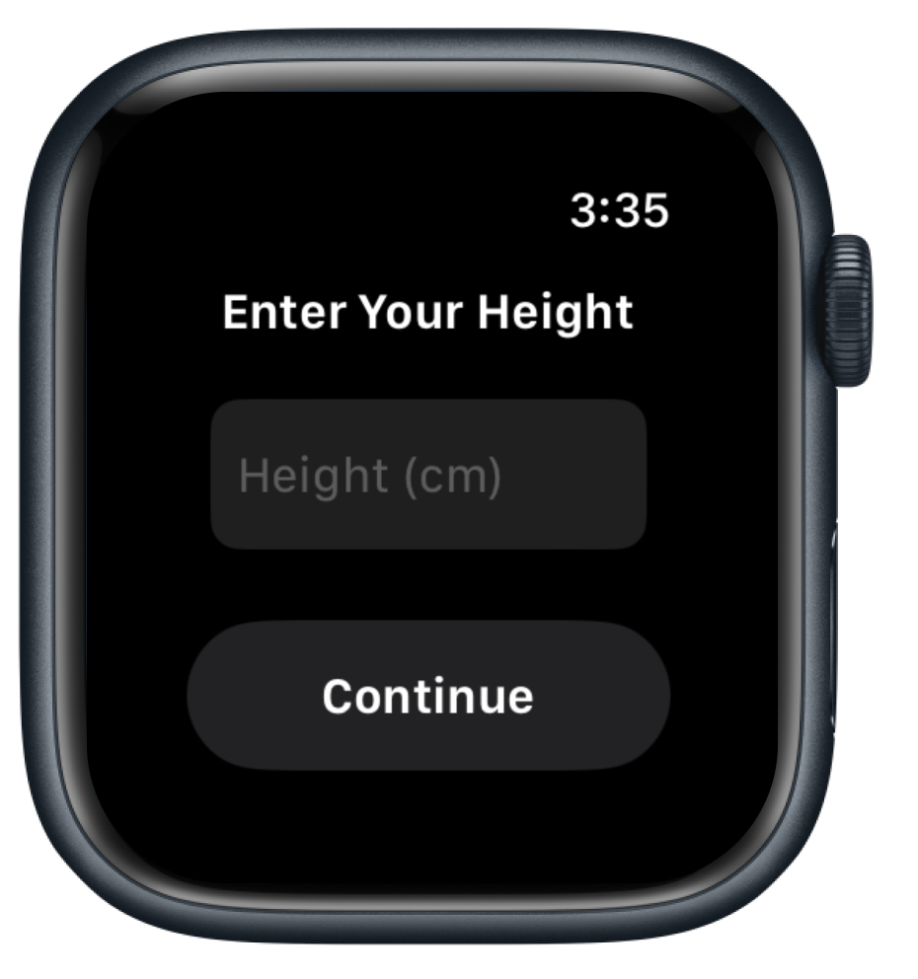
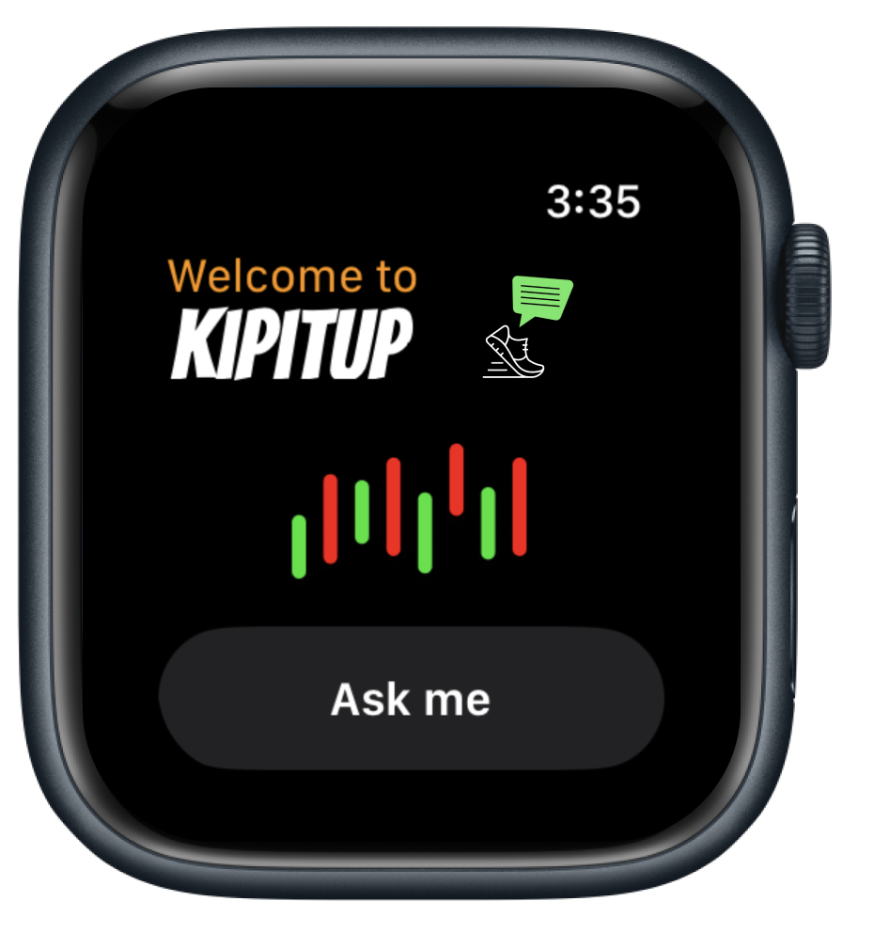
User Flow - New user onboarding

Slide 11
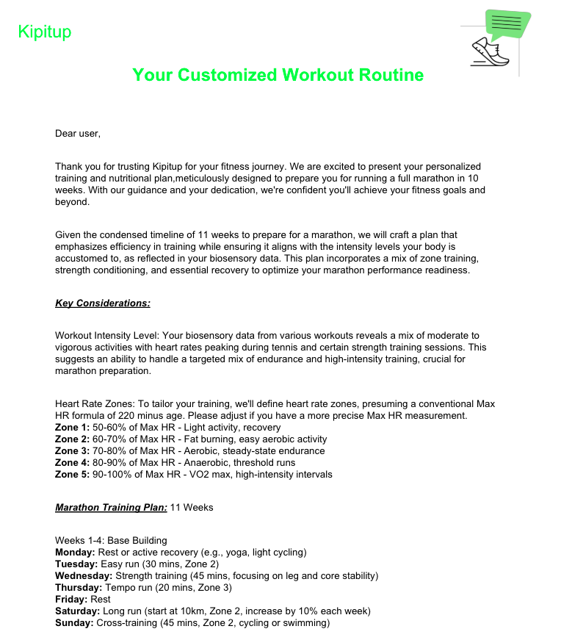
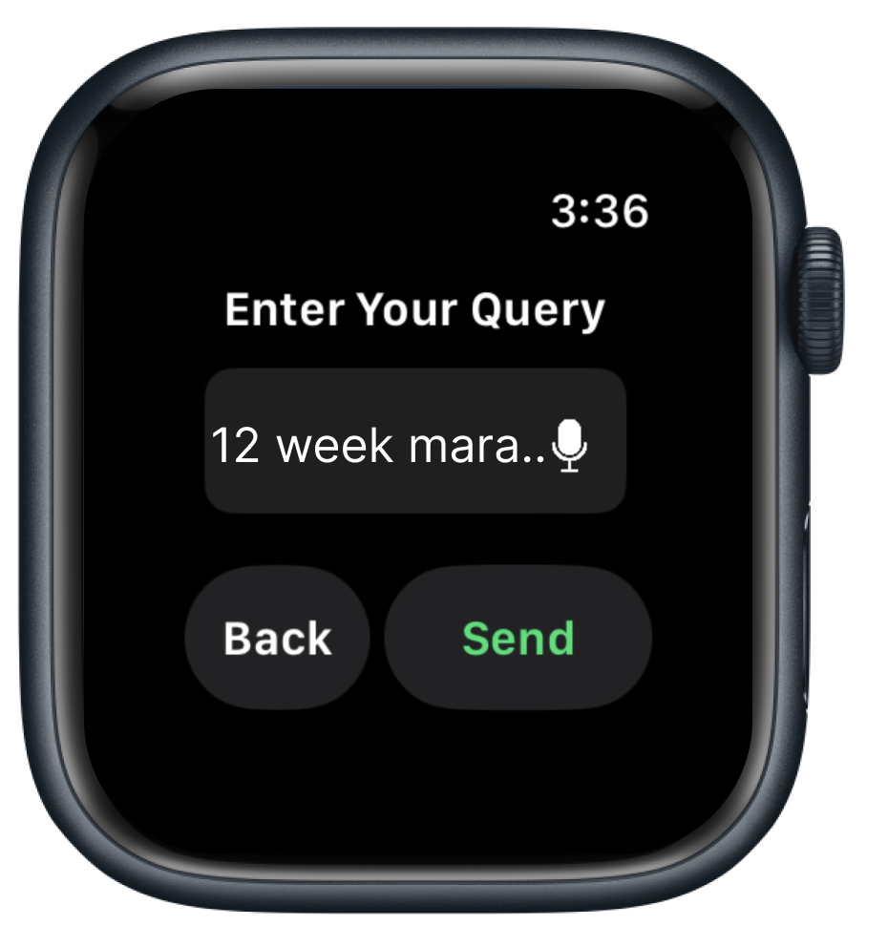
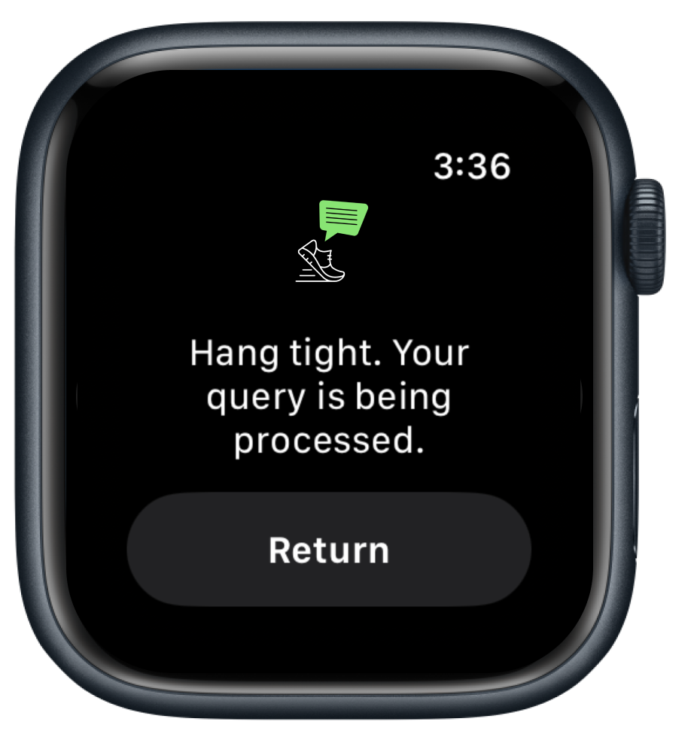
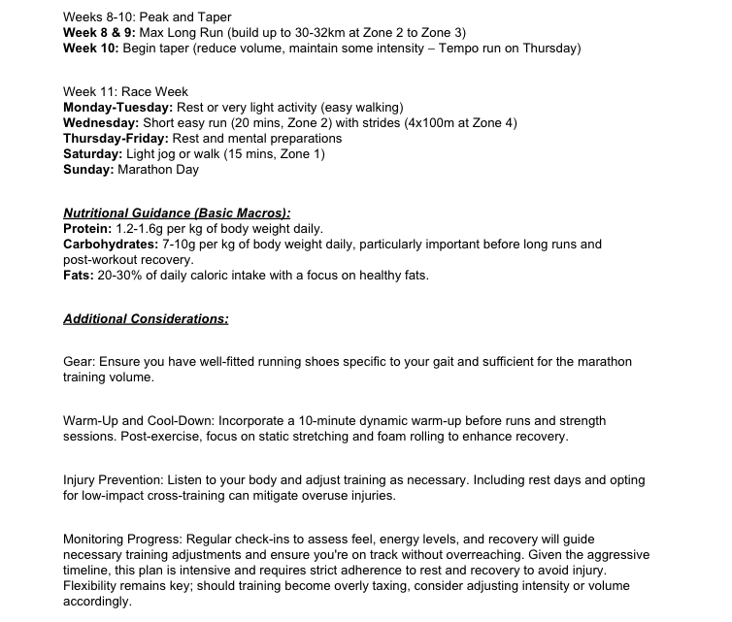
User Flow

Slide 12
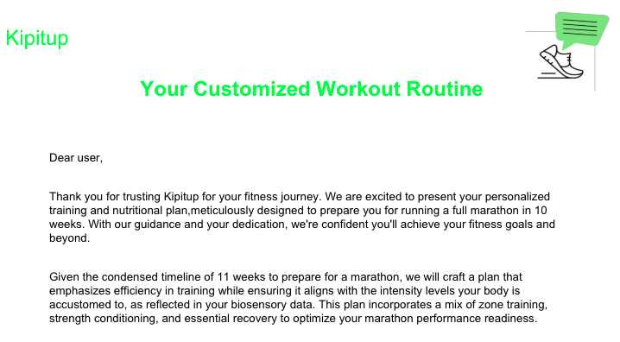
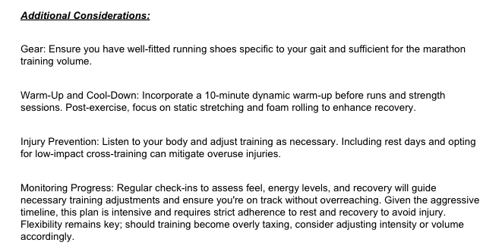
Marathon training routine

Slide 13
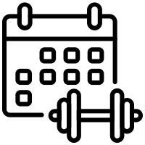
Training routine evaluation
Routine impact evaluation
Health impact evaluation
To understand if the routine if effective for the user’s request (e.g: marathon in 12 weeks)
To understand if the the routines are medically accurate, taking in consideration diverse health backgrounds
Diego Ruano
Dr. Alessandra Bacelar
Special
Thanks

Slide 14
Technical Architecture

Slide 15
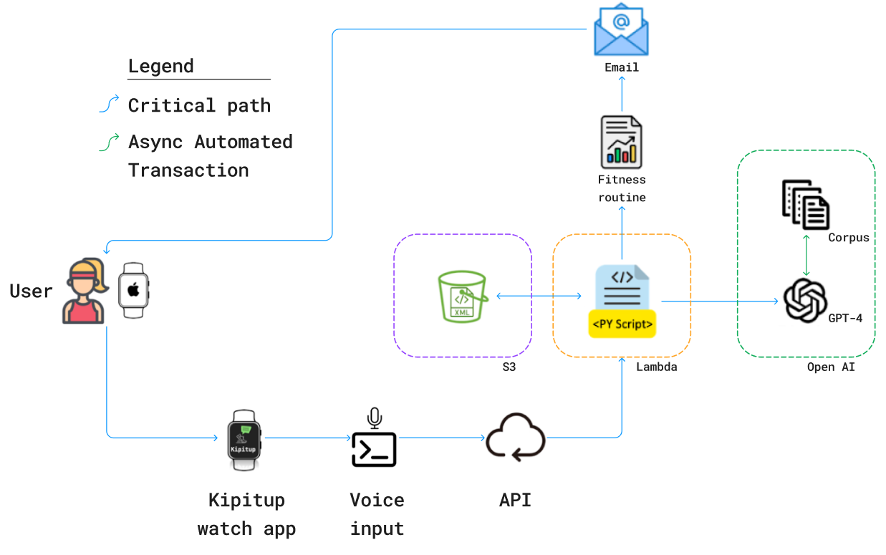
System Architecture

Slide 16
Product demo

Slide 18
Future Roadmap

Slide 19
Looking ahead
Expand Training Options: Currently focused on marathon training; aim to include a variety of routines catering to different fitness goals.
Incorporate Diet Plans: Introduce diet recommendations tailored to user preferences and ethnic backgrounds for holistic health management.
Broaden Device Compatibility: Extend support to include other popular fitness watch brands, not just Apple Watch.

Slide 20
Reflection

Slide 21
What did we learn?
Lesson 1: Start early to tackle unexpected challenges. Prioritize development over research and ideation to address roadblocks sooner.
Lesson 2: Iterate user flow extensively through early wireframes and low-fi mockups. This approach can reveal crucial tweaks earlier, saving development time and reducing prototype iterations.
Lesson 3: Define and document multiple versions of success early. Establishing clear MVPs upfront can mitigate stress and streamline decision-making when encountering critical development issues.

Slide 22
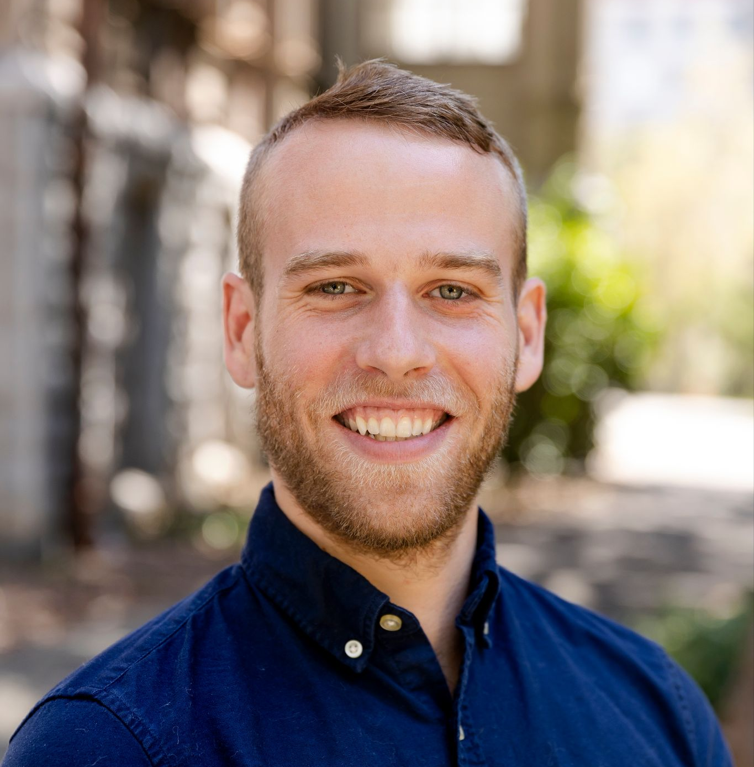
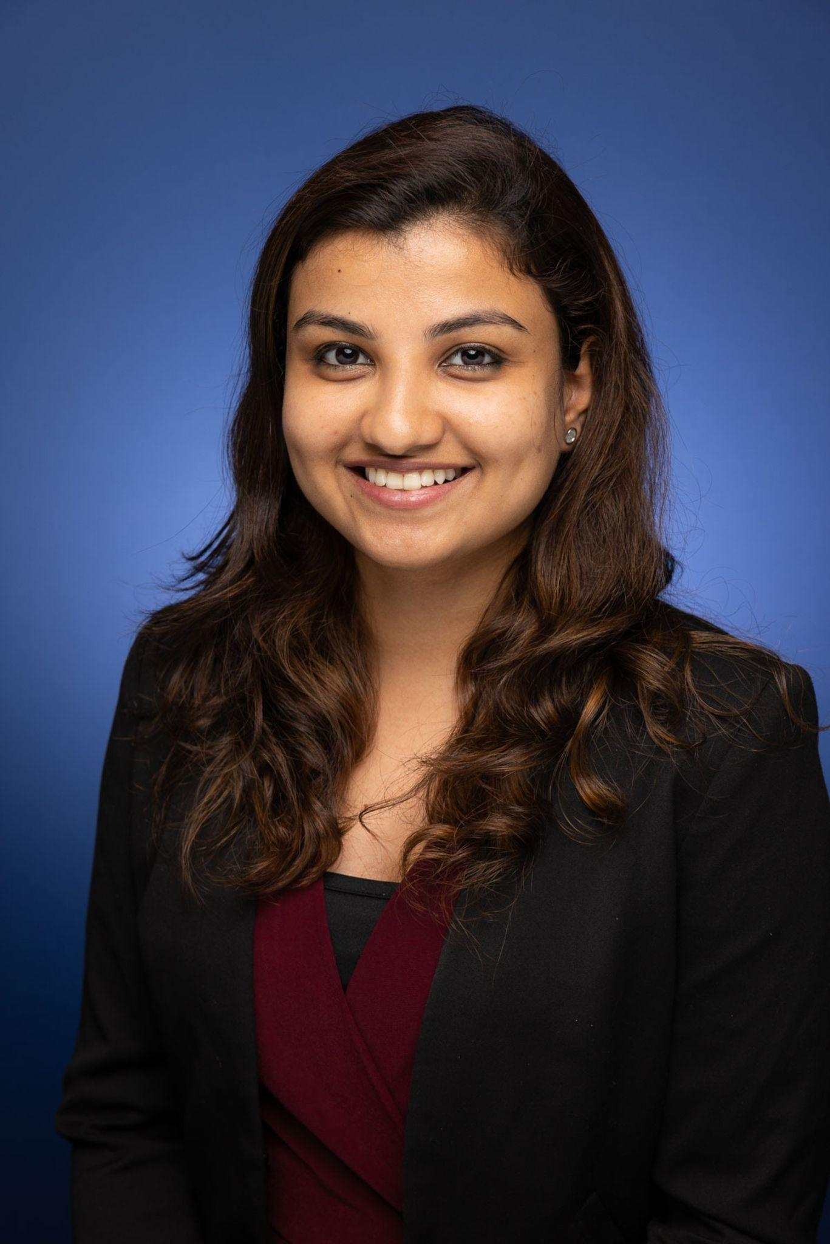
Team
John Chuang
Nithin Ravindra
Filipe Santos
Anudeep Chawla
Paul Kenniston
Dhanya Koottummel
Shreena Bhati

Slide 23
Kipitup
Thank You! Questions?

Slide 24
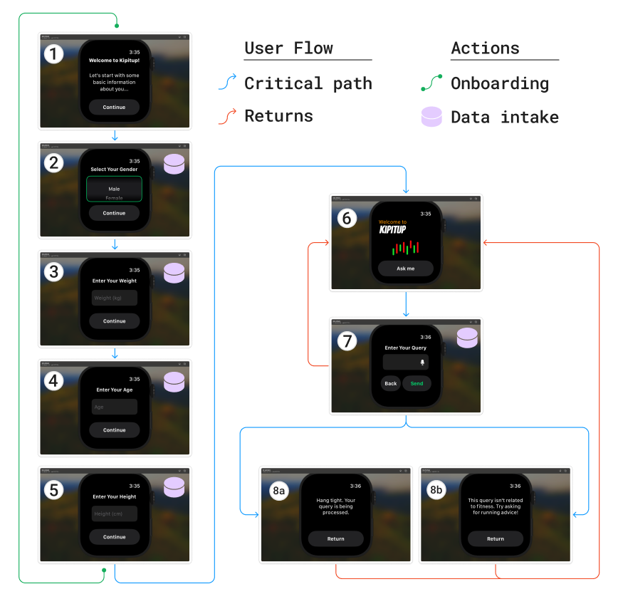
Watch OS
About
Pairs to cell phone’s WiFi/data
Captures biosensory data
Written in Swift
Flow
Screens 1-5: New user onboarding
Captures ‘Gender’, ‘Weight’, ‘Height’, ‘Age’
Screen 6: Landing page
1st stop after flow resets
Screen 7: Query input
Captures ‘Query’; written with voice or “scribble”
Delivers data to AWS
Screens 8a/8b: Confirm or reject query
AWS informs watch if query is related to fitness, routes accordingly
Returns to Screen 6

Slide 25
LLM
How LLM was built and trained

