Slide 1
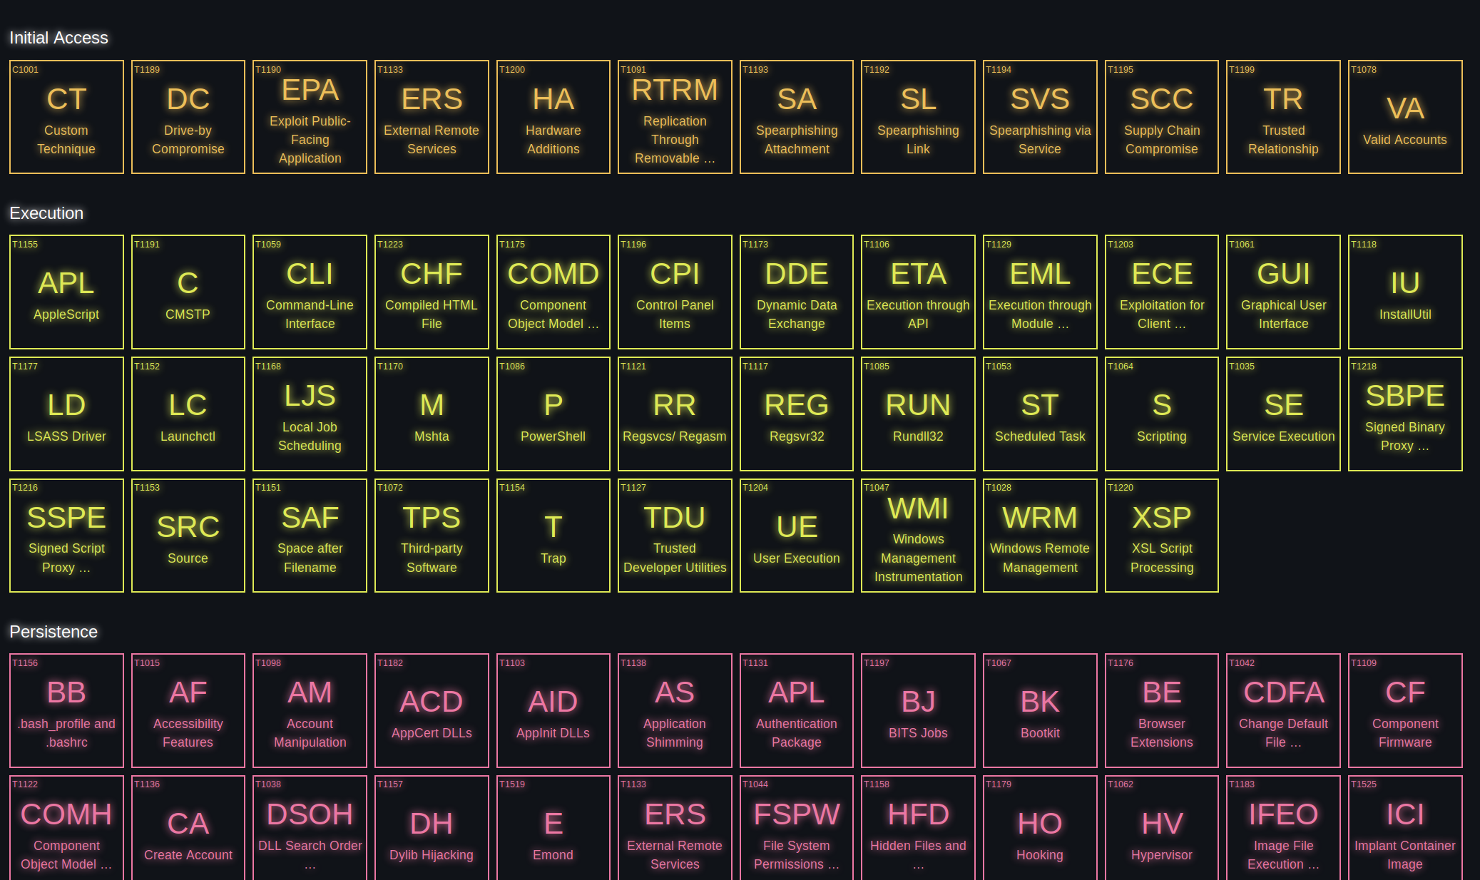
A Periodic Table for defending against cyber miscreants.

Slide 2
whoami /all
Josh Hakala
Sr Cyber Threat Intel Analyst @ Epsilon
Erick Pasco
MBA Candidate at Tepper School of Business
Aaron Crouch
DoD Technical and Physical Security Consultant
Steve Rice
IT System Lead at UC Berkeley

Slide 3
Agenda
Blue, Red, Purple Teams
Security Operations Center Detection Methodology & Challenges
ATT&CK, Sigma, Atomic Red Team
Elemental & Use Cases
Demo

Slide 4
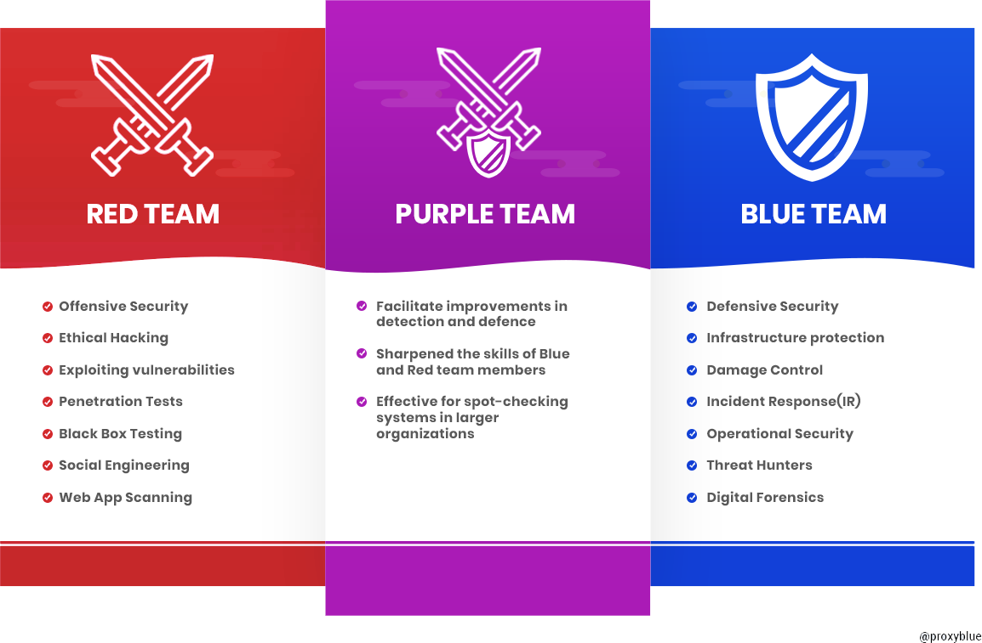
Red, Blue, Purple Teams

Slide 5
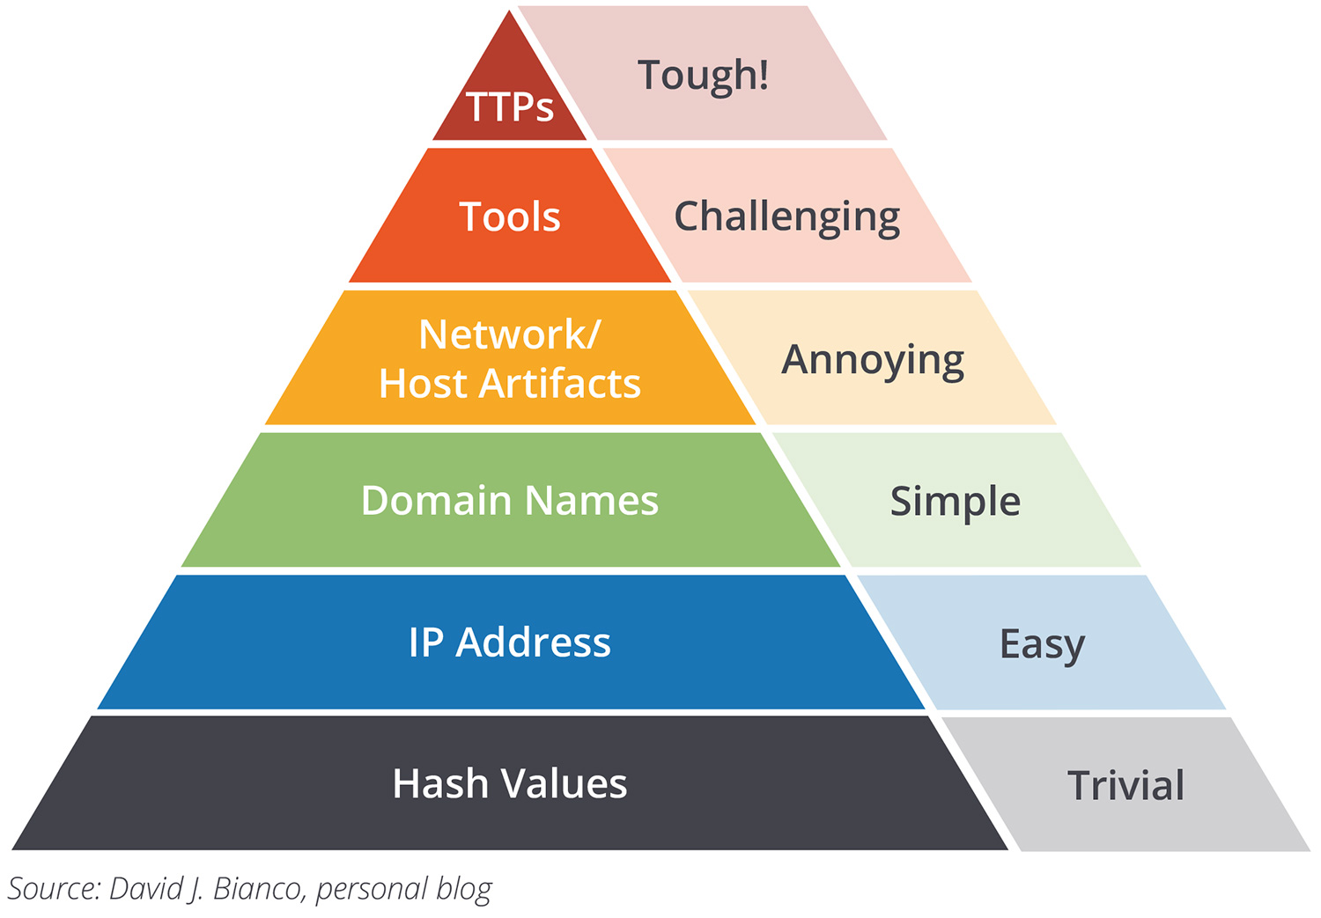
Security Operations Center Challenges
Blue teams may lack direction in building detections
Red and Blue teams need a common language for describing various attack methods
Adversaries can easily change Indicators of Compromise (IOCs)
Behavior-based detection forces adversary to update TTPs (Tactics, Techniques, and Procedures)
Pyramid of Pain
Behavior-based
Detections

Slide 6
Knowledge base of adversary tactics and techniques based on real-world observations.
Terminology has been integrated into numerous open source and enterprise security vendor platforms.
A Sigma rule is for log files what a Snort rule is for network traffic.
Generic and open signature format.
Describes detection information about malicious activity discoverable in log files.
Atomic
Red Team
Allows every security team to test their controls by executing simple commands/scripts, called "atomic tests"
Simulates the same techniques used by adversaries (all mapped to Mitre ATT&CK Framework).

Slide 8
Elemental App
Open source web application for enterprise security operations teams
Combines ATT&CK, Atomic Red Team, and Sigma into simple platform
Stood up locally or in the cloud
Django Web Framework
Python, Apache, SQLite
Built in protections for XSS, CSRF, SQL Injection
Innovative file-importing code programmatically links the Sigma and Atomic files to the ATT&CK techniques they support
Applied dramatic styling to enhance usability

Slide 9
Use Cases
Blue Team
Identify detection rule gaps
Validate Sigma Rule efficacy
Develop custom Techniques
Threat Hunting
Red Team
Highlights adversary techniques to test
Modify atomic test to avoid detection

Slide 10
Live Demonstration

Slide 11
Roadmap
Integrate other open source projects
Provide metrics on detection coverage
Add additional functionality based on community feedback

Slide 12
Questions?

Slide 13
References
Red, Blue, Purple Team
Pyramid of Pain
Atomic Red Team
Mitre ATT&CK
Sigma

