Slide 1
Comprehensive cloud security countermeasures available for all….always.
Presented By:
Summer Zakaria | Strategy & Operations Managing Director
Matt Culbert | Architecture & Engineering Managing Director
Justin Wasden | DevOps & System Security Managing Director
Robert Crawford | Public Relations & Intelligence Managing Director
Notes:
Good Afternoon Everyone, and welcome to Aegis. The Aegis model you will be viewing today was engineered to deliver cloud competency to a shockingly underserved market demographic – the pioneers and technical innovators of developing organizations.

Slide 2
Comprehensive cloud security countermeasures available for all….always.
Problem Scape
Leaving Outbound Traffic Unrestricted
Failure To Encrypt EBS Volumes
Lack of Inventory Management & Disaster Recovery
Insecure Dev Credentials
Exposure Losses
Misunderstanding Storage Access
Rogue Cloud Services
Restrictive Guardrails
Disabled Logging & Monitoring
Accountability
Arbitrary Software Deployments
Digital Transformation
Fragmented Understanding
A New Variant of Shadow IT
Open ICMP Access
As-a-Service Architypes
Simultaneous Procurement & Dispersion
Application Modernization
Insecure Software Development
Shared Responsibility
Ambiguity
Circumventing Compensating Controls
Cryptography
Access Control
Bypass Vendor Assessments
Configuration
Data Exposure
Overly Permissive Access
CSP Security Obligations
IaaS Enablement
Default Public Access Settings
Undefined Actor Behavior
Reducing Infrastructure Overhead
Negligent Risk Assessments
Cloud Native Threat Classification
Misconfigured Network Constructs
Lack of MFA For Privileged Users
Session Management
Error Reporting
Client Due Diligence
Denial of Service
Auditing & Logging
Maintaining Relevancy – Competitive Edge
Data Validation
Authentication
Timing
Patching
Enable Developer Agility
Regulatory Compliance
Notes:
Much like their enterprise counter-parts, developing organizations rushed to embrace cloud based services to remain competitive in their respective markets - fixated on the increased agility, scalability, and interoperability offered by major Cloud Service Providers. These as-a-service offerings were particularly appealing to:
Organizations looking to distinguish their product-lines through a full digital transformation
Industries looking to modernize their applications and services – especially amidst the global Covid19 pandemic.
Companies looking to just reduce their infrastructure overhead
Industries that are looking to encourage innovation and agility from their technical staff
Organizations seeking to meet regulatory compliance through cloud hosted services. These may be organizations that lack certain technical expertise and are looking to offload some responsibilities to cloud service vendors.
And while cloud enabled services accelerated technological innovation and offered developing and established organizations alike the opportunity to modernize and automate service offerings; cloud service offerings also introduced new variants of risk and an overwhelming swarm of misunderstandings and ambiguities.
The misconceptions surrounding the responsibilities of cloud-based solutions, due to rushed cloud deployments, a poor understanding of the shared responsibility model, and the associated delineations for each cloud service architecture, created spectacular ambiguity for big and small organizations alike - resulting in exponential cloud service misconfigurations and customer oversight that proved to be notoriously exploitable by external adversaries.
Shown in this ominous storm cloud of misconfigurations, threats, uncertainties, and emotion is a matrix of Cloud – Native Threat variants and commonly reported configuration oversights.
An important thing to note here also is the shadow IT phenomenon that has plagued organizations with cloud hosted services – wherein Infrastructure as a Service offerings allowing for simultaneous procurement and distribution create an environment wherein security administration teams are unaware of applications/services actually present within their own infrastructure.
Clearly a cluster of complications and potential points of exposure.
Unlike major organizations with specialized DevSecOps groups and GRC solutions, emerging industries are limited in spending and often lack the staff and technical resources for specialized security groups – how can these developing industries thrive or at least maintain competitive relevancy for their cloud-based service offerings?
This is our clientele and this is why Aegis was designed – to inspire innovation and to deliver comprehensive cloud security counter measures for all…always.

Slide 3
Comprehensive cloud security countermeasures available for all….always.
What We Do
Nonpartisan Research & Analytics
Strategic Public & Private Partnerships
U.S Compliance Frameworks & Vendor Reference Architecture
Niche Cloud Governance Counsel
Addressing The Ambiguous
Market Relevancy
Heightened Customer Serviceability
Hardened User Interface & Established Maintenance Cycle
Extended Locus of Control
Tangible Compliance-as-Code Baselines
Strategic Security Configurations
Threat Discovery, Monitoring, and Incident Response
Delivering Equity & Modernization
Designed Cloud Infrastructure Hardening For Pioneers
Creating Fair Access, Opportunity, and Advancement
Notes:
Aegis What We Do
The Aegis solution was derived out of necessity – at Aegis, the value is in our research. We offer exclusively complied nonpartisan analytics meaning we are not sponsored by major vendors nor are we susceptible to research bias or coercion.
Our Cloud Security Governance solution ingests the reference architecture from major cloud service providers, regional compliance frameworks, and international standards to offer a relevant, lean, and approachable cloud security blueprint of baseline controls.
We have found our niche for Cloud Governance and it’s offering counsel to developing organizations in supplying actionable compliance guardrails needed by developing dreamers and doers to go forward and create. We promise these individuals relevant and timely data so they can focus more so on growing their product.
The Aegis UI was developed with the end-user in mind and offers heightened usability through accessible/downloadable content and custom intake questionnaires free from technical jargon. At Aegis we recognize that the realm of cloud security can be a bit daunting to those with less technical ability, and with that in mind we designed a tool to extend our customers locus of control or perceived extent of control when approaching cloud based services.
The Aegis tool offers tangible compliance as code recommendations and strategic baseline controls aggregated and customized specifically for an emerging business. These guardrails expand beyond general configuration and span to offer support in threat discovery and incident response.
Our tool strives to promote fair opportunity within the cloud and seeks to create fair access and advancement for emerging industries. At Aegis we will not allow comprehensive cloud security to be gatekept my major enterprises, we promise continuous delivery and transparency at cost to our clients as apart of our ongoing commitment to innovation & advancement.

Slide 4
Comprehensive cloud security countermeasures available for all….always.
The Aegis Pledge
Inclusivity & Continuous Affordability
Limited Data Sharing & Retention
An Engineered Solution Hyper Focused On The Developing Business & Secure Cloud-Computing
Strategic Commercial Partnerships To Reassure Continuous Affordability
Major Vendor Compliance Offerings & Commercial Audit Solutions – The Risk Of Subcontractors & Third-Party Affiliates
Vendor Lock-In, Dependency, and Incompatibility
Aegis Limits Data Retention and Prohibits Third-Party Data Transport/Sale
Our Promise To Deliver Consistent & Current Control Regulations
Addressing Impeding Risks For Developing Trades
Aegis Annual Transparency Report
Cloud Service Adoption Trend Assessment
Microsoft Azure :
Amazon Web Services:
Google Cloud Platform:
Average Aegis Client Size:
Relevant & Accessible Data
Transparency & Trend Analysis
Notes:
At Aegis, our pledge is to deliver a hyper-focused cloud governance solution for the modern developing organization. And though these organizations have modest budgets and limited technical staff, through our strategic partnerships with regulatory agencies we pledge continuous affordability as emerging businesses approach, migrate, and deploy cloud based solutions.
Unlike Commercial Auditing solutions and Vendor Compliance offerings with Aegis you will find we do not have extensive affiliate lists or third-party subcontractors – we pledge to continue our limitations and restrictions on third-party vendors and subcontractors as our way of partially mitigating inherent risk of cloud computing for moderately developed organizations. (Supply Chain Security/Management – Beyond Their Purview)
Our data will never become irrelevant or stale, at Aegis we actively audit and reassess our data streams for optimum functionality and applicability – assuring major trends and impeding risks are addressed and solutioned.
The Aegis team also pledges our ongoing transparency – in the upcoming fiscal year we will be releasing our first annual transparency report – which will detail our customer analytics and our security protocols for retaining/destroying customer provided data.

Slide 5
Comprehensive cloud security countermeasures available for all….always.
Personifying Our Clientele
Clinic Organization & Departments:
Placer County Community Health Clinic
Departments:
On-Site Clinical Staff (80)
Accounting & Finance (20)
Customer Service Desk (10)
Mobile & Web App Development (12)
Data Management (8)
Human Resources (10)
Sales & Marketing Staff (15)
Upper Management (5)
Office Administration Staff (5)
Customer Base & Analytics:
Annual Clinic In-Patient Treatments
FY22 In-Patient Treatments & Services Growth Rate: 18%
Auburn | 8,563
Colfax | 9,215
Lincoln | 6,449
Loomis | 11,881
Business Objectives:
Improving Current Mobile & Web Application Usability
Securing Customer/Company Data
Supporting On-Site Clinical Staff
Investing In Cutting Edge Clinical Technology & Equipment
Solutioning Automated Tasks To Improve Productivity
Expanding Services & Entering New Territories
Financial Analysis:
Quarterly Revenue: $5,347,174.72
Quarterly Net Profit: $2,729,390.24
Quarterly Expenditures:
Real-Estate: $1,151,741.48
Salaries: $3,968,682.82
Suppliers : $226,750.42
Quarterly Budget Allocations:
Run: $1,094,858.66
Grow: $925,773.32
Transform : $708,758.26
“Providing Quality Local Health Care To Our Underserved Neighbors and Communities”
Available Technology:
Micro Data Center – Rocklin, CA
AWS Storage Gateway
AWS Direct Connect
AWS Private Link
AWS Lambda
Amazon S3 Buckets
On-Premise Active Directory
AWS CodeBuild
Amazon RDS
Notes:
Personifying Our Clientele
Alright, I have talked considerably about the Aegis solution and problem we are working to solve, now I would like to take this opportunity to introduce you to our subjective clientele:
Meet The Placer County Community Health Clinic – a local Northern California health partner dedicated to providing quality local health care to their underserved neighbors and communities.
At present they see approximately 36 thousand patients annually and have seen an 18% uptick in patient services since their last fiscal year. Placer County Community Health has 165 employees on their payroll and 20 employees serving in operational technology teams.
This past year, their net profit reigned in at over two million and with these proceeds’ leadership has decided to re-invest in clinic services – dedicating over fifty percent to Run/Transform budgets. Their primary objectives are to enhance current mobile/web application services, secure both company and client data and expand current clinic services into new territories such as vision, dental, and psychiatry.
The technology stack is relatively simple within the clinic organization, previously they were utilizing a micro data center in their Rocklin office however in this past year they have adopted a few AWS resources and have begun migrating their applications and resources. They are really loving the cost savings that AWS can offer them and they want to use this as an opportunity for growth and expansion into cloud hosted services – but where to begin? Placer Community Health does not have dedicated security practitioners and the resources configured were done so at the guidance of AWS Support Engineers.

Slide 6
Comprehensive cloud security countermeasures available for all….always.
Introducing John Dev Doe
Department & Duties
Background & Technical Work
A spirited technologist for the Mobile & Web Application Development at the Placer County Community Health Headquarters. Duties Include:
Back-End Data Integration
UI Development
Application Architecture& Debug
John has been with Placer County Community Health for three years and has extensive contacts throughout the business. His technical expertise include:
JavaScript, HTML, Python, .NET, XML, and C#
CSS, SQL, Object-Oriented Programming, PowerShell
Troubleshooting & Software Composition Analysis
John’s Limitations & Worries:
John’s Opportunities:
Limited Cloud Security Expertise
Service Architecture Ambiguity – Service Requirements Needing To Be Reevaluated
Infrastructure Visibility & Discovery
Front-End Interface Availability
Overly Permissive Access & Insecure Defaults
Misconfigured Resources Prone To Attack
Due to his seniority, John is department delegate to leadership.
The Mobile & Web Application Team specifically is allocated 15% of the FY22 Grow Budget and 10% of the Transform Budget.
Recognizes the potential for a multi-cloud environment to encourage future innovation.
Notes:
Introducing John Dev Doe & Demo Hand-Off
Ok, we now understand the developing northern California organization, now let’s meet their most senior technologist the person leadership will rely on for service orchestration and refinement. This is John Dev Doe – John is one of twenty technologists working in the corporate headquarters of Placer County Community Health. John is one of twelve on the Mobile & Webb Application Development team, and his duties center on Back-End Data Integration, Front End UI Development, and application architecture process mapping.
He's been with Placer County Community Health for just over three years and prides himself on being a dependable Full-Stack Developer. He’s done some general trainings with cloud computing and was around when the Clinic set up their existing AWS resources but beyond the surface John does not have any significant DevOps Training or Cloud Security expertise.
But he cares about this organization and while he is excited the clinic is looking towards transformative cloud-enabled client solutions he’s worried. He’s worried because he knows this business and he understands the technical limitations stemming from the lack of a specialized Cloud Sec/DevSecOps group. John recognizes that in the spirit of ingenuity with cloud computing comes ambiguity – the AWS architecture present for the Placer Community Health Clinic is foreign to him and he is certain those services will need to be reevaluated and scrutinized. And mostly John is worried that with this enhanced focus on digital transformation and in their quest for modernization the community health clinic will inadvertently forsake security – and as the company grows the debilitating effects of such oversights will only grow.
However, in spite of these troubles and woes John still recognizes opportunity. He is the most senior person on his team and knows he has a direct line to leadership to voice his concerns. John also has access to shares of grow and transform budgets to invest in new cloud-enabled technology. And through his willingness to learn John also recognizes the potential advantages of considering a multi-cloud environment equipped with various vendor services and cloud environments – meaning John will need to look beyond AWS for optimized client applications.
Sure, John can begin rampantly googling for guidance or start attaining quotes from commercial auditors or John can choose to look into a thoroughly engineered, hyper-focused cloud governance solution, specifically designed by Berkeley students for organizations like his – delivered at cost.

Slide 7
Comprehensive cloud security countermeasures available for all….always.
Live Product Demonstration
Presented By:
Architecture & Engineering Managing Director - Matt Culbert
DevOps & System Security Managing Director -
Justin Wasden
Notes:
Matt Culbert, our Aegis Architecture & Engineering Managing Director, and Justin Wasdin our DevOps & System Security Managing Director will now go beyond my descriptions and present to you, now the Aegis Product.

Slide 8
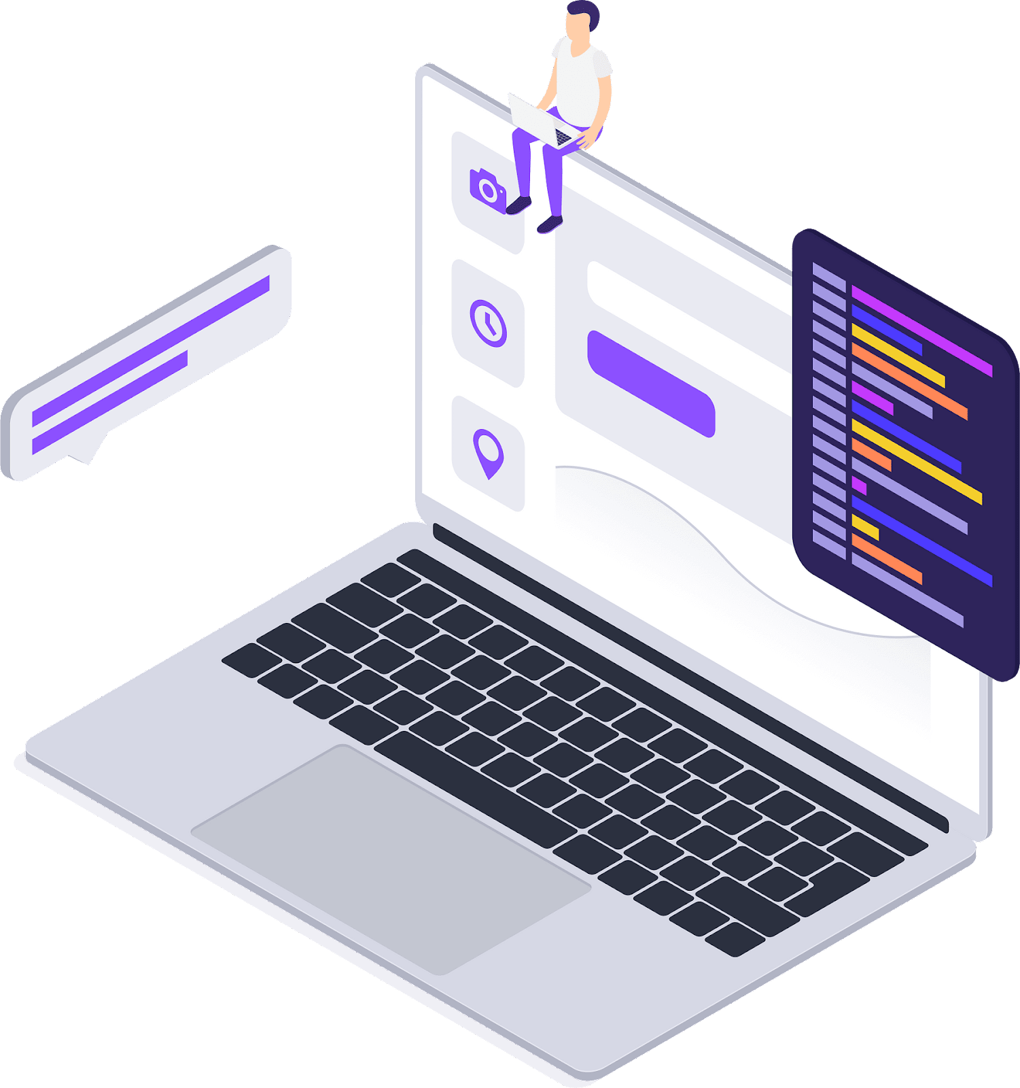
Comprehensive cloud security countermeasures available for all….always.
Designed For An Intuitive Flow
The questions are built around your needs
John is a developer - security isn’t his focus
John needs to protect PHI first and foremost
John also needs to manage a team of contractors
Notes:
When designing Aegis Check, we wanted to make it so that anyone with any level of experience could understand it and get the results that they need. For example with John, he’s a developer and not a security engineer. This isn’t his speciality.
To that point, we wanted to exemplify the discussions from the Immersion event and ensure that we didn’t use acronyms and that there was no technical understanding required. Acronyms by nature can be very exclusionary
The person filling out the survey though would require working knowledge of how their teams function in order to answer things like if there are any contractor accounts, but we specifically avoided questions like “Do you have a dedicated GRC team to manage your SOC and SOX compliance”

Slide 9
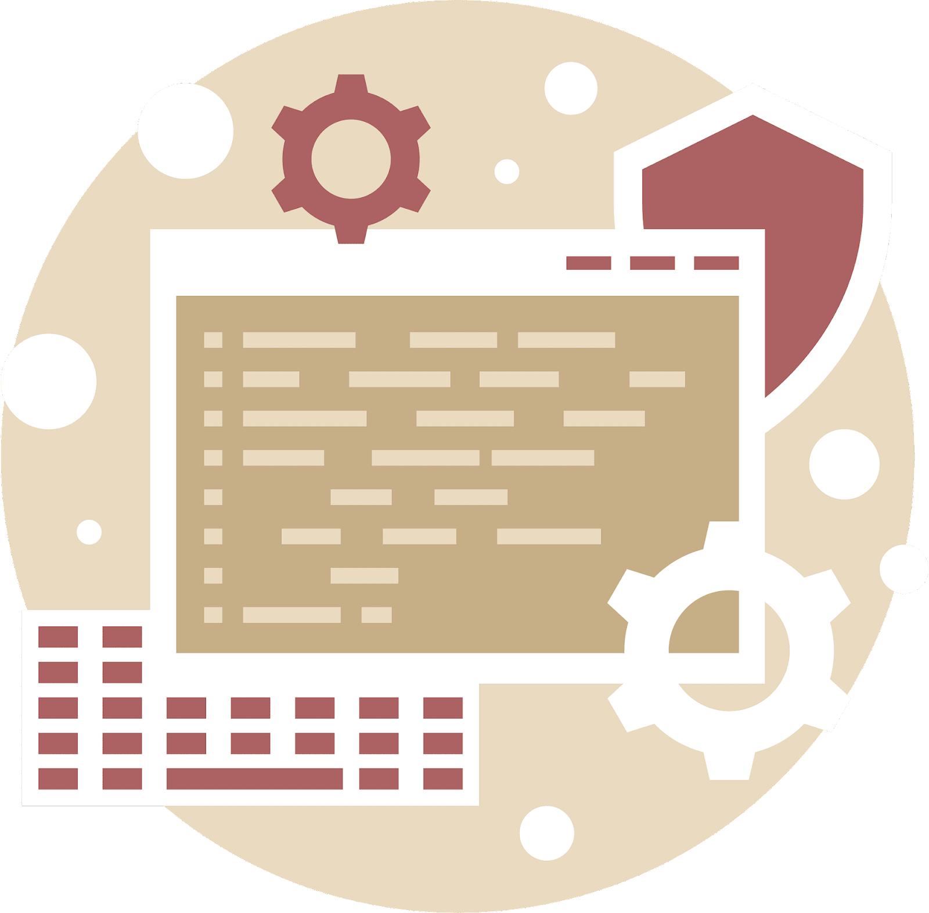
Comprehensive cloud security countermeasures available for all….always.
The Survey Continually Evolves, Ensuring Controls Are Tailored To Your Specific Environment
You don’t have to worry about questions not applying to your cloud architecture
You can be confident that we understand your needs and will provide all relevant information
John needs to get his cloud app running and running properly - health care can’t afford for you to misstep
Notes:
We really wanted the control questions as well to be tailored to individual environments. In order to do this. we tried a few different platforms that let us use advanced branching logic and eventually settled on Office 365 Customer Voice.
This platform let us do branching such that we could make different questions appear if you used Amazon vs Azure.
This way, when John is filling out the survey, they won’t have to deal with questions that might only apply to a platform that they don’t use.

Slide 10
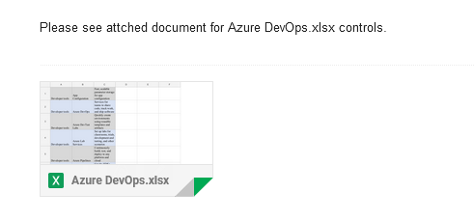
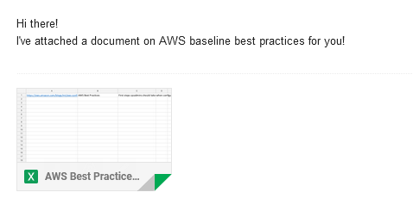
Comprehensive cloud security countermeasures available for all….always.
We Took The Guesswork Out Of A Complicated Process
Using a series of precompiled documentation links, we can generate a robust data store to help any size business
This way, you know where to look for information the first time
Notes:
How can we deliver value, though, to John?
That was the underlying question driving our design thoughts. We didn’t want to be in a position where we were recommending directly that people do something, but we also did not want to take a passive stance on controls.
In order to accomplish this, we chose to dig through all the different documentation links, design questions around if they use relevant components, and then send off the official documentation for setting that up.
This allowed us to be confident that we were giving correct information to small to medium sized businesses, without putting us in a position where we might recommend something incorrect due to not having familiarity with different environments.
Next up we have a video walkthrough demonstrating what this whole survey process looks like.

Slide 11
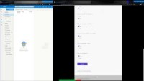
Comprehensive cloud security countermeasures available for all….always.
Live Product Demonstration
Actionable results create a roadmap to a secure and compliant architecture:
Step 1: Fill out a form at Aegischeck.com
Step 2: Check your email
Step 3: Prioritize the recommended solutions to meet your business needs
Step 4: Use as needed for guidance and control implementation
Notes:
Thank you Matt, for your explanation of the Aegis tool’s intuitive design. This background video demonstrates how quickly and easily John can obtain actionable information to secure his workloads by simply filling out the form on aegischeck.com.
Aegis provides accurate technical control information to customers with industry recommended vendor and non-vendor specific controls for each service offering that an organization employs. This comprehensive list provides a roadmap to compliance for clients like John, with actionable recommendations that not only protect small/medium sized businesses like theirs from regulatory compliance issues, but also from the threat of cyber incident.
All these cloud platform controls, as well as NIST and ISO standards, are well documented and freely available to the point where it can be overwhelming for people like John to discern what is/or is not important, what can be done with the budget they have, and where to even start. To someone with limited security experience, this really can be information overload.
This problem is exacerbated by the fact that cyber security is likely treated as a collateral duty, one in which a developer like John may be unfamiliar or uncomfortable performing without direction. Aegis is a free tool that aggregates all this disparate information, filters out the unnecessary or irrelevant data, and provides professionals like John with only what they need to be successful in securing their infrastructure.
You have now seen, in under a minute I might add, how Aegis delivered customized and comprehensive security countermeasures to a simulated client.

Slide 12
Comprehensive cloud security countermeasures available for all….always.
Product Assessment & The Road Ahead
Presented By: Public Relations & Intelligence Managing Director – Robert Crawford
Notes:
Now I will pass it off to Robi, the Aegis Public Relations/Intelligence managing director to go through the security assessment that ensures the longevity and security of the Aegis solution.

Slide 13
Comprehensive cloud security countermeasures available for all….always.
Threat Modeling
Step 1
A usable web app
Quick results for each circumstance
Step 7
Step 2
Risk remains low if:
continual analysis of frameworks & documentation
Implementation of Terms of Service
Define Objective
No hardware we need to manage
Rely on tested platforms
Risk and Impact Analysis
Define Technical Stage
Step 6
Step 3
Analyzed:
workflow of product
Identified where threats and vulnerabilities lie in the workflow
Microsoft Power Automate
Microsoft Customer Voice
Model Attack
Decompose Application
Step 5
Step 4
The Scope is limited to U.S. Based Organizations
Misuses of Web Application
Liability
Vulnerabilities & Weaknesses Analysis
Analyze Threats
Usability & Accessibility
Competition
Notes:
Thanks Justin.
As we developed our product Aegis, we took a look at threat modeling to ensure that Aegis performs as we and our customer John would expect.
For our Initial requirement, we wanted a Usable web app that would be easy for Customers like John to use. We also wanted to ensure that there are quick results for each circumstance.
While analyzing our technical scope, we wanted to make sure that the platforms we utilized were stable so John could use Aegis whenever he wanted. This led us to the requirement of not utilizing any hardware and instead relying on cloud offerings ourselves. We also wanted to rely on tested platforms for consistency and security. This led us to the use of Microsoft Forms and Microsoft Customer Voice, both tried and tested platforms.
With our platforms selected, we took a look at the threats Aegis may face. Threats like usability, like the product becoming too complicated for John, and accessibility, or John not being able to use Aegis due to incorrect assumptions we made about our customers. Competition was also in our minds through development as there are Audit services and manufacturer services available. We want to ensure that Aegis will differentiate itself from the competition.
We also have to understand some of the weaknesses and vulnerabilities Aegis may have. One such example is that the scope is limited to U.S. Based organizations. Some other vulnerabilities include Misuses of the product and legal liability.
We then analyzed the workflow that Aegis follows to ensure that we could identify where the threats and vulnerabilities are and if they are properly addressed.
We concluded that the Risk will remain low if we ensure that a continual analysis of the frameworks and manufacturer documentation occurs and we implement a terms of service for Aegis.

Slide 14
Comprehensive cloud security countermeasures available for all….always.
Looking To Our Future Opportunities
Migration to Microsoft Power Automate
API Integration
Automatic Application of Recommendations to Cloud Service Providers
Tie into an Organization Ticketing System
Expansion of Recommendations beyond the Cloud
Integration with Industry Frameworks
NIST Cyber Security Framework (CSF)
NIST Risk Management Framework (RMF)
Center for Internet Security (CIS) Critical Security Controls (CSC)
Notes:
Now that we’ve taken a look into the threat modeling of Aegis, let’s take a look at some of the future opportunities we have for Aegis.
The first future opportunity we have is the migration into Microsoft Power Automate. This would allow us to further develop API Integration into our product to allow more flexibility for Customers like John. One such example is the automatic application of Recommendations to the three cloud service providers we support, which is Microsoft Azure, Google Cloud Platform, and Amazon AWS. That way, it would be seamless for John to apply these recommendations to his deployment. Another example is a tie into an organization's ticketing system. And during this migration, we would make continual improvements to the front end of the Web Application to ensure that Aegis remains a state of the art resource for our customers.
And the second future opportunity we have is the furthering value to John by looking beyond the cloud. We recognize that while cloud is at the forefront of deployments for developing organizations, they will have risks that extend beyond the cloud. Some risks beyond the cloud include lacking a business continuity plan, lacking incident response procedures, privacy information, and even physical security. This is where we could further integrate industry leading risk management frameworks, such as the NIST Cyber Security Framework, NIST Risk Management Framework, and even the Center for Internet Security (CIS) Critical Security Controls (CSC) and others into Aegis. This will give our customer John, or other developing organizations, a comprehensive and holistic view of where all of their risk lies.

Slide 15
Comprehensive cloud security countermeasures available for all….always.
Q & A
Notes:
And this is our product, Aegis. We have demonstrated how Aegis can add value to developing organizations and our dedication to the longevity and security of our solution. We want to thank the panel and the audience for allowing us to showcase our product Aegis today. We look forward to answering any questions and feedback you any may have.

