Slide 1
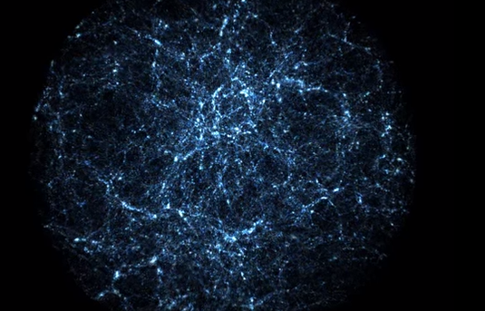
Dark Matter Halos
Analyzing Correlations in the Bolshoi Simulations
(The Search for New Correlations in Cosmology)
Samuel Kahn, Lisa Kirch, Nikhil Gopinath Kurup, Wei Shi, Bovard Tiberi
W251 Spring 2015

Slide 2
Agenda
Background - What are Dark Matter Halos?
Proposed Analysis - Why is it important?
Data - transfer, storage and management
Compute - planning and orchestration
Data Crunching
Correlation Analysis
Feature Importance
Outcome and Next Steps

Slide 3
Dark Matter
Hypothetical, invisible matter that only interacts gravitationally
27% of matter in the universe
Explains the structure of the universe and the rotation of galaxies
Why do we care about Halo Shape?
Nurseries for galaxies

Slide 4
Dark Matter Halos
Envelope of dark matter around galaxies
Dominates the mass of a galaxy
Explains the rotational velocity discrepancy in galaxies

Slide 5
Bolshoi Simulation
A series of simulations of the universe
Seeded with 8.6 billion dark matter “particles”, each 200 million solar masses
Initial condition of the universe constantly refined by observational data
“State of the universe” measured at 180 time intervals from Big Bang to current time
Each measurement tracks 76 features of about 20 Million halos each

Slide 6
Proposed Analysis
As the universe expands the relative influence of different features changes over time (e.g. weak forces vs gravity)
Does the importance of halo features change over time? If so how?
This could help in understanding the evolution of galaxy sizes and shapes

Slide 7
Tools Used
Data transfer - FTP, rsync, scp, Netcat
Data storage - Block storage, HDFS cluster
Cluster provisioning - Vagrant, Puppet, ansible
Scalable computing - Hadoop with Yarn, Spark
Statistical analysis and Machine learning - MLlib, NumPy, SciPy, pandas, PySpark
Programming languages - Scala, Python
IDEs - Eclipse, IPython, PyCharm
Build and deployment - sbt, shell scripts
Monitoring - nmon
Collaboration - ISVC, Google Drive, Google Hangouts, Speek.com, Email
Source code hosting - Github

Slide 8
Data Transfer
180 files in FTP server that we transferred
Total data volume = 2 TB
Transferred using scp
Time taken for transfer approximately 6 hours

Slide 9
Data Storage and Management
Data stored in a block storage in Softlayer attached to a Ubuntu server node.
The block storage node could be reattached to different cluster master nodes based on computing needs
Moved to HDFS cluster with replication using shell scripts right before computation
Also moved piecemeal files to individual cluster nodes for data locality

Slide 10
Data Processing
Python scripts used to
Cleanup individual data files
Remove superfluous features from analysis (ids, etc.)
Filter out halos with masses less than 10^10 solar mass (roughly the mass of the Milky Way)
Reduce the data size 500%, from 2TB to 308 GB
The data is partitioned across 180 timesteps
No normalization is needed as PCA was abandoned

Slide 11
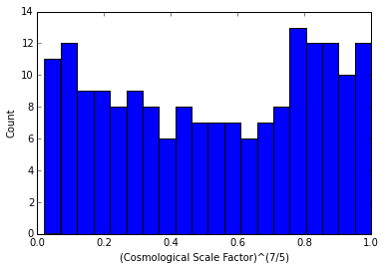
Cosmological Scale
Data from the simulations were collected at discrete time steps known as the cosmological scale factor and recorded. This gives us the view of the universe during different points in time which can then be validated against observations. This data was found to be be in agreement with observations and predictions and give a deeper understanding of how the structure of the universe has ensued.

Slide 12
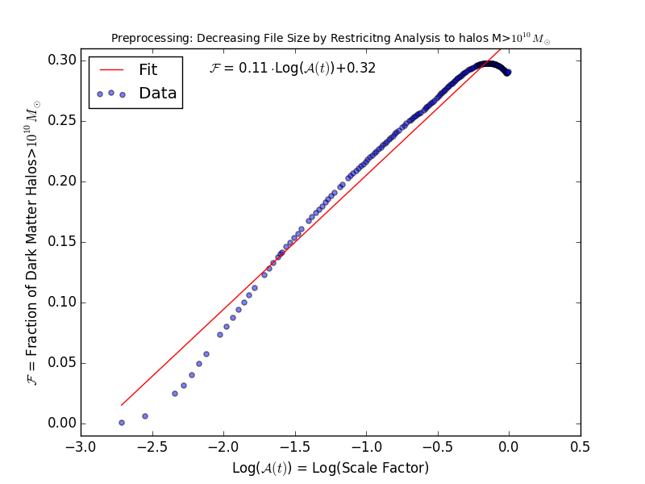
Preprocessing
The algorithms which determine the shape of the dark matter halos are not accurate for small halos because they do not contain a lot of particles and are thus not well-defined.
So, we limit our analysis to halos which are only larger than 10^10 solar masses. This allows us to analyze those halos that are well-defined and reduces the size of our data.
The amount the data size reduced by preprocessing decreases log-linearly with each timestep.

Slide 13
Cluster Orchestration
Customized version of vagrant-cluster¹ with additional support for
Creating a cluster in the existing VLAN
Cluster communication over private VLAN
Auto attach and mount data block storage to master node
Install additional python libraries
1 -https://github.com/irifed/vagrant-cluster

Slide 14
Correlation Analysis
In a given instance/time-step, how correlated are the independent features?
Create a 62x62 grid of Pearson correlation for each of the 180 time steps
Plot and observe the changes in correlation over time
Three attempts
PySpark with scikit-learn - Memory errors
Spark with Scala - 20 node/16 cores/ 16GB - 13 days
NumPy and shell - 6 node/ 8 cores/32GB - 15 hours

Slide 15
Correlation Output
#scale(0) | id(1) | desc_scale(2) | num_prog(4) | phantom(8) | sam_mvir(9) | --- | max@Mpeak(71)
id(1) | 1 | 3.04E-15 | 1 | 9.99E-17 | -2.78E-16 | --- | -3.09E-15
desc_scale(2) | 3.04E-15 | 1 | -2.97E-15 | -0.04436117 | -0.09166446 | --- | -0.02980431
num_prog(4) | 1 | -2.97E-15 | 1 | -6.28E-17 | 9.27E-17 | --- | -3.07E-15
phantom(8) | 9.99E-17 | -0.04436117 | -6.28E-17 | 1 | 0.1182337 | --- | -0.06042489
sam_mvir(9) | -2.78E-16 | -0.09166446 | 9.27E-17 | 0.1182337 | 1 | --- | -0.04288056
--- | --- | --- | --- | --- | --- | --- | ---
max@Mpeak(71) | -3.09E-15 | -0.02980431 | -3.07E-15 | -0.06042489 | -0.04288056 | --- | 1
180 62x62 NumPy correlation files generated - 8MB each
Initial analysis points to the emergence of some patterns

Slide 16
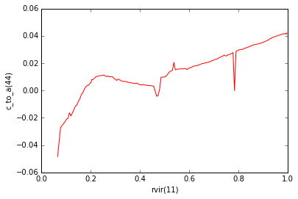
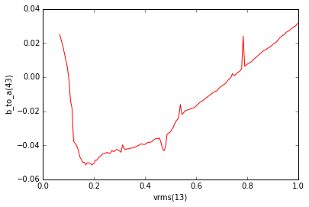
Correlation Output
The halo shape starts out negatively correlated with the radius of a halo and gradually becomes positively correlated as The Universe evolves.
The correlation between the shape and speed at which the particles inside the halo are moving start out positively correlated, becomes negatively correlated, and than gradually becomes positively correlated as The Universe evolves.

Slide 17
Feature Importance
Three attempts
PCA - Reduction of the dimensionality makes feature importance less meaningful
PySpark - OutOfMemory exception persists for large files with >500MB
Scala - 11 machine (100 GB HDD, 4 GB RAM, 2 cores) Spark cluster
Ended up using DTs on Spark in scala
1 run = 13 hours on 11 node-cluster

Slide 18
Feature Importance
feature: 1
gain: 254
init array of 0s
recurse through
add gain to arr[ftr#]
feature: 8
gain: 274
feature: 3
gain: 343
feature: 2
gain: 124
feature: 4
gain: 234
feature: 5
gain: 167
feature: 9
gain: 97

Slide 19
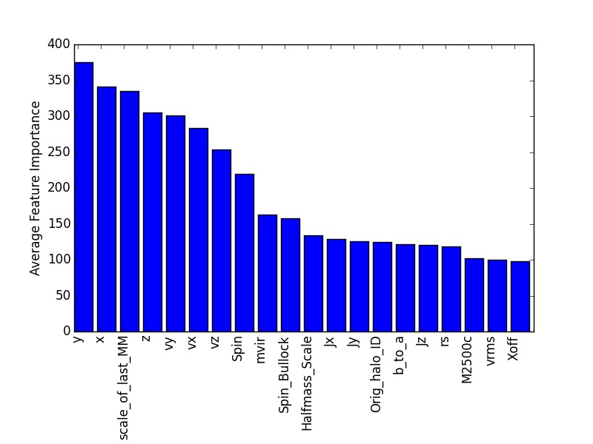
Feature Importance Results
Surprisingly, the halo shape seems to be highly dependent on the x, y, and z coordinates of the halo in the simulation.
This likely means that halo shape is highly dependent on the position of the halo in the Cosmic Web and the way matter is flowing into the halo.
We also find that halo shape is highly dependent on how long ago a halo merged with another halo, its velocity in space, its mass, its angular momentum, and its spin.

Slide 20
Conclusion and Next Steps
BIG Data
Interesting Problem
Great Team
Results!
Next Step: Further Analysis

Slide 21
Questions?

