Slide 1
Spritz Experiment
Final Presentation, Fall 2014
Murat Aydogdu, Samuel Kahn, Lisa Kirch, Nikhil Gopinath Kurup, Sam Zaiss
Notes:
Lisa/Sam

Slide 2
Speed Reading & RSVP
Efforts to systematically improve reading speed date back to 1925, focused on text features.
In the 1970s, text presentation methods emerged as a means to help increase reading speed without sacrificing comprehension.
One such method -- rapid serial visual presentation (RSVP) -- was the basis for multiple speed reading apps post-2000.
Notes:
Lisa/Sam

Slide 3
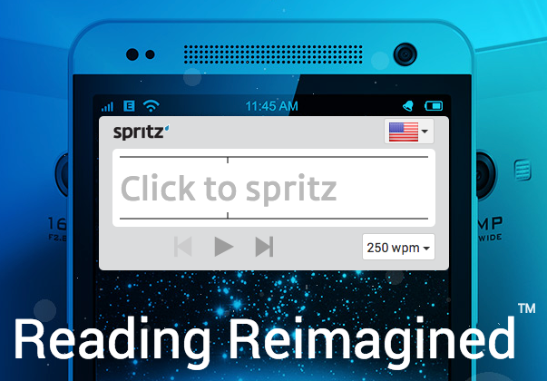
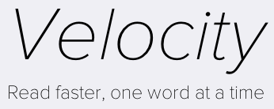
Apps Using RSVP
Notes:
Lisa/Sam

Slide 4
Past Research: Effects of RSVP
Wobbrock, Forlizzi, Hudson, & Myers (2002): Used RSVP to achieve reading speeds up to 720 wpm, but not in a controlled experiment.
Öquist & Goldstein (2002): RSVP improved reading speeds by 33% for short texts. Didn’t help reading speed for longer texts, and also increased cognitive load.
Notes:
Lisa/Sam

Slide 5
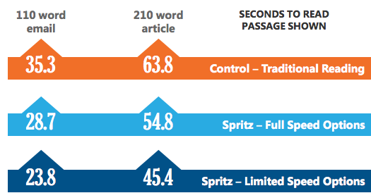
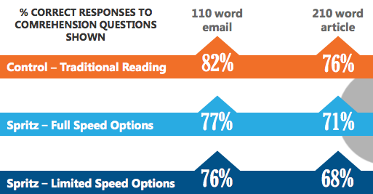
Our Focus & Hypothesis
PSB (2014) experiment found positive effect for Spritz in speed & marginally negative effect for comprehension.
Specifics of the PSB study are unclear; there were some drawbacks.
We hypothesized that using Spritz, participants’ reading speed would increase while comprehension would stay constant for slightly longer texts.
Notes:
Sam K

Slide 6
Experiment Design: Participants
Used Amazon Mechanical Turk to recruit 550 participants.
50 Pilot/500 Main Experiment
Challenges included tuning the restrictions correctly and locking on the appropriate incentive amount to reach 500 participants quickly.
AMT users tend to mostly be from the US and India, and vary as a group from the population of these countries overall.
Notes:
Sam K

Slide 7
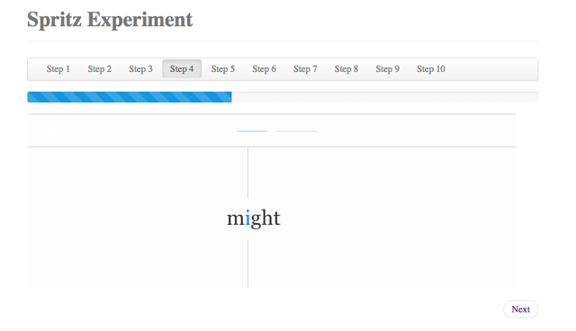
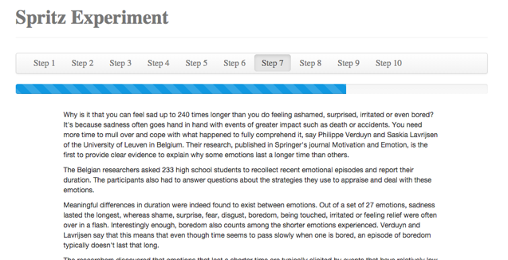
Experiment Design: Materials
We built a website to take AMT participants through the entirety of the experiment:
Notes:
Nikhil

Slide 8
Experiment Design: Procedure
Within-subjects design. Each subject read two articles: One normally, and one with Spritz.
Subjects were randomly assigned to four conditions based on counterbalancing control / treatment order and article order.
To account for any effects of seeing Spritz for the very first time, we gave subjects a brief practice before showing the article.
Each article was followed by 5 comprehension questions.
The experiment concluded with general demographic questions.
Notes:
Nikhil

Slide 9
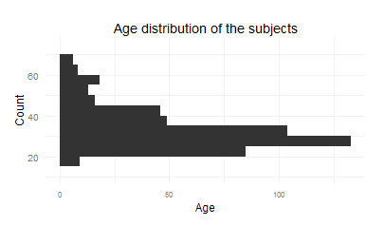
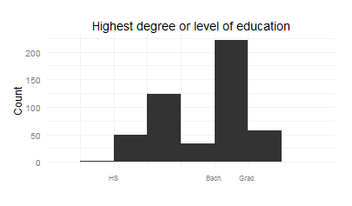
Results: Descriptive Statistics
Our subjects (N = 487)
Primary language: English (90%)
Men (52%) and women (48%)
White (59%), Asian (24%), and other races
College degree and more
Use glasses (47%), new to Spritz (83%)
“Read”
Text messages and social media | 405
Books or e-books | 320
Science and technology journals | 129
Magazine articles or blogs | 324
Professional documents like emails or reports | 255
I don't read any of the above | 0
Notes:
Murat

Slide 10
Results: Model & Analysis
Four conditions from counterbalancing article order and treatment order. Subjects were randomly assigned to conditions:
Outcome: How many of the 5 questions did the subject get right for each article?
 |  | The first article is
 |  | FUN | SAD | Total
The Spritz article is | FUN | 123 | 119 | 242
 | SAD | 135 | 110 | 245
 | Total | 258 | 229 | 487
Notes:
Murat

Slide 11
Results: Model & Analysis
The “everything” model
summary(lm(Y ~ trt + isSAD + firstNormal
+ Age + SpritzExp + UsesGlasses + DegreeCode + PrimEng + Female + RaceCode
+ readTM + readBook + readSci + readMag +readProf))
Number of correct answers
Spritz = 1 Normal = 0
SAD article = 1
FUN article = 0
First article is normal = 1
First article is Spritz = 0
Notes:
Murat

Slide 12
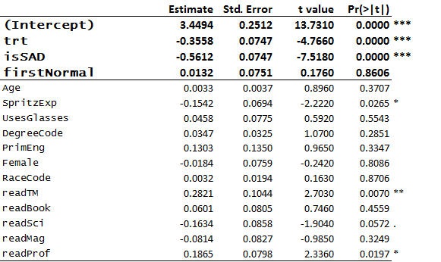
Results: Model & Analysis
Notes:
Murat

Slide 13
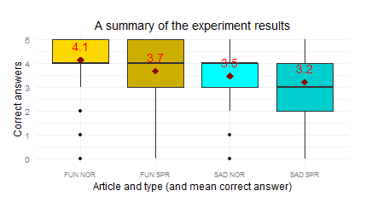
Results: Visualization
Notes:
Murat

Slide 14
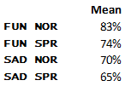
Conclusion
Main finding: negative treatment effect
Possible explanations - gradual learning?
Comparison to PSB study
Spritz folks “don’t do too bad” with comprehension (Control: 76%, Limited Speed Spritz: 68%)
Statistical significance not assessed clearly
Subjects not experienced with Spritz
Notes:
Murat

Slide 15
Spritz Experiment
Spritz Experiment
Q&A

