Slide 1
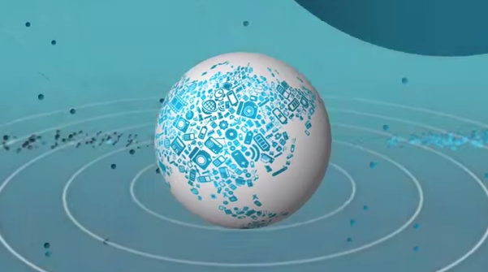
Guiding the Future of the Internet of Things
Kelsey Clubb, Lisa Kirch, and Nital Patwa
W231 Spring 2015
Notes:
Connected globe image from IBM Social Media https://www.youtube.com/watch?v=sfEbMV295Kk

Slide 2
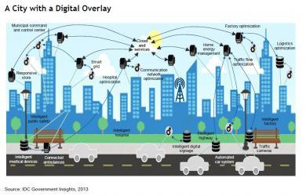
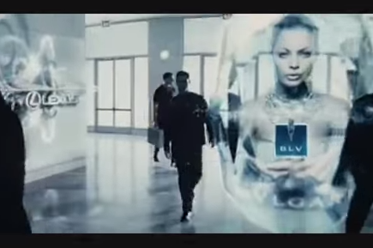
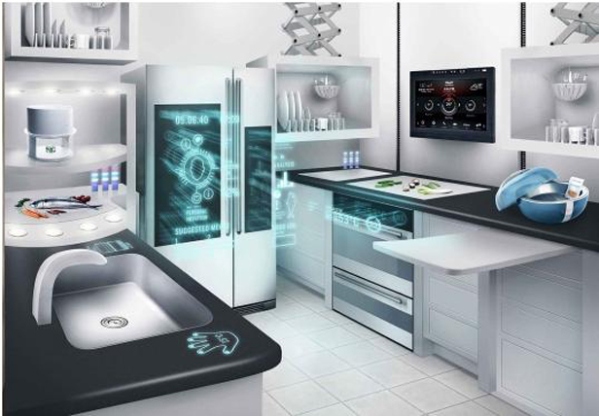
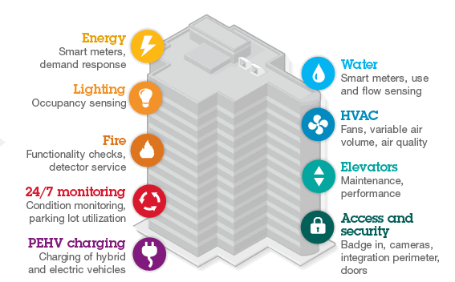
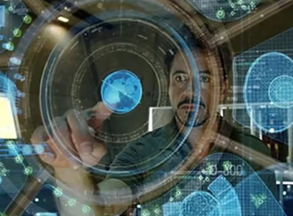
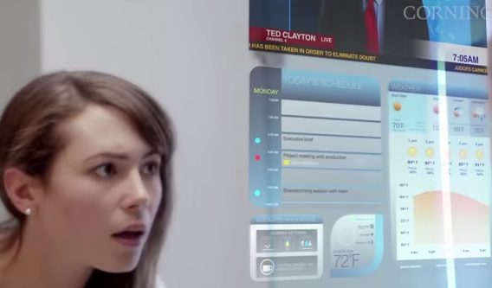
What Is the Internet of Things?
Notes:
systems of systems linked together by sensors - acting smarter because they know about each other acting smarter and more efficiently
high degree of autonomous data capture
event transfer
network connectivity and interoperability
ubiquity and pervasiveness
miniaturization and invisibility
automatic identification
mediation and autonomous agency
embedded intelligence and extended mind
seamless transfer
distributed control
merging digital and physical
inexpensive sensors
Minority Report - Personal Advertising in the Future (John Anderton)
https://www.youtube.com/watch?v=7bXJ_obaiYQ
Smart appliance image from http://www.freemalaysiatoday.com/wp-content/uploads/2014/11/Smart_Appliance_011.jpg
Watch your day in 2020
https://www.youtube.com/watch?v=OptqxagZDfM
10 Future Technologies That Will Change The World
https://www.youtube.com/watch?v=lMymFYJWW5M
Smart City image from Smart Cities Council http://smartcitiescouncil.com/resources/smart-cities-and-internet-everything-foundation-delivering-next-generation-citizen-services
livability, workability, and sustainability
Smart Buildings by IBM - http://www.ibm.com/smarterplanet/us/en/green_buildings/overview/?re=spf

Slide 3
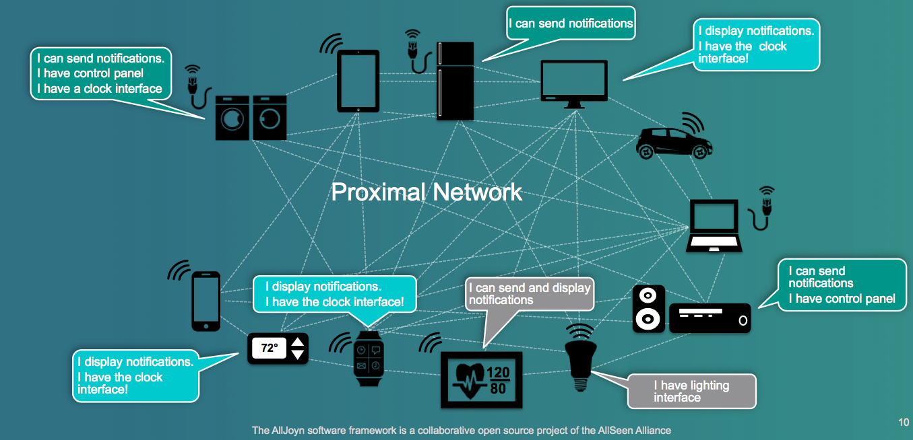
Sensors in Action
Notes:
low cost sensors making this possible
Proximal Network Image from AllSeen Alliance
How Many Sensors are in a Smartphone? http://buildsmartrobots.ning.com/profiles/blogs/the-emgrobotics-audio-dual-motor-controller-board-admcb-use-your-
Light sensors
Touch sensors
Magnetometer
Proximity sensors
Near Field sensors
RFID
Telematics
GPS Tracking
WiFi
Real-time location
Grid sensors
Mesh networks
Accelerometers
Gyroscopes

Slide 4
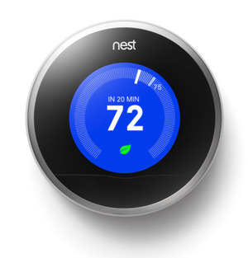
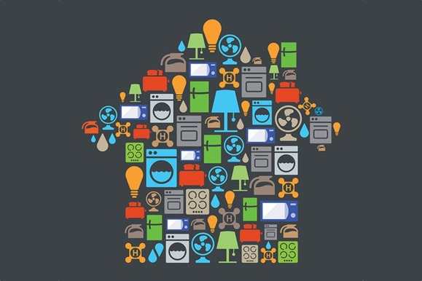
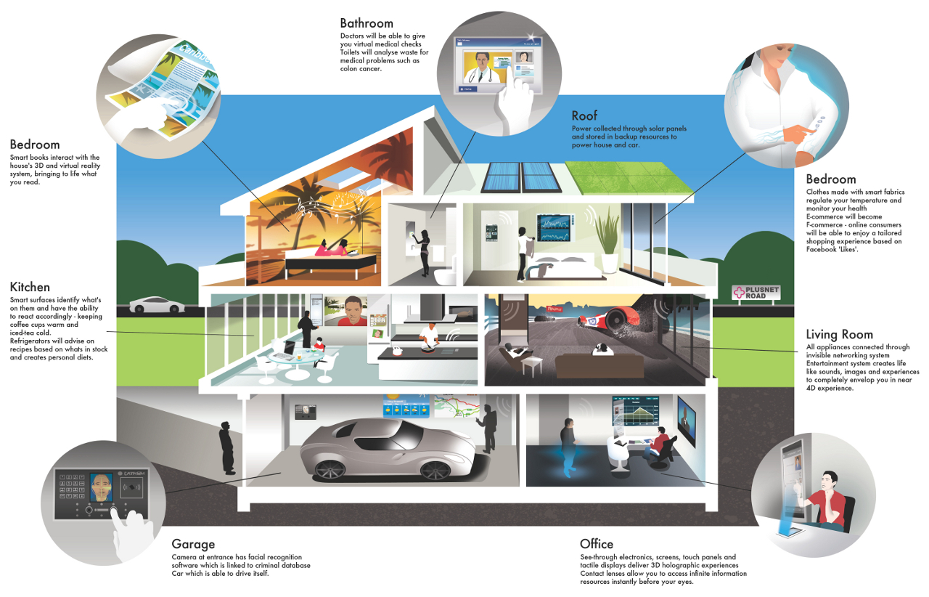
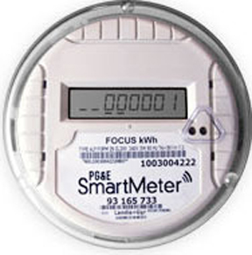
Smart Homes
Notes:
nest has a developer program, “works with nest” https://nest.com/works-with-nest/
works with wearables, appliances, and even your car
http://www.techhive.com/article/2367100/nest-thermostat-to-work-with-wearables-appliances-and-even-your-car.html
images from nest
Smart Home image from http://agovernmentofwolves.com/tag/connected/
Smart Homes of the Future Will Know Us by Our Heartbeats
http://www.wired.com/2014/10/smart-homes-of-the-future/
Canary - a discreet, easy to install monitoring and notification system that provides round the clock reassurance to family members whilst allowing the older or vulnerable person to stay in the home they love. - https://www.canarycare.co.uk

Slide 5
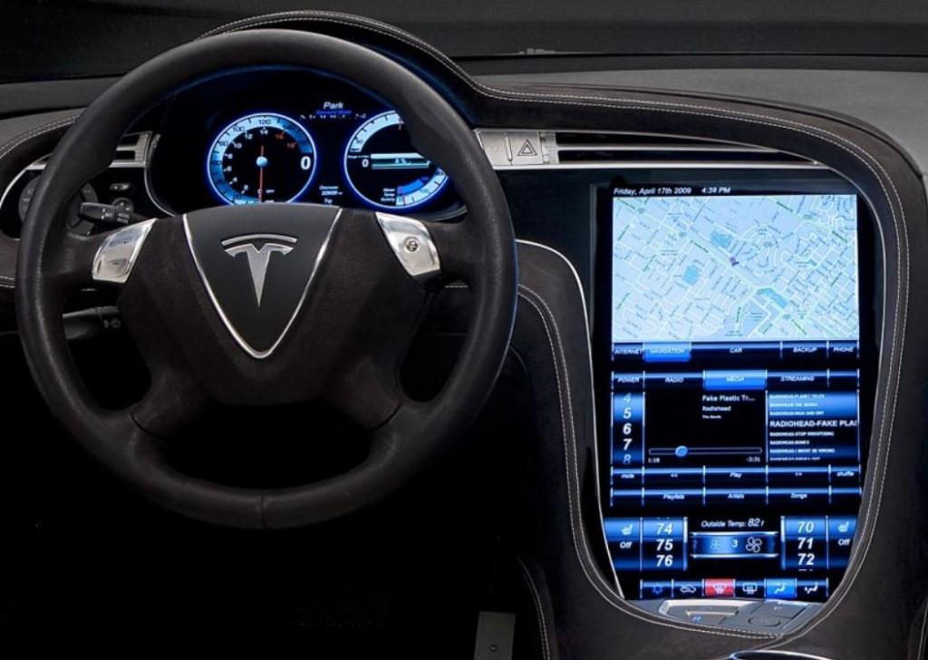
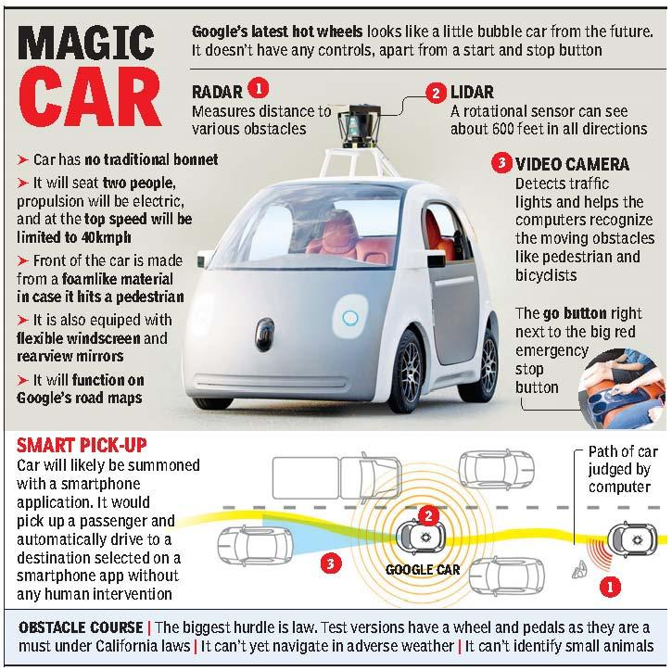
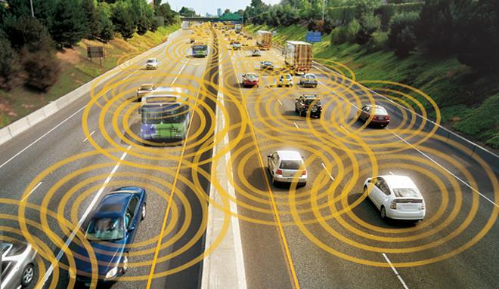
Connected Cars
Notes:
Connected car image from Wired http://www.wired.com/images_blogs/autopia/2012/08/vehicleswithcircleshighway-660.jpg
Tesla S image from http://www.autoconnectedcar.com/2014/04/is-tesla-the-king-of-the-world-of-connected-cars-for-web-surfers-surfers/
Magic Car - http://blogs.timesofindia.indiatimes.com/Mocking-Bird/the-google-car-and-indian-roads/

Slide 6
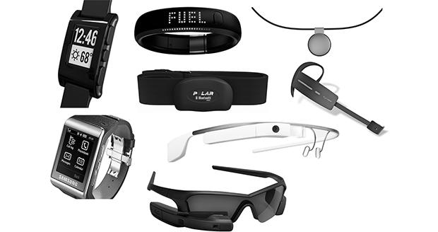
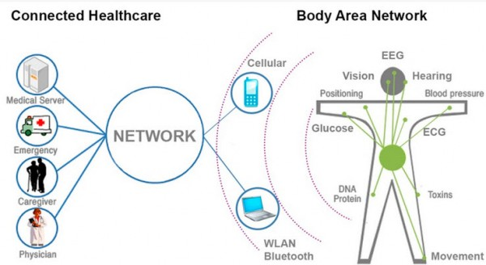
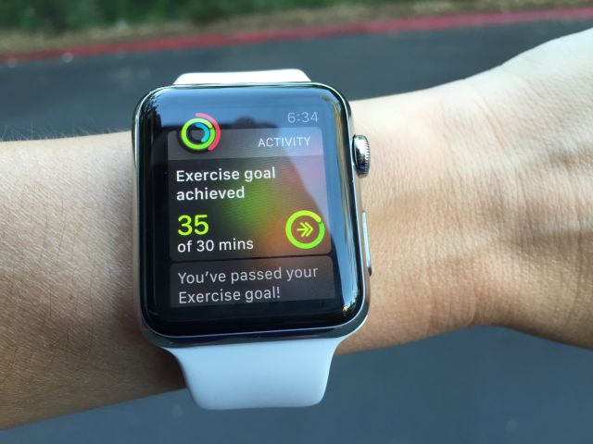
Connected Wearables
Notes:
Kelsey
Wearable images from http://www.onlinetmd.com/FileUploads/image/wearable.jpg
http://www.zmescience.com/medicine/smart-fiber-for-medicine-05464/
https://recodetech.files.wordpress.com/2015/04/apple-watch-goal-acheived.jpg?quality=80&strip=info&w=640

Slide 7
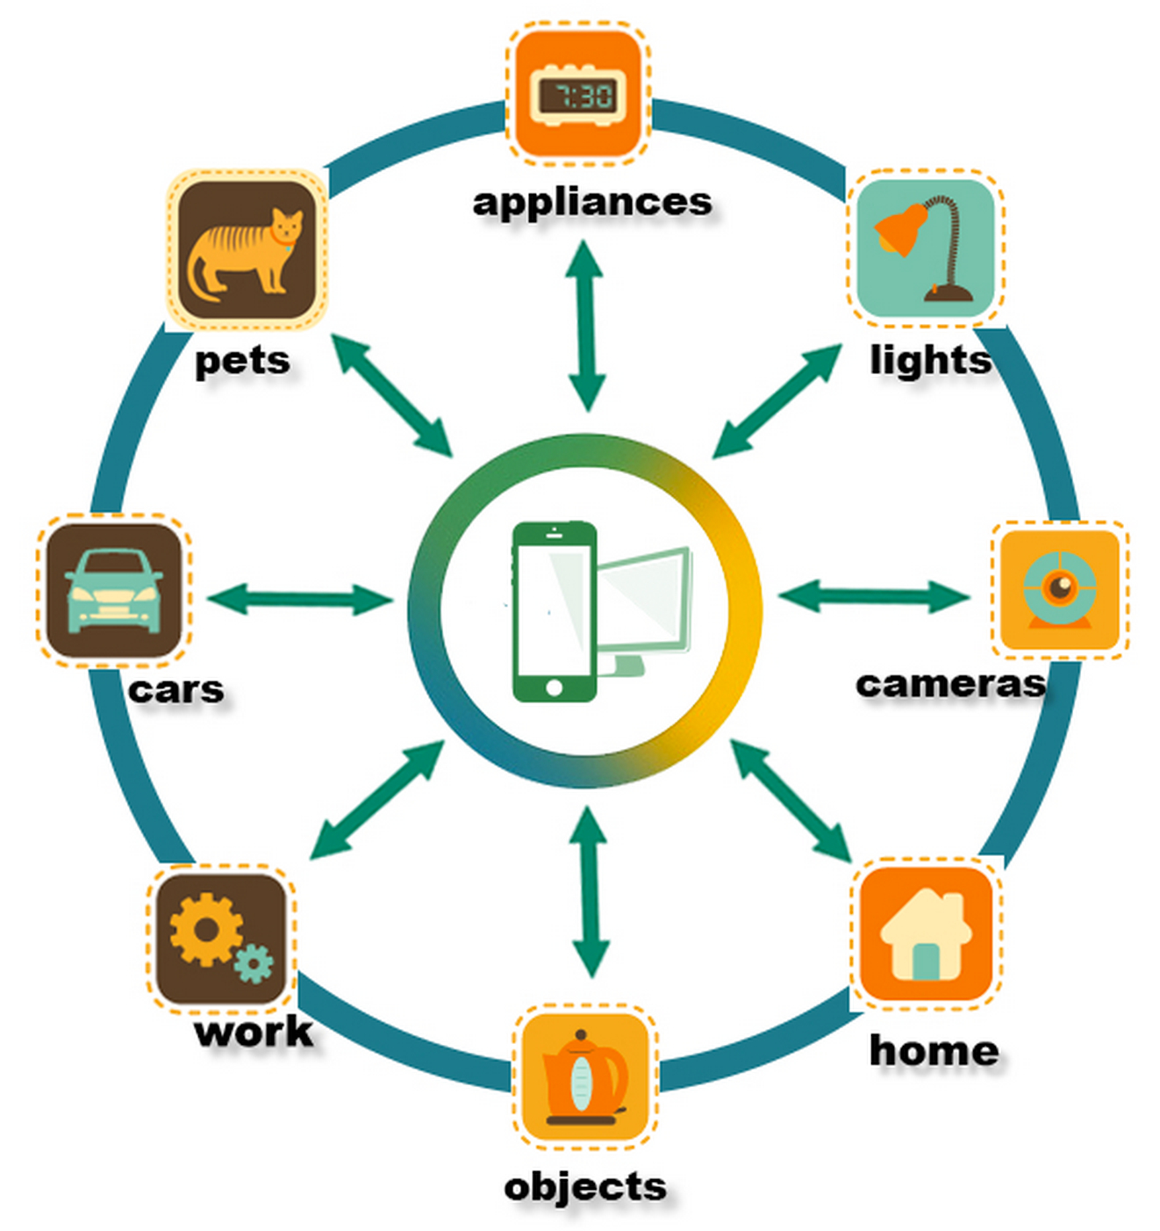
Why Worry about Internet of Things?
Many connected sensors
Datasets contain sensitive info
Hacked IoT device is unsafe
Notes:
systems of systems linked together by sensors - acting smarter because they know about each other acting smarter and more efficiently
high degree of autonomous data capture
event transfer
network connectivity and interoperability
ubiquity and pervasiveness
miniaturization and invisibility
identification
mediation and autonomous agency
embedded intelligence and extended mind
seamless transfer
distributed control
IoT image http://www.ecsblog.org/announcements/education/iot-and-sensors-creating-a-multitrillion-dollar-market/

Slide 8
IoT Leads to New Ethical
and Legal Questions
Security
Privacy
Transparency
Data ownership
Ethical and legal usage and sharing
Inappropriate situations for data collection
“Digital Knowledge Divide”
Notes:
What happens when the Internet connection goes down?
What if the IoT product vendor’s services experience downtime at a critical juncture?
Is there a guarantee for security/hacker-proofing on the cloud side of IoT services to prevent nefarious access to a home’s internal network?
Who is responsible or liable for patching IoT devices, routers, and cloud connections?
What happens if the IoT product vendor goes out of business and no longer supports the product?
Who owns the data generated and collected by these connected devices?
With much of the communication occurring between devices without the user knowing, or possibly understanding, what happens when a device chooses to act independently of its owner or acts in unintended ways - from ordering the wrong products, to vacuuming at an unreasonable hour, to misinterpreting facial expressions or gestures and responding appropriately?
Who owns the data?
Are there situations where these devices should not be collecting data?
What about those who do not have smart devices or the knowledge to use them? “Digital knowledge divide”
What if the consumer wants to opt out?

Slide 9
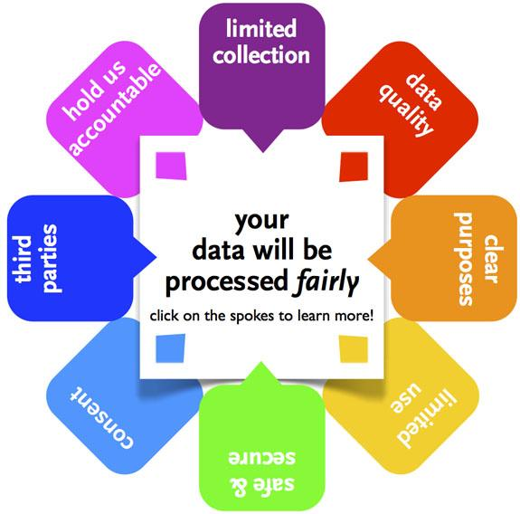
Existing Laws and Regulations
FIPPs Guidelines
Notes:
Need to expand on existing regulations to handle new IoT scenarios.
Fair Credit Reporting Act (FCRA September 2012)
Equal Employment Opportunity Act (EEOA March 1972)
Health Insurance Portability and Accountability Act (HIPPA 1996)
Children’s Online Privacy Protection Act (COPPA 1998)
Electronic Communications Privacy Act (ECPA 1986)
Fair Information Practice Principles (FIPPS 1974) “Hew Report” - image from http://firstmonday.org/ojs/index.php/fm/article/view/4010/3274
Breach Notification Rule
OECD Privacy Guidelines (1998)
FIPPs Guidelines
There must be no personal data record-keeping systems whose very existence is secret.
There must be a way for a person to find out what information about the person is in a record and how it is used.
There must be a way for a person to prevent information about the person that was obtained for one purpose from being used or made available for other purposes without the person's consent.
There must be a way for a person to correct or amend a record of identifiable information about the person.
Any organization creating, maintaining, using, or disseminating records of identifiable personal data must assure the reliability of the data for their intended use and must take precautions to prevent misuses of the data.

Slide 10
NOT ENOUGH!
PII generated by IoT is quite sensitive and there are many unforeseen uses.
Consumer-originated health data is not protected by HIPPA.
Notes:
For example, insurance.

Slide 11
Internet of Things “Bill of Rights” Proposed by Pachube in 2011
People own the data they (or their “things”) create.
People own the data someone else creates about them.
People have the right to access data gathered from public space.
People have the right to access their data in full resolution in real-time.
People have the right to access their data in a standard format.
People have the right to delete or backup their data.
People have the right to use and share their data however they want.
People have the right to keep their data private.
Notes:
Proposed IoT Bill of Rights - http://postscapes.com/open-internet-of-things-assembly

Slide 12
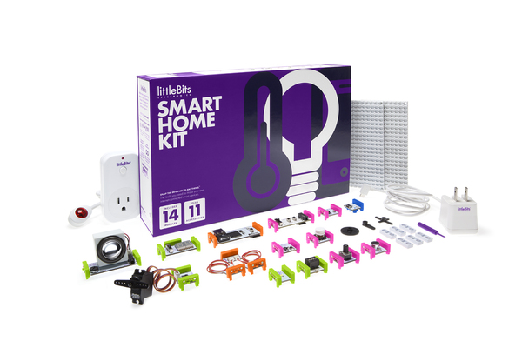
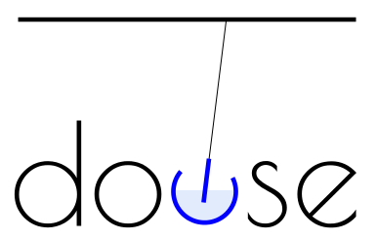
Current State of IoT Affairs
Notes:
European Union is further ahead than the US in making rules, regulations, and thinking ahead on legal, ethical, and privacy issues.
In the mean time, industry leaders, developers, designers, and enthusiasts are taking matters into their own hands and discussing these issues and solving some of these issues themselves.
APIdays - http://sf.apidays.io/ - June 17-18, 2015, San Francisco
Solid conference - http://solidcon.com/internet-of-things-2015 - June 23-25, 2015, San Francisco
Ubiquitous Commons - International research effort dedicated to understanding the transformation of data, information and knowledge in the age of ubiquitous technologies - http://www.ubiquitouscommons.org/
DataEdge - http://dataedge.ischool.berkeley.edu/ - May 7-8, 2015, Berkeley
AllSeen Alliance - “To enable widespread adoption and help accelerate the development and evolution of an interoperable peer connectivity and communications framework based on AllJoyn for devices and applications in the Internet of Everything.” https://allseenalliance.org/
Open Internet Consortium - http://openinterconnect.org/
Industrial Internet Consortium - To “…influence the global development standards process for internet and industrial systems.” - http://www.industrialinternetconsortium.org/
oneM2M - standards for M2M and the Internet of Things - http://www.onem2m.org/
M2M.com - community for the Internet of Things, machine-to-machine and connected consumer devices development - http://m2m.com/welcome
Bastille -provides situational awareness into devices in your airspace - https://www.bastille.io/
IEEE - http://iot.ieee.org/
thread - solves reliability, security, power, and compatibility issues for connecting products around the home - http://threadgroup.org/
Open Interconnect - the open interconnect consortium is being founded by leading technology companies with the goal of defining the connectivity requirements and ensuring interoperability of the billions of devices that will make up the emergeing internet of things - http://openinterconnect.org/
IoT Live - Solving the unanswered questions in IoT - http://iotlive.org/two/
douse - hub for local area network awareness - http://dowse.equipment
IFTTT - https://ifttt.com
Old TCP/IP internet stack to IP6 6LoWPAN
http://orbigo.net/wp-content/uploads/2011/06/6LoWPAN_Stack.png
Thread’s network diagram - climate control, lighting, security, appliances, access control, and safety - http://threadgroup.org/Technology.aspx
spark - suite of hardware and software tools to help you prototype, scale, and manage your IoT products - https://www.spark.io
Right Now, The Internet of Things Is Like the Internet of the 1990s: A World of Connected Devices Are Starting to Come Online. Don’t Mistake What They Do Now for What They’ll Accomplish in the Future
IFTTT image from http://www.fastcompany.com/3044375/sector-forecasting/the-future-of-the-internet-of-things-is-like-the-internet-of-the-1990s
Internet of Things. Trends
http://www.slideshare.net/baraev/internet-of-things-trends

Slide 13
Our Recommendations
Security first and throughout the expected life cycle.
Transparency, Notice, and Consent of anything collected beyond Expected Usage.
De-identification Is Not Enough.
Meaningful Opt-Outs.
Build in ability for human decision and overrides.
Option to pay to own and control the dataset.
Centralized Opt-Out for any IoT Dataset traded by Data Brokers.
Companies and Data Brokers Liable for Damages.
Notes:
Design For User Experience, Resiliency, Adaptability, and Security at the Beginning
Create Contextual Apps/Environments/Experiences
Add in ability for Human Override and Decision Making
Develop IoT Standards
Include Transparency
Payout Option for Data Ownership and Usage Rights
Comprehensible Terms of Use & Opt-Out Option for Broader Usage Rights
New Data Broker Rules for IoT Datasets
De-identification Is Not Enough
Liability for Damages

Slide 14
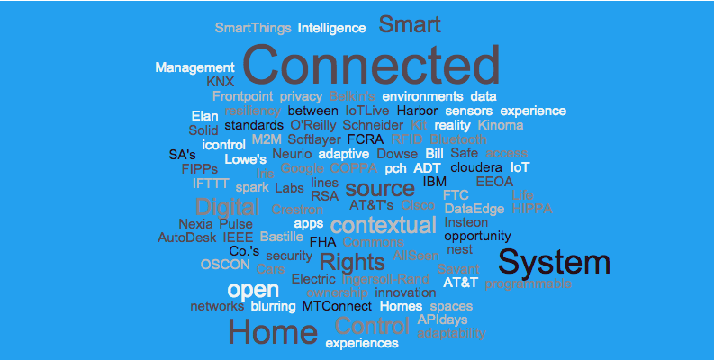
Questions?

