Slide 1
The uConserve Dashboard
Rahul Bansal, Lisa Kirch, Nital Patwa
W210 - Summer 2015

Slide 2
Goals and Potential Impact
Our goal is to drive awareness and conservation of the world’s natural resources through compelling analytics, insightful visualizations, and targeted, actionable conservation recommendations.
Electricity
20% of electricity in homes is wasted¹
Corresponds to $40 billion and 50% of US coal usage annually¹
In Austin alone, if 500K houses reduce usage 5% → >$2.5M savings
Water
US water consumption per capita is 2X + compared to other industrialized nations²
Gas
Often times a trade-off between gas and electricity usage
Is it possible to optimize when to use which resource?
http://www.ted.com/talks/alex_laskey_how_behavioral_science_can_lower_your_energy_bill
http://green.blogs.nytimes.com/2012/02/15/tracking-how-the-world-guzzles-water/?_r=0
http://www.finweb.com/real-estate/gas-or-electric-which-is-cheaper.html#axzz3cPunnls5
Notes:
WATER
US: 2.8K cubic meters/yr
China: 1K cubic meters/yr
India: 1K cubic meters/yr
UK: 1.2K cubic meters/yr

Slide 3
Evolution of our Thinking
- Focus on the results we want to drive
- What data do we need to support to support those decisions
- Psychology of behavior change in energy consumption
- Perform analytics that drive action instead of just information
- Discover available datasets
- Explore granularity
- Let data determine our outputs
- Focus on visualizations
- Build UI mockups first so we have an end product in mind

Slide 4
Minimum Viable Product
Use fine-grained, per-household data for electricity
Perform time-series, component, and behavioral analysis
Create actionable insights for the home owner
Develop basic visualization framework to deliver results and recommendations
Stretch Goals
Draft recommendations for policy makers based on detailed resident usage information
Move beyond consumer dashboards and work on macro issues such as the California water crisis
Develop comprehensive web solution

Slide 5
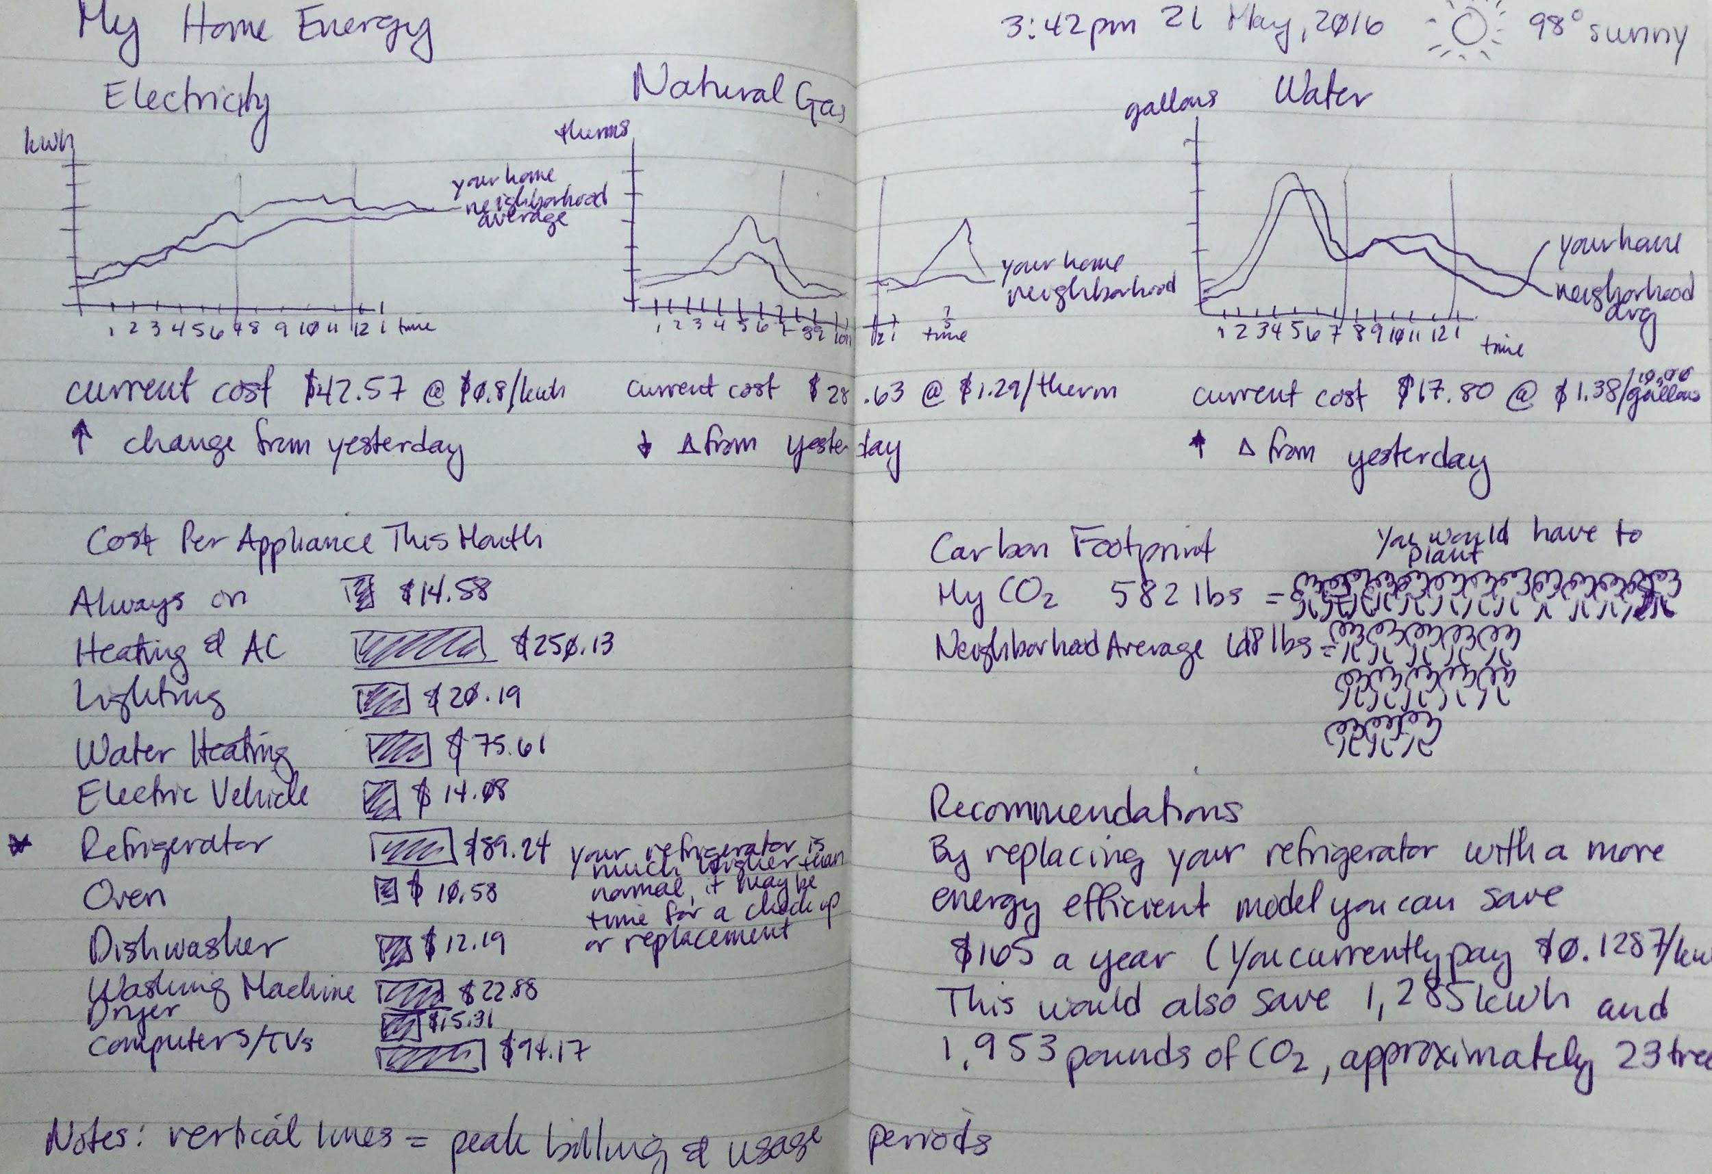

Slide 6
Data Sources
As we began searching for data sets to support our project, we came across many publically available sources. A few are listed below.
Pecan Street Dataport - disaggregated electricity, gas, and water data at the minute level (2011-2014)
U.S. Energy Information Administration
Residential Energy Consumption Survey (RECS)
Updated Buildings Sector Appliance and Equipment Costs and Efficiencies (2015)
Residential Gas Usage Data
USGS Water Usage Data
Water Footprint Network - National Water Footprint Statistics
OpenWeatherMap - weather data, forecasts, precipitation
Berkeley Lab Home Energy Scoring Tool and Home Energy Saver
Cost of electricity per kwh, cost of water per cubic foot, cost of gas per thousand cubic feet
Notes:
Pecan Street Data Port
https://dataport.pecanstreet.org/
Energy Usage Data
http://www.eia.gov/consumption/residential/index.cfm
http://www.eia.gov/analysis/studies/buildings/equipcosts/pdf/full.pdf
Water Usage Data
http://www.usgs.gov/blogs/features/usgs_top_story/think-short-creative-and-inviting/
http://waterdata.usgs.gov/nwis/wu
http://waterfootprint.org/en/resources/water-footprint-statistics/#CP1
Residential Gas Usage Data
http://www.eia.gov/dnav/ng/ng_cons_sum_dcu_nus_m.htm
http://www.eia.gov/dnav/ng/hist/n3010us3m.htm
US Utility Rate Database
http://en.openei.org/wiki/Utility_Rate_Database
Weather Data
http://openweathermap.org/weather-data#current
Berkeley Lab Home Energy Scoring Tool
https://developers.buildingsapi.lbl.gov/hes/service
https://developers.buildingsapi.lbl.gov/hescore/documentation/scoring-tool-api

Slide 7
Pecan Street Data
“World’s largest source of disaggregated customer energy data for university researchers around the world.”
Resource usage data on more than 1,200 residences in TX, CO, CA
Electricity usage data per household at minute intervals
Sub-circuit data to assist labeling
Broken out into washer/dryer, dishwasher, furnace, AC, refrigerator, water heater, indoor and outdoor plugs
Majority of data from Austin for 2013-2014
Survey data
House size, # floors, # rooms, age, # residents
Appliance audits
Manufacturer, model, age, power (BTUs)
Weather data
Notes:
Dataport is the world's largest source of disaggregated customer energy data for university researchers around the world.
More than 1,200 individual residences in Texas, Colorado and California
Circuit-level (disaggregated) and whole-home electricity use data
Smart water meter data
Smart natural gas meter data

Slide 8
Analysis Roadmap
Phase 1: Time Series Analysis
Phase 2: Behavior Extraction
Phase 3: Component Analysis
Phase 4: Pattern Identification and Clustering
Tools: Python Pandas and/or R
Custom Tooling

Slide 9
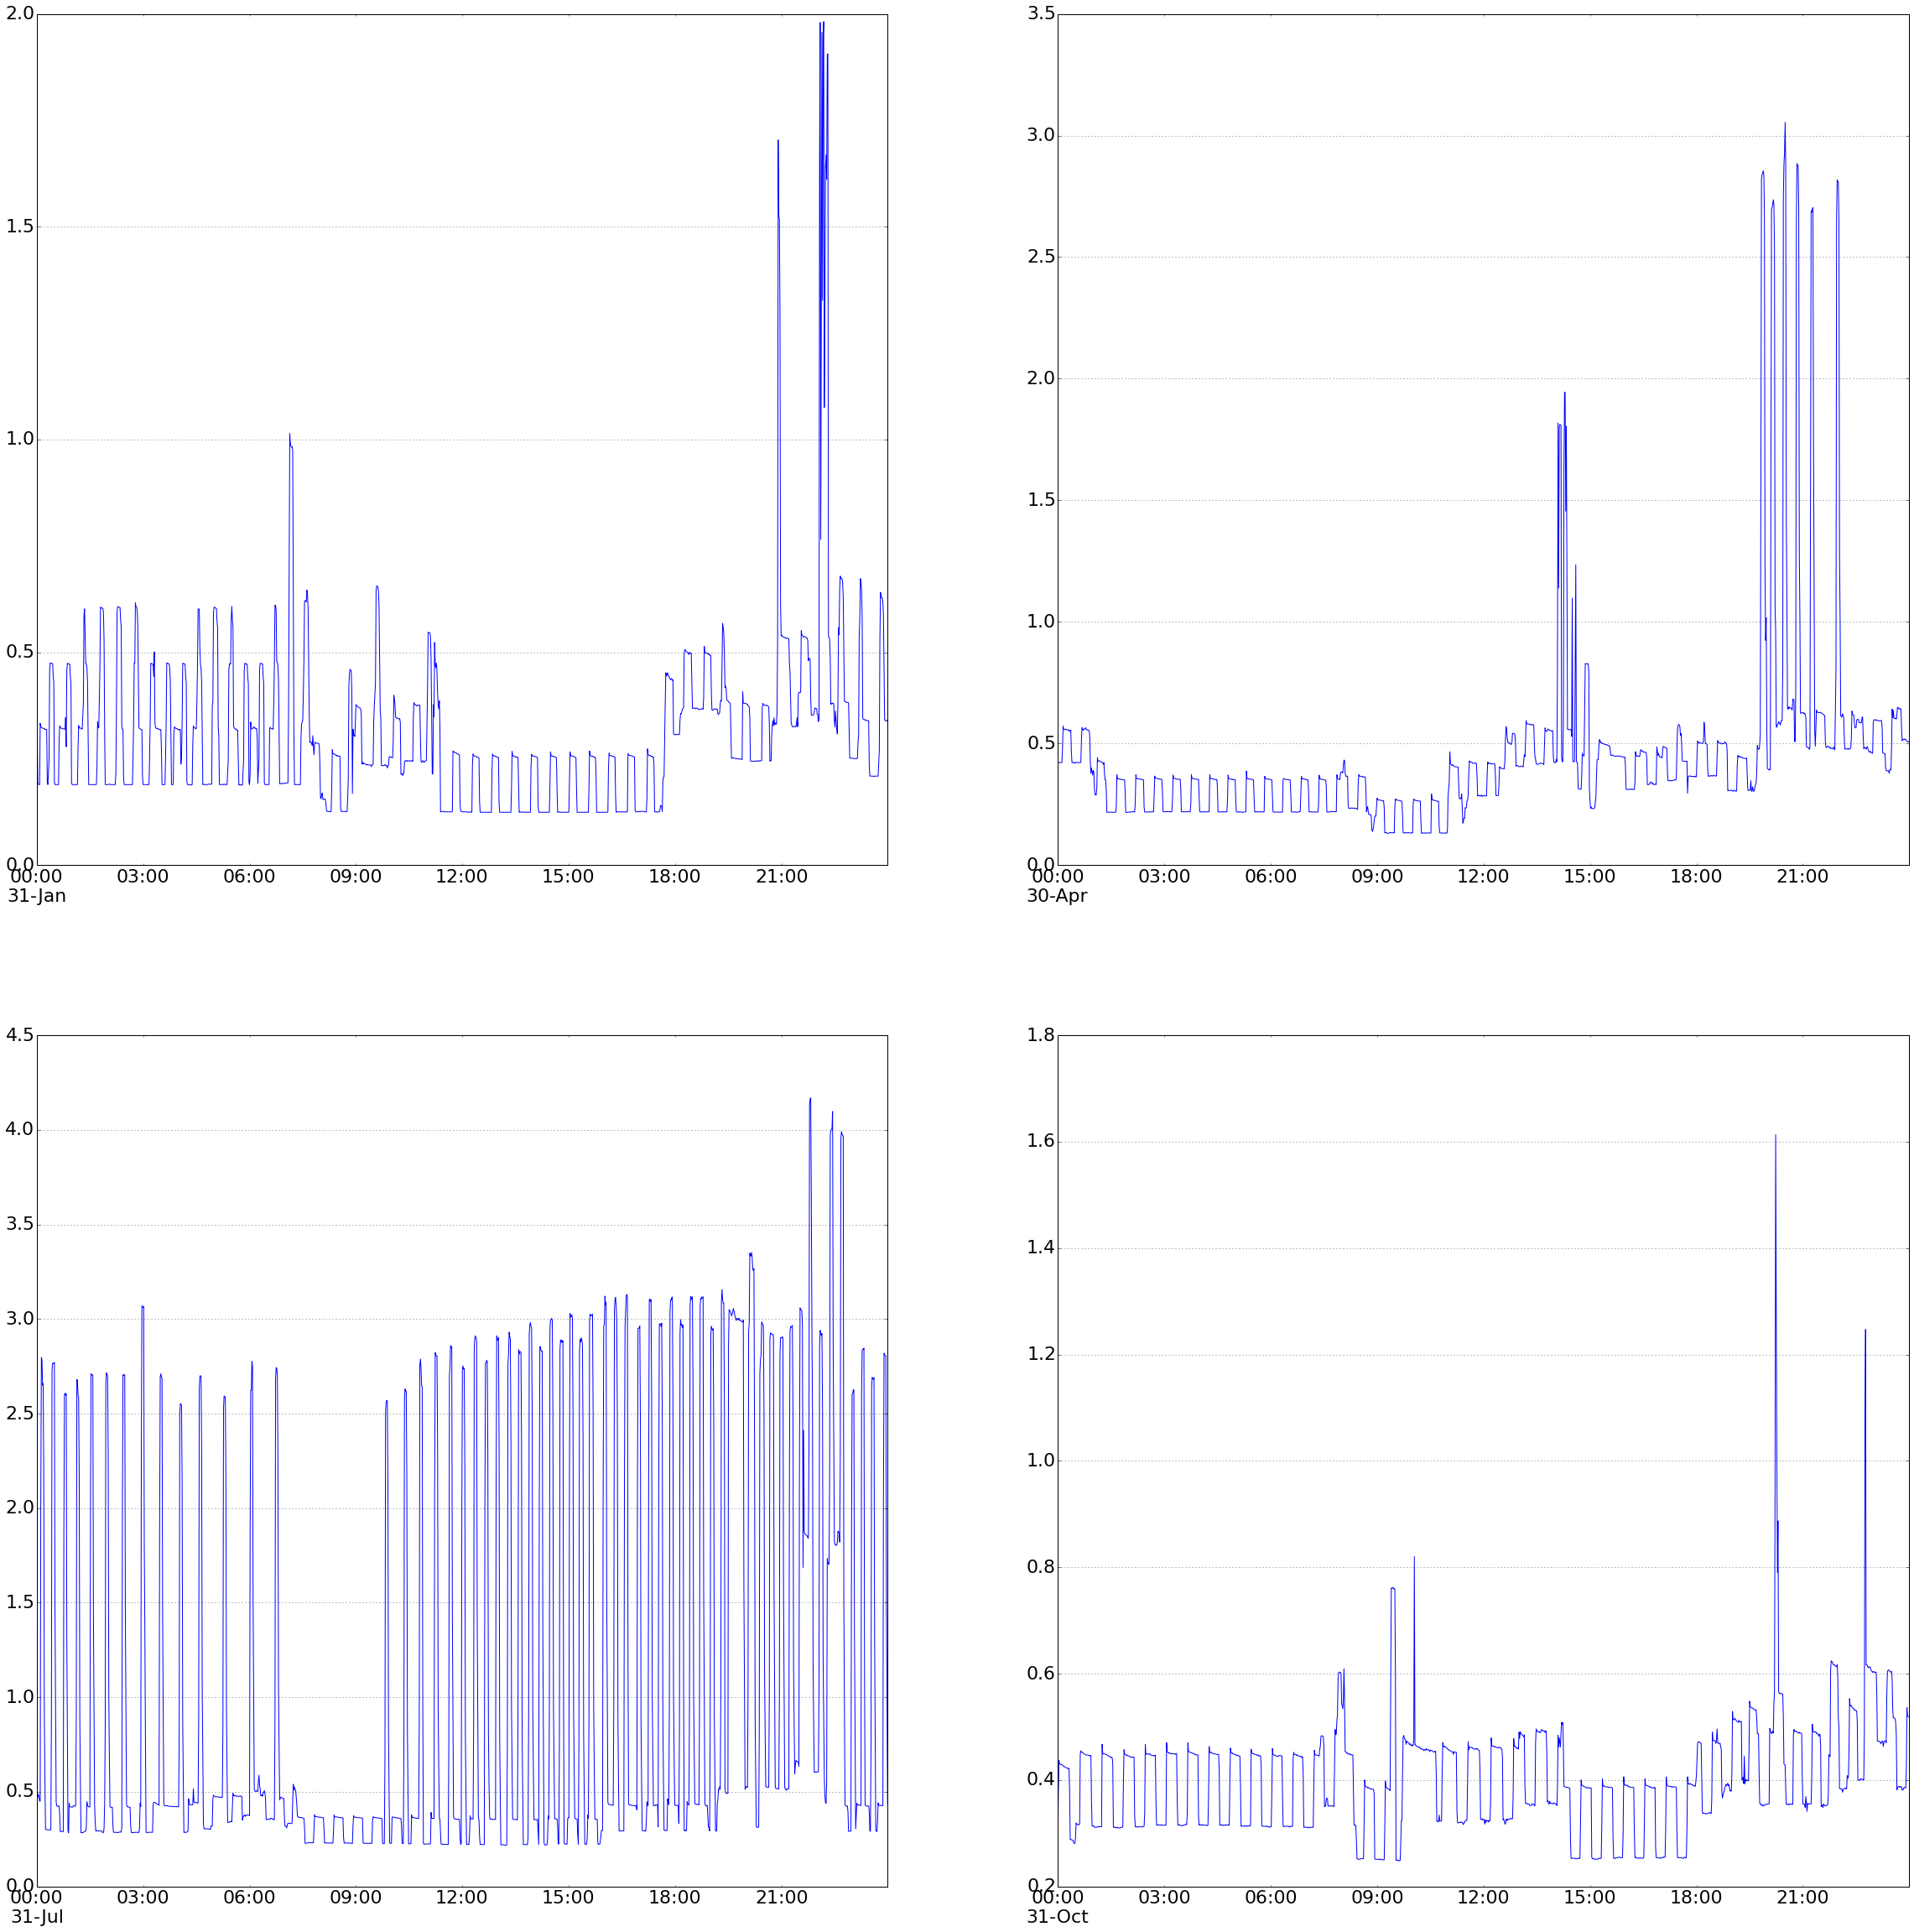
Daily Usage Time Series
Winter
Spring
0.5
0.5
Summer
Fall
3
0.5
0.5

Slide 10
Behavior Extraction
Post-dinner 9-10pm
Post-Dinner 9-10PM
Why Gap?

Slide 11
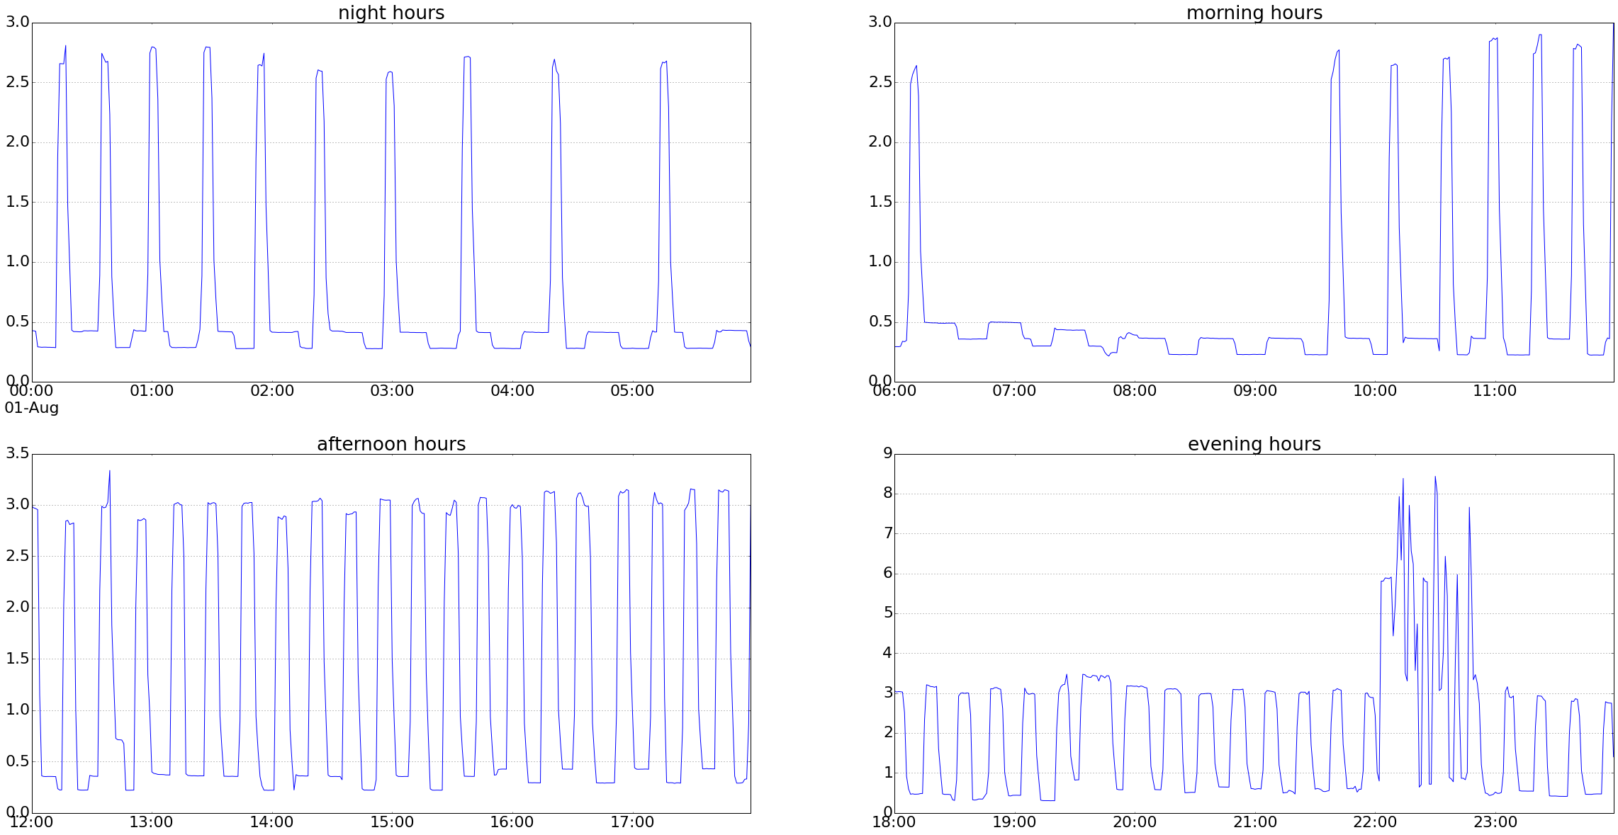
Summer Day Usage (08/01/13)
Natural
Cooling
Heavy Usage From?

Slide 12
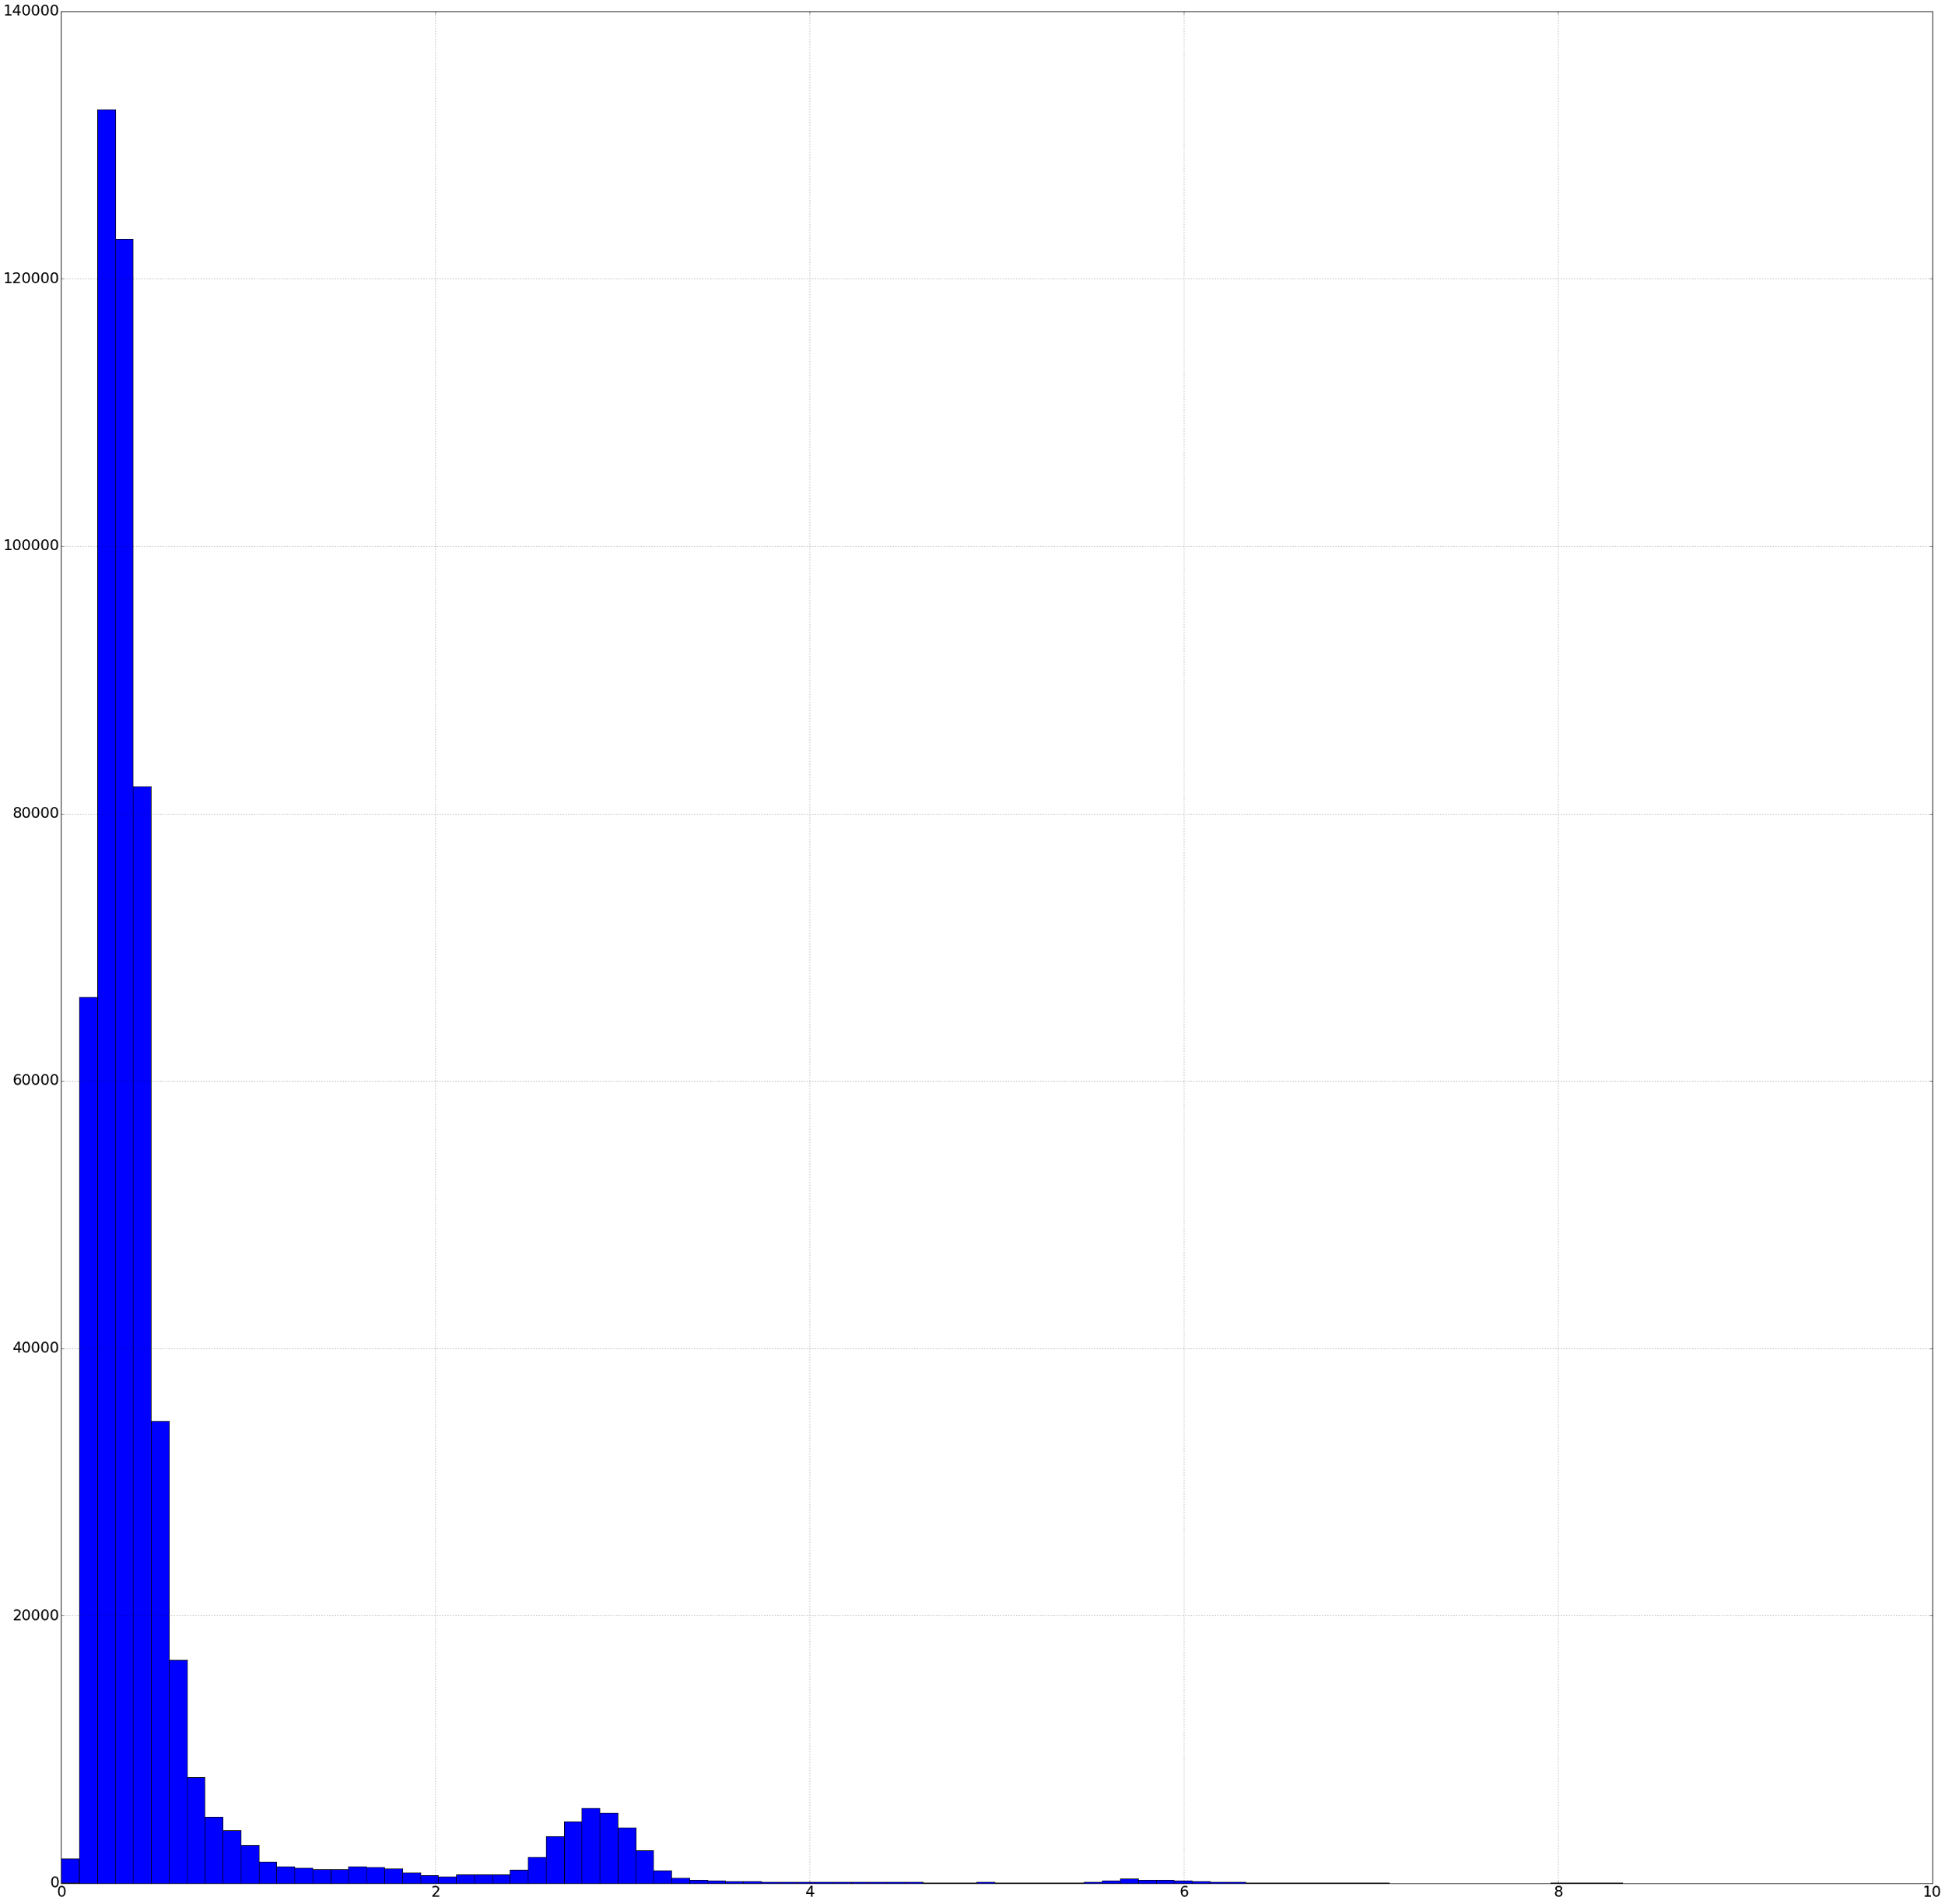
Per-Minute Usage Histogram
Quad-Modal Distribution
Centered at 0.5, 3, 6 and 8 W-H/Min
Contribution to yearly usage:
61%, 32%, 5%, 0.5%
61.5%
32.5%
5.35%
0.5%
2
4
6
8

Slide 13
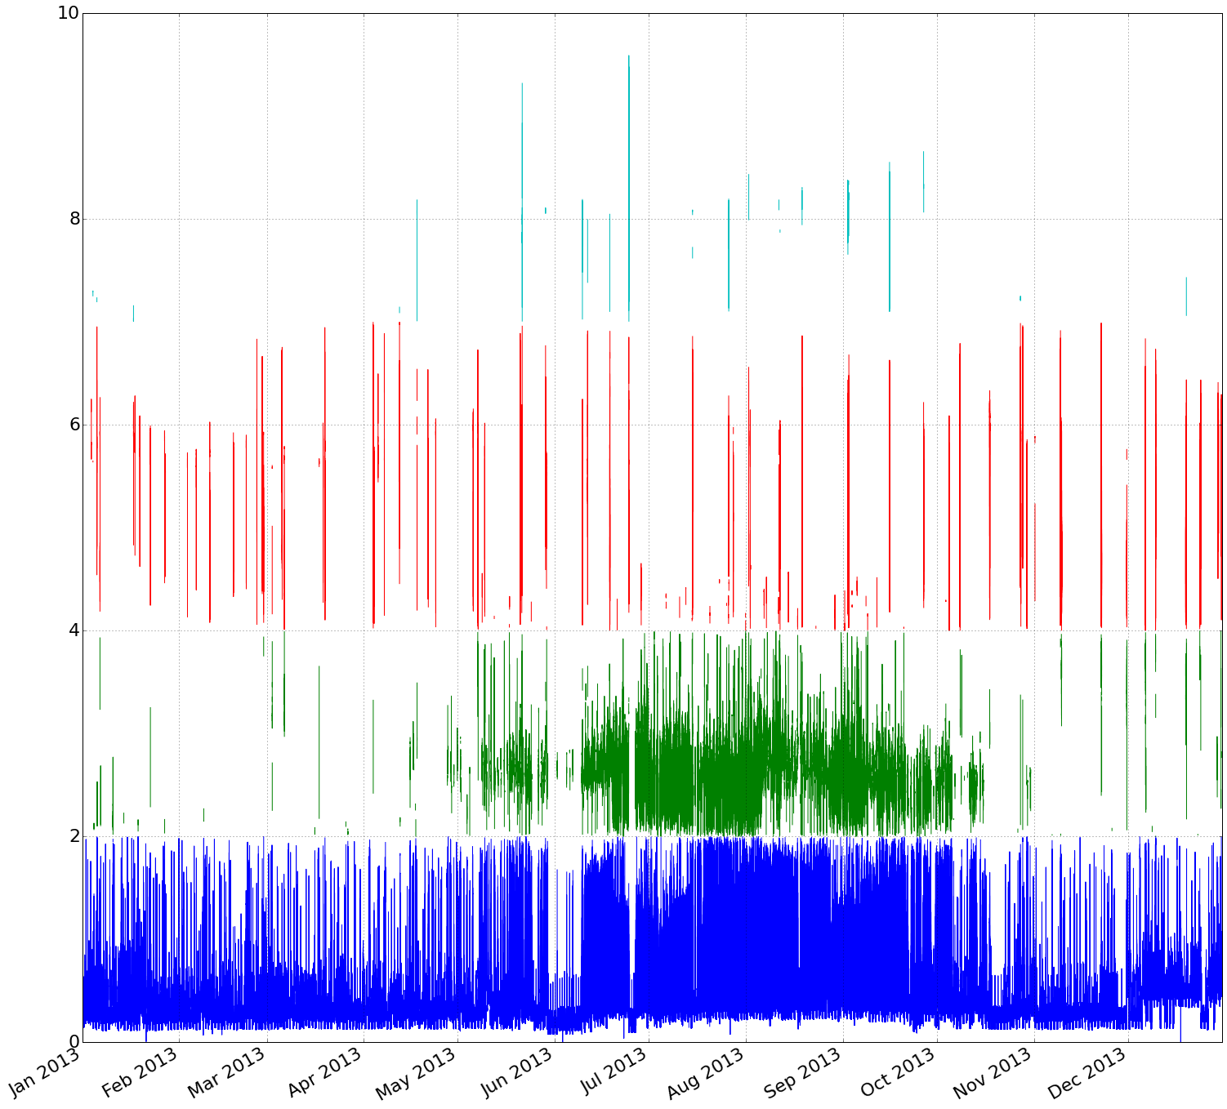
Component Contribution Over One Year
8
6
4
2

Slide 14
Next Steps
Complete data gathering
Full data profiling
Continue principle component analysis and time series analysis
Begin to draft final visualizations and think about web-based deliverable

Slide 15
Q & A

