Slide 1
MyBestHospital.com
Rahul Bansal, Lisa Kirch, Joe Morales, and Christopher Walker
W209 Summer 2014

Slide 2
Goal
To build a web application that provides hospital recommendations to consumers based on their location, current circumstances, and health care needs. By allowing users to enter basic information regarding their care needs and selecting the options that matter most to them, they are able to customize their experience and compare hospitals on a variety of quantitative and qualitative metrics to select their best hospital.
Primary aspects to take into account:
Price | Safety
Outcome | Patient Satisfaction

Slide 3
Data Sources
Used the Centers for Medicare & Medicaid Services (CMS) “Hospital Compare” data to create JSON files
Emergency Department Throughput.csv
HCAHPS Measures.csv
Outcome of Care Measures.csv
Medicare_Provider_Charge_Inpatient_DRG100_FY2012.csv
to assess hospital performance.
The data can be found at https://data.medicare.gov/ and https://data.cms.gov

Slide 4
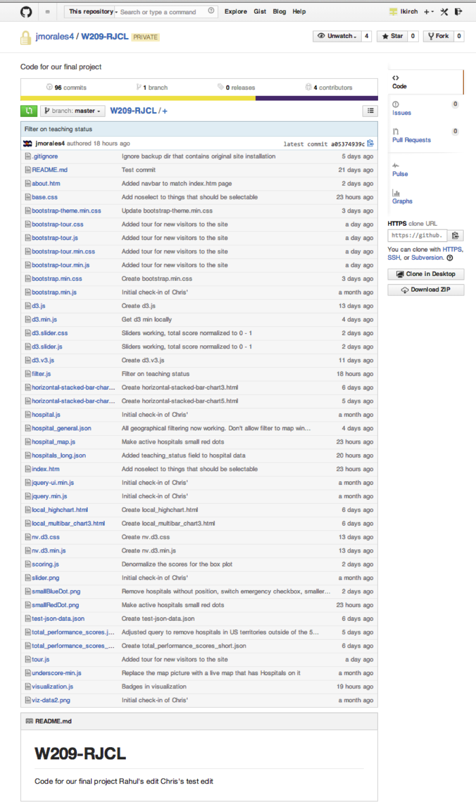
Tools Used
Selected readily available data and development tools:
HTML/CSS/JS: Bootstrap, Bootstrap-tour, and jQuery
Data Visualization: D3, d3.slider, NVD3, Google Maps API
Medicare Data: Excel, PostgreSQL
Version Control: GitHub
Usability Testing: Silverback

Slide 5
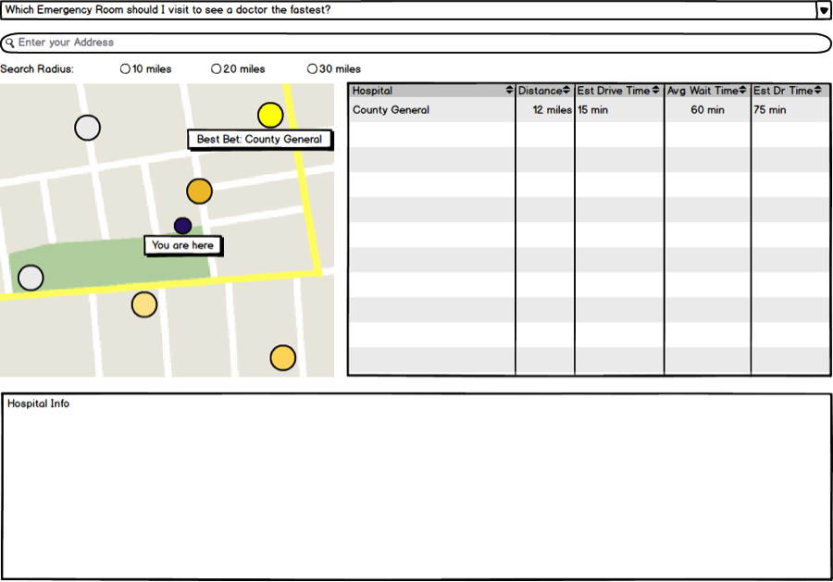
Initial Concept
At this point we conducted user interviews to see what was most important to people when selecting a hospital.
Notes:
- Which hospitals will bankrupt me?
- Which hospital should I go to if I like living and want to keep doing it?
- Which hospitals care about me?
- How slammed is the hospital?

Slide 6
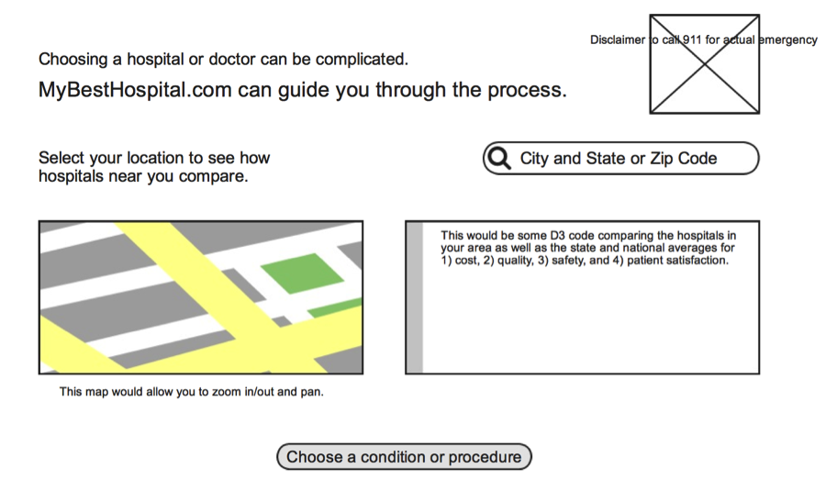
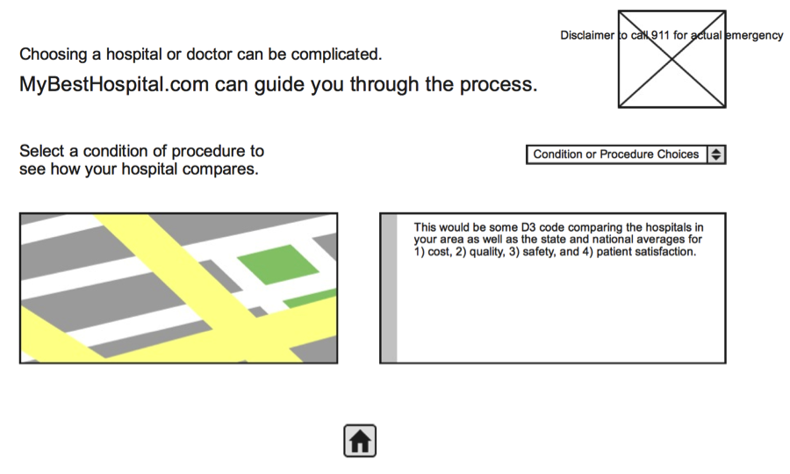
Iteration 2

Slide 7
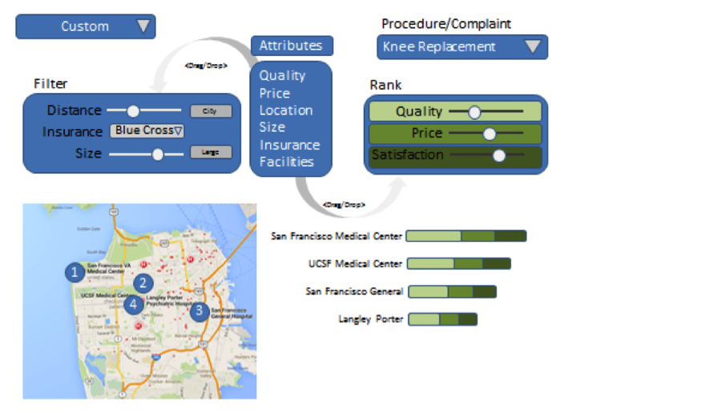
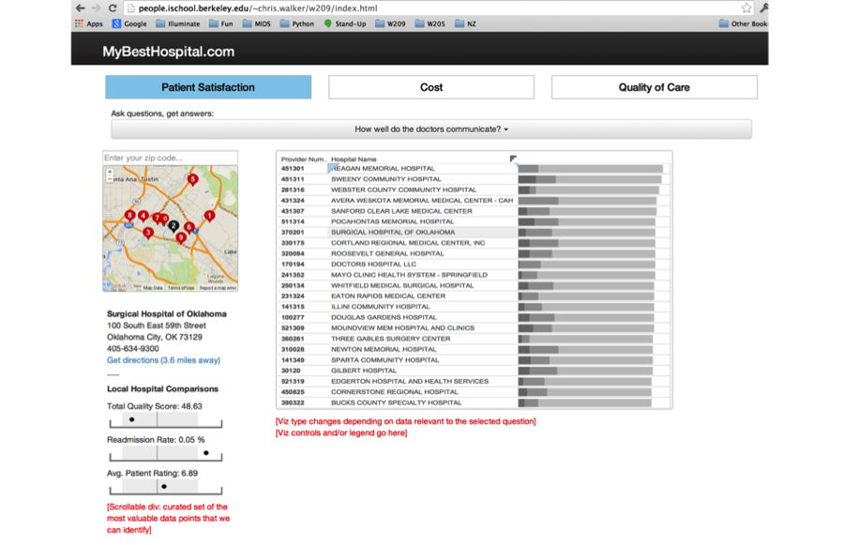
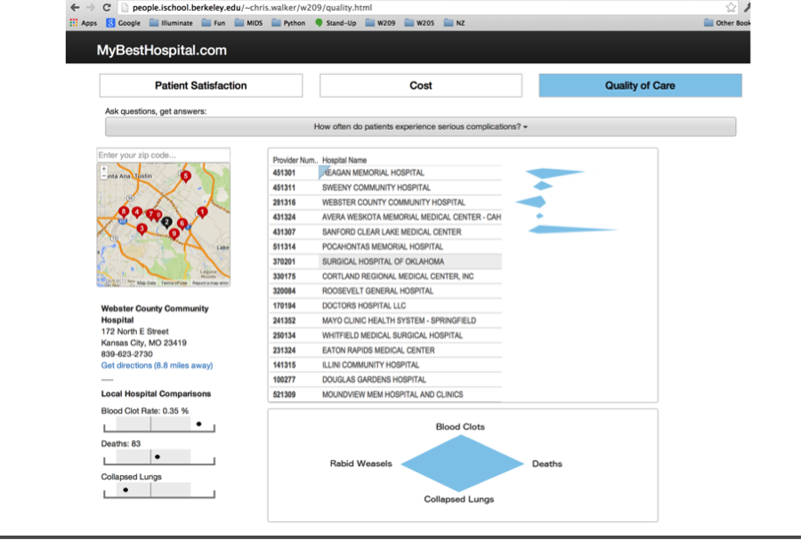
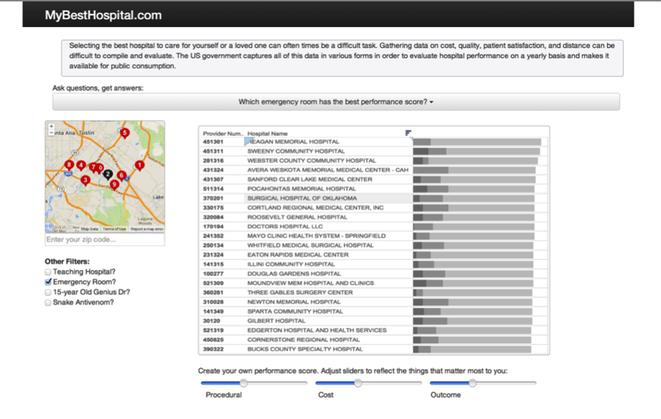
Iteration 3

Slide 8
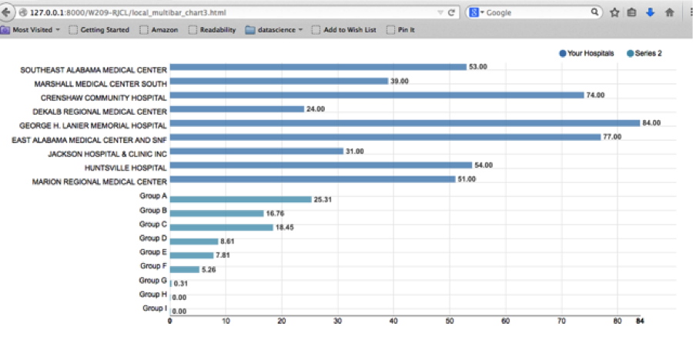
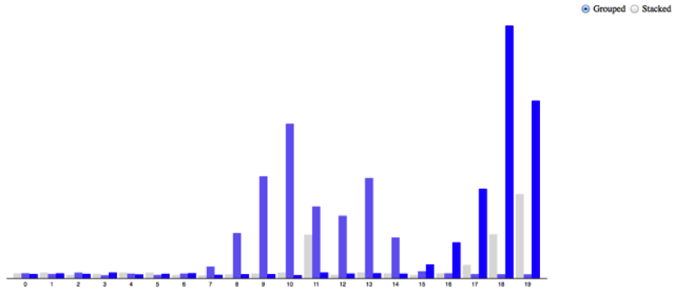
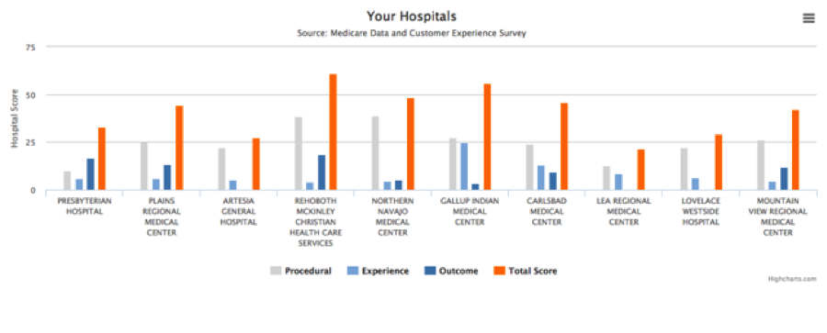
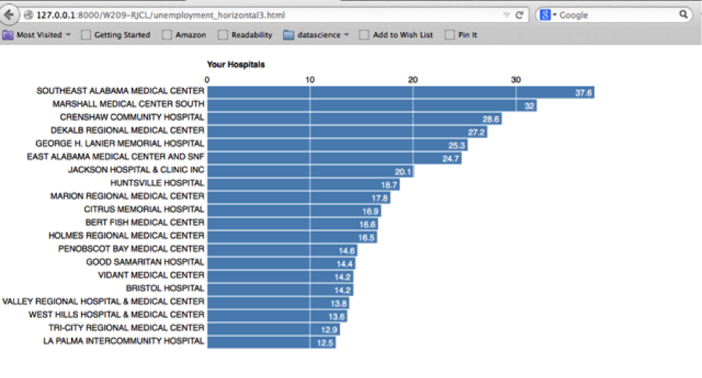
Iteration 4

Slide 9
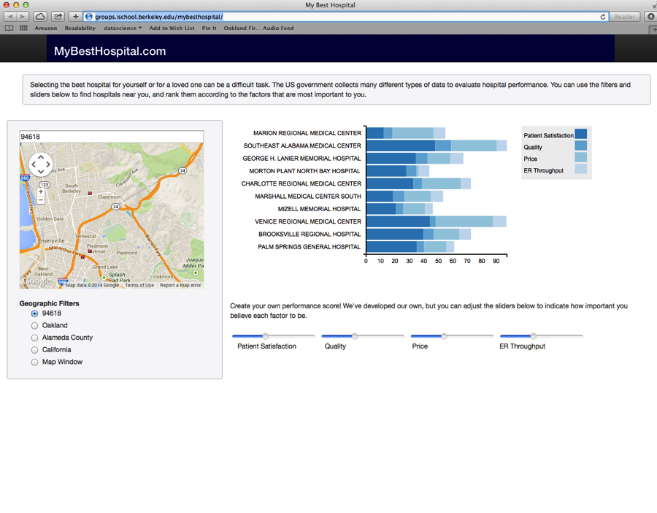
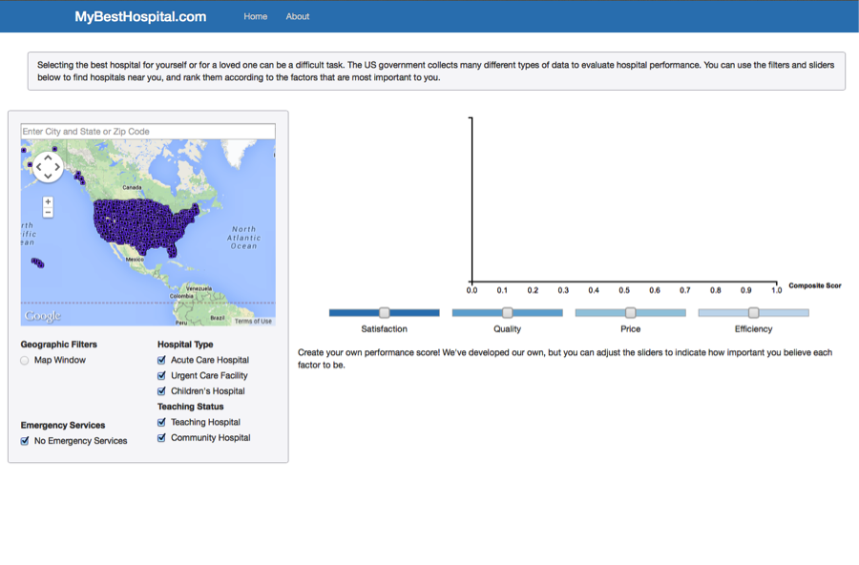
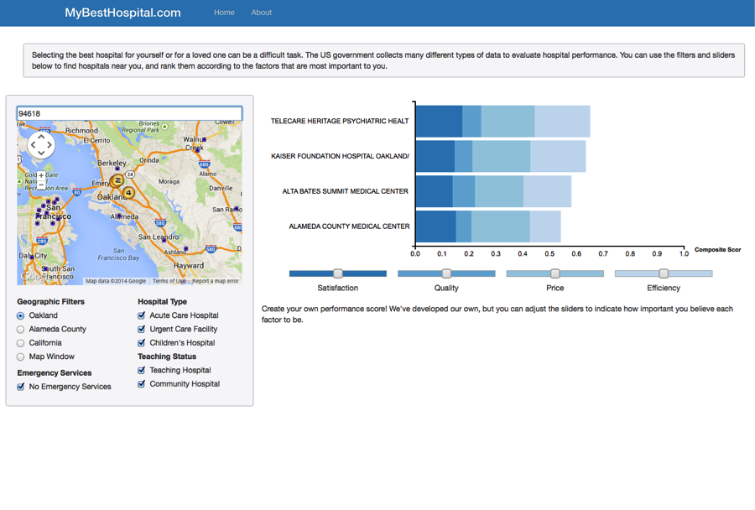
Iterations 5 and 6
Real map data, mock up sliders and chart data
Real map data, real chart data, functioning sliders, and most filters working

Slide 10
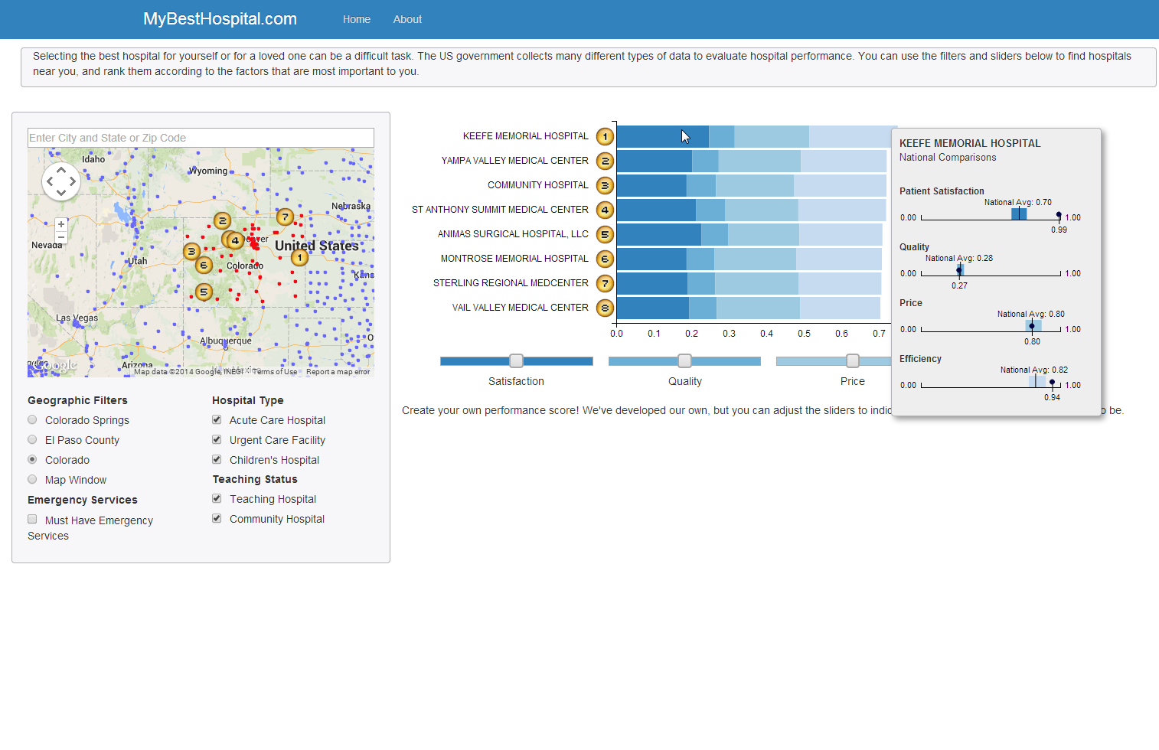
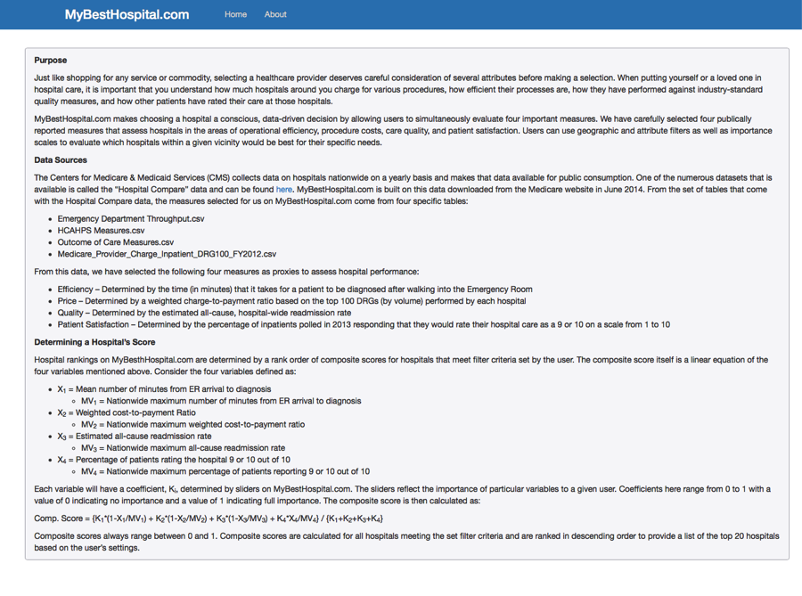
Iteration 7
Notes:
- Added in geographic filters by county.
- Filtered out Puerto Rico and other US territories since the Google map API treated them as separate countries.
- Filtered out hospitals missing longitude and latitude data as they appeared in the ocean off Africa.
- The rank is based on the total score of the 4 components.
- If hospitals are missing a score, then we use the national average and handle this in the scoring code.
- Added an Infobox showing how the hospital compares to the national average on the 4 scoring components.
- Added an About page to explain where we got the data and how we used it.
- Limited search results to top 8 hospitals for now.

Slide 11
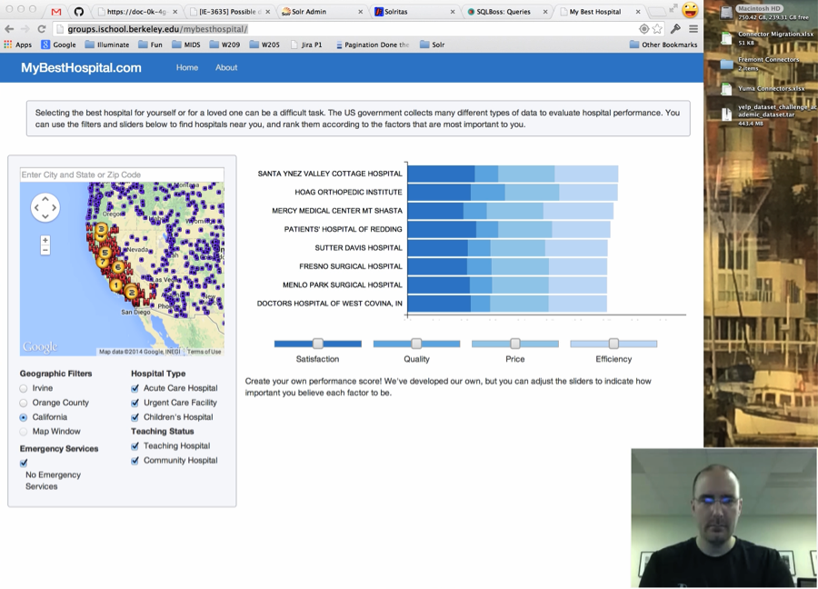
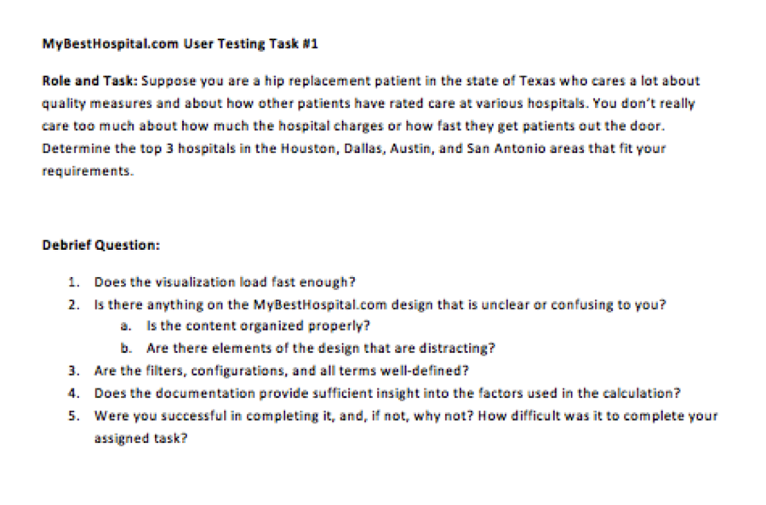
Summary Usability Feedback
Recruited 7 Usability Testers
Reduce the scope of our project and drop the ER related aspects and social media ratings.
Users needed some explanation of the sliders and the filters.
Need the same number from the map next to the hospital name.
In small windows, the Infobox and longer hospital names got cut off.
The emergency care filter was particularly confusing.
Some sort of help or user introduction is needed.
The scale was not clear.
Notes:
Ran additional tests:
- http://colorfilter.wickline.org/
- http://www.vischeck.com/ - to simulate colorblindness; however, this site was unavailable for testing
- http://validator.w3.org/ - W3C Markup Validation Service
- http://www.checkmycolours.com/ - to analyze color contrast of pages
- http://www.webpagetest.org/ - for speed using several global locations and different browsers
- http://wordscount.info/ - just for some fun interesting statistics on the wording we used

Slide 12
MoSCoW Prioritization of Usability Feedback
MUST
Emergency Services filter confusing
Include more instruction on how to use the site
SHOULD
Sliders work strangely after resize
Resize the InfoBox so it doesn’t get cut off
COULD
Badges on the bar graph to match the map
Help popups on screen elements
WON’T
Responsive design for small screens

Slide 13
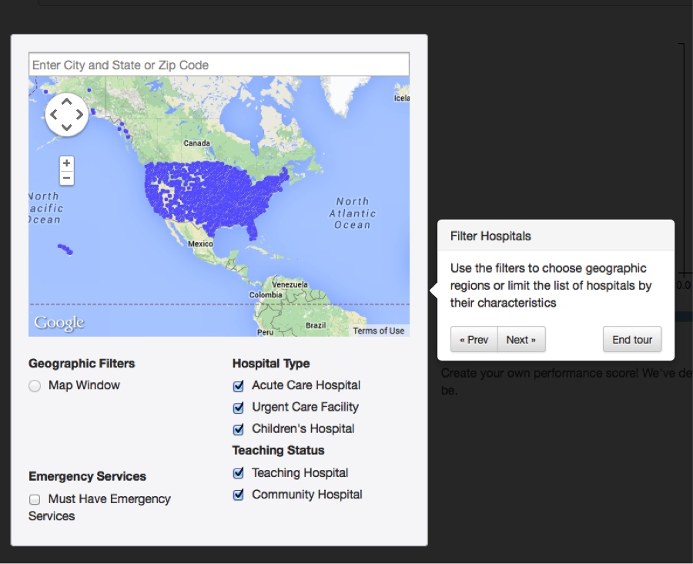
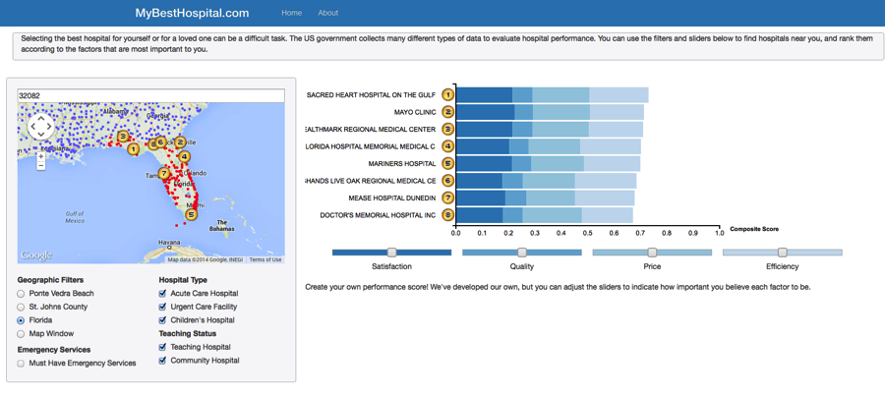
Current Site Demo
Notes:
- Added in Composite Score label.
- Made red dots outside focus smaller.
- Added badges to hospital names to match the map.
- Moved Infobox over.
- Added website tour.

Slide 14
Possible Future Enhancements
Is the hospital in my network?
How long before I see the doctor?
How many miles I am willing to travel to see the doctor?
Allow the user to select how many hospitals they want in their search results - 5, 10, 20, etc.
Make the windows automatically scale to the user’s browser window size.
Restart the tour.
Somewhat unpredictable behavior on click

