Slide 1
Correlating Stock Price Shifts with Predictions from Twitter
W205 Summer 2014
Rahul Bansal
Joe Morales
Christopher Walker
Lisa Kirch

Slide 2
Project Idea
271 million active Twitter users monthly and 500 million tweets sent daily
=> a fairly sizable corpus of sentiment is available for analysis.
Downside Hedge , Dataminr, et al doing targeted financial sentiment analysis
The End of Theory: The Data Deluge Makes the Scientific Method Obsolete http://archive.wired.com/science/discoveries/magazine/16-07/pb_theory
“All models are wrong, and increasingly you can succeed without them.”
- Peter Norvig, Director of Research at Google
Notes:
Joe to present

Slide 3
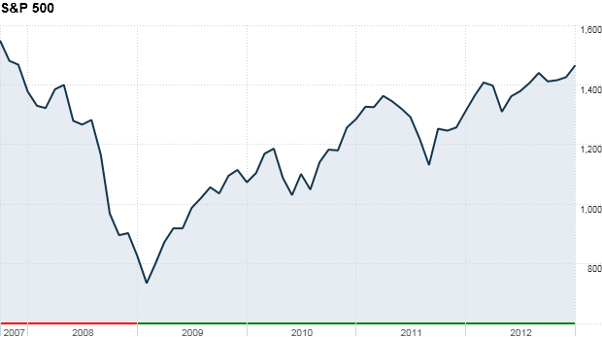
Project Overview
Gather Tweets
Score/Filter By Sentiment
Score/Filter by Relevance to S&P 500 Companies
Correlate to Stock Price
Notes:
Joe

Slide 4
Tools and Methods
Purpose | Tools Used
Code Base | Github - https://github.com/jmorales4/W205-RJCL
Version Control | SourceTree by Atlassian
Storage | S3 - http://rjcl-tweets.s3.amazonaws.com/ http://rjcl-stockquotes.s3.amazonaws.com/ http://10k-clean-data.s3.amazon.com
Twitter Sentiment Analysis | Python sentiment analysis courtesy Alex Davies http://alexdavies.net/
Search / Relevance Scoring | Apache Solr
Hadoop Platform | Amazon Elastic MapReduce Hadoop streaming using Python
Languages | Python (with tweepy, boto, BeautifulSoup, numpy, and solrpy) Perl R
APIs | Twitter Solr Yahoo Finance
Other | XML JSON Tableau
Notes:
Chris

Slide 5
Company Information System
Selected the S&P 500 Companies
Form 10-K: annual reports containing text data describing each company (business, products, services, officers, etc.)
Beautiful Soup: clean and parse data
Upload to Apache Solr running on EC2
Notes:
Chris to present

Slide 6
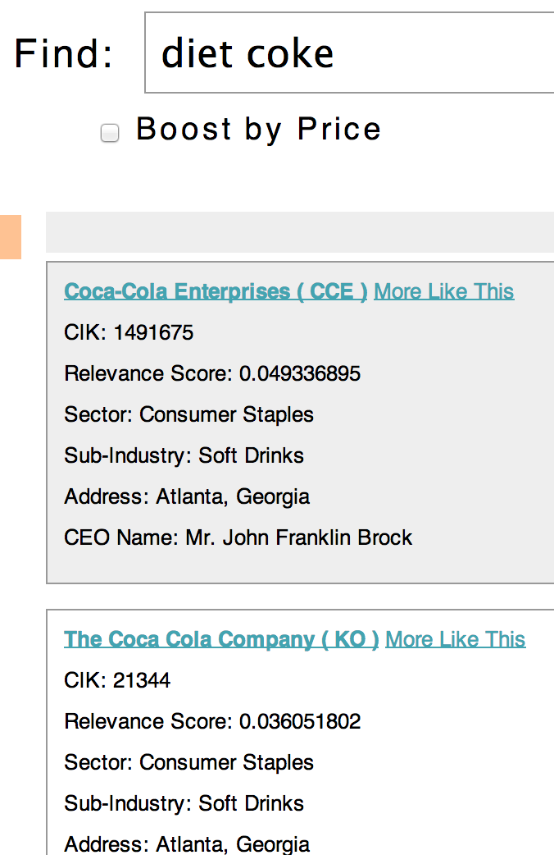
Solr Evolution and Demo
Facets matched to our metadata, lots of search options
Tweets are very hard to parse for specific metadata elements
Why search metadata when the main document text already contains it?
API test harness
Natural search vs. explicit OR: OR returned results reliably
Load/Performance concerns: t2.micro vs. m3.large
Notes:
Chris to present

Slide 7
Stock Price Data Flow
Every 10 minutes, get stock prices from Yahoo Finance API
Store on Amazon S3: 468 files (37 MB)
Map step: parse stock data, round to nearest 10 minute
Reduce step: emit CSV for analysis with Twitter data
Analyze in R
Notes:
Rahul

Slide 8
Tweet Data Flow
Twitter firehose: 5700 TPS average
Twitter sample stream: 67 TPS average
Amazon S3: 90m tweets total (269 GB)
30m tweets in period of interest (8/4 – 8/9)
Map step 1: sentiment score, filter neutral tweets
Map step 2: relevance score, filter irrelevant tweets
Reduce step: aggregate scores by company and time (10 min buckets)
Combine with stock price data and output as CSV
Analyze in R
Notes:
Joe

Slide 9
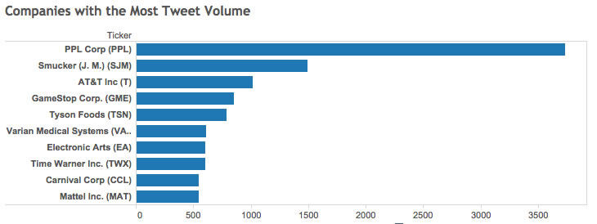
Top 10 Companies on Twitter
Based on Tweets collected and scored against company 10-Ks during the week of August 4th through August 8th
Notes:
Lisa to present
Upon further analysis, we determined that we had false positives for PPL Corp and Smuckers.
- Tweeters use “ppl” as an abbreviation for people.
- Smuckers had Empty throughout the css comments.

Slide 10
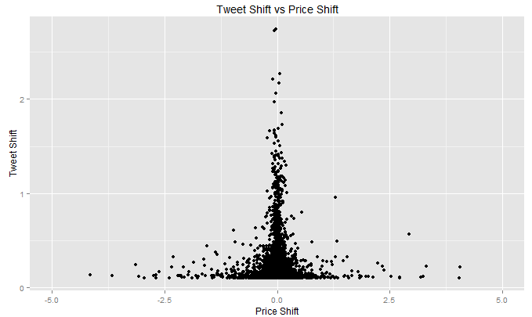
Correlating Price Shift and Tweet Shift
We started by looking at correlation of price shifts and predicted Twitter shifts at a 10-minute interval
Looking at the data at this level did not produce any significant correlation. Next we decided to roll up the shifts at the hourly level.
Notes:
Lisa to present

Slide 11
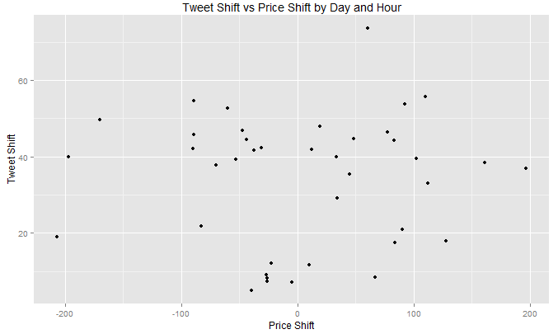
Correlating Price Shift and Tweet Shift
Looking at correlation of price shifts and predicted Twitter shifts at an hourly interval
Looking at the data at this level did not produce any significant correlation either. Next we decided to roll up the shifts at the day level.
Notes:
Rahul to present

Slide 12
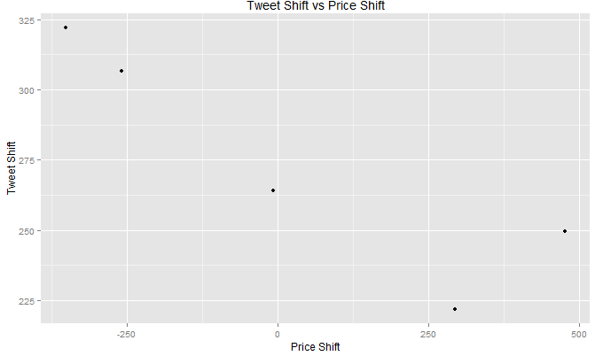
Correlating Price Shift and Tweet Shift
Looking at correlation of price shifts and predicted Twitter shifts at the day interval
Looking at the data at this level does produce a strong correlation but with such a small sample size. We need more data to conclude anything at the day level.
Negative correlation indicating positive tweets result in negative price shifts.
Notes:
Rahul to present

Slide 13
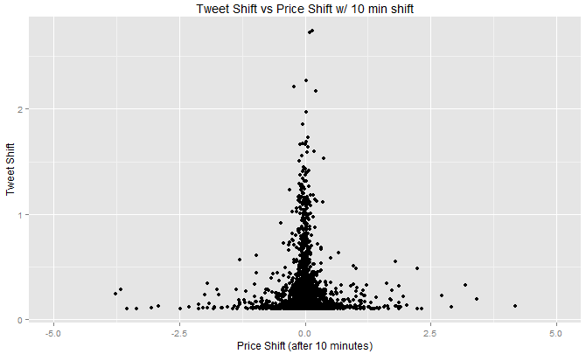
Correlating Price Shift and Tweet Shift
Finally, we looked whether there was a correlation between price shifts 10 minutes after predicted Tweet shifts. This would indicate a lag in market reaction time.
No real correlation evident with this 10-minute shift.
Notes:
Rahul to present

Slide 14
Lessons Learned
Number of tweets captures were a small part of the Twitterverse.
The sentiment package used did not produce reliable scores.
Solr relevance scores did not always make intuitive sense (e.g., searching for Big Mac yielded McDonald’s as the 3rd most relevant company with a relevance score that was <1% of the relevance score of the top relevant company, Macerich).
Financial markets are open 9:30 AM - 4 PM ET, but people tweet 24 hours a day. Need a better way to capture correlations (perhaps include Asian market data).
Due to time constraints, we only have one week of stock quote data processed. Perhaps trends would become more apparent over a longer period of data.
Notes:
Lisa to present

