Slide 1
WiserResources
uConserve Dashboard
Project Update
July 6th, 2015
Rahul Bansal
Lisa Kirch
Nital Patwa

Slide 2
Roadmap for Discussion
Projects Goals and Potential Impact
Product Research and Design
Update on Project Plan
Current Status
Next Steps
Group Needs

Slide 3
Project Goals and Potential Impact

Slide 4
The Firm’s Mission
At WiserResources, our mission is to drive awareness and conservation of the world’s natural resources through compelling analytics, insightful visualizations, and targeted, actionable conservation recommendations.

Slide 5
Bringing the Mission to Life
The uConserve dashboard is the manifestation of our mission in the form of a web application that allows users to see, understand, and intelligently change their resource consumption habits
uConserve shows our consumers their usage across all three resources - electricity, water, and natural gas - in one convenient location
Founded on research in behavioral science on the most effective ways of inflecting behavioral change
Incentives
Monetary
Emotional
Meaningful Comparisons
Competition
Personal pledges and goal setting

Slide 6
uConserve Impact Potential
Driving a 5% reduction in power consumption will have a significant effect
Opportunity in Electricity
Population | Avg Yr Consumption / Home | % Reduction | Yearly Energy Savings | Power # Vehicles for One Year | Power # Homes for One Year
Pilot - 152 homes | 14,500 kWh | 5% | 0.11 gWh | 16 | 7.6
Austin ~350,000 homes |  |  | 253.75 gWh*** | 36,000 | 17,500
*** Equivalent to 175,000 Metric Tons CO₂
Notes:
If everyone in our area reduced their water use by 10%, we'd save over 13 million gallons of water per day!
http://www.ci.austin.tx.us/water/watercon/calculator.cfm
2008 water usage in Austin, TX = 102 gallons per capita per day
Water for Texas 2012 State Plan
http://www.twdb.texas.gov/publications/state_water_plan/2012/2012_SWP.pdf
Austin-Round Rock-SanMarcos (MSA), TX as of July 2014
population 1,889,700
median income $58,932
median home price $221,600
average days > 90 F = 101; national average = 37
average days < 32 F = 23; national average = 88
http://www.forbes.com/places/tx/austin/
EIA’s 2009 Residential Energy Consumption Survey
Texas households consume an average of 77 million Btu per year
The average annual electricity cost per Texas household is $1,801,approx. 14,000 kwh
average TX square footage = 1,757: US average = 1,971
http://www.eia.gov/consumption/residential/reports/2009/state_briefs/pdf/tx.pdf
CO2
average carbon footprint for Austin, TX = 14.70 metric tons
In 2013, Environment Texas did a study that calculated that combined power plants in Texas spew out CO2 at approximately the same rate as 45.9 million cars
http://www.earthlab.com/carbon-footprint/Texas/Austin-carbon-calculator.aspx
Austin Electric Rates
1000 kwh summer bill (June-Sept.) = $122.10
1000 kwh winter bill (Oct.-May) = $102.41
Natural Gas Costs
Oct 2014 $19.31 per 1,000 cubic feet
Mar 2015 $7.48 per 1,000 cubic feet
http://www.eia.gov/dnav/ng/ng_pri_sum_dcu_stx_m.htm
Austin Water Rates
MONTHLY TIERED MINIMUM CHARGE: (Based on Total Billed Volume)
Single-Family Residential
0 - 2,000 Gallons $2.20
2,001 - 6,000 Gallons $4.70
6,001 - 11,000 Gallons $7.65
11,001 - 20,000 Gallons $12.70
20,001 - over Gallons $12.70
https://www.austintexas.gov/sites/default/files/files/Water/Rates/Approved%20Retail%20Water%20Service%20Rates%202012-13.pdf
WATER
US: 2.8K cubic meters/yr
China: 1K cubic meters/yr
India: 1K cubic meters/yr
UK: 1.2K cubic meters/yr
Hermitte, S., & Mace., R. (2012, November 1). Linear Regression Analysis of Energy Consumption Data. (n.d.). Retrieved June 23, 2015, from http://www.degreedays.net/regression-analysis. Retrieved June 23, 2015, from https://www.twdb.texas.gov/publications/reports/technical_notes/doc/SeasonalWaterUseReport-final.pdf
Annual Average Water Use Austin 2004 - 2011 -
indoor use 11,532,894,150 gallons;
outdoor use 5,879,032,288 gallons;
outdoor use as a percentage of total use 33;
gallons per household per day for indoor use 176 gallons;
gallons per household per day for outdoor use 89 gallons
ELECTRICITY
Meehan, P., Mcardle, C., & Daniels, S. (2014). An Efficient, Scalable Time-Frequency Method for Tracking Energy Usage of Domestic Appliances Using a Two-Step Classification Algorithm. Energies, 7041-7066.
http://www.mdpi.com/1996-1073/7/11/7041/htm
Up to 42 unique appliances contribute to the average household’s electric load, although, typically, 80% of its total power consumption can be attributed to eight appliances.
NATURAL GAS
Trends in U.S. Residential Natural Gas Consumption. (2010, June 1). Retrieved June 23, 2015, from http://www.eia.gov/pub/oil_gas/natural_gas/feature_articles/2010/ngtrendsresidcon/ngtrendsresidcon.pdf
Long-term downward per-customer consumption trend
Appliance efficiency gains, improved housing construction, population shift towards warmer regions, higher commodity price, and an increase in the share of natural gas customers who do not use natural gas as their primary space heating fuel have resulted in a significant decrease in the average volume of natural gas used by U.S. households with natural gas service. Per customer consumption fell in 16 out of the past 19 years. On a weather-adjusted basis, U.S. residential consumption over the 19-year period (1990- 2009) fell from 95 thousand cubic feet (Mcf) per customer in 1990 to 74 Mcf in 2009, or 22 percent.
Residential end-users accounted for about 21 percent of the total natural gas consumption in the United States in 2009. The residential sector primarily uses natural gas for space heating
EPA Calculations and References
http://www.epa.gov/cleanenergy/energy-resources/refs.html
0.039 metric ton CO2 per urban tree planted
WaterSense
Water: 5,100 gallons saved annually is equivalent to washing 130 loads worth of laundry
Electricity: 430 kwh annually is equivalent to running a refrigerator for 4 months
Greenhouse Gas Emissions: 660 pounds of greenhouse gas annually is equivalent to taking 1 car off of the road for 21 days.
EIA Residential Energy Consumption Survey, 2009
http://www.eia.gov/consumption/residential
Average annual electricity cost per Texas household: approx. $1,800, 15,000 kwh
example: 15,000 kwh decreased electricity usage -> 14,250 kwh annually (750 kwh savings per household)
US Census http://quickfacts.census.gov/qfd/states/48/4805000.html
Austin has 337,791 households between 2009-2013; estimated 2013 population 885,4000
http://www.climatecentral.org/blogs/helpful-energy-comparisons-anyone
Image Credits
water - San Francisco Public Utilities
CO2 - carbonvisuals.com

Slide 7
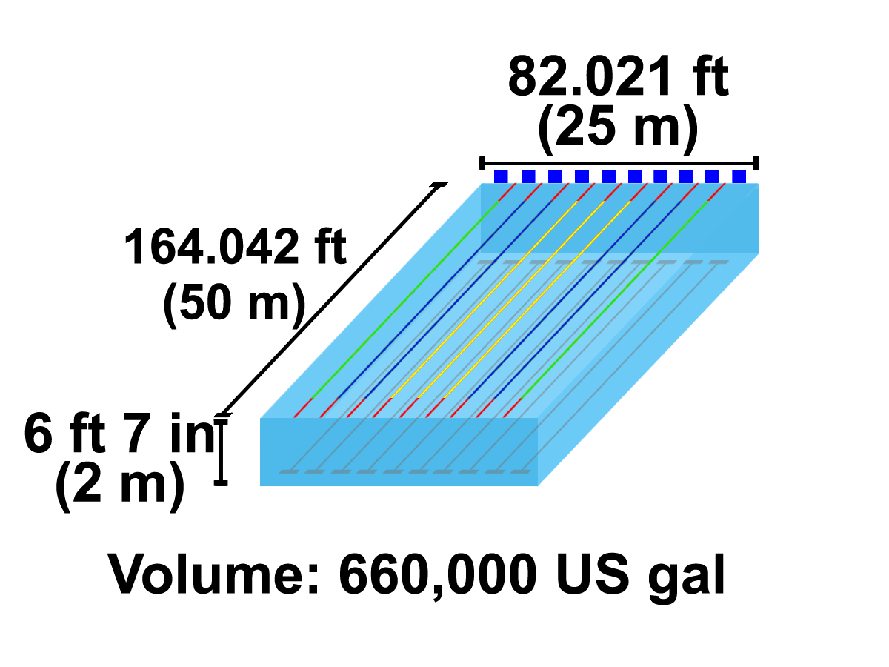
uConserve Impact Potential
Austin Water is asking residents to pledge a 10% reduction. Here is the impact on just 5%.
Opportunity in Water
Population | Daily usage per capita | % Reduction | Yearly Water Savings
Pilot - approx 600 residents | 136 gallons | 5% | 1.5 M gallons
Austin - 1M+ residents |  |  | 2.4 B gallons***
*** Equivalent to 3,760 Olympic size swimming pools
Notes:
If everyone in our area reduced their water use by 10%, we'd save over 13 million gallons of water per day!
http://www.ci.austin.tx.us/water/watercon/calculator.cfm
2008 water usage in Austin, TX = 102 gallons per capita per day
Water for Texas 2012 State Plan
http://www.twdb.texas.gov/publications/state_water_plan/2012/2012_SWP.pdf
Austin-Round Rock-SanMarcos (MSA), TX as of July 2014
population 1,889,700
median income $58,932
median home price $221,600
average days > 90 F = 101; national average = 37
average days < 32 F = 23; national average = 88
http://www.forbes.com/places/tx/austin/
EIA’s 2009 Residential Energy Consumption Survey
Texas households consume an average of 77 million Btu per year
The average annual electricity cost per Texas household is $1,801,approx. 14,000 kwh
average TX square footage = 1,757: US average = 1,971
http://www.eia.gov/consumption/residential/reports/2009/state_briefs/pdf/tx.pdf
CO2
average carbon footprint for Austin, TX = 14.70 metric tons
In 2013, Environment Texas did a study that calculated that combined power plants in Texas spew out CO2 at approximately the same rate as 45.9 million cars
http://www.earthlab.com/carbon-footprint/Texas/Austin-carbon-calculator.aspx
Austin Electric Rates
1000 kwh summer bill (June-Sept.) = $122.10
1000 kwh winter bill (Oct.-May) = $102.41
Natural Gas Costs
Oct 2014 $19.31 per 1,000 cubic feet
Mar 2015 $7.48 per 1,000 cubic feet
http://www.eia.gov/dnav/ng/ng_pri_sum_dcu_stx_m.htm
Austin Water Rates
MONTHLY TIERED MINIMUM CHARGE: (Based on Total Billed Volume)
Single-Family Residential
0 - 2,000 Gallons $2.20
2,001 - 6,000 Gallons $4.70
6,001 - 11,000 Gallons $7.65
11,001 - 20,000 Gallons $12.70
20,001 - over Gallons $12.70
https://www.austintexas.gov/sites/default/files/files/Water/Rates/Approved%20Retail%20Water%20Service%20Rates%202012-13.pdf
WATER
US: 2.8K cubic meters/yr
China: 1K cubic meters/yr
India: 1K cubic meters/yr
UK: 1.2K cubic meters/yr
Hermitte, S., & Mace., R. (2012, November 1). Linear Regression Analysis of Energy Consumption Data. (n.d.). Retrieved June 23, 2015, from http://www.degreedays.net/regression-analysis. Retrieved June 23, 2015, from https://www.twdb.texas.gov/publications/reports/technical_notes/doc/SeasonalWaterUseReport-final.pdf
Annual Average Water Use Austin 2004 - 2011 -
indoor use 11,532,894,150 gallons;
outdoor use 5,879,032,288 gallons;
outdoor use as a percentage of total use 33;
gallons per household per day for indoor use 176 gallons;
gallons per household per day for outdoor use 89 gallons
ELECTRICITY
Meehan, P., Mcardle, C., & Daniels, S. (2014). An Efficient, Scalable Time-Frequency Method for Tracking Energy Usage of Domestic Appliances Using a Two-Step Classification Algorithm. Energies, 7041-7066.
http://www.mdpi.com/1996-1073/7/11/7041/htm
Up to 42 unique appliances contribute to the average household’s electric load, although, typically, 80% of its total power consumption can be attributed to eight appliances.
NATURAL GAS
Trends in U.S. Residential Natural Gas Consumption. (2010, June 1). Retrieved June 23, 2015, from http://www.eia.gov/pub/oil_gas/natural_gas/feature_articles/2010/ngtrendsresidcon/ngtrendsresidcon.pdf
Long-term downward per-customer consumption trend
Appliance efficiency gains, improved housing construction, population shift towards warmer regions, higher commodity price, and an increase in the share of natural gas customers who do not use natural gas as their primary space heating fuel have resulted in a significant decrease in the average volume of natural gas used by U.S. households with natural gas service. Per customer consumption fell in 16 out of the past 19 years. On a weather-adjusted basis, U.S. residential consumption over the 19-year period (1990- 2009) fell from 95 thousand cubic feet (Mcf) per customer in 1990 to 74 Mcf in 2009, or 22 percent.
Residential end-users accounted for about 21 percent of the total natural gas consumption in the United States in 2009. The residential sector primarily uses natural gas for space heating
EPA Calculations and References
http://www.epa.gov/cleanenergy/energy-resources/refs.html
0.039 metric ton CO2 per urban tree planted
WaterSense
Water: 5,100 gallons saved annually is equivalent to washing 130 loads worth of laundry
Electricity: 430 kwh annually is equivalent to running a refrigerator for 4 months
Greenhouse Gas Emissions: 660 pounds of greenhouse gas annually is equivalent to taking 1 car off of the road for 21 days.
EIA Residential Energy Consumption Survey, 2009
http://www.eia.gov/consumption/residential
Average annual electricity cost per Texas household: approx. $1,800, 15,000 kwh
example: 15,000 kwh decreased electricity usage -> 14,250 kwh annually (750 kwh savings per household)
US Census http://quickfacts.census.gov/qfd/states/48/4805000.html
Austin has 337,791 households between 2009-2013; estimated 2013 population 885,4000
http://www.climatecentral.org/blogs/helpful-energy-comparisons-anyone
Image Credits
water - San Francisco Public Utilities
http://ca.water.usgs.gov/data/drought/runoff.html
CO2 - carbonvisuals.com

Slide 8
Product Research and Design

Slide 9
Key Takeaways from our Research
A few founding principles based on our evaluation of a small portion of published research on behavioral change.
Households presented with frequent usage information are significantly more responsive to price changes and decreased energy usage by 11-14%
Voluntary consumer-oriented programs can reduce household carbon footprints by 5-20%
Pledges have long-term effects
Behavior change is frequently motivated more by peer pressure than virtue or self-interest
Better to emphasize a few key behaviors rather than presenting long lists of possible changes
Notes:
¹ Jessoe, K., & Rapson, D. (2013, April 18). Knowledge is (Less) Power: Experimental Evidence from Residential Energy Use. Retrieved June 22, 2015, from https://ei.haas.berkeley.edu/research/papers/WP241.pdf
² Jones, C., & Kammen, D. (2011). Quantifying Carbon Footprint Reduction Opportunities for U.S. Households and Communities. Environmental Science & Technology Environ. Sci. Technol., 45, 4088-4095.
http://pubs.acs.org/doi/full/10.1021/es102221h
³ Whitsett, D., Justus, H., & Steiner, E. (2014, November 14). Persistence of Energy Efficiency Behaviors over Time: Evidence from a Community-Based Program. Retrieved June 27, 2015, from http://escholarship.org/uc/item/2nh0h4nb
⁴Opower. (n.d.). Retrieved June 27, 2015, from http://www.opower.com/results

Slide 10
Following an Average User’s Thought Process
Our theory for how a user would start to learn about, trust, and use data through uConserve.
Understand your data first
Simple usage graphs
Summary statistics
Appliance breakdown
Explore comparisons with meaningful comparison groups
Start with city-wide comparisons (eg. across Austin, TX)
Build groups based on house size, age, # of residents
Overlay usage patterns of “similar” users
Implement, track progress against usage reduction recommendations
AC setting recommendation based on weather
End-of-month bill prediction, highlight potential savings
Facilitate competition and user-specific pledges
Emotionally compelling equivalencies between usage and environmental impact
Notes:
This is the mindmap slide

Slide 11
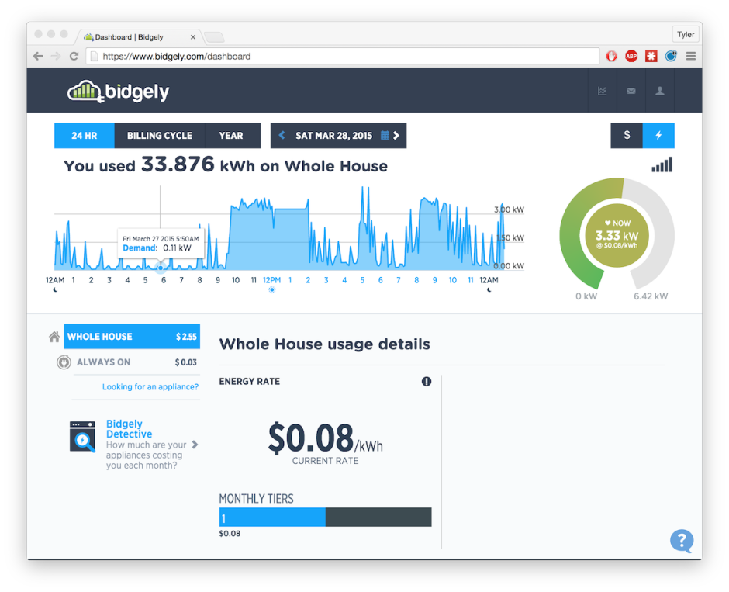
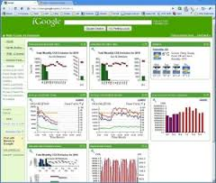
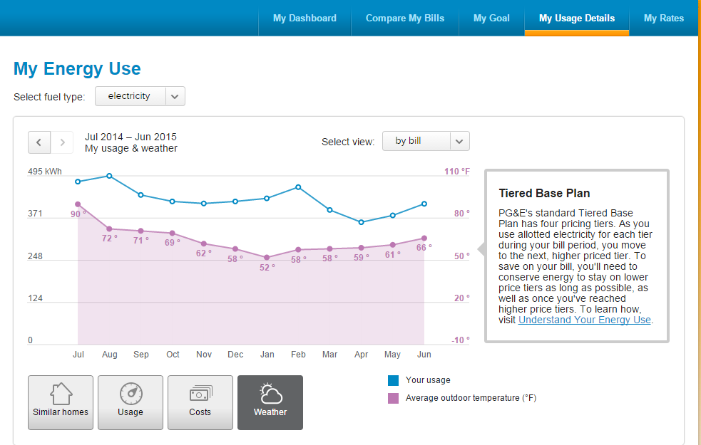
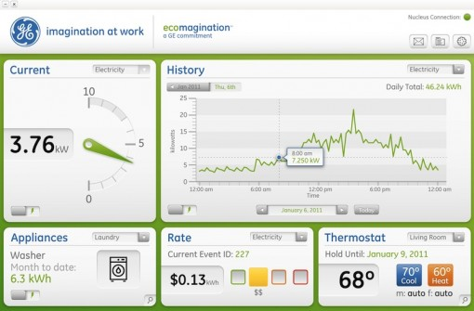
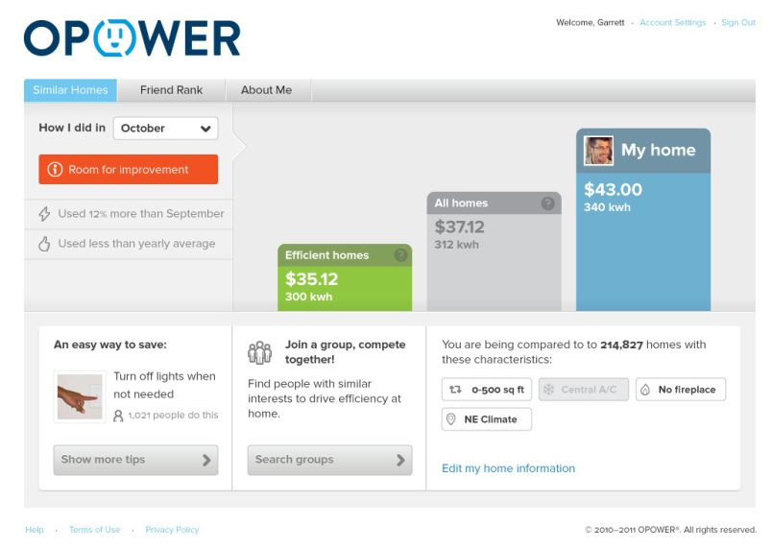
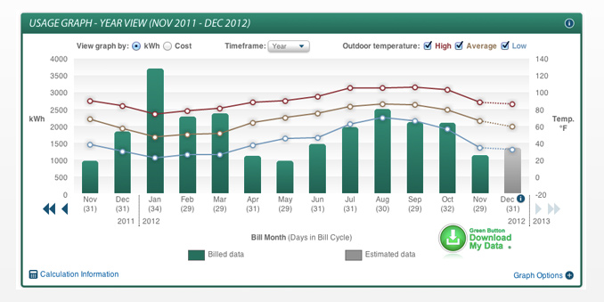
Dashboards on the Market
PG & E
Bidgely
Google’s PowerMeter
OPower
GE
Green Button Data
Notes:
cluttered
difficult to read
incomplete
hard to find natural gas or water dashboards

Slide 12
How are we different?
Several utility companies as well as downstream analytics companies have released applications that try to inform consumers about their resource consumption. What differentiates uConserve?
First application to blend resource consumption across all three utilities
Allow users to delve deep into their data
Meaningful, apples-to-apples comparisons and benchmarks
Natural weather/temperature overlay
End-of-month bill prediction
Facilitate friendly competition as well as self-fulfillment through pledges

Slide 13
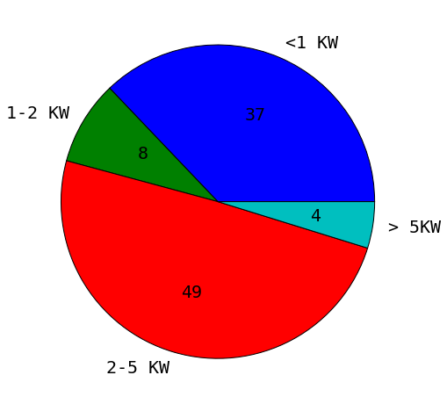
Which Appliances Dominate Usage?
400W
PC, TV, Lights
Dip
1000W
4500W
AC

Slide 14
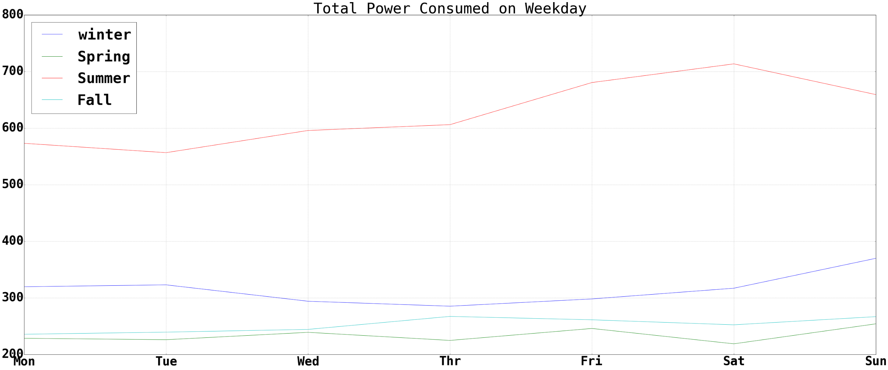
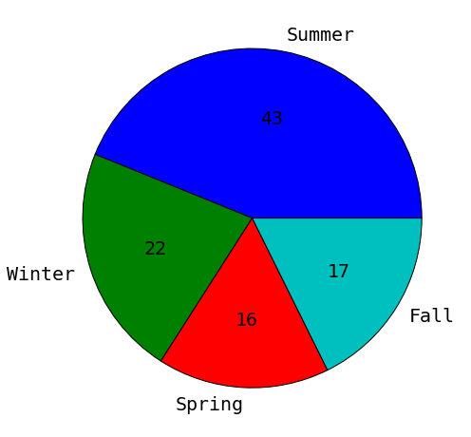
Power Usage Doubles in Summer

Slide 15
Your Usage During a Day
Winter
Could You Recognize This Usage at noon?
Summer
AC is ON Continuously

Slide 16
Update on Project Plan

Slide 17
Our Progress
ITERATIVE TESTING
Planning
Research
Analysis
UX
Launch
June 8th
Today
August 17th
On track to hit August 17th launch goal based on current scope and pacing
Foundational research completed shortly after checkpoint #1 on June 8th
Survey of existing literature on behavior change in energy consumption
Incorporating early feedback from faculty and peers around feasibility and scope
Currently iterating on analyses and compelling visualizations
Driving to be impactful and engaging from the very first use
No immediate needs from WiserResources Executive Team

Slide 18
Q & A
WiserResources

Slide 19
Appendix

Slide 20
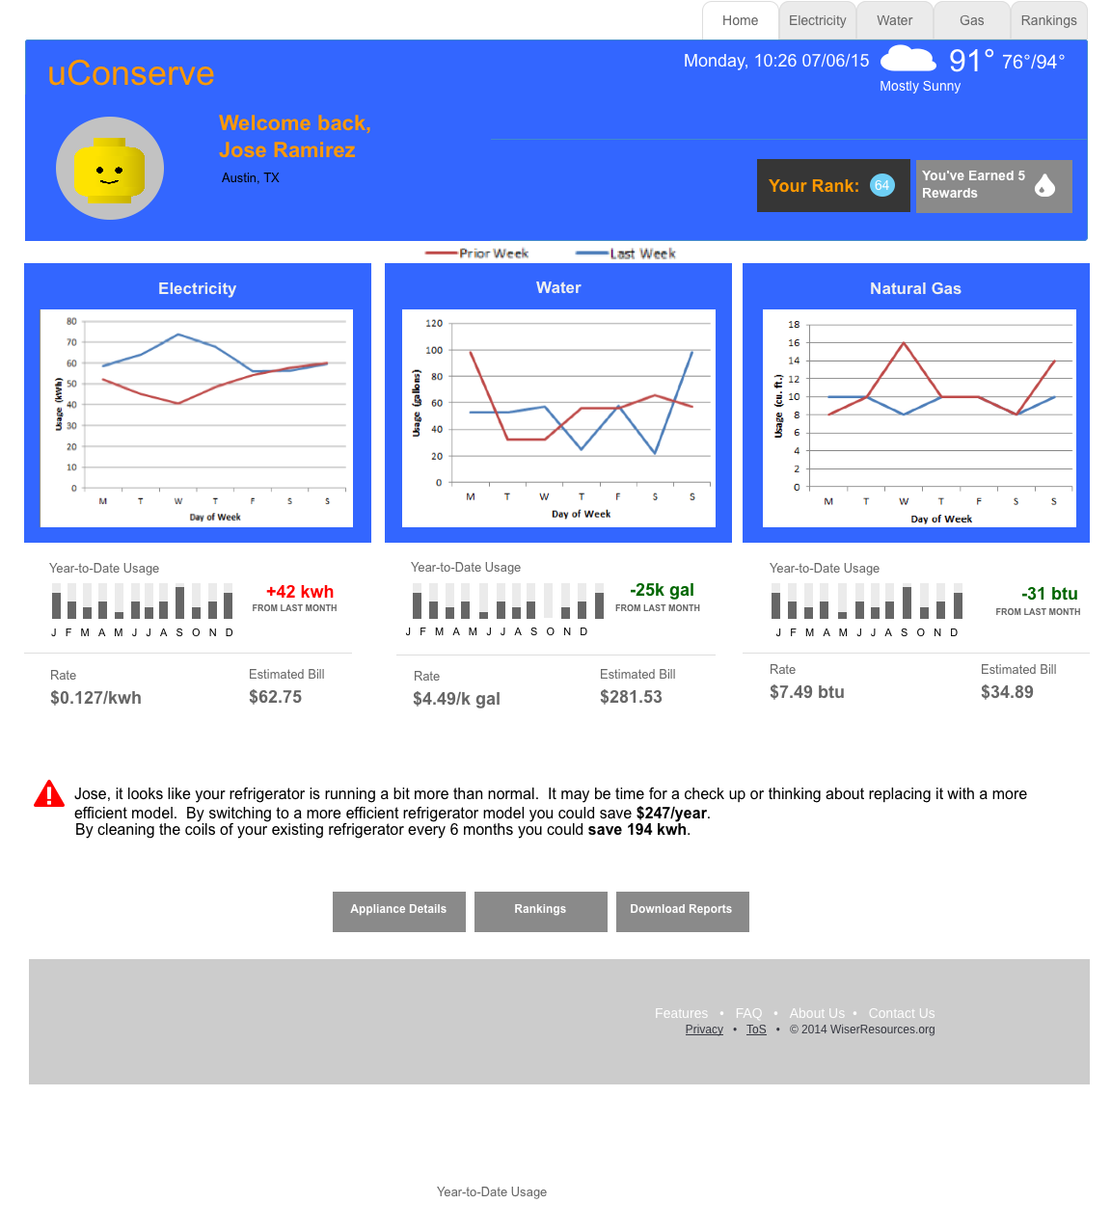

Slide 21
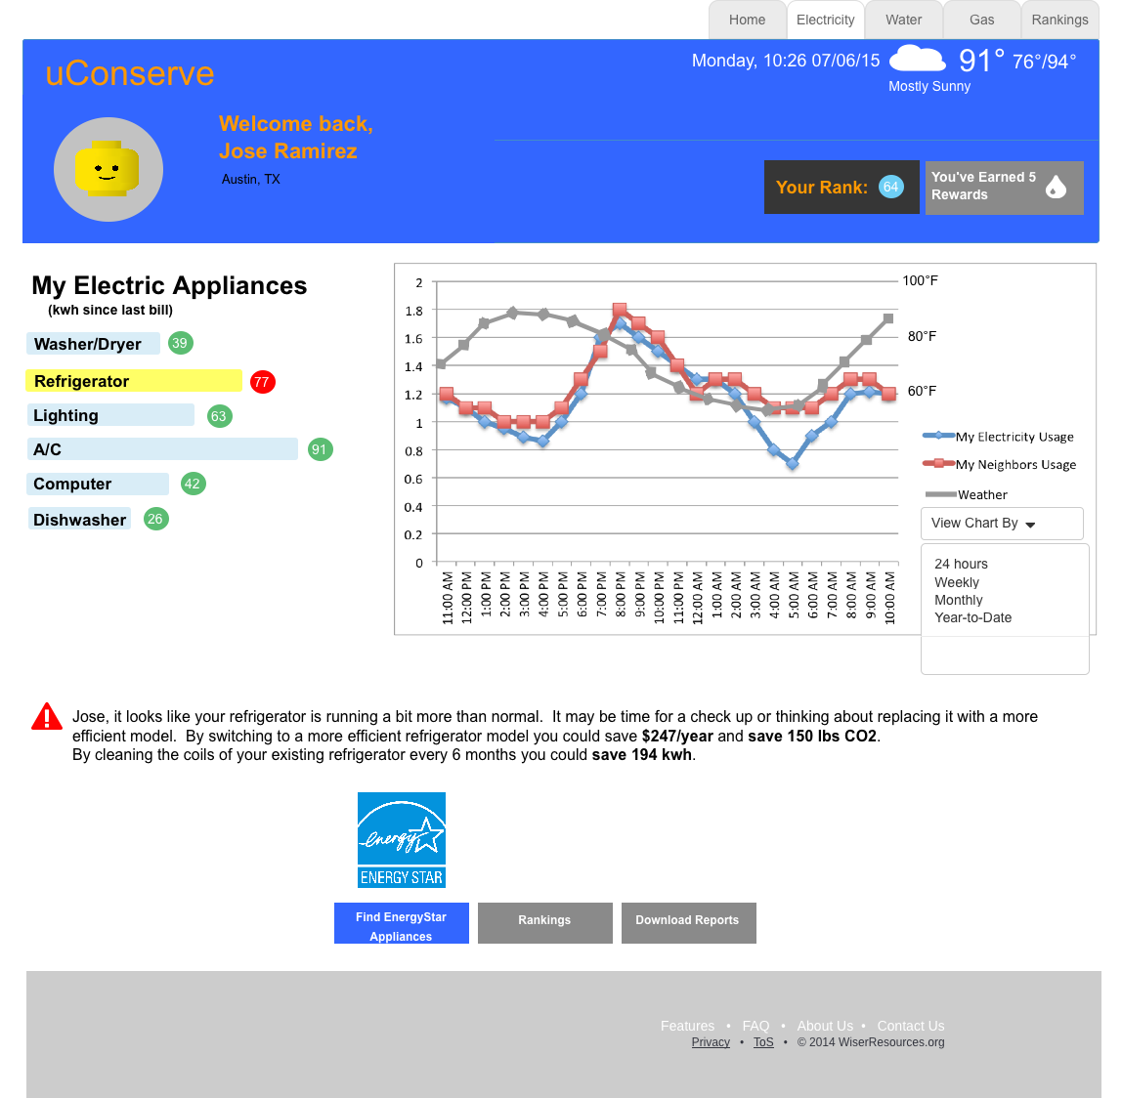

Slide 22
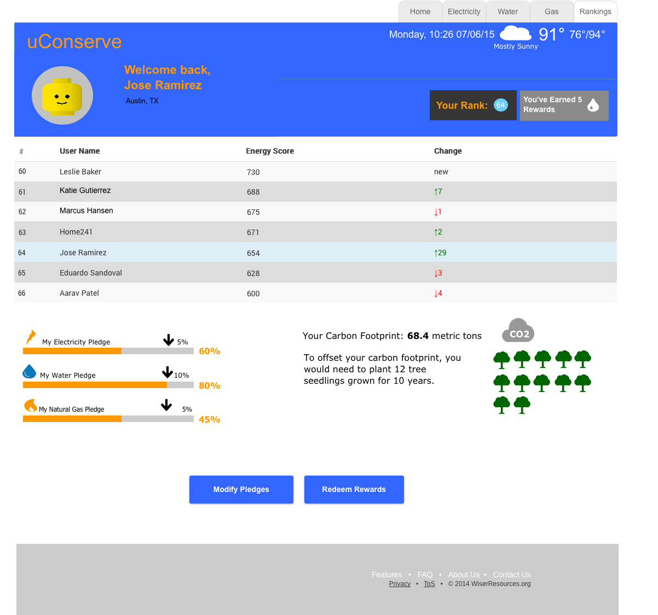
Notes:
CO2 info based upon http://coolclimate.berkeley.edu/maps and http://www.carbonrally.com/challenges/16-save-electricity
Refrigerator calculations based on http://michaelbluejay.com/electricity/refrigerators.html

Slide 23
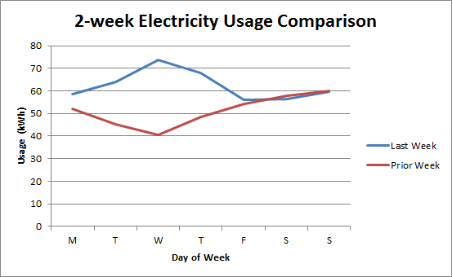
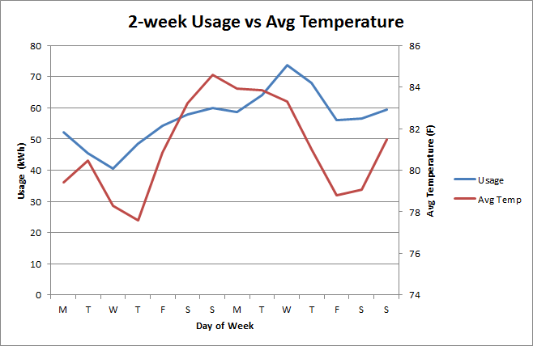
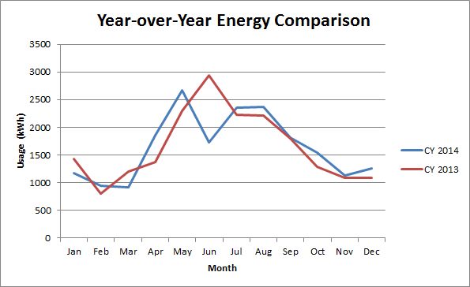
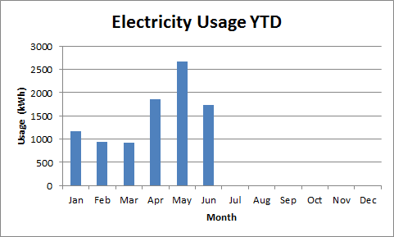

Slide 24
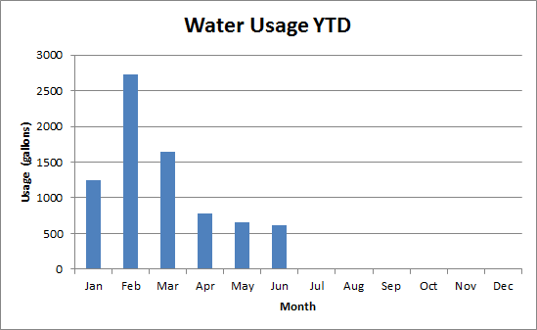
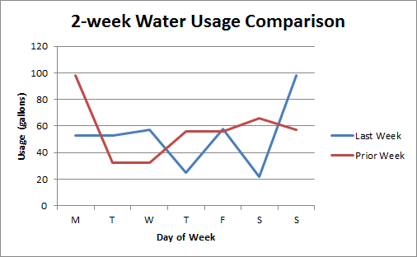
Water graphs

Slide 25
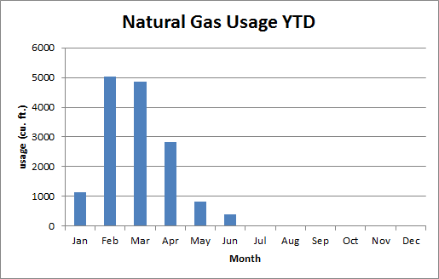
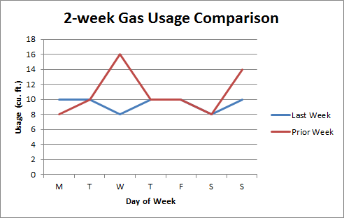
Gas graphs

Slide 26
Data Sources
Cost of electricity per kwh, cost of water per cubic foot, cost of gas per thousand cubic feet provided by Pecan Street Dataport - disaggregated electricity, gas, and water data at the minute level (2013-2014)
Sub-circuit data to assist labeling - broken out into washer/dryer, dishwasher, furnace, AC, refrigerator, water heater, indoor and outdoor plugs
Survey data - house size, # floors, # rooms, age, # residents
Appliance audits - manufacturer, model, age, power (BTUs)
Census data
Weather data
Notes:
may not even need this page for the 2nd presentation
Pecan Street Data Port
https://dataport.pecanstreet.org/
Energy Usage Data
http://www.eia.gov/consumption/residential/index.cfm
http://www.eia.gov/analysis/studies/buildings/equipcosts/pdf/full.pdf
Water Usage Data
http://www.usgs.gov/blogs/features/usgs_top_story/think-short-creative-and-inviting/
http://waterdata.usgs.gov/nwis/wu
http://waterfootprint.org/en/resources/water-footprint-statistics/#CP1
Residential Gas Usage Data
http://www.eia.gov/dnav/ng/ng_cons_sum_dcu_nus_m.htm
http://www.eia.gov/dnav/ng/hist/n3010us3m.htm
US Utility Rate Database
http://en.openei.org/wiki/Utility_Rate_Database
Weather Data
http://openweathermap.org/weather-data#current
Berkeley Lab Home Energy Scoring Tool
https://developers.buildingsapi.lbl.gov/hes/service
https://developers.buildingsapi.lbl.gov/hescore/documentation/scoring-tool-api

Slide 27
Minimum Viable Product
---- what needs to be in our product that reflect our learnings from research
Use fine-grained, per-household data for electricity, gas, and water
Perform time-series, component, and behavioral analysis
Create actionable insights for the home owner
Allow the homeowner to make pledges to reduce resource usage
Develop basic visualization framework to deliver results and recommendations

Slide 28
Illustrative Displays
Your Power Usage is Highest During Evening Hours
Your Power Usage is Higher During Weekends

Slide 29
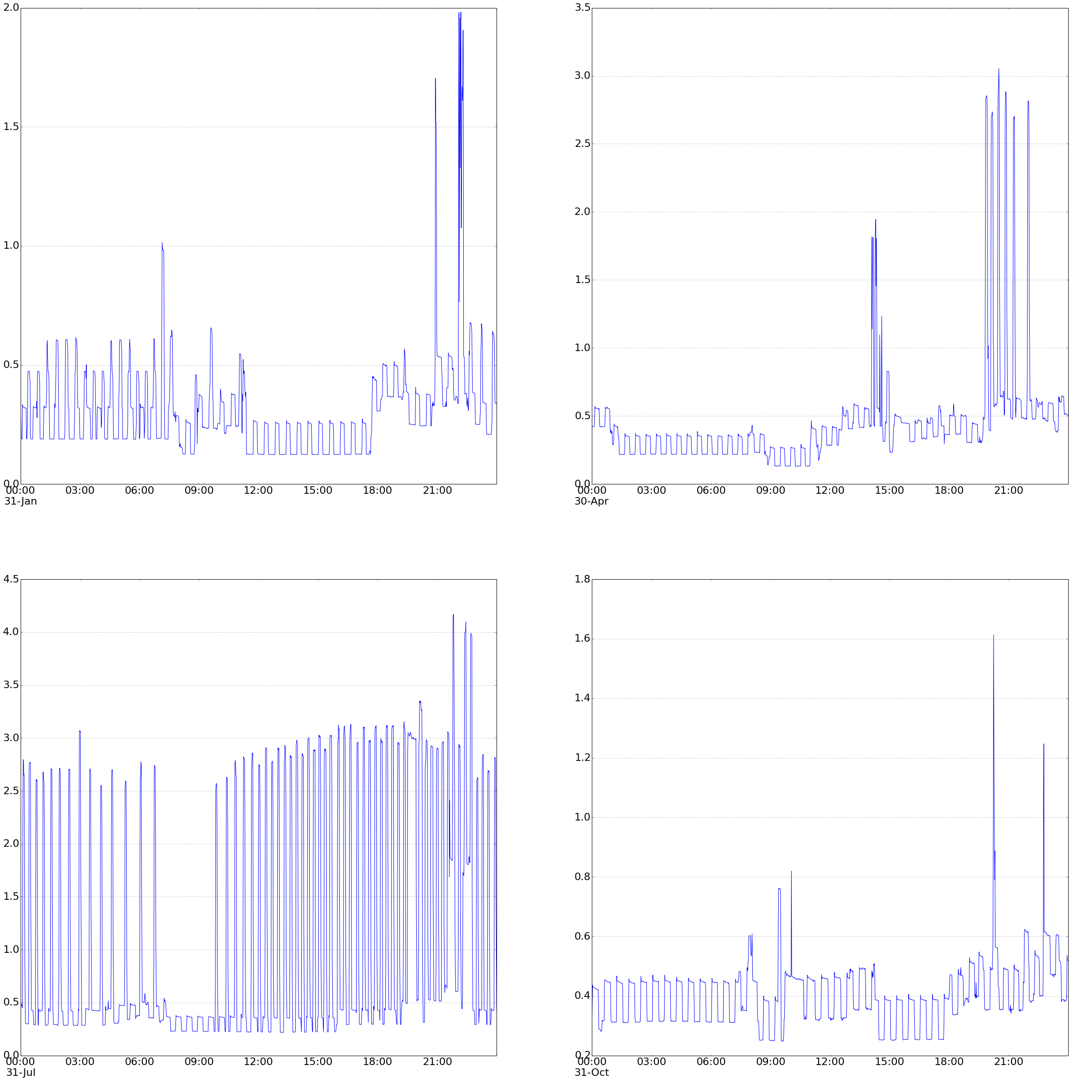
Daily Usage Time Series
Winter
Spring
0.5
0.5
Summer
Fall
3
0.5
0.5

Slide 30
Behavior Extraction
Post-dinner 9-10pm
Post-Dinner 9-10PM
Why Gap?

Slide 31
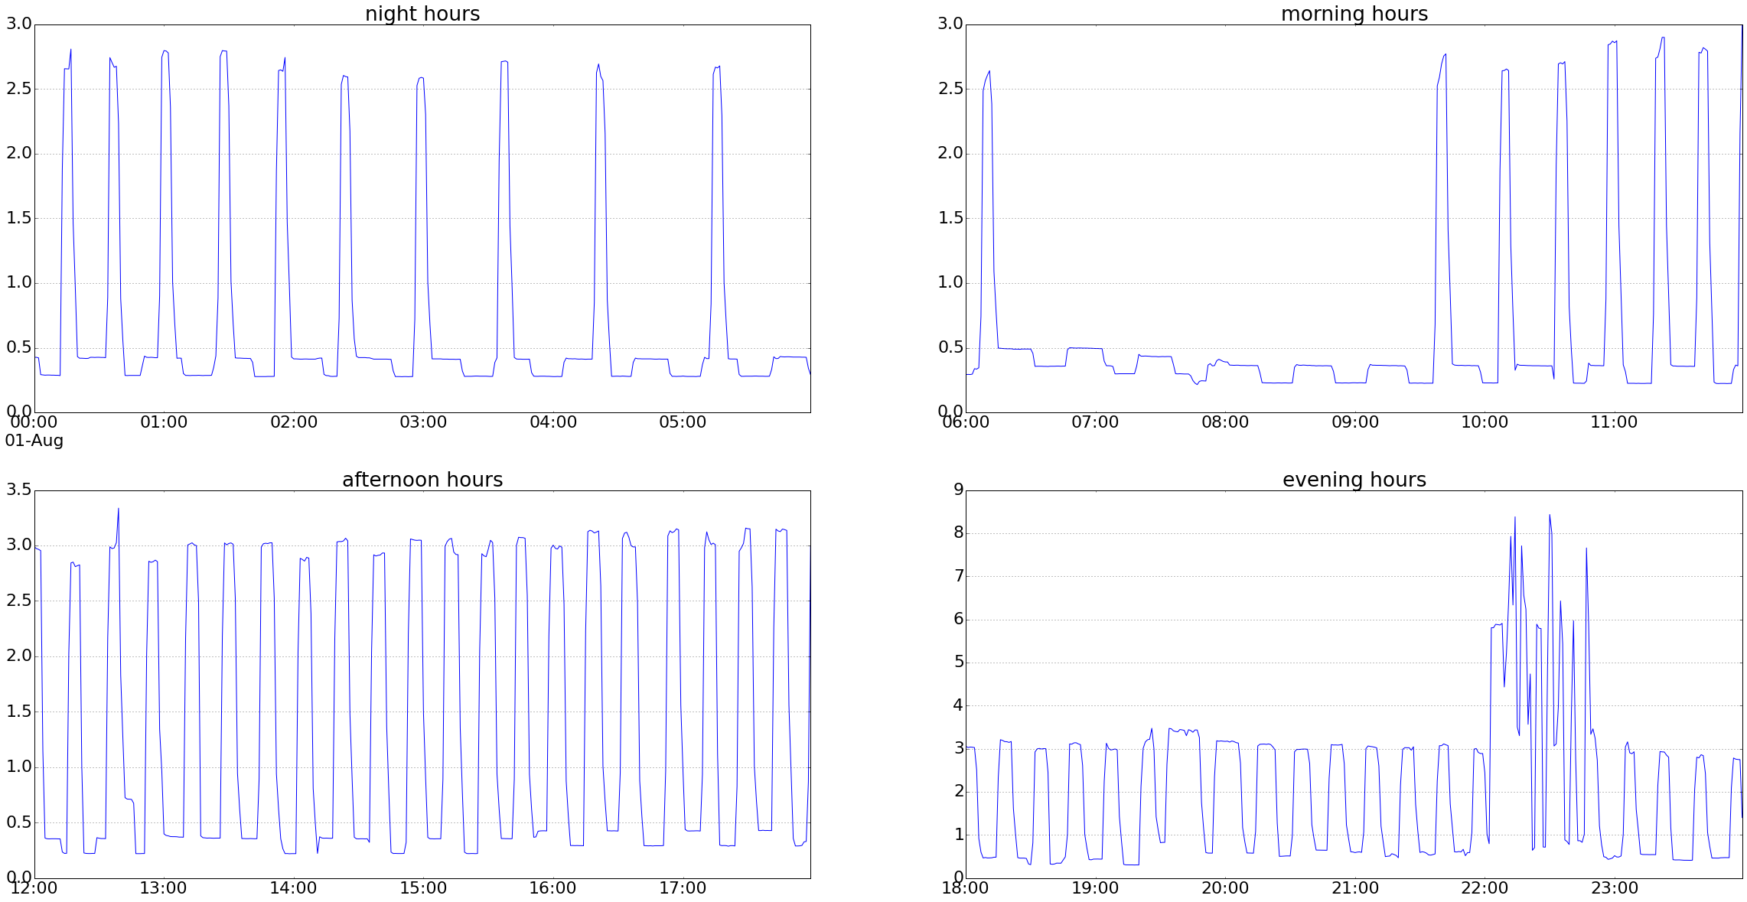
Summer Day Usage (08/01/13)
Natural
Cooling
Heavy Usage From?

Slide 32
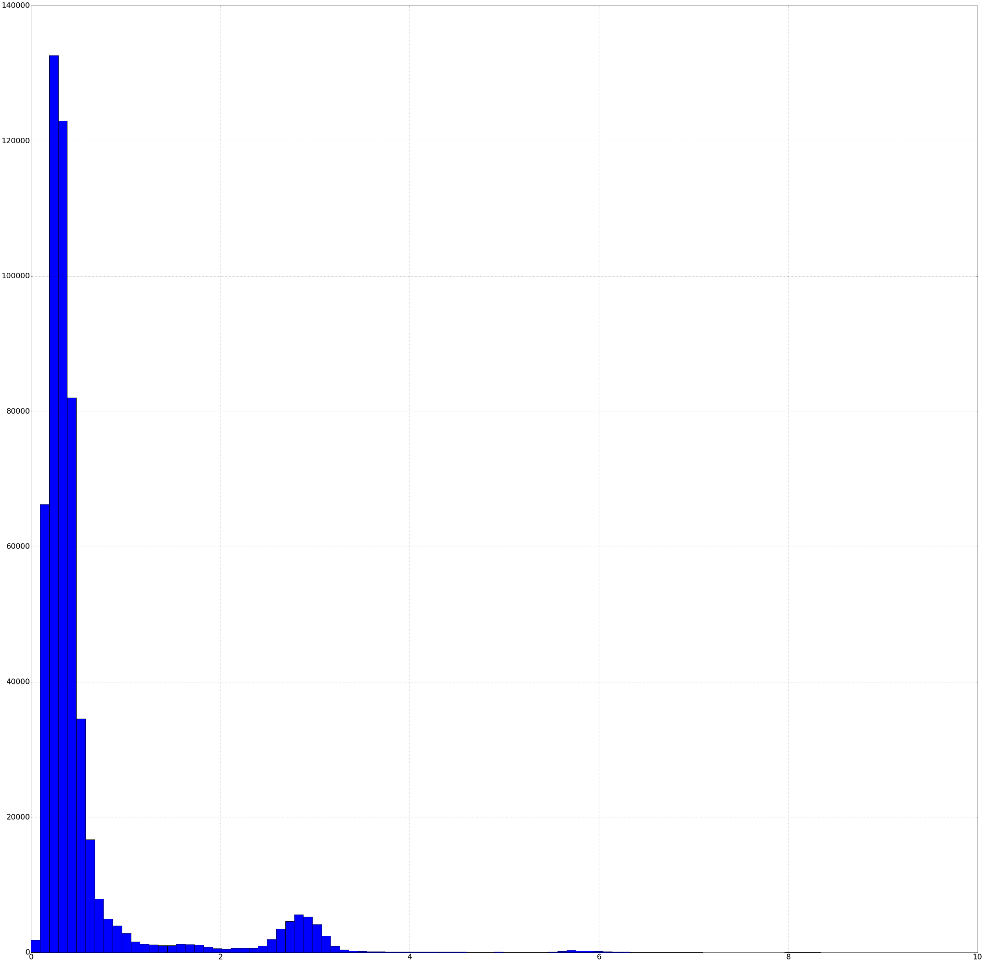
Per-Minute Usage Histogram
Quad-Modal Distribution
Centered at 0.5, 3, 6 and 8 W-H/Min
Contribution to yearly usage:
61%, 32%, 5%, 0.5%
61.5%
32.5%
5.35%
0.5%
2
4
6
8

Slide 33
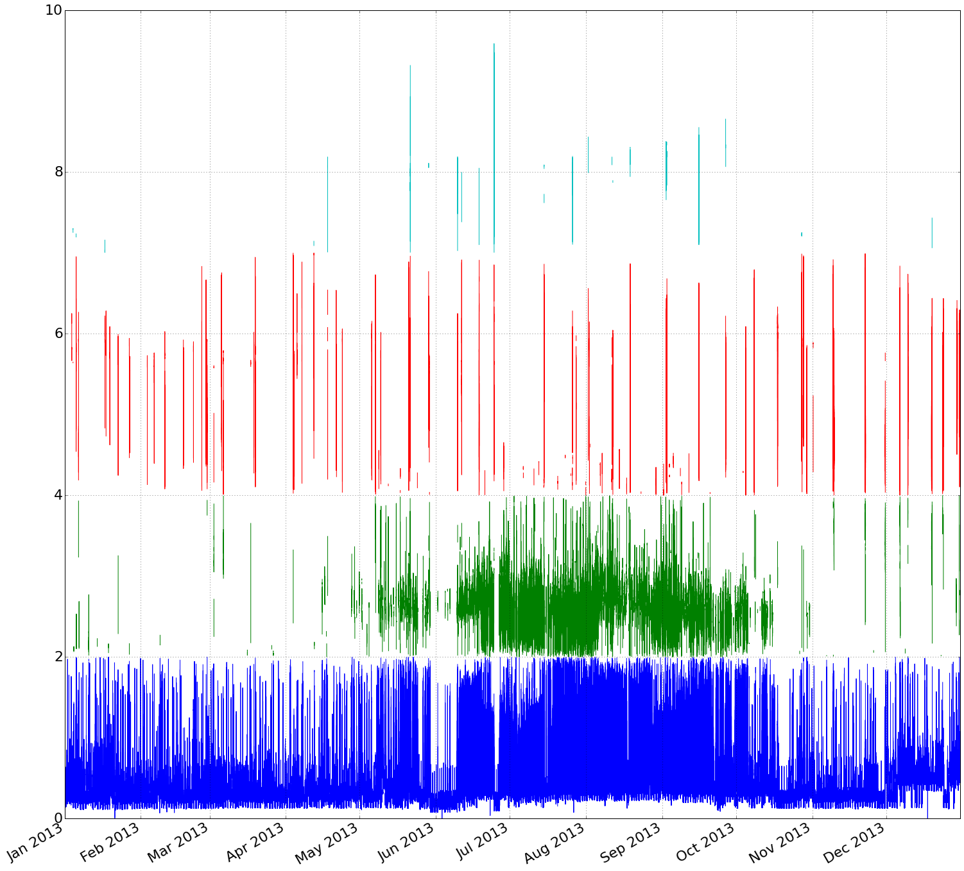
Component Contribution Over One Year
8
6
4
2

Slide 34
