Slide 2
Visual Disability in USA ⁺
All Ages
65 Years +
7.5M
2.4%
2.9M
6.8%
⁺ nfb.org/blindness-statistics

Slide 3
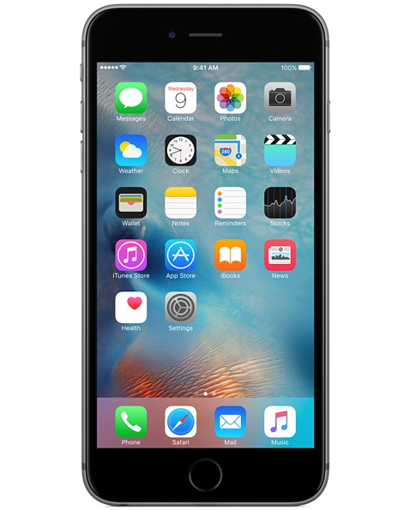
“Biggest Assistive Aid Since Braille” ⁺
⁺ eastersealstech.com/2014/05/13/visually-impaired-use-smartphones-see-world/
Notes:
Mention 2011 smartphone stats: When the Bureau of Engraving and Printing launched their EyeNote app last year, they said that "more than 100,000 blind and visually impaired individuals could currently own an Apple iPhone".Unfortunately they didn&#39;t give a source for this figure, and the use of the word &#39;could&#39; suggests that it might have been little more than a best guess.The figure would appear not to include other iOS devices and presumably refers only to the USA.I&#39;m not aware of any more up-to-date figures, or ones that are global or include all iOS devices.
http://www.applevis.com/forum/app-development/how-many-blind-people-use-iphone

Slide 4
Assistive Smartphone Apps
Mobility
Recognition
Shopping
Notes:
Reading bills used to a great challenge. “Before a smartphone was accessible we had to carry six different things, and now all of those things are in one of those devices,” Rush said, “A $150 money reader is now a $1.99 app. These devices are a game changer.”
Talk about the Uber, taxi scenario. Orbitz scenario.

Slide 6
User Research
User # | Age | Gender | Occupation | VoiceOver Proficiency | Cellphone Type | Blind since
1 | 60s | Female | Professor | Medium | iPhone | High School
2 | 50s | Female | Tech Worker | High | Android | -
3 | 40s | Female | Tech Instructor | High | iPhone | -
4 | 60s | Female | - | Non-User | Feature Phone | 20s
5 | 42 | Female | - | Low-Medium | iPhone | -
6 | 32 | Female | Usability Tester | High | iPhone | -
7 | 40s | Female | - | High | iPhone | Birth
8 | 40s | Female | - | Medium Low | iPhone | Birth
9 | 60s -70s | Female | Tech Instructor | High | iPhone | -
10 | 60s -70s | Female | - | Low | iPhone | -
11 | 60s -70s | Male | - | High | iPhone | -

Slide 7
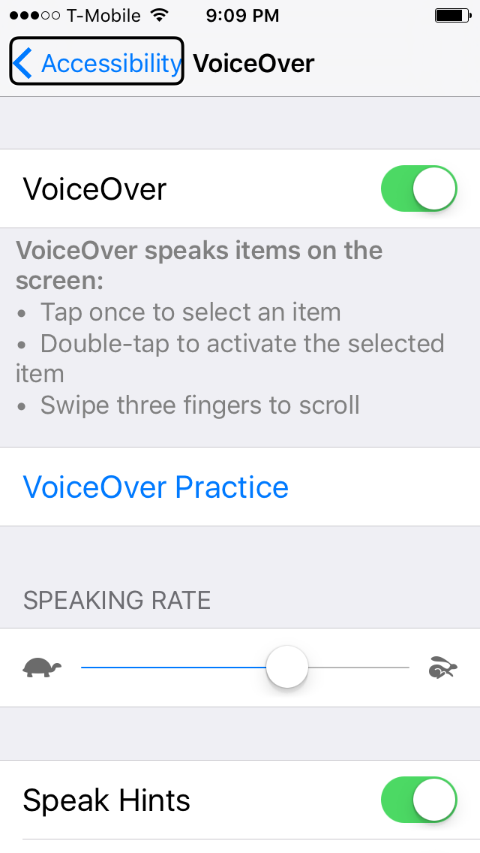
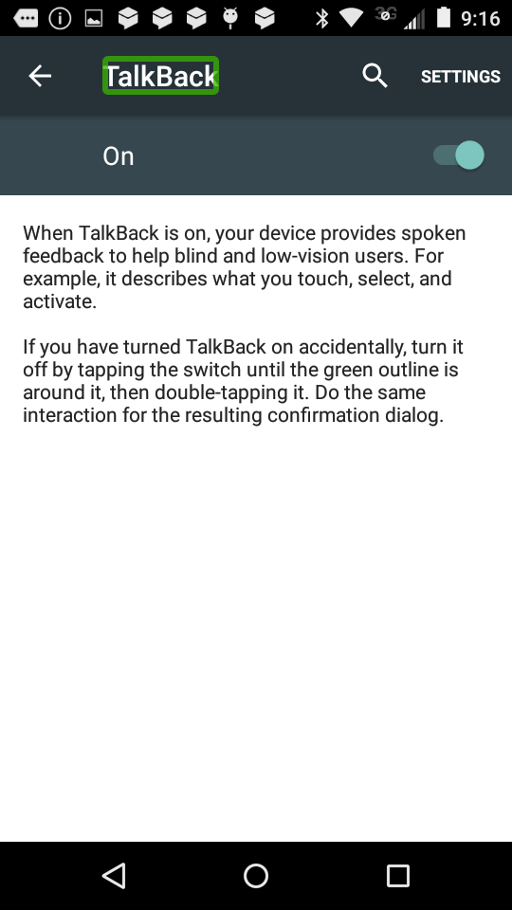
VoiceOver & TalkBack
Notes:
Demo this briefly

Slide 8
4 User Groups, by VoiceOver Familiarity
Regular VoiceOver User
Interviewer: How do you currently enter a form?
User: Ahh I poke around, you know…
Advanced VoiceOver User
“I think voiceover is very useful. It helps me a lot.”
Novice VoiceOver User
“I’m still learning. I’ll get there.”
Non VoiceOver User
“I don’t use the iPhone because it’s all flat! If it had buttons I can feel then I would use it,”
Notes:
Need to verbally explain more to drive the message home.

Slide 9
4 User Groups, by VoiceOver Familiarity
Regular VoiceOver User
Interviewer: How do you currently enter a form?
User: Ahh I poke around, you know…
Advanced VoiceOver User
“I think voiceover is very useful. It helps me a lot.”
Novice VoiceOver User
“I’m still learning. I’ll get there.”
Non VoiceOver User
“I don’t use the iPhone because it’s all flat! If it had buttons I can feel then I would use it,”

Slide 10
VoiceOver Observation
Regular VoiceOver User
Interviewer: How do you currently enter a form?
User: Ahh I poke around, you know…
Video of A Blind Smartphone User Demonstrating How She Used the Orbitz App.

Slide 11
VoiceOver Usability Challenges
Regular User
Challenges
Understand the conceptual model
Memorize shortcut gestures for quick navigation
Figure out layouts of new applications
Memorize screen button locations for quick access
Novice User
Non User

Slide 12
Research Finding
For non-advanced smartphone users, VoiceOver is challenging to learn, and once a user has learned it, it is hard to operate it fast.
Design Challenge
Can we make an alternative navigation method that blind smartphone users can try when VoiceOver does not suit their needs?

Slide 13
She lives in San Francisco with her dog Chipper. Jasmine was born blind. Jasmine used a Nokia flip phone for many years, but recently purchased an iPhone based on friends’ recommendation. She hopes the iPhone can help her be more independent and connected with family and friends. Jasmine is taking a class on how to use VoiceOver at the San Francisco Lighthouse. It has been challenging to learn and remember gestures and buttons, but she thinks the eventual benefit is worth the work.
Jasmine, 52
Customer Service Rep
Target User Personas
Devin, 55
Financial Analyst
He lives in San Dieago with his wife and has two children who now work in other states. He lost his vision due to an illness 15 years ago. Devin bought his first smartphone, an iPhone 5, in 2014. Devin uses his iPhone on a daily basis. He uses the phone to make calls, send text messages, check emails, get directions, request ubers and read news articles. Occasionally, he hears about a new useful app and downloads it from the App Store. Sometimes it takes Devin a long time to complete a task on his phone using VoiceOver. He wonders if there is a faster way.
Teresa, 64
Retired Teacher
Teresa is a retired teacher in her late 60s. She lives in Michigan with her husband. Teresa lost her vision two years ago due to illness. Teresa’s daughter gave her an Android phone last Christmas hoping it could help stay more connected. Teresa felt the phone would be hard to learn and still hasn’t tried it.
Regular User
Novice User
Non User

Slide 14
User Insight
Regular VoiceOver User
Interviewer: How do you currently enter a form?
User: Ahh I poke around, you know…
What would be useful with [a future feature], would be I will open up the app, it will ask me destination, I would say London Heathrow Airport, and it will ask departure, and I would say Oakland, rather than sort of having to poke around.

Slide 15
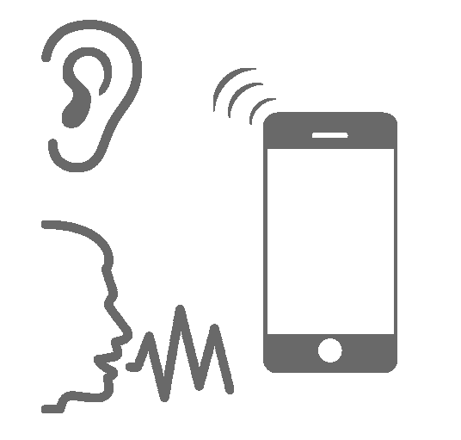
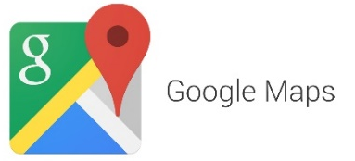
Voice UI As VoiceOver Alternative
Regular User
Novice User
Non User

Slide 16
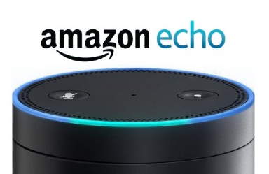
Existing Applications
Does not provide in-app navigation for most applications. Mostly performs system level navigation such as launching an app.
Longer system response is shown as visual only.
Works on a stationary device. Cannot be used mobile.
Does not track state. Therefore cannot perform any tasks that require state.
Specific to text editing

Slide 17
Apps To Voice-ify
Mobility
Shopping
GPS Location
Address Preset
Multiple Rounds of Input & Output
A large amount of information entry and output
Notes:
We referenced design patterns for Interactive Voice Response, a technology that allows a computer to interact with humans through the use of voice and DTMF tones input via keypad.
https://en.wikipedia.org/wiki/Interactive_voice_response

Slide 18
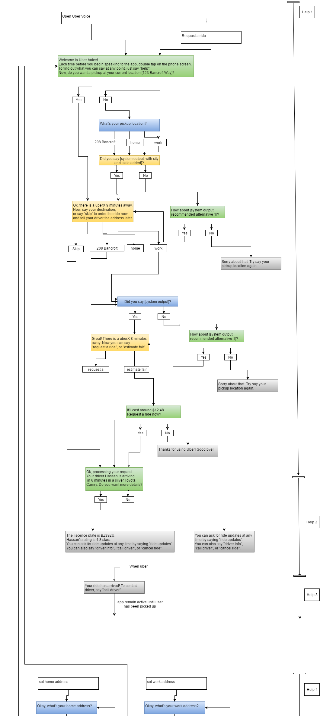
Voice
5 Iterations
Think-Aloud User Testing
Heuristic Evaluation
Added Contextual Help
Added Verifications for Address input
Added presets for home and work addresses
Enabled Multiple System Response Triggers
Notes:
We referenced design patterns for Interactive Voice Response, a technology that allows a computer to interact with humans through the use of voice and DTMF tones input via keypad.
https://en.wikipedia.org/wiki/Interactive_voice_response

Slide 19
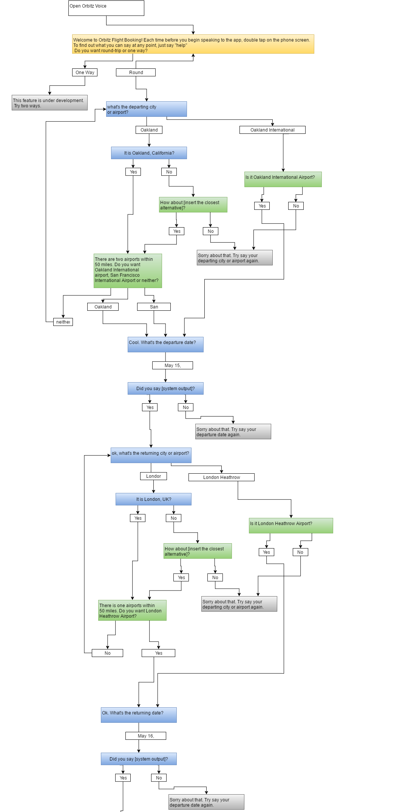
Voice
2 Iterations
Cognitive Walkthrough
Refined System Response Wording
Switched Question Orders
Added Tutorial for Navigating Flight Results
Notes:
We referenced design patterns for Interactive Voice Response, a technology that allows a computer to interact with humans through the use of voice and DTMF tones input via keypad.
https://en.wikipedia.org/wiki/Interactive_voice_response

Slide 20
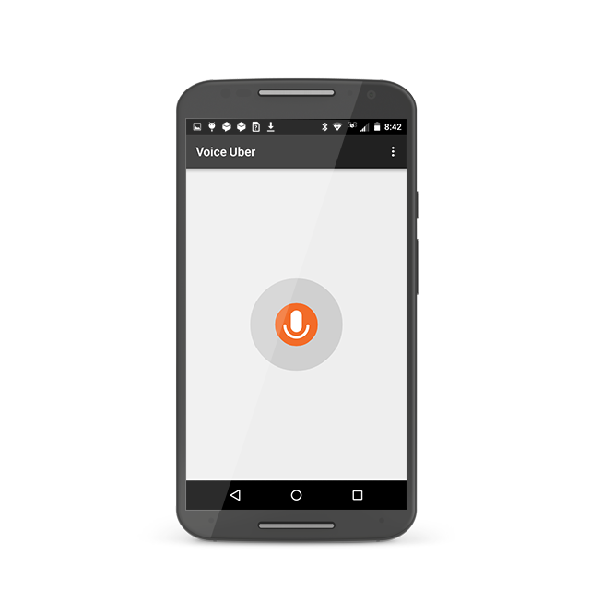
Demo
Notes:
We referenced design patterns for Interactive Voice Response, a technology that allows a computer to interact with humans through the use of voice and DTMF tones input via keypad.
https://en.wikipedia.org/wiki/Interactive_voice_response

Slide 21
Usability Evaluation
Voice Uber App
Wizard-of-Oz Testing:
“Human App” Mocking Synthesized Voice and Only Responding to Predefined Prompts
Novice User (1)
Non User
(2)
Usability Evaluation Tasks | Success Rates
Specify Pickup Location w/ Uber Voice | 5/5
Select Ride w/ Voice UI | 4/5
Select Ride w/ Gesture Control | 4/5
Check Ride Updates & Ride Details | 4/4
Proxy Users
Proxies to Orbitz Flight Selection
Advanced User
(2)
Notes:
We referenced design patterns for Interactive Voice Response, a technology that allows a computer to interact with humans through the use of voice and DTMF tones input via keypad.
https://en.wikipedia.org/wiki/Interactive_voice_response

Slide 22
General User Feedback
Regular User
(1)
“Yes, [Uber Voice] clearly works better than the way it currently works.”
Novice User (1)
Preferred browsing Uber drivers using voice control over using gesture control
Found voice control more intuitive
Non User
(2)
Proxy Users
Voice input is less useful in noisy environment.
Dictation is sometimes error-prone.
Combine VUI with VoiceOver to give users options.
Advanced User
(3)
Notes:
We referenced design patterns for Interactive Voice Response, a technology that allows a computer to interact with humans through the use of voice and DTMF tones input via keypad.
https://en.wikipedia.org/wiki/Interactive_voice_response

Slide 23
Future of Voice UI
Regular User
(1)
“Yes, [Uber Voice] clearly works better than the way it currently works.”
Still needs work, but hopeful.
We want to encourage more designers and developers to experiment with and create VUI mobile apps. Together we can work out the kinks and more it better.
Novice User (1)
Preferred browsing Uber drivers using voice control over using gesture control
Found voice control more intuitive
Non User
(2)
Proxy Users
Voice input is less useful in noisy environment.
Dictation is sometimes error-prone.
Combine VUI with VoiceOver to give users options.
Advanced User
(3)
Notes:
We referenced design patterns for Interactive Voice Response, a technology that allows a computer to interact with humans through the use of voice and DTMF tones input via keypad.
https://en.wikipedia.org/wiki/Interactive_voice_response

Slide 24
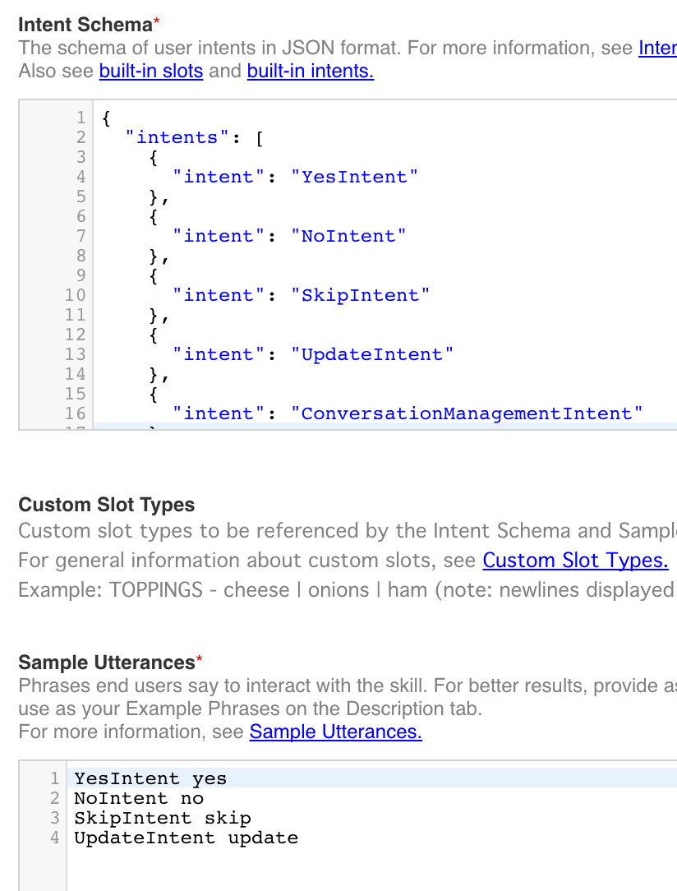
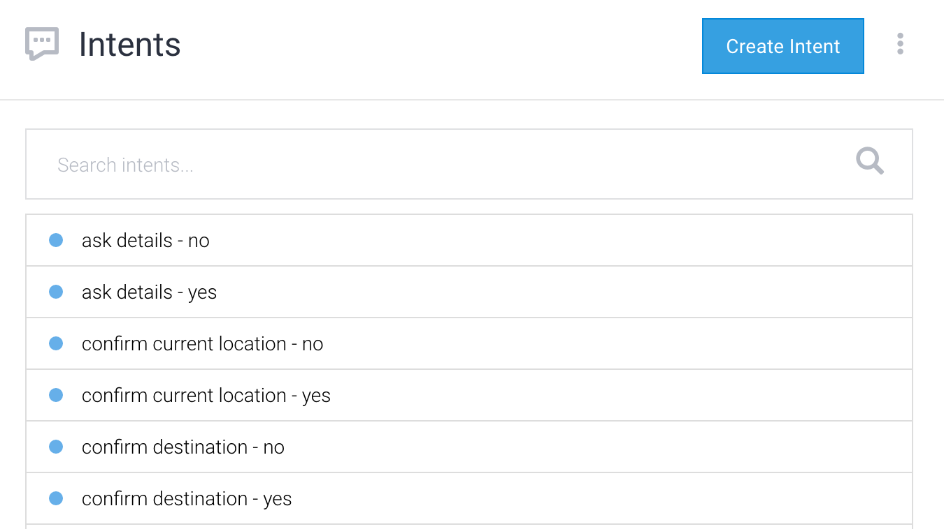
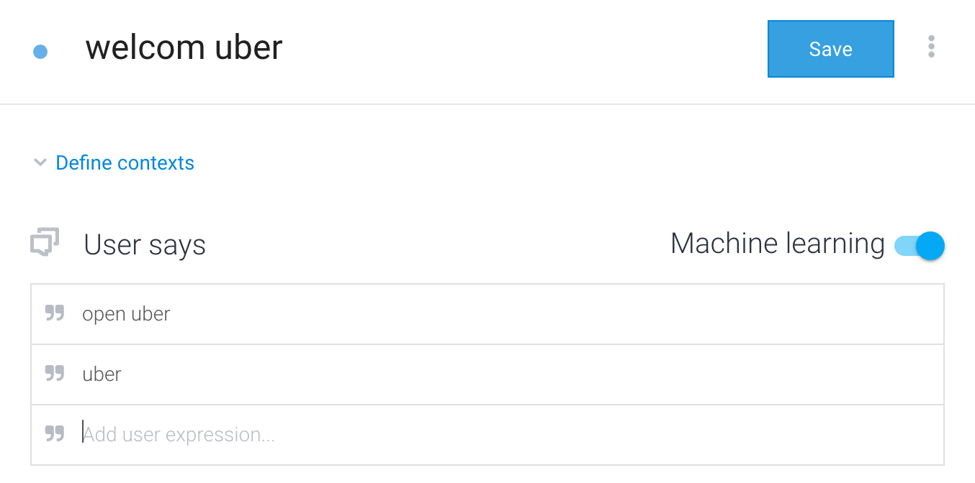
Existing VUI Dev Tools
Amazon Alexa
API.ai

Slide 25
Current VUI Dev Method
Designer
Developer
Design
Paper or Diagramming Tool
Conversation Logic
Testing
Wizard-of-Oz Testing
Front-End

Slide 26
Improved VUI Dev Method
Designer
Developer
Design
Diagramming Tool
Conversation Logic
Testing
Functional Prototype
Front-End
Notes:
Design
Designers can quickly create graphical conversation flowchart
Designers can quickly build hi-fi prototype
Development
Speed up development time by saving engineers from manually writing conversation logic, engineers only need to write front-end code.

Slide 27
Demo
Let’s make a voice adventure game!

Slide 28
Future Work
Design
Design better error prevention and handling.
Design more robust tutorials.
Conduct usability evaluations using functional prototypes.
Explore potential of combining VoiceOver and VUI.
Explore other potential users of mobile VUI. E.g. Users with carpal tunnel or dexterity challenges.
Dev Tool
Implement more advanced features.
Implement better error prevention and handling.
Make shortcuts more discoverable.
Develop context AI.
Open source!
Notes:
Because VUI is so new and many usability and technical issues still need to addressed. There is a lot of work to be done.

Slide 29
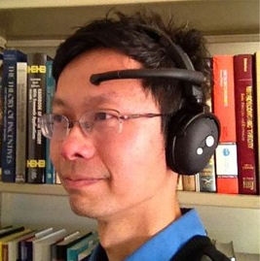
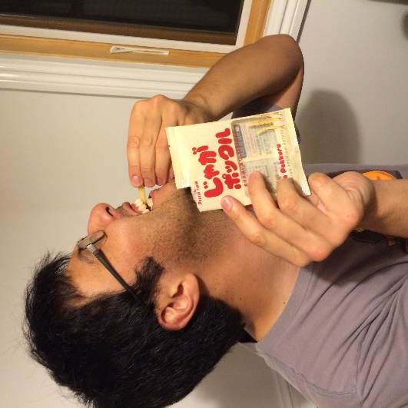
Special Thanks
John Chuang
Ching-Wen Hsu
Safei Gu
Toshiro Nishimura
Jong-Kai Yang & Eric Pai for user research
Georgina Kleege & Lucy Greco for user insights
East Bay Center for the Blind for research support
Steve Fadden for user research guidance
This project would not have been possible without all of you!
Notes:
We want to thank our project advisor John Chuang for his guidance and support throughout the project, Safei Gu, Jong-Kai Yang, and Eric Pai from the INFO 214 team for their hard work on user research and testing, Georgina Kleege and Lucy Greco for their invaluable insights, East Bay Center for the Blind for their generous support, Jing-Wan Hsu for her great coding contribution, Steve Fadden for his guidance on user research, and Toshiro Nishimura for just being awesome in general. This project would not have been possible without all of you!

Slide 30
Collaborate with Us
Wenqin Chen
jwqchen@berkeley.edu
Pi-Tan Hu
pitan.hu@berkeley.edu
Visit us at mole-bile-voice.herokuapp.com

Slide 31
