Slide 1
Path Finder
A cycling data analytic tool using Apache Hive
Lei Yang | Nilesh Bhoyar | Tuhin Mahmud
MIDS W205 Final Project, Fall 2015

Slide 2
Outline
App Overview
Architecture
data flow
technology stack
Data flow
retrieval
ingestion
transform
processing
serving
visualization
Limitation
Summary

Slide 3
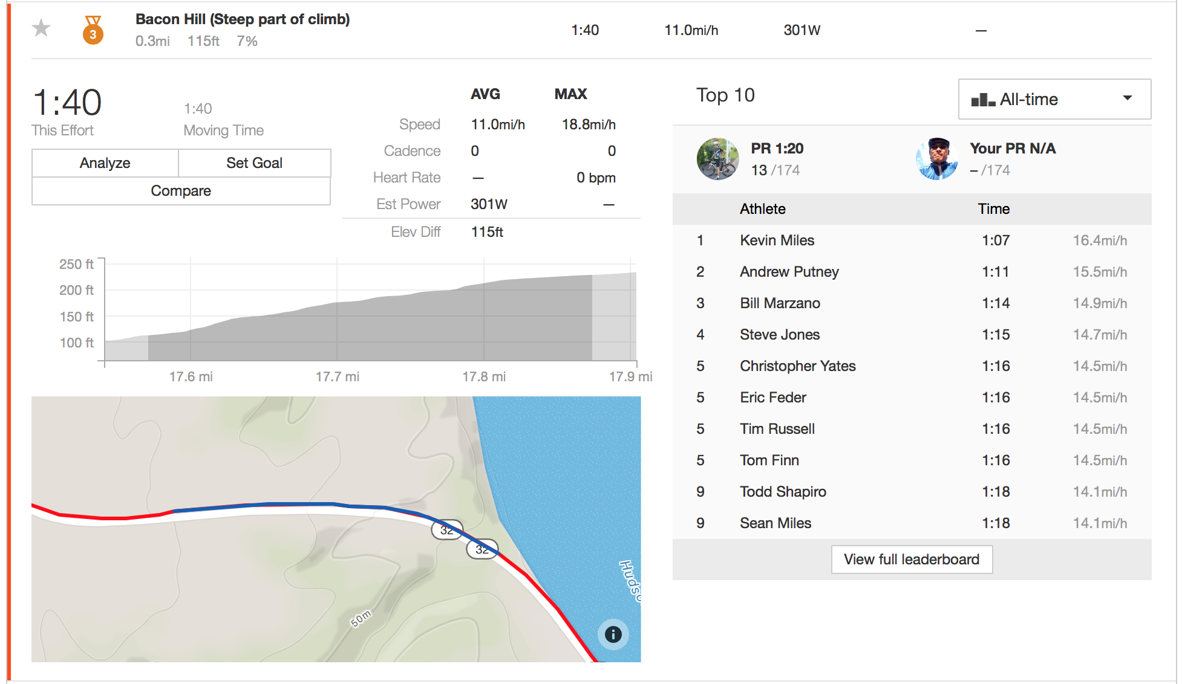
Overview
Strava is popular cycling community.
Rider competes with each other by climbing on the segment leaderboard.
Current segment info is organized individually.
Issue: Impossible to search and compare segments by category, distance, location, popularity etc. Users are asking for wind/weather conditions on leader board,which impacts finishing time.
Goal: develop a solution, based on publicly available segment data, to enable broader search, comparison, and visualization of segments.

Slide 4
Architecture
Hive External Tables
Hive Managed Tables
Postgres Tables
Format
Cleaning
Processing
Data Flow
Strava API
Technology Stack
Query
Query
Web Service
Server (AWS) |  |  | Client
Ingestion | Processing | Serving | Visualizing
stravalib | hiveserver2 | Python CGI | Javascript
pywom | psycopg2 | ajax | d3
 | pyhs2 | jQuery | Google map
Filtering, visualizing
HTML Webpage

Slide 5
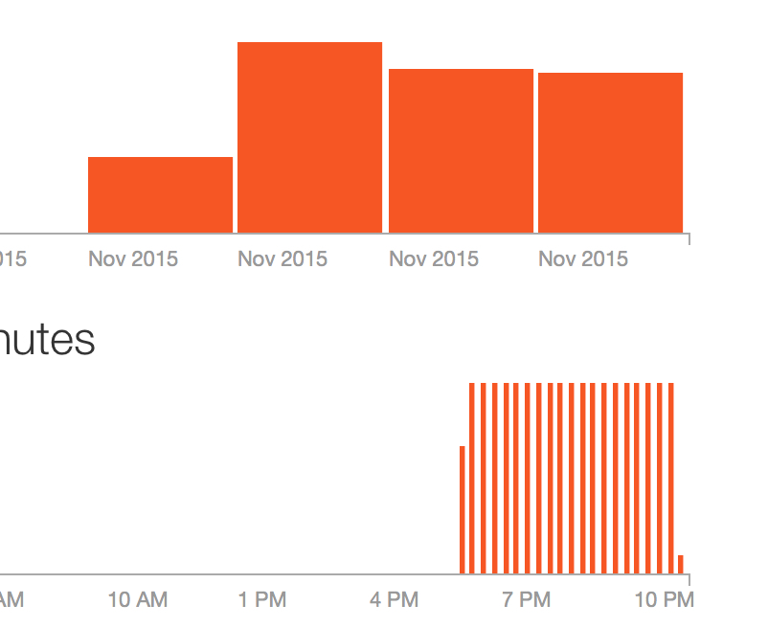
Data Flow - Retrieval
Variety
segment: name, id, location, distance, category etc.
leaderboard: timing, athlete, rank, date etc.
activity: participant, type, calories etc.
geo data: elevation, latitude & longitude
Volume
600 requests / 15 minutes, daily max 30k requests
1 GB of history data of 4 areas in US
Retrieval
Python script using stravalib via StravaAPI
export csv files for segment, leaderboard, activity, and geo data respectively

Slide 6
Weather on Strava
There are several request on Strava user forum for weather data. Riders would like to tell everyone, how windy it was when they took a ride.
Users want to see most popular segments and weather forecast for next 5 days for those segments.
Even in extreme cases , if someone is on long bike route , he would like to get real time notification for any hazards.
Also historical weather data and activity data should be analyzed to find interesting patterns

Slide 7
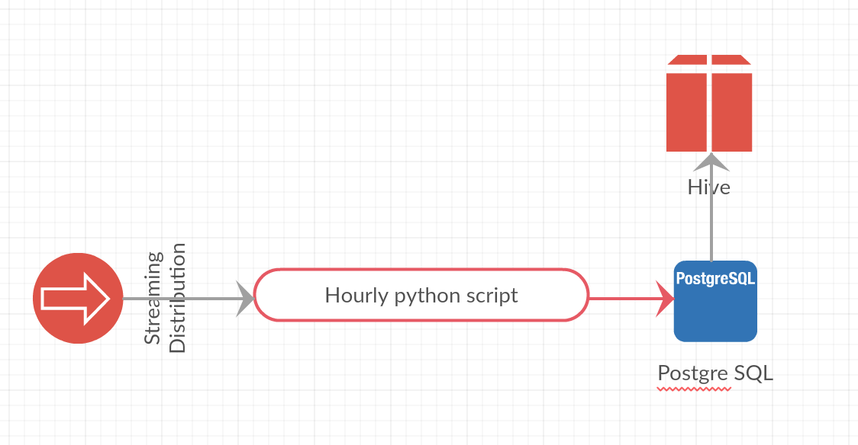
Weather Data Ingestion and Storage
We need real time as well as historical weather data.
Python script extracts data using http://openweathermap.org/ API for all US cities. Python library pywom is used for data pull.
Data is stored in PostgreSQL for quick retrieval.
Before new data is extracted , current data is archived to Hive tables for analytics.

Slide 8
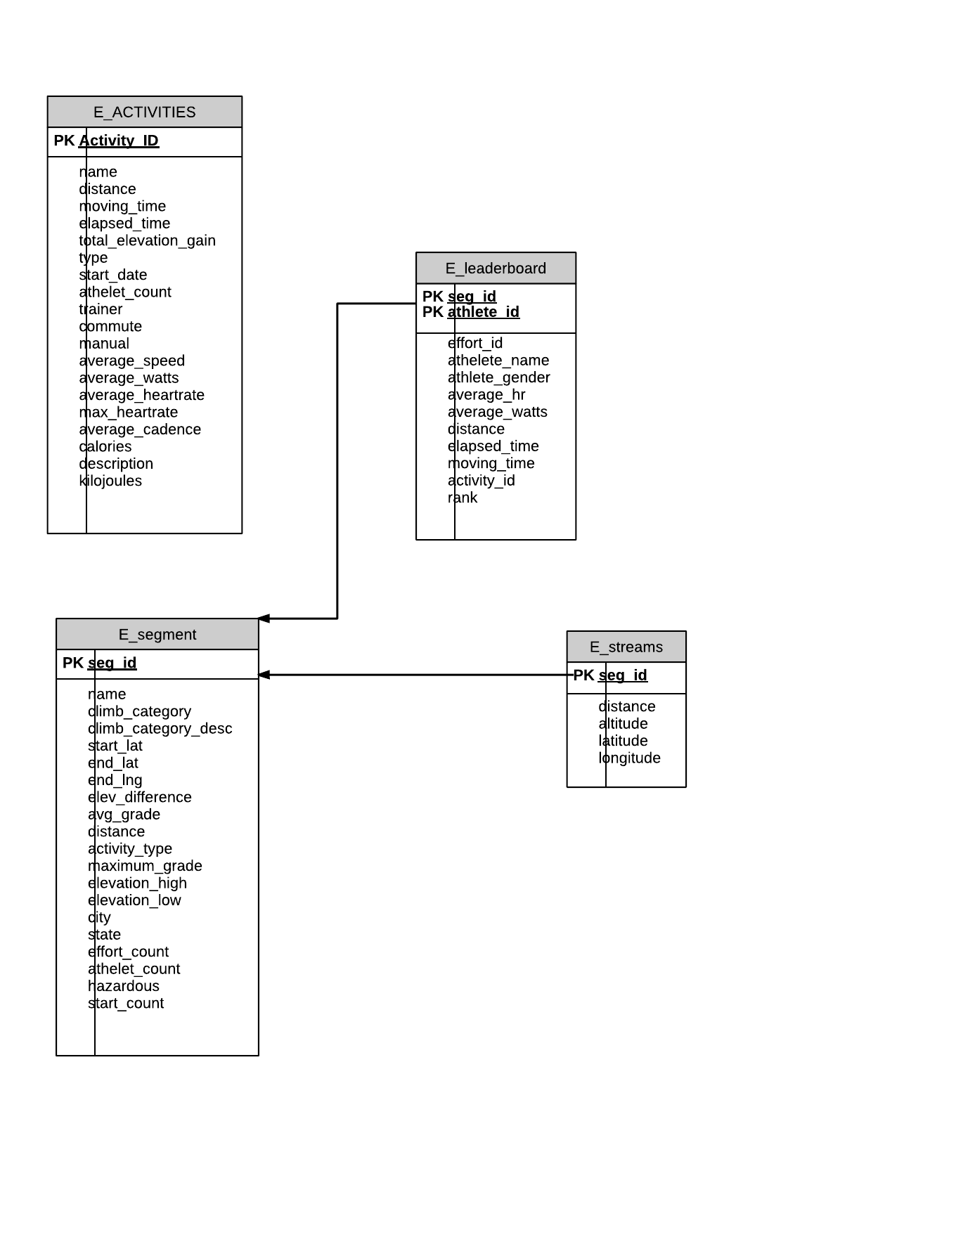
Data Flow - Ingestion
Convert geo data to wide format
Create Hive external table for exploration
Data quality issues:
missing values due to empty entry, network transfer loss etc.
inconsistent representation (e.g. Texas vs. TX)
string representation for measurements (e.g. 1039 m, 15 mph) → prevent sorting
Schema: ER diagram
segment ID as PK in segment table
seg_id as FK in other three table

Slide 9
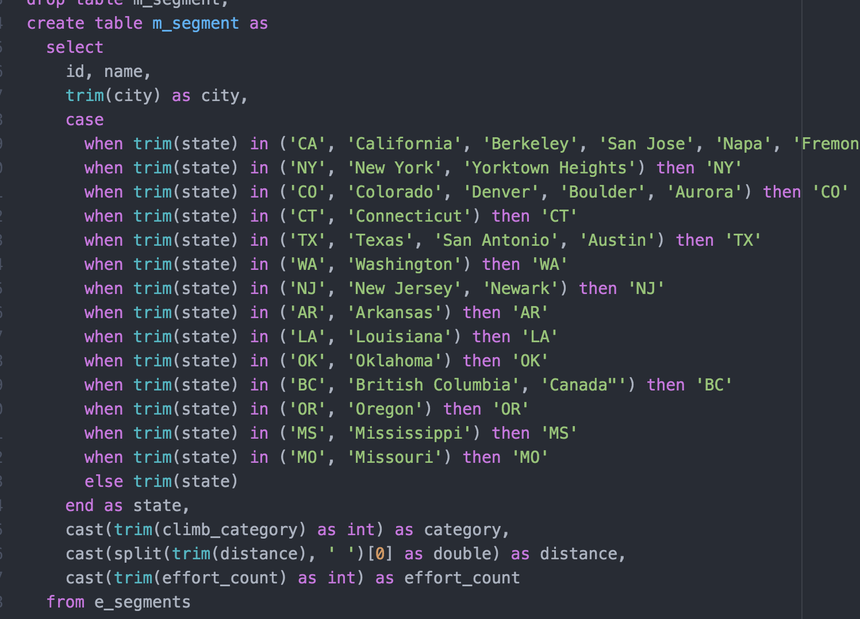
Data Flow - Transform
Use SQL statement to clean up data:
extract number and cast in numeric format
converge state name to 2-letter format
inner join with segment table to ensure data integrity
Store transformed data in managed table in Hive

Slide 10
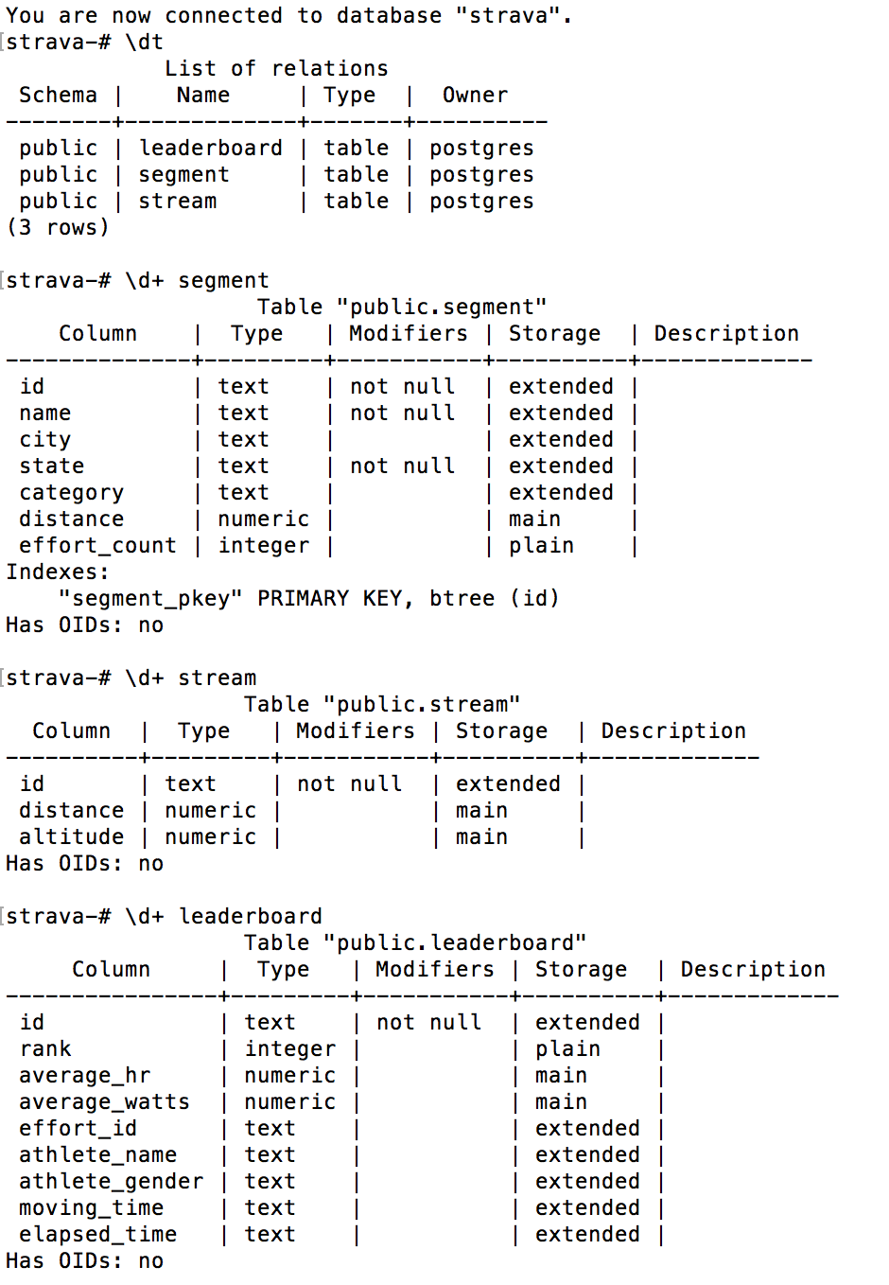
Data Flow - Processing
Processing Goal: to find the most popular segments for each segment in every state, and store geo data in a Postgres database, for better visualization.
Steps:
rank segment, partitioned by state and category, in descending order of effort count
choose segment whose ranking number is below 30
push geo location data into Postgres

Slide 11
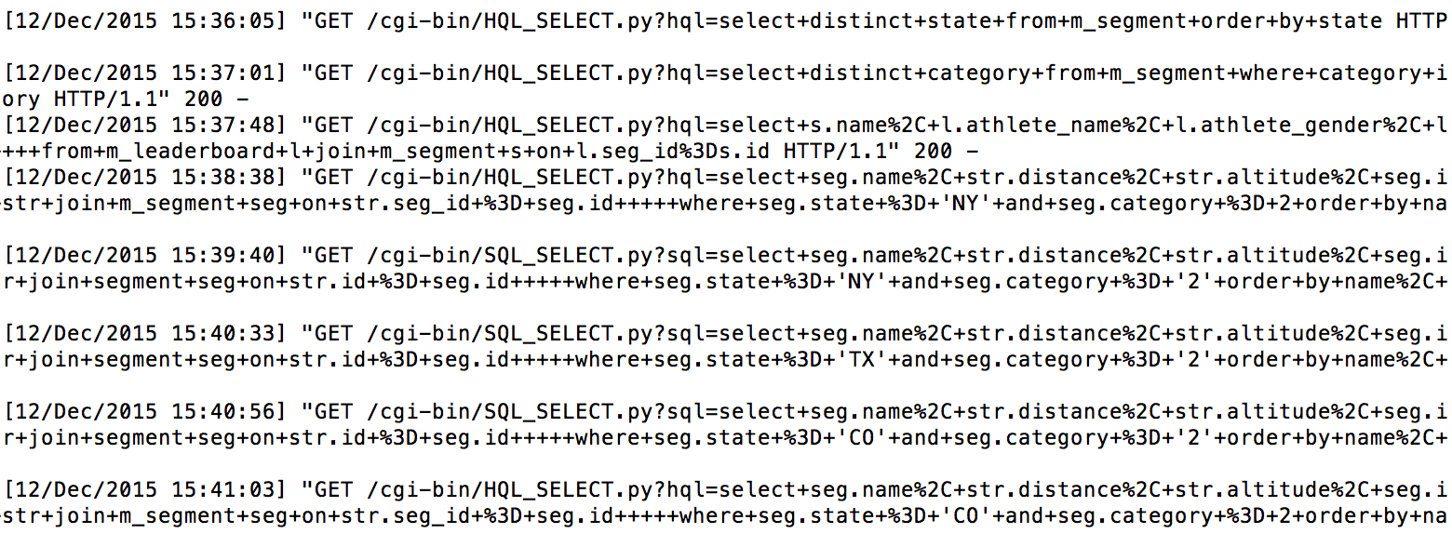
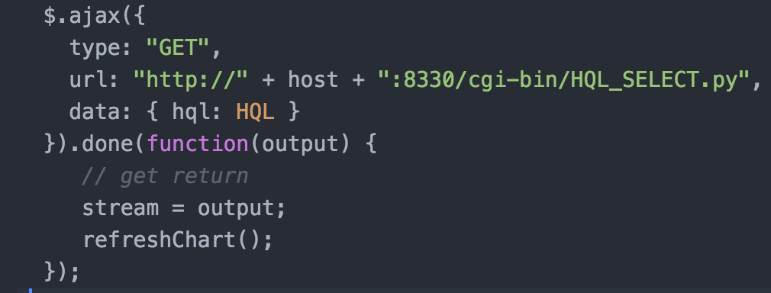
Data Flow - Serving
host a Python CGI server on AWS
place query code under cgi-bin
send select query from html via http request with ajax
database client access:
hive: hiveserver2, pyhs2
postgres: psycopg2
server return query results in json format
javascript parse return locally for visualization

Slide 12
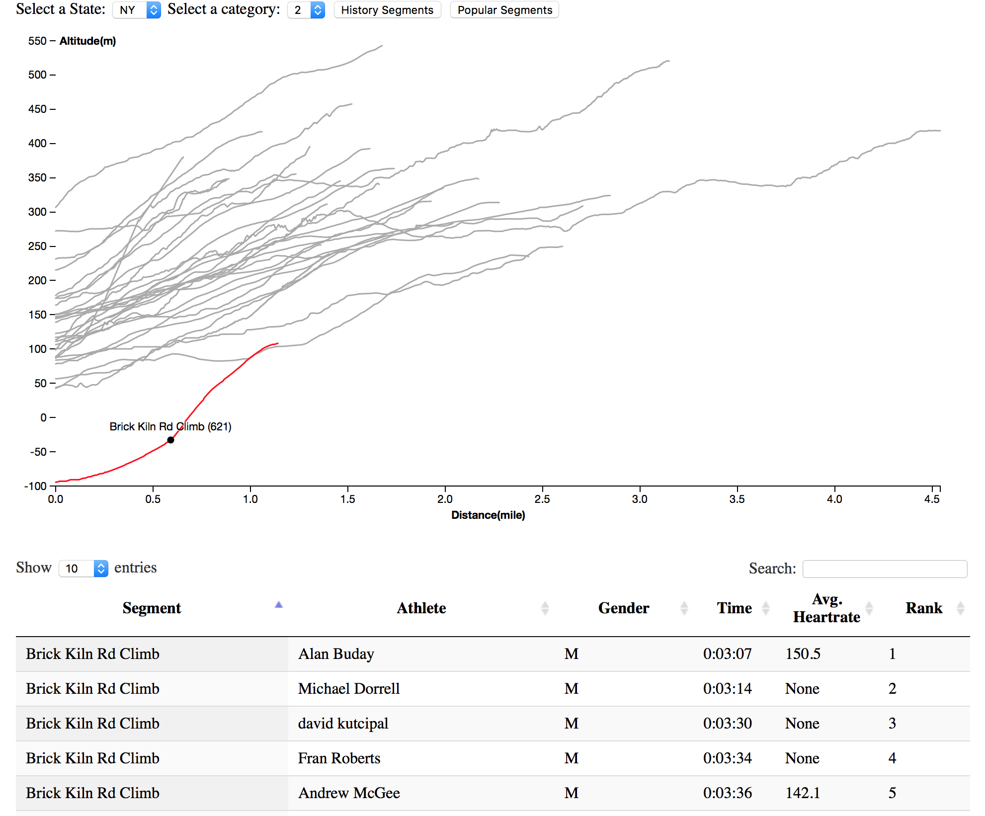
Data Flow - Visualization
Retrieve segment with state and category as filter
Two retrieving modes:
history segments: Hive
popular segments: Postgres
Highlight segment in the Voronoi chart: distance vs. climb elevation
number of attempts indicated
click on the line to refresh leaderboard of this segment
Summary info displayed in datagrid

Slide 13
Google Map Visualization
node.js webserver hosted on IBM bluemix for map visualization.
http://pathfindermids.mybluemix.net (works best with firefox)
AWS hosting tested with
python -m SimpleHTTPServer 8000
Preprocessing of segment data for fast rendering
Google Map API features used
Bicycle route
Geocode lookup from city name.
Interactive Zooming
HeatMap ( dynamic loading from JSON)
Heatmap toggle, change gradient,radius and opacity
OpenWeatherMap APi integration
weather of cities ( dynamic where map is focused)

Slide 14
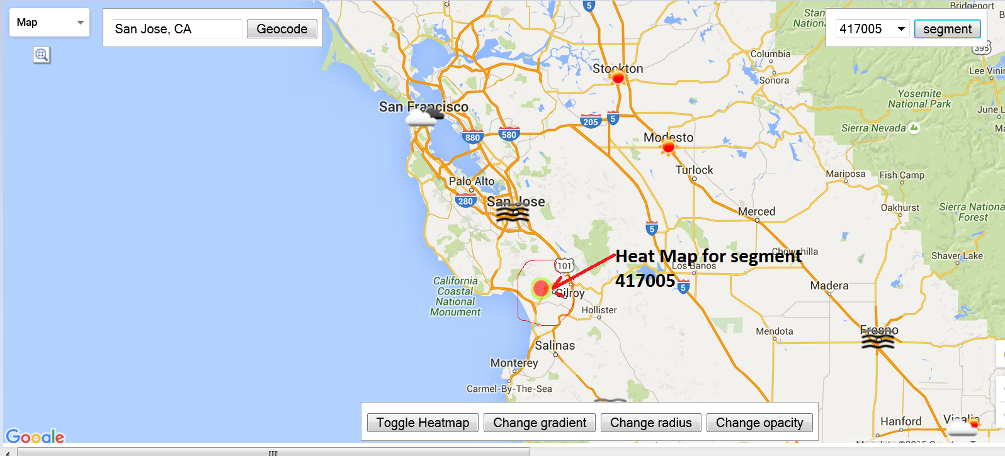
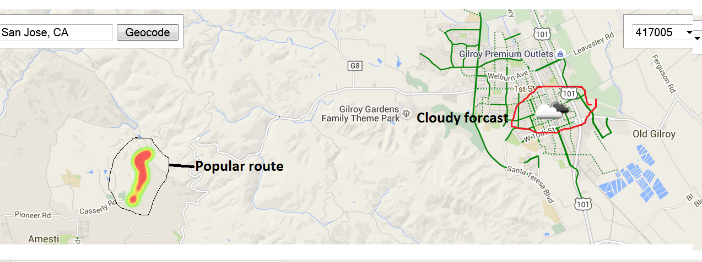
Weather and Segment data integration on Google map
http://pathfindermids.mybluemix.net
Retrieved segments Path visualaztion on the map along with the current weather from openweathermap.org using openweathermap API.
Current weather representation using pictures: for ease of use and integration.

Slide 15
Limitation & Possible Improvement
Storage scale:
hive: good scalability with HDFS
postgres: could be an issue with global data
Processing strategy:
nuclear approach for cleaning → need more dedicated procedure
just simple comparison, no advanced alg. behind → to add more analytics
Results latency:
there is no speed layer, CRON job can only run periodically
to use Spark Stream to improve it
Serving speed:
hive: slow → to apply partition. bucket for better organization
python CGI server: not production grade data serving
Visualization:
more filter criteria
Maps providing most popular segments with weather data
integrated geo and searching page
App providing real time notifications for any hazard on path/segment

Slide 16
Summary
Accomplishments:
practice technologies for an end-to-end data storage and retrieval solution
apply Lambda architecture to address challenges in ingesting, processing and serving data
gain hands-on experiences on various techniques and systems
Lesson learned:
API limit prevents us retrieving large amount of data
Scope change due to complexities at different stages of the project
There is no small change in the world of data storage and retrieval

Slide 17
Questions?

