Slide 1
Home Energy Dashboard
Lisa Kirch
W210 - Summer 2015

Slide 2
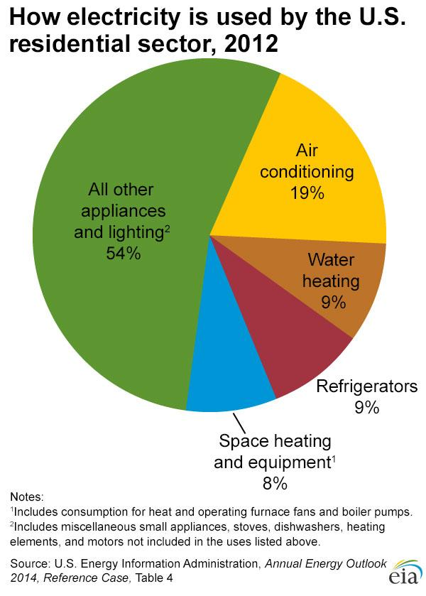
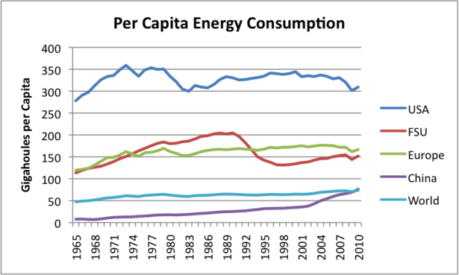
Increasing Energy Consumption
Notes:
Per Capita Energy Consumption graph
http://www.theoildrum.com/node/9023#more
How electricity is used by the U.S. residential sector, 2012
http://www.eia.gov/energyexplained/index.cfm?page=electricity_use
Newer homes are 30% larger but consume as about as much energy as old
http://www.electronicstakeback.com/wp-content/uploads/Facts_and_Figures_on_EWaste_and_Recycling.pdf

Slide 3
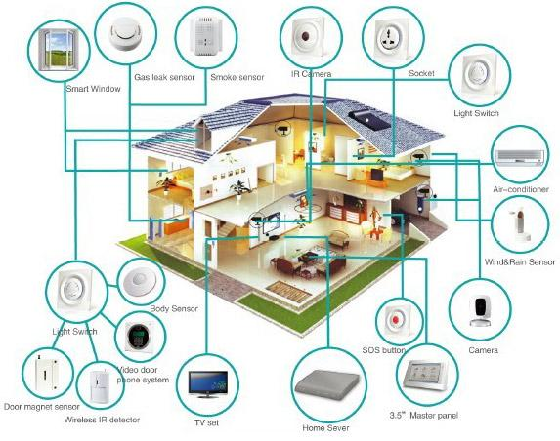
Increasing Energy Consumption
In 2012, the average U.S. household spent $1,312 on consumer electronics (CE) products a year, according to a study, by the Consumer Electronics Association (CEA).
The average household reports owning 24 discrete CE products.
Notes:
http://www.electronicstakeback.com/wp-content/uploads/Facts_and_Figures_on_EWaste_and_Recycling.pdf
The 15th Annual Household CE Ownership and Market Potential Study also found that consumer electronics (CE) spending is up for individuals (35 percent) and households (36 percent) over the last 12 months.
smart home image source: http://smarthomeenergy.co.uk/what-smart-home

Slide 4
Energy Consumption Efficiency Tree
Total YTD, Monthly, Daily Costs
Electricity,
gas, water usage,
carbon footprint
Show them what their homes are using
Cost by Appliance
Median electricity, gas, water usage
How can we educate consumers to decrease energy consumption?
Compare usage with other users
Highlight potential savings, leaks, and waste points in the system
Flag appliances or watering devices that may be leaking or could be turned off
Notes:
Home Energy Saver
http://hes.lbl.gov/consumer/
http://coolcalifornia.org/
http://coolcalifornia.org/calculator
Additional stakeholders - consumers, utilities, policy makers

Slide 5
Goals and Benefits
California’s Assembly Bill 32 requires California to reduce greenhouse gas emissions to 1990 levels by 2020 and to 80% below 1990 emission levels by 2050
Save energy
More efficient use of resources
Reduce costs
Improve the environment (reduce greenhouse gases)

Slide 6
Data Sources
U.S. Energy Information Administration
Residential Energy Consumption Survey (RECS)
Updated Buildings Sector Appliance and Equipment Costs and Efficiencies (2015)
Residential Gas Usage Data
USGS Water Usage Data
Water Footprint Network - National Water Footprint Statistics
OpenWeatherMap - weather data, forecasts, precipitation
Berkeley Lab Home Energy Scoring Tool and Home Energy Saver
Cost of electricity per kwh, cost of water per cubic foot, cost of gas per thousand cubic feet
Notes:
Energy Usage Data
http://www.eia.gov/consumption/residential/index.cfm
http://www.eia.gov/analysis/studies/buildings/equipcosts/pdf/full.pdf
Water Usage Data
http://www.usgs.gov/blogs/features/usgs_top_story/think-short-creative-and-inviting/
http://waterdata.usgs.gov/nwis/wu
http://waterfootprint.org/en/resources/water-footprint-statistics/#CP1
Residential Gas Usage Data
http://www.eia.gov/dnav/ng/ng_cons_sum_dcu_nus_m.htm
http://www.eia.gov/dnav/ng/hist/n3010us3m.htm
US Utility Rate Database
http://en.openei.org/wiki/Utility_Rate_Database
Weather Data
http://openweathermap.org/weather-data#current
Berkeley Lab Home Energy Scoring Tool
https://developers.buildingsapi.lbl.gov/hes/service
https://developers.buildingsapi.lbl.gov/hescore/documentation/scoring-tool-api

Slide 7
Potential Challenges
Getting data for the same time periods for all energy sources
Persuading consumers that the investment and behavior changes are worth implementing (cost-benefit analysis)
Keeping the dashboard simple, intuitive, and useful

